Slide 1

How did the spreading of COVID-19 and the regulations in association with it influence the game market, in particular the game League of Legends, in terms of monthly player numbers, and popularity in Europe ?
Babiak Chiara , Führer Angelika, Rinner Clemens

Slide 2
Assumption
Growing Numbers of infections concerning Covid 19 and strong regulations set in Countries lead to increased number of players ( indoor hobbies increase )

Slide 3
Finding the answer
What Regulations were present the most ?
How high or low was the number of players during or after the first lockdown ?
Are there other aspects which might lead to drops or increases ?

Slide 4
Regulations

Slide 5
Regulations available:
StayHomeOrder = Stay-at-home orders for the general population (these are enforced and also referred to as ‘lockdown’)
RegionalStayHomeOrder = Regional stay-at-home orders for the general population at least in one region (these are enforced and also referred to as ‘lockdown’)
StayHomeGen = Stay-at-home recommendations for the general population (which are voluntary or not enforced)
StayHomeRiskG = Stay-at-home recommendations for risk groups or vulnerable populations (such as the elderly, people with underlying health conditions, physically disabled people, etc.)
SocialCircle = Social circle/bubble to limit social contacts e.g. to limited number of households
PrivateGatheringRestrictions = Restrictions on private gatherings
ClosDaycare = Closure of educational institutions: daycare or nursery.
ClosPrim = Closure of educational institutions: primary schools.
ClosSec = Closure of educational institutions: secondary schools.
ClosHigh = Closure of educational institutions: higher education
MassGatherAll = Interventions are in place to limit mass/public gatherings (any interventions on mass gatherings up to 1000 participants included)
66
Regulations

Slide 6
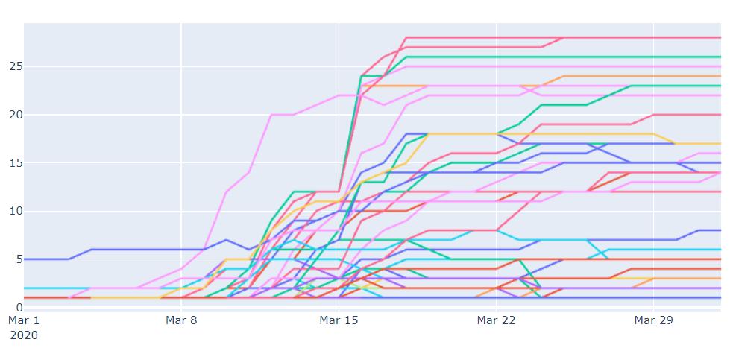

Slide 7
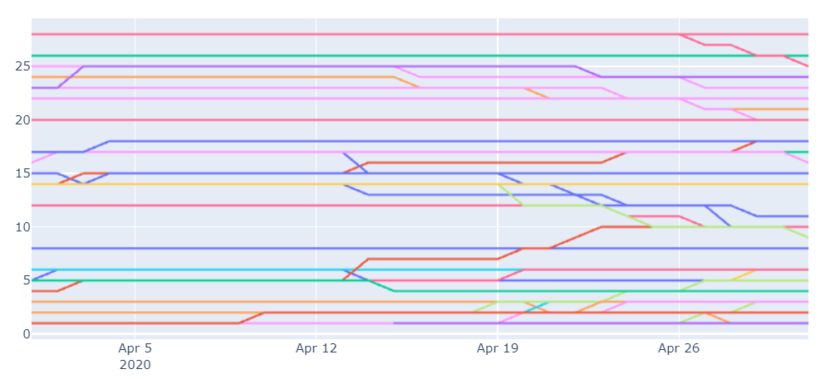

Slide 8
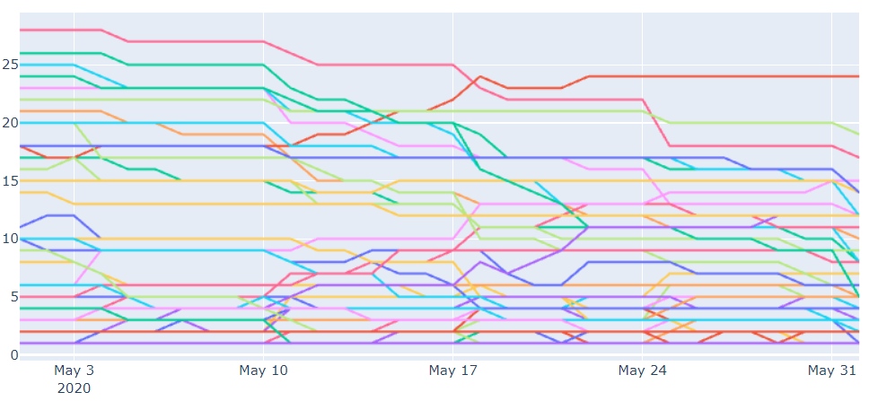

Slide 9
Cases

Slide 10
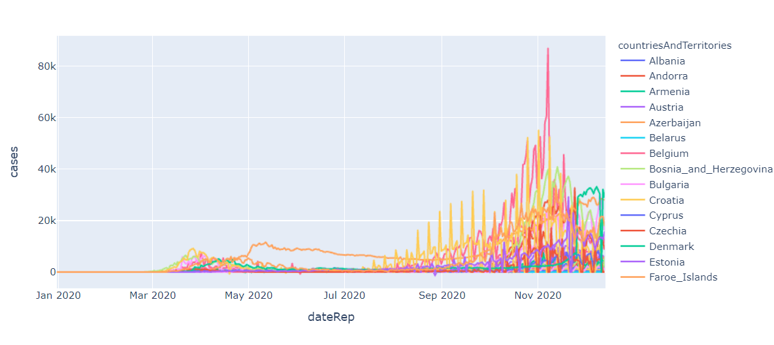

Slide 11
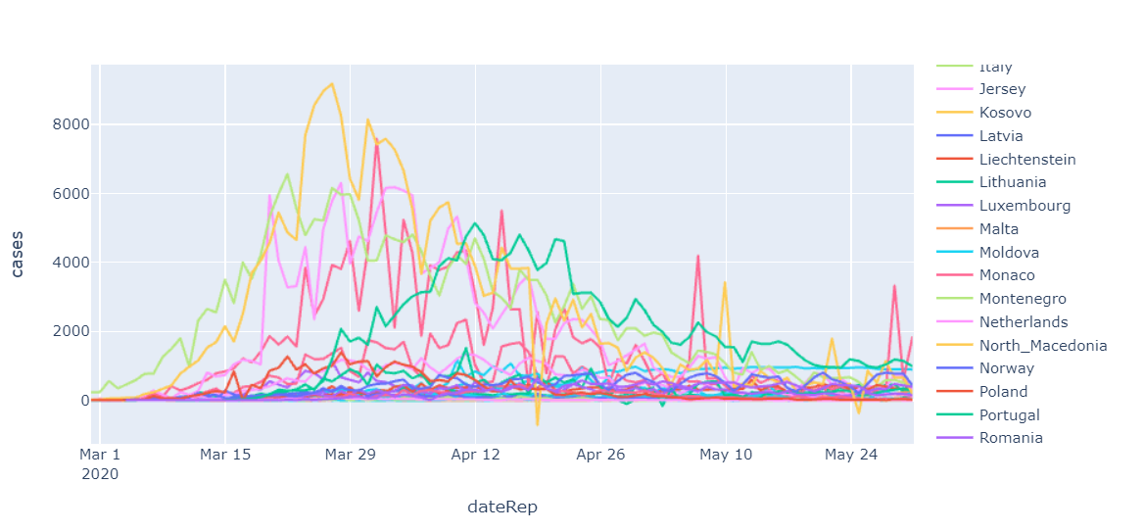

Slide 12
Other Games

Slide 13
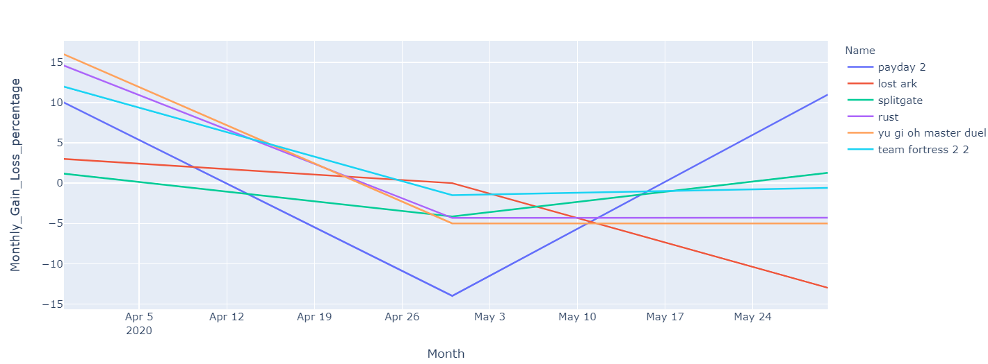

Slide 14
League of Legends

Slide 15
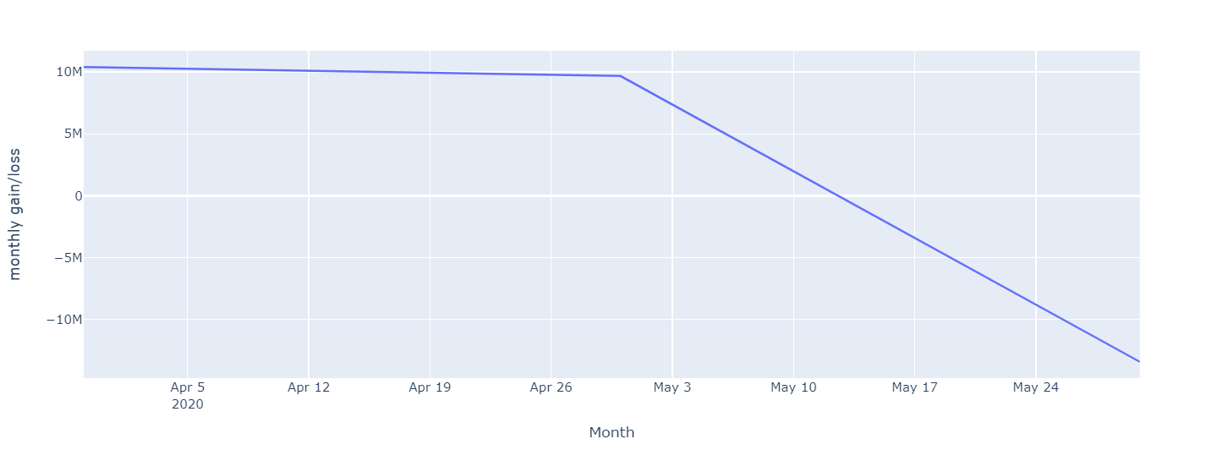

Slide 16
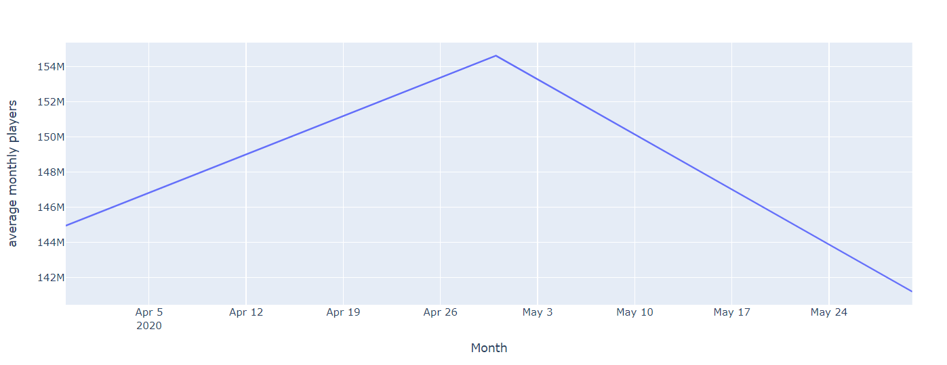

Slide 17
Conclusion
While more and more countries where starting to increase the number of regulations on outdoor activities and other hobby related things, the number of players was high up. But right after those regulations dropped and people were able to meet up again as well as had to go to school again, attend Matura ( in case of Austria ) and were able to do any kind of Entertainment related things, the game lost active players. We can also support and prove this theory because the number of players started to slowly increase again after summer ( a time in which loads of countries started to have more infections again and started enabling regulations for their population all over again - which was later marked as the second lockdown. )

Slide 18
Conclusion (2)
For the game itself ( looking at the core season time ) the lockdowns were put perfectly, since the first one was at the beginning of the season and the second one at the end of the 10th season , making it easier for players who were already invested in the game to spend more time on the game itself.

