Slide 1
HacI TURKISH COFFE CAFÉ Investment FOR FIRST PLACE
KIVANC USLU
COURSERA CAPSTONE PROJECT – DATA SCIENCE

Slide 2
WHAT DATA SOUCES BEING USED
RICH NEIGHBORHOOD TABLE
FOURSQUARE API - VENUE
MAPREQUEST API - LOCATION

Slide 3
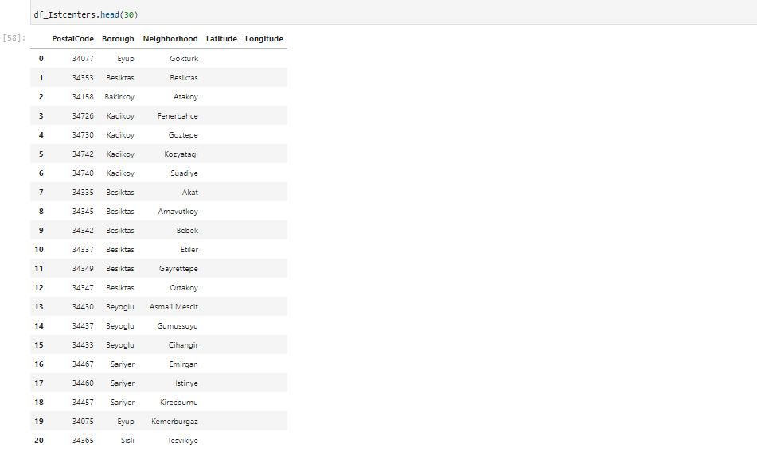
ISTANBUL 21 RICH (HIGH INCOME) NEIGHBORHOODS

Slide 4
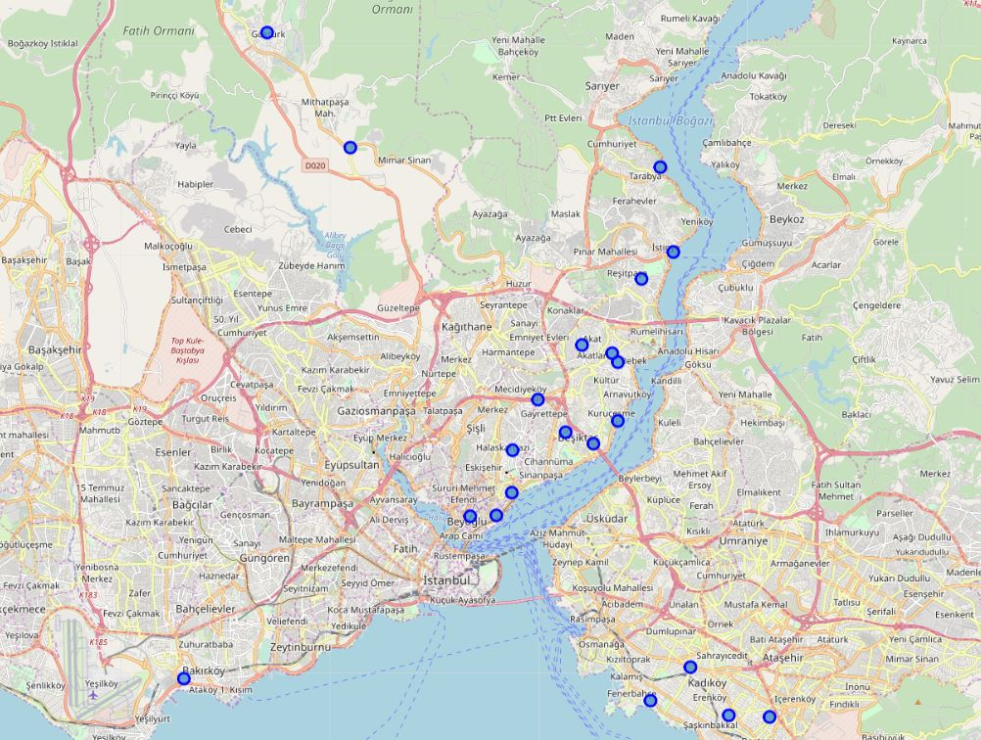
21 RICH NEIGHBORHOODS ARE SCATTERED SO WE need to ANALYZE THIS

Slide 5
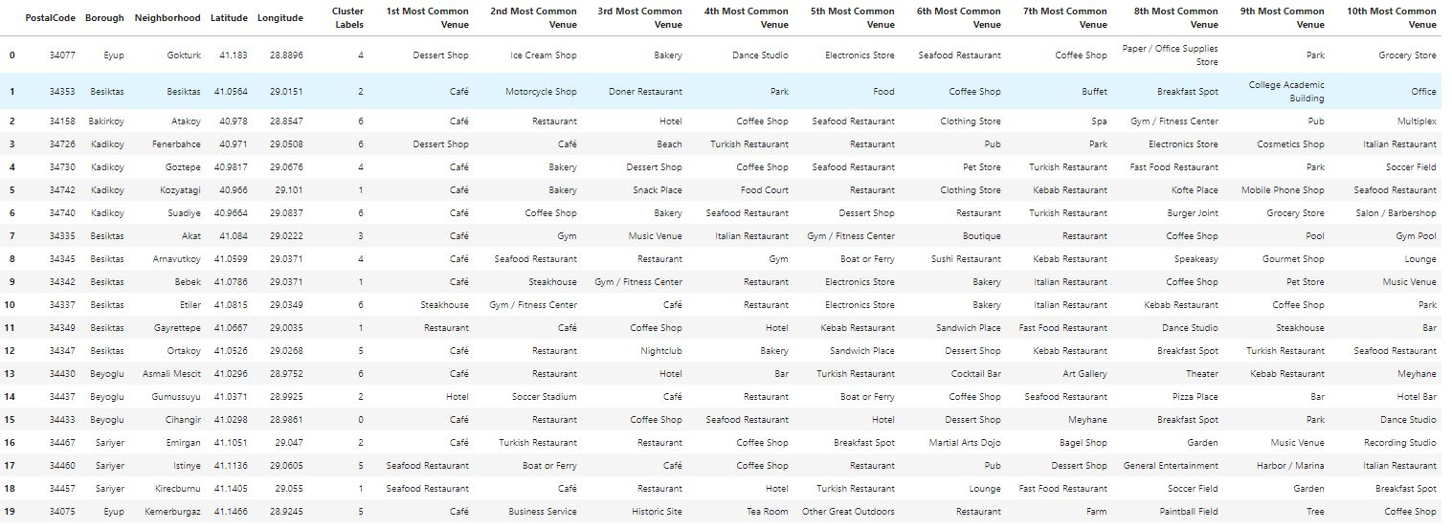
TOP VENUES IN NEIGBORHOODS

Slide 6
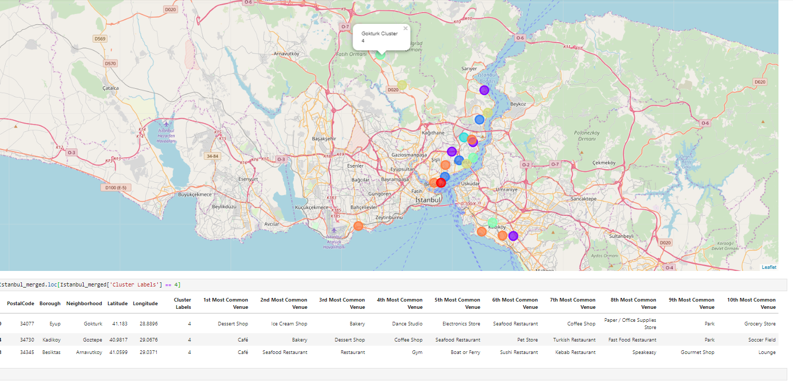
GOKTURK seems to BE PERFECT PLACE TO BE INVESTED EVEN IN THE SAME CLUSTER

Slide 7
FuRTHER INVESTIGATIONS
Existing venue details – recommendation, venue rating, likes so on
Renting coffee shop(Café) place
Employee availability
Commute options.

