Slide 1
tableau
introduction

Slide 2
Tableau:-
Tableau is easy, Powerful and fast and help in taking important business decision. We don’t need any prior coding skill or technical background in order to learn Tableau. These BI tools are so powerful that it can work on large amount of data & can convert it into meaningful formats.

Slide 3
Start Page of Tableau Desktop, there consist of 3 sections:
1. Connect – Connect sections allows tableau to connect with desktop files(different file type) and different database type. File type can be ms excel, pdf, csv, json, statistical file etc.
2. Open - You can open your existing workbook or workbook in which you have work earlier. By clicking on open you can access earlier version of workbook that you have created for visualization.

Slide 4
3. Discover – In the discover section, we get short tutorial provided by tableau community. Important blogs or also some important work done by all contributor in tableau community

Slide 5
Data visualization:-
Data visualization is the graphical representation of information and data. By using visual elements like charts, graphs, and maps, data visualization tools provide an accessible way to see and understands trends, outliers, and patterns in data.

Slide 6
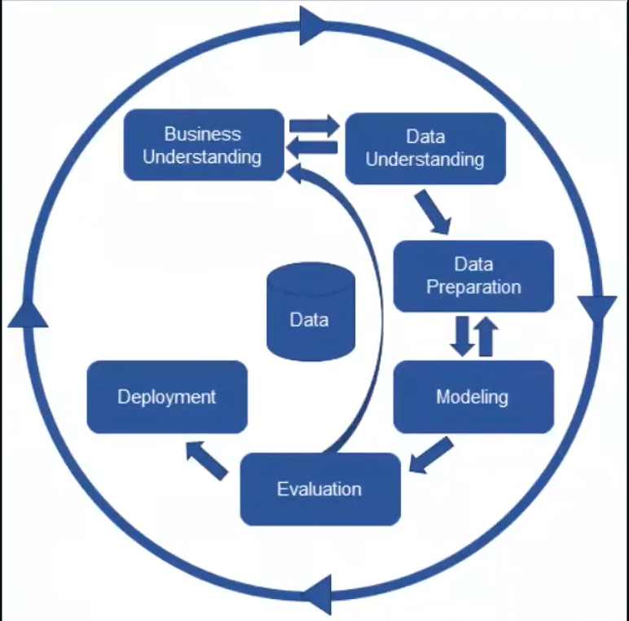
Steps of process flow of BI Project:-

Slide 7
Process flow of BI Project –
1. Business understanding
2. Data understand
3. Data Preparation
4. Modeling
5. Evaluation
6. deployment.

