Slide 1
Cross-Border Commuters in Switzerland
EPFL Extension School – Applied Data Science and Machine Learning
Krunoslav Ivesic

Slide 2
Motivation
Opportunity to apply the skills from the course and to learn something new
Familiar topic for everyone
Personal interest in politics
Data set prepared by a federal organization
Presumably a reliable source

Slide 3
Data Set
Data
Number of commuters from 1999 to 2018
For each quarter (notation: Q1, Q2, Q3, and Q4)
Expressed separately and summed up for the categories:
Gender
Age group
Canton (all the cantons and Switzerland as a whole)
Cleaning and preparation
No missing values or outliers detected
Extra check for sum consistency

Slide 4
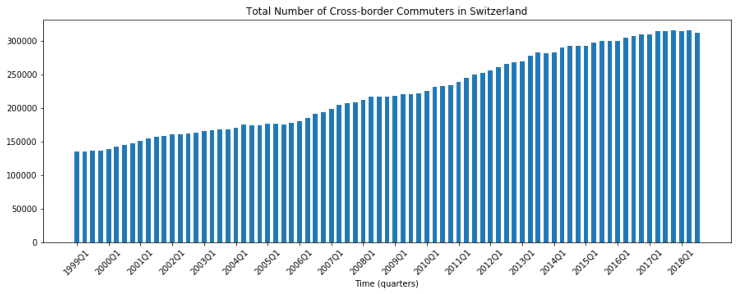
Plots
Total number of commuters per quarter
Number of commuter, split by categories
By gender
By age group
By canton

Slide 5
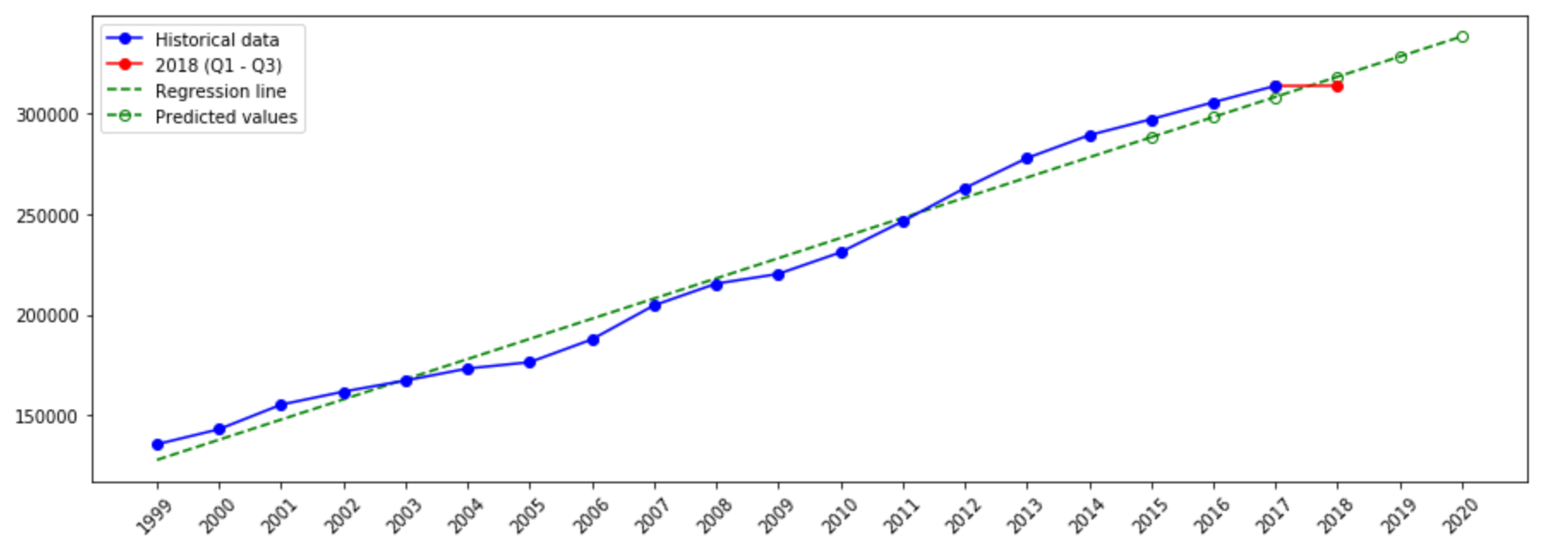
Prediction per year
Based on average values over year

Slide 6
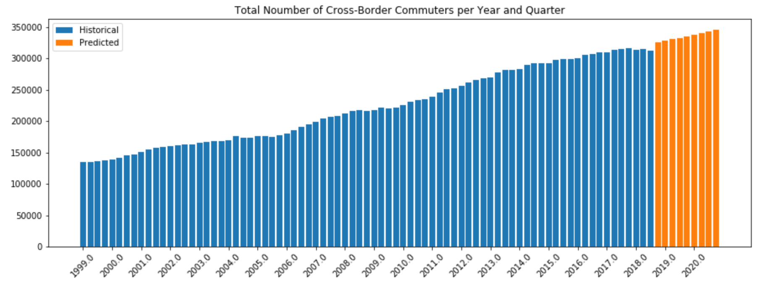
Prediction per year and quarter
Quarterly trend visible in recent years – quarter as a feature?

Slide 7
Conclusion
Most accurate precision achieved by linear regression in year and quarter
All predictions show general expected trend for the period to come
Based on the general trend, not on recent years only
Quarterly fluctuations cannot be modelled if the whole data span is considered

Slide 8
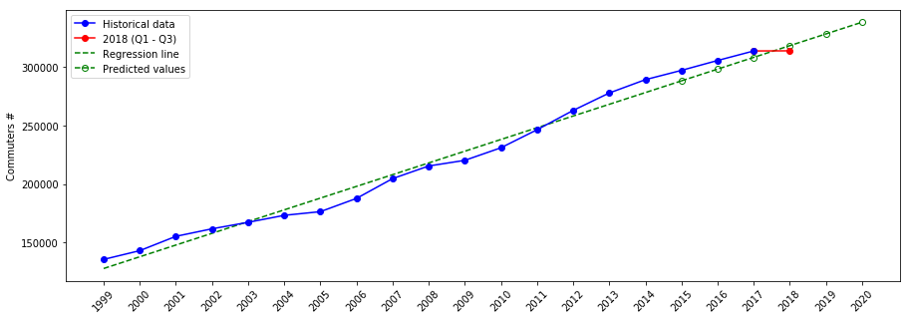
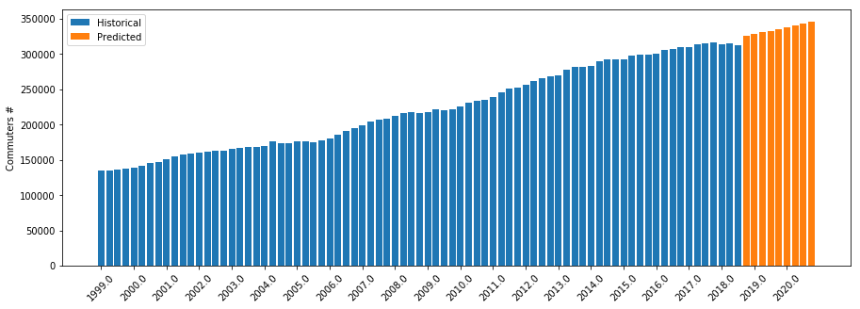
Cross-Border Commuters in Switzerland
Prediction of future number of commuters based on:
Yearly averages
Year and quarter
Krunoslav Ivesic

