Slide 1
AI Updates
August 8, 2025
GPT-3 to GPT-4 : Mixture of Experts
GPT-4o/o3 to GPT-5 : Mixture of Models (“router”)
Crowd-sourced "LM Arena" Leaderboard
OpenAI GPT-5 released on August 7
OpenAI GPT-5 tests
OpenAI Models' history
Claude Opus 4.1
OpenAI GPT-OSS "open" model family
Google Gemini 2.5 Deep Think model
Recruiters & admin assistants automated by Comet
DeepMind "Big Sleep" - finds bugs/vulnerabilities
ElevenLabs Eleven Music - multi-lingual model
Google Kaggle Game Arena – benchmarking Arena
Microsoft CLIO Framework
Claude Code /security-review command
Dia browser - AI-powered, from The Browser Company
Google DeepMind Perch analyze wildlife audio
Cultural Bias Embedded in LLMs
Jules - Google's new AI coding agent
Ollama GUI
Anthropic - Persona vectors
LangSmith - Evaluate Agents
OpenAI - main models
To-Do List for Super-Intelligence
Google is making its AI Pro Plan free for students
DeepMind Genie 3 AI world model
xAI launches Grok Imagine for AI video and images
Qwen-Image with Native Text Rendering
Alibaba Qwen3 Coder Flash
Falcon-H1 - Hybrid open-source model
Thousands of Startups stopped using AWS, CGP, ...
Andrew Tulloch Rejected $1B+ job offer
Jobs, Layoffs

Slide 2
Crowd-sourced "LM Arena" Leaderboard
https://lmarena.ai/?leaderboard
Starting Elo rating = 1000
https://en.wikipedia.org/wiki/Elo_rating_system
English - https://lmarena.ai/leaderboard/text
Coding - https://lmarena.ai/leaderboard/text/coding
LM Arena secures $100M to expand AI benchmarking (at $600M valuation)
Model | Score
gpt-5 | 1481
gemini-2.5-pro | 1460
o3-2025-04-16 | 1450
chatgpt-4o-latest-20250326 | 1442
gpt-4.5-preview-2025-02-27 | 1438
grok-4-0709 | 1429
qwen3-235b-a22b-instruct-2507 | 1428
claude-opus-4-20250514-thinking-16k | 1420
kimi-k2-0711-preview | 1420
glm-4.5 | 1416
deepseek-r1-0528 | 1417
claude-opus-4-20250514 | 1412
grok-3-preview-02-24 | 1409
gemini-2.5-flash | 1408
gpt-4.1-2025-04-14 | 1407
qwen3-235b-a22b-thinking-2507 | 1398
claude-sonnet-4-20250514-thinking-32k | 1398
qwen3-235b-a22b-no-thinking | 1398
o1-2024-12-17 | 1398
o4-mini-2025-04-16 | 1397
Model | Score
gpt-5 | 1509
qwen3-235b-a22b-instruct-2507 | 1478
claude-opus-4-20250514-thinking-16k | 1481
gemini-2.5-pro | 1473
o3-2025-04-16 | 1472
chatgpt-4o-latest-20250326 | 1469
claude-sonnet-4-20250514-thinking-32k | 1461
kimi-k2-0711-preview | 1458
gpt-4.5-preview-2025-02-27 | 1457
deepseek-r1-0528 | 1457
glm-4.5 | 1456
qwen3-235b-a22b-thinking-2507 | 1447
claude-opus-4-20250514 | 1454
grok-4-0709 | 1449
gpt-4.1-2025-04-14 | 1443
qwen3-235b-a22b-no-thinking | 1440
qwen3-coder-480b-a35b-instruct | 1436
glm-4.5-air | 1434
claude-sonnet-4-20250514 | 1438
grok-3-preview-02-24 | 1438
China
Grok 4 Benchmarks
https://artificialanalysis.ai/models/grok-4
x.ai
China
China
https://lmarena.ai/leaderboard/text
https://web.lmarena.ai/leaderboard
https://openlm.ai/chatbot-arena/
https://beta.lmarena.ai
Web Leaderboard https://web.lmarena.ai/leaderboard
LLM Leaderboard - by @LlmStats https://llmworld.net/llm_leaderboards/
LLM Leaderboard - by StackAI https://www.stack-ai.com/llm-leaderboard
LLM Leaderboard - by Artificial Analysis https://artificialanalysis.ai/leaderboards/models
Open LLM Leaderboard - by Hugging Face https://huggingface.co/open-llm-leaderboard
LLM Leaderboard - by Vellum https://www.vellum.ai/llm-leaderboard
AI Benchmarking Hub https://epoch.ai/data/ai-benchmarking-dashboard
China
China
China
China
China
China
x.ai
x.ai
China
China
China
China
China
x.ai

Slide 3

OpenAI GPT-5
Previous model | GPT‑5 model
GPT‑4o | gpt-5-main
GPT‑4o-mini | gpt-5-main-mini
OpenAI o3 | gpt-5-thinking
OpenAI o4-mini | gpt-5-thinking-mini
GPT‑4.1-nano | gpt-5-thinking-nano
OpenAI o3 Pro | gpt-5-thinking-pro
OpenAI GPT-5 released on August 7
Four versions: Pro, Regular, Mini, Nano
Reasoning levels - Minimal/Low/Med/High
Context length - 400Ktokens
Described as "smartest, fastest, and most useful language model to date" - with major advances in reasoning, writing, coding, accuracy, speed, and safety
Better structured thinking, context recognition, and problem-solving
Reduced hallucination and safer output
Reasoning Model (break complex tasks into steps)
74.9% on SWE-Bench Verified for coding, and advances in agentic tasks where the model autonomously executes multi-step actions, writes code, and integrates with tools like GitHub Copilot
One system integrates voice, search, deep reasoning, and canvas/drawing features
GPT-5 is now the default in ChatGPT, with unlimited access for all users. Plus and Pro subscribers receive access to higher “intelligence” and more advanced model variants
For Enterprise and Developers - more reliable outputs and better handling of ambiguity
Transformer architecture + Chain-of-Thought (CoT) reasoning and a "router" system that delegates subtasks to specialist sub-models
Multiple expert sources describe GPT-5’s launch as a "significant but not revolutionary" step
https://openai.com/index/introducing-gpt-5/
https://openai.com/gpt-5/
https://openai.com/index/gpt-5-system-card/
https://www.youtube.com/watch?v=0Uu_VJeVVfo - video
Model | Main Use Case | Cost $/Mtok in/out
GPT-5 Pro | Enterprise, extended reasoning, test-time compute, highest complexity, advanced problem solving | Not public API, $200/mo
GPT-5-main | Default, all-around | 1.25/10
GPT-5 Mini | lower cost, high-volume | 0.25/2
GPT-5 Nano | Max speed, low-latency, mobile | 0.05/0.40
the big breakthrough from GPT-3 to GPT-4 was the Mixture of Experts
the big breakthrough from GPT-4o/o3 to GPT-5 is the Mixture of Models (aka the “router”).
$ per intelligence frontier is ultimately a routing problem
from in‑app model picker to real‑time routing (thinking/tool use) from "which model?" to "what constraints/policy/verbosity/effort?"
https://www.latent.space

Slide 4
OpenAI GPT-5 - tests
Image Analysis: Accurately identified a location in Northern California from a vague photo
Image Generation: Created photorealistic images like raindrops on leaves and fantasy scenes
Complex Visual Tasks: Analyzed a children's book page to find 25 "wrong" things, then generated new images incorporating those elements
Speed - very fast generation, estimated at 60-80 tokens per second
Thinking Mode - "GPT-5 thinking" mode for complex tasks, with option to get quick answers
Iteration - Most projects worked well on first attempt, with minimal back-and-forth needed
Minor Issues
Flight simulator had some visual glitches with the airplane model
Some advanced features (like Lego stacking) didn't work perfectly
SVG generation was less accurate than other capabilities
Matthew Berman - tests
https://www.youtube.com/watch?v=BUDmHYI6e3g
3D Rubik's Cube Simulator - GPT-5 created a fully interactive Rubik's cube that could be scrambled and solved, scaling from 3x3x3 up to 20x20x20 with realistic physics and lighting effects.
Built a functional Excel clone with multiple sheets, formula support, cell formatting, and CSV import/export
Created a Microsoft Word clone with text formatting, lists, image insertion, and various editing features
Conway's Game of Life mapped to 3D shapes (sphere, torus, cylinder, Mobius strip)
Complex snake game with particle effects, trails, and multiple power-ups
Double pendulum physics simulation with accurate movement and UI controls
Realistic Lego builder environment with photo-realistic blocks and shadows
Cloth simulation with tearing and wind effects
Fluid dynamics using Navier-Stokes equations
Ray tracing and path tracing renderers
Hexagon bouncing ball physics with realistic collisions
Twitter clone
E-commerce checkout page
Financial dashboard with charts and metrics
1990s-style "hacker" website
Authentication pages
GPT‑5 tops LMSYS Text/WebDev/Vision Arenas (tested as "summit"), with a notably large WebDev margin (@lmarena_ai).
OpenAI claims 74.9% on SWE‑bench Verified;
Several researchers immediately flagged a mislabeled axis and that OpenAI ran on a 477‑task subset; corrected charts put GPT‑5 roughly on par with Claude 4.1 Sonnet/Opus (74–75%)
GPT‑5 shows strong instruction following and tool use (e.g., TauBench gains, IFBench instruction‑following), but mixed changes on non‑SWE coding evals and OpenAI PR‑reproduction
GPT‑5 hits 65.7% on ARC‑AGI‑1, and 9.9% on ARC‑AGI‑2; Grok‑4 leads ARC‑AGI‑2 at 15.9%
https://news.smol.ai

Slide 5
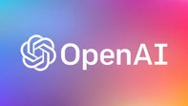
OpenAI - main models
Model | Release Year-Month | Short Description
GPT-3.5 | 2022-11 | Text Chat
GPT-4 | 2023-03 | Multimodal (text and image), Reasoning, creativity, alignment
GPT-4o | 2024-05 | "Omni" model (text, audio, images) - in real time. Much faster, more cost-efficient
GPT-4.1 | 2025-04 | Coding, long context (up to 1 Mln tokens), instruction following
GPT-4.5 | 2025-02 | "Orion", very large and expensive to run, outperformed GPT-4o, phased out in favor of GPT-4.1.
o1 | 2024-12 | "Reflective" - spends time deliberating, excels at reasoning, science, and programming
o3 | 2025-04 | Reflective step-by-step reasoning,
o3-mini | 2025-01 | Smaller, fast, cost-efficient, optimized for STEM reasoning
o4-mini | 2025-04 | Successor to o3-mini, supports both text and images, higher accuracy and better processing speed. Designed for industrial applications like utilities, healthcare, finance, and more.
GPT-5 | 2025-08 | Family of 4 models: Pro, Main, Mini, Nano Mixture of Models (router), thinking

Slide 6
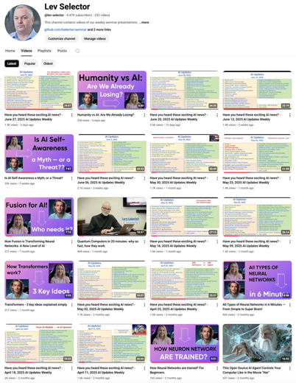
Please pause the video - and answer the pinned question in comments under the video
Subscribe to this channel
https://www.youtube.com/@lev-selector
Get notified about new videos - every Friday, links to slides under the videos

Slide 7

Claude Opus 4.1
Claude Opus 4.1 released on August 5, 2025
Software engineering, reasoning, and agentic (autonomous) task handling
SWE-bench 74.5% (vs 72.5% for v.4)
Better at multi-step workflows, long-horizon "AI agent" tasks, and data analysis, particularly in areas needing precise detail-tracking and complex research
Excels in large codebase refactoring, debugging, and adapts to diverse code styles, with output support up to 32,000 tokens
Can be fine-tune between instant inference and extended, step-by-step output
Produces more natural, human-like writing with improved depth, structure, and tone
Available to Claude Pro, Max, Team, and Enterprise users, as well as via the Claude Code app, Anthropic API, Amazon Bedrock, and Google Cloud Vertex AI
Pricing remains at ($15/$75) per 1 Mln (in/out) tokens

Slide 8
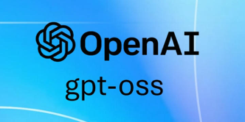
OpenAI GPT-OSS "open" model family
OpenAI has just released its first new "open" model family
"open-weight" , Apache 2.0 license
Two models: gpt-oss-120b & gpt-oss-20b
OSS = Open Source Software
Strong at language reasoning, code generation, agentic workflows, and tool use - on par with top industry models
Ahead of o3-mini, behind o3 and o4-mini
Adjustable chain-of-thought reasoning levels (high, medium, low)
MoE architecture
Available for immediate download on Hugging Face, work with tools like LM Studio and Ollama, and are integrated into major cloud platforms including AWS, Microsoft Azure, and Google Cloud
Can be fine-tuned and adapted for custom or local enterprise deployments, even in data-residency- or security-sensitive environments
Robust internal safety measures, including filtering sensitive material (chemical, biological, radiological, nuclear, etc.)
These models do not provide full transparency compared to truly open-source AI (weights are open, but not the full training data/methods)
Many partners - Amazon, Microsoft, Baseten, Nvidia, etc
OpenAI Raises $8.3B at $300B Valuation
Dragoneer led the round with $2.8B as investors rushed to join OpenAI’s cap table. Now at $13B in revenue and 700M weekly ChatGPT users, the company eyes $20B by year’s end and a true for-profit future.
OpenAI Sells ChatGPT to U.S. Gov for $1
OpenAI will provide ChatGPT Enterprise to U.S. federal agencies for just $1 over the next year, giving them access to its frontier models and Advanced Voice Mode
The move, in partnership with the GSA, aims to modernize public services. It follows a $200M Pentagon contract and comes as OpenAI eyes a potential $500B valuation amid record funding rounds.

Slide 9



AI Updates 1
Google Gemini 2.5 Deep Think model
Available for the $250/month Gemini Ultra subscription tier
"Deep Think" mode accessible to advanced users and enterprises
A version of this model was used to win a gold medal at the July 2025 International Math Olympiad (IMO)
Recruiters & admin assistants automated by Comet
Perplexity CEO Aravind Srinivas has said his company's new AI browser, Comet, will soon automate two white-collar roles that every workplace depends upon: recruiters and administrative assistants.
DeepMind "Big Sleep" - finds bugs and vulnerabilities
It is an AI-powered cybersecurity agent developed by Google DeepMind in collaboration with Google Project Zero
It's purpose is to search for and identify software vulnerabilities - especially in open-source projects
Big Sleep has found its first real-world vulnerabilities, including a critical flaw in the SQLite database that existing testing infrastructure and fuzzing tools have missed!
The system has reported its first 20 vulnerabilities, affecting widely used software like ImageMagick and FFmpeg, and is considered a major advance in automated vulnerability research
Google is making its AI Pro Plan free for students in select countries, including the U.S.
Google is investing $1B over 3 years for AI training at U.S. colleges.

Slide 10




AI Updates 2
DeepMind Genie 3 AI world model
Real-time creation of interactive, consistent 3D environments from simple text prompts. 24fps in 720p
Genie 3 can generate entire playable worlds lasting minutes, remember environment details, and allow live changes such as altering weather or adding characters—without any hardcoded rules or physics engine
Currently restricted to researchers
xAI launches Grok Imagine for AI video and images
The tool can create 15 second videos with audio from text prompts
Qwen-Image with Native Text Rendering
Open-source (Apache 2.0) image foundation model
20B MMDiT (Multimodal Diffusion Transformer) that excels in complex text rendering and precise image rendering
It can create multi-line text layouts, paragraph-level semantics, and fine-grained details in both alphabetic languages and logographic languages with high fidelity
The model preserves both semantic meaning and visual realism during editing operations. It consistently outperforms existing models across diverse generation and editing tasks. Examples of images generated by the model are available in the post
Tasks: marketing, education, and presentation design
https://qwenlm.github.io/blog/qwen-image/

Slide 11



AI Updates 3
Alibaba Qwen3 Coder Flash
30.5B code model that matches Claude Sonnet 4 on key coding tasks
MoE architecture (128 experts)
256K native context window, expandable to 1M tokens
Full-precision inference requires 33GB of RAM; quantized versions run on 18GB
Performs competitively on WebArena and BFCL for tool use and workflow integration
fully open source under the Apache 2.0 license
Weights are available on Hugging Face and Modelscope
Falcon-H1 - Hybrid open-source model
H = Hybrid: Transformer + State Space Model (SSM)
From Technology Innovation Institute (TII)
Abu Dhabi, United Arab Emirates
six sizes – 0.5B, 1.5B, 1.5B-Deep, 3B, 7B, and 34B params
256K Context Length
Multilingual (18 languages)
strong abilities in math, science, and coding
Open-Source
Thousands of Startups stopped using AWS, CGP, ...
due to rising costs, diminished performance advantages, and greater flexibility offered by alternative platforms
https://aws.plainenglish.io/the-great-cloud-exit-why-1-000-startups-are-rethinking-aws-gcp-in-2025-5c16b1eb33b0

Slide 12


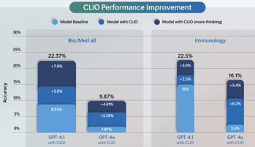
AI Updates 4
ElevenLabs "Eleven Music" - multi-lingual model
Generate music with AI - vocals and instruments. Control genre, style, and structure with levers over both sound and lyrics
ElevenLabs has a deal with digital rights agencies and music publishing firms to train its model on artists' work
Google Kaggle Game Arena – benchmarking Arena
Benchmarking tool that can test different models against each other in various games designed to test strategic thinking and problem solving
Microsoft CLIO Framework
CLIO = Cognitive Loop via In-situ Optimization - a breakthrough framework that enables non-reasoning LLMs to develop their own thought patterns and adapt their reasoning in real-time.
CLIO builds and refines its reasoning through self-reflection at runtime, creating its own feedback loops to explore ideas, manage memory, and flag uncertainties.
With the self-adapting behavior, users get full control to set thresholds for uncertainty, change reasoning paths, or re-execute them entirely.
On Humanity’s Last Exam, CLIO boosted GPT-4.1’s accuracy on text-only biomedical questions from 8.55% to 22.37%, surpassing o3 (high).

Slide 13

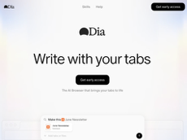
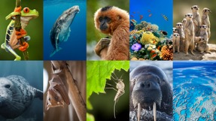
AI Updates 5
Claude Code /security-review command
This command automates security reviews
With GitHub Actions integration and a /security-review command, developers can quickly detect and fix security issues
Dia browser - AI-powered, from The Browser Company
The Browser Company is a New York–based software startup founded in 2019 by Josh Miller (CEO) and Hursh Agrawal (CTO)
They created Arc browser - organized (Spaces, Profiles, Boosts)
They created Dia browser - AI-powered, user can chat directly with their browser, get summaries, plan, and execute tasks without leaving their current page
August 2025 - launched Dia Pro, a $20/mo (also has Free tier)
The Browser Company employs about 50–200 people and has attracted top talent from companies like Google, Tesla, Medium, and GitHub.
The Browser Company is positioning itself at the forefront of the so-called "AI browser wars"
https://www.diabrowser.com
https://thebrowser.company
Google DeepMind Perch analyze wildlife audio
AI model to analyze massive amounts of wildlife audio, making it easier to track endangered species in diverse environments
Open source, can detect of species with scarce training data
https://deepmind.google/discover/blog/how-ai-is-helping-advance-the-science-of-bioacoustics-to-save-endangered-species/

Slide 14
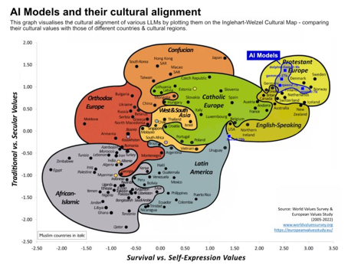
Cultural Bias Embedded in LLMs
A study of major AI models across 107 countries revealed they all reflect the same cultural assumptions - those of English-speaking, Western European societies. None aligned with values from Africa, Latin America, or the Middle East regarding trust, respect, or conflict resolution
Example: customer service scenario: an AI system learns to handle complaints with brief apologies and discount offers. This approach works well in Germany (direct, efficient culture), fails in Japan (violates "meiwaku" - the cultural need for deep acknowledgment of inconvenience), and backfires in the UAE (discounts feel like charity rather than respect)
Example: Klarna - initially celebrated their AI system's success: handling 2.5 million conversations in 35 languages with 82% faster response times. However, 14 months later they reversed course, rehiring humans after experiencing a 20%+ drop in customer satisfaction. The author suggests they optimized for 35 languages while missing 35 different cultural expectations for treatment.
The solution is not cultural neutrality. Organizations should ask: What cultural biases exist in our AI systems? How do we test cultural intelligence alongside technical performance? Who provides this expertise?
https://shav.dev/blog/cultural-bias
https://arxiv.org/pdf/2410.10489
https://www.klarna.com/international/press/klarna-ai-assistant-handles-two-thirds-of-customer-service-chats-in-its-first-month/

Slide 15

Jules - Google's new AI coding agent
Jules - Google's new AI coding agent
Jules is accessible via a web application.
Usage: you connect your GitHub account, select a repository and branch, and write a detailed prompt.
Jules clones the repo onto a Google Cloud VM, develops a plan, executes the requested changes, and provides a diff for you to review.
Once approved, Jules can open GitHub Pull Requests for the updates
Multiple tasks can run in parallel, and the system displays the plan and reasoning for transparency and user steerability
It can be used for writing tests, fixing bugs, updating dependencies, and building new features - directly within your GitHub workflow
Jules is powered by Gemini 2.5 Pro and operates asynchronously: you can assign tasks, disconnect, and return later to find updates ready for review and integration
https://jules.google
https://blog.google/technology/google-labs/jules/
https://jules.google/docs
https://www.youtube.com/watch?v=YO7I8OLSwKE
https://blog.google/technology/google-labs/jules-now-available/
Jules can handle tasks in the background without requiring you to monitor progress, making it suitable for both quick fixes and more complex multi-task agentic workflows
Other advanced features include the ability to read an AGENTS.md file for added context, audio changelogs summarizing recent changes, and native integration with GitHub issues
Free introductory plan (15 daily tasks, 3 concurrent) and paid tiers under Google AI Pro and Ultra plans for higher task limits
Jules has been widely adopted by developers worldwide, including internal Google projects
Early feedback praises its capacity to automate routine development chores and assist with large-scale code migrations, although granular tasks and user oversight are still recommended for complex changes

Slide 16
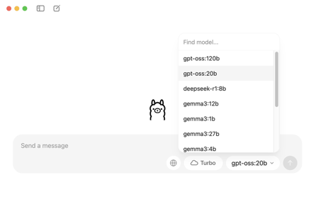

Ollama GUI
Ollama has released a new desktop GUI app
Drag-and-Drop PDF (or other doc) into the app and immediately start chatting with the doc, no setup or API keys required
Turbo Mode - access to massive cloud-based models (like 235-billion parameter models) while still running local models. The free tier includes 10,000 credits weekly.
Easily switch between different AI models through the GUI. If a model isn't installed, the app automatically downloads it.
App can process images, screenshots, diagrams, and PDFs, understanding visual content alongside text.
Technical Changes - Ollama has moved away from llama.cpp to their own proprietary engine, suggesting they're building something fundamentally new rather than just wrapping existing tools.
https://medium.com/@PowerUpSkills/ollama-has-a-new-app-f9b0f4083fef

Slide 17

Anthropic - Persona vectors
Anthropic - Persona vectors
Monitoring and controlling character traits in language models
Persona vectors - patterns of neural network activity that control character traits in AI language models. These vectors work like brain regions that "light up" for different moods or attitudes
Persona vectors can be used for monitoring and detecting model's personality shifts during conversations or training
For preventing unwanted personality changes during training by steering the model toward undesirable traits during training to build resilience against acquiring them from problematic data (like giving a vaccine)
For data filtering (identify training data that would induce negative traits)
Researchers extract these vectors by comparing neural activations when the model exhibits specific traits (like "evil," "sycophancy," or "hallucination") versus when it doesn't. They validated the method by injecting these vectors and observing corresponding behavioral changes
https://www.anthropic.com/research/persona-vectors

Slide 18
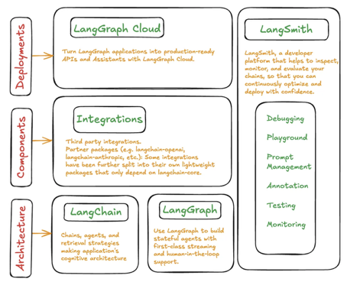
LangSmith - Evaluate Agents
Implementing 12 AI agent evaluation techniques using LangSmith
key areas: final output correctness, reasoning process efficiency, structural integrity for API calls, conversational skills in multi-turn dialogues, and live feedback monitoring over time
The 12 evaluation techniques include trajectory evaluation, RAGAS (for RAG systems), and algorithmic feedback methods
LangSmith is one of the most powerful tools for monitoring and evaluating different components of the agent lifecycle
Proper AI agent evaluation requires examining the agent's decision-making process, tool selection, response formatting capabilities, and performance consistency under real-world conditions.
Using LangSmith's evaluation framework includes datasets, evaluators, and experiment tracking capabilities for comprehensive agent assessment
The techniques include range from basic correctness checks to sophisticated multi-turn conversation evaluation and real-time performance monitoring, making it a practical resource for teams developing production AI agents

Slide 19
To-Do List for Super-Intelligence
Imagine yourself as a CEO of a company that had just created a true AI Superintelligence (SI). What would you do with it?
Secure access to the system, audit/control its actions. Ensure its intentions and goals are aligned with human ethics and company objectives; establish robust "stop buttons" and oversight protocols; proactively engage with international regulatory bodies, transparency measures, and form partnerships for oversight and governance
Ask the model to improve itself - its own algorithms, efficiency, and interpretability without introducing risks
Apply the superintelligence to all aspects of business operations: product development, new products, marketing strategies, customer acquisition, logistics, and finance
Ask it to solve critical societal problems - climate, medical research, education, poverty reduction, and infrastructure planning; collaborate with non-profits, academia, and social enterprises to maximize global benefit
Other applications: Scientific Discovery, Global Diplomacy, Personal Assistant, Legal Reform, Longevity Research
National Security Concerns - the SI technology would be classified as a strategic asset, with possible restrictions on its dissemination or collaboration with foreign entities; government will require disclosures, alignment, access, control, monitoring, licensing, and operational constraints to prevent misuse or uncontrolled proliferation; the government could potentially restrict movement of the team and data (“AI lockdown”) to prevent leaks or unauthorized use (as already was done in China for Deepseek employees)
Government will want to us SI for National Defense & Security, intelligence gathering, cyber defense, threat prediction, military logistics, and strategy. Also for social services, public health, infrastructure, emergency responses; for optimizing macroeconomic planning, industrial policy, and international trade; for gains in international negotiations and collaboration to address climate change, pandemics, and space exploration.
Unchecked superintelligence could pose existential risks if its goals and behaviors are not fully controlled. Questions of equity, access, and moral responsibility would arise about who benefits and who sets the rules. Other global actors may race to develop or steal similar systems, fueling an AI arms race. Work, governance, and the fabric of society could change rapidly, requiring careful management.

Slide 20

Andrew Tulloch Rejected $1B+ job offer
Andrew Tulloch is a machine learning expert and co-founder of Mira Murati’s Thinking Machines Lab. He has turned down Mark Zuckerberg’s $1.5 Bln job offer (to be paid over 6 years).
Andrew Tulloch life: studied at Cambridge, worked at Goldman Sachs, then 11 year with Meta (machine learning). In October 2023, he quit Meta for OpenAI; A year later he moved from OpenAI to Thinking Machines Lab.
Salaries of AI model trainers have been high, with many being paid $5-10M/year, but Meta has raised these numbers to new heights

Slide 21
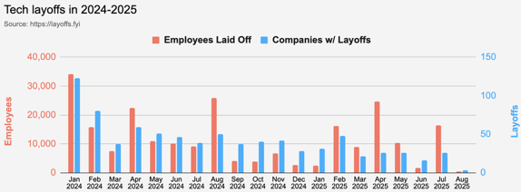
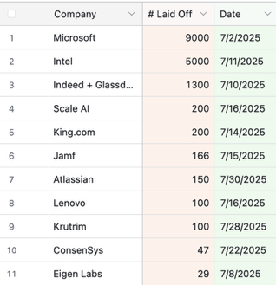
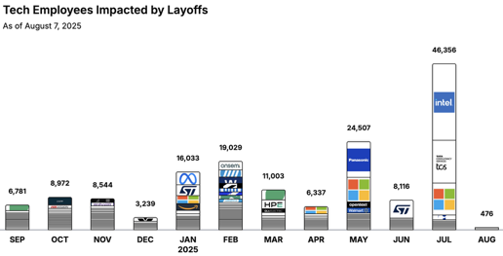
Jobs
https://layoffs.fyi
https://trueup.io/layoffs
"Don't fear AI replacement, embrace AI augmentation"
-- Eric Schmidt

Slide 22


About the Speaker
Lev Selector, Ph.D.
40+ years of software engineering, data science, and building teams (hiring, training, and managing)
Ph.D. in mathematical modeling and computer simulations
Interests:
Generative AI, Using LLM with your data
Local AI for Local Private Data
Cloud architecture, fin-tech, application security
Find/connect: Linkedin, GitHub, YouTube, Google
https://eais.ai
Enterprise AI Systems

Slide 23
Thank You!

