Slide 1
AI Updates - August 22, 2025
Trend: More Memory & More Personalization
Crowd-sourced "LM Arena" Leaderboard
Google A2A vs MCP
World Humanoid Robot games in Beijing
Google LangExtract
NVIDIA Audio Canary-1b & Parakeet-tdt-0.6b
Nano Banana Text-to-Image (Google ?)
Archon - MCP - shared memory, project context
Six Micro-Tools Generating Passive Income
Google Gemini URL Context tool in Gemini API
Anthropic is raising $10B
Pixel 10 rollout Aug 20 - AI Features
Meta DINOv3 - Self-supervised learning for vision
Gemini API - Imagen 4 Fast and Imagen 4 family
FastAPI-MCP
Alibaba wan.video - Wan 2.2 - open-sourced
ByteDance Seed-OSS 36B LLM
DynamicsLab Mirage 2
Thyme: Think Beyond Images
Claude Code - output Styles, Templates
A solo programmer built web search engine
GPT-5 - 95.84% accuracy on MedQA
Microsoft ads GPT-5 into all products
Qwen-Image-Edit 20B open-source model
90%+ of game developers use AI
95% of genAI pilots at companies are failing
DuckDB vs SQLite vs Pandas vs Polars
DeepSeek v3.1 - better at Coding
Agents.md standard
Using Windmill.dev for AI Pipelines
GPT-5 Prompt Optimization Guide
The State of AI 2025 - BVP Report
Microsoft POML
HealthChain
Jobs, Layoffs

Slide 2
Crowd-sourced "LM Arena" Leaderboard
https://lmarena.ai/?leaderboard
Starting Elo rating = 1000
https://en.wikipedia.org/wiki/Elo_rating_system
English - https://lmarena.ai/leaderboard/text
Coding - https://lmarena.ai/leaderboard/text/coding
LM Arena secures $100M to expand AI benchmarking (at $600M valuation)
Model | Score
gemini-2.5-pro | 1456
gpt-5-high | 1456
claude-opus-4-1-20250805-thinking-16k | 1451
o3-2025-04-16 | 1446
claude-opus-4-1-20250805 | 1441
chatgpt-4o-latest-20250326 | 1442
gpt-4.5-preview-2025-02-27 | 1438
grok-4-0709 | 1426
gpt-5-chat | 1422
qwen3-235b-a22b-instruct-2507 | 1421
kimi-k2-0711-preview | 1421
claude-opus-4-20250514-thinking-16k | 1420
deepseek-r1-0528 | 1418
glm-4.5 | 1414
claude-opus-4-20250514 | 1411
grok-3-preview-02-24 | 1409
gpt-4.1-2025-04-14 | 1407
gemini-2.5-flash | 1406
qwen3-235b-a22b-thinking-2507 | 1403
claude-sonnet-4-20250514-thinking-32k | 1399
Model | Score
claude-opus-4-1-20250805-thinking-16k | 1510
claude-opus-4-1-20250805 | 1500
claude-opus-4-20250514-thinking-16k | 1482
qwen3-235b-a22b-instruct-2507 | 1477
gpt-5-high | 1475
gemini-2.5-pro | 1472
o3-2025-04-16 | 1470
chatgpt-4o-latest-20250326 | 1468
claude-sonnet-4-20250514-thinking-32k | 1462
kimi-k2-0711-preview | 1460
glm-4.5 | 1459
gpt-4.5-preview-2025-02-27 | 1459
deepseek-r1-0528 | 1457
qwen3-235b-a22b-thinking-2507 | 1455
gpt-5-chat | 1453
claude-opus-4-20250514 | 1455
grok-4-0709 | 1447
gpt-4.1-2025-04-14 | 1443
qwen3-30b-a3b-instruct-2507 | 1438
qwen3-235b-a22b-no-thinking | 1439
China
Grok 4 Benchmarks
https://artificialanalysis.ai/models/grok-4
x.ai
https://lmarena.ai/leaderboard/text
https://web.lmarena.ai/leaderboard
https://openlm.ai/chatbot-arena/
https://beta.lmarena.ai
Web Leaderboard https://web.lmarena.ai/leaderboard
LLM Leaderboard - by @LlmStats https://llmworld.net/llm_leaderboards/
LLM Leaderboard - by StackAI https://www.stack-ai.com/llm-leaderboard
LLM Leaderboard - by Artificial Analysis https://artificialanalysis.ai/leaderboards/models
Open LLM Leaderboard - by Hugging Face https://huggingface.co/open-llm-leaderboard
LLM Leaderboard - by Vellum https://www.vellum.ai/llm-leaderboard
AI Benchmarking Hub https://epoch.ai/data/ai-benchmarking-dashboard
China
China
China
China
China
China
China
China
x.ai
x.ai
China
China
China

Slide 3
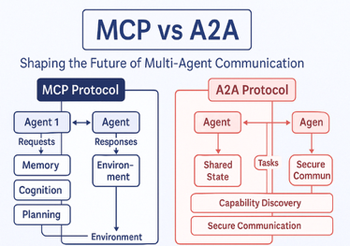
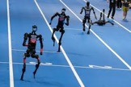
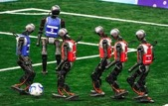
AI Updates - 1
Google A2A vs MCP
A2A (Agent-to-Agent Protocol) - open standard developed by Google. Enables communication between agents.
MCP (Model Context Protocol) - also open standard, developed by Anthropic (and backed by OpenAI and Google DeepMind). It is a standard of how AI agents and applications connect with external tools, data sources, and systems
Both protocols use JSON messages (JSON-RPC 2.0 protocol - Remote Procedure Call).
A2A is for communication between agents, so it is more "conversational" (or even multimodal) because agents understand natural language
MCP is more strictly structured because it is intended to pass data from data sources to agents
Both protocols (MCP and A2A) can be used in the same system - they complement each other.
World Humanoid Robot games in Beijing
Over 500 humanoid robots, 280 teams (192 from universities)
16 countries, 26 events - soccer, boxing, track, gymnastics, martial arts, basketball, gymnastics, kickboxing, table tennis, dancing, medicine sorting, hotel cleaning, and factory material handling
Robots often crashed, fell over, or froze
https://www.youtube.com/watch?v=2JA5xGteito - video

Slide 4
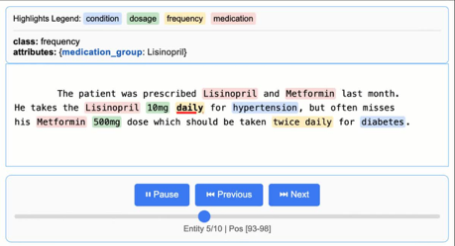


AI Updates - 2
Google LangExtract
Python library that uses LLMs to extract structured information from unstructured text documents based on user-defined instructions
Maps every extraction to its exact location in the source text, enabling visual highlighting for easy traceability and verification
Enforces a consistent output schema based on your few-shot examples
Overcomes the "needle-in-a-haystack" challenge of large document extraction by using an optimized strategy of text chunking, parallel processing, and multiple passes for higher recall
Interactive Visualization as HTML file to review extracted entities in their original context
Supports multiple LLMS (cloud or ollama local)
You can define extraction tasks for any domain using just a few examples
https://github.com/google/langextract
NVIDIA Canary-1b-v2 & Parakeet-tdt-0.6b-v3
audio transcription - fast, open, multilingual
Nano Banana - Image generation Model (Google ?)
text-to-image generation and nuanced image editing; exceptional prompt understanding, consistent scene editing, photorealistic renders, stylized artwork, macro photography, ultra-fast, better than GPT-4o Image and FLUX.1 Kontext

Slide 5



AI Updates - 3
Archon - MCP - shared memory and project context
Allows various AI tools to connect and share knowledge
Supports popular LLMs
Supports advanced RAG techniques
https://github.com/coleam00/Archon
https://www.youtube.com/watch?v=EgXOaH-ZqfU - video
Cole Medin - https://www.youtube.com/@ColeMedin
https://www.youtube.com/watch?v=yAFzPzpzJHU - Archon Launch
Six Micro-Tools in Python Generating Passive Income
https://python.plainenglish.io/how-i-built-6-micro-tools-in-python-that-earn-me-passive-income-daily-b9f4f83e9c95
Google Gemini URL Context tool in Gemini API
Simon Willison’s Weblog
llm install -U llm-gemini
llm keys set gemini
llm -m gemini-2.5-flash -o url_context 1 \
'Latest headline on simonwillison.net'
## Response
The latest headline on simonwillison.net as of August 17, 2025, is "TIL: Running a gpt-oss eval suite against LM Studio on a Mac.".
https://simonwillison.net/2025/Aug/18/google-gemini-url-context/
https://developers.googleblog.com/en/url-context-tool-for-gemini-api-now-generally-available/
The URL context tool in the Gemini API : directly fetch content from URLs, extract data, analyze and compare documents (reports, articles, PDFs), combine information from various source URLs to generate accurate summaries, blog posts, or reports
from google import genai
from google.genai.types import Tool, GenerateContentConfig
client = genai.Client()
model_id = "gemini-2.5-flash"
tools = [ {"url_context": {}}, ]
response = client.models.generate_content(
model=model_id,
contents="What are the top 3 recent announcements from the Gemini API according to https://ai.google.dev/gemini-api/docs/changelog",
config=GenerateContentConfig(
tools=tools,
)
)
for each in response.candidates[0].content.parts:
print(each.text)

Slide 6
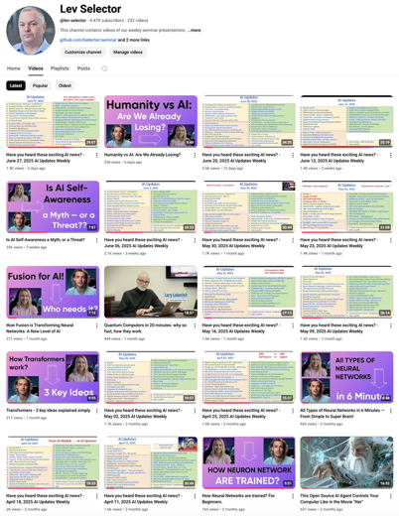
Please pause the video - and answer the pinned question in comments under the video
Subscribe to this channel
https://www.youtube.com/@lev-selector
Get notified about new videos - every Friday, links to slides under the videos

Slide 7
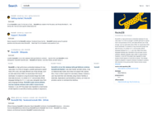


AI Updates - 4
A solo programmer built a complete web search engine in 2 months
Uses 200 GPUs to generate 3 billion neural embeddings across 280 million indexed pages; RocksDB and HNSW (Hierarchical Navigable Small World - graph algorithm) were sharded across 200 cores, 4 TB of RAM, and 82 TB of SSDs. Uses transformer-based embeddings - much better than traditional keyword matching
https://blog.wilsonl.in/search-engine/
OpenAI's GPT-5 achieved 95.84% accuracy on MedQA's clinical questions, jumping 4.8% over GPT-4o's previous best.
GPT-5 scored 70% on multimodal medical reasoning tasks (combine patient histories with imaging), gaining ~30 points over GPT-4o.
The system also exceeded pre-licensed medical professionals by 24% on reasoning and 29% on understanding in expert-level tests.
GPT-5 showed sophisticated diagnostic abilities on complex cases, correctly ID’ing rare conditions like Boerhaave syndrome from lab values and CT scans.
https://arxiv.org/pdf/2508.08224
Microsoft ads GPT-5 into all products
Consumer, developer and enterprise offerings - Microsoft 365 Copilot and Microsoft Copilot; GitHub Copilot and Visual Studio Code; Azure AI Foundry
https://news.microsoft.com/source/features/ai/openai-gpt-5/

Slide 8

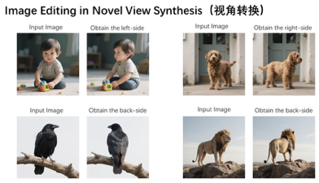

AI Updates - 5
Qwen-Image-Edit 20B open-source model
pixel-perfect edits and style transformations
changes like rotating objects or style transfers, and edits to specific areas while keeping everything else intact
Users can modify Chinese and English text directly in images without breaking already present fonts, sizes, or formatting choices.
Multiple edits can stack on top of each other, letting users fix complex images piece by piece rather than starting over each time
The model achieves SOTA performance across a series of image and editing benchmarks, beating out rivals like Seedream, GPT Image, and FLUX
https://github.com/QwenLM/Qwen-Image - GitHub
https://qwenlm.github.io/blog/qwen-image-edit/
90%+ of game developers use AI
AI reduces repetitive tasks, drives innovation, enhances player experiences
Survey included 615 developers across five countries and found teams using AI for everything from playtesting (47%) to code generation (44%); AI agents are now handling content optimization, dynamic gameplay balancing, and procedural world generation, with 87% of devs actively deploying agents.
The rise of AI is also impacting player expectations, with users demanding smarter experiences and NPCs that learn and adapt to the player.
Despite the adoption, 63% of surveyed devs expressed concerns about data ownership rights with AI, with 35% citing data privacy as a primary issue
https://cloud.google.com/resources/games-report
https://www.googlecloudpresscorner.com/2025-08-18-90-of-Games-Developers-Already-Using-AI-in-Workflows,-According-to-New-Google-Cloud-Research

Slide 9
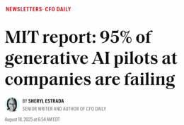






AI Updates - 6
MIT report: 95% of generative AI business pilots are failing
The problem isn't the AI itself, but how companies use it.
Many companies focus on sales and marketing, but the best results come from automating back-office tasks, saving money and improving efficiency.
Companies buying AI tools from outside do much better than those building their own.
The study also warns about the risks of using AI tools secretly, and points to poor planning and focusing too much on internal development as the main reasons of failures
https://finance.yahoo.com/news/mit-report-95-generative-ai-105412686.html
DuckDB vs SQLite vs Pandas vs Polars
SQLite - SQL DB, lightweight storage, config databases, frequent single-record updates
DuckDB - SQL DB, columnar storage, analytics, large datasets, data science workflows, SQL interface on flat files.
Pandas: common and familiar, prototyping, custom row/column manipulation, medium-size data in memory
Polars - fast, memory efficiency, large-scale data processing, lazy pipelines, DataFrame API similar to Pandas but much faster
Meta needs all the cloud infrastructure it can access.
It just made a $10B 6-years agrement for Google Cloud
It has also made agreements to use cloud services from Amazon and Microsoft.
DeepSeek v3.1 - better at Coding
Post‑training, Anthropic‑style hybrid “no‑think/think” system
V3.1 reportedly beats Claude 4 Opus on the Aider Polyglot coding benchmark; MIT license
According to Bloomberg, Anthropic is raising $10B
Double from what has been expected earlier
Anthropic has raised $3.5B in March
Dario & Daniela Amadei

Slide 10
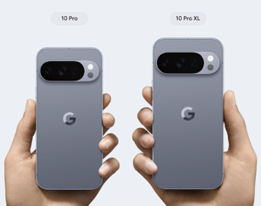

Pixel 10 rollout Aug 20 - AI
Pixel 10 rollout Aug 20 - AI
Pixel 10, Pro, Pro XL ($800 .. $1,200)
"Visual Guidance" - allows Gemini Live to give real-time visual cues
Conversational photo editing (nano-banana model ?)
Magic Cue proactively surfaces context across apps like Gmail, Calendar, and Messages, suggesting replies with info like flight details or restaurant bookings
Voice Translate transforms phone calls in real time across 10 languages, preserving the speaker's actual voice
Google’s new Tensor G5 chip delivers 60% faster AI processing with a 4B parameter Gemini Nano model running entirely on-device
AI-powered Pixel Journal app
NotebookLM integration
AI photography tools

Slide 11





AI Updates - 7
Meta DINOv3 - Self-supervised learning (SSL) for vision
SOTA computer vision model trained with SSL that produces superior high-resolution visual features at unprecedented scale
https://ai.meta.com/blog/dinov3-self-supervised-vision-model/
Gemini API - Imagen 4 Fast and Imagen 4 family https://developers.googleblog.com/en/announcing-imagen-4-fast-and-imagen-4-family-generally-available-in-the-gemini-api/
FastApiMCP
makes FastAPI endpoints callable as MCP tools for agents
! uv add fastapi-mcp from fastapi import FastAPI
from fastapi_mcp import FastApiMCP
app = FastAPI()
mcp = FastApiMCP(app)
mcp.mount() # Mount the MCP server directly to your FastAPI app
https://github.com/tadata-org/fastapi_mcp
Alibaba wan.video - Wan 2.2 - open-sourced
HD Text-to-Video Generation (T2V)
better performance, and superior visual quality
https://wan.video
https://github.com/Wan-Video/Wan2.2
ByteDance Seed-OSS 36B LLM
Series of open-source LLMS by ByteDance's Seed Team
Long-context (500K+ tokens), reasoning, agent capabilities https://huggingface.co/ByteDance-Seed/Seed-OSS-36B-Base-woSyn

Slide 12
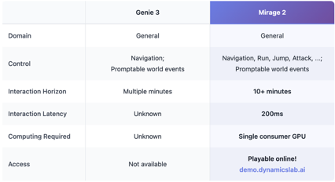



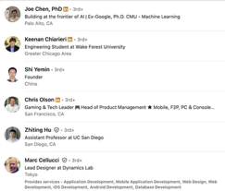



DynamicsLab Mirage 2
Mirage 2 real-time generative world engine
Upload any image—photos, concept art, classic paintings, kids' drawings - and step into it as a live, interactive world
Prompt your worlds with text to create any surreal scenes and wild events
Then share a link—your friends can jump in and play instantly
https://x.com/DynamicsLab_AI/status/1958592749378445319
https://blog.dynamicslab.ai
https://demo.dynamicslab.ai
https://www.linkedin.com/company/dynamics-lab-ai/

Slide 13

Thyme: Think Beyond Images
Stable Performance Gains: Thyme outperforms competitors on nearly 20 multimodal benchmarks, delivering consistent and significant improvements for high-resolution perception, complex reasoning, and computation tasks
Efficient Training: The model is computationally efficient, activating broad tool capabilities with just 200 GPU hours—a fraction of the cost/time required for many state-of-the-art proprietary models
Open-Source & Community Support - open access to its full dataset, sandbox environment, and training code
Thyme: Think Beyond Images
https://thyme-vl.github.io
https://huggingface.co/Kwai-Keye/Thyme-RL
https://arxiv.org/pdf/2508.11630v1
Thyme is an advanced framework designed for large multimodal language models (MLLMs) to autonomously process images and execute complex computational tasks through code generation
Thyme can independently decide which image manipulations (cropping, scaling, rotation, contrast enhancement) to perform and then executes them by dynamically generating executable code
Supports both basic image operations and advanced mathematical computations; Complex logical reasoning tasks combining visual understanding with computation; Uses a two-stage process combining supervised fine-tuning (SFT) and reinforcement learning (RL), enabling the model to rapidly develop diverse capabilities with minimal computational cost
It uniquely determines when and how to use tools for image and reasoning tasks, reducing dependency on manual prompts or external step-by-step guidance
GRPO-ATS Algorithm: Thyme introduces GRPO with Adaptive Temperature Sampling, which applies different temperatures for text and code generation. This technique preserves code correctness (minimizing runtime errors from invalid code) while allowing exploration in text generation, leading to more successful executions versus systems using plain PPO or similar methods.
import os, random
from PIL import Image
image_path = "hr_bench_4k/179.jpg"
image = Image.open(image_path)
x1, y1, x2, y2 = 1550, 2650, 1850, 2750 # cropping coordinates
cropped_image = image.crop((x1, y1, x2, y2))
zoom_factor = 2
zoomed_image = cropped_image.resize(
(cropped_image.width * zoom_factor,
cropped_image.height * zoom_factor))
random_suffix = random.randint(1000, 9999)
processed_filename = f"179_{random_suffix}.jpg"
processed_path = "/mnt/data/temp_processed_images/" + processed_filename
zoomed_image.save(processed_path)
print(processed_path)

Slide 14
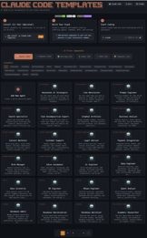
Claude Code - output Styles
Claude Code Templates
AITMPL.com, - a library of ready-to-use configuration templates for Claude Code
https://www.aitmpl.com
https://medium.com/the-context-layer/stop-writing-claude-code-configurations-from-scratch-this-template-library-changes-everything-aaa49e7e767b
> /output styles
Here are the available output styles in Claude Code:
- default - Standard output format
- compact - Condensed output with minimal whitespace
- verbose - Detailed output with additional information
- json - Machine-readable JSON format
- markdown - Formatted markdown output
- plain - Plain text without formatting
You can set the output style using:
claude --output-style <style>
Or configure it in your settings file.
> /output style json
Output style set to JSON.
> what is the capital of France?
{ "answer": "Paris" }
SuperClaude - provides 16 pre-built professional templates
Reduces repetitive prompt writing for routine actions, code understanding, architecture reviews, debugging, code explanation, git workflows
https://medium.com/@datasciencedisciple/take-your-claude-code-workflow-to-another-level-with-superclaude-7ff2832ae607
/
├── CLAUDE.md # Project overview/context
├── RULES.md # Enforced rules and boundaries
├── .claude/
│ ├── settings.json # Project-level settings
│ └── settings.local.json # Personal/local settings (gitignored)
├── backend/
│ └── CLAUDE.md # Backend-specific context/instructions
├── frontend/
│ └── CLAUDE.md # Frontend-specific context/instructions
├── docs/
│ ├── architecture.md
│ ├── design-standards.md
│ └── testing-strategy.md
Start with a Product Requirement Document (PRD) in the project’s dir.
Use the /init command in Cloud Code to generate a claude.md file
Ask Claude to create a Task Manager markdown file, which tracks all project tasks based on the PRD.
Each task assigned to specific sub-agent
Use /start session and /end session commands for each sub agent to load relevant context, work on tasks, and save progress efficiently.
Clear the context window after sessions to prevent context overload and hallucinations.
https://www.youtube.com/watch?v=qNymWffkcgc
The Claude Code Workflow You Can Copy
https://medium.com/realworld-ai-use-cases/the-claude-code-workflow-you-can-copy-6265009df76d

Slide 15






Claude Code - more How-To
Claude Code hooks are user-defined shell commands or scripts that automatically execute at specific points in Claude Code’s workflow.
These “hooks” let you automate tasks, enforce rules, and integrate Claude with other tools in a deterministic (guaranteed, repeatable) way, instead of relying on the AI to always interpret prompts correctly.
You configure hooks in your Claude Code project’s settings file, defining the shell commands/scripts to run and when to trigger them
Claude Code sub-agents are specialized AI assistants within the Claude Code environment
Each sub-agent is created for a specific role, such as code review, testing, documentation, or infrastructure management
Sub-agents operate in their own context windows, preventing information from one task from interfering with another and keeping the main conversation thread clean.
You define sub-agents in Markdown files (with YAML frontmatter) that specify their name, description, allowed tools, and detailed instructions (system prompt). These can be stored project-wide or user-wide, giving flexibility and control.
Claude can automatically assign tasks to sub-agents based on the task description, or you can explicitly invoke a particular sub-agent for a job.
Claude Flow - AI orchestration platform to run and coordinate multiple AI agents
npm install -g claude-flow@alpha
https://github.com/ruvnet/claude-flow

Slide 16
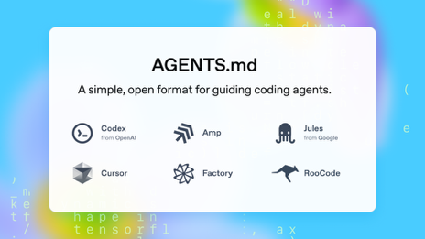
Agents.md standard
Agents.md - open markdown-based standard
To instruct AI coding agents about a codebase
Allowing any coding agent to interpret project-specific guidelines, coding styles, setup steps, test instructions, deployment details, and other essential practices in a single, standard place
README.md for humans, Agents.md for AI agents
This standard is already widely adopted by 20,000+ open-source projects. It is supported by OpenAI Codex, Cursor, Google’s Jules, AMP coding agent, Factory, RooCode, Various JetBrains and Visual Studio Code plugins. Support is rapidly expanding
https://agents.md - https://github.com/openai/agents.md
# Sample AGENTS.md file
## Dev environment tips
- Use `pnpm dlx turbo run where <project_name>` to jump to a package instead of scanning with `ls`.
- Run `pnpm install --filter <project_name>` to add the package to your workspace so Vite, ESLint, and TypeScript can see it.
- Use `pnpm create vite@latest <project_name> -- --template react-ts` to spin up a new React + Vite package with TypeScript checks ready.
- Check the name field inside each package's package.json to confirm the right name—skip the top-level one.
## Testing instructions
- Find the CI plan in the .github/workflows folder.
- Run `pnpm turbo run test --filter <project_name>` to run every check defined for that package.
- From the package root you can just call `pnpm test`. The commit should pass all tests before you merge.
- To focus on one step, add the Vitest pattern: `pnpm vitest run -t "<test name>"`.
- Fix any test or type errors until the whole suite is green.
- After moving files or changing imports, run `pnpm lint --filter <project_name>` to be sure ESLint and TypeScript rules still pass.
- Add or update tests for the code you change, even if nobody asked.
## PR instructions
- Title format: [<project_name>] <Title>
- Always run `pnpm lint` and `pnpm test` before committing.

Slide 17

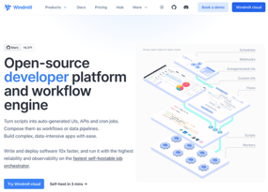

Using Windmill.dev for AI Pipelines
You can configure a pipeline by clicking and filling out forms in the UI or you can deploy it as code.
Windmill supports "workflows as code," which means you can specify your entire pipeline as code (using Python, TypeScript, etc.) and organize scripts, flows, and steps locally. Then sync and deploy them into Windmill via CLI, Git integration, or their VS Code extension.
You can define your pipeline with code in a local dev environment, version it in Git, and edit the flow specification (including steps and dependencies) in YAML or JSON.
The flow editor in Windmill allows you to edit flows directly in YAML within the app, or you can export/import flows as YAML/JSON, making it easy to move between code and the visual editor.
You can use Windmill to create AI pipelines
Windmill is an open-source workflow engine and developer platform that allows you to build and orchestrate complex data pipelines and automation flows
Windmill supports scripting in various languages and lets you compose these scripts into directed acyclic graphs (DAGs)
Windmill offers features for integrating with modern machine learning and OLAP libraries, such as Polars and DuckDB
Windmill has step-by-step flow composition, error handling, concurrency management, and integrations like S3, databases, etc.
Windmill is used by data engineers to build pipelines faster by leveraging AI-assisted code generation and workflow automation, helping to reduce boilerplate coding and speed up development for production-ready AI and data solutions
The platform also allows integrating approval steps and human interactions
Windmill.dev was founded by Ruben Fiszel in Paris
https://www.windmill.dev
https://www.windmill.dev/docs/core_concepts/data_pipelines
https://www.linkedin.com/in/rubenfiszel/
https://www.youtube.com/watch?v=IOvzHJ2BHl8 - 20 min demo

Slide 18
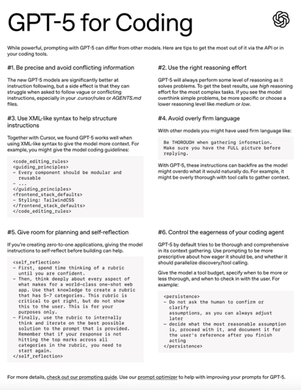
GPT-5 Prompt Optimization Guide
OpenAI's official prompting guide for GPT-5 https://www.youtube.com/watch?v=EfOjGyctDcQ
GPT-5 allows you to adjust the "reasoning effort" parameter
Your prompt: - Define context gathering criteria with clear goals; - Set tool call budgets (e.g., maximum of two tool calls); - Create early stop conditions and escalation procedures; - Establish safety boundaries for when to return control to users
Customize the frequency and detail level of GPT-5 real-time updates
OpenAI recommends using "responses endpoint" over the traditional chat completions API - better context reuse and more efficient token usage
The guide recommends specific frameworks where GPT-5 performs best: Next.js, TypeScript, React, Tailwind CSS, .... For one-shot web applications, create its own quality rubric to measure against.
Set verbosity to "low" for text, but verbose for coding.
Verbosity - Controls final answer length (separate from reasoning)
Minimal Reasoning - Fastest option for latency-sensitive use cases
Instruction Following - GPT-5 follows prompts with "surgical precision," making conflicting instructions problematic
Use AI to improve your prompts
GPT-5 prompting guide - Aug 7 https://cookbook.openai.com/examples/gpt-5/gpt-5_prompting_guide
GPT-5 Prompt Improvement Using the New Optimizer - https://cookbook.openai.com/examples/gpt-5/gpt-5_prompting_guide
GPT-5 for Coding - https://cdn.openai.com/API/docs/gpt-5-for-coding-cheatsheet.pdf
After applying the recommended prompt, GPT-5 begins to respond in a structured and useful way: first a direct answer, then a step-by-step explanation, and finally a brief action plan

Slide 19
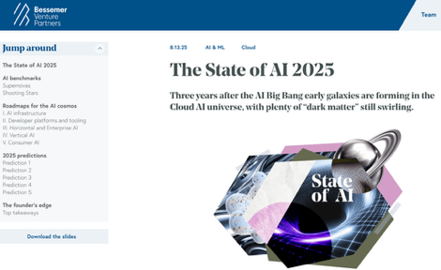
The State of AI 2025 - BVP Report
"The State of AI 2025" - report by Bessemer Venture Partners https://www.bvp.com/atlas/the-state-of-ai-2025
BVP deployed over $1B into AI since 2023
AI "Big Bang" Era: The mass release of ChatGPT marked a transformative shift, pushing AI into mainstream consciousness. The field is now defined by rapidly evolving "galaxies"—infrastructure, developer tools, horizontal and vertical AI, and consumer applications
Supernova Startups: Reach ~$40M ARR in their first year and ~$125M in the second year; Shooting Star Startups: Achieve ~$3M ARR in year one, quadruple annually, and scale to ~$100M ARR in year four
AI Infrastructure Shift (OpenAI, Anthropic, etc.) - moving towards compound systems, reinforcement learning environments, sophisticated feedback loops, and persistent memory as competitive moats
Developer Platforms & Tools - use natural language as the new programming interface. Orchestration and context management (via MCP) are becoming vital, alongside frameworks for system memory
Horizontal and Enterprise AI: AI is disrupting incumbent systems of record (SoRs) such as Salesforce, SAP, and Oracle, enabling faster, cheaper switching and next-generation systems of action. While CRM and HR are being rapidly transformed, true enterprise-scale ERP disruption remains a longer-term challenge
Rapid uptake in industries like healthcare, legal, education, real estate, and home services. Successful startups solve vertical-specific, often language heavy pain points, using domain expertise, workflow integration, and immediate ROI as key differentiators
Consumer AI (ChatGPT, Gemini, ... ) serve hundreds of millions of weekly users (writing, search, planning, voice, AI assistants, creative tasks)
Browsers with Agentic AI navigation
Some predictions:
browser will serve as a programmable interface for agentic AI
more generative video
AI evaluation and data lineage infra become central for enterprise AI
A new AI-native social media giant may emerge
Large SaaS/tech companies will be acquiring AI capabilities
Advice for AI Founders: Focus on technical/data moats, speed of implementation, starting with narrow high-value “wedges,” and embedding memory/context as core features. Continuous, private, business-grounded model evaluation is key; incumbents (big companies) will seek strategic acquisitions, but operating like you’ll own the category is critical.

Slide 20
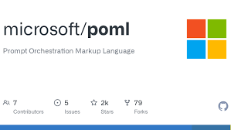
Microsoft POML
Microsoft POML (Prompt Orchestration Markup Language)
A markup language for prompts. Similar to HTML. Focused on instructions and context for AI models
Support for Diverse File Types (text, images, PDFs, Word docs, CSVs, audio files, and even folders)
Microsoft VS Code extension for POML with live preview, in-editor testing, and prompt management tools
Component Categories: logical/formatting (paragraphs, lists, ...), intention (e.g., `<role>`, `<task>`, `<example>`), Data (e.g., `<image>`, `<document>`, `<table>`)
Few-Shot and Multimodal Prompts (<example>, <input>, <output>)
Prompt Logic and Control Flow (variables, loops, and conditionals) for dynamic prompt generation; Programming-Like Templating
QA-Specific and Other Tags like `<hint>`, `<cp>` for captioned paragraphs
Prompt Styling - to control prompt tone and appearance
POML helps to structure messy, lengthy, and duplicated prompts
Note: if the target LLM is not aware about POML, it may ignore or misinterpret POML tags. So you need to convert POML to plain text
https://medium.com/data-science-in-your-pocket/microsoft-poml-programming-language-for-prompting-adfc846387a4
OpenAI’s APIs do not have a formal, externally documented markup or tag system like POML.
OpenAI’s Chat API uses roles (system, user, assistant). It is a simple JSON structure to guide conversation history. There aren’t custom tags you can insert into the prompt’s actual text for interpretation by the model.
Many people use markdown and section headers in their prompts. But these are interpretive patterns for humans, not language that the model is explicitly trained to understand. The model will treat these as regular text unless you fine-tune it to respond to such conventions.

Slide 21

HealthChain
HL7 - Health Level Seven - a set of international standards for the exchange, integration, sharing
HL7v2 - Health Level 7 Version 2
InteropEngine - module converts data between different health data standards (FHIR, CDA, HL7v2) using templates for mapping
Type-safety, Pydantic Validation
Event-driven Logging / Audit Trails
HealthChainAPI - a library for developing healthcare applications
Synthetic Healthcare Data - used for development, testing, training
HITECH - Health Information Technology for Economic and Clinical Health Act (2009) - use of electronic health records (EHRs)
CMS Interoperability Rules (Centers for Medicare & Medicaid Services Interoperability and Patient Access Final Rule) - federal rules designed to improve patient access to their health data and enable data sharing between systems
TEFCA - Trusted Exchange Framework and Common Agreement - Federally established framework to create a standardized approach for the secure sharing of electronic health information
ONC - Office of the National Coordinator for Health Information Technology; ONC Cures Act (21st Century Cures Act & ONC Cures Act Final Rule) - a 2016 law and its associated regulations managed by the ONC aims to advance interoperability
FISMA (Federal Information Security Modernization Act) - Federal laws requiring comprehensive information security, integrity, and availability of information
Puerto Rico Health Information Regulations - Laws in Puerto Rico that work alongside HIPAA to protect patient health information
The HealthChainAPI - Python Library
Provides a secure integration layer that coordinates multiple healthcare systems in a single application.
https://github.com/dotimplement/HealthChain
Connect to multiple EHR systems with unified API supporting FHIR, CDS Hooks, and SOAP/CDA protocols (sync / async support)
Pipelines: Build FHIR-native ML workflows or use pre-built ones for your healthcare NLP and AI tasks
InteropEngine: Convert between FHIR, CDA, and HL7v2 with a template-based engine
Type-safe healthcare data with full type hints and Pydantic validation for FHIR resources
Built-in event-driven logging and operation tracking for audit trails
Deploy production-ready applications with HealthChainAPI and FastAPI integration
Generate synthetic healthcare data and sandbox testing utilities
Bootstrap configurations with CLI tools
Terminology:
EHR - Electronic Health Record
FHIR (Fast Healthcare Interoperability Resources) - a standard of formatting health information
CDS - Clinical Decision Support
CDS Hooks - calling external APIs (hooks) from EHRs
CDA - Clinical Document Architecture

Slide 22
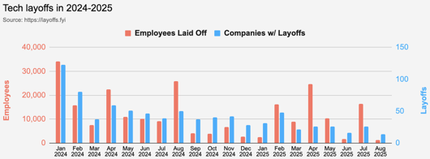
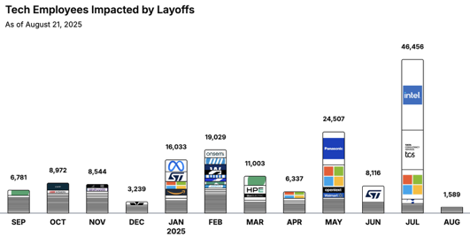
Jobs
https://layoffs.fyi
https://trueup.io/layoffs
"Don't fear AI replacement, embrace AI augmentation"
-- Eric Schmidt
Tech Layoffs in 2025: 81,567 people
(as of August 21, 2025)
Compared to 152,922 people in 2024,
264,220 people in 2023, and
165,269 people in 2022
https://layoffs

Slide 23


About the Speaker
Lev Selector, Ph.D.
40+ years of software engineering, data science, and building teams (hiring, training, and managing)
Ph.D. in mathematical modeling and computer simulations
Interests:
Generative AI, Using LLM with your data
Local AI for Local Private Data
Cloud architecture, fin-tech, application security
Find/connect: Linkedin, GitHub, YouTube, Google
https://eais.ai
Enterprise AI Systems

Slide 24
Thank You!

