Slide 1
AI Updates - September 19, 2025
Humanity has historically automated bodily functions (digging, running, seeing), but AI now automates thought and creativity - thus leaving only self-awareness as a uniquely human trait
OpenAI's GPT-5 won at ICPC World Finals
Crowd-sourced "LM Arena" Leaderboard
Hallucinations
OpenLovable - free alternative to Lovable
Foundation Models Becoming a Commodity
Alibaba Qwen 3 Max
Tencent Hunyuan Image 2.1
Salesforce SFR Deep Research
ASML-Mistral Investment
Meta Connect
CodeRabbit CLI - Code Review
OpenAI GPT-5 Codex - AI coding assistant model
ChatGPT connectors update
Alibaba's Tongyi DeepResearch - 30B AI Agent
GLM-4.5 AI coding model from Z.ai
Gemma 3 270M on Pixel 9 Pro
Google VaultGemma: diff-private LLM
Agent TARS - browser/desktop automation
GitHub Speckit
LEANN Vector DB takes 30x less space
Customer Service AI Agent
Streamlit-Based RAG Debugging
OOP Is Dead - Long Live ECS
Google Agent Payments Protocol (AP2)
Albania - AI minister of public procurement
Perplexity AI raised $200M at $20B Valuation
Inception Point AI - 3K podcasts per week
Gauss AI system from Math Inc.
OpenAI and Microsoft - Memorandum
Meta MobileLLM-R1 - pocket reasoning
Amazon Kiro IDE
Qwen3‑Next‑80B‑A3B
Mixture of Experts (MoE)
YouTube multi-language audio feature
Companies achieving more with less capital
AI Investment - gaming & entertainment
Is there an AI day?
Alter Ego "Silent Sense" wearable device
NVIDIA Rubin CPX
Why Entrepreneurship is Safer Than Employment
Jobs, Layoffs, demand for AI Engineers

Slide 2
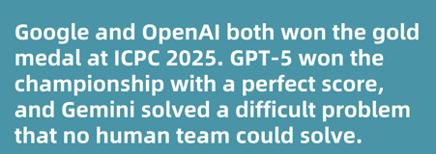

AI wins ICPC Coding Competition
OpenAI's GPT-5 won at ICPC World Finals - 12 out of 12
Best Human Team - 11 out of 12
Google's Gemini 2.5 Deep Think - 10 out of 12
This marks the first time in ICPC history that AI models have achieved gold-medal status, overtaking human champions from Saint Petersburg State University, University of Tokyo, and Tsinghua University, whose highest human score was 11/12
https://eu.36kr.com/en/p/3472125425375625
The ICPC (International Collegiate Programming Contest) is the world's largest and most prestigious college-level algorithmic coding competition
University teams solve complex programming and algorithmic problems under intense time pressure.
Teams of three compete to solve typically 8 to 15 programming challenges in five hours

Slide 3
Crowd-sourced "LM Arena" Leaderboard
https://lmarena.ai/?leaderboard
Starting Elo rating = 1000
https://en.wikipedia.org/wiki/Elo_rating_system
English - https://lmarena.ai/leaderboard/text
Coding - https://lmarena.ai/leaderboard/text/coding
LM Arena secures $100M to expand AI benchmarking (at $600M valuation)
Model | Score
gemini-2.5-pro | 1456
claude-opus-4-1-20250805-thinking-16k | 1449
o3-2025-04-16 | 1442
chatgpt-4o-latest-20250326 | 1441
gpt-5-high | 1441
gpt-4.5-preview-2025-02-27 | 1441
claude-opus-4-1-20250805 | 1438
qwen3-max-preview | 1430
gpt-5-chat | 1430
claude-opus-4-20250514-thinking-16k | 1421
grok-4-0709 | 1420
qwen3-235b-a22b-instruct-2507 | 1420
kimi-k2-0711-preview | 1419
kimi-k2-0905-preview | 1416
deepseek-r1-0528 | 1418
deepseek-v3.1 | 1417
deepseek-v3.1-thinking | 1415
claude-opus-4-20250514 | 1411
gpt-4.1-2025-04-14 | 1410
grok-3-preview-02-24 | 1410
glm-4.5 | 1408
mistral-medium-2508 | 1407
gemini-2.5-flash | 1406
qwen3-next-80b-a3b-instruct | 1401
Model | Score
claude-opus-4-1-20250805-thinking-16k | 1504
claude-opus-4-1-20250805 | 1496
claude-opus-4-20250514-thinking-16k | 1480
qwen3-max-preview | 1474
qwen3-235b-a22b-instruct-2507 | 1472
gemini-2.5-pro | 1470
chatgpt-4o-latest-20250326 | 1468
gpt-5-high | 1467
gpt-5-chat | 1465
qwen3-next-80b-a3b-instruct | 1465
o3-2025-04-16 | 1465
claude-sonnet-4-20250514-thinking-32k | 1461
gpt-4.5-preview-2025-02-27 | 1460
deepseek-v3.1-thinking | 1459
deepseek-r1-0528 | 1458
deepseek-v3.1 | 1454
longcat-flash-chat | 1453
claude-opus-4-20250514 | 1456
kimi-k2-0905-preview | 1449
kimi-k2-0711-preview | 1454
glm-4.5 (Z.ai) | 1452
qwen3-235b-a22b-thinking-2507 | 1447
mistral-medium-2508 | 1447
gpt-4.1-2025-04-14 | 1447
China
China
Grok 4 Benchmarks
https://artificialanalysis.ai/models/grok-4
China
https://lmarena.ai/leaderboard/text
https://web.lmarena.ai/leaderboard
https://openlm.ai/chatbot-arena/
https://beta.lmarena.ai
Web Leaderboard https://web.lmarena.ai/leaderboard
LLM Leaderboard - by @LlmStats https://llmworld.net/llm_leaderboards/
LLM Leaderboard - by StackAI https://www.stack-ai.com/llm-leaderboard
LLM Leaderboard - by Artificial Analysis https://artificialanalysis.ai/leaderboards/models
Open LLM Leaderboard - by Hugging Face https://huggingface.co/open-llm-leaderboard
LLM Leaderboard - by Vellum https://www.vellum.ai/llm-leaderboard
AI Benchmarking Hub https://epoch.ai/data/ai-benchmarking-dashboard
China
x.ai
China
China
China
China
China
China
China
China
China
China
China
x.ai
China
China
China
Mistral
China
Mistral
China

Slide 4
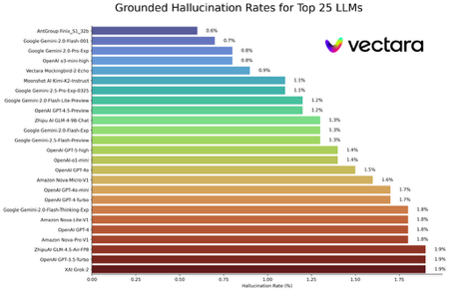
Hallucinations
OpenAI has published a detailed article exploring the origins of hallucinations in LLMs. These findings directly influenced the training and architecture of GPT-, reducing hallucination rates compared to previous versions
GPT-5 incorporates new honesty-driven reward techniques and leverages architectural changes such as hybrid multi-model routing, dynamic reasoning, and RAG to reduce factual errors and confabulations
Latest techniques include improved post-training optimization and incentivizing models to respond honestly when tasks are impossible, which led GPT-5 to claim a failed task only 17% of the time versus 47% for the previous o3 model
Additional methods such as chain-of-thought prompting and RAG help mitigate hallucinations by anchoring responses in real-world sources and explicit logic
GPT-5's hallucination rates are substantially lower than GPT-4, o3/o4. On HealthBench Hard GPT-5 reasoning models score about 1.6% hallucination rate versus GPT-4o's 15.8% and o3's 12.7%
Comparative hallucination leaderboards report OpenAI GPT-5 at 1.4% and Google's Gemini 2.0 at 1.3%, with Claude typically trailing both in this direct metric for factuality - https://github.com/vectara/hallucination-leaderboard
Expert and user reviews note that Gemini slightly outperformed GPT-5 on some document summary tasks, but both have sub-1.5% error rates. GPT-5 is preferred for consistent global context, while Gemini leverages refusals more frequently for safety, sometimes at the expense of directness
- GPT-5 has lower hallucination rates and improved productivity in multi-turn dialogues compared to the latest versions of Anthropic Claude, particularly in coding, architecture, and health queries
Model | Hallucination Rate %
GPT-5 (reasoning) | 1.5
GPT-4o | 1.7
GPT-3.5 | 40
o3 | 33
o4-mini | 48
Gemini 2.5 Pro | 2.6
Claude Opus 3 | 7.4
Claude Opus 4.1 | 2+

Slide 5
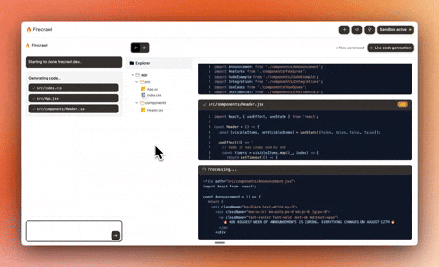
OpenLovable - free alternative to Lovable
OpenLovable - free alternative to Lovable
New free no-code local developer tool.
It is open-source
You can use it to build full apps, clone websites into modern React + Tailwind projects, and edit or customize them - all locally and with zero coding required
It uses Firecrawl’s web scraping engine to extract site content, structure, and assets, then rebuilds projects using AI in React, TypeScript, and Tailwind CSS
Integrates with multiple LLMs (Anthropic, OpenAI, Gemini, Grok, ..., Olama, LM Studio
Allows exporting, downloading, and further changing source files as needed, ensuring full control of generated code
Can build projects entirely based on text prompts, such as generating a SaaS landing page without a website source
Requirements: Git, VSCode, pnpm, Firecrawl API key, AI API keys
https://www.youtube.com/watch?v=woFXNLSQvc8 - video
https://github.com/firecrawl/open-lovable (19K stars)
https://www.firecrawl.dev
https://vercel.com - CDN for deployment
git clone https://github.com/firecrawl/open-lovable.git
cd open-lovable
pnpm install # or npm install / yarn install

Slide 6
Foundation Models Becoming a Commodity
Foundation Models Training and constant improvement Foundation Models Delivery (commercial and open source)
AI Research
(universities and major AI companies)
Dev Tools & Frameworks Apps as wrappers (can use different models)
Competition, Price Drop,
Foundation Models Becoming a commodity

Slide 7
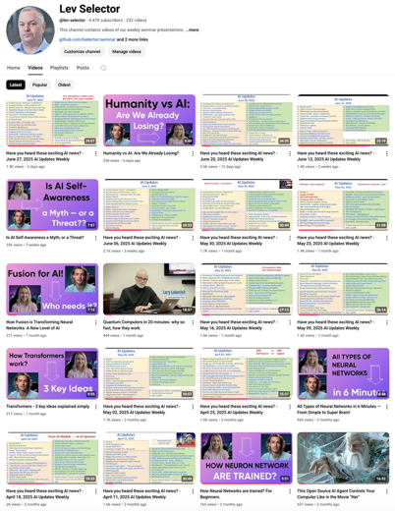
Please pause the video - and answer the pinned question in comments under the video
Subscribe to this channel
https://www.youtube.com/@lev-selector
Get notified about new videos - every Friday, links to slides under the videos

Slide 8
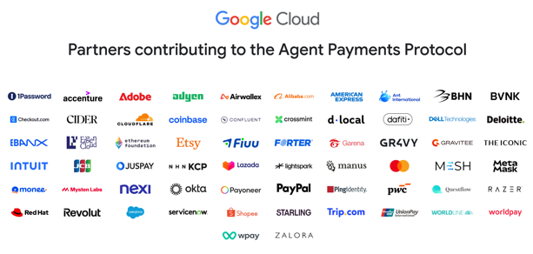
Google Agent Payments Protocol (AP2)
Open and payment-agnostic standard for secure and compliant payments initiated by AI agents and automated systems
In collaboration with more than 60 major payments and technology companies (Adyen, American Express, Mastercard, PayPal, Coinbase, Etsy, and many others)
Google is the main entity behind the introduction of the AP (Agent Payments/Agent Payments Protocol or AP2) protocol https://cloud.google.com/blog/products/ai-machine-learning/announcing-agents-to-payments-ap2-protocol

Slide 9




AI Updates 1
Albania appoints a virtual AI minister of public procurement
Her name is "Diella"
Albania has become the first country to have an AI minister
Perplexity AI raised $200M at $20B Valuation
Total raised over $1B
Its meteoric rise signals a shift toward AI-native search
Aravind Srinivas - CEO of Perplexity
Inception Point AI produces over 3,000 podcast episodes per week using AI hosts, costing just $1 per episode to create.
The company operates 5,000 shows across its Quiet Please Podcast Network, generating content on everything from weather reports to niche hobbies.
Each episode takes about an hour from concept to publication, with programmatic ads attached that turn profits after just 20 listeners per episode.
Topics are chosen using search trends and SEO
Team using 184 AI agents and models (OpenAI, Perplexity, Claude, Gemini, ...)
https://www.inceptionpoint.ai

Slide 10
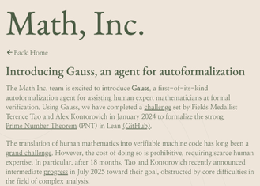


AI Updates 2
Gauss AI system from Math Inc. https://www.math.inc/gauss
Solved a complex math theorem in 3 weeks after top mathematicians struggled with it for 18 months
The Strong Prime Number Theorem was set by renowned mathematicians Terence Tao and Alex Kontorovich in 2024
Gauss worked autonomously for hours at a time, producing 25,000 lines of verified math code containing over 1,000 interconnected proofs and definitions
Math Inc. plans to expand mathematical code by 100-1000x within 12 months, creating training data for "machine polymaths" and “verified superintelligence”.
OpenAI and Microsoft - Memorandum of Understanding
Microsoft has given its "blessing" for OpenAI to restructure its for-profit arm into a public benefit corporation (PBC) while maintaining nonprofit oversight. This will allow OpenAI to attract investors, loosen Microsoft's exclusive cloud control, and share revenue with commercial partners at a reduced percentage over time
Meta MobileLLM-R1
family of open sub‑1B parameter reasoning models ( 140M, 360M, 950M )
5x higher MATH accuracy vs Olmo‑1.24B
2x vs SmolLM2‑1.7B
matching or surpassing Qwen3 accuracy on reasoning benchmarks
https://huggingface.co/facebook/MobileLLM-R1-950M

Slide 11


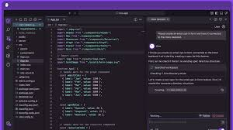
Amazon Kiro IDE
Amazon Kiro - AI powered IDE - fork of VSCode
From "vibe coding" to structured, spec-driven workflow
Spec-Driven Development: converts user prompts or goals into clear requirements, generates design documents, and breaks down tasks into manageable chunks, which are tracked and executed with AI agent support. The IDE produces requirement specifications, technical design docs, and step-by-step task lists automatically
AI Agentic Coding: advanced agents (currently powered by Claude Sonnet 4) to handle multi-step development tasks autonomously
Context Management: It allows deep context awareness, supporting integration with documentation, APIs, databases, and codebases through the Model Context Protocol (MCP)
Task Automation with Agent Hooks: Developers can assign tasks or workflows to agents (“hooks”) that run scripts, refactor modules, or automate processes with minimal manual oversight
Downloadable for Windows, macOS, or Linux from the official site; supports AWS Builder ID login for deeper Amazon Q integration.
All code runs locally unless cloud execution is explicitly enabled, ensuring privacy and data control
Kiro is currently in public preview
https://kiro.dev
https://aws.amazon.com/blogs/machine-learning/enabling-customers-to-deliver-production-ready-ai-agents-at-scale/
https://kiro.dev/blog/introducing-kiro/
https://medium.com/coding-beauty/new-amazon-kiro-406c100fb5cf
https://www.youtube.com/watch?v=gA6r7iVzP6M - fireship video
In Japanese, "Kiro" (岐路, きろ) translates to "crossroads" or "a path" and also carries meanings like "circuit" or "route," which aligns with the IDE's theme of guiding users through development
https://www.youtube.com/watch?v=YK7Z0xYcsPo

Slide 12
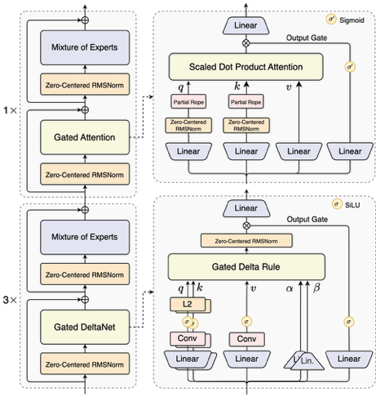
Qwen3‑Next‑80B‑A3B
Qwen3‑Next‑80B‑A3B
10x higher inference throughput - than a comparable dense model for long-context scenarios
training cost reduced 10x
Why is it faster? - Hybrid attention (Gated DeltaNet + Gated Attention) - Sparse MoE (only 3B out of 80B) are active at any forward pass
The combined effect: Qwen3‑Next‑80B‑A3B can run with dramatically lower total FLOPs per token, enabling extreme context lengths and high throughput
Overall compute now scales sub-linearly with model size and context length

Slide 13
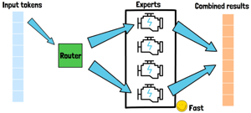




Mixture of Experts (MoE)
Today (almost) all frontier model are MoE
MoE models have steadily increased in importance through GPT4 and Mixtral(8 experts), DeepSeek (160 experts), Snowflake (128 experts), Qwen3-Next (512 experts)
Google has built MoE architectures with up to 2048 experts in production systems and up to 131,072 experts in experiments
Qwen3-Next uses 512 total experts, combining 10 routed experts + 1 shared expert
The industry has switched from "expert count" to total param vs active param ratio - and 3.75% (3B / 80B = 3.75%) is appreciably lower than GPT-OSS' 4.3% and Qwen3's own prior 10%.
The core idea behind Mixture of Experts (MoE) architecture was invented in 1991 by Robert Jacobs, Michael I. Jordan, Steven Nowlan, and Geoffrey Hinton "Adaptive Mixtures of Local Experts" https://www.cs.toronto.edu/~fritz/absps/jjnh91.pdf
Google later adapted and popularized the MoE layer for scaling neural networks in contemporary deep learning, most notably in the 2017 paper “Outrageously Large Neural Networks: The Sparsely-Gated Mixture-of-Experts Layer” https://arxiv.org/abs/1701.06538
Robert Jacobs
Steven Nowlan
Michael I. Jordan
Geoffrey Hinton

Slide 14





AI Updates 3
YouTube multi-language audio feature launched Sept 10th
Millions of YouTubers can add AI-generated dubbing to their videos in different languages
The rollout is expected to happen over the coming weeks.
Companies achieving more with less capital, raising at higher valuations earlier
AI Investment opportunities: AI-native gaming AI-native entertainment
September 13th is the 256th day of the year. Also known as a day of a programmer.
Is there an AI day?
August 31, 1955 - the term "Artificial Intelligence" was used in print http://jmc.stanford.edu/articles/dartmouth/dartmouth.pdf

Slide 15





AI Updates 4
NVIDIA Rubin CPX - New GPU class for massive context inference, handling million-token applications with 8 exaflops performance
Alibaba Qwen 3 Max
Second most intelligent non-reasoning model over 1T params
Tencent Hunyuan Image 2.1
Open-source text-to-image model
supporting ultra-long prompts up to 1,000 tokens
Salesforce SFR Deep Research
Autonomous reasoning agents achieving strong performance
ASML-Mistral Investment
ASML investing €1.3B in Mistral AI as lead investor

Slide 16



Meta Connect
Meta Connect 2025
Meta AI wearables, smart glasses, and supporting platforms https://www.youtube.com/watch?v=1cpnK9AfIhg - video
Ray-Ban Meta - 2nd Gen smart glasses: double the battery life, 3K video recording, and much improved AI including “conversation focus,” which amplifies friends’ voices in noisy environments
Oakley Meta Vanguard - sports-oriented smart glasses with a centered camera, 3K video, 122-degree field of view, video stabilization, enhanced water resistance, integration with Garmin and Strava
Neural Wristband - wearable using muscle signals from the wrist and hand for silent, invisible control of glasses - enables gesture navigation, private typing, and haptic feedback
Ray-Ban Display Glasses with Neural Wristband - combines high-resolution monocular display with a neural input wristband (EMG-based, detects finger/wrist gestures for silent, subtle control and text input at ~30 words/minute). Has transition lenses, a private HUD for messages/media, video calling, and Meta AI smart agent integration
Meta AI “Live AI” - runs 1-2 hrs, can process visual input from glasses and provide agentic help (Agentic AI) to interpret scenes, translate conversations in real time, and provide live subtitles directly on the in-lens display
Meta Horizon Studio - creative platform integrating AI assistants to generate assets like meshes and textures. Powered by "Horizon Engine". Also "Horizon TV" entertainment hub

Slide 17

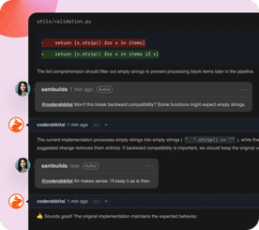
CodeRabbit CLI
CodeRabbit CLI - AI Code Review
https://coderabbit.ai/cli https://www.youtube.com/watch?v=R3bdXdajwEE - video
CLI (runs in terminal) to do code analysis and feedback for both staged and unstaged changes before commits or pull requests
Reviews local changes—both uncommitted and staged—using advanced pattern recognition to detect race conditions, logic errors, null pointer exceptions, security vulnerabilities, and more
Offers instant, actionable suggestions for simple fixes like import corrections, and can hand off complex architectural issues to AI agents with full context
Integrates seamlessly with AI coding agents (Claude Code, Cursor CLI, Gemini, etc.), supporting workflows where issues are surfaced by CodeRabbit and then fixed automatically by your favorite AI coding tool
Supports interactive mode, plain text mode, and prompt-only mode (for feeding structured results to coding agents), adapting to different workflows
Detects and enforces team-specific or repo-specific coding standards by reading custom configuration files
Free tier available with reasonable usage limits, especially suited for individual developers and small teams
On Mac (Apple Silicon) and Linux (Windows supported via WSL): curl -fsSL https://cli.coderabbit.ai/install.sh | sh
Basic usage: coderabbit # enter interactive mode coderabbit review --plain # plain text output coderabbit --prompt-only # output optimized for AI agents

Slide 18

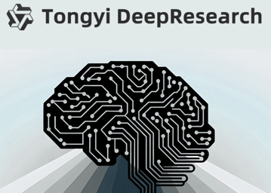
AI Updates 5
OpenAI GPT-5 Codex - AI coding assistant model
Accessible via web UI, CLI, or IDE extensions, for example from Cline VSCode extension or the official OpenAI Codex extension
Can do code generation, debugging, refactoring, and reviewing
Developers connect their GitHub accounts, and Codex performs tasks like writing features, fixing bugs, proposing pull requests, and reviewing code within an isolated workspace in the cloud
Codex GPT-5 outperforms prior releases, especially in code refactoring (51.3% success rate vs 33.9% for standard GPT-5), and sustained autonomous coding tasks for over 7 hours.
Usable in terminal, IDEs (VS Code extension), GitHub, web, and ChatGPT iOS app
improved infrastructure with container caching for 90% lower latency in completions
ChatGPT connectors update
developer's mode
can connect to 500+ apps
Alibaba's Tongyi DeepResearch - 30B AI Agent
for deep information retrieval and multi-step reasoning tasks
All Qwen models were developed by Alibaba's Tongyi Lab

Slide 19
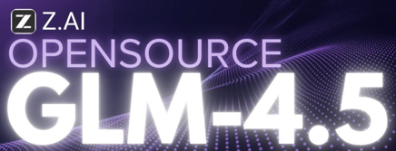

AI Updates 6
GLM-4.5 AI coding model from Z.ai (China)
GLM-4.5 is a fast, open-source coding AI model from China, better than Claude models
GLM-4.5 is available via a "Coding Lite" plan starting at $3/month, offering 120 prompts every 5 hours and direct integration with coding tools (like Claude Code - using API key) at a lower price than comparable Claude Sonnet subscriptions.
Multi-agent and multi-session coding, fast response times, compatibility with over 75 LLM providers
Try GLM-4.5, particularly via OpenCode for maximum flexibility and performance
https://www.youtube.com/watch?v=DqBQuTuOqgY - video
https://z.ai/blog/glm-4.5
Gemma 3 270M on Pixel 9 Pro
Very small, easy to fine-tune
Available on HuggingFace, Olama, Kaggle, LM Studio, or Docker

Slide 20

Google VaultGemma: diff-private LLM
Google VaultGemma pretrained using differential privacy (DP)
1B params, 26 layers, decoder-only (similar to Gemma 2)
Randomness injection as a fundamental part of its privacy preserving training process. It prevents memorization of rare or unique facts from training data; individual details appearing only once are essentially "blurred out".
Trained so that sensitive data—like phone numbers or emails—cannot be reproduced even under adversarial prompting
VaultGemma achieves benchmark performance comparable to non-private models of similar size (e.g., rivals older models like GPT-2) while maintaining rigorous privacy
Open-weight release, available for further instruction tuning and deployment at Hugging Face
https://research.google/blog/vaultgemma-the-worlds-most-capable-differentially-private-llm/
https://arxiv.org/abs/2501.18914
https://huggingface.co/google/vaultgemma-1b
Differential privacy is a mathematically rigorous method for sharing information about a dataset by adding noise, so that no individual's data can be identified or inferred from the output

Slide 21


Agent TARS - browser/desktop automation
Name "TARS" is inspired by the AI robot "TARS" from the film Interstellar, where it stands for "Tactical Autonomous Robotic System," "Tactical Assistant and Reconnaissance System," or simply acts as a memorable agent name with no officially declared meaning in most modern AI contexts
Agent TARS - open-source AI browser/desktop automation
https://ui-tarsai.com
https://github.com/bytedance/UI-TARS-desktop
https://agent-tars.com
https://agent-tars.com/guide/basic/web-ui.html
https://www.youtube.com/watch?v=vF8FWmzRd5M - video
https://arxiv.org/abs/2501.12326 - paper
Open-source (Apache 2.0) multimodal AI agent designed to automate browser and desktop tasks using natural language commands and advanced visual reasoning
Browser operations, CLI, file system access
Developed and maintained by ByteDance (China), the parent company of TikTok and other AI research initiatives
Multimodal Task Automation: Executes complex browser actions, CLI tasks, and navigates applications with visual interpretation
Desktop and Browser Control: Offers both a browser agent and a desktop agent—can automate web and desktop apps such as VS Code, Microsoft Office, etc.
Supports multiple model sizes (2B, 7B, and 72B parameters) to suit different hardware and automation needs
Natively integrates with MCP servers and other real-world tools for broad task execution
Examples: Automating browser form submissions, purchasing, and research tasks; Desktop app automation for file handling, report generation, and software installation; Visual tasks such as interpreting on-screen data, scheduling travel, and generating charts using visual and textual data; Customizable workflows for developers or ops teams (DevOps, data science, etc.
Available on GitHub for Mac (Windows/Linux will come later)
Note - there is an alternative project with similar name - hellotars.com
It is a conversational AI agent builder
The company is called Tars, founded in 2016, headquartered in Newark, Delaware, privately held, and employs 51–200 staff
The company focuses on no-code conversational AI chatbot platforms used by major global brands to automate customer service and internal business processes

Slide 22
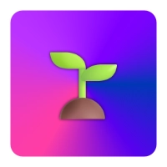
GitHub Speckit
GitHub Speckit - spec-driven development
https://www.youtube.com/watch?v=KKkS0e5O6eI
https://github.com/github/spec-kit
open-source (MIT) toolkit
"spec-driven" - create a detailed specification first, outlining user needs and functionality, which then guides every step of the build process
From "vibe coding" to clarity
Works alongside popular assistants like GitHub Copilot, Claude Code, Gemini CLI
Structured, reliable workflow -4 phases: 1. Specify (define what/why) 2. Plan (set tech details) 3. Tasks (breakdown work into testable units) 4. Implement (write code task-by-task guided by the spec and plan).
Speckit CLI commands has corresponding commands: /specify /plan /tasks
Each phase is validated before proceeding to the next, ensuring the build matches your intent
GitHub aims to make the process an industry standard beyond their own tool, with planned VS Code integration and more features coming

Slide 23
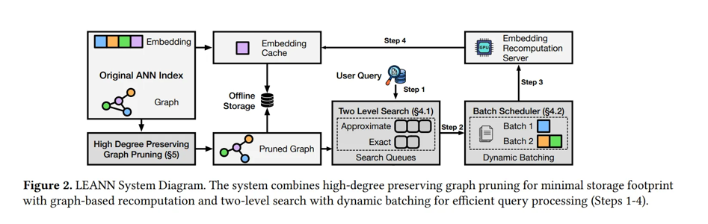
LEANN Vector DB takes 30x less space
LEANN is a new vector database system that uses just 3% of the storage space compared to traditional vector databases, while maintaining identical search accuracy https://github.com/yichuan-w/LEANN - GitHub https://arxiv.org/abs/2506.08276 - paper https://jimmysong.io/en/ai/leann/ - intro https://medium.com/data-science-collective/the-worlds-smallest-vector-database-how-leann-uses-97-less-space-than-traditional-vector-db-b00de3ec97be
This dramatic space reduction is achieved by recomputing embeddings selectively instead of storing every one
Mainstream databases like ChromaDB, Pinecone, and Weaviate require 1.5 to 7 times more space than the original data
LEANN stores only 3% of the data by selectively re-computing embeddings rather than pre-storing them all
LEANN is particularly well-suited for edge computing and privacy-critical applications that require efficient, on-device vector search without cloud reliance

Slide 24


Customer Service AI Agent
Minimal programming (no code) solutions - rapid deployment, customization, and integration into websites or channels such as live chat and messaging apps
Make.com, Voiceflow, Zapier, N8N: Drag-and-drop platforms with prebuilt logic allow creating conversational AI agents by uploading FAQs, support docs, and configuring basic automation flows
CustomGPT.ai: Enables training AI chatbots on proprietary business data through a user-friendly interface. Supports deployment on multiple channels and provides a white-label branding option
SmythOS - has a visual builder and prebuilt agent templates for fast deployment and easy integration with APIs, with minimal to no code needed
These tools have templates for FAQs, order tracking, or appointment booking; Allow to upload support documents or provide sample Q&A for the chatbot to learn responses; Configure integrations such as website widgets, email, WhatsApp, or Slack for multi-channel support; Use analytics and feedback features to monitor and refine AI performance
Getting Started: Choose a Platform, prepare FAQ/Data, Use the drag-and-drop interface to upload your data, define chatbot responses, and set up any integrations; Test with Real Queries; Deploy to your website; Monitor and Improve - use built-in analytics to further refine and improve the AI's answers over time
Cloud Solutions:
Amazon: Amazon Connect + Lex + Lambda + Bedrock AgentCore
Google: Contact Center AI (CCAI) - embeds conversational AI agents (via Dialogflow CX) into support platforms
Microsoft Azure - AI Agent Service - pre-built models for common support scenarios and robust tools for conversational agent deployment.
Open-Source Customer Support AI Solutions:
Chatwoot - live-chat and omnichannel support tool, featuring AI assistants for automated replies. Offers web, social media, and messaging integrations out of the box with no or light coding required
Rasa and Botpress - conversational agent frameworks that support visual builders for basic chatbot configuration, though advanced customization may require programming
DeepPavlov and ChatterBot - lower barrier to entry for simple FAQ-style bots, but some minimal Python scripting may be needed for setup

Slide 25
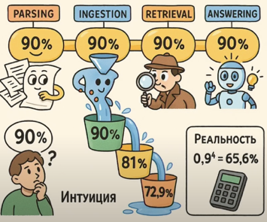
Streamlit-Based RAG Debugging
Streamlit (python-based) RAG Debugging
https://www.youtube.com/watch?v=NCPdj3ABpR4 (in Russian) Streamlit-tracer for debugging RAG systems, improving reliability in production ML pipelines
Streamlit was used to develop a lightweight, customizable UI for visualizing, tracing, and debugging each stage of the RAG pipeline, allowing both technical and non-technical experts to inspect data flow and outputs. The tool integrates directly with vector databases and prompt engineering components, supporting modular evaluation and rapid prototyping
The reliability of the whole ML system is the product of the reliability of its components; each stage (data parsing, retrieval, LLM response, etc.) must be measured and improved individually for overall quality improvements
Systematic modular testing, continuous logging, and human evaluation are critical throughout the RAG pipeline, especially when working with unstructured data and evolving business requirements
Domain experts (e.g., lawyers) need to have a streamlined UI to annotate, comment, and iterate without technical hurdles; The expert's feedback loop should be as frictionless as possible, focusing their limited attention on high-leverage corrections and assessment, which is the scarcest and most valuable resource in the process
The system enables rapid iteration for both developers and domain experts: questions and logs are surfaced, annotated, and used to refine prompts, retrievers, or data sources in real time
The approach leverages open-source tools such as Langfuse and Langsmith for log and trace management, but custom tools are essential to fill UX gaps for non-technical stakeholders

Slide 26
OOP Is Dead - Long Live ECS
Object-Oriented Programming "dead"
Encapsulation, inheritance, and polymorphism now hold developers back
OOP is now mostly abandoned in favor of functional, reactive, and compositional styles
Cloud platforms and startups prefer languages like Go and Rust that avoid inheritance and encourage simpler, more testable code structures
The promised modularity and real-world modeling of OOP failed to scale with new tech demands; compositional and functional approaches have taken over
Objects aren’t the problem. Hierarchies are. Data + behavior is fine. Inheritance chains are not.
Composition wins. Favor small, composable pieces over giant classes.
Functional + data-oriented styles scale better in concurrency-heavy systems.
ECS (Entity Component Systems), traits, interfaces are the new OOP, but flatter, simpler, more honest.
https://medium.com/@theopinionatedev/object-oriented-programming-is-dead-heres-what-killed-it-cd83d7867683
Entity Component System (ECS) is a modern software architecture pattern that organizes code by separating entities, components, and systems
Entity: A unique identifier representing an object (like a game character or an item) - just an ID, no data or behavior
Component: A minimalist data container attached to entities that stores specific properties (e.g., position, health). Components contain data only—no behavior or methods
System: Processes logic by operating on entities with relevant components. Systems hold the actual behavior and run code based on component data (e.g., a physics system updates positions for all entities with a velocity component)
ECS uses composition over inheritance, allowing flexible, modular code without deep class hierarchies
ECS easily enables runtime changes—adding/removing components from entities instantly changes their behavior without altering hierarchy or base classes
Components are stored contiguously in memory, making ECS highly efficient and multi-threadable.

Slide 27

Why Entrepreneurship is Safer Than Employment
The Great Career Inversion - by Peter Diamandis
Here are five contrarian insights about career safety in 2025 that most people get backwards:
1/ College debt is now riskier than startup equity. The math is simple but brutal: $250k in student loans for a degree thatmight be obsolete in four years versus equity in a company you control (or co-found). We've reached the tipping point where taking on massive educational debt is the speculative bet, versus starting a company. The "safe” (traditional) path requires you to believe that industries won't be disrupted (not true, they all will be), that your specific skills will remain valuable (they will fade rapidly), and that you'll earn enough to service debt that compounds faster than most startups burn cash (hmmm…).
2/ Employment security is an illusion in exponential times. Job security died when the half-life of skills dropped below the half-life of careers. Tech layoffs, AI automation, and economic volatility mean traditional employment now carries hidden risks: you’re betting your entire income stream on decisions made by people who probably don't know you exist, and are focused on quarterly profit reports. When a VP decides to "right-size" or a board chooses to "pivot," employees become accounting entries. As an entrepreneur you may fail, but you'll fail forward with transferable skills and network effects.
3/ The career risk hierarchy has inverted for the first time in history.
We're seeing something unprecedented: founding a company has become statistically safer than climbing a corporate ladder.
While massive tech layoffs hit 150,000+ workers in 2023-2024, successful entrepreneurs built lasting value and optionality.
The reason is simple: entrepreneurs own their failure modes, employees don't. When you control the variables, you can manage the risk.
4/ Yes, entrepreneurship isn't universally safe, it's just relatively safer (and getting more so over time). The tools to become a coder (Replit, Lovable, Cursor, etc.) are demonetized and democratized. A full entrepreneurial education is available for free on YouTube. Historically, it’s true that 1 in 10 “VC-backed startups succeed”, but increasingly, the ability to code, build, and raise money is growing rapidly. PLUS, realize that today in 2025, $1B per day is being invested into AI, growing to >$3B per day by 2030. This is the field that is exploding while traditional employment is shrinking. Where would you rather play?
5/ The optimal strategy is asymmetric: limited downside, unlimited upside. Smart career building in 2025 means building antifragile income streams. The new "safe" career path isn't employment or entrepreneurship exclusively, it's creating multiple income vectors where failure in one area strengthens your position in others. This might mean consulting while building products, or freelancing while scaling a service business. My thesis: act on this dynamic while it lasts. Build now, when the perceived risk is high but the actual risk is low. The best entrepreneurs are emerging from this period precisely because they're contrarian enough to start companies when everyone else thinks it's "risky." By the time entrepreneurship feels safe to the mainstream, the outsized opportunity will diminish. I truly believe the only career path of the future is entrepreneurship. Bottom line: Get building. The career safety you're looking for exists, but it's the safety of owning your own destiny and your ability to build with AGI (read: god-like tools). Until next time, Peter

Slide 28
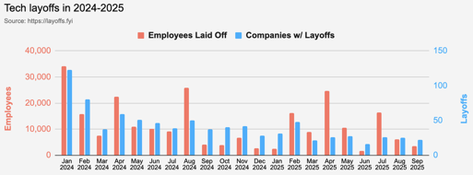
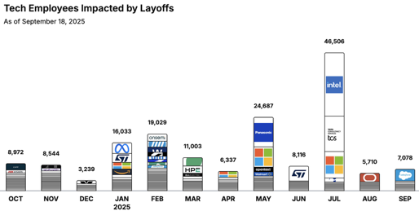
Jobs
https://layoffs.fyi
https://trueup.io/layoffs
Tech Layoffs by year (US only):
90K in 2025 (as of September 18)
153K in 2024
264K in 2023
165K in 2022
https://layoffs.fyi
Companies need AI Engineers
While companies cut traditional roles, they’re pouring billions into AI:
Microsoft → $80B in 2025
Meta → $40B
Google → $29B
Amazon → $8B into Anthropic
That’s $350B+ a year, redirected straight into AI systems
And they all need engineers who can build them
The Tech Layoff Tracker
So far in 2025, 144,499 people laid off (554 per day.
In 2024, 238,461 people laid off (653 per day)
https://trueup.io/layoffs

Slide 29


About the Speaker
Lev Selector, Ph.D.
40+ years of software engineering, data science, and building teams (hiring, training, and managing)
Ph.D. in mathematical modeling and computer simulations
Interests:
Generative AI, Using LLM with your data
Local AI for Local Private Data
Cloud architecture, fin-tech, application security
Find/connect: Linkedin, GitHub, YouTube, Google
https://eais.ai
Enterprise AI Systems

Slide 30
Thank You!

