Slide 1
AI Updates
August 8, 2025
"Don't fear AI replacement, embrace AI augmentation" -- Eric Schmidt
Claude Opus 4.1
OpenAI GPT-OSS "open" model family
Crowd-sourced "LM Arena" Leaderboard
Google Gemini 2.5 Deep Think model
Recruiters & admin assistants automated by Comet
DeepMind "Big Sleep" - finds bugs and vulnerabilities
xxx
DeepMind Genie 3 AI world model
xAI launches Grok Imagine for AI video and images
Qwen-Image with Native Text Rendering
Alibaba Qwen3 Coder Flash
Falcon-H1 - Hybrid open-source model
Thousands of Startups stopped using AWS, CGP, ...
Jules - Google's new AI coding agent
Ollama GUI
OpenAI - main models
To-Do List for Super-Intelligence
Andrew Tulloch Rejected $1B+ job offer
xxx
Jobs, Layoffs

Slide 2
Claude Opus 4.1
Claude Opus 4.1 released on August 5, 2025
Software engineering, reasoning, and agentic (autonomous) task handling
SWE-bench 74.5% (vs 72.5% for v.4)
Better at multi-step workflows, long-horizon "AI agent" tasks, and data analysis, particularly in areas needing precise detail-tracking and complex research
Excels in large codebase refactoring, debugging, and adapts to diverse code styles, with output support up to 32,000 tokens
Can be fine-tune between instant inference and extended, step-by-step output
Produces more natural, human-like writing with improved depth, structure, and tone
Available to Claude Pro, Max, Team, and Enterprise users, as well as via the Claude Code app, Anthropic API, Amazon Bedrock, and Google Cloud Vertex AI
Pricing remains at ($15/$75) per 1 Mln (in/out) tokens

Slide 3
OpenAI GPT-OSS "open" model family
OpenAI has just released its first new “open” model family
"open-weight" , Apache 2.0 license
Two models: gpt-oss-120b & gpt-oss-20b
OSS = Open Source Software
Strong at language reasoning, code generation, agentic workflows, and tool use - on par with top industry models
Ahead of o3-mini, behind o3 and o4-mini
Adjustable chain-of-thought reasoning levels (high, medium, low)
MoE architecture
Available for immediate download on Hugging Face, work with tools like LM Studio and Ollama, and are integrated into major cloud platforms including AWS, Microsoft Azure, and Google Cloud
Can be fine-tuned and adapted for custom or local enterprise deployments, even in data-residency- or security-sensitive environments
Robust internal safety measures, including filtering sensitive material (chemical, biological, radiological, nuclear, etc.)
These models do not provide full transparency compared to truly open-source AI (weights are open, but not the full training data/methods)
Many partners - Amazon, Microsoft, Baseten, Nvidia, etc
OpenAI Raises $8.3B at $300B Valuation
Dragoneer led the round with $2.8B as investors rushed to join OpenAI’s cap table. Now at $13B in revenue and 700M weekly ChatGPT users, the company eyes $20B by year’s end and a true for-profit future.

Slide 4
Crowd-sourced "LM Arena" Leaderboard
https://lmarena.ai/?leaderboard
Starting Elo rating = 1000
https://en.wikipedia.org/wiki/Elo_rating_system
English - https://lmarena.ai/leaderboard/text
Coding - https://lmarena.ai/leaderboard/text/coding
LM Arena secures $100M to expand AI benchmarking (at $600M valuation)
Model | Score
gemini-2.5-pro | 1460
o3-2025-04-16 | 1457
chatgpt-4o-latest-20250326 | 1448
gpt-4.5-preview-2025-02-27 | 1444
grok-4-0709 | 1441
claude-opus-4-20250514-thinking-16k | 1432
deepseek-r1-0528 | 1425
kimi-k2-0711-preview | 1423
grok-3-preview-02-24 | 1424
claude-opus-4-20250514 | 1421
claude-sonnet-4-20250514-thinking-32k | 1419
gpt-4.1-2025-04-14 | 1419
gemini-2.5-flash | 1414
deepseek-r1 | 1410
deepseek-v3-0324 | 1410
o4-mini-2025-04-16 | 1410
minimax-m1 | 1409
qwen3-coder-480b-a35b-instruct | 1402
o1-2024-12-17 | 1410
o1-preview | 1409
qwen3-235b-a22b-no-thinking | 1407
claude-sonnet-4-20250514 | 1401
Model | Score
claude-opus-4-20250514-thinking-16k | 1474
gemini-2.5-pro | 1474
o3-2025-04-16 | 1471
chatgpt-4o-latest-20250326 | 1465
claude-sonnet-4-20250514-thinking-32k | 1457
gpt-4.5-preview-2025-02-27 | 1456
kimi-k2-0711-preview | 1455
claude-opus-4-20250514 | 1453
deepseek-r1-0528 | 1452
grok-4-0709 | 1449
gpt-4.1-2025-04-14 | 1441
qwen3-coder-480b-a35b-instruct | 1435
qwen3-235b-a22b-no-thinking | 1436
grok-3-preview-02-24 | 1435
claude-sonnet-4-20250514 | 1433
deepseek-r1 | 1429
deepseek-v3-0324 | 1428
claude-3-7-sonnet-20250219-thinking-32k | 1425
o4-mini-2025-04-16 | 1425
qwen3-235b-a22b | 1422
o1-2024-12-17 | 1420
mistral-medium-2505 | 1417
Grok 4 Benchmarks
https://artificialanalysis.ai/models/grok-4
x.ai
China
China
China
https://lmarena.ai/leaderboard/text
https://web.lmarena.ai/leaderboard
https://openlm.ai/chatbot-arena/
https://beta.lmarena.ai
Web Leaderboard https://web.lmarena.ai/leaderboard
LLM Leaderboard - by @LlmStats https://llmworld.net/llm_leaderboards/
LLM Leaderboard - by StackAI https://www.stack-ai.com/llm-leaderboard
LLM Leaderboard - by Artificial Analysis https://artificialanalysis.ai/leaderboards/models
Open LLM Leaderboard - by Hugging Face https://huggingface.co/open-llm-leaderboard
LLM Leaderboard - by Vellum https://www.vellum.ai/llm-leaderboard
AI Benchmarking Hub https://epoch.ai/data/ai-benchmarking-dashboard
x.ai
China
x.ai
China
China
China
x.ai
China
China
China
China
China
China
China
M

Slide 5
AI Updates 1
Google Gemini 2.5 Deep Think model
Available for the $250/month Gemini Ultra subscription tier
"Deep Think" mode accessible to advanced users and enterprises
A version of this model was used to win a gold medal at the July 2025 International Math Olympiad (IMO)
Recruiters & admin assistants automated by Comet
Perplexity CEO Aravind Srinivas has said his company's new AI browser, Comet, will soon automate two white-collar roles that every workplace depends upon: recruiters and administrative assistants.
DeepMind "Big Sleep" - finds bugs and vulnerabilities
It is an AI-powered cybersecurity agent developed by Google DeepMind in collaboration with Google Project Zero
It's purpose is to search for and identify software vulnerabilities - especially in open-source projects
Big Sleep has found its first real-world vulnerabilities, including a critical flaw in the SQLite database that existing testing infrastructure and fuzzing tools have missed!
The system has reported its first 20 vulnerabilities, affecting widely used software like ImageMagick and FFmpeg, and is considered a major advance in automated vulnerability research

Slide 6




AI Updates 2
DeepMind Genie 3 AI world model
Real-time creation of interactive, consistent 3D environments from simple text prompts. 24fps in 720p
Genie 3 can generate entire playable worlds lasting minutes, remember environment details, and allow live changes such as altering weather or adding characters—without any hardcoded rules or physics engine
Currently restricted to researchers
xAI launches Grok Imagine for AI video and images
The tool can create 15 second videos with audio from text prompts
Qwen-Image with Native Text Rendering
Open-source (Apache 2.0) image foundation model
20B MMDiT (Multimodal Diffusion Transformer) that excels in complex text rendering and precise image rendering
It can create multi-line text layouts, paragraph-level semantics, and fine-grained details in both alphabetic languages and logographic languages with high fidelity
The model preserves both semantic meaning and visual realism during editing operations. It consistently outperforms existing models across diverse generation and editing tasks. Examples of images generated by the model are available in the post
Tasks: marketing, education, and presentation design
https://qwenlm.github.io/blog/qwen-image/

Slide 7
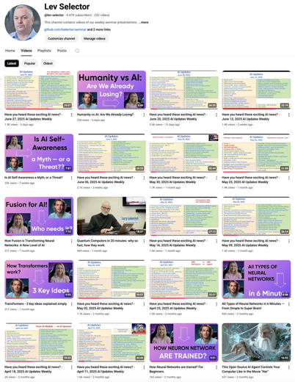
Please pause the video - and answer the pinned question in comments under the video
Subscribe to this channel
https://www.youtube.com/@lev-selector
Get notified about new videos - every Friday, links to slides under the videos

Slide 8
AI Updates 3
Alibaba Qwen3 Coder Flash
30.5B code model that matches Claude Sonnet 4 on key coding tasks
MoE architecture (128 experts)
256K native context window, expandable to 1M tokens
Full-precision inference requires 33GB of RAM; quantized versions run on 18GB
Performs competitively on WebArena and BFCL for tool use and workflow integration
fully open source under the Apache 2.0 license
Weights are available on Hugging Face and Modelscope
Falcon-H1 - Hybrid open-source model
H = Hybrid: Transformer + State Space Model (SSM)
From Technology Innovation Institute (TII)
Abu Dhabi, United Arab Emirates
six sizes – 0.5B, 1.5B, 1.5B-Deep, 3B, 7B, and 34B params
256K Context Length
Multilingual (18 languages)
strong abilities in math, science, and coding
Open-Source
Thousands of Startups stopped using AWS, CGP, ...
due to rising costs, diminished performance advantages, and greater flexibility offered by alternative platforms
https://aws.plainenglish.io/the-great-cloud-exit-why-1-000-startups-are-rethinking-aws-gcp-in-2025-5c16b1eb33b0

Slide 9

Jules - Google's new AI coding agent
Jules - Google's new AI coding agent
Jules is accessible via a web application.
Usage: you connect your GitHub account, select a repository and branch, and write a detailed prompt.
Jules clones the repo onto a Google Cloud VM, develops a plan, executes the requested changes, and provides a diff for you to review.
Once approved, Jules can open GitHub Pull Requests for the updates
Multiple tasks can run in parallel, and the system displays the plan and reasoning for transparency and user steerability
It can be used for writing tests, fixing bugs, updating dependencies, and building new features - directly within your GitHub workflow
Jules is powered by Gemini 2.5 Pro and operates asynchronously: you can assign tasks, disconnect, and return later to find updates ready for review and integration
https://jules.google
https://blog.google/technology/google-labs/jules/
https://jules.google/docs
https://www.youtube.com/watch?v=YO7I8OLSwKE
https://blog.google/technology/google-labs/jules-now-available/
Jules can handle tasks in the background without requiring you to monitor progress, making it suitable for both quick fixes and more complex multi-task agentic workflows
Other advanced features include the ability to read an AGENTS.md file for added context, audio changelogs summarizing recent changes, and native integration with GitHub issues
Free introductory plan (15 daily tasks, 3 concurrent) and paid tiers under Google AI Pro and Ultra plans for higher task limits
Jules has been widely adopted by developers worldwide, including internal Google projects
Early feedback praises its capacity to automate routine development chores and assist with large-scale code migrations, although granular tasks and user oversight are still recommended for complex changes

Slide 10
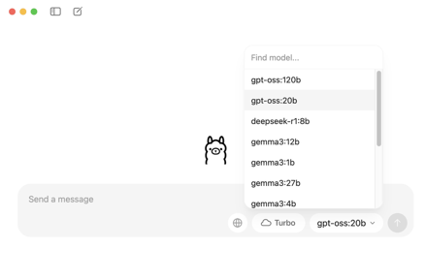
Ollama GUI
Ollama has released a new desktop GUI app
Drag-and-Drop PDF (or other doc) into the app and immediately start chatting with the doc, no setup or API keys required
Turbo Mode - access to massive cloud-based models (like 235-billion parameter models) while still running local models. The free tier includes 10,000 credits weekly.
Easily switch between different AI models through the GUI. If a model isn't installed, the app automatically downloads it.
App can process images, screenshots, diagrams, and PDFs, understanding visual content alongside text.
Technical Changes - Ollama has moved away from llama.cpp to their own proprietary engine, suggesting they're building something fundamentally new rather than just wrapping existing tools.
https://medium.com/@PowerUpSkills/ollama-has-a-new-app-f9b0f4083fef

Slide 11
OpenAI - main models
Model | Release Year-Month | Short Description
GPT-3.5 | 2022-11 | Text Chat
GPT-4 | 2023-03 | Multimodal (text and image), Reasoning, creativity, alignment
GPT-4o | 2024-05 | "Omni" model (text, audio, images) - in real time. Much faster, more cost-efficient
GPT-4.1 | 2025-04 | Coding, long context (up to 1 Mln tokens), instruction following
GPT-4.5 | 2025-02 | "Orion", very large and expensive to run, outperformed GPT-4o, phased out in favor of GPT-4.1.
o1 | 2024-12 | "Reflective" - spends time deliberating, excels at reasoning, science, and programming
o3 | 2025-04 | Reflective step-by-step reasoning,
o3-mini | 2025-01 | Smaller, fast, cost-efficient, optimized for STEM reasoning
o4-mini | 2025-04 | Successor to o3-mini, supports both text and images, higher accuracy and better processing speed. Designed for industrial applications like utilities, healthcare, finance, and more.

Slide 12
To-Do List for Super-Intelligence
Imagine yourself as a CEO of a company that had just created a true AI Superintelligence (SI). What would you do with it?
Secure access to the system, audit/control its actions. Ensure its intentions and goals are aligned with human ethics and company objectives; establish robust "stop buttons" and oversight protocols; proactively engage with international regulatory bodies, transparency measures, and form partnerships for oversight and governance
Ask the model to improve itself - its own algorithms, efficiency, and interpretability without introducing risks
Apply the superintelligence to all aspects of business operations: product development, new products, marketing strategies, customer acquisition, logistics, and finance
Ask it to solve critical societal problems - climate, medical research, education, poverty reduction, and infrastructure planning; collaborate with non-profits, academia, and social enterprises to maximize global benefit
Other applications: Scientific Discovery, Global Diplomacy, Personal Assistant, Legal Reform, Longevity Research
National Security Concerns - the SI technology would be classified as a strategic asset, with possible restrictions on its dissemination or collaboration with foreign entities; government will require disclosures, alignment, access, control, monitoring, licensing, and operational constraints to prevent misuse or uncontrolled proliferation; the government could potentially restrict movement of the team and data (“AI lockdown”) to prevent leaks or unauthorized use (as already was done in China for Deepseek employees)
Government will want to us SI for National Defense & Security, intelligence gathering, cyber defense, threat prediction, military logistics, and strategy. Also for social services, public health, infrastructure, emergency responses; for optimizing macroeconomic planning, industrial policy, and international trade; for gains in international negotiations and collaboration to address climate change, pandemics, and space exploration.
Unchecked superintelligence could pose existential risks if its goals and behaviors are not fully controlled. Questions of equity, access, and moral responsibility would arise about who benefits and who sets the rules. Other global actors may race to develop or steal similar systems, fueling an AI arms race. Work, governance, and the fabric of society could change rapidly, requiring careful management.

Slide 13

Andrew Tulloch Rejected $1B+ job offer
Andrew Tulloch is a machine learning expert and co-founder of Mira Murati’s Thinking Machines Lab. He has turned down Mark Zuckerberg’s $1.5 Bln job offer (to be paid over 6 years).
Andrew Tulloch life: studied at Cambridge, worked at Goldman Sachs, then 11 year with Meta (machine learning). In October 2023, he quit Meta for OpenAI; A year later he moved from OpenAI to Thinking Machines Lab.

Slide 14
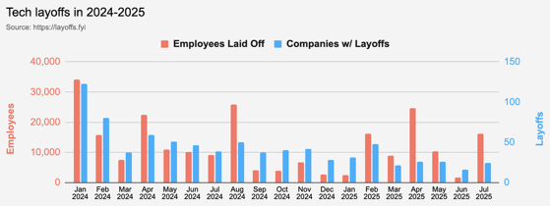
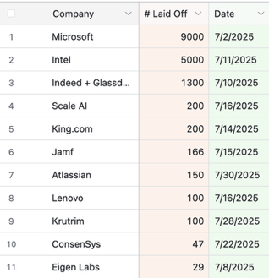
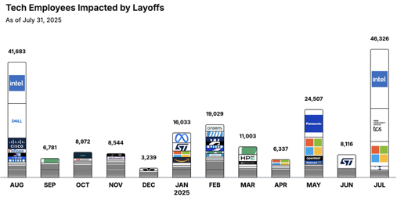
Jobs
https://layoffs.fyi
https://trueup.io/layoffs
Salaries of AI model trainers have been high, with many being paid $5-10M/year, but Meta has raised these numbers to new heights
TCS = Tata Consultancy Services

Slide 15
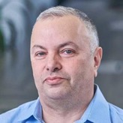

About the Speaker
Lev Selector, Ph.D.
40+ years of software engineering, data science, and building teams (hiring, training, and managing)
Ph.D. in mathematical modeling and computer simulations
Interests:
Generative AI, Using LLM with your data
Local AI for Local Private Data
Cloud architecture, fin-tech, application security
Find/connect: Linkedin, GitHub, YouTube, Google
https://eais.ai
Enterprise AI Systems

Slide 16
Thank You!

