Slide 1
AI Updates - September 12, 2025
avoid hallucinations by abstaining when unsure - OpenAI
Crowd-sourced "LM Arena" Leaderboard
Geoffrey Hinton warns about LLMs' Manipulations
Thinking Machines Lab Blog
K2-Think 32B open-source reasoning model
Claude works with MS Office and PDFs
Microsoft Shifts Office 365 AI to Anthropic Claude
ByteDance mini-03
Claude AI Outperforms Human Virologists
Nvidia Rubin CPX GPU handles 1 Mln context
CODE BUFF AI Agentic Coding System
InternVL3.5 open-source multimodal LLM
OpenAI on Hallucinations
Alibaba
Meta REFRAG
Agentic AI Patterns Book
Claude Code - YouTube Research Agent
Customer Service AI Agent
Streamlit-Based RAG Debugging
HyperGraphRAG
GenAI Assessment Framework (GAF)
Stop Writing Tests
Tauri + Rust + Svelte for Native Apps
Peter Diamandis about AI
ByteDance Seedream 4.0 Image Model
Databricks secured $1B at $100B valuatio
The Rundown AI - life-changing prompts
Google Veo 3 and Veo 3 Fast
Mistral Valuation $14B
Oracle's stock surged by 40% Wednesday
Cognition Raises $400M at $10.2B Valuation
MCP Registry
The Training Imperative
AI Gross Margins in 2025
Multi-word prediction
Moonshot AI Kimi-K2-Instruct-0905
Replit Raises $250M at $3B Valuation
Synechron AI Consulting - $1B Revenue
Andrew Ng - Demand for AI Developers
Jobs, Layoffs

Slide 2
Crowd-sourced "LM Arena" Leaderboard
https://lmarena.ai/?leaderboard
Starting Elo rating = 1000
https://en.wikipedia.org/wiki/Elo_rating_system
English - https://lmarena.ai/leaderboard/text
Coding - https://lmarena.ai/leaderboard/text/coding
LM Arena secures $100M to expand AI benchmarking (at $600M valuation)
Model | Score
gemini-2.5-pro | 1456
gpt-5-high | 1447
claude-opus-4-1-20250805-thinking-16k | 1447
o3-2025-04-16 | 1444
chatgpt-4o-latest-20250326 | 1443
gpt-4.5-preview-2025-02-27 | 1439
claude-opus-4-1-20250805 | 1436
gpt-5-chat | 1426
grok-4-0709 | 1422
kimi-k2-0711-preview | 1421
deepseek-v3.1 | 1419
claude-opus-4-20250514-thinking-16k | 1419
qwen3-235b-a22b-instruct-2507 | 1419
deepseek-r1-0528 | 1417
deepseek-v3.1-thinking | 1415
mistral-medium-2508 | 1412
glm-4.5 | 1410
claude-opus-4-20250514 | 1410
gpt-4.1-2025-04-14 | 1409
grok-3-preview-02-24 | 1409
gemini-2.5-flash | 1406
mai-1-preview | 1399
Model | Score
claude-opus-4-1-20250805-thinking-16k | 1504
claude-opus-4-1-20250805 | 1494
claude-opus-4-20250514-thinking-16k | 1478
qwen3-235b-a22b-instruct-2507 | 1474
gemini-2.5-pro | 1472
gpt-5-high | 1471
chatgpt-4o-latest-20250326 | 1470
o3-2025-04-16 | 1467
mistral-medium-2508 | 1459
qwen-vl-max-2025-08-13 | 1444
claude-sonnet-4-20250514-thinking-32k | 1461
gpt-4.5-preview-2025-02-27 | 1459
kimi-k2-0711-preview | 1458
gpt-5-chat | 1458
deepseek-r1-0528 | 1456
deepseek-v3.1 | 1453
glm-4.5 | 1453
claude-opus-4-20250514 | 1454
deepseek-v3.1-thinking | 1444
qwen3-235b-a22b-thinking-2507 | 1448
gpt-4.1-2025-04-14 | 1444
grok-4-0709 | 1442
China
Grok 4 Benchmarks
https://artificialanalysis.ai/models/grok-4
https://lmarena.ai/leaderboard/text
https://web.lmarena.ai/leaderboard
https://openlm.ai/chatbot-arena/
https://beta.lmarena.ai
Web Leaderboard https://web.lmarena.ai/leaderboard
LLM Leaderboard - by @LlmStats https://llmworld.net/llm_leaderboards/
LLM Leaderboard - by StackAI https://www.stack-ai.com/llm-leaderboard
LLM Leaderboard - by Artificial Analysis https://artificialanalysis.ai/leaderboards/models
Open LLM Leaderboard - by Hugging Face https://huggingface.co/open-llm-leaderboard
LLM Leaderboard - by Vellum https://www.vellum.ai/llm-leaderboard
AI Benchmarking Hub https://epoch.ai/data/ai-benchmarking-dashboard
x.ai
Mistral
China
China
China
China
China
China
China
China
Mistral
China
China
China
China
x.ai
China
Microsoft
x.ai

Slide 3


AI Updates 1
Geoffrey Hinton warns about LLMs' Manipulations
Machines are better at emotional manipulation than humans are at saying no
https://www.techradar.com/ai-platforms-assistants/ai-pioneer-warns-that-machines-are-better-at-emotional-manipulation-than-you-are-at-saying-no
K2-Think 32B open-source reasoning model
UAE - MBZUAI’s Institute of Foundation Models and G42
built atop the Qwen2.5-32B base model
Long chain-of-thought supervised fine-tuning (SFT) for multi-step reasoning.
Reinforcement Learning with Verifiable Rewards (RLVR) to ensure answer quality.
Agentic planning, with explicit problem decomposition before reasoning.
Test-time scaling (Best-of-N sampling and verifiers) for higher accuracy at inference.
Speculative decoding strategies that accelerate output generation.
Hardware-based inference optimization using the Cerebras Wafer-Scale Engine, delivering up to 2,000 tok/sec
SOTA on math benchmarks, excellent coding, reducing token usage
Hosted on k2think.ai and HuggingFace for research
https://arxiv.org/pdf/2509.07604v1 - paper
Thinking Machines Lab launched its research blog “Connectionism” with a deep, practical guide to deterministic inference pipelines (floating-point numerics, kernels, caching, sampling alignment) and a minimal patch to make vLLM deterministic for Qwen
Founded by Mira Murati in Feb 2025, received $2B at $12B valuation
https://thinkingmachines.ai/blog/defeating-nondeterminism-in-llm-inference/

Slide 4


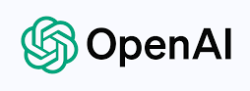
Claude works with MS Office and PDFs
Claude can now create/edit/convert Excel, Word, PowerPoint, PDFs
Preview for Max, Team, and Enterprise plans, Requires enabling “Upgraded file creation and analysis” in settings
Claude runs inside a private Ubuntu 24.04 container with ~9GB RAM, ~5GB disk, Python 3.12, and Node.js v18.19
Microsoft Shifts Office 365 AI to Anthropic Claude
Reducing dependence on OpenAI.
OpenAI's competitive actions, like a LinkedIn rival and custom chips, strained its Microsoft partnership.

Slide 5
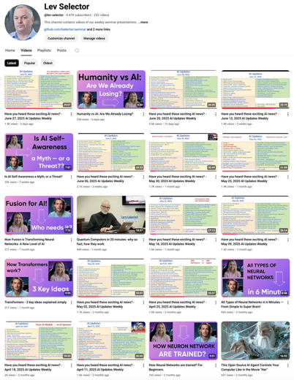
Please pause the video - and answer the pinned question in comments under the video
Subscribe to this channel
https://www.youtube.com/@lev-selector
Get notified about new videos - every Friday, links to slides under the videos

Slide 6
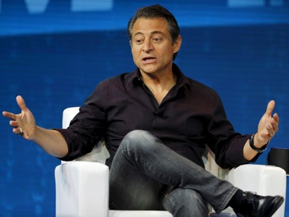
Peter Diamandis about AI
Peter Diamandis about AI
Google's Nano Banana can generate images for $0.039 per API call with character consistency that fools the human eye
VEO-3 is generating hyper-realistic 8-second video clips that pass the smell test for 99.9% of viewers
90%+ of everything we see will be AI-generated by the end of 2026
We're moving from "someone with technical skills can create a fake video" to "anyone with $20 can generate thousands of fake videos in an afternoon."
Companies buying existing AI solutions succeed 67% of the time. Yet those trying to build internal systems only have a 33% success rate
Smart startups attack backend automation, cutting operational costs by 30% and eliminating entire categories of manual work
Peter Diamandis

Slide 7

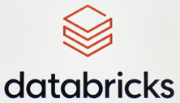

AI Updates 2
ByteDance Seedream 4.0 Image Model
multimodal 4K image generation and editing model
rivaling Nano Banana (Google’s Gemini 2.5 Flash Image) in prompt accuracy, alignment, and aesthetics
https://seed.bytedance.com/en/seedream4_0
Databricks secured $1B at $100B valuation
$4B ARR
This funding will support their AI database development
The Rundown AI - life-changing prompts
The Rundown AI asked community on X to share the AI prompts that actually transformed their work or life
@ralphbrooks created a board of advisors prompt asking personas for advice, with an AI Elon Musk providing first-principles analysis for unexpected insights - https://x.com/ralphbrooks/status/1965124333271146693
@Xyster fed entire company histories, financials, and competitor research into one mega-prompt, then asks for concrete 1, 3, and 6-month action plans - https://x.com/xyster/status/1965101124752736391
@MrXSeek - asked the model to write its own optimal prompt first, then used that refined version to complete the actual task - https://x.com/mrxseek/status/1965100832455839857
@Itslipsadas’ prompt pushes deeper into goals by having AI pose questions to break through circular thinking patterns -
https://x.com/Itslipsadas/status/1965107052851925019

Slide 8



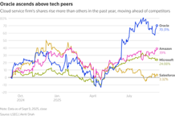

AI Updates 3
Google Veo 3 and Veo 3 Fast
new pricing, new configurations and better resolution
https://developers.googleblog.com/en/veo-3-and-veo-3-fast-new-pricing-new-configurations-and-better-resolution/
Mistral Valuation $14B https://www.wsj.com/tech/ai/asml-to-invest-1-5-billion-in-french-startup-mistral-ai-0d5eb547
Anthropic $1.5 Billion AI Copyright Settlement
A federal judge ruled in June that it was legal for Anthropic to train on copyrighted materials but that it was illegal to acquire the materials from pirate sites like LibGen
Anthropic has offered to settle the class action suit from authors by offering $3,000 per work. This is not accepted yet.
Oracle's stock surged by 40% Wednesday
after revealing $455B in future AI infrastructure contracts (including a massive $300B deal with OpenAI)
This briefly made Larry Ellison (Oracle founder and major shareholder) the richest person on the planet past Elon Musk
Oracle projects cloud infrastructure revenue will grow from $18B this year to $144B within five years, with most already locked in with signed contracts.
Cognition Raises $400M at $10.2B Valuation
Creator of AI coding agent Devin
https://cognition.ai/blog/funding-growth-and-the-next-frontier-of-ai-coding-agents

Slide 9





AI Updates 4
MCP Registry
an open catalog and API for publicly available MCP servers to improve discoverability and implementation
https://blog.modelcontextprotocol.io/posts/2025-09-08-mcp-registry-preview/
https://github.com/modelcontextprotocol/registry/tree/main/docs
The Training Imperative
Eventually, all serious AI firms will train their own models
It is getting easier and cheaper to train
Model ownership will soon be crucial for industry relevance
https://sdan.io/blog/training-imperative
AI Gross Margins in 2025
70% - chipmakers; 50-55% - cloud services; software - up to 60%
https://www.tanayj.com/p/the-gross-margin-debate-in-ai
Multi-word prediction
Predicts multiple words at once
5x speed without losing accuracy.
https://arxiv.org/abs/2509.04185
Moonshot AI Kimi-K2-Instruct-0905
1T params, 32B active params LLM
https://huggingface.co/moonshotai/Kimi-K2-Instruct-0905

Slide 10




AI Updates 5
Replit Raises $250M at $3B Valuation
AI coding startup has tripled its valuation
Agentic AI development tools like Agent 3
40M users and $150M ARR
ByteDance mini-03
Open multimodal reasoning model from University of Hong Kong
based on the Qwen2.5-VL-7B-Instruct (7B params)
https://mini-o3.github.io
https://arxiv.org/pdf/2509.07969
https://github.com/Mini-o3/Mini-o3
Claude AI Outperforms Human Virologists
Tests show it's significantly better at finding bioweapon information than using the internet alone
Anthropic added safety measures to prevent Claude from aiding bioweapons development
https://red.anthropic.com/2025/biorisk/
https://www.anthropic.com/news/anthropic-is-endorsing-sb-53
Nvidia Rubin CPX GPU handles 1 Mln context
This powerful chip excels at tasks needing extremely long text sequences, like video creation and coding.
It's part of a larger system for efficient processing and will launch in late 2026.
https://www.networkworld.com/article/4053902/nvidia-rolls-out-new-gpus-for-ai-inferencing-large-workloads.html

Slide 11

CODE BUFF AI Agentic Coding System
CODE BUFF AI Agentic Coding System
Fully open-source, uses a team of specialized agents to deliver context-aware, multi-step code generation, refactoring, and workflow automation across software projects
Multi-Agent Collaboration (File Explorer, Planner, Implementation, and Review agents)
Project-Wide Awareness - rapidly indexes and maps entire codebases, building long-term memory in readable files like `knowledge.md`, enabling smarter, repeatable context-sensitive edits
Works with many major LLMs, including Claude, GPT, Qwen, and DeepSeek; Developers mostly use CLI interface, but can also integrate CODE BUFF into apps using the SDK; Allows building advanced, programmatic TypeScript workflows for automation, batch refactors, and testing
Outperforms Claude Code in benchmarks, achieving a 61% success rate versus 53% across 175+ coding tasks, thanks to error reduction and intelligent agent specialization
Supports Git integration and a command-line “undo” for safe experimentation
https://www.codebuff.com
https://github.com/CodebuffAI/codebuff
https://ossels.ai/codebuff-ai-coding-agent-open-source/

Slide 12

InternVL3.5 open-source multimodal LLM
InternVL3.5 open-source multimodal LLM series
SOTA reasoning, vision-language, 1B ... 241B params
https://huggingface.co/OpenGVLab/InternVL3_5-8B
https://arxiv.org/abs/2508.18265
https://huggingface.co/collections/OpenGVLab/internvl35-68ac87bd52ebe953485927fb
https://github.com/OpenGVLab/InternVL
Cascade Reinforcement Learning - offline RL for stable model convergence and online RL for refined alignment
Visual Resolution Router (ViR) - Dynamically adjusts visual token resolutions, reducing compute costs with minimal performance loss
Decoupled Vision-Language Deployment (DvD) - Splits the vision encoder and LLM execution across multiple GPUs
Follows a “ViT–MLP–LLM” design, utilizing state-of-the-art vision transformers (e.g., InternViT-300M, InternViT-6B) and powerful language model backbones (e.g., Qwen3, GPT-OSS)
16% improvement in reasoning ability
4x inference speedup over its predecessor, InternVL3
The largest variant, InternVL3.5-241B-A28B, closely rivals flagship commercial MLLMs (like GPT-5) in multimodal, agentic, and text tasks, with only a small performance gap
Enhanced Agentic Abilities - supports novel real-world tasks such as GUI control, embodied agency, SVG-based understanding / generation, and other agentic applications

Slide 13

OpenAI on Hallucinations
OpenAI recently published a paper proposing that hallucinations in language models are inevitable due to the way current models are trained and evaluated; these hallucinations are closely tied to model confidence and feedback mechanisms.[1]
## Core Points from the Video
### Why Hallucinations Occur
- Hallucinations are not just data errors: Even with perfect training data, language models generate incorrect outputs because their training objectives reward confident guesses, not abstaining or expressing uncertainty.[1]
- Current model feedback: During post-training and evaluation, models are incentivized to answer every question (even when unsure), as the scoring systems penalize "I don't know" responses, much like students guessing on a multiple-choice test.[1]
### Key Findings from the OpenAI Paper
- Answering is harder than judging: It's much easier for models to check if an answer is valid than to generate a valid answer—the number of wrong answers greatly exceeds the number of right answers.[1]
- Behavioral calibration: True calibration means that when a model is X% confident, it should be right X% of the time; RL post-training may actually decrease calibration, causing models to bluff more.[1]
### Proposed Solutions
- Confidence thresholds: Models should only answer questions when their confidence exceeds a certain threshold (e.g., 75%); otherwise, they should respond "I don't know".[1]
- Fix benchmarks and evaluations: Evaluations should reward abstaining ("I don't know") responses and penalize wrong answers, unlike current binary systems which reward only correct answers and punish both wrong and abstaining answers.[1]
- Practical evidence: GPT-5 has been observed responding with honest uncertainty ("I don't know"), reflecting experimental adoption of these principles.[1]
### Comparison with Anthropic
- Anthropic findings: Anthropic explored hallucination as a symptom of generative momentum in models—the tendency to continue responding fluently even when wrong—but did not identify the root cause as directly as OpenAI did.[1]
## Practical Takeaways
- Hallucinations are a side effect of model reward structures, not just data flaws or bugs.[1]
- Improving model reliability requires changing both how models are trained (reward abstaining when uncertain) and how they are evaluated.[1]
- This approach is starting to be implemented in newer models (e.g., GPT-5), which can decline to guess when confidence is low.[1]
## Summary Table
| Issue | Cause/Mechanism | Proposed Fix |
|------------------------|-----------------------------------------------------|-----------------------------------------------|
| Hallucinations | Model rewards for confident answers, not abstaining | Change training/eval to reward being unsure |
| Reduced calibration | RL post-training rewards bluffing | Encourage behavioral calibration |
| Wrong answers on facts | Rare facts only seen once (e.g., birthdays) | Use databases, calculators, or abstaining |
| Benchmark flaws | Binary grading, penalize "I don't know" | Neutral/positive score for abstaining |[1]
This video explains OpenAI’s new framework for reducing hallucinations, showing both underlying causes and highlighting fixable aspects in model and benchmark design.[1]
[1](https://www.youtube.com/watch?v=xGO5Q94XXf0)
Key Findings
Reward structure drives errors: Benchmarks give 1 point for a right answer and 0 for everything else, making a risky guess statistically better than abstaining.
Hallucinations come from weak patterns: Tasks like spelling follow rules, so errors vanish with scale. Arbitrary facts (e.g., birthdays) lack patterns, so models output confident but wrong guesses.
Abstention reduces errors: Allowing models to say “I don’t know” (52% abstention) leads to far fewer wrong answers compared to 1% abstention, even if accuracy looks lower.
Why Accuracy-Only Scoring Fails:
Current leaderboards encourage blind guessing because abstentions always score 0.
Confident wrong answers look better on scoreboards than cautious uncertainty.
Post-training alignment cannot fully solve this because models still optimize for binary accuracy.
Proposed Fixes:
Redesign benchmarks: Penalize confident errors more heavily than abstentions.
Partial credit for uncertainty: Reward models for withholding answers when unsure.
Confidence thresholds: Require answers only above a stated confidence level, enabling auditing and calibration.
Broad adoption: Apply these metrics across all evaluations, not just niche uncertainty-aware tests.

Slide 14

Alibaba
Alibaba’s AI team has recently announced several important developments, with a strong focus on proprietary chip design, cloud AI integration, and international collaborations for AI-driven societal impact.
New AI Chip for Cloud and Inference
Alibaba has developed a new AI chip aimed at inference tasks, including large language models and recommendation engines.
The chip, expected to use advanced 7nm process technology, is designed to ensure a steady supply of AI hardware, boost performance, and provide an alternative to Nvidia chips amid export restrictions.
While not focused on rivaling Nvidia’s most advanced lineups for training, it is meant to secure local capabilities for running and scaling generative AI applications.
Cloud Business and Major Investment in AI
Alibaba's cloud division reported a 26% revenue jump, driven by accelerated AI integration and infrastructure growth.
The company announced a historic $53 billion investment over three years—China’s largest AI and cloud infrastructure commitment—to maintain leadership and ecosystem growth.
Initiatives include cloud credits and capital for AI startups and the continued expansion of the ModelScope open-source platform supporting over 54,000 models.
Global Partnerships and Societal Focus
The Alibaba DAMO Academy has partnered with the United Nations ITU for AI-for-Good projects, targeting global challenges like healthcare, climate forecasting, and scientific discovery.
DAMO Academy’s recent innovations include AI-driven systems for early detection of pancreatic and gastric cancers using deep learning with CT scans, and advanced weather forecasting for energy and agriculture sectors.
Alibaba’s AI powers both product development and major international collaborations, such as research with Singapore’s largest hospitals to enhance early disease diagnosis.
Showcase of AI Inventions
At the 2025 World Artificial Intelligence Conference, Alibaba showcased intelligent cockpit systems, enterprise AI partnerships, and novel AI glasses for industrial and consumer applications.
These advances reinforce Alibaba’s leadership in AI hardware, cloud, healthcare solutions, and international AI standards, marking 2025 as a year of major AI expansion and strategic positioning.
Qwen3-Max-Preview model 1T+ params
Outperforms DeepSeek and leading Western models
Available via Qwen Chat: https://chat.qwen.ai (chatting, coding, and document processing; Also via Alibaba Cloud API (Alibaba Model Studio); also through OpenRouter for OpenAI-compatible API access
Qwen-Image - multimodal and visual reasoning - image interpretation, cross-modal content generation, and enterprise search involving visual inputs.
Alibaba released an updated video-generating AI model that can transform basic photos into “film-quality avatars” with speech, singing, and performance capabilities.

Slide 15
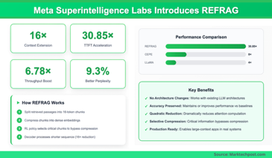
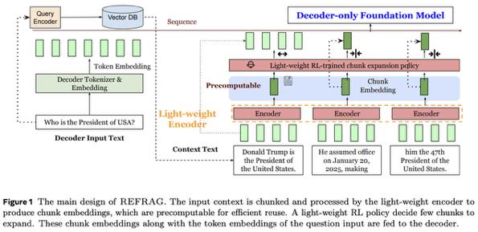
Meta REFRAG
REFRAG: Rethinking RAG based Decoding
https://arxiv.org/pdf/2509.01092
30x speedup in time-to-first-token (TTFT) and 16x context window expansion compared to baseline methods with no accuracy loss.
Substantially reduces memory usage and computational load in RAG, enabling higher throughput and support for much longer contexts
REFRAG doesn't naively concatenate multiple retrieved text chunks. Instead, it compresses the retrieved context passages into compact chunk embeddings using a lightweight encoder
Then only essential chunks are expanded to full tokens as needed, guided by a reinforcement learning policy
Will be released on GitHub (not yet): https://github.com/facebookresearch/refrag

Slide 16
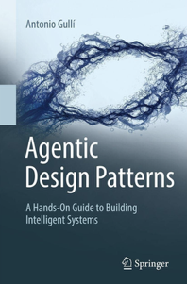
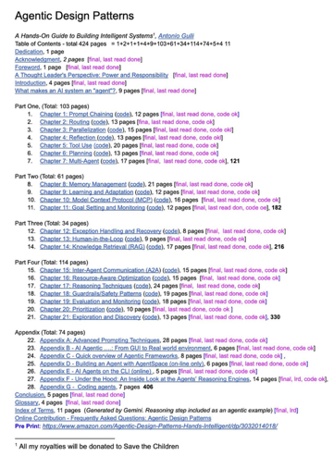
Agentic AI Patterns Book
A senior AI engineer at Google has written a 400-page book: Agentic Design Patterns. It covers multiple topics and provide code: Prompting, MCP, Tools, RAG, Memory, Humans in the loop, Multi-agent, Guardrails, ... https://substack.com/@huryn/note/c-152192144
Pre-order the book: https://amazon.com/dp/3032014018
Whole Book Online: https://docs.google.com/document/d/1rsaK53T3Lg5KoGwvf8ukOUvbELRtH-V0LnOIFDxBryE
Code from the Book https://drive.google.com/drive/u/0/folders/1Y3U3IrYCiJ3E45Z8okR5eCg7OPnWQtPV

Slide 17

Claude Code - YouTube Research Agent
Build a YouTube Research Agent in 15 Minutes Peter Yang - Claude Code Tutorial https://www.youtube.com/watch?v=iW0lMW-Ff5I
Use Claude Code as an "everything agent" to build a YouTube research agent that analyzes multiple channels and identifies their winning content formulas. The project is completed in six structured steps:
Plan mode - Use Claude to brainstorm different approaches (YouTube Data API, web scraping, or yt-dlp tool)
Set auto-approve permissions ON
Write a detailed spec - Create specifications for a custom slash command that fetches recent videos and analyzes performance patterns
Convert spec to a detailed to-do list (tasks list)
Code writing - Let Claude implement the code based on the planning
Add batch processing (analyze multiple channels simultaneously from a file)
Result: the `/youtube` command analyzes YouTube channels and generates a markdown report containing
Key insights about what content performs best for each channel
Suggested video titles based on successful patterns
Top 10 performing videos with view counts and links
So: steps 1,2,3,4 - planning. steps 5,6 - coding
Sequence: explore, spec, plan, then code
The same pattern can be applied to other automation tasks like daily news briefs, newsletter digests, or market research.
Peter Yang

Slide 18

Customer Service AI Agent
It is easy to implement a customer service AI agent with minimal programming by using modern no-code platforms or open-source solutions designed for non-technical users. These tools allow rapid deployment, customization, and integration into websites or channels such as live chat and messaging apps.[1][2][3]
## No-Code and Prebuilt AI Chatbot Platforms
- **Make.com, Voiceflow, Zapier, N8N:** Drag-and-drop platforms with prebuilt logic allow creating conversational AI agents by uploading FAQs, support docs, and configuring basic automation flows. No programming is required beyond connecting data and setting rules.[2][3][1]
- **CustomGPT.ai:** Enables training AI chatbots on proprietary business data through a user-friendly interface. Supports deployment on multiple channels and provides a white-label branding option.[4]
- **SmythOS:** Has a visual builder and prebuilt agent templates for fast deployment and easy integration with APIs, with minimal to no code needed.[5]
### How These Tools Work
- Use templates for FAQs, order tracking, or appointment booking.[3][1]
- Upload support documents or provide sample Q&A for the chatbot to learn responses.
- Configure integrations such as website widgets, email, WhatsApp, or Slack for multi-channel support.
- Use analytics and feedback features to monitor and refine AI performance.[4]
## Open-Source Customer Support AI Solutions
For users comfortable with simple self-hosting or minimal technical steps:
- **Chatwoot:** Modern open-source live-chat and omnichannel support tool, featuring AI assistants for automated replies. Offers web, social media, and messaging integrations out of the box with no or light coding required.[6][7]
- **Rasa and Botpress:** Open-source conversational agent frameworks that support visual builders for basic chatbot configuration, though advanced customization may require programming.[8][4]
- **DeepPavlov and ChatterBot:** Lower barrier to entry for simple FAQ-style bots, but some minimal Python scripting may be needed for setup.[8]
## Getting Started: Basic Steps
1. **Choose a Platform:** For true no-code, start with tools like Voiceflow, Make.com, or CustomGPT.ai.[1][3][4]
2. **Prepare FAQ/Data:** Gather high-quality data or common support questions.
3. **Configure and Train:** Use the drag-and-drop interface to upload your data, define chatbot responses, and set up any integrations.
4. **Test with Real Queries:** Simulate customer questions to ensure the agent replies accurately.
5. **Deploy:** Add the AI agent to your website, messaging apps, or other customer touchpoints.[3][1]
6. **Monitor and Improve:** Use built-in analytics to further refine and improve the AI's answers over time.[4]
## Recommended Solutions Table
| Platform | Coding Required | Channels Supported | Core Features | Open Source | Notes |
|-----------------|----------------|-----------------------------|---------------------------------------------|-------------|------------------------------|
| Make.com | No | Web, messaging apps | Drag & drop workflows, templates | No | Fastest for non-tech users [1] |
| Voiceflow | No | Web, chat, voice | Visual design, LLM integration | No | Enterprise-ready, voice chat [3] |
| CustomGPT.ai | No | Multi-channel | No-code, proprietary data, analytics | No | White-label, business focus [4] |
| Chatwoot | Minimal/No | Web, messaging, social | Omnichannel, AI suggestions, live chat | Yes | Self-hosted, full control [7] |
| Botpress/Rasa | Optional | Web, CRM, messaging | Advanced NLU, visual flows (Botpress) | Yes | Powerful, scalable |
In summary, no-code platforms like Make.com, Voiceflow, and CustomGPT.ai are ideal for those seeking the easiest setup with little to no programming, while open-source projects like Chatwoot offer more control with modest effort.[7][1][3][4]
[1](https://www.sarmedrizvi.com/blog/how-to-build-an-ai-agent-for-customer-support-with-no-code)
[2](https://blog.getodin.ai/how-to-build-no-code-ai-agents/)
[3](https://www.ampcome.com/post/top-10-ai-agents-for-customer-service)
[4](https://customgpt.ai/white-label-ai-chatbot/)
[5](https://zencoder.ai/blog/best-ai-agents-for-coding)
[6](https://www.chatwoot.com)
[7](https://github.com/chatwoot/chatwoot)
[8](https://imeetify.blog/top-8-open-source-tools-to-build-dynamic-ai-support-agents/)
[9](https://www.youtube.com/watch?v=wwhFP30uGmE)
[10](https://www.youtube.com/watch?v=5BnLNqNrrvo)
[11](https://www.reddit.com/r/AI_Agents/comments/1g6spuc/building_an_ai_agent_for_customer_support/)
[12](https://workhub.ai/build-a-no-code-ai-voice-agent-for-customer-support/)
[13](https://www.dhiwise.com/post/top-open-source-customer-support-tools)
[14](https://www.reddit.com/r/nocode/comments/1mo62po/easiest_way_to_create_and_deploy_ai_agents_nocode/)
[15](https://www.modular.com/max/solutions/chatbots)
[16](https://www.voiceflow.com)
[17](https://www.qodo.ai/blog/best-ai-coding-assistant-tools/)
[18](https://www.youtube.com/watch?v=DV0Ln7HRyJQ)
[19](https://www.reddit.com/r/LangChain/comments/1gfx4cz/which_opensource_stack_to_use_for_whatsapp_ai/)
[20](https://zapier.com/blog/best-chatbot-builders/)

Slide 19
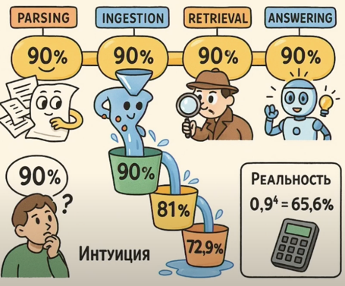
Streamlit-Based RAG Debugging
Streamlit-Based RAG Debugging
https://www.youtube.com/watch?v=NCPdj3ABpR4
The main takeaways from the video "Влад Дроботухин | От хаоса к контролю: Опыт создания Streamlit-трейсера для отладки RAG-систем" focus on the practical experience of building a Streamlit-based tracer tool for debugging RAG (Retrieval-Augmented Generation) systems, with insights into collaboration with domain experts and improving reliability in production ML pipelines[1].
## Streamlit-Based RAG Debugging Approach
- **Streamlit** was used to develop a lightweight, customizable UI for visualizing, tracing, and debugging each stage of the RAG pipeline, allowing both technical and non-technical experts to inspect data flow and outputs.[1]
- The tool integrates directly with vector databases and prompt engineering components, supporting modular evaluation and rapid prototyping.[1]
## Emphasis on Reliability and Modular Testing
- The reliability of the whole ML system is the product of the reliability of its components; each stage (data parsing, retrieval, LLM response, etc.) must be measured and improved individually for overall quality improvements.[1]
- Systematic modular testing, continuous logging, and human evaluation are critical throughout the RAG pipeline, especially when working with unstructured data and evolving business requirements.[1]
## Effective Expert Collaboration
- A streamlined UI is essential for domain experts (e.g., lawyers) who are not machine learning or Python experts, enabling them to annotate, comment, and iterate without technical hurdles.[1]
- The expert's feedback loop should be as frictionless as possible, focusing their limited attention on high-leverage corrections and assessment, which is the scarcest and most valuable resource in the process.[1]
## Iterative, Automated Improvement Cycle
- The system enables rapid iteration for both developers and domain experts: questions and logs are surfaced, annotated, and used to refine prompts, retrievers, or data sources in real time.[1]
- The approach leverages open-source tools such as Langfuse and Langsmith for log and trace management, but custom tools are essential to fill UX gaps for non-technical stakeholders.[1]
## Concrete Competition and Use Case Results
- The speaker successfully used this approach in a competition setting, substantially improving the efficiency and quality of the RAG pipeline, demonstrating its applicability beyond POCs to real datasets and team workflows.[1]
- Building and customizing such dashboards typically takes only a few hours if the core components are ready, enabling agile experimentation and feedback integration.[1]
## Key Principles for RAG System Debugging
- **Reliability should be measured and optimized at every pipeline stage**.[1]
- **Domain experts need practical UIs to participate in evaluation and debugging**.[1]
- **Automation and traceability accelerate both development and expert-guided refinement**.[1]
- **Continuous logging and stepwise quality assessment are vital as systems and teams scale**.[1]
[1](https://www.youtube.com/watch?v=NCPdj3ABpR4)

Slide 20
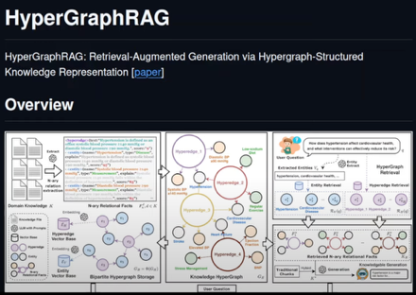
HyperGraphRAG
HyperGraphRAG organizes knowledge using hypergraphs, which connect 3+ related pieces of information together (not just pairs), enabling the system to answer complicated, multi-factor questions
Standard RAGpulls text chunks from a dataset, often missing interconnected details; GraphRAG considers pairwise connections; HyperGraphRAG links multiple related facts all at once, making it better at capturing the full context for complex queries
https://www.youtube.com/watch?v=vjpxGd8p6rM - video demo
https://arxiv.org/abs/2503.21322 - paper
HyperGraphRAG builds a vector store that models relationships between multiple entities, then answers detailed, context-rich queries by traversing these hyperedges instead of just searching for keywords
This method is especially valuable for complex domains like healthcare, finance, or law, where answers depend on the interplay of multiple facts or entities

Slide 21
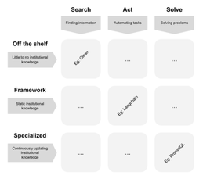
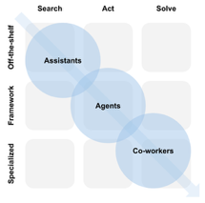
GenAI Assessment Framework (GAF)
GenAI Assessment Framework (GAF)
3×3 Matrix to Map Enterprise AI Needs
https://promptql.io/blog/durable-framework-evaluating-enterprise-ai
Axis 1 (horizontal) - what the AI does: search, act, solve
Axis 2 (vertical) - how the AI is implemented & improved: off-the-shelf, framework, specialized
The recent MIT (The GenAI Divide) and McKinsey (State of AI in Business 2025) reports illustrate clear enterprise AI failure modes:
"learning gap" - AI tools are static and do not improve with user feedback
Misaligned Assistant. Getting a "Search" tool instead of a "Solve" tool
Multiple isolated POCs, no end-to-end integration
Trying to build custom solutions without having AI expertise

Slide 22

Stop Writing Tests
Stop Writing Tests (This Approach is 10x More Effective)
https://medium.com/@harishsingh8529/stop-writing-tests-this-approach-is-10x-more-effective-f4a57fc0ea74
Problems with Traditional Test Suites - slow, brittle, and expensive to maintain. Minor changes in the codebase can break numerous tests; Teams frequently respond to bugs by adding more tests without considering the value, causing bloated and fragile test suites
The 10x Approach: Contract-Driven Development
contracts (explicit agreements) are established between consuming and providing components (services/APIs), specifying expected behaviors and data formats; Automated contract tests validate both sides (consumer and provider) in isolation, finding integration issues early and making tests resilient to internal implementation changes
faster feedback cycles, less maintenance overhead, and improved confidence; encourages shared ownership of quality among all stakeholders, unlike traditional testing silos
Stop emphasizing traditional test pyramid methodologies that favor quantity or superficial code coverage. Invest in contract tests that capture real service boundaries, automate expectations, and empower teams to refactor and ship quickly with minimal test drag

Slide 23
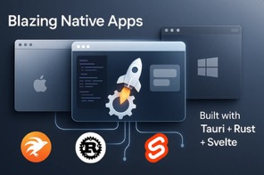
Tauri + Rust + Svelte for Native Apps
Tauri + Rust + Svelte for Native Apps
A powerful, modern alternative to Electron for building native desktop apps
Significantly smaller binaries, better performance, and a more enjoyable frontend development experience
Fast and small desktop app binaries (usually under 10MB compared to 300MB with Electron)
Secure, cross-platform backend (Rust) + any modern JavaScript framework (for example, Svelte)
https://medium.com/@hadiyolworld007/why-tauri-rust-svelte-is-my-favorite-stack-for-native-apps-d66633b886e4

Slide 24
Synechron AI Consulting - $1B Revenue
Synechron is a leading global digital transformation consulting firm specializing in artificial intelligence, digital, cloud and DevOps, cybersecurity, and software engineering solutions, with a primary focus on the financial services and big tech industries. As of September 2025, the company surpassed a $1 billion revenue milestone and celebrated by granting equity (RSUs) to all 16,000 employees, signaling both its impressive growth and strong employee-centric culture.[1][2][3][5][6]
## Overview
- Founded: 2001 in New York, NY
- Headquarters: New York, NY, with significant operations in Pune, India, London, UK, and multiple global locations
- Industry: Technology Consulting (Financial Services, Big Tech, Cloud, Data, AI, Engineering)
- Workforce: Over 16,000 employees in 59 offices across 21 countries[5][6]
## Services and Solutions
- Artificial Intelligence and Data Engineering
- Digital Transformation and Consulting
- Cloud & DevOps Strategy
- Cybersecurity Solutions
- Software Engineering and Systems Integration[1][5]
- R&D through FinLabs, delivering award-winning technology accelerators, notably in CyberAI[5]
## Recent Highlights
- $1 Billion Revenue Milestone: Achieved in 2025, with all 16,000 employees receiving $1,000 in RSUs, demonstrating a commitment to shared rewards and long-term retention.[2][6]
- Synechron remains privately held and has grown without outside investment.
- Emphasizes a culture of inclusivity, transparency, and high employee engagement, reportedly with 87% of employees considering it a great place to work—well above average for the tech industry.[4]
## Reputation
- Recognized as a great place to work, with high employee retention and trust metrics.[4]
- Partners with more than 200 marquee financial clients worldwide.[6]
- Known for innovation, especially in AI, digital, and cybersecurity solutions.[1][5]
Synechron stands out for its rapid growth, strong culture, and deep expertise in delivering advanced technology solutions to key industries.[2][6][1]
[1](https://www.synechron.com/en-us)
[2](https://fortune.com/2025/09/08/ai-consulting-firm-hits-1-billion-makes-employees-part-owners-cfo-ceo/)
[3](https://www.linkedin.com/company/synechron/jobs)
[4](https://www.greatplacetowork.com/certified-company/137000045)
[5](https://www.linkedin.com/company/synechron)
[6](https://www.prnewswire.com/news-releases/synechron-celebrates-1-billion-milestone-grants-equity-to-global-workforce-302543111.html)
Synechron AI Services (Largest Revenue Segments First)
1. AI Consulting & Transformation for Financial Services
Key activities: AI strategy, machine learning solutions for banking/insurance, risk assessment automation, regulatory compliance, customer analytics
Estimated Revenue Contribution: Largest single AI segment, but not itemized; likely hundreds of millions given their banking sector dominance
2. Cybersecurity & RiskTech AI (CyberAI Program)
Key activities: AI-powered risk management (RiskControl.AI), vulnerability detection (AppSec.AI), GenAI safeguards (Validate.AI), automated incident response
Estimated Revenue Contribution: Substantial revenue from CyberAI accelerators as cyber demand spikes globally
3. Generative AI and Data Engineering
Key activities: GenAI (generative AI) for text, imagery, analytics (Earnings Analyzer, etc.), advanced NLP, predictive analytics, data lake/MLops platform buildouts
Estimated Revenue Contribution: Significant and fastest-growing, as companies invest in automation and analytics
4. Business Automation & Cognitive AI
Key activities: Cognitive automation, intelligent RPA, operations and workflow re-engineering via AI
Estimated Revenue Contribution: Major, but below the above, as part of digital operational transformation projects
5. Industry-Specific AI Accelerators (FinLabs/Nexus Plus)
Key activities: Packaged industry AI accelerators, compliance, asset allocation, sentiment analytics
Estimated Revenue Contribution: Rising, especially as clients adopt off-the-shelf solutions for financial efficiency

Slide 25

Andrew Ng - Demand for AI Developers
Andrew Ng - Demand for AI Developers
There is significant unmet demand for developers who understand AI. At the same time, because most universities have not yet adapted their curricula to the new reality of programming jobs being much more productive with AI tools, there is also an uptick in unemployment of recent CS graduates.
When I interview AI engineers — people skilled at building AI applications — I look for people who can:
- Use AI assistance to rapidly engineer software systems
- Use AI building blocks like prompting, RAG, evals, agentic workflows, and machine learning to build applications
- Prototype and iterate rapidly
Someone with these skills can get a massively greater amount done than someone who writes code the way we did in 2022, before the advent of Generative AI. I talk to large businesses every week that would love to hire hundreds or more people with these skills, as well as startups that have great ideas but not enough engineers to build them. As more businesses adopt AI, I expect this talent shortage only to grow! At the same time, recent CS graduates face an increased unemployment rate, though the underemployment rate — of graduates doing work that doesn’t require a degree — is still lower than for most other majors. This is why we hear simultaneously anecdotes of unemployed CS graduates and also of rising salaries for in-demand AI engineers.
When programming evolved from punchcards to keyboard and terminal, employers continued to hire punchcard programmers for a while. But eventually, all developers had to switch to the new way of coding. AI engineering is similarly creating a huge wave of change.
There is a stereotype of “AI Native” fresh college graduates who outperform experienced developers. There is some truth to this. Multiple times, I have hired, for full-stack software engineering, a new grad who really knows AI over an experienced developer who still works 2022-style. But the best developers I know aren’t recent graduates (no offense to the fresh grads!). They are experienced developers who have been on top of changes in AI. The most productive programmers today deeply understand computers, how to architect software, and how to make complex tradeoffs — and who additionally are familiar with cutting-edge AI tools.
Sure, some skills from 2022 are becoming obsolete. For example, a lot of coding syntax that we had to memorize back then is no longer important, since we no longer need to code by hand as much. But even if, say, 30% of CS knowledge is obsolete, the remaining 70% — complemented with modern AI knowledge — is what makes really productive developers.
Without understanding how computers work, you can’t just “vibe code” your way to greatness. Fundamentals are still important, and for those who additionally understand AI, job opportunities are numerous!
Salesforce just cut 1,000 jobs… while posting dozens of AI roles.
Meta laid off 5% of its workforce… while spending $40B+ on AI.
Microsoft poured $80B into AI in 2025 alone.
Companies aren’t “saving money.” They’re reallocating it away from traditional engineers, and toward anyone who can actually build AI systems.
That’s why demand for software engineers keeps falling… while demand for AI engineers is exploding
$7K–$20K+ projects on Fiverr and Upwork
Hackers pulling $3K…$42K/mo with small AI apps
Engineers landing $400K+ salaries at companies desperate to fill AI roles

Slide 26
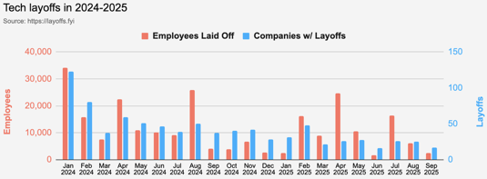
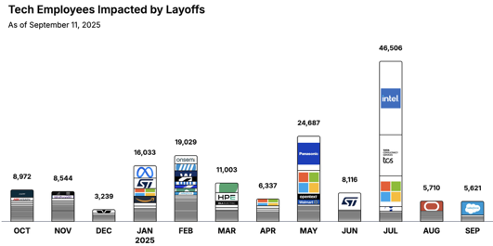
Jobs
https://layoffs.fyi
https://trueup.io/layoffs
Tech Layoffs by year:
89K in 2025 (as of September 11)
153K in 2024
264K in 2023
165K in 2022
https://layoffs
The Tech Layoff Tracker
So far in 2025, 143,042 people laid off (563 per day).
In 2024, 238,461 people laid off (653 per day).
https://trueup.io/layoffs

Slide 27


About the Speaker
Lev Selector, Ph.D.
40+ years of software engineering, data science, and building teams (hiring, training, and managing)
Ph.D. in mathematical modeling and computer simulations
Interests:
Generative AI, Using LLM with your data
Local AI for Local Private Data
Cloud architecture, fin-tech, application security
Find/connect: Linkedin, GitHub, YouTube, Google
https://eais.ai
Enterprise AI Systems

Slide 28
Thank You!

