Slide 1
AI Updates - August 15, 2025
Google Search - for humans
MCP - for apps & AI
Crowd-sourced "LM Arena" Leaderboard
GPT-5 impressions
HRM (Hierarchical Reasoning Model)
Why Terminal AI Assistants are Popular
Babuschkin Ventures
Tiny models - Multiverse 94M, Gemma 270M
Void - Open-source Cursor alternative
LangDiff: Progressive UI from LLM
Deep Agent from Abacus AI
Google LangExtract
SciSpace Agent - an AI Co-Scientist
Geoffrey Hinton - maternal instincts into AI
Claude 1M context window
Skywork’s Matrix Game 2.0
Leopold Aschenbrenner $1.5B Hedge Fund
Mistral AI released Medium 3.1
Gemini "Personal Context"
Perplexity’s video generation tool on smart phones
OpenAI achieved "gold" in Math
Microsoft Magnetic-UI (Human + AI)
MCP History 2024-2025
MCP vs Google Search
MCP for AI Development
MCP use: Claude.ai, VSCode, PyCharm, Terminal
MCP Server for your docs
MCP Client for your App
MCP Examples, MCP + Firebase
Claude Code - Basic Commands
RAG - Traditional vs Agentic RAG
David Sacks - Best Case Scenario For AI?
NVIDIA’s AI-Q blueprint architecture
Self-Questioning Language Models
"America Is Running the Wrong AI Race"
xAI's Grok 4 AI Now Freely Available worldwide
Merge Labs - new Sam Altman's startup
NVIDIA Innovations at SIGGRAPH 2025 in Vancouver
Cohere $6.8B, Joelle Pineau
Humanloop (Human-in-the-Loop) + Anthropic
AI Adoption Progress
AI is disrupting the Big Four
René Descartes and AI
Jobs, Layoffs

Slide 2
Crowd-sourced "LM Arena" Leaderboard
https://lmarena.ai/?leaderboard
Starting Elo rating = 1000
https://en.wikipedia.org/wiki/Elo_rating_system
English - https://lmarena.ai/leaderboard/text
Coding - https://lmarena.ai/leaderboard/text/coding
LM Arena secures $100M to expand AI benchmarking (at $600M valuation)
Model | Score
gpt-5-high | 1481
gemini-2.5-pro | 1458
o3-2025-04-16 | 1451
claude-opus-4-1-20250805 | 1446
chatgpt-4o-latest-20250326 | 1440
gpt-4.5-preview-2025-02-27 | 1438
grok-4-0709 | 1430
qwen3-235b-a22b-instruct-2507 | 1428
kimi-k2-0711-preview | 1420
claude-opus-4-20250514-thinking-16k | 1420
deepseek-r1-0528 | 1418
glm-4.5 | 1414
claude-opus-4-20250514 | 1412
grok-3-preview-02-24 | 1409
gemini-2.5-flash | 1409
gpt-4.1-2025-04-14 | 1406
qwen3-235b-a22b-thinking-2507 | 1401
claude-sonnet-4-20250514-thinking-32k | 1399
o1-2024-12-17 | 1398
o4-mini-2025-04-16 | 1398
qwen3-235b-a22b-no-thinking | 1397
deepseek-r1 | 1394
Model | Score
gpt-5-high | 1509
claude-opus-4-1-20250805 | 1499
qwen3-235b-a22b-instruct-2507 | 1477
claude-opus-4-20250514-thinking-16k | 1480
o3-2025-04-16 | 1473
gemini-2.5-pro | 1473
chatgpt-4o-latest-20250326 | 1468
claude-sonnet-4-20250514-thinking-32k | 1462
kimi-k2-0711-preview | 1459
gpt-4.5-preview-2025-02-27 | 1458
glm-4.5 | 1456
qwen3-235b-a22b-thinking-2507 | 1451
deepseek-r1-0528 | 1455
claude-opus-4-20250514 | 1454
grok-4-0709 | 1449
gpt-4.1-2025-04-14 | 1442
qwen3-30b-a3b-instruct-2507 | 1438
qwen3-235b-a22b-no-thinking | 1440
qwen3-coder-480b-a35b-instruct | 1435
glm-4.5-air | 1435
grok-3-preview-02-24 | 1437
claude-sonnet-4-20250514 | 1437
China
Grok 4 Benchmarks
https://artificialanalysis.ai/models/grok-4
x.ai
China
https://lmarena.ai/leaderboard/text
https://web.lmarena.ai/leaderboard
https://openlm.ai/chatbot-arena/
https://beta.lmarena.ai
Web Leaderboard https://web.lmarena.ai/leaderboard
LLM Leaderboard - by @LlmStats https://llmworld.net/llm_leaderboards/
LLM Leaderboard - by StackAI https://www.stack-ai.com/llm-leaderboard
LLM Leaderboard - by Artificial Analysis https://artificialanalysis.ai/leaderboards/models
Open LLM Leaderboard - by Hugging Face https://huggingface.co/open-llm-leaderboard
LLM Leaderboard - by Vellum https://www.vellum.ai/llm-leaderboard
AI Benchmarking Hub https://epoch.ai/data/ai-benchmarking-dashboard
China
China
China
China
China
China
China
x.ai
x.ai
China
China
China
China
China
China
x.ai
China

Slide 3



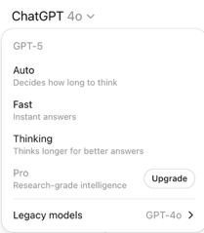
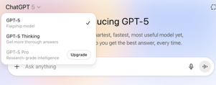

GPT-5 impressions
Mathew Berman tests: https://www.youtube.com/watch?v=BUDmHYI6e3g
Robin Ebers - GPT-5 Will NOT Replace Claude Code (not practical slow, spends too many tokens) https://www.youtube.com/watch?v=bTCNOIee31c
What Went Wrong With GPT-5...(People Hate It)
Router was not working correctly
Model is not as friendly as previous versions "intelligent co-pilot that doesn't care about you" https://www.youtube.com/watch?v=lmuXAoHLc8s
Early GPT‑5 results: strong across reasoning, with problems related to routing, cost, and effort
Early tests found GPT‑5 consumed 4–5× more tokens than GPT‑4.1 on identical vision prompts, likely due to more verbose internal “thinking”
GPT-5 did receive updates this week in response to user backlash and technical issues - bug fixes, improved model selection routing, increasing message limits for Plus subscribers, and the temporary re-allowing of GPT-4o for some users
All previous models were removed. Now there is only GPT-5
Microsoft's Copilot now has GPT-5 for free.
Before it was offering varios OpenAI models (depending on payment plan)
GPT-OSS Playground https://gpt-oss.com

Slide 4
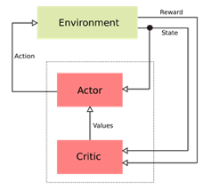
HRM (Hierarchical Reasoning Model)
HRM (Hierarchical Reasoning Model) - Open Source
Very small 27M params system outperforms much bigger models
Created by Sapient Intelligence - small startup from Singapore
https://www.youtube.com/watch?v=2KC03FPuOCs - video
https://github.com/sapientinc/HRM - github
https://arxiv.org/abs/2506.21734 - paper
HRM achieved a major breakthrough in machine reasoning
Its key innovation is a brain-inspired, planner-worker architecture
A high-level "planner" creates strategies
A low-level "worker" carries them out and reports back, enabling the model to think in self-correcting loops rather than fragile, linear chains of thought
40.3% on ARC AGI benchmark (compare with 34.5% OpenAI o3-mini-high and 21.2% of Claude 3.7)
Extreme Sudoku, HRM solved 55% of cases, versus a 0% success rate for popular chain-of-thought models
HRM can be trained for such tasks in only 2 GPU hours
This means that AI of this caliber could run locally on laptops !
HRM's creators argue this result shows the future of AI may depend less on model size and more on smarter, human-like cognitive architectures
HRM approach closely resembles the agentic system
with a separation of planning/orchestration and specialist execution
In any complex organization - from corporations to governments and militaries - the most effective outcomes arise when strategy and execution are clearly separated, yet strongly aligned through communication, feedback, and shared metrics
Examples of Separation of Responsibilities:
Reinforcement Learning actor/critic
Military soldiers/generals
Business workers/managers

Slide 5




Why Terminal AI Assistants are Popular
Terminal AI assistants - such as Claude Code, Gemini CLI, Cursor CLI, and similar tools - combine the power of modern AI with the flexibility, speed, and universality of the command line
Allow to automate repetitive command-line operations like file management, deployments, and script generation
Faster Command Discovery - users can describe tasks in natural language and let the AI suggest precise commands or scripts
Terminal assistants can detect command typos and risky instructions, suggesting corrections in real-time
Approve/Reject Before Execution
AI is embedded directly into the terminal, eliminating context switching between the code editor, browser, and chatbots
Many terminal assistants support non-interactive operation, enabling powerful automation for CI/CD pipelines, batch processing, and other workflow integrations
Plain Language Instructions, Conversational Experience, Personalization, Learning from User Behavior, Continuous Improvement, Customizable (behavior, context, file access, and model choice for different projects), Open Source, easy to integrate into any environment, Professional-Grade Results with less "friction" compared to traditional IDE plugins or sidebar-based assistants
Warp.dev https://www.warp.dev/coding
OpenCode SST https://github.com/sst/opencode
Kilo Code https://kilocode.ai
Gemini CLI https://developers.google.com/gemini-code-assist/docs/gemini-cli
Claude Code CLI https://www.anthropic.com/claude-code
Cursor CLI https://docs.cursor.com/en/cli/overview
Grok CLI - https://github.com/superagent-ai/grok-cli
AIChat
OpenAI Codex CLI https://github.com/openai/codex
Open Interpreter https://github.com/openinterpreter/open-interpreter

Slide 6
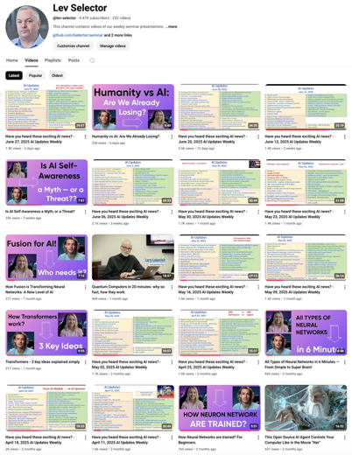
Please pause the video - and answer the pinned question in comments under the video
Subscribe to this channel
https://www.youtube.com/@lev-selector
Get notified about new videos - every Friday, links to slides under the videos

Slide 7
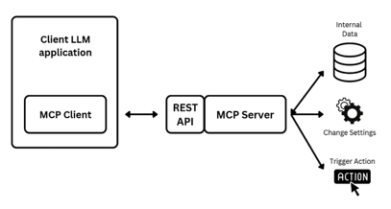
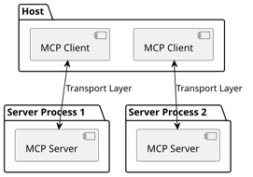
MCP History 2024-2025
Anthropic Model Context Protocol (MCP) allows AI models and agents to get access to data (context)
November 2024 - initial release, open-sourced
February 2025 - 1st official SDKs
May 2025 - Claude Code SDK, support for agentic workflows. support for real-time SSE and HTTP transport, multi-language capabilities (TypeScript, Python, C#, Java), and easy integration into Anthropic's API and Claude models
https://github.com/modelcontextprotocol - GitHub
https://en.wikipedia.org/wiki/Model_Context_Protocol - Wikipedia

Slide 8
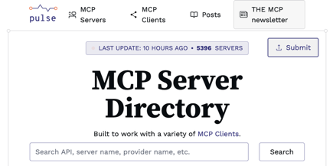
MCP vs Google Search
There are thousands of MCP servers listed in multiple directories.
Any data from web pages, docs, databases, etc. can now be made available via MCP to be used in (AI) applications
https://www.pulsemcp.com/servers - 5396 servers listed
https://portkey.ai/mcp-servers
https://mcp.so
https://glama.ai/mcp/servers
https://github.com/punkpeye/awesome-mcp-servers
https://www.mcpserverfinder.com
https://cursor.directory/mcp
https://www.mcpserver.directory
https://github.com/modelcontextprotocol/servers
https://code.visualstudio.com/docs/copilot/chat/mcp-servers
Google Search
for Humans
MCP
for Apps & AI
Data

Slide 9
MCP for AI Development
GitHub MCP Server https://github.com/github/github-mcp-server GitHub’s official MCP server, now in public preview, transforms how you manage repositories and analyze code. Repository management; Issue tracking automation; Pull request workflows; Organization-wide searches
GitMCP — The Code Hallucination Killer https://github.com/idosal/git-mcp AI search through repository documentation finding only relevant sections, reduces AI hallucinations by 70% when working with large codebases
Playwright MCP by Microsoft https://github.com/microsoft/playwright-mcp Microsoft’s game-changing browser automation tool that enables structured browser interactions for LLMs. Perfect for: Web automation workflows; UI testing at scale; Browser-based data extraction
Memory MCP Server — AI That Remembers https://github.com/modelcontextprotocol/servers Knowledge graph-based persistent memory system that allows AI to remember previous conversations and learned information. Teams report 40% faster onboarding of new team members
Filesystem MCP — Secure File Operations https://github.com/modelcontextprotocol/servers Enterprise-grade file system management with configurable access controls and security features.
Fetch MCP Server — Web Content Made Simple https://github.com/modelcontextprotocol/servers Efficiently fetch and transform web content for optimized LLM consumption.

Slide 10
How to use MCP from Claude.ai Chat
How to use MCP from VS Code
How to use an MCP server from within "Cliine" in VSCode
I asked Cline to add external public MCP server "context7" available at URL "https://mcp.context7.com/mcp"
Cline has edited this config file:
"$HOME/Library/Application Support/Code/User/globalStorage/saoudrizwan.claude-dev/settings/cline_mcp_settings.json"
and added the following into it:
{
"mcpServers": {
"github.com/upstash/context7-mcp": {
"command": "npx",
"args": ["-y", "@upstash/context7-mcp"],
"disabled": false,
"autoApprove": []
}
}
}
Now I can use it from text prompt in Cline like this: use context7 how to make docker bake file
Note:
start VSCode from terminal like this: "code ." This way it inherits the environment properly and can find mcp config files.
Note:
use .clinerules file (or .cline/*.md files) to define custom rules and instructions for AI model in Cline
Using MCP from Claude.ai chat
Click your profile/avatar (often in the bottom-left corner) and select "Settings", navigate to "Connectors" and select "Add Custom Connector"
Provide the MCP server’s integration URL (for example, https://mcp.context7.com/mcp) and give the integration a name, for example "Context7"; Review security permissions, accept them, and click "Add"
In chat "Search and tools" - check that it is enabled
========================================================
To use an MCP resource in a chat, mention it like this: "use context7" - this is usually sufficient
========================================================
Other way to reference specific data in MCP server:
search for "docker bake file" like this: @context7:doc://docker/bake/file -
search for "build bake reference" like this: @context7:doc://https/docs.docker.com/build/bake/reference/ -
You can also ask Claude to use documentation site directly: "Show me an example of a multi-target Docker Bake file using the latest syntax from https://docs.docker.com/build/bake/reference/"

Slide 11
MCP use from PyCharm & Terminal
MCP servers are supported natively in recent PyCharm versions (2025.2 and later) via the built-in MCP Server interface
"Claude" is supported through AI Assistant plugin
Ensure PyCharm is updated to version 2025.2 or later.
Confirm the AI Assistant plugin is installed and enabled.
Select the model (for example, choose "Claude") - you may need to sign in or provide your API key, depending on licensing/enterprise setup
You can claude and MCP from terminal: sudo npm install -g @anthropic-ai/claude-code which claude claude "what is the capital of France" # add this line to your environment dot file(s) ~/.claude.json & ~/.claude/ export CLAUDE_CONFIG_DIR="$HOME"
# add mcp server (will be added into ~/.claude.json ) claude mcp add --transport http context7 https://mcp.context7.com/mcp
Go to `Settings` → `Tools` → `AI Assistant` → Model Context Protocol (MCP).
- You can also type `/` in the AI Assistant chat and select the “Add Command” to bring up MCP configuration.
Click "Add" to create a new MCP server configuration, specify the command and arguments used to launch the MCP server.
Paste a JSON snippet that configures the MCP server connection. For example, to connect to the public Context7 server:
{
"mcpServers": {
"context7": {
"type": "http",
"url": "https://mcp.context7.com/mcp"
}
}
}
Name the server as desired (“context7”, etc.), select if the MCP configuration should be global (available in all projects) or just for the current one; Apply and Restart (if needed)
Use AI chat in the right sidebar or with the `/` shortcut in the chat window. You can reference MCP server in your AI prompts, for example “use context7” or reference direct resources/events

Slide 12
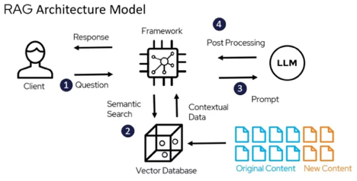

MCP Server for your docs
You do not need to write your own MCP server from scratch—there are ready-to-use open-source MCP server solutions built specifically for serving local documentation, and they’re easy to set up for use with both VSCode and PyCharm
Docs MCP Server - It indexes 3rd party documentation from various sources (websites, GitHub, npm, PyPI, local files) and offers powerful, version-aware search tools via the Model Context Protocol (MCP). https://github.com/arabold/docs-mcp-server
In VSCode or PyCharm, add to your MCP JSON config:
{
"mcpServers": {
"docs-mcp-server": {
"type": "http",
"url": "http://localhost:6280/mcp"
}
}
}
See also:
https://platform.openai.com/docs/mcp - Building MCP servers for ChatGPT and API integrations
https://www.youtube.com/watch?v=nTMSyldeVSw - Build a custom mcp server in 15 mins
https://www.builder.io/blog/mcp-server - How to Build Your Own MCP Server
Docs MCP Server implements RAG using custom "semantic splitter", generating embeddings, and storing them in an SQLite database with the sqlite-vec extension for vector search. Traditional full-text search is also implemented via SQLite FTS5
The server crawls and processes documentation from sources such as local files (Markdown, HTML, text), websites, GitHub, npm, PyPI, etc.
Note: Context7 stores its embeddings in a vector database, and is designed to work with any backend that supports efficient vector storage and similarity search (it doesn't require a single, hard-coded backend database)
Context7 uses its own MCP server implementation (distributed as @upstash/context7-mcp - https://github.com/upstash/context7 ), not the arabold/docs-mcp-server itself, but the underlying design, goals, and protocol compatibility are almost identical
Creating MCP server to invoke GPT-5 from Claude Code https://www.youtube.com/watch?v=SEcvuS4u0dk

Slide 13
MCP Client for your App
You can add MCP Client to any application (not necessarily AI). You can used it to get data from external data sources which have MCP server in front of them
There are ready-to-use MCP client implementations available as part of the Official Anthropic MCP SDK
For example, for Python - Anthropic provides an official Python SDK for MCP that includes both server and client functionality: https://github.com/modelcontextprotocol/python-sdk
Installation: pip install mcp
There's also a community-maintained mcp packages that provide client capabilities: pip install python-mcp-client or similar variants
Nexus - the Open-Source AI Router
AI agents send one request to Nexus, which handles authentication, connection, response aggregation, and consistent API delivery
Nexus replaces complex webs of connections with a single integration point
New MCPs or LLMs can be added without code changes, while built-in failover ensures operational continuity
Nexus routes tasks to the most suitable LLM based on type of task, cost, latency, required context length, and model availability. This enhances both cost efficiency and performance
Nexus provides real-time monitoring, performance analysis, governance, and security enforcement
Nexus is built for seamless integration into existing AI workflows
Nexus supports varied use cases like customer service bots or advanced reasoning tools
Plans to add advanced routing algorithms, real-time analytics, custom policies, enhanced security, and rate limiting
https://nexusrouter.com/blog/introducing-nexus-the-open-source-ai-router
https://nexusrouter.com
https://github.com/grafbase/nexus
from mcp import MCPClient
import asyncio
async def main():
client = MCPClient()
await client.connect("stdio://path/to/mcp-server")
resources = await client.list_resources()
content = await client.read_resource("resource-uri")
tools = await client.list_tools()
result = await client.call_tool("tool-name", {"param": "value"})
asyncio.run(main())

Slide 14
MCP Messages - Examples
MCP Survival Guide, MCP Security
https://towardsdatascience.com/the-mcp-security-survival-guide-best-practices-pitfalls-and-real-world-lessons/
# MCP Request Example
# RPC = Remote Procedure Call
{
"jsonrpc": "2.0",
"id": 1,
"method": "tools/list"
}
Use Firebase for security
MCP hosted on cloud and other major MCP server implementations use Firebase Authentication as their primary authentication mechanism for web UIs and for securing API access.
You authenticate your frontend or API users using the standard Firebase Authentication SDK (with email/password, Google, GitHub, etc.). The user's ID token, received after login, is sent along with API or MCP requests
On the backend, the MCP server verifies this Firebase ID token, establishes sessions, and applies security rules and roles based on this identity, allowing you to reuse your existing Firebase user base and access controls
On the frontend: Use the Firebase Web SDK to handle sign-in, sign-out, and token management.
When sending API/MCP requests, attach the Firebase Auth ID token as a Bearer token in your HTTP Authorization header.
On the backend/MCP server: Verify the token with Firebase Admin SDK, then authorize access and manage sessions as appropriate.
All Firebase Authentication methods: email/password, OAuth (Google, GitHub), multi-factor authentication (MFA), etc. are supported. Identity propagation to all secured actions handled by the MCP server. Also supported user management, role-based access control (RBAC), and audit logging
# MCP Response Examples
{
"jsonrpc": "2.0",
"id": 1,
"result": {
"tools": [
{
"name": "echo",
"description": "Echo a message",
"inputSchema": {
"type": "object",
"properties": {
"message": {"type": "string"},
"repeat_count": {
"type": "integer",
"minimum": 1,
"maximum": 10}
},
"required": ["message"]
}
}
]
}
}

Slide 15
Claude Code - Basic Commands
Claude Code Quick Start: https://docs.anthropic.com/en/docs/claude-code/quickstart
Official Documentation: https://docs.anthropic.com/en/docs/claude-code/overview
Claude Code Cheat-Sheet:
https://github.com/Njengah/claude-code-cheat-sheet
MCP Documentation: https://docs.anthropic.com/en/docs/mcp
GitHub for Claude Code: https://github.com/anthropics/claude-code
Customizing Claude:
Project root: ./CLAUDE.md - Applies to the specific project can be created using /init command
Global: ~/.claude/CLAUDE.md - Applies to all Claude Code sessions
Subdirectories: ./tests/CLAUDE.md - specific to that part
For repeated workflows, create custom "/" (slash) commands by storing prompt templates in Markdown files within the .claude/commands folder. Examples of commands: /project:fix-issue 1234 /project:test UserAuthentication /user:security-review
You can define subagents: .claude/agents/security-auditor.md and use the /agents command for interactive subagent management
Claude Code hooks are shell commands that execute at various points in Claude Code's lifecycle - https://www.builder.io/blog/claude-code
MCP Server configuration - https://docs.anthropic.com/en/docs/claude-code/mcp
Project-Level MCP Configuration: file .mcp.json in your project root
Claude Code supports "Opus plan, Sonnet execute" via /model
Sonnet 4 context expands to 1M tokens on the API
prompt caching TTL is now 1 hour GA
Cline added immediate support for Sonnet‑1M

Slide 16
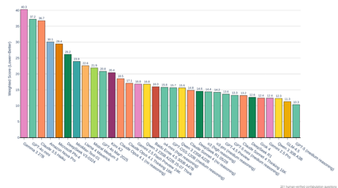
RAG - Traditional vs Agentic RAG
Nowaday people moved from naive simple RAG systems to multi-step or advanced RAG systems
self-reflection & grading - system reviews its own generated answers, checking for mistakes, gaps in reasoning, relevance, or factual errors
Cross-encoders - after using simple vector similarity search (bi-encoder), system uses transformer model or LLM to check the question against the found texts - and re-rank the findings accordingly. This is a slow process.
The Death of Vector Databases https://pub.towardsai.net/the-death-of-vector-databases-how-agentic-rag-is-revolutionizing-information-retrieval-79f0d1f2f118
From Traditional Retrieval-Augmented Generation (RAG) systems, which rely on vector databases to "Agentic RAG" which uses intelligent agents for retrieval.
This shift makes information retrieval more flexible, context-aware, and efficient compared to static, vector-database-centric approaches.
The author suggests that as agentic systems mature, the reliance on standalone vector databases for basic RAG may decline, with agents orchestrating more sophisticated and adaptive information retrieval
1. GLM-4.5 (medium reasoning)
2. Qwen 3.5 30B A3B
3. Gemini 2.5 Pro
4. Grok 4-mini
5. DeepSeek R1
6. GPT-5 Preview
7. Claude Sonnet 4 (medium reasoning)
8. Claude Sonnet R1 (05/29)
9. GPT-4.5 mini (medium reasoning)
10. 03 pro (high reasoning)
11. DeepSeek Sonnet 4 (no reasoning)
12. 03 pro (medium reasoning)
13. DeepSeek R1 (medium reasoning)
14. Qwen 3.5 72B A2N28
15. Qwen 3.5 32B A2N28
16. GPT-4.5 Preview (medium reasoning)
17. Claude Opus 4.1 (Thinking 24K)
18. Gemini 2.5 Flash Preview 24K
18. Gemini 2.5 Flash Preview 24K
19. Baidu ERNIE 4.5-300B
20. 04-mini (high reasoning)
21. Claude 3 Opus
22. Kimi K12
23. GPT-4 Add Mar 2025
24. Gemini 1.5 Flash
25. Llama 3-OpenChat
26. MiniMax Texa-01
27. Mistral Pro
28. Microsoft Phi-4
29. DeepSeek V3.5-MoE
30. Amazon Titan
31. Claude 3 Haiku
32. GPT-4o mini
33. Gemma 2-27B
LLM Confabulation (Hallucination) Leaderboard for RAG score: lower - better - https://github.com/lechmazur/confabulations

Slide 17
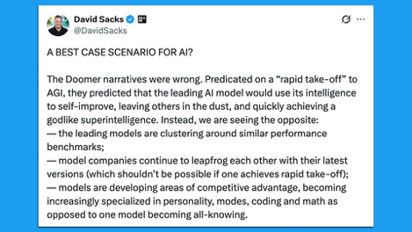
David Sacks - Best Case Scenario For AI?
David Sacks A Best Case Scenario For AI?
https://x.com/DavidSacks/status/1954244614304739360
The Doomer narratives were wrong. Predicated on a “rapid take-off” to AGI, they predicted that the leading AI model would use its intelligence to self-improve, leaving others in the dust, and quickly achieving a godlike superintelligence. Instead, we are seeing the opposite:
the leading models are clustering around similar performance benchmarks;
model companies continue to leapfrog each other with their latest versions (which shouldn’t be possible if one achieves rapid take-off);
models are developing areas of competitive advantage, becoming increasingly specialized in personality, modes, coding and math as opposed to one model becoming all-knowing.
... right now ... we have 5 major American companies vigorously competing on frontier models. “We have many models from many factions that have all converged on similar capabilities, rather than a huge lead between the best model and the rest. So we should expect a balance of power between various human/AI fusions rather than a single dominant AGI that will turn us all into paperclips/pillars of salt.”
So far, we have avoided a monopolistic outcome that vests all power and control in a single entity. In my view, the most likely dystopian outcome with AI is a marriage of corporate and state power similar to what we saw exposed in the Twitter Files, where “Trust & Safety” gets weaponized into government censorship and control. ...
There is likely to be a major role for open source. These models excel at providing 80-90% of the capability at 10-20% of the cost...
There is likely to be a division of labor between generalized foundation models and specific verticalized applications...
There is also an increasingly clear division of labor between humans and AI. AI models are still at zero in terms of setting their own objective function. Models need context, they must be heavily prompted, the output must be verified, and this process must be repeated iteratively to achieve meaningful business value.... AI is not end-to-end but middle-to-middle...
In summary, the latest releases of AI models show that model capabilities are more decentralized than many predicted. The current state of vigorous competition is healthy. It propels innovation forward, helps America win the AI race, and avoids centralized control. This is good news - that the Doomers did not expect.

Slide 18
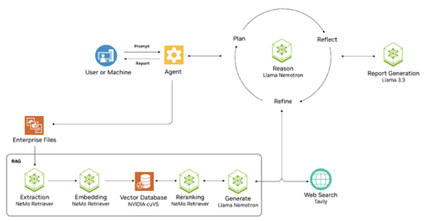
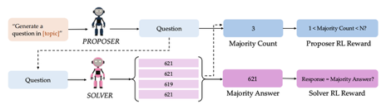

AI Updates - 1
NVIDIA’s AI-Q blueprint architecture
enterprise-grade answers in a secure, high-speed pipeline
multimodal data ingestion and embedding (NeMo Retriever)
RAG, cuVS vector database
agentic reasoning using Nemotron model that iteratively plans, reflects, and refines outputs.
Self-Questioning Language Models
https://www.arxiv.org/abs/2508.03682
Can an AI improve its reasoning abilities by generating and answering its own questions?
Tested a system of two models - a proposer and a solver.
The proposer generates questions for the solver to answer.
They both receive rewards for good questions and answers (similar to how GAN (Generative Adversarial Network) is trained
Using this method, a base language model was able to significantly improve its performance without any new human-labeled data
"America Is Running the Wrong AI Race"
"Winning in AI isn’t about being the first to build the smartest machine. It’s about being the first to scale it wisely - across every school, clinic, factory, and business. It's about turning intelligence into abundance for everyone, not just shareholders" - Alvin Wang Graylin - interview by Peter Diamandis
https://www.youtube.com/watch?v=N4yc7iB08O4

Slide 19








AI Updates - 2
xAI's Grok 4 AI Now Freely Available worldwide
Access to Grok 4 Heavy remains exclusive to SuperGrok Heavy subscribers.
Merge Labs - new Sam Altman's startup
building brain-computer interface (BCI) to rival Elon Musk’s Neuralink
Merge Labs is seeking $250 Mln at $850 Mln valuation
Alex Blania—the CEO of Tools for Humanity (formerly World) is a key co-founder and is expected to lead day-to-day operations
Cohere raises $500M at $6.8B Valuation;
Joelle Pineau, former lead of META FAIR, joins as Chief AI Officer
xAI Co-Founder Igor Babuschkin is leaving xAI to launch his own venture capital firm, Babuschkin Ventures, which he says will support AI safety research and back startups that "advance humanity and unlock the mysteries of our universe."
NVIDIA Innovations at SIGGRAPH 2025 in Vancouver
Neural rendering, 3D generation, simulation, reasoning models for physical AI. Highlights included new Omniverse NuRec libraries for large-scale reconstruction, Cosmos Reason VLM for physics-aware reasoning, and updates to the Metropolis vision AI platform.
NVIDIA Cosmos AI models for Robotics - Cosmos Reason 7B vision-language model, Cosmos Transfer-2 for synthetic data generation, 3D simulation libraries, CARLA integration, Omniverse SDK updates, new RTX Pro servers for unified robotics development
Tiny models for fine-tuning, instruction following, ultra-low power, embedding:
Spanish AI startup Multiverse:
Multiverse SuperFly 94M
Multiverse ChickBrain 3.2B
https://finance.yahoo.com/news/buzzy-ai-startup-multiverse-creates-150000130.html
https://multiversecomputing.com
Google Gemma 3 270M
https://developers.googleblog.com/en/introducing-gemma-3-270m/
Void - open-source Cursor alternative
https://github.com/voideditor/void

Slide 20
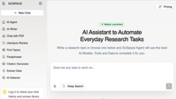

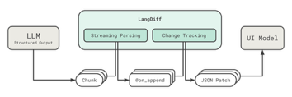

AI Updates - 3
Google LangExtract
open-source Python library for converting large volumes of unstructured text into consistent, structured data
Use for literary analysis, clinical notes, financial reports, or technical docs
Define a prompt and few-shot examples to enforce the desired schema. Long-document optimization using chunking, parallel processing, and multiple passes.
Interactive HTML visualization to highlight and review extracted entities in context
https://github.com/google/langextract
SciSpace Agent - an AI Co-Scientist, combines 150+ academic tools and 59 databases in one platform. With a single prompt, it reads literature, analyzes data, and drafts papers, cutting 90% of research time and accelerating your path from hypothesis to discovery.
https://scispace.com
LangDiff: Progressive UI from LLM
Open-source Python library to stream structured LLM outputs to frontends
https://github.com/globalaiplatform/langdiff
Deep Agent from Abacus AI
dynamically create and orchestrate multiple specialized agents, MCP communication, Automated Discovery of Tools, Systems, Platforms, Prompt-driven, clarification dialogue; Agents adapt to changes
Real-World Workflow Examples:
Creating entire CRMs or marketing pipeline
Generating/editing high-res. charts, PDFs, reports
Instantly syncing platforms like Jira and Slack, or Notion and task trackers (no manual mapping)
Building a social media management system that automates content scheduling, caption generation, and hashtag discovery
Geoffrey Hinton argues we should engineer “maternal instincts” into the AI systems - so they genuinely care about human wellbeing even as they become more powerful. While he admits that technically achieving this is unclear, he insists it’s the only viable path to prevent AI from replacing us

Slide 21



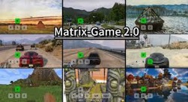




AI Updates - 4
Claude Sonnet 4 - 1 Mln token context window in beta, at a higher price:
≤ 200K: $3/$15 /MTok in/out
> 200K: $6/$22.5 /MTok in/out
Gemini "Personal Context" - remembers previous chats (personalization) unless you use "Temporary" chat
Perplexity’s video generation tool on smart phones - for Pro and Max subscribers - low monthly quotas
Skywork’s Matrix Game 2.0 - open-source real-time interactive world model (similar to Google's Genie 3)
Use keyboard and mouse prompts to generate long, high-fidelity, and physically realistic video sequences at 25 fps - for gaming.
Users can explore, manipulate, and construct virtual environments. Applications in game engines, embodied AI, and virtual humans. The model is 1.3B parameters and runs at real time on one GPU.
OpenAI achieved "gold" level at the International Olympiad in Informatics (IOI) scoring above 325 out of 330 human participants
Leopold Aschenbrenner $1.5B Hedge Fund
ex-OpenAI researcher, approx 23 y.old, raised $1.5B for a hedge fund ("Brain Trust on AI"), applying his "situational awareness" paper insights to investments.
The fund is up 47% after fees in the first half of the year, investing in AI-relevant stocks and shorting industries likely to fall behind.
Leopold is very young (born in 2001 or 2002 ?)
Microsoft Magentic-UI - “Human-AI collaboration improved task accuracy by 71% compared to autonomous systems
https://www.microsoft.com/en-us/research/blog/magentic-ui-an-experimental-human-centered-web-agent/
Mistral AI released Medium 3.1
128K context window, estimated 40B .. 70B params
better (creative) writing, smarter searches, better reasoning
Available via API and enterprise/commercial licensing

Slide 22


Humanloop
Humanloop - acquired by Anthropic
https://humanloop.com
Humanloop is named to evoke the idea of "human in the loop"
Humanloop is a collaborative enterprise platform for building, testing, and rigorously evaluating LLM applications (including RAG)
Humanloop links user feedback, ground-truth data, and real-world performance in deployed AI systems, making it enterprise-ready and reliable
It provides an integrated environment for managing prompts, embeddings, retrieval tools, and language models.
You can create, test, and automatically evaluate RAG pipelines with sets of queries and measure quality using human, coded, or AI-based evaluators
Humanloop allows product managers, engineers, and subject-matter experts to collaborate on LLM projects - managing data sources, prompt versions, retrievers, and feedback in a single place.
Lets you connect LLMs to APIs or functions (e.g., run a Google Search or call a weather API) seamlessly in your pipeline
Human-in-the-Loop: Key judgments and iterative refinements can involve humans at any step, to correct, score, or direct the system - something plain RAG pipelines or search don’t offer.

Slide 23

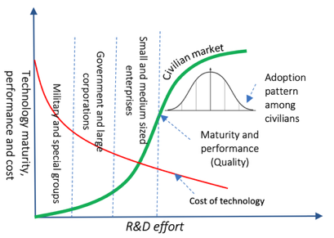
AI Adoption Progress
5-year cycle that repeats itself again and again:
Step 1: Skepticism (Year 1-2)
“That’s just a fad.”
“This isn’t real engineering.”
“We don’t need this where I work.”
Step 2: Slow Adoption (Year 3-4)
A few forward-thinking engineers start learning and applying it.
Companies begin testing it internally.
The first high-paying jobs emerge.
Step 3: Mass Adoption (Year 5+)
Companies require it in job descriptions.
Engineers who learned early are in high demand.
Everyone else is playing catch-up.
This happened with:
Cloud Computing (2010s)
DevOps & Automation (2015-2020)
AI in Software Engineering (Now) - we are between step 1 and 2
Credit to newline team
https://sendy.fullstack.io/w/nwcZcxBg8cjO0bPpSmjx0A/8924UeZ6gL8ZGppw4ViBRQ6Q/sidcYyHMjwn8tu8NDumsaA

Slide 24
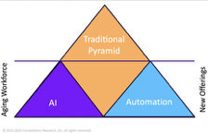
AI is disrupting the Big Four
AI allows smaller firms and in-house teams to access analysis previously only available from the Big Four. Boutique firms are winning more business and attracting Big Four talent.
Prices of services went down 50%. Hour-based pricing is shifting to outcome-based pricing.
Each firm has built proprietary AI platforms and invest into AI heavily.
KPMG announced $2B over five years targeting $12B in added revenue.
AI assurance and auditing AI systems themselves could become significant revenue streams, especially with regulations like the EU AI Act.
AI is disrupting the Big Four consulting firms
Deloitte - Deloitte Touche Tohmatsu Limited
PwC - PricewaterhouseCoopers
EY - Ernst & Young
KPMG - Klynveld Peat Marwick Goerdeler
The Big Four historically dominated through a pyramid model of billable hours. As AI is automating core functions, graduate hiring dropped 44% in 2024, with some firms cutting cohorts by 30%.
Structured, data-heavy work like audit, tax compliance, due diligence, and forensics are being automated rapidly.
Industry experts predict 50% of roles in these areas could be eliminated within 3-5 years, with AI solutions already capable of handling 90% of audit processes.
AI Examples:
KPMG scans millions of accounting entries with AI
EY's AI helps 80K tax professionals hande 3+ Mln cases annually
Deloitte launched Zora AI for automated processing
Firms are shifting from large graduate intakes doing repetitive work to a "diamond model" with fewer entry-level roles, more mid-career technical experts who can manage AI outputs and handle exceptions.
Three Critical New Roles:
Controls Engineers: Make AI safe and auditable
Domain Translators: Convert business problems into AI solutions and back to actionable insights
Exception Handlers: Investigate and resolve AI-flagged anomalies
So, complete collapse of big four is unlikely given their capital and entrenchment, but the old operating model is dying.
In the next 5 years expect diamond-shaped organizations with fewer total employees but more AI engineers and hybrid operators.
Winners will need to move fast on pricing models, measure AI impact, build reusable AI components, and treat AI as a teammate rather than a threat.
The fundamental question isn't whether AI will change the Big Four - it already has. The question is whether they can reinvent fast enough to maintain their market position against more agile, tech-enabled competitors
credit - summarized from "Oli's AI Dispatch"

Slide 25

René Descartes and AI
René Descartes and AI
A 17th-century philosopher René Descartes has created a method of breaking big problems into smaller, manageable pieces - which is exactly how AI systems work today
He emphasized using pure logic and reason, which became the foundation for how AI programs think
Descartes said that humans have minds (which think) separate from bodies (which are physical). He believed real thinking requires consciousness and self-awareness
This creates a challenge for AI: even very smart AI systems might just be copying thinking patterns without actually understanding anything, like a very sophisticated calculator
https://en.wikipedia.org/wiki/Ren%C3%A9_Descartes
René Descartes (1596 - 1650)
a French philosopher, scientist, and mathematician.
Cartesian coordinate system is named after him.
Descartes is also credited as the father of analytic geometry
He has often been called the father of modern philosophy.
His best known philosophical statement is:"cogito, ergo sum" ("I think, therefore I am")

Slide 26
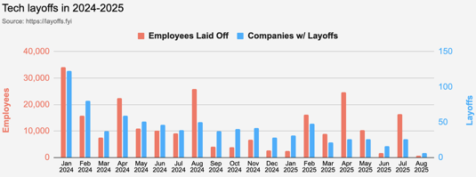
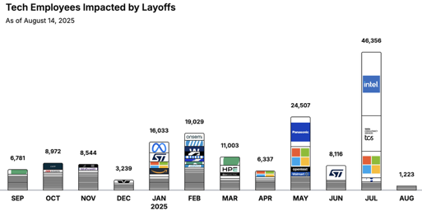
Jobs
https://layoffs.fyi
https://trueup.io/layoffs
"Don't fear AI replacement, embrace AI augmentation"
-- Eric Schmidt
Tech Layoffs in 2025: 80,945 people
(as of August 14, 2025)
Compared to 152,922 people in 2024,
264,220 people in 2023, and
165,269 people in 2022
https://layoffs

Slide 27


About the Speaker
Lev Selector, Ph.D.
40+ years of software engineering, data science, and building teams (hiring, training, and managing)
Ph.D. in mathematical modeling and computer simulations
Interests:
Generative AI, Using LLM with your data
Local AI for Local Private Data
Cloud architecture, fin-tech, application security
Find/connect: Linkedin, GitHub, YouTube, Google
https://eais.ai
Enterprise AI Systems

Slide 28
Thank You!

