Slide 1
AI Updates - September 05, 2025
Some learn Python.
Others learn JavaScript or Rust.
He learns AI — and finishes first.
Crowd-sourced "LM Arena" Leaderboard
Nvidia Jet-Nemotron and Nemotron Nano
Google MAD (Max Adaptive Degree)
LLMs as Judges
Google’s LangExtract with Gemma via Ollama
State of AI in Business 2025 Report
1B+ people now use AI chatbots regularly
AI-powered stethoscope
Salesforce Cuts 4,000 Jobs Due to AI Agents
AI Tool Predicts Hereditary Disease Risk
Switzerland "Apertus" National Model
US Government buys 10% of Intel ($8.9B)
NVIDIA Omniverse and Cosmos robotics tools
Anthropic raises $13B Series F at $183B valuation
Lovable - $100M ARR in 8 months
OpenAI acquires Statsig for $1.1B
OpenAI acquires Alex coding assistant for Xcode
Meituan’s LongCat‑Flash‑Chat open-source LLM
Google Jules 2.0 Coding Agent
Blackrock Build AI Agents for Stock Picking
Make Claude Code a Genius with Prompts
GPT-5 Prompt Leaked
Mistral $14B valuation, makes Enterprise AI Free
Automating Browser with Selenium & Playwright
The 100 Most Influential People in AI
GitIngest
The Top 100 [Gen AI] Consumer Apps
RAG, MCP
AI for Podcast Process/Create
AI Hits Entry-Level Jobs Hardest
Cloudflare runs more AI on fewer GPUs
Microsoft VibeVoice open-source text-to-speech
Apple FastVLM and MobileCLIP2 VLMs
Weaviate 8-bit Rotational Quantization
AI helps paralyzed patients control robots
Base44, Bolt.new, Lovable
Jobs, Layoffs

Slide 2
Crowd-sourced "LM Arena" Leaderboard
https://lmarena.ai/?leaderboard
Starting Elo rating = 1000
https://en.wikipedia.org/wiki/Elo_rating_system
English - https://lmarena.ai/leaderboard/text
Coding - https://lmarena.ai/leaderboard/text/coding
LM Arena secures $100M to expand AI benchmarking (at $600M valuation)
Model | Score
gemini-2.5-pro | 1456
gpt-5-high | 1447
claude-opus-4-1-20250805-thinking-16k | 1447
o3-2025-04-16 | 1444
chatgpt-4o-latest-20250326 | 1443
gpt-4.5-preview-2025-02-27 | 1439
claude-opus-4-1-20250805 | 1436
gpt-5-chat | 1426
grok-4-0709 | 1422
kimi-k2-0711-preview | 1421
deepseek-v3.1 | 1419
claude-opus-4-20250514-thinking-16k | 1419
qwen3-235b-a22b-instruct-2507 | 1419
deepseek-r1-0528 | 1417
deepseek-v3.1-thinking | 1415
mistral-medium-2508 | 1412
glm-4.5 | 1410
claude-opus-4-20250514 | 1410
gpt-4.1-2025-04-14 | 1409
grok-3-preview-02-24 | 1409
gemini-2.5-flash | 1406
mai-1-preview | 1399
Model | Score
claude-opus-4-1-20250805-thinking-16k | 1504
claude-opus-4-1-20250805 | 1494
claude-opus-4-20250514-thinking-16k | 1478
qwen3-235b-a22b-instruct-2507 | 1474
gemini-2.5-pro | 1472
gpt-5-high | 1471
chatgpt-4o-latest-20250326 | 1470
o3-2025-04-16 | 1467
mistral-medium-2508 | 1459
qwen-vl-max-2025-08-13 | 1444
claude-sonnet-4-20250514-thinking-32k | 1461
gpt-4.5-preview-2025-02-27 | 1459
kimi-k2-0711-preview | 1458
gpt-5-chat | 1458
deepseek-r1-0528 | 1456
deepseek-v3.1 | 1453
glm-4.5 | 1453
claude-opus-4-20250514 | 1454
deepseek-v3.1-thinking | 1444
qwen3-235b-a22b-thinking-2507 | 1448
gpt-4.1-2025-04-14 | 1444
grok-4-0709 | 1442
China
Grok 4 Benchmarks
https://artificialanalysis.ai/models/grok-4
https://lmarena.ai/leaderboard/text
https://web.lmarena.ai/leaderboard
https://openlm.ai/chatbot-arena/
https://beta.lmarena.ai
Web Leaderboard https://web.lmarena.ai/leaderboard
LLM Leaderboard - by @LlmStats https://llmworld.net/llm_leaderboards/
LLM Leaderboard - by StackAI https://www.stack-ai.com/llm-leaderboard
LLM Leaderboard - by Artificial Analysis https://artificialanalysis.ai/leaderboards/models
Open LLM Leaderboard - by Hugging Face https://huggingface.co/open-llm-leaderboard
LLM Leaderboard - by Vellum https://www.vellum.ai/llm-leaderboard
AI Benchmarking Hub https://epoch.ai/data/ai-benchmarking-dashboard
x.ai
Mistral
China
China
China
China
China
China
China
China
Mistral
China
China
China
China
x.ai
China
Microsoft
x.ai

Slide 3

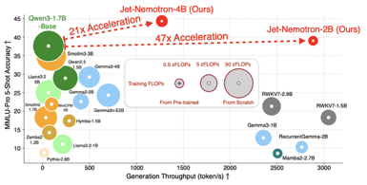

Nvidia Jet-Nemotron and Nemotron Nano
Nvidia Jet-Nemotron and Nemotron Nano
Jet-Nemotron is a newer hybrid-architecture LLM series, specifically engineered for extreme inference speed and resource efficiency by employing a combination of full-attention and novel JetBlock linear attention modules; available in very small sizes (2B and 4B params) and are 53x faster than previous models; Core innovations include the PostNAS pipeline (post-training architecture search) and JetBlock technology https://arxiv.org/abs/2508.15884
Nemotron Nano (notably, the Nano 2 9B model) is part of the original Nemotron family and leverages a hybrid Transformer-Mamba backbone; most full-attention layers are replaced by efficient Mamba-2 state space modules for speed and edge hardware suitability; Nemotron Nano models are generally larger than Jet-Nemotron (e.g., Nano 2 is 9B), achieving strong throughput (up to 6x faster than alternatives) but not matching the Jet-Nemotron’s headline throughput in small model regimes
Both series focus on hy Nemotron Nano leverages Mamba-2 blocks, while Jet-Nemotron uses JetBlock and a hardware-aware architecture search for even greater efficiency in smaller models
Jet-Nemotron retrofits existing pre-trained Transformer models by freezing MLP weights and systematically replacing most full-attention layers with JetBlock linear attention blocks
Strategic retention of some full-attention layers ensures high accuracy for complex reasoning and retrieval tasks
The majority of computation is handled by efficient linear or dynamic JetBlock designs - this reduces memory (especially KV cache size) and compute requirements, allowing much faster inference

Slide 4
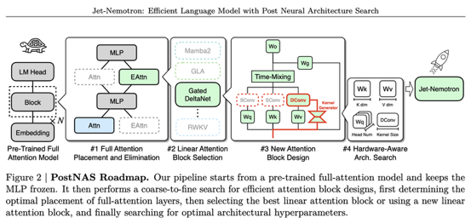
Nvidia Jet-Nemotron and Nemotron Nano
Nvidia Jet-Nemotron and Nemotron Nano
Jet-Nemotron is a newer hybrid-architecture LLM series, specifically engineered for extreme inference speed (53x) and resource efficiency. Available in 2B & 4B params sizes, but same technology can be used in bigger models
The model is trained normally. Then the MLP weights are frozen, but attention is optimized using PostNAS pipeline (post-training architecture search) where most of full-attention blocked are substituted with JetBlock linear attention blocks - https://arxiv.org/abs/2508.15884
Nemotron Nano (notably, the Nano 2 9B model) is part of the original Nemotron family and leverages a hybrid Transformer-Mamba backbone; most full-attention layers are replaced by efficient Mamba-2 state space modules for speed and edge hardware suitability; Nemotron Nano models are generally larger than Jet-Nemotron (e.g., Nano 2 is 9B), achieving strong throughput (up to 6x faster than alternatives) but not matching the Jet-Nemotron’s headline throughput in small model regimes
Both series focus on hy Nemotron Nano leverages Mamba-2 blocks, while Jet-Nemotron uses JetBlock and a hardware-aware architecture search for even greater efficiency in smaller models

Slide 5

Google MAD (Max Adaptive Degree)
Google MAD (Max Adaptive Degree)
Privacy-preserving algorithm developed by Google and MIT for detecting subtle online trends without exposing individual user data
https://www.youtube.com/watch?v=rREARu5U184
Challenge - discovering important rare phrases, niche topics, or early trends in massive datasets without accidentally revealing unique user queries or activities
Every data item starts with equal weight. When an item's score is far above the privacy threshold, MAD trims excess weight off that item and rerouts to underrepresented, smaller items—amplifying quieter signals; The system then fine-tunes the balance, adds Gaussian noise for privacy, and produces a result set of interesting items
Think of the old system as a traffic jam: popular "lanes" get clogged while less-traveled "lanes" barely move. MAD dynamically shifts "traffic" (data weight) to underutilized lanes so new, rare signals get visibility without compromising anyone's privacy.
MAD2R - advanced version, runs the process in two rounds. First yields a rough sketch of trends using noisy data, then refines the output by focusing the algorithm on promising trends, further improving accuracy
The algorithm was tested on nine massive datasets (including Reddit, IMDb, Twitter, Wikipedia, Amazon, and Common Crawl).
MAD2R outperformed previous privacy-preserving methods on most benchmarks, surfacing significantly more unique items from large pools of data
Nvidia Jet-Nemotron and Nemotron Nano
Jet-Nemotron is a newer hybrid-architecture LLM series, specifically engineered for extreme inference speed and resource efficiency by employing a combination of full-attention and novel JetBlock linear attention modules; available in very small sizes (2B and 4B params) and are 53x faster than previous models; Core innovations include the PostNAS pipeline (post-training architecture search) and JetBlock technology https://arxiv.org/abs/2508.15884
Nemotron Nano (notably, the Nano 2 9B model) is part of the original Nemotron family and leverages a hybrid Transformer-Mamba backbone; most full-attention layers are replaced by efficient Mamba-2 state space modules for speed and edge hardware suitability; Nemotron Nano models are generally larger than Jet-Nemotron (e.g., Nano 2 is 9B), achieving strong throughput (up to 6x faster than alternatives) but not matching the Jet-Nemotron’s headline throughput in small model regimes
Both series focus on hy Nemotron Nano leverages Mamba-2 blocks, while Jet-Nemotron uses JetBlock and a hardware-aware architecture search for even greater efficiency in smaller models

Slide 6
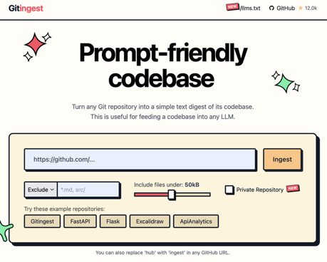
AI Updates 1
LLMs as Judges
https://huggingface.co/papers/2508.18076
The paper critiques the use of large language models as judges for evaluating natural language generation systems, questioning their reliability, capabilities, scalability, and cost-effectiveness.
Using Google’s LangExtract with Gemma via Ollama
https://towardsdatascience.com/using-googles-langextract-and-gemma-for-structured-data-extraction/
State of AI in Business 2025 Report
https://mlq.ai/media/quarterly_decks/v0.1_State_of_AI_in_Business_2025_Report.pdf
1B+ people now use AI chatbots regularly
Recent releases have given even unpaid users access to the most powerful models like GPT-5 or nano banana.
AI will only get cheaper and more abundant
Institutions of every size face the chaos of a billion people wielding AI that outperforms humans at intellectual tasks
https://www.oneusefulthing.org/p/mass-intelligence
The 100 Most Influential People in AI
https://time.com/collections/time100-ai-2025/
GitIngest
https://gitingest.com
The Top 100 [Gen AI] Consumer Apps
https://a16z.com/100-gen-ai-apps-5/

Slide 7
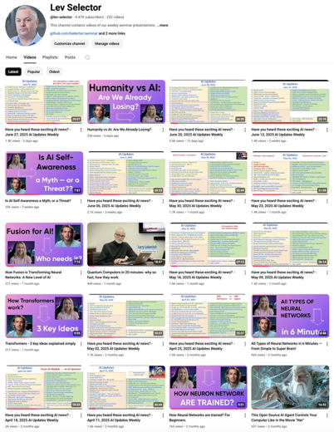
Please pause the video - and answer the pinned question in comments under the video
Subscribe to this channel
https://www.youtube.com/@lev-selector
Get notified about new videos - every Friday, links to slides under the videos

Slide 8
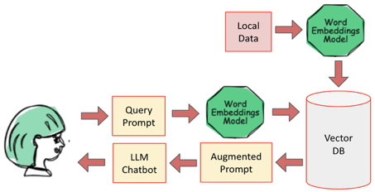

RAG = Retrieval Augmented Generation
Original paper: Retrieval-Augmented Generation for Knowledge-Intensive NLP Tasks - https://arxiv.org/abs/2005.11401
Interview with Douwe Kiela - https://www.youtube.com/watch?v=PubPPPG6uJk
Douwe Kiela is the inventor of Retrieval Augmented Generation (RAG). He was a research scientist at FAIR (Facebook AI Research, now Meta AI) at the time and co-authored the original paper on the topic.

Slide 9
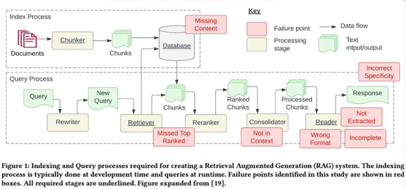
Advance RAG - Improve RAG performance
https://luv-bansal.medium.com/advance-rag-improve-rag-performance-208ffad5bb6a
Seven Failure Points When Engineering a Retrieval Augmented Generation System (January 2024)
https://arxiv.org/pdf/2401.05856.pdf
A Practical Guide to RAG Pipeline Evaluation (Part 1 & 2)
https://medium.com/@yisz
https://medium.com/relari/a-practical-guide-to-rag-pipeline-evaluation-part-1-27a472b09893
https://medium.com/relari/a-practical-guide-to-rag-evaluation-part-2-generation-c79b1bde0f5d
https://github.com/relari-ai/continuous-eval

Slide 10


Make RAG Better
LLM Agent Classifier,
may ask to refine question
LLM Agent question
rewriter,
embedding
One problem with RAG is that the questions and answers don't have to be semantically similar.
One way of solving it - search in the space of "exam" questions.
Text vector indexing:
split text into text chunks,
generate embedding vectors from those text chunks,
index them as (vector_from_text, text)
Question vector indexing:
split text into big chunks - chapters.
for each chapter generate multiple "exam" questions
generate embedding vectors from questions
index them as (vector_from_question, text)
You can also use hybrid approach using both methods together
Request
LLM Agent summarizer
LLM Agent semantic re-runking
Response
Semantic re-runking:
Send tuple (question, chunk of text) to LLM ask it to rank the relevancy of the text to the question
If your search found 10 text chunks - you can make 10 separate queries (in parallel) to LLM, get 10 ranks - and sort them to select the best match
Some good techniques to use:
classification step
query expansion
re-ranking
prompt engineering
tool use
Multi-Agent Systems:
Multiple agents can be used for query understanding, retriever, ranker, reader, orchestrator; Can mitigate single-agent RAG's relevance, scalability, and latency limitations
Multiple frameworks available (LangChain, Microsoft AutoGen, LLamaIndex, ...)

Slide 11
MCP Server (RAG) for your docs
You do not need to write your own RAG system. There are many pre-built open-source systems on GitHub.
Even better - you can use a system which exposes data as MCP server
Docs MCP Server - It indexes 3rd party documentation from various sources (websites, GitHub, npm, PyPI, local files) and offers powerful, version-aware search tools via the Model Context Protocol (MCP). https://github.com/arabold/docs-mcp-server
In VSCode or PyCharm, add to your MCP JSON config:
{
"mcpServers": {
"docs-mcp-server": {
"type": "http",
"url": "http://localhost:6280/mcp"
}
}
}
Docs MCP Server implements RAG using custom "semantic splitter", generating embeddings, and storing them in an SQLite database with the sqlite-vec extension for vector search. Traditional full-text search is also implemented via SQLite FTS5
The server crawls and processes documentation from sources such as local files (Markdown, HTML, text), websites, GitHub, npm, PyPI, etc.
Note: Popular Context7 MCP server implementation (distributed as @upstash/context7-mcp - https://github.com/upstash/context7 ), not the arabold/docs-mcp-server itself, but the underlying design, goals, and protocol compatibility are almost identical

Slide 12
Evaluate/Improve RAG
Typical problems:
Bad retrieval:
low precision, not relevant data, hallucination, lost in the middle
low recall, not all relevant data retrieved, so not enough data to synthesize and answer
redundant or outdated data
Bad Response Generation:
Hallucination, Irrelevance, Toxicity/Bias
How to improve?
Store additional information, multi-model data store like Activeloop's Deep Lake
Embeddings - make them better
Retrieval - make better using Activeloop's Deep Memory
Synthesis - use LLMs for more than generation
Evaluate RAG:
e2e (End-to-end) or evaluate separately retrieval and synthesis.
retrieval - precision & recall
synthesis - labeled (accuracy), non-labeled ( faithfulness, relevancy, adheres to guidelines, toxicity-free)
There are multiple ready-to-use tools to evaluate RAG systems:
RAGAS (Retrieval-Augmented Generation Assessment Suite) https://github.com/explodinggradients/ragas
Open RAG Eval https://www.vectara.com/blog/introducing-open-rag-eval-the-open-source-framework-for-comparing-rag-solutions
RAGChecker https://www.deepchecks.com/best-rag-evaluation-tools/
LlamaIndex evaluation modules https://www.deepchecks.com/best-rag-evaluation-tools/
REMi & nuclia-eval https://nuclia.com/developers/remi-open-source-rag-evaluation-model/
DeepEval https://dev.to/guybuildingai/-top-5-open-source-llm-evaluation-frameworks-in-2024-98m
R-Eval https://www.deepchecks.com/best-rag-evaluation-tools/

Slide 13
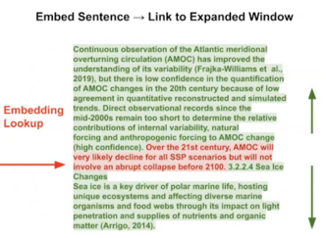
RAG - Advanced - activeloop.ai
https://www.youtube.com/watch?v=TdjvzSpjBuI
Better Parsers, Chunk Sizes, Hybrid Search, Metadata Filters
Deep Memory, Reranking
Recursive Retrieval, Embedded Tables, Small-to-Big Retrieval
Agents, Multi-agents, routing, query planning, multi-document agents
Embedding Fine-tuning & LLM Fine-tuning
Pain Point | Solutions
Retrieval is bad | Deep Memory Adjusting chunk sizes / parsers Reranking Small-to-big retrieval Fine-tuning Embeddings
Handling structured/unstructured data | Metadata Filters Augmenting SQL with semantic search
Parsing embedded tables in PDFs | Recursive Retrieval
Handling Complex Questions | Routing Query Planning Multi-Document Agents
Deep Memory - a set of tools offered by Activeloop.ai
https://docs.activeloop.ai/example-code/tutorials/vector-store/improving-search-accuracy-using-deep-memory
Deep Memory a tiny neural network, it analyzes your data and computes a tailored transformation for your embeddings, placing embeddings in an optimized space, significantly improving the accuracy of vector search (up to 22% increase in accuracy).
Small-to-big retrieval - embed sentence, return with text before and after (implemented in LlamaIndex)

Slide 14






GraphRAG, Other Graph RAG Systems
Microsoft GraphRAG - uses LLM to create knowledge graph as a GNN (Graph Neural Network). GNN is used to both embedding the knowledge into the graph (as numeric embedding vectors) and to identify key information (ranked retrieval).
https://www.microsoft.com/en-us/research/blog/graphrag-unlocking-llm-discovery-on-narrative-private-data/
Neo4j - graph database - https://neo4j.com .. https://www.youtube.com/watch?v=ftlZ0oeXYRE - Neo4j RAG .. https://www.youtube.com/watch?v=jMKRUo4wVKA - Neo4j RAG .. https://www.youtube.com/watch?v=DuUtzRYbpNM - Neo4j in 10 min .. https://medium.com/singapore-gds/from-conventional-rag-to-graph-rag-a0202a1aaca7
Amazon Neptune - fully managed graph database - https://aws.amazon.com/neptune/
Stardog - enterprise knowledge graph platform - https://www.stardog.com
Ontotext GraphDB - an RDF database, great for semantic search. RDF = Resource Description Framework, stores information as graph of tripples (subject, predicate (property or relationship), object) - https://www.ontotext.com/products/graphdb/
NebulaGraph - Graph RAG https://www.nebula-graph.io/posts/graph-RAG
Graph Engine Service (GES) on Huawei Cloud - distributed high scale graph DB - https://www.huaweicloud.com/intl/en-us/product/ges.html

Slide 15
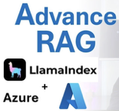
Advanced RAG
Advanced RAG with Azure AI Search and LlamaIndex
https://techcommunity.microsoft.com/t5/ai-azure-ai-services-blog/advanced-rag-with-azure-ai-search-and-llamaindex/ba-p/4115007
Using LlamaIndex and Azure AI Search (OpenAI embedding and LLM models, AzureAISearchVectorStore using Lucene).
Using pre-retrieval and post-retrieval steps.
Generating multiple questions from original question, and running multiple retrievals.
10 techniques to improve RAG accuracy
Hybrid search - Combining exact keyword matching with semantic vector search
tuning the internal structure of your vector index by developing denser HNSW (Hierarchical Navigable Small World) search graphs
Chunking & parsing optimization - by sentence, paragraph, or semantically coherent sections
Fine-tune your embeddings using contrastive learning or domain-specific corpora
Fine-tune the LLM
Semantic caching - allows you to preload high-confidence answers
Long-term memory (multi-turn dialogue or long-running interactions)
Query transformation / reformulation / enriching
LLM as judge
Re-ranking

Slide 16
Advanced RAG - 2
RAG ("context engineering"):
Core Philosophy: "RAG is Dead, Context Engineering is King"
from crude "dump everything into context" to sophisticated context curation focused on "what should be in the context window" at each generation step.
The 5 Key Retrieval Tips:
Don't ship "RAG." Ship retrieval - Name the primitives (dense, lexical, filters, re-rank, assembly, eval loop)
Win the first stage with hybrid recall - 200-300 candidates is fine since LLMs can read much more than humans
Always re-rank before you assemble context - Use LLMs as re-rankers to go from ~300 candidates down to ~20-40
Respect context rot - Tight, structured contexts beat maximal windows (models perform worse as token count increases)
Invest in creating a small gold set - Buy pizza, create evaluation datasets, wire them into CI and dashboards
The Recommended Architecture:
[Ingest] → Parse + chunk → Enrich with metadata → Embeddings + sparse signals → Write to DB
[Query] → First-stage hybrid search → ~100-300 candidates → Re-rank to top ~20-40 → Context assembly
[Outer loop] → Cache/cost guardrails → Generative benchmarking → Error analysis → Memory/compaction
Key Insights:
Context rot is real: Model performance degrades significantly as context length increases, regardless of marketing claims about perfect needle-in-haystack performance
LLMs as re-rankers: Use LLMs themselves for re-ranking rather than specialized re-ranking models - this is becoming the dominant paradigm
Quality over quantity: A tight, well-curated context of 20-40 chunks beats stuffing the entire context window
Evaluation is critical: Create small golden datasets of query-chunk pairs to quantitatively measure improvements
The overarching theme is treating context engineering as a high-status engineering discipline focused on precision and measurable improvement rather than naive "throw everything at the model" approaches.

Slide 17
RAG Misc
contextual.ai - startup - https://contextual.ai
building foundation models to run on your stack
customizable, trustworthy, privacy-aware AI
secure by default
RAG 2.0 - https://contextual.ai/introducing-rag2/
A typical RAG is a "Frankenstein’s monster" using:
a frozen off-the-shelf model for embeddings
a vector database for retrieval
a black-box LLM for generation
The RAG 2.0 approach pretrains, fine-tunes, and aligns all components as a single integrated system, backpropagating through both the language model and the retriever to maximize performance
https://pub.towardsai.net/rag-2-0-finally-getting-rag-right-f74d0194a720
rerankers provide a simple API for all popular rerankers
https://github.com/AnswerDotAI/rerankers/
Initial retrieval in a RAG system is usually done using vector similarity. It is fast and cheap, but not good quality.
The retrieved docs are scored for relevancy - and sorted based on scores. The top of the prioritized list is fed to LLM.
There are multiple ways to do the scoring.
Cross-Encoders (specifically trained Neural Networks) are good. You can also use feature-based ML methods. Or even an LLM.
Agentic RAG - https://cobusgreyling.medium.com/agentic-rag-context-augmented-openai-agents-578e96212bc0
Designing RAG - https://towardsdatascience.com/designing-rags-dbb9a7c1d729
RAG using Knowledge Graph - https://pub.towardsai.net/how-to-do-rag-without-vector-databases-45fd4f6ced06
RAG with Knowledge Graph - https://medium.com/@rajib76.gcp/rag-recipe-needs-a-knowledge-graph-feb263bdcb62
Mastering RAG: How to Select A Reranking Model
https://www.rungalileo.io/blog/mastering-rag-how-to-select-a-reranking-model
Advanced Chunking
https://www.rungalileo.io/blog/mastering-rag-advanced-chunking-techniques-for-llm-applications
GPT-5 Mini - speed, intelligence, memory (300 pages), low cost
https://medium.com/@Micheal-Lanham/gpt-5-mini-just-changed-the-rag-game-forever-e50944297799

Slide 18

AI for Podcast Process/Create
Tom operates entirely in the terminal for speed and low latency, using tools like Claude Code for rapid modifications.
Initially tried to keep everything local using Ollama and Stanford NLP libraries, but shifted to more powerful cloud models for better named entity extraction.
Despite fine-tuning models and providing 2,000 blog posts as context, Tom acknowledges that AI still struggles to perfectly capture his writing voice and linking patterns.
Individuals can now build custom tools that fit their exact workflows - something that wasn't economically feasible before generative AI
AI can be very effective as a writing assistant for feedback and iteration rather than wholesale content generation.
The system exemplifies how AI can augment human capabilities while maintaining editorial control and personal voice in the final output.
https://www.youtube.com/watch?v=8P7v1lgl-1s
Tomasz Tunguz - AI-Powered Podcast Processing System
"Parakeet podcast processor" to stay on top of 36 podcasts/week
Daily Processing Pipeline:
Downloads podcast files automatically each day
Transcribes audio using Nvidia's Parakeet (previously OpenAI's Whisper)
Cleans transcripts using Gemma 3 to remove filler words while preserving technical content
Stores processed files in a local DuckDB database
Generate daily summaries containing Host and guest info and summaries, Key quotes, Actionable investment theses for venture capital opportunities, Company mentions that might warrant further research, Twitter post suggestions, Blog post prompts in Tom's writing style
Blog Post Generation Workflow:
Use AI to generate blog post drafts
Use an "AP English teacher" grading system
Three rounds of self-critique until reaching an A- grade
Focus on improving hooks, transitions, and conclusions
Maintain his preferred style: 500 words or less, no section headers, flowing paragraphs with max two sentences each
Claire Vo Tomasz Tunguz

Slide 19

AI Updates 2
AI Hits Entry-Level Jobs Hardest
Stanford study - 13% drop in employment for early-career workers in AI-exposed fields since 2022, especially in software engineering and customer service
Younger workers are more vulnerable as their skills often overlap with what AI like ChatGPT can do. Older employees fare better due to experience-based knowledge.ple in AI
https://time.com/collections/time100-ai-2025/
How Cloudflare runs more AI models on fewer GPUs
Omni is Cloudflare’s internal platform for efficiently running and managing multiple (small) AI models on a single machine and GPU using lightweight isolation techniques.
Omni is a control plane and runtime system that allows Cloudflare to spawn, orchestrate, and manage multiple AI models on their edge network nodes.
Its purpose is to fully maximize GPU usage by allowing multiple small or low-volume models to share GPU resources, minimizing idle capacity and improving overall system efficiency.
Note: Cloudflare is public technology company with over 4K employees, ~ $1.7B annual revenue, ~$75B Market Cap
Cloudflare is a big CDN (Content Delivery Network) with many useful services
https://blog.cloudflare.com/how-cloudflare-runs-more-ai-models-on-fewer-gpus/

Slide 20



AI Updates 3
Microsoft VibeVoice - open-source text-to-speech (TTS) framework
Convert text into multi-speaker audio (up to 4 voices, up to 90 min)
Ideal for podcasts, audiobooks, interviews, or multi-character narration without the need for manual audio editing or splicing
Two-part architecture: a LLM to interpret the text flow and emotions, and specialized “diffusion head” generates high-fidelity, natural-sounding speech
Can handle emotional nuance and subtle vocal dynamics, including limited singing capabilities.
Cross-lingual ability: Primarily trained in English and Chinese
no simultaneous speaking or background effects
Contains audio watermarks and disclaimers to prevent misuse and ensure ethical standards.
VibeVoice-1.5B: Lightweight, efficient model for faster inference and smaller setups
VibeVoice-Large (~9–10B) - better quality
Ouperformed Gemini-2.5 TTS (Google) and Eleven-V3 (ElevenLabs)
https://github.com/microsoft/VibeVoice.git
https://huggingface.co/microsoft/VibeVoice-1.5B
Apple FastVLM and MobileCLIP2 VLMs
Small open-source Vision-Language Models (VLMs) on Hugging Face
https://www.reddit.com/r/LocalLLaMA/comments/1n3b13b/apple_releases_fastvlm_and_mobileclip2_on_hugging/
These models can run directly in the browser, leveraging WebGPU for real-time applications such as live video captioning

Slide 21
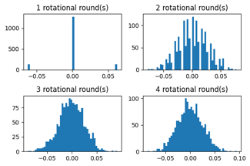
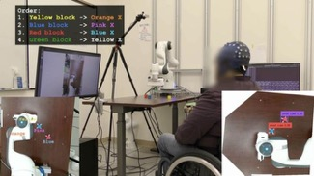
AI Updates 4
Weaviate 8-bit Rotational Quantization
Compress Vectors by 4x, need 4x less memory, similarity search runs much faster
Loses 1-2% of recall
"Rotational" means that when setting up the system, a random rotation matrix is created. This matrix will "spin" every vector in the same way, so when comparing vectors, the math always makes sense.
Random rotation randomizes the weights between vectors' elements, thus making their values more "even", thus improving the quality of compression. Authors used 3 rounds of rotations
https://weaviate.io/blog/8-bit-rotational-quantization
AI helps paralyzed patients control robots
UCLA Wearable EEG AI Decoder interprets EEG signals and enables paralyzed users to control robotic arms using their thoughts without invasive surgery
Paired EEG decoder with a camera-based AI
Tested on four users, including one paralyzed participant who completed robotic tasks in 6.5 minutes versus being unable to without it
Participants moved cursors to targets and directed robotic arms to relocate blocks, completing both tasks nearly 4x faster with AI assistance.
The system used standard EEG caps, eliminating surgical risks while still achieving performance levels similar to the invasive alternatives
https://www.eurekalert.org/news-releases/1096148

Slide 22


AI Updates 5
AI-powered stethoscope
Imperial College London published a study testing a small card-size device across 200 doctors’ offices with over 12,000 patients
AI analyzes heartbeat patterns and blood flow variations undetectable to human ears while simultaneously capturing ECG readings
The cloud-based AI algorithms flag at-risk individuals within seconds
2x rates of heart failure detection
3.5x higher detection of atrial fibrillation
2x the diagnosis rate for valve disease
https://www.bhf.org.uk/what-we-do/news-from-the-bhf/news-archive/2025/august/ai-stethoscope-can-detect-three-heart-conditions-in-15-seconds
Salesforce Cuts 4,000 Jobs Due to AI Agents
Salesforce CEO Marc Benioff says AI agents replaced nearly half of the company’s support staff, cutting 4,000 roles
Despite the cuts, customer satisfaction stayed level
https://www.techspot.com/news/109282-ceo-marc-benioff-confirmssalesforce-cut-4000-roles-ai.html
AI Tool Predicts Hereditary Disease Risk
Mount Sinai scientists built an AI model using 1M+ health records to assess how likely rare genetic variants are to cause disease
Helping tailor care and reduce false alarms
https://www.euronews.com/health/2025/08/29/scientists-create-new-ai-tool-to-predict-genetic-risk-for-common-hereditary-diseases

Slide 23



AI Updates 6
NVIDIA launches Omniverse and Cosmos robotics tools
Omniverse libraries and Cosmos world foundation models (WFMs) accelerate the development and deployment of robotics solutions
https://nvidianews.nvidia.com/news/nvidia-opens-portals-to-world-of-robotics-with-new-omniverse-libraries-cosmos-physical-ai-models-and-ai-computing-infrastructure
Anthropic raises $13B Series F at $183B valuation
https://techcrunch.com/2025/09/02/anthropic-raises-13b-series-f-at-183b-valuation/
Lovable - $100M ARR in 8 months
A Swedish AI "vibe coding" app that helps non-coders build websites and apps, has rapidly grown to over 2.3 million active users and reached $100 million ARR in just eight months, with a recent $1.8 Billion valuation and investors eager for a $4 Billion Series B.
Lovable enables users—even those without coding experience—to guide AI models in creating software, making the process more accessible.
The company focuses on fast, secure, and user-friendly experiences, adding new AI agents that read files, debug, search the web, and more.
Osika emphasizes building with multiple foundation models, leveraging providers like Anthropic and OpenAI, which gives Lovable flexibility and broad capabilities.
https://techcrunch.com/2025/09/01/lovables-ceo-isnt-too-worried-about-the-vibe-coding-competition/
Peter Diamandis: Massive Transformative Purpose (MTP) is no longer “corporate jargon.” It’s a survival strategy. It allows you to:
Build movements and communities
Attract top talent
Inspire products and services
Focus during hyper-growth
Align people beyond politics
OpenAI acquires Statsig for $1.1B
Statsig is an A/B testing platform
https://openai.com/index/vijaye-raji-to-become-cto-of-applications-with-acquisition-of-statsig/
Kevin Weil, Chief Product Officer at OpenAI, put it bluntly: “Every product, every service, every device we use today was built pre-AI. They’re all going to be reinvented.”
OpenAI has acquired Alex, an AI coding assistant for Xcode
https://ossels.ai/openai-acquires-alex-ai-coding-assistant/

Slide 24
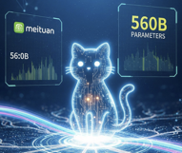


AI Updates 7
Meituan’s LongCat‑Flash‑Chat open-source LLM
560B params, MoE architecture, 128k context length, agentic and tool-use tasks, MIT license
Meituan is a leading Chinese technology company that operates an extensive online platform for local lifestyle services, most notably excelling in food delivery, restaurant reviews, travel bookings, hotel reservations, retail, and other on-demand services. Headquartered in Beijing and founded in 2010
GitHub and Hugging Face for research and application development
https://huggingface.co/meituan-longcat/LongCat-Flash-Chat
https://arxiv.org/html/2509.01322v1
Switzerland’s Apertus
Fully open, Multilingual LLM with 15 Trillion‑Token Training
Released on September 2, 2025
Available in two sizes, with either 8 billion or 70 billion parameters
Supports over 1000 languages and long context
https://huggingface.co/swiss-ai/Apertus-8B-Instruct-2509
https://the-decoder.com/swiss-ai-initiative-introduces-apertus-as-a-fully-open-language-model-focused-on-transparency-and-privacy
US Government buys 10% of Intel ($8.9B)
aims to secure domestic semiconductor manufacturing and support Intel’s foundry operations, which are critical to U.S. technology and national security interests
https://www.youtube.com/watch?v=wnbcCSmRmEM - video

Slide 25


AI Updates 8
Mistral Makes Enterprise AI Free
Mistral AI announced its Le Chat platform now includes a “Memories” system and more than 20 enterprise app connectors on its free tier
Directly undercutting premium offerings from OpenAI, Anthropic, Microsoft, and Google
https://www.ainvest.com/news/mistral-challenges-ai-giants-gifting-enterprise-power-2509/
Google Jules 2.0 Autonomous Asynchronous Coding Agent
Powered by Gemini 2.5 Pro (1M token context window)
Starts with a free a 15‑tasks‑per‑day tier
https://jules.google/
https://jules.google/docs
https://www.itpro.com/software/development/google-jules-coding-agent-code-quality-update
Blackrock Build AI Agents for Stock Picking
AlphaAgents introduces a modular multi-agent system, powered by large language models (LLMs), for equity research and portfolio construction, aiming to improve stock selection and mitigate cognitive biases through collaborative agent reasoning.
https://arxiv.org/html/2508.11152v1
Make Claude Code a Genius with Prompts
https://github.com/Alexanderdunlop/ai-architecture-prompts
OpenAI Jobs Platform
AI-powered hiring platform, to take on LinkedIn in 2026
OpenAI is expanding into several new markets beyond ChatGPT. Including a browser and a social media app.
GPT-5 Prompt Leaked
https://medium.com/data-science-in-your-pocket/gpt-5-system-prompt-leaked-7-prompt-engineering-tricks-to-learn-85532a647cdf

Slide 26
Automating Browser with Selenium & Playwright
Automating Browser with Selenium & Playwright
https://medium.com/codrift/i-tried-automating-my-entire-browser-with-python-now-i-barely-click-anything-3789288002ce
form_data = { "name": "John", "project": "myproj", "hours": "8",}
for field, value in form_data.items():
page.fill(f"input[name='{field}']", value)
page.click("button[type='submit']")
pip install selenium
from selenium import webdriver
from selenium.webdriver.common.by import By
driver = webdriver.Chrome()
driver.get("https://example.com/login")
driver.find_element(By.ID, "username").send_keys("myusername")
driver.find_element(By.ID, "password").send_keys("mypassword")
driver.find_element(By.ID, "submit").click()
pip install 2captcha-python
from twocaptcha import TwoCaptcha
solver = TwoCaptcha('YOUR_API_KEY')
result = solver.normal('captcha.jpg')
print(result['code']) # Send this value to the input field
page.click("a.download-report")
page.wait_for_timeout(3000)
browser_context = browser.new_context(accept_downloads=True)
pip install playwright
playwright install
from playwright.sync_api import sync_playwright
with sync_playwright() as p:
browser = p.chromium.launch(headless=True)
page = browser.new_page()
page.goto("https://example.com")
page.fill("#username", "myusername")
page.fill("#password", "mypassword")
page.click("#submit")
print(page.title())
browser.close()
pip install schedule
import schedule, time
schedule.every().day.at("16:00").do(download_report)
while True:
schedule.run_pending()
time.sleep(1)
# WhatsApp
pip install pywhatkit
import pywhatkit as kit
kit.sendwhatmsg("+1234567890", "This message was sent with Python!", 17, 30)

Slide 27


Fast Growth: Base44, Bolt.new, Lovable
Base44
~ 7 months to $40M ARR (?); was acquired by Wix in June 2025 when it had 250K-400K users, and almost doubled after that
Base44 has use personal connections to test and improve MVP, users were sharing their "Wow!" reactions. The platform prioritized minimizing friction, encouraging exploration and immediate results, which triggered user-driven viral expansion. Base44 focused on authentic storytelling and regular updates about product advances in public forums—especially LinkedIn—to cultivate a broad audience of indie hackers and non-technical creators. The founder even built internal tools powered by Base44 to automate engaging social content, which itself served as live demos for prospects. The company rewarded customers with platform credits for posting about their creations, transforming each user into a marketing engine and accelerating organic, community-driven growth
Tech stack: Frontend - React (JavaScript/TypeScript), CSS, ...; Can be exported only on paid plans. Backend - proprietary Base44 (can not be exported)
Bolt.new
~5 months to $40M ARR (in July 2025), 5Mln+ users
viral, community-centered, and influencer-led marketing, a “build-in-public” ethos, and lightning-fast product execution
referral programs where users earn free credits for bringing new users
“World’s Largest Hackathon” attracted 100K+ signups
Bolt.new strategically sponsored prominent indie developer influencers such as Pieter Levels and engaged with the tech Twitter/X and IndieHackers communities
Frequent publications about constant product improvements
Bolt.new made it easy for users to launch and share what they built, with integrations into platforms like Netlify, Supabase, and GitHub - a tactic that “piggybacks” on existing user bases
Tech stack: JavaScript-based for both front-end and back-end development, emphasizing Node.js
StackBlitz’s WebContainers (Rust+WASM) run GUI in browser
Code export is supported
Lovable
~7 months to $40M ARR, $120M ARR in Aug 2025.
Originally (2023) as an open-source coding tool ("GPT-Engineer") that quickly garnered tens of thousands of GitHub stars and a strong early community (hundreds of thousands of of early “tinkerers”..
October 2024 received $7.5M Pre-Seed Funding - pay for development and GPU By February achieved $10M ARR, 30K+ paying customers, 85% 30-day user retention
February 2025 - $15M Series A - started aggressive PPC (Pay-Per-Click) advertising, 12+ growth channels simultaneously, including Linkedin, X (Twitter), Discord, Youtube, Google, partnerships, Github, Product Hunt, podcasts, events, ads, and Reddit - reportedly adding 1,500 customers per day; frequent campaigns offering free access; blogging, partnerships; 54K stars on GitHub; Using Lovable itself to build marketing campaign pages; actively collecting user feedback, rapidly iterating on product features, and maintaining open communication across channels; The emphasis on fast troubleshooting, instant undo actions, and responsive AI ensures users get the help and outcomes they want without delay
Tech stack: React (JavaScript/TypeScript); Vite and Tailwind CSS for styling, node.js based backend code, build tooling; Integrations for backend services (Supabase, Cloudflare hosting, third-party APIs). User can export code to run on his own infrastructure

Slide 28
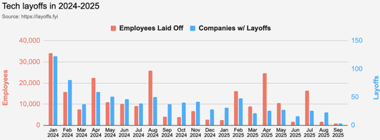
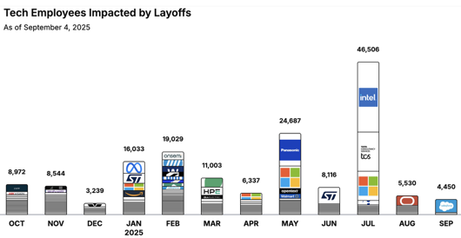
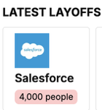
Jobs
https://layoffs.fyi
https://trueup.io/layoffs
Tech Layoffs by year:
83K in 2025 (as of September 4)
153K in 2024
264K in 2023
165K in 2022
https://layoffs
The Tech Layoff Tracker
So far in 2025, 141,691 people laid off (574 per day).
In 2024, 238,461 people laid off (653 per day).
https://trueup.io/layoffs

Slide 29


About the Speaker
Lev Selector, Ph.D.
40+ years of software engineering, data science, and building teams (hiring, training, and managing)
Ph.D. in mathematical modeling and computer simulations
Interests:
Generative AI, Using LLM with your data
Local AI for Local Private Data
Cloud architecture, fin-tech, application security
Find/connect: Linkedin, GitHub, YouTube, Google
https://eais.ai
Enterprise AI Systems

Slide 30
Thank You!

