Slide 1
AI Updates - August 29, 2025
Implementation beats optimization
Shipping beats perfecting
Results beat research
Crowd-sourced "LM Arena" Leaderboard
Gemini "Nano Banana" image generation
OpenAI GPT Realtime Speech Agents
Cohere – Command A Reasoning
Alibaba Qoder - An Agentic Coding
NVIDIA's Nemotron Nano 2
Turing - improve training data
ChatGPT’s "Study & Learn"
Anthropic Claude Chrome Extension
NVIDIA Nemotron Nano 9B V2 reasoning
Hermes 4 by Nous Research
Grok Code Fast 1
OpenAI Codex - GPT model fine-tuned for code tasks
Google AI Mode in Search - now Agentic
Build $80M Website Builder in Under 1 Hour
RAG, MCP
Stacking Sliding Windows Problem
Memory Decoder - Small Pretrained LLM
Microsoft Data Formulator
Memory Decoder - Pretrained Small LLM
Apple Explores Google Gemini for Siri
GitHub has open-sourced its own MCP server
OpenAI Assistants API => Responses API
xAI open-sources Grok 2.5
OpenAI model - turn cells into stem cells
Coinbase fires coders who don’t use AI
NotebookLM Video Overviews in 80 languages
Agentic RAG for Information Retrieval
Memento: Fine-tuning Agents without Fine-tuning LLMs
AI Generated YouTube Stories & Shorts
Claude Code Hints
FastAPI Example
Deep Think with Confidence
Jobs, Layoffs

Slide 2
Crowd-sourced "LM Arena" Leaderboard
https://lmarena.ai/?leaderboard
Starting Elo rating = 1000
https://en.wikipedia.org/wiki/Elo_rating_system
English - https://lmarena.ai/leaderboard/text
Coding - https://lmarena.ai/leaderboard/text/coding
LM Arena secures $100M to expand AI benchmarking (at $600M valuation)
Model | Score | 95%
gemini-2.5-pro | 1456 | ±5
gpt-5-high | 1449 | ±7
claude-opus-4-1-20250805-thinking-16k | 1448 | ±7
o3-2025-04-16 | 1444 | ±4
chatgpt-4o-latest-20250326 | 1443 | ±4
gpt-4.5-preview-2025-02-27 | 1439 | ±6
claude-opus-4-1-20250805 | 1437 | ±6
gpt-5-chat | 1427 | ±7
grok-4-0709 | 1422 | ±6
kimi-k2-0711-preview | 1421 | ±5
claude-opus-4-20250514-thinking-16k | 1419 | ±5
qwen3-235b-a22b-instruct-2507 | 1419 | ±6
deepseek-r1-0528 | 1417 | ±6
glm-4.5 | 1411 | ±6
mistral-medium-2508 | 1411 | ±8
claude-opus-4-20250514 | 1410 | ±5
gpt-4.1-2025-04-14 | 1409 | ±5
grok-3-preview-02-24 | 1409 | ±4
mai-1-preview | 1402 | ±10
gemini-2.5-flash | 1406 | ±5
Model | Score | 95%
claude-opus-4-1-20250805-thinking-16k | 1506 | ±12
claude-opus-4-1-20250805 | 1495 | ±10
claude-opus-4-20250514-thinking-16k | 1479 | ±8
qwen3-235b-a22b-instruct-2507 | 1475 | ±10
gemini-2.5-pro | 1471 | ±7
gpt-5-high | 1471 | ±11
chatgpt-4o-latest-20250326 | 1470 | ±7
o3-2025-04-16 | 1467 | ±7
mistral-medium-2508 | 1459 | ±13
gpt-5-chat | 1459 | ±13
qwen-vl-max-2025-08-13 | 1447 | ±28
claude-sonnet-4-20250514-thinking-32k | 1461 | ±8
gpt-4.5-preview-2025-02-27 | 1459 | ±11
kimi-k2-0711-preview | 1457 | ±8
deepseek-r1-0528 | 1456 | ±8
glm-4.5 | 1454 | ±10
claude-opus-4-20250514 | 1455 | ±8
qwen3-235b-a22b-thinking-2507 | 1448 | ±12
mai-1-preview | 1435 | ±19
gpt-4.1-2025-04-14 | 1443 | ±8
China
Grok 4 Benchmarks
https://artificialanalysis.ai/models/grok-4
https://lmarena.ai/leaderboard/text
https://web.lmarena.ai/leaderboard
https://openlm.ai/chatbot-arena/
https://beta.lmarena.ai
Web Leaderboard https://web.lmarena.ai/leaderboard
LLM Leaderboard - by @LlmStats https://llmworld.net/llm_leaderboards/
LLM Leaderboard - by StackAI https://www.stack-ai.com/llm-leaderboard
LLM Leaderboard - by Artificial Analysis https://artificialanalysis.ai/leaderboards/models
Open LLM Leaderboard - by Hugging Face https://huggingface.co/open-llm-leaderboard
LLM Leaderboard - by Vellum https://www.vellum.ai/llm-leaderboard
AI Benchmarking Hub https://epoch.ai/data/ai-benchmarking-dashboard
x.ai
Mistral
China
China
China
China
China
China
Mistral
China
China
x.ai
China
Microsoft
Microsoft
Note new Microsoft Model MAI-1-preview ~ 500B params, MoE architecture

Slide 3
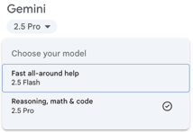


Gemini "Nano Banana" image generation
Gemini 2.5 Flash's "Nano Banana" image generation model
#1 on LM Arena's image editing leaderboard with nearly 200-point ELO score jump over competitors
3D Understanding & Multi-view Generation - can predict what objects look like from different angles, rotate the object
Maintains the same character/person across multiple edits and generations while changing poses and angles; preserves facial features and appearance through complex transformations
Realistic reflections in glasses, car grills, and other reflective surfaces; accurate shadows, lighting, and condensation effects; proper bokeh and depth of field effects
Sophisticated Image Editing: add/remove objects or background, style transfer (converting photos to anime, 3D, etc.); material changes (ice to metal teapots while preserving other elements)
Can expand scenes logically (zooming out to show full environments); understands spatial relationships and context; creates believable multi-panel sequences
Can generate new images or edit existing images; works for thumbnails, memes, photo restoration, and colorization; sSupports continuity sequences (showing progression over time)
Free to use - Google AI Studio and Gemini interface
Excellent for content creators (YouTube thumbnails, social media)
Photo restoration and colorization
Product visualization and 3D modeling preparation
Marketing and advertising materials
Gemini 2.5 Pro & Flash Image Tools may be different
I couldn't find definite answer to this question
https://www.youtube.com/watch?v=-gPL9EA2pP8 - video demo
https://developers.googleblog.com/en/introducing-gemini-2-5-flash-image/ - official introduction - August 26, 2025
Pricing via API: $0.039 / image

Slide 4

OpenAI GPT Realtime Speech Agents
OpenAI GPT Realtime speech-to-speech agents & API
https://www.youtube.com/watch?v=nfBbmtMJhX0 - announcement
natural, emotionally expressive, and responsive speech agents for customer-facing apps where natural interaction is essential
Input and output are audio (voice, speech)
Extremely low latency
Capturing emotions, handling interruptions, switching languages
Strictly adheres to instructions (e.g., refund policies) and can reliably call external functions, passing correct details in complex multi-turn interactions
Image Input along with voice, allowing multi-modal conversations where the AI can describe and analyze visual elements
Phone integration and "capabilities plugins" (MCP) for expanded, pluggable actions during voice interactions
Robust privacy enhancements and flexible session/context tools for global, enterprise use
Improved accuracy benchmarks, especially for instruction following and function calling in challenging real-world scenarios
For training used high-quality voice data and reinforcement learning focused on production use cases, enabling natural sounding voices and robust mistake handling (e.g., misheard input, phone numbers)
T-Mobile’s team used GPT Realtime for an AI-powered device upgrade flow, demonstrating human-like, emotionally aware support for common customer requests and policy handling
T-Mobile praised the conversational quality, emotional intelligence, and contextual adaptability of the model for transforming user experiences beyond simple automated responses

Slide 5

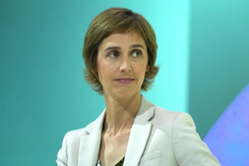
Cohere – Command A Reasoning
Cohere – Command A Reasoning (open weights)
111B params open weights LLM
pecifically designed for advanced reasoning, tool use, and multilingual enterprise applications
Its release provides transparent access for research and non-commercial use
Requires direct enterprise agreements for commercial use
Context window 256K tokens
Toggleable 'reasoning' mode on/off
Multilingual (23 languages), reducing hallucinations, tool use
Model excels in enterprise document repositories, email threads, hierarchical agent workflows, and parallel research systems, outperforming comparable models on instruction-following and content depth benchmarks
Strong safety framework with balanced abuse prevention
The model can run on a single H100/A100 GPU, or scale up for ultra-long context tasks, with a unique token budget feature for controlling depth and cost
https://huggingface.co/CohereLabs/command-a-reasoning-08-2025
https://huggingface.co/CohereLabs/c4ai-command-r-plus
https://docs.cohere.com/docs/models
Cohere AI is headquartered at Toronto, Ontario, Canada
new Chief AI Officer at Cohere is Joelle Pineau,
who joined the company in 2025
after previously leading Meta’s Fundamental
AI Research (FAIR) team

Slide 6
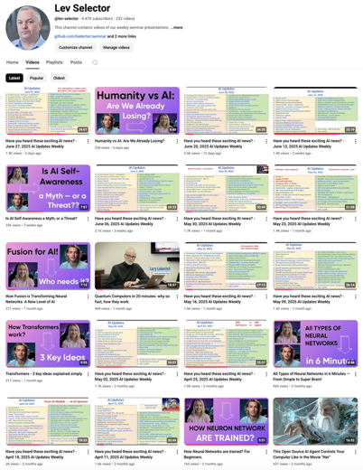
Please pause the video - and answer the pinned question in comments under the video
Subscribe to this channel
https://www.youtube.com/@lev-selector
Get notified about new videos - every Friday, links to slides under the videos

Slide 7

Alibaba Qoder - An Agentic Coding
Alibaba Qoder - An Agentic Coding Platform
Editor, advanced context engineering, hybrid retrieval architectures (combining code graphs and vector search), long-term memory systems, and spec-driven workflows
Two primary modes: Agent & Quest
Agent Mode - coding assistant, conversational pair programming
Quest Mode - fully autonomous coding specialist. Plans, implements, tests, and verifies code, outputting production-ready solutions
Deep repo searching and automated documentation generation with a "Repo Wiki"
Automated Refactoring & Testing
Qoder automatically selects optimal AI models for each task (Claude, Gemini, and GPT, ...)
MCP (Memory, Context, Plugins), compatibility with external tools, web search, auto-run terminal commands, and broad language coverage
Uses Qwen3-Coder-480B-A35B-Instruct
Limitations: Does not currently support Linux (but works with MacOS and Windows); Repo Wiki and auto-indexing have scale limits; Some developer plugins (e.g., GitHub Pull Requests) currently suffer version compatibility issues
Qoder is completely free to use with no rate limits
Download and install the IDE from https://qoder.com

Slide 8
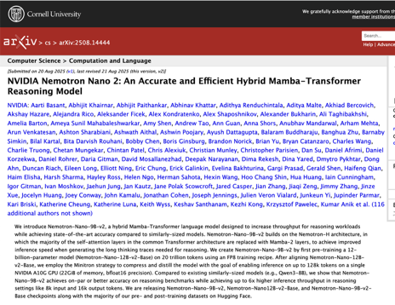
NVIDIA's Nemotron Nano 2
NVIDIA's Nemotron Nano 2 Mamba-Transformer hybrid
Most self-attention layers replaced with Mamba-2 layers
The architecture uses just 6 attention layers alongside 28 Mamba-2 layers and 28 FFN layers
Up to 6x faster
A 9B parameter model that runs 128K context on a single A10G GPU (just 22GB memory)
The model was trained on 20 trillion tokens, then compressed from 12B to 9B parameters while maintaining performance.
Importance: High-quality reasoning models can run on single GPUs instead of clusters
https://arxiv.org/abs/2508.14444 - paper

Slide 9
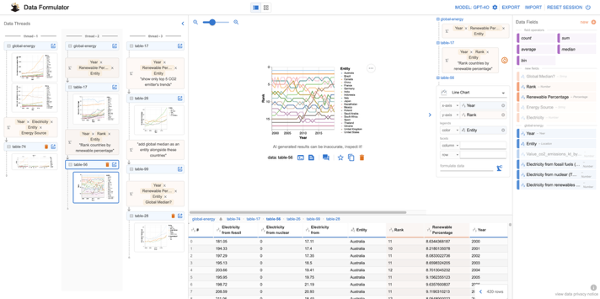
Microsoft Data Formulator
Microsoft Data Formulator
Open-source, AI-powered tool to help analysts create data visualizations (charts); drag-and-drop UI and optionally refine visualization details through prompts
Python based, recommended to use with OpenAI GPT API key
pip install data_formulator
https://github.com/microsoft/data-formulator

Slide 10
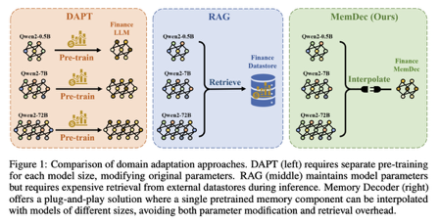



AI Updates - 1
Memory Decoder: A Pretrained, Plug-and-Play LLM Memory
https://arxiv.org/abs/2508.09874
Memory Decoder is a small (0.5B-1B) model that learns to mimic retrieval (RAG) behavior through specialized pretraining
During inference, it runs in parallel with the main LLM, with outputs interpolated together
A Memory Decoder works with any model sharing the same tokenizer - true plug-and-play domain adaptation
Research shows that a single 0.5B Memory Decoder reduces domain-specific perplexity by 76-79% in biomedicine and finance. Inference overhead is just 1.28x compared to RAG's 2.17x
Remarkably, a 0.5B model with Memory Decoder outperforms vanilla 72B models - that's 140x parameter efficiency
Apple Explores Google Gemini for Siri. Also considers OpenAI and Anthropic.
GitHub has open-sourced its own MCP server
It allows LLMs to interface with GitHub reducing hallucinations and unlocking new automation workflows
https://github.blog/open-source/maintainers/why-we-open-sourced-our-mcp-server-and-what-it-means-for-you/
OpenAI Assistants API => Responses API: code interpreter, persistent conversations, MCP, and computer use; web search gets domain filtering, source reporting, and a price cut from $25 to $10/1K calls

Slide 11




AI Updates - 2
xAI open-sources Grok 2.5
Reasoning 270B-params, MoE architecture
Free for research and commercial use
https://huggingface.co/xai-org/grok-2
OpenAI model redesigns proteins to turn cells into stem cells
https://openai.com/index/accelerating-life-sciences-research-with-retro-biosciences/
Achieving 50x better efficiency than the original Nobel-Prize winning versions discovered in 2012.
Researchers built GPT-4b micro model trained on biological data to redesign ‘Yamanaka’ proteins that reprogram aging cells.
The AI-designed proteins converted the cells into stem cells 50x more efficiently, showing dramatically better DNA repair abilities.
The results essentially reversed one of the key signatures of aging at the cellular level, with multiple labs validating the results across testing methods.
Coinbase fires coders who don’t use AI
Coinbase mandated engineers to use GitHub Copilot and Cursor - and fired a few who refused to even onboard
Coinbase leaned into training, holding monthly sessions where teams share innovative AI uses
NotebookLM Video Overviews are now available in 80 languages
It uses AI to generate narrated slide-style videos summarizing and visually explaining the key content from your documents
https://blog.google/technology/google-labs/notebook-lm-audio-video-overviews-more-languages-longer-content/

Slide 12


AI Updates - 3
Agentic RAG is Transforming Information Retrieval:
Reflection: Critique and improve outputs
Planning: Break queries into steps
Tool Use: Call external resources (e.g., web search, APIs)
Multi-Agent Collaboration: Multiple agents team up (e.g., one retrieves, another validates)
https://medium.com/@tam.tamanna18/how-agentic-rag-is-transforming-information-retrieval-faad92f588b6
Turing - improve training data
Turing helps AI teams migrate, manage, and improve training datasets for advanced projects
Supports AI training for speech, vision, simulation, and complex workflows using high-quality, researcher-aligned data.
Enables teams to leave legacy vendors without vendor friction, delays, or quality gaps.
Offers data and onboarding for 60+ languages, 10+ domains, and thousands of tasks, including speech, text, reasoning, animation, and robotics.
https://www.turing.com
ChatGPT’s "Study & Learn"
https://openai.com/index/chatgpt-study-mode/
Select “Tools” in ChatGPT, choose “Study and learn,” and provide context or specific goals to begin the interactive experience.

Slide 13

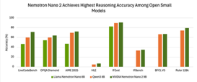



AI Updates - 4
Anthropic Claude Chrome Extension
The browser extension lets its AI assistant observe webpages, click buttons, fill forms, and more
Available to select Max-plan users
The company underscores that safety is the primary priority: it’s addressing real-world threats like prompt injection attacks, which previously succeeded 23.6% of the time in red-teaming tests, but now—with layered defenses—they’ve dropped the risk to 11.2%.
NVIDIA Nemotron Nano 9B V2 reasoning
Scoring highest among sub-10B models
Uses hybrid Mamba-transformer architecture
Hermes 4 by Nous Research
Open-source hybrid reasoning model (70B and 405B versions) positioned as uncensored and creative.
Grok Code Fast 1
https://x.ai/news/grok-code-fast-1
Fast-first, for agents in multi-agent architecture
Latency is only 67 ms (Claude Sonnet 4 5..8 sec), speed 92 tok/sec
On Cursor, GitHub Copilot, Cline (free for now)
Price per Mln tokens in/out: $0.20/$1.50
OpenAI Codex - GPT model fine-tuned for code tasks
Codex is available via chat interfaces (e.g., ChatGPT Plus/Pro/Enterprise subscriptions), code editors, or terminal commands

Slide 14

Google AI Mode in Search - now Agentic
Google’s new AI agentic update to AI Mode in Search
Perform real-world tasks like booking restaurants, scheduling appointments, and purchasing tickets—directly within Search
Example: Restaurant Reservations: AI Mode now allows users to specify criteria (party size, date, time, location, cuisine), then searches across various platforms, finds real-time availability, ...
Example: Event Tickets and Service Appointments: Coming soon, users will be able to book tickets (concerts, sports, etc.) and local services using natural language prompts, with AI handling cross-platform research and booking.
Personalization: For those opted into the Labs experiment, AI Mode will tailor results and suggestions based on users' previous searches and stated preferences, delivering recommendations that match their habits and tastes—such as favorite cuisines or outdoor seating.
Link-sharing: Users can now share AI Mode results, enabling collaborative planning and follow-up among contacts, who can continue the conversation or booking from where it was left off.
Powered by Project Mariner & Gemini: The infrastructure relies on advanced models and real-time web browsing for up-to-date, context-rich responses.
Basic AI Mode conversational features and enhanced personalization are available in 180 countries in English
The most advanced agentic features are currently available for Google AI Ultra subscribers ($250/month) via the Labs experiment

Slide 15
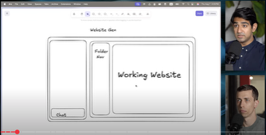
Build Your Own $80M Website Builder
Rapid creation of a three-pane layout: chat on the left, folder navigator center, live website preview right (all controlled via AI)
Integration with Monaco editor for in-browser code editing, autosave functionality, and keyboard shortcuts
Project persistence, planning document updates, and automated git commits after tasks complete for robust tracking
Use of Sandpack for in-browser code previews; various advanced commands for code analysis and documentation
Key Insights and Tips:
Cloud Code Planning Mode: Review and approve proposed changes before code is generated
Effective Task Management: Maintain separate planning and to-do files to persist context and project history across sessions
Parallelism with Subagents: Divide labor across multiple agents for design updates or feature rollouts, preventing bottlenecks in complex codebases
Critique and Refinement: Harness multiple AI models for critiquing and iterating on plans, ensuring completeness and relevant feature prioritization
Build Your Own $80M Website Builder in Under 1 Hour (with Claude Code) - https://www.youtube.com/watch?v=ZBBzTs0Ow7E
Anand, a former Flexport engineer and founder, demonstrates building the core features of Base44 - an app sold for $80 million six months after launch - using Claude Code in under an hour
App includes a full-stack website and SaaS builder, offering instant database, authentication, and payments
Start with wireframing in Excalidraw, then detailed planning using advanced AI models (initially GPT-5), resulting in thorough task
breakdowns before code generation
Step-by-Step Workflow - Wireframing & Planning: Initial UI/UX is mapped out in Excalidraw; screenshots and descriptive prompts are sent to AI to generate a precise implementation checklist
Planning Document: Tasks are grouped into epics (large milestones), with a checklist for each. These cover everything from layout to backend features; Cloud Code IDE: Anand uses Claude Code (sometimes inside Cursor IDE) to automatically scaffold the project, leveraging planning mode to review and approve steps before execution. The Claude Code automates folder structure, setup, and Next.js integration
Custom Commands & Subagents: The video explains the difference - commands are reusable system prompts, while subagents parallelize workflows across tasks or codebase sections. Subagents are particularly useful for large-scale collaborative projects or batch operations

Slide 16
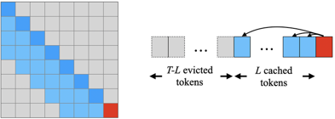
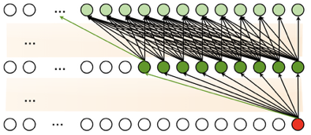
Stacking Sliding Windows Problem
Why Stacking Sliding Windows Can't See Very Far
Modern LLMs use sliding window attention to handle long texts efficiently. These models struggle to use information from more than about 1,500 words ago, far less than the theoretical 100,000.
This is because information gets diluted as it spreads through the network, and residual connections create an exponential barrier that blocks distant information.
https://guangxuanx.com/blog/stacking-swa.html

Slide 17

Memento: Finetuning Agents
Memento: Fine-tuning LLM Agents without Fine-tuning LLMs
A memory-based, continual-learning framework that helps LLM agents improve from experience without updating model weights
https://github.com/Agent-on-the-Fly/Memento
Core Concept - Learn from experiences, not gradients. Memento logs successful & failed trajectories into a Case Bank and retrieves by value to steer planning and execution, enabling low-cost, transferable, and online continual learning
No LLM weight updates. Memento reframes continual learning as memory-based online reinforcement learning over a memory-augmented MDP. A neural case-selection policy guides actions; experiences are stored and reused via efficient Read/Write operations
Two-stage planner–executor loop. A CBR-driven Planner decomposes tasks and retrieves relevant cases; an Executor runs each subtask as an MCP client, orchestrating tools and writing back outcomes
Comprehensive tool ecosystem. Built-in support for web search, document processing, code execution, image/video analysis, and more through a unified MCP interface
Strong benchmark performance. Achieves competitive results across GAIA, DeepResearcher, SimpleQA, and HLE benchmarks

Slide 18



AI GeneratedYouTube Stories & Shorts
Auto-generate video stories, YouTube (Russian, Jenya Zaitsev)
https://www.youtube.com/watch?v=C1kgOKDsRPE
$60K/mo: Copy stories (often from Reddit) or generate (GPT ?), convert to audio, combine with a gameplay video, auto-generate subtitles; can make 10 videos in 3 hours
Use real human face in profile and intro (wave hand) - for higher chance of monetization approval
Target wealthy, older (65+) viewers
Start channel with short clips to gain traction.
Then move to longer stories (more ads = more $$)
Create viral faceless videos with free AI tools (Russian)
https://www.youtube.com/watch?v=BOlpAH1AztQ
Idea - replicate viral video formats - like dramatic moments involving luxury cars - using AI-generated visuals and animations instead of filming real-world events
Screenshot key frames from viral videos - before and after the action; Use ChatGPT to generate highly detailed prompts for visual creation and animation by analyzing the screenshots; Use Leonardo.ai, selecting advanced models (e.g., Flow State) for realistic visuals, formatted for vertical mobile videos (9x16); Apply ChatGPT-generated prompts to get professional-quality images
Transfer images to free neural network platforms for animation; use allocated platform credits to animate, and start over with new accounts if credits run out
Use ChatGPT to endlessly generate new video concepts and prompts for both visuals and animation
Edit videos simply in free apps like CapCut, stacking clips, adding smooth transitions, and optimizing formats for viewer retention
Use AI platforms like ElevenLabs to generate custom sound effects tailored to each scene, which significantly boosts watch time and virality
Instead of relying on ad revenue, creators offer paid guides or memberships (e.g., via Patreon) detailing their production methods
Social profiles and video descriptions link directly to these resources
Monetization is achieved primarily through selling digital products and memberships, not ads
Reposting TikTok videos as YouTube Shorts with original voice-over commentary
https://www.youtube.com/watch?v=WwSiPZkRgFk
$1.3K/mo by reposting TikTok videos as YouTube Shorts with added voice-over commentary.
The process is simple, can be done on the cheapest Android smartphone in just 15 minutes per day
Find trending TikTok videos (animals, ...), download, write a simple commentary, use AI to generate voice narration, combine the video and audio using simple video editor, add background music, and upload to YouTube Shorts
Discipline - repeatedly posting new Shorts every day increases the chance of a viral hit

Slide 19
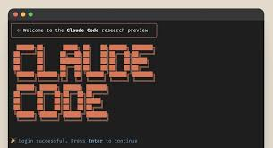
Claude Code Hints
Claude Code Hints
Add a .gitignore early and aggressively; Use /compact when preserving conversation history. Use /clear before switching tasks. Exclude directories like dist/, logs/, .next/, coverage/ , .env , node_modules/
Use CLAUDE.md files
Use Plan Mode Like an Architect
Use XML Tags in prompts - Claude is strangely obedient
Create Custom Slash Commands, for example: .claude/commands/audit.md
Hooks for pre-, post-, and other automation
Demand to Return ONLY a unified diff patch, no prose or summaries
Use Claude to open/handle PRs
Clean Your Workspace Before Inviting Claude In
Share CLAUDE.md, slash commands, hook scripts
Give Claude function signatures and data structures examples
https://medium.com/@apicraft/10-claude-code-power-hacks-they-dont-tell-you-but-should-49096ba6c8ff
SuperClaude Framework
Enhances Claude Code with 21 new slash commands, 14 specialized AI agents, and 6 MCP server integrations
Creates structured workflows for development tasks
14K stars on GitHub in a month
Claims to reduce context usage by 30-50%.
https://github.com/SuperClaude-Org/SuperClaude_Framework
Use Claude Subagents
https://medium.com/@ooi_yee_fei/building-with-claude-code-subagents-my-beloved-minions-b5a9a4318ba5

Slide 20

FastAPI Example
# Run with: uvicorn main:app --reload
# test with https://localhost:8000/docs
# ---------------------------------------------
# GET endpoint
@app.get("/users/{user_id}", response_model=UserResponse)
async def get_user(user_id: int):
user = next((u for u in users if u["id"] == user_id), None)
if user:
return UserResponse(**user, message="User found")
return UserResponse(
id=user_id,
name="Unknown",
is_active=False,
message="User not found"
)
# ---------------------------------------------
# POST endpoint
@app.post("/users", response_model=UserResponse)
async def create_user(user: UserRequest):
global user_counter
new_user = {
"id": user_counter,
"name": user.name,
"age": user.age,
"email": user.email,
"is_active": user.is_active,
"score": user.score
}
users.append(new_user)
user_counter += 1
return UserResponse(**new_user,
message="User created successfully")
from fastapi import FastAPI
from pydantic import BaseModel
from typing import Optional
app = FastAPI()
# ----------------------------------
# Pydantic Models
class UserRequest(BaseModel):
name: str
age: Optional[int] = None
email: Optional[str] = None
is_active: Optional[bool] = True
score: Optional[float] = None
class UserResponse(BaseModel):
id: int
name: str
age: Optional[int] = None
email: Optional[str] = None
is_active: bool
score: Optional[float] = None
message: str
# ----------------------------------
# In-memory storage
users = []
user_counter = 1

Slide 21
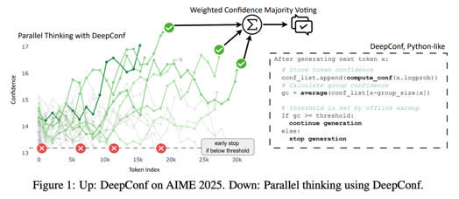
Deep Think with Confidence
How the Confidence Scores Are Constructed:
Token Confidence - based on the negative average log-probability of the top-k token predictions (higher log-probability means higher confidence).
Group Confidence - the model averages confidence scores over sliding windows (short ranges of steps) to capture local trends, rather than just a global, sequence-wide metric.
Tail Confidence - emphasizes the confidence of the last part of the reasoning trace, since final answers often reveal reasoning errors missed earlier.
Lowest Group Confidence - the weakest segment of the trace. A sudden drop in confidence is highly predictive of an error or reasoning collapse.
Bottom Percentile Confidence - the bottom x% of token confidence values within a trace to surface the most error-prone parts.
DeepConf - new method from Meta for improving LLM reasoning
DeepConf = Deep Think with Confidence
https://jiaweizzhao.github.io/deepconf/
https://arxiv.org/abs/2508.15260
https://jiaweizzhao.github.io/deepconf/static/pdfs/deepconf_arxiv.pdf - paper
DeepConf uses internal confidence scores to filter out low-quality reasoning traces
Achieves higher accuracy and greatly reduced computation
Outperforms standard majority voting on complex benchmarks while requiring up to 84.7% fewer generated tokens
DeepConf is simple to implement
DeepConf does not need extra training or tuning
Early Filtering - DeepConf can discard low-confidence paths before they reach completion or enter voting, saving computation and focusing on high-quality traces only.
By capturing local uncertainty, DeepConf can stop poor traces early, avoiding "averaging out" errors or letting low-quality reasoning dilute the answer.
Weighted Voting: Instead of treating all traces equally when voting, DeepConf assigns higher voting weight to traces with higher confidence, making it more robust to noisy, ambiguous, or error-prone traces.
DeepConf often achieves equal or better accuracy than majority voting with up to 85% fewer generated tokens.

Slide 22
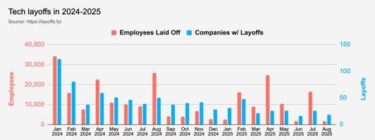
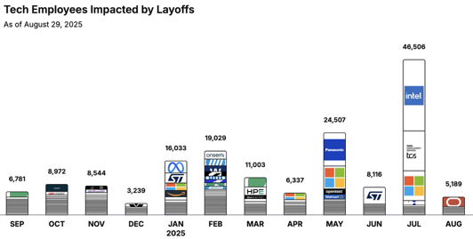
Jobs
https://layoffs.fyi
https://trueup.io/layoffs
"Don't fear AI replacement, embrace AI augmentation" -- Eric Schmidt
Tech Layoffs by year:
137K in 2025 (as of August)
238K in 2024
264K in 2023
165K in 2022
https://layoffs
Tool use ≠ career advancement
"AI power users" are stuck at $85K/year:
They know how to prompt ChatGPT
They know how to use vibe coding
They know how to use OpenAI API
But companies pay $200K-$400K for engineers who can:
Build a parser that processes 3,000 resumes/day
Architect invoice-processing pipeline that scale to enterprise level and passes compliance
Deploy multimodal security systems that catches anomalies in video frames in real-time
In other words: engineers who implement AI in production, not just "use" it

Slide 23


About the Speaker
Lev Selector, Ph.D.
40+ years of software engineering, data science, and building teams (hiring, training, and managing)
Ph.D. in mathematical modeling and computer simulations
Interests:
Generative AI, Using LLM with your data
Local AI for Local Private Data
Cloud architecture, fin-tech, application security
Find/connect: Linkedin, GitHub, YouTube, Google
https://eais.ai
Enterprise AI Systems

Slide 24
Thank You!

