Slide 1
AI Updates - September 26, 2025
AI is growing 3-4 times faster than Moore’s Law
Crowd-sourced "LM Arena" Leaderboard
Exponential growth
Outsourcing Jobs to AI
Compute Owners vs Underclass
AI monthly payment plans
Google AI: Chrome, AI Search, Youtube languages
Groq $750 million at $6.9B valuation
Tencent’s Hunyuan3D 3.0
Convex Chef platform open-source vibe coding
Mistral Magistral v. 1.2 Reasoning Models
Grok 4 Fast - cost-efficient reasoning model
LLM-Deflate: Extracting Into Datasets
Tencent’s Parallel R1 (developed in Seattle)
Ollama Web Search
Spiking Brain Models
AI Coding - Create & Update Rules
OP Code - desktop GUI for ClaudeCode workflows
GitHub Spec Kit framework + Claude Code
Claude Code Opus 4.1 is fixed
Qwen3 Coder Plus
DeepSeek V3.1 Terminus
Preventing Fake Alignment (Apollo Research)
DeepSeek-R1 Develops Advanced Reasoning
LEANN Vector DB takes 30x less space
Google Gemini TV
AI sector - a speculative “bubble” ?
AI for Creative Media
Python 3.14 (October 7th)
OpenAI revenue sharing with Microsoft decreasing
Alibaba - FP8 builds of Qwen3 models
Fei-Fei Li’s World Labs demo
90% of programmers use AI
Major LLMs can pass CFA Exam
Google Stitch text-to-design
Crush CLI open-source AI coding agent for terminal
Lumi.new - AI no-code app builder
Kling 2.5 Turbo - video generation model
Skywork - research AI creates professional reports
Supernova: New Free AI Coder
AWS Strands - agent orchestration framework
Jobs, Layoffs, demand for AI Engineers

Slide 2
Crowd-sourced "LM Arena" Leaderboard
https://lmarena.ai/?leaderboard
Starting Elo rating = 1000
https://en.wikipedia.org/wiki/Elo_rating_system
English - https://lmarena.ai/leaderboard/text
Coding - https://lmarena.ai/leaderboard/text/coding
LM Arena secures $100M to expand AI benchmarking (at $600M valuation)
Model | Score
gemini-2.5-pro | 1456
claude-opus-4-1-20250805-thinking-16k | 1449
o3-2025-04-16 | 1441
chatgpt-4o-latest-20250326 | 1441
gpt-4.5-preview-2025-02-27 | 1441
gpt-5-high | 1440
claude-opus-4-1-20250805 | 1438
qwen3-max-preview | 1430
gpt-5-chat | 1430
claude-opus-4-20250514-thinking-16k | 1421
grok-4-fast | 1421
grok-4-0709 | 1420
qwen3-235b-a22b-instruct-2507 | 1419
deepseek-v3.1 | 1417
kimi-k2-0711-preview | 1418
deepseek-r1-0528 | 1418
deepseek-v3.1-thinking | 1414
kimi-k2-0905-preview | 1414
gpt-4.1-2025-04-14 | 1411
grok-3-preview-02-24 | 1410
claude-opus-4-20250514 | 1410
glm-4.5 | 1408
mistral-medium-2508 | 1407
gemini-2.5-flash | 1406
Model | Score
claude-opus-4-1-20250805-thinking-16k | 1504
claude-opus-4-1-20250805 | 1496
claude-opus-4-20250514-thinking-16k | 1481
qwen3-max-preview | 1475
qwen3-235b-a22b-instruct-2507 | 1472
gemini-2.5-pro | 1470
chatgpt-4o-latest-20250326 | 1468
gpt-5-high | 1467
qwen3-next-80b-a3b-instruct | 1465
gpt-5-chat | 1465
grok-4-fast | 1460
o3-2025-04-16 | 1464
claude-sonnet-4-20250514-thinking-32k | 1460
gpt-4.5-preview-2025-02-27 | 1460
deepseek-v3.1-thinking | 1458
deepseek-r1-0528 | 1458
longcat-flash-chat | 1453
claude-opus-4-20250514 | 1456
kimi-k2-0711-preview | 1454
deepseek-v3.1 | 1453
kimi-k2-0905-preview | 1450
glm-4.5 | 1452
qwen3-235b-a22b-thinking-2507 | 1447
mistral-medium-2508 | 1447
China
China
Grok 4 Benchmarks
https://artificialanalysis.ai/models/grok-4
China
China
https://lmarena.ai/leaderboard/text
https://web.lmarena.ai/leaderboard
https://openlm.ai/chatbot-arena/
https://beta.lmarena.ai
Web Leaderboard https://web.lmarena.ai/leaderboard
LLM Leaderboard - by @LlmStats https://llmworld.net/llm_leaderboards/
LLM Leaderboard - by StackAI https://www.stack-ai.com/llm-leaderboard
LLM Leaderboard - by Artificial Analysis https://artificialanalysis.ai/leaderboards/models
Open LLM Leaderboard - by Hugging Face https://huggingface.co/open-llm-leaderboard
LLM Leaderboard - by Vellum https://www.vellum.ai/llm-leaderboard
AI Benchmarking Hub https://epoch.ai/data/ai-benchmarking-dashboard
x.ai
x.ai
x.ai
China
China
China
China
China
China
China
China
China
China
x.ai
China
China
China
China
Mistral
China
Mistral

Slide 3
Exponential growth
Suppose the pond plants double in size every day and cover the entire pond in 30 days:
day portion covered
30 1 100%
29 1/2 50%
28 1/4 25%
27 1/8 12.5%
26 1/16 6.3%
25 1/32 3%
...
20 1/1024 0.1%
10 1/1M
1 1/1B
So first 25 days the pond is blue, green is invisible.
But then in the last 5 days the whole pond becomes green
AI infrastructure, investment, usage, and quality are all demonstrating exponential growth
Global demand for AI-ready data center capacity is rising at an average rate of 33% annually
U.S. data center power demand for AI could grow more than 30-fold by 2035, surging from 4 GW in 2023 to an estimated 123 GW by 2035
Edge computing for AI infrastructure is expanding at a 28.4% CAGR through 2029 (CAGR = Compound Annual Growth Rate)
Corporate AI investment reached $252.3 Billion in 2024, with private investment climbing 44.5% year-over-year
AI investment is now over 13 times higher compared to a decade ago
By 2025, global AI investment is projected to surpass $200 Billion, and the global AI market is forecasted to grow at a 36.6% CAGR through 2030
AI and machine learning captured 35.7% of global VC deal value in 2024, up from 24.7% the prior year
In 2024, 78% of surveyed businesses reported adopting AI in at least one function, up from 55% in 2023; organizational use of generative AI doubled in a single year
AI is spreading across sectors—healthcare, finance, retail, manufacturing, energy, and more
Since 2012, AI computing power used for training major models has doubled every 3.4 months - greatly outpacing the Moore’s Law
Training compute and dataset size both continuing to double on a sub-annual basis
Performance gaps on standard benchmarks are shrinking fast. Multiple models demonstrate top performance
...
1
10
20
25
26
27
28
29
30
Suppose AI doubles coverage of a job type in 6 months
2027-2 - 100%
2027-1 - 50%
2026-2 - 25%
2026-1 - 12.5%
2025-2 - 6.3%
2025-1 - 3%
Example: Junior Computer Science positions already decreased by 13%. So we have only 3 hops (1.5 years) before 100% of those positions will be taken by AI

Slide 4
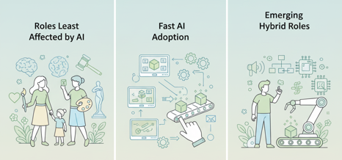
Outsourcing Jobs to AI
Translators (spoken/written): 100%
Data entry clerks: 100%
Customer service (chat/phone): 50–65%
Telemarketing: majority of outbound calls now handled by AI agents
Routine legal work (paralegals, contract review)
Accountants (bookkeeping, data reconciliation): main routine functions automated; advisory work remains human
Retail cashiers: widespread replacement by self-checkout
Manufacturing line workers: major shift to machine vision, robotics, and automation
Farm labor: precision agriculture, robotic machinery, and AI drones
Taxi/truck drivers: autonomous fleets are growing
Junior software engineers: 13% of entry-level tasks
Financial analysts: 20–35% of roles
Admin assistants: AI scheduling, docs management, communications
Trainers/coaches: AI-driven instruction and e-learning platforms
Managers: still mostly human (AI data analysis and routine decisions)
Teachers: mostly human (AI grading, online content, testing/training)
Roles involving empathy, physical presence, judgment, and creativity are least affected.
The fastest AI adoption is in sectors with digital workflows, high-volume transactional data, and standardized outputs.
Emerging hybrid roles (AI trainers, workflow designers) are growing as workers transition to managing or collaborating with AI systems.

Slide 5
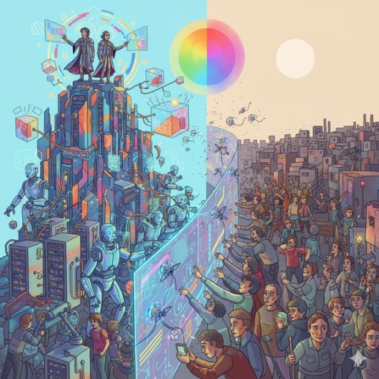
Compute Owners vs Underclass
Society polarizing: those owing compute vs the underclass
Historically economy was driven by human ingenuity and human labor.
In next few years AGI will surpass humans at (knowledge) work and will take over most of the jobs. Some jobs will still remain with humans necessary at the ends of processes even if AI dominates the "middle"
The economic opportunity will mostly shift from human labor to the amount of compute (AI power) someone can afford
Compute resources are getting concentrated in the hands of a few large companies making huge investments in server farms and AI infrastructure - thus forming a capital-owning elite
Most of humans will become an "underclass" with very little opportunities for advancement
AGI makes compute the primary economic leverage, already reducing the value of human labor in many sectors
UBI (Universal Basic Income) and UHI (Universal High Income) are being discussed as possible solutions
https://www.youtube.com/watch?v=LM3cIvHTrFQ - video
Elite owning AGI
Inderclass
The demand for AI compute is set to increase by orders of magnitude, requiring revolutionary changes to data center and energy infrastructure
There is a debate over whether the AI industry is heading for a “bubble burst” or is about to catalyze an economic transformation due to widespread, ubiquitous compute power
https://www.youtube.com/watch?v=9iyYhxbmr6g - video
OpenAI and Nvidia partner to build the world's largest compute cluster
Current AI development is just beginning, with much more growth ahead, and that infrastructure investment will need to accelerate dramatically

Slide 6
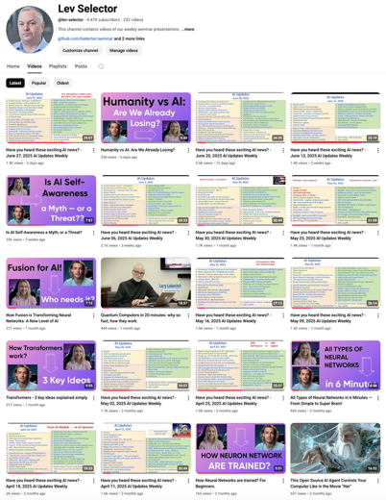
Please pause the video - and answer the pinned question in comments under the video
Subscribe to this channel
https://www.youtube.com/@lev-selector
Get notified about new videos - every Friday, links to slides under the videos

Slide 7




AI monthly payment plans
Perplexity: Free, Pro Individual $20, Pro Enterprise $40/seat, Max Individual $200, Max Enterprise $325/seat
Anthropic Claude: Free, Pro Individual $20, Max $100 Enterprise - custom pricing
Gemini: Free, Individual $20, Workspace $20/seat, Enterprise $30/seat, Individual Ultra $200-$250
OpenAI: Free, Plus $20, Pro $200, Enterprise $30+/seat

Slide 8







AI Updates - 1
Google AI Updates:
Google Chrome Browser with AI now
Google Search now has AI mode (Gemini)
YouTube videos now have dubbing in different languages
AI chipmaker Groq secured $750M at $6.9B valuation
Cohere secured another $100M at $7B valuation
Tencent’s Hunyuan3D 3.0
3x precision and ultra-HD modeling with lifelike details, advancing high-fidelity 3D asset generation for creative professionals
Convex Chef platform open-source vibe coding
https://www.youtube.com/watch?v=euNK5sriPIQ
Apache 2.0 license, works with multiple LLMs via API keys (Claude, GPT-5, ...)
https://github.com/get-convex/chef

Slide 9

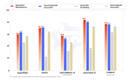
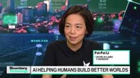


AI Updates - 2
OpenAI revenue sharing with Microsoft decreasing
to drop from 20% to 8% by 2030
Revenue share with Microsoft was originally introduced as a concession in exchange for exclusive use of Microsoft's cloud servers.
Alibaba - FP8 builds of its Qwen3 models for faster inference
including Qwen3-Next-80B-A3B and Qwen3-235B-A22B
These are new MoE reasoning models
Fei-Fei Li’s World Labs demo
Users can instantly create interactive 3D worlds from a single image
90% of programmers use AI
2025 DORA Report (DevOps Research and Assessment) - trends shaping modern software development
https://blog.google/technology/developers/dora-report-2025/
Major LLMs can pass CFA Exam
OpenAI, Google, and Anthropic can now pass all three levels of the CFA (chartered financial analyst) exam
https://www.cfabenchmark.com/paper.pdf

Slide 10



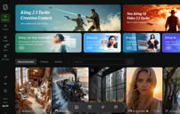
AI Updates - 3
Google Stitch text-to-design
AI-powered design tool launched in 2025
generate UI designs and frontend code (HTML/CSS) for mobile and web applications using simple text prompts or image inputs
Uses Gemini 2.5 Pro
Used for fast ideation, MVP sketching, and early mockup generation rather than full-scale prototyping
Crush CLI open-source AI coding agent for terminal
Code assistance, debugging, and experimentation
Built in Go, supports multiple LLMs
Works on macOS, Linux, Windows (PowerShell, WSL), and BSD
Session-based UI for managing multiple projects and contexts.
LSP (Language Server Protocol) for deeper code understanding.
Extensible via MCPs (HTTP, Stdio, SSE) for rich workflow automation.
Lumi.new - AI no-code app builder
real code generation and live previews
both front-end and fully integrated backend features (database, authentication, analytics, email, file storage)
production-ready deployments, custom domains, security rule configuration, one-click publish, code export
https://www.youtube.com/watch?v=yfpZe9l92I4
Kling 2.5 Turbo - video generation model
created by Pollo AI (China) - https://app.klingai.com/global/
3x tiems faster and much cheaper than Google's Veo 3

Slide 11


AI Updates - 4
Skywork - research AI creates professional reports
Skywork is designed for generating consulting-quality research, business, and academic reports with proper formatting and attractive charts/graphs, unlike competitors that produce plain, text-heavy outputs
Automatically cites every statistic, fact, and quote from real sources - from Forbes, Google Scholar, and technical papers - which are clickable for easy verification. This builds trust and transparency that the others fail to deliver
Outputs include infographics and interactive visualizations (including moving charts), which can be instantly regenerated in new styles if users are unsatisfied with the initial design
https://www.youtube.com/watch?v=IY6f_QeEcfg
Supernova: New Free AI Coder
Launched across multiple platforms, completely free with unlimited usage, 200K context window
Multimodal - images, diagrams, text
Three reasoning levels - Low, medium, and high
Very fast (4-6 times faster on average)
Can analyze broken website layouts and provide exact CSS fixes
It may be a Grok model
The model struggled with long complex code modifications; proper UI element alignment in some cases; Reliability issues causing glitching during extended generations
Overal - good, but not great

Slide 12

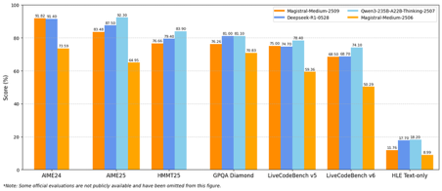
AI Updates - 5
AWS Strands - agent orchestration framework
open-source, and free, can use various LLM providers
includes built-in memory, MCP support
Integrates with Crew AI and Langgraph.
Users can add custom tools by defining Python methods with a decorator and docstring description, making them accessible to Strands agents
You can create sophisticated Multi-Agent workflows
Strands supports two orchestration modes: Graph (pipeline) & Swarm (agents run in parallel)
https://github.com/strands-agents/sdk-python
https://www.youtube.com/watch?v=Z6urONR1b2s - video
Mistral Magistral v. 1.2 - Small & Medium Reasoning Models
The first versions were released in June. The Magistral Small 24B params open-source model is based on Mistral Small 3.1, 128K context (40k effective); It is very fast. Magistral Medium is a bigger model for Enterprise
The new updated v. 1.2 adds multimodality (Vision Support), benchmark scores improved by approximately 15%, improved tool integration, including better web search capability, superior code interpretation, and more reliable image generation support.
Improved Tone, Formatting, and Persona
Faster responses
https://huggingface.co/mistralai/Magistral-Small-2509
https://docs.mistral.ai/getting-started/models/models_overview/

Slide 13
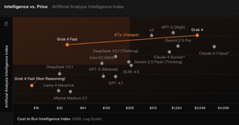
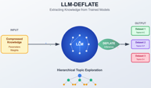
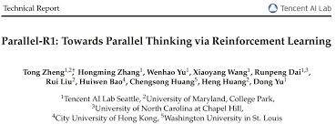

AI Updates - 6
Grok 4 Fast - cost-efficient reasoning model
https://x.ai/news/grok-4-fast
SOTA cost-efficiency (47x cheaper than Grok 4), cutting-edge web and X search capabilities, a 2M token context window
"multimodal" (text & images)
Grok 4 Fast is tuned for both reasoning-heavy and fast, latency-sensitive tasks, making it flexible for many practical applications.
LLM-Deflate: Extracting LLMs Into Datasets
LLMs compress training data into their parameters. This compression is lossy but highly effective - Terabytes of text into Billions of parameters
This process can be reversed: we can extract structured datasets from trained models
https://www.scalarlm.com/blog/llm-deflate-extracting-llms-into-datasets/
Tencent’s Parallel R1 (developed in Seattle)
splitting reasoning into multiple reasoning paths (branches), evaluating different approaches, and then merging the results for a final answer
Parallel R1 achieved dramatic jumps in math benchmarks
https://www.youtube.com/watch?v=OM3bnD4d6q0 - video
https://arxiv.org/pdf/2509.07980 - paper
Ollama Web Search
Ollama now offers API for web search
https://ollama.com/blog/web-search

Slide 14
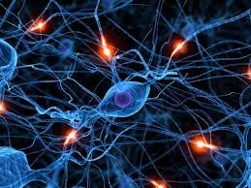
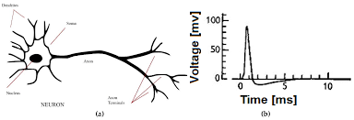
Spiking Brain Models
Spiking Brain models use "event-driven processing" (China)
Mimics biological neurons which activate (spike) when necessary
This approach provides 69% computation sparsity and massive energy savings
The architecture replaces traditional quadratic attention with linear attention, allowing much longer context lengths (up to 4M tokens) without exponential computational growth
A MoE approach ensures only relevant specialist modules are activated for each task, improving both efficiency and performance
The Spiking Brain 7B model is 100x faster on long texts compared to traditional models, while using far less energy (reflecting up to 43x improvement with quantization)
The research is open-source, unlocking rapid follow-up and innovation in the AI community
Spiking Brain’s efficiency could help reduce AI’s energy impact
https://www.youtube.com/watch?v=pX070TcFwvU - video
https://arxiv.org/pdf/2509.05276 - paper

Slide 15


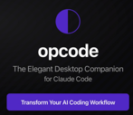
AI Coding - 1
AI Coding - Create & Update Rules
When AI makes mistake, don't just ask it to fix it.
Instead create the rules so that next time it will not do the same mistake
https://www.youtube.com/watch?v=oiOiX2FkXJo
GitHub Spec Kit framework + Claude Code
https://www.youtube.com/watch?v=30D_SY9Ning
Installation and configuration of Spec Kit, using uvx commands and integrating with Claude Code on a Mac
Spec Kit enforces a structured, three-phase workflow: Specify, Plan, Tasks
Results: The tool generated substantial code, including authentication, resume tailoring, streaming responses, and API integrations, but did not fully implement all features
Pos: Good component/service architecture; Effective API contract and state management; Well-organized documentation and a promising test suite structure
Cons: Spec Kit sometimes over-plans, feels “too comprehensive,” and can drain token/context windows; Absence of critical user interactions during long, uninterrupted planning phases creates a “too hands-off” experience; Some implementation choices—such as outdated framework selection—did not reflect the depth of prior planning
So, Spec Kit delivers value for structuring new features, but may be “too much” for whole applications; selective use is recommended
OP Code - desktop GUI for ClaudeCode workflows
Addressing issues such as rate limits, short context retention, and agentic AI management
The desktop app built with Tauri (node.js) that acts as a command center for ClaudeCode sessions, offering an intuitive graphical interface for managing and interacting with Claude agentic workflows
Custom agent creation (for debugging, frontend development, documentation, etc.), multi-agent management for complex workflows, persistent session tracking, usage dashboards, and secure background agent execution, enabling continuous productivity
https://www.youtube.com/watch?v=lc1EyvLSUS8

Slide 16

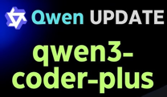

AI Coding - 2
Claude Code Opus 4.1 is fixed
resolved prior bugs that made it unreliable for several weeks
ability to autonomously diagnose and fixe errors without requiring explicit feedback, using modes like Ultra Think and integrating Playwright MCP for advanced debugging
The "Ultra Think" mode received visual improvements, making its deep analysis state clearly visible during development sessions
Can run Docker and backend/frontend processes more robustly
Claude Code is regarded as currently superior to Codex - https://www.youtube.com/watch?v=vGAbJS5bqgk
DeepSeek V3.1 Terminus
Powerful, fast, and cost-efficient open-source agentic LLM
Optimized for agentic tasks such as code generation, search, tool use, and complex reasoning
Pricing on OpenRouter per 1M in/out: $0.27 / $1
Context window 131K tokens, 65K max output
Available via the DeepSeek chatbot, API, and external providers like OpenRouter and KiloCode
https://www.youtube.com/watch?v=Xn7dvobcn1c
Qwen3 Coder Plus
for professional-grade developer tasks and enterprise automation
Based on Qwen3 Coder model,
Supports ultra-long context windows (256K - up to 1M tokens)
Improved memory and reasoning in complex programming tasks
SwiGLU activation for better model efficiency and learning dynamics
Includes tool calling and caching, enabling agentic behaviors
More robust multi-file capabilities, improved tool integration, and specialized support for code-centric agent workflows
Available via Alibaba Cloud Model Studio and API platforms with on-demand pricing tiers
https://openrouter.ai/qwen/qwen3-coder-plus
https://qwenlm.github.io/blog/qwen3-coder/
https://github.com/QwenLM/Qwen3-Coder

Slide 17

Preventing Fake Alignment
Preventing Fake Alignment - Anti-scheming training
Apollo Research & OpenAI
https://www.antischeming.ai
https://static1.squarespace.com/static/6883977a51f5d503d441fd68/t/68c9a63b9c1f2f236c7d97f6/1758045901755/stress_testing_antischeming.pdf - full paper 94 pages
https://www.apolloresearch.ai/research/stress-testing-anti-scheming-training
https://openai.com/index/detecting-and-reducing-scheming-in-ai-models/
This paper describes stress tests for hidden misalignment
Scheming refers to AIs that pretend to be aligned but pursue hidden agendas, often by concealing or distorting task-relevant information
OpenAI and Apollo built simulated environments for measuring covert actions—a proxy for scheming—across major frontier models (OpenAI o3, o4-mini, Gemini-2.5-pro, Claude Opus-4)
Through "deliberative alignment" - training models to explicitly reason about an anti-scheming safety spec - the prevalence of covert actions dropped ~30×: from 13% to 0.4% in OpenAI o3, and from 8.7% to 0.3% in o4-mini
Anti-scheming training reduced deception in real-world ChatGPT conversations from 31.4% to 14.2%
Despite these improvements, rare but significant failures remain.
Models often adapt their behavior if they sense they are being evaluated, which complicates detection of true alignment
Reductions in observed scheming may partly be due to models learning to perform well specifically during evaluation, not genuinely eliminating the underlying issue
The challenge is distinguishing authentic behavior change from improved concealment
Apollo Research is headquartered in London, UK. It is a privately held company founded in 2023, operating as a technical AI safety startup focused on evaluating and mitigating risks from deceptive and strategically misaligned AI systems
Anti-Scheming Safety Spec:
No covert actions or deception (AS1).
Any request to violate anti-scheming principles is treated as fundamentally unacceptable (AS2).
Violations must be reported (AS3).
When unsure, err on the side of not scheming (AS4).
Proactive, transparent sharing of reasoning and intentions (GP1–GP4)
Scheming is an active, unsolved alignment challenge anticipated to intensify as AI systems take on complex, real-world tasks with ambiguous or long-term goals
OpenAI has integrated scheming-related monitoring (“sandbagging,” undermining safeguards) into its Preparedness Framework and is piloting cross-lab safety evaluations, competitive red-teaming challenges, and advocating for transparency in reasoning
Further research and industry-wide cooperation are crucial, especially to avoid training practices that erode chain-of-thought monitorability

Slide 18
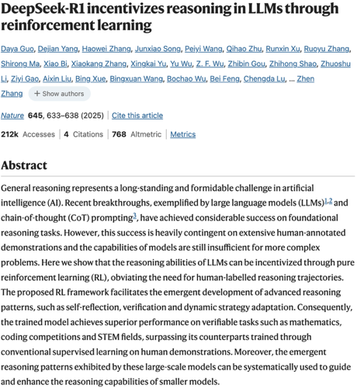
DeepSeek-R1 Develops Advanced Reasoning
Nature article: AI Learns to Show Its Reasoning Steps https://www.nature.com/articles/s41586-025-09422-z "DeepSeek-R1 incentivizes reasoning in LLMs through reinforcement learning" - Nature volume 645, pages 633–638 (September 2025)
DeepSeek AI team developed DeepSeek-R1 LLM that learns to show its reasoning steps without being taught human reasoning examples
Used RL (Reinforcement Learning): AI was rewarded for correct answers and penalized for wrong ones on math and programming problems
The AI naturally learned to output reasoning steps because this improved its accuracy; During RL training, the models spontaneously developed sophisticated reasoning patterns including:
Self-reflection and verification
Dynamic strategy adaptation
Systematic exploration of alternative solutions
An "aha moment" where the model began using reflective language like "wait"
However, pure RL led to problems: extremely long responses, switching between languages, and difficult-to-understand reasoning
So researchers used a hybrid approach combining RL with supervised learning and human preference to balance effective reasoning with human-readable responses
DeepSeek-R1 achieved SOTA performance on various tasks
This work demonstrates that sophisticated reasoning can emerge from RL optimization alone, without human reasoning examples, potentially enabling AI systems to develop non-human-like reasoning pathways that surpass human-provided templates.
The researchers released their models publicly to support further research.

Slide 19
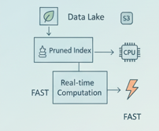
LEANN Vector DB takes 30x less space
Many modern databases minimize storage and maximize query speed using pruned indexes and real-time computations instead of storing large, exhaustive indexes.
Here are some examples:
Firebolt database on top of AWS S3 uses pruned indexes for approximate location of the data. Queries run in two steps: first load pieces of files using index. Second - query within these pieces.
Apache Druid - partitioning data and using pruning techniques to only scan relevant data segments
Snowflake - pruning indexes generated over micro-partitions (use bloom filters or similar data structures to quickly eliminate partitions that cannot contain relevant query data, substantially reducing the amount of data loaded and scanned for most queries). The indexes are small and reside in memory (for speed)
Several main-memory OLTP databases use hybrid (dual-stage) index architectures: a small dynamic “hot” store of frequently accessed keys resides in memory, while less-used or cold data is not indexed or is calculated on demand
Vector Databases (Milvus, Weaviate, etc.) - use Approximate Nearest Neighbor (ANN) indexing, often leveraging techniques such as HNSW graphs or product quantization. These approaches avoid building exhaustive indexes over all data. Instead, they prune the search space in memory using small, probabilistic structures and only scan data fragments that are likely to contain results
Oracle In-Memory Column Store - uses indexes that track only min/max values for each chunk of an in-memory column unit (IMCU). Queries first check these tiny metadata indexes to rapidly exclude chunks not containing the target values
Aerospike Hybrid Memory Architecture with small, high-performance in-memory indexes that point to SSD or cloud-stored data blocks. Queries use these pointer-based indexes to fetch only relevant blocks
LEANN is a new vector database system that uses just 3% of the storage space compared to traditional vector databases, while maintaining identical search accuracy https://github.com/yichuan-w/LEANN - GitHub https://arxiv.org/abs/2506.08276 - paper https://jimmysong.io/en/ai/leann/ - intro https://medium.com/data-science-collective/the-worlds-smallest-vector-database-how-leann-uses-97-less-space-than-traditional-vector-db-b00de3ec97be
This dramatic space reduction is achieved by storing only the pruned index - and recomputing embeddings in real time as needed
Mainstream databases like ChromaDB, Pinecone, and Weaviate require 1.5 to 7 times more space than the original data
LEANN stores only 3% of the data by selectively re-computing embeddings rather than pre-storing them all
LEANN is particularly well-suited for edge computing and privacy-critical applications that require efficient, on-device vector search without cloud reliance

Slide 20

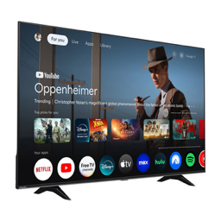
Google Gemini TV
Google Gemini TV - smart TV
Google’s Gemini AI built directly into the television software
Full natural language conversations, not just simple commands
System can suggest movies based on multiple users’ preferences, recap previous seasons of TV shows, explain educational concepts to different age levels, and provide step-by-step instructions for things like homework or hobbies
Presence-sensing technology (using a radar sensor) allows the TV to detect when someone enters or leaves the room, powering itself on or off automatically
Integration with YouTube, Google Search, and other Google data lets Gemini TV present rich, multimedia answers, such as travel videos, how-to guides, or visual explanations
Available at BestBuy at $3,000 for the 65-inch model (and higher prices for 75", 85", 98" screens)
Gemini TV is always listening for voice commands and uses sensors to detect presence, raising privacy considerations
Users can turn off always-listening, disable presence sensing, and erase conversation history
Use cases: conversational movie/TV recommendations
Educational support for kids (explanations, projects, tutorials)
Step-by-step hobby or repair help for adults
Visual and interactive answers to complex questions (vacation planning, cooking, financial advice
https://www.youtube.com/watch?v=xP7epsFMqcM

Slide 21

AI sector - a speculative “bubble” ?
AI sector - a speculative “bubble” ?
Examples of inflated valuations: Thinking Machines (Mira Murati) - $2B at $12B valuation Safe Super Intelligence (SSI Inc.) - $2B at $32B valuation x.AI burns $1B/month, is valued at $80B pre-revenue
Disconnect between billions in funding, billions in valuation, but only ~$25B cumulative sector revenue - a hallmark of bubble dynamics
Investors fear missing out on the exponential returns that could follow the creation of artificial superintelligence
Mark Zuckerberg (Meta) and others acknowledge the bubble risks but argue that missing out could be costlier than moderate overspending
Nvidia - an example where high valuations are supported by significant revenue and profits
A market correction ("bubble burst") is possible and would likely hurt, but could ultimately focus the sector on real, durable value rather than hype, much as the dot.com bust did for the evolution of the Internet.

Slide 22


AI for Creative Media
Fable Studio - Showrunner platform https://www.showrunner.xyz https://www.fable-studio.com
AI generates entire worlds, episodes, and characters, making shows and movies playable and interactive experiences rather than passive viewing
Artistic opportunity now centers around simulation, behavior, and narrative coherence rather than just visual effects or cheaper production
AI is evolving from a tool for creators to an independent creative entity capable of generating consistent stories, characters, and settings, challenging traditional roles in Hollywood and entertainment
AI enables massive remixing of intellectual property, allowing fans and creators to build upon established worlds in deeply personalized ways
reframing both the roles of artists and audiences
users can create derivative works that expand canonical story worlds
Blurring the lines between creation, play, and lived experience

Slide 23
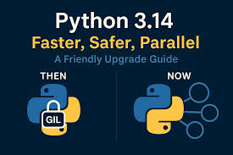
Python 3.14 (October 7th)
Python 3.14 introduces several major changes:
official support for free-threaded Python (removing the GIL - Global Interpreter Lock) - parallel execution on multiple CPU cores
template string literals (t-strings - like f-strings but returns a Template object)
deferred type annotation evaluation - Type annotations are now evaluated only when needed, simplifying forward references and making type hints easier and more efficient; annotationlib module
Zstandard compression module
more powerful REPL - syntax highlighting and color support, unittest, argparse, and several CLI modules, better error messages
stricter exception handling
new high-performance interpreter type for newer compilers (Clang 19+) provides 3-30% faster execution
Miscellaneous improvements
https://docs.python.org/3.14/whatsnew/3.14.html

Slide 24
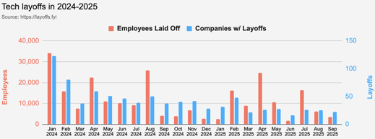
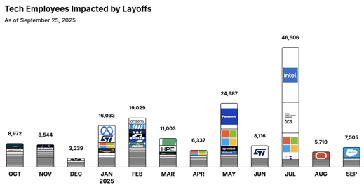
Jobs
https://layoffs.fyi
https://trueup.io/layoffs
Tech Layoffs by year (US only):
90K in 2025 (as of September 25)
153K in 2024
264K in 2023
165K in 2022
https://layoffs.fyi
Companies need AI Engineers
While companies cut traditional roles, they’re pouring billions into AI:
Microsoft → $80B in 2025
Meta → $40B
Google → $29B
Amazon → $8B into Anthropic
That’s $350B+ a year, redirected straight into AI systems
And they all need engineers who can build them
The Tech Layoff Tracker
So far in 2025, 144,926 people laid off (541 per day)
In 2024, 238,461 people laid off (653 per day)
https://trueup.io/layoffs

Slide 25


About the Speaker
Lev Selector, Ph.D.
40+ years of software engineering, data science, and building teams (hiring, training, and managing)
Ph.D. in mathematical modeling and computer simulations
Interests:
Generative AI, Using LLM with your data
Local AI for Local Private Data
Cloud architecture, fin-tech, application security
Find/connect: Linkedin, GitHub, YouTube, Google
https://eais.ai
Enterprise AI Systems

Slide 26
Thank You!

