Slide 1


THE FRANK-WOLFE Algorithm
Gonghan Xu

Slide 2
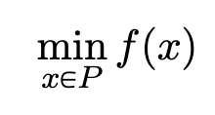
The optimization problem
P is a compact convex set. f(x) is convex.

Slide 3
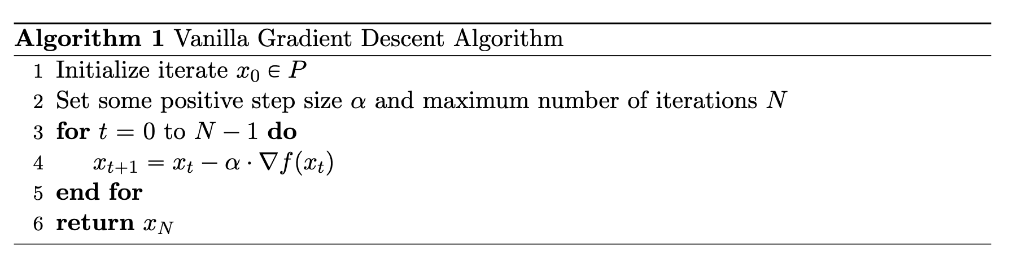
Naïve Gradient Descent

Slide 4


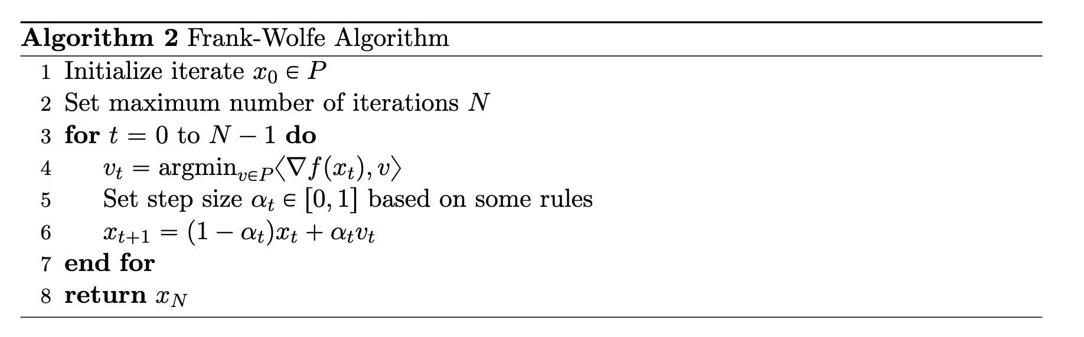
The Frank-Wolfe Algorithm
The target point:
Descent step:

Slide 5
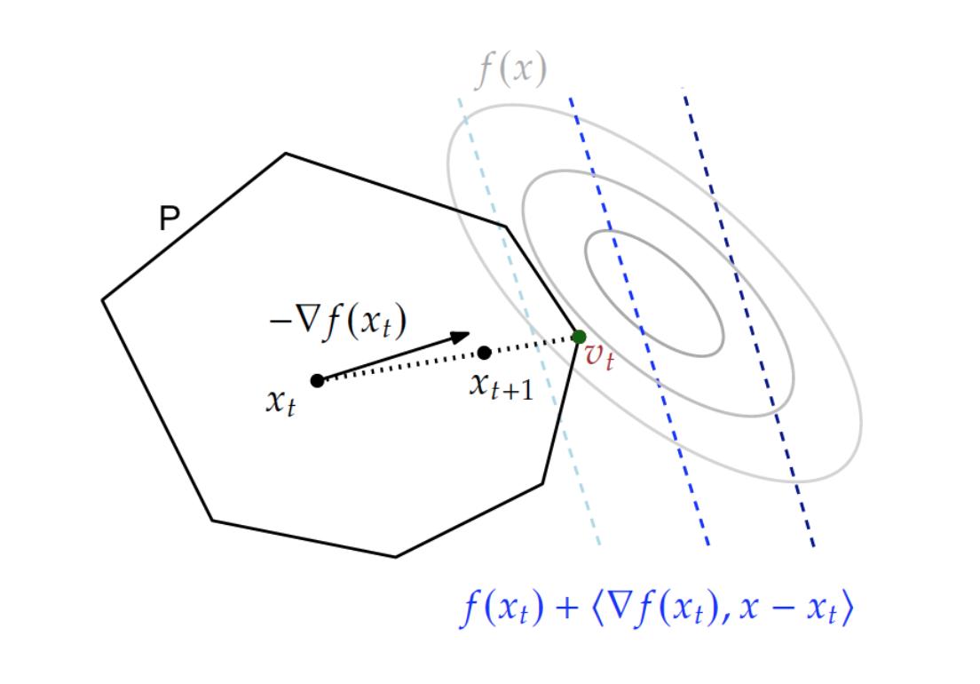
The Illustration

Slide 6
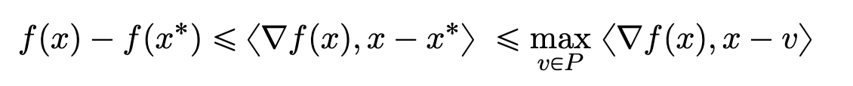
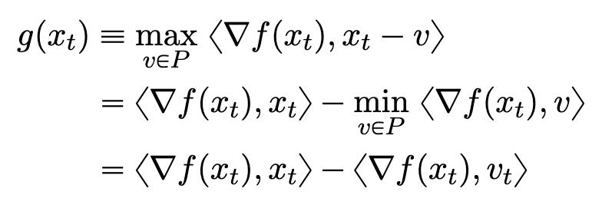
The Frank-Wolfe Gap
Suboptimality
Frank-Wolfe Gap g(x)

Slide 7
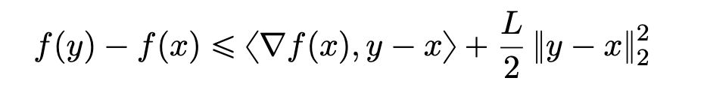
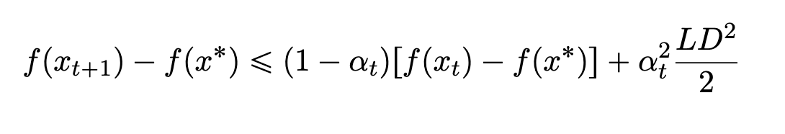
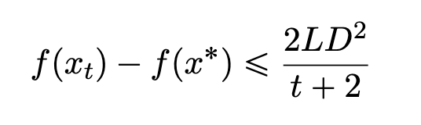
Towards Convergence

Slide 8
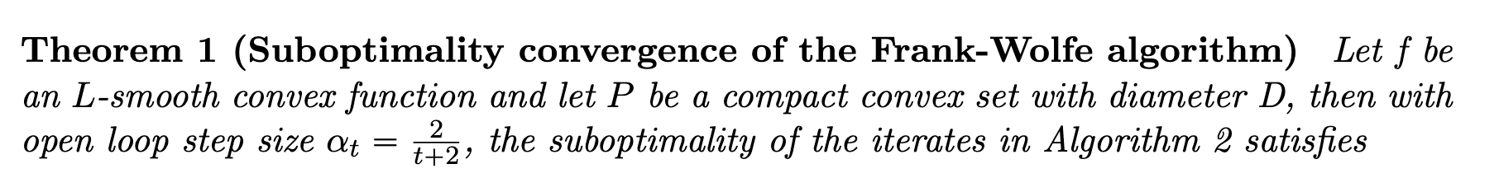
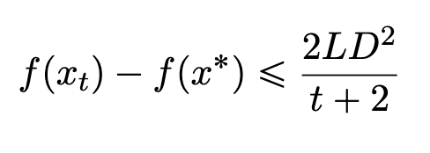
Proved by induction!

Slide 9
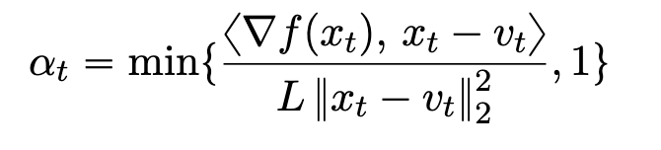
Step Size Choices
1. Constant step size
2. Open loop step size: 2/t+2
3. Short step:
4. Line search:

Slide 10
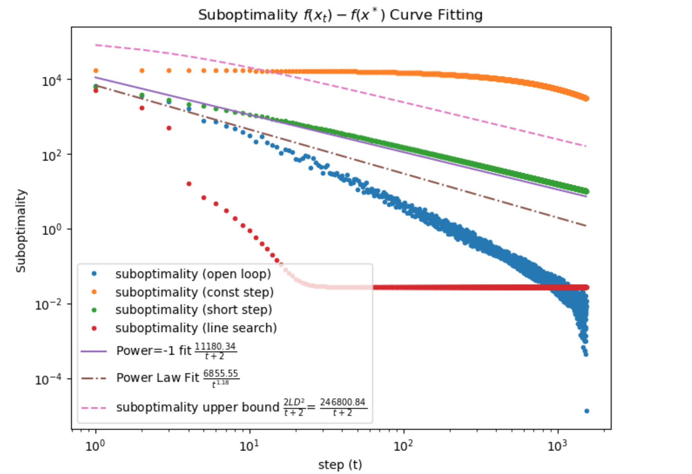
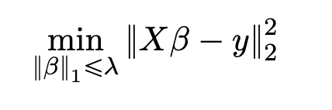
Experiment on Lasso Problem

