Slide 1
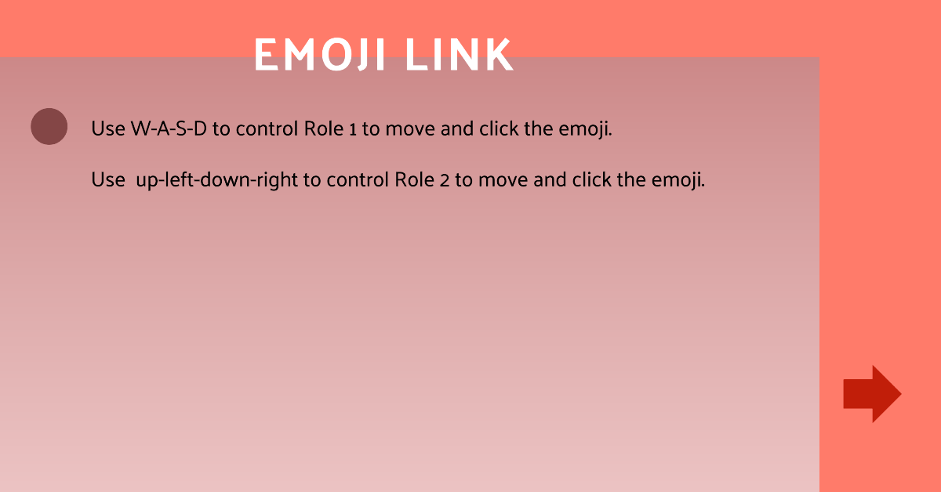






Item:
Diszzy the other player for 10s,
the direction of movement is reversed
Increase time by 30s
Reset the place of emoji.
Use the mouse to control the role.
(keyboard available) 5s
Hint the linkable emoji for 10s.
Freeze the other player for 3s (unable
to move)
Click to continue

