Slide 1
Statistics
Descriptive stats

Slide 2
Learning Objectives & Agenda

Slide 3

What You'll Be able to do
Be able to
Estimate measures of where the distribution is centered (mean, median)
Estimate how spread out points are (variance and standard deviation)
Interpret graphical representations of distributions

Slide 4
Motivating Example

Slide 5
Tire Defects
We have a log of the number of defects found in a particular store
Sales | Defects Found
01/01 | 2
01/08 | 6
01/15 | 3
……. | ……..
What questions might we have about this data?
How would we describe it?
Notes:
Give them a few minuets to brainstorm some ideas. This is the first example in the course, so it is worthwhile allowing them to get started

Slide 6
Tire Defects
Here are some ideas:
What are the typical number of defects I might expect? This can help me know how many to over-order. This is a measure of central tendency.
How much variation can I expect? This also helps me know how many to over-order. Is it relatively constant, or does it change wildly? This is a measure of spread.
Is the typical number of defects staying the same? Imagine improvements in the manufacturing process that reduce the number of defects. Is that happening? If we are ordering more tires, we might expect to see more defects. Questions of "is the distribution the same" are hypothesis tests (covered tomorrow)
…. and many more!
Notes:
Be open about the questions. We don't expect them to hit only the questtons on this slide!
They might use the actual technical terms (e.g. average number of defects). Here the goal is to use the more general terms (e.g. central tendancy) before commiting to which one to use (mean, median, etc)
Spread could be standard deviation, or interquartile range, or range for example.
If they brainstorm ideas that come up in the course, let them know if this is something that will be covered today or tomorrow

Slide 7
Tire Defects
Two basic modes of looking at the data:
Descriptive: - What is the mean of this sample of data? - What is the std. dev. or range of this sample of data? ….. Information about the data we collected only.
Parametric: - What is the chance that there are 6 defects in next weeks batch? - Is the average number of defects changing? - Do different types of tires have different defect ratest? Questions that try to generalize (e.g. predict) from the sample. Requires assumptions.
Notes:
The important thing to emphasize here is that it isn't an either/or situation. You may have some people that want to exclusively focus on descriptive, because that is what we "know". Others may want to focus exclusively on the theoretical distributions.
For the descriptive only camp, exercise 2 is useful in the tire_defects workbook. It has the number of tires ordered fluctuation, and intuitively (i.e. with an underlying distribution in mind) we expect that ordering more tires will lead to more defects, but that the proportion of defects might not change too much. In the very simple cases, descriptive statistics might be enough but the world is often more complicated!

Slide 8
Descriptive Statistics

Slide 9
Exercise
Open spreadsheet "tire_defects.xlsx"
Make sure you are on sheet "TireDefects_Ex1"
In Column E, there are some cells with FILLIN
In cell E3, enter =AVERAGE(B$2:B$61) This will calculate the average number of defects per week.
Copy and paste this formula into cell E4. Do you get the same number?
Copy and paste this formula into cell F3. Do you get the same number?
What is the $ sign doing?
Remember: Only need to touch cells with yellow backgrounds. Not all cells will be filled in this exercise.
Notes:
This is the first formula that they will be looking at. It is an example of using formulas on arrays, and a gentle introduction to the $ (anchor) sign. The choice was made because the dollar sign looks similar to an anchor – the reference won't get updated if you copy and paste it elsewhere.
For Q4: They should get a number around 7.5
For Q5: They should get the same number (copying and pasting to a different row still uses B$2:B$61 as the numbers are anchored)
For Q6: They should get #DIV/0. The columns are not anchored, so when they copy and paste the CELL, the formula will be updated to the range C$2:C$61. To get the expected behavior, we would need to anchor the column as well: $B$2:$B$61.
Note: if they do get the same number for Q6, it is possible they are interpreting "copy and paste" as "copy the formula (as text) and then paste it into the new cell". This is a good chance to reiterate what the

Slide 10

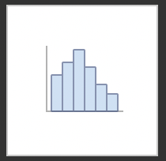
Exercise
In this exercise we are going to visualize the data.
Highlight the cells B2 to B61 (i.e. the sales).
Click "Insert" on the toolbar
Click on the histogram icon
Choose the plain histogram
You will probably need to right click on the graph. Select Format Data Series → Bins --> Bin Width and set the value to 2.0
Notes:
The goal here is just to get them used to making a histogram to visualize the data, so that we have the histogram to introduce the concepts of median, percentiles, IQR, etcetera.
Personally I cannot find how to add labels to the axes (not change the label names from the bins, but to add a legitimate x-axis telling you "number of defective tires"). My old method was to click on the default axis and edit it, but one isn't provided anymore. I have given up – please edit this note if you find how to do it!

Slide 11
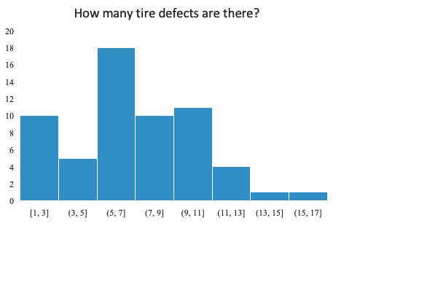
Median and Mean (Average)
Both measures of the location of the "center" of the distribution.
median
mean
Mean: =AVERAGE(…)
If every value in the data set was the mean, you would get the same total. e.g. if we had X defects every week, then the total number of defects are the same
Useful for estimation of costs, amortization
Skewed by outliers
# of weeks with this many defects
Median: =MEDIAN(…)
Half the data is less or equal to median, half is greater than median
Not skewed by outliers
Good for determining what the typical week looks like
Does not amortize correctly
Defects in this week
Notes:
Some good points to make:
if you want to estimate how many defects to anticipate in a typical week (say stock space is limited) then the median is probably more useful, you just have to realize there may be a few weeks where you run short (outliers) and customers are unhappy
When doing budgets, the mean is probably more useful. You can think of $50000 in defective tires being replaced over 61 weeks as having to budget $820 per week (the totals are the same).
Note in this example (no outliers/weird examples) the mean and median are close. It is when we have extreme values in the data they pull apart. It is still worth thinking about whether you are more interested in a _typical_ value (median) or an _amotized_ value (mean) when doing your analysis
In statistics, people will refer to both of these as "averages". In common parlance, "average" almost always means "mean" (as is the case with Excel formulas)
Note that we are giving the Excel formulas as part of the description

Slide 12

Percentiles and IQR
The Xth percentile is a value that has X% of data less or equal to it.
The median is the 50th percentile. We would find it using either =MEDIAN(…) or =PERCENTILE(…, 0.5)
Two other commonly used percentiles: The 25th percentile (called the lower quartile)
The 75th percentile (called the upper quartile)
LQ
UQ
# of weeks with this many defects
Half the data lie inside the shaded rectangle, gives us an idea of the range of typical values. UQ – LQ is called the Interquartile Range (IQR)
Defects in this week
Other percentile ranges can be used if you want to be more conservative. e.g. Planning stock so that you know 95% of weeks you don't run out, use 95th percentile.
Notes:
The definition at the top is technically correct: there are generally multiple percentiles. For example, in [1,2,3,4,5], 1, 1.1, 1.5, 1.9 are all examples of 20th percentiles. This isn't worth drawing attention to unless someone is objecting to the use of "a value" rather than "the value".
In addition to quartiles, quintiles and deciles are also in common use

Slide 13
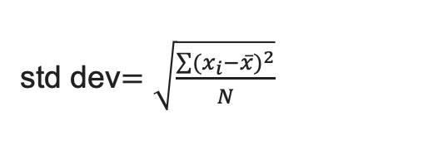
Spread: Standard Deviation
The standard deviation (intuitively) is the average deviation from the mean.
To stop positive deviations and negative deviations from cancelling, we square each deviation in the formula. Also referred to as the Root-Mean Squared deviation
mean
# of weeks with this many defects
std dev$=\sqrt{\frac{\sum{{(x_{i}−\overline{x})}^{2}}}{N}}$
Here xbar is the mean, and N is the number of data points. Excel formula is =stdev(..)
Defects in this week
Std dev large: values spread out from mean Std dev small: values close to mean.
Comparison of IQR (grey)
to +/- 1 std dev from mean (purple)
Notes:
I tell them that I can never remember if the Excel formula is "stdev" or "stddev" (it’s the former)
Mention it is common to measure points as "how many std dev it is from the mean" (z score) as a method of determining how typical the point is.

Slide 14
Descriptive Statistics Summary
Quantity | Formula | Measures | Robust (i.e. not sensitive to outliers)
Mean | =AVERAGE(…) | Centrality | No
Median | =MEDIAN(…) | Centrality | Yes
Percentile | =PERCENTILE(…, x) | Distribution | Yes
IQR | Difference of 75th and 25th percentiles | Spread | Yes
Standard deviation | =STDEV(…) | Spread | No

Slide 15
Exercise
In the sheet tire_defects.xlsx, fill in cells E5-E9
i.e. calculate the median, 25th percentile, 75th percentile, IQR, and standard deviation

Slide 16
Array Formula

Slide 17
Frequency Bin Counts
Array Formula: entering many formula at once!
Highlight E13:E21
Type =FREQUENCY(B$1:B$61, D$13:D$21)
Instead of pressing "return", press "control + shift + return"
You should get the frequency of each bin in column E, with the bins given by column D.
This is dynamic (if the bins change, the frequencies change). If you are okay with static, the Data → Data Analysis → Histogram provides a guided way of creating frequency tables
Notes:
This may take a couple of attempts. Common sources of error are people deselecting the range highlighted in 1 when doing step 2 (e.g. just entering the formula in the first step, or pressing return at the end of step 2

Slide 18
Recap

Slide 19
Takeaways
Measure location of a data set (mean and median)
Measure spread of a data set (IQR and std dev)
Bin by frequency (array formula)
Plot histogram of data
Notes:
2

Slide 20
QUESTIONS?

