Slide 1
Statistics
Discrete Distributions

Slide 2
Learning Objectives & Agenda

Slide 3

What You'll Be able to do
Be able to
Identify an appropriate distribution for a variety of problems
Distinguish between a statistic and a parameter
Estimate parameters for Binomial and Poisson distributions
Calculate probabilities and cumulative probabilities from Binomial and Poisson distributions

Slide 4
Motivating Example

Slide 5
Tire Defects
We have a log of the number of defects found in a particular store
Sales | Defects Found
01/01 | 2
01/08 | 6
01/15 | 3
……. | ……..
How would you estimate the number of defects next week?
Notes:
This is the same example from last time. The difference is in the question being asked.

Slide 6
Tire Defects
Here are some ideas:
Calculate the average of previous weeks defects
Calculate the 95th percentile of previous defects, and claim the number will be smaller than that with 95% probability (conservative estimate of how many won't be available to customers)
Would these answers hold if we were ordering a varying number of tires a week (e.g. if we ordered 25 more tires every week than previous weeks, is the second calculation still reasonable?)
If we are willing to model this process, we can answer this question even if fluctuation order number
Notes:
Ask if they think the second bullet point is reasonable BEFORE revealing the next point.
The point of this slide is to motivate why we need metal models ("generative models") for our processes in the first place. There is a temptation to say "let's just use the data" as suggested in the second bullet point, and that modeling a process is too suseptible to unwarranted "ivory tower" assumptions.
If people are struggling with the second part, a good intro is to ask what do they think will happen if you doubled the number of tires ordered (most groups would expect the number of defects to double as well). We are implicitly using a mental model where there is a probability (iid) of a tire being defective

Slide 7
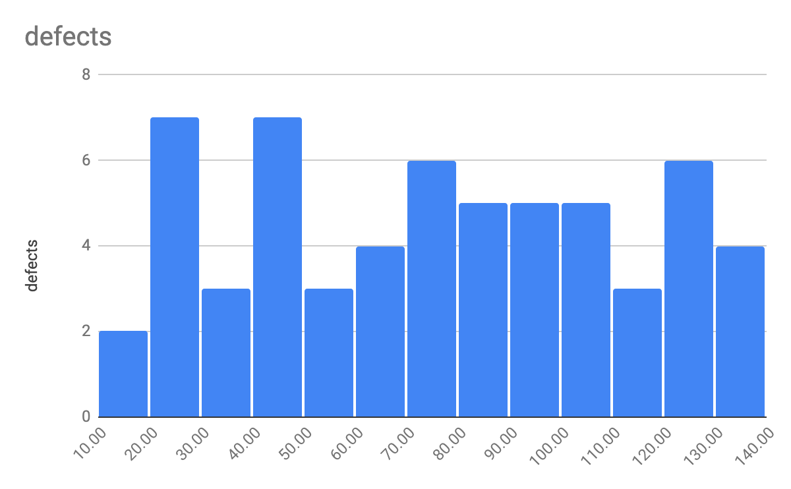
Tire Defects
Ordering more tires each week: 95th percentile not very informative

Slide 8
Tire Defects
As we increase the number of tires ordered, we see an increase in the number of defects
We would say the number of defects in a batch and number ordered in a batch are correlated
Notes:
Excel defaults to exporting ALL elements to white (even though they appear black in Excel). Can replace with a screenshot, but it is simpler just to change background to light grey. Just ensure that they numbers/labels are converted to black so they are visible.
We are coming back to the idea of correlation later (and correlation coefficient) but this is a good place to let them see it.

Slide 9
Binomial Distribution

Slide 10
Introduction to the Binomial Distribution
We have a fixed number of independent "trials" N
Each trial has one of two results (usually called "success" and "failure")
The probability p of "success" is the same trial to trial
The binomial distribution tells us what the probability of having S successes in N trials is.
Terminology: N, p: Parameters. These are things we need to calculate the probability. They are (assumed) known and fixed
S: Random variable. The thing we are trying to calculate.
Quantity | Formula | Measures | Robust (i.e. not sensitive to outliers)
Mean | =AVERAGE(…) | Centrality | No
Median | =MEDIAN(…) | Centrality | Yes
Percentile | =PERCENTILE(…, x) | Distribution | Yes
IQR | Difference of 75th and 25th percentiles | Spread | Yes
Standard deviation | =STDEV(…) | Spread | No

Slide 11
Our example
Next week we have an order of 200 tires coming in. We know from looking at previous orders that we can expect 4% of tires to be defective (on average). We want to know
What is the probability that we have no defective tires?
What is the probability that we have (exactly) 1 defective tire?
What is the probability that we have less than 5 defective tires in this batch (we are pretty sure we will need at least 196 on-hand)
Assume Binomial!
Each tire can either be defective ("success" – weird, I know!) or not. Two outcomes.
Each tire is its own trial. We are ordering 200 tires (i.e. N = 200)
We assume that each tire is independently defective or not. This wouldn't be true if a batch was defective because of poor rubber processing for a batch, but would probably hold for random machining errors.
We know that 4% of tires historically have been defective. If each tire is independent, reasonable to assume probability of any one tire being defective is p=0.04
Notes:
Worth pointing out here "success" usually means "thing that we are looking for" (in this case, we are looking for defects, so "success" would be a defective tire). We could use a different name, but so many books and webpages use "success" for the outcome that using something else would make it hard to refer to other references.

Slide 12
Probability of Zero Defective Tires
Each tire has a probability of 0.04 of being defective, so a 0.96 probability of being fine.
0 defects means that all the tires are good. Since the tires are independent, the probabilities multiply: P(all good) = 0.96 x 0.96 x 0.96 x ….. 0.96 = (0.96)²⁰⁰ = 0.00028 i.e a 0.028% chance of all being good. In Excel, we can get this result with =BINOMDIST(0, 200, 0.04, FALSE) i.e. Probability of getting 0 defects, with 200 trials, probability of defect as 0.04, not cumulative.

Slide 13
Probability of One Defective Tire
P(only tire 1 is defective) = 0.04 x 0.96 x 0.96 x …. x 0.96 = (0.04)(0.96)¹⁹⁹ P(only tire 2 is defective) = 0.96 x 0.04 x 0.96 x …. x 0.96 = (0.04)(0.96)¹⁹⁹ P(only tire 3 is defective) = 0.96 x 0.96 x 0.04 x …. x 0.96 = (0.04)(0.96)¹⁹⁹ ….. P(only tire 200 is defective) = 0.04 x 0.96 x 0.96 x …. x 0.04 = (0.04)(0.96)¹⁹⁹ Lots of possibilities, but same number 200 times! Since we don't care which tire is defective, we have P(only 1 tire defective) = 200(0.04)(0.96)¹⁹⁹ = 0.0023 = 0.23% Using Excel, we can get this with =BINOMDIST(1, 200, 0.04, FALSE)
Notes:
I would not try pointing out how to calculate the number of pairs, but you can tell them that the number of pairs for 200 tires is 200.199/2 = 19900, so the sophistication grows rapidly. Luckily Excel can help us (I deliberately didn’t show the binomial formula nCs p^s (1-p)^{n-s} because it wouldn't be useful for the typical member of this audience)
Bottom line: we are going to move to Excel to do these calculations for us!

Slide 14
Probability of S Defective Tires
Let's use Excel to speed this process up for us:
S – Number of defects | Prob of S defects
0 (A2) | =BINOMDIST(A2, 200, 0.04, False)
1 | 0.00237173
2 | 0.0098328
3 | 0.0270402
4 | 0.05548874
5 | 0.09063161
6 | 0.12273031
7 | 0.14172429
8 | 0.14246243
9 | 0.12663327
10 | 0.10077898
11 | 0.07253033
12 | 0.04759803

Slide 15
Exercise
Open spreadsheet "tire_binomial.xlsx"
Make sure you are on sheet "Binomial_Ex1"
In column B, calculate the probability using BINOMDIST
You should get P(0 defects) = 0.00028 P(1 defect) = 0.00237 etc This answers our first two questions. What is the probability of having less than 5 defects (i.e. 0, 1, 2, 3 or 4 defects)?
Get a scatter plot for the probability of the number of defects vs number of defects
Remember: Only need to touch cells with yellow backgrounds. Not all cells will be filled in this exercise.
Notes:
for parts 1 – 3 they should be able to self evaluate. Part 4 is P(0) + P(1) + P(2) + P(3) + P(4) = 0.095 (i.e. 9.5%). I don't expect them to know about the cumulative sum argument at this point – that is what we will do next.
For question 5, a bar graph is the "correct" graph, but Excel processes it strangely. It would take some effort to make the graph look nice (or at least it did for me) while the scatter plot comes out almost exactly the way I want.

Slide 16
Getting Probability of Fewer than 5 Defective Tires
Can combine the probability that we have 0, 1, 2, 3, or 4 defects: P(S <= 5) = P(0) + P(1) + P(2) + P(3) + P(4) = 0.095 = 9.5%
Can also use the "cumulative" argument in Binomial distribution: =BINOMDIST(4, 200, 0.04, TRUE) returns 0.095 or 9.5%

Slide 17
Distributions and Inference

Slide 18
Distributions and Expected Values
In a sample of actual data, we had the descriptive statistics: Mean, Median, Percentiles, IQR, Standard Deviation A statistic is a property of a sample. When talking about distributions, we need to know parameters. For the binomial distribution, these are the number of trials (N) and the probability (p) of success. We can ask what do we expect a very large sample to have as its statistic given the parameters? We have analogous distribution properties: e.g. Distribution Mean = Expected value of the sample mean of a large sample Distribution S.D. = Expected value of the sample S.D. of a large sample
Notes:
Since this is an introduction to statistics, it probably isn't worth discussing the difference between a biased estimator and an unbiased estimator. For example, the replacement of n in the distribution (or populaion) SD to (n-1) in the denominator is a well-known example of reducing the bias in the statistic estimating the population parameter.
The statement isn't _wrong_ (except in the sense that I am using the "large N" as a colloquial way of saying "the limit as N → oo) as even in the SD case, the bias tends to zero as N → oo, it just does approaches it from below
E(std dev of size N without debiasing) < std dev, but difference approaches 0 in the limit)

Slide 19
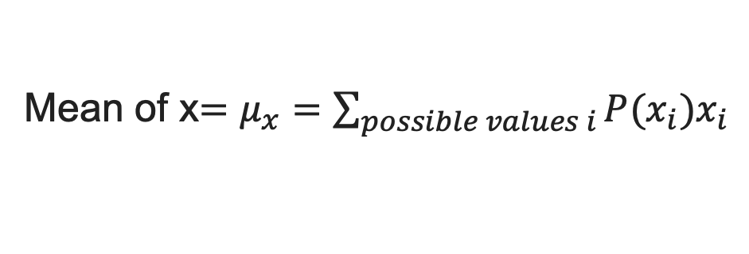
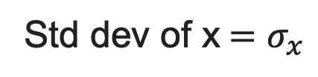
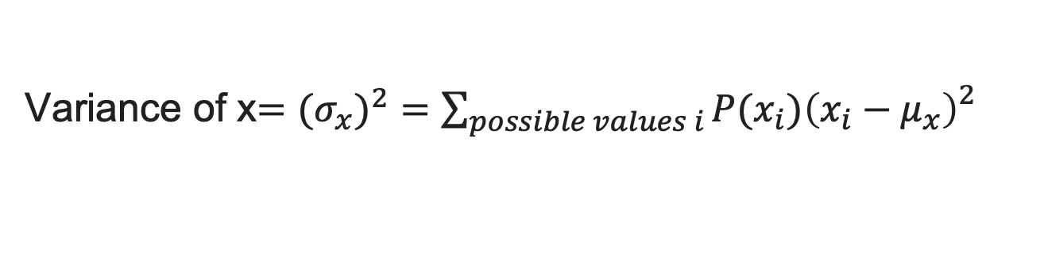
Mean and Standard Deviation of Distribution
There are formula we can use for general (discrete) distributions
Mean of x$=μ_{x}=\sum_{possible values i}{P(x_{i})x_{i}}$
For standard deviation, it is convenient to define the variance first
Variance of x$={{(σ}_{x})}^{2}=\sum_{possible values i}{P(x_{i}){{\left(x_{i}−μ_{x}\right)}_{}^{2}}_{}}$
The standard deviation is then the square root of the variance
Std dev of x$=σ_{x}$
Notes:
You can tell them this is a "cocktail slide": it is so they have seen the defintiions and can impress the boss at cocktail parties. We don't expect them to use these formula.

Slide 20
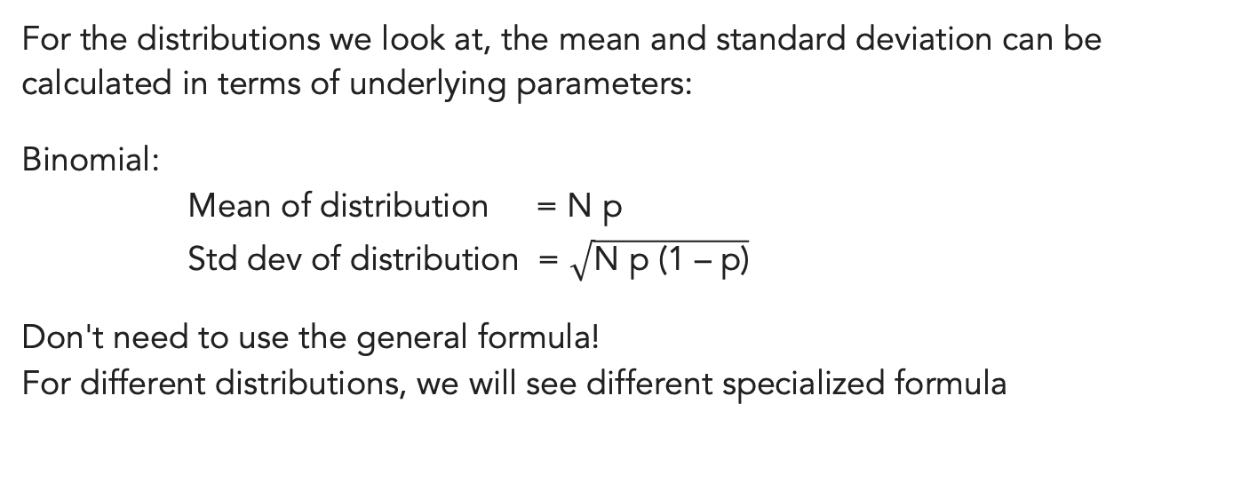
For Binomial Only
For the distributions we look at, the mean and standard deviation can be calculated in terms of underlying parameters:
Binomial: Mean of distribution = N p Std dev of distribution = $\sqrt{\text{N} \text{p}\text{ (1 – }\text{p}\text{)}}$
Don't need to use the general formula! For different distributions, we will see different specialized formula

Slide 21
Inference
The binomial distribution has two parameters, N and p. N is the number of trials (e.g. number of tires ordered). It seems easy to see how we could set that. p is the probability of success. Binomial assumes we know this, but usually we don't set it directly. Solution: For large sample, use the sample Mean ~ Np. If the sample is large, this equation is approximately true. We have use the sample to infer the value of the parameter. p ~ (Sample Mean of successes) / (Number in sample)

Slide 22
Exercise
1. Open tire_binomial.xlsx
2. Go to sheet TireDefects_Ex2
3. Find the total number of defects over the 60 weeks
4. Calculate the total number of tires ordered over the 60 weeks
5. Infer p by taking the total number of defects and dividing it by the total number of tires ordered. Warning: number is different from 4% used in example!
6. If we are ordering 500 tires next week, what is the probability fewer than 30 having defects?
Notes:
Answers: Q3: 4506 defects
Q4: 56250 tires ordered
Q5: roughly 0.08, or 8%
Q6: Roughly 3.6%, using BINOM.DIST(29, 500, <answer to Q5>, TRUE). Note: looking for FEWER than 30, not less than or equal to 30

Slide 23
Summary of Inference For Binomial Problems
Pool historical data: find total number of trials N_{tot} and total number of successes S_{tot}
Estimate p with S_{tot}/N_{tot}
For next experiment (e.g. next weeks order) we know N. Use the p found in step 2. Warning: If you suspect p has changed over time, you want to restrict step one to only sum where p is (assumed) the same. Hardest parts of inference: Has p changed? (Hypothesis testing) How confident are we in step 2? (Confidence Intervals)

Slide 24
Poisson Distribution
Notes:
This section will be shorter, because we have introduced some of the big concepts already

Slide 25
Motivating Example
We are trying to predict the number of calls coming into a call center in an hour. Could we model this with a binomial distribution? i.e. a "success" is a call that arrives.
No
Don't have a fixed number of trials, could get any number of calls (no upper limit N)
Don't have single trials with probability p
Need another distribution / model!
Notes:
Actually, if it serves EXISTING customers you could model this as a binomial process, where N is the number of customers, and p is the (small!!) probability that a particular customer rings in the next hour. The real reason to discourage modeling the problem this way is that the binomial factors are hard to deal with.
Note that
mean = Np
variance = Np(1-p) ~ Np (because p <<< 1)
So in this limit of large N, small p, the two distributions do converge.
Here I am drawing an artifically hard line for clarity, but if someone argues the point that you _could_ model this with a binomial, it is a fair point.
I suspect that since this is in the section "Poisson Distribution" participants will anticipate the expected answer is no.

Slide 26
Poisson Distribution
The Poisson Distribution gives the probability of getting S events ("successes") in a time t under the following assumptions:
Successes are independent (a call coming in doesn't affect if other customers try and call)
Successes occur at random (e.g. people are not only calling at the quarter hour marks)
The rate of successes isn’t changing (e.g. if we double the amount of time, we expect the number of calls received to approximately double as well)
In a call center, the last bullet isn't true over long intervals (different times of day have different "business") but it is approximately true over ~ 1 hour intervals
Notes:
Technically the Poisson distribution only needs to count some number of successes per some continuous interval, where the rate of success is proportional to the length of the continuous interval. It is most commonly time, although sometimes you will also see the Poisson process used for looking at potholes along a road (ie. the rate here is "potholes per mile")

Slide 27
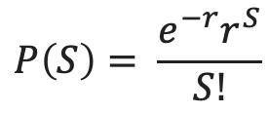
Poisson distribution
The Poisson distribution has one parameter: r, the rate of successes per interval.
The formula the probability of having S successes in an interval is
$$P\left(S\right)= \frac{e^{−r}r^{S}}{S!}$$
In Excel, we can calculate this using =POISSON.DIST(S, r, False) We can also calculate the probability of S or fewer successes in the interval with =POISSION.DIST(S, r, True)

Slide 28
Exercise
Open spreadsheet "call_poisson.xlsx"
Make sure you are on sheet "CallCenter_Ex1"
Time to do some inference! What are the average number of calls per hour (note: same time every day)
What is the average number of calls per 15 minutes?
Fill in the probabilities of getting S calls in the next 15 minutes (assume between 2 and 3 PM). Hint: use the rate inferred in parts 3 and 4!
Notes:
Q3: 18.2 calls/hour (data was generated with rate of 18, so this is pretty good)
Q4: 4.55 calls/15 mins, using proportionality assumption
Q5: Lots of answers, but for sanity checks, P(0) ~ 1.05%, P(2) ~ 10.9% and P(6) ~ 13%. P(4) is highest at 18.9%

Slide 29
Mean and Standard Deviation for Poisson
The formula for the mean and variance of the Poisson distribution is very simple: Mean successes per unit time = r
Variance in successes per unit time = r i.e. the mean and variance are both equal, and they are equal to the only parameter! The standard deviation is square root of the variance

Slide 30
Recap

Slide 31
Takeaways
Binomial distribution: - fixed trials N, and success probability p - Mean = Np, Variance = Np(1-p) - BINOMIAL.DIST(…., N, p, False) to get probability
Poisson distribution: - fixed rate r - counts successes, but could have 0, 1, 2, ….. successes - Mean = r, Variance = r - POISSON.DIST(…., r, False) to get probability
Cumulative probability: useful for getting probability that successes are lower (or higher) than a cutoff
Used Inference: using sample mean for a large sample to estimate a population parameter (p for binomial, r for Poisson)
Notes:
If there is time, might poll class to get examples of what other things they think might be modeled by a Poisson or Binomial process

Slide 32
To come
How do we know how good our inference is? Or at least, what our uncertainty is? This is tackled by confidence intervals.
How do we know if a population parameter is changing? For example, we might be interested to know if a new treatment decreased defects, or if two plants have the same defect rate. This is hypothesis testing.
These are both interesting questions, but before addressing them we will need to look at some continuous distributions – in particular the normal distribution.

Slide 33
QUESTIONS?

