Slide 1
Course Overview
Statistics

Slide 2
Your Instructor
<INSERT PICTURE OF INSTRUCTOR HERE>

Slide 3

What You'll Be able to do
This course covers
Using statistics to summarize the data that you have
Using inference to estimate parameters, in order to generalize the data you have
Estimating the uncertainty you have in estimating parameters using confidence intervals
Testing if two populations are different with Hypothesis testing
Notes:
This is not a point-by-point recap of the learning outcomes. Instead, it is written for the audience attending to give them an idea of what they should walk away with. For example neither , correlation, nor Law of Large Numbers are explicitly mentioned, but those are more tools to aid understanding to "do things" rather than things participants would want to do.

Slide 4
Tools Used
Excel The focus of this training will be showing you how to use Excel for analysis You will need Excel installed The data analysis plugin is useful, but not required. (It can be found via Data → Data Analysis on the far right)
Python notebooks Python notebooks are used for generating data and demonstrating concepts You don't need to have Python installed for this course The Python material will be demonstration only

Slide 5
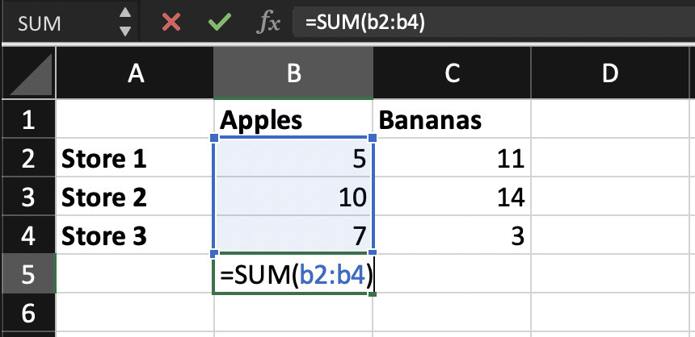
Excel Conventions
Each cell has an address e.g. the cell being entered is B5
Cell contents in Excel use this font
An array of cells is start:stop. e.g. B2:B4 are the cells highlighted in blue
An Excel formula starts with "=", to distinguish it from text. e.g. =SUM(B2:B4) says fill this cell with the result of SUM on B2:B4
Excel is case-insensitive
We will indicate cells you should edit with a yellow background
Notes:
Some things you might want to show them:
If you want a formula to appear, place ' (the apostrophe) before the = sign so Excel interprets it as text
Copy and pasting cells, and how the formula references get updated (i.e. it using relative positioning)
The Anchor ($) to keep cell references fixed. This gets covered in the first lecture and we prompt them to explain it. You can either leave it out and have them learn it there, or use that question as a checkpoint for understanding if they learn it here

Slide 6
Agenda
Notes:
2

Slide 7
QUESTIONS?

