Slide 1
Statistics
Parametric stats

Slide 2
Learning Objectives & Agenda

Slide 3

What You'll Be able to do
Be able to
Identify an appropriate distribution for a variety of problems
Distinguish between a statistic and a parameter
Estimate parameters for Binomial, Poisson, and Normal distributions
Calculate probabilities and cumulative probabilities from Binomial, Poisson, and Normal distributions

Slide 4
Motivating Example

Slide 5
Tire Defects
We have a log of the number of defects found in a particular store
Sales | Defects Found
01/01 | 2
01/08 | 6
01/15 | 3
……. | ……..
How would you estimate the number of defects next week?
Notes:
This is the same example from last time. The difference is in the question being asked.

Slide 6
Tire Defects
Here are some ideas:
Calculate the average of previous weeks defects
Calculate the 95th percentile of previous defects, and claim the number will be smaller than that with 95% probability (conservative estimate of how many won't be available to customers)
Would these answers hold if we were ordering a varying number of tires a week (e.g. if we ordered 25 more tires every week than previous weeks, is the second calculation still reasonable?)
If we are willing to model this process, we can answer this question even if fluctuation order number
Notes:
Ask if they think the second bullet point is reasonable BEFORE revealing the next point.
The point of this slide is to motivate why we need metal models ("generative models") for our processes in the first place. There is a temptation to say "let's just use the data" as suggested in the second bullet point, and that modeling a process is too suseptible to unwarranted "ivory tower" assumptions.
If people are struggling with the second part, a good intro is to ask what do they think will happen if you doubled the number of tires ordered (most groups would expect the number of defects to double as well). We are implicitly using a mental model where there is a probability (iid) of a tire being defective

Slide 7
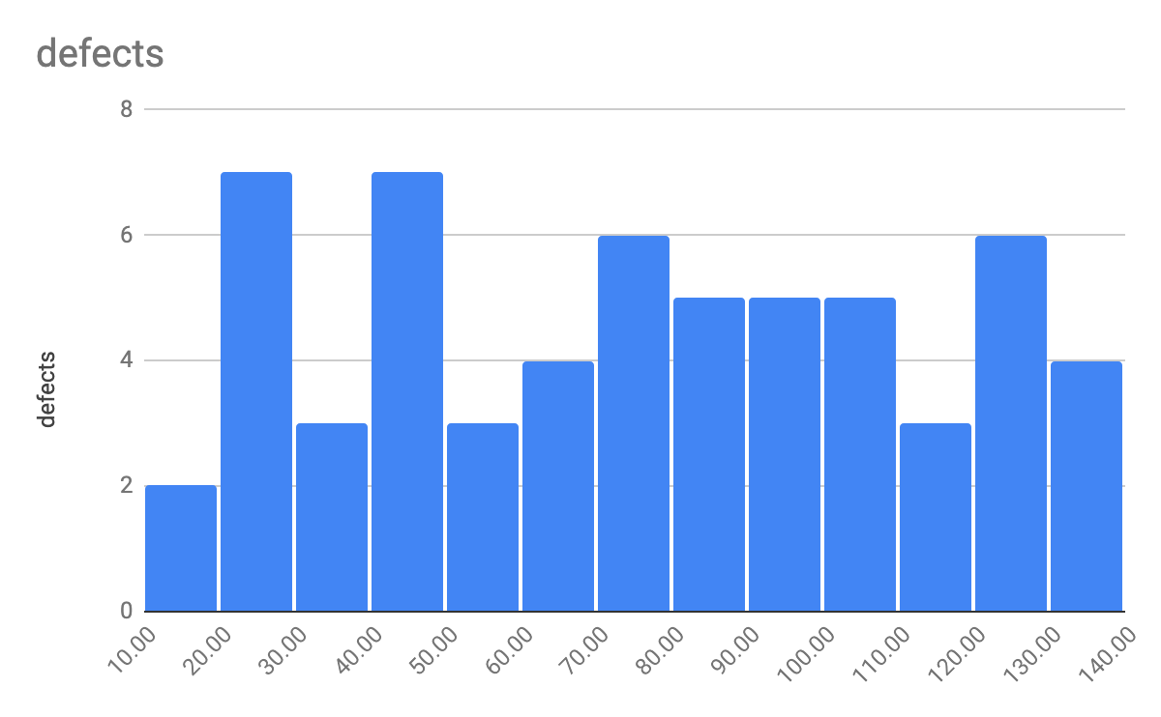
Tire Defects
Ordering more tires each week: 95th percentile not very informative

Slide 8
Tire Defects
As we increase the number of tires ordered, we see an increase in the number of defects
We would say the number of defects in a batch and number ordered in a batch are correlated
Notes:
Excel defaults to exporting ALL elements to white (even though they appear black in Excel). Can replace with a screenshot, but it is simpler just to change background to light grey. Just ensure that they numbers/labels are converted to black so they are visible.
We are coming back to the idea of correlation later (and correlation coefficient) but this is a good place to let them see it.

Slide 9
Binomial Distribution

Slide 10
Introduction to the Binomial Distribution
We have a fixed number of independent "trials" N
Each trial has one of two results (usually called "success" and "failure")
The probability p of "success" is the same trial to trial
The binomial distribution tells us what the probability of having S successes in N trials is.
Terminology: N, p: Parameters. These are things we need to calculate the probability. They are (assumed) known and fixed
S: Random variable. The thing we are trying to calculate.
Quantity | Formula | Measures | Robust (i.e. not sensitive to outliers)
Mean | =AVERAGE(…) | Centrality | No
Median | =MEDIAN(…) | Centrality | Yes
Percentile | =PERCENTILE(…, x) | Distribution | Yes
IQR | Difference of 75th and 25th percentiles | Spread | Yes
Standard deviation | =STDEV(…) | Spread | No

Slide 11
Our example
Next week we have an order of 200 tires coming in. We know from looking at previous orders that we can expect 4% of tires to be defective (on average). We want to know
What is the probability that we have no defective tires?
What is the probability that we have (exactly) 1 defective tire?
What is the probability that we have less than 5 defective tires in this batch (we are pretty sure we will need at least 196 on-hand)
Assume Binomial!
Each tire can either be defective ("success" – weird, I know!) or not. Two outcomes.
Each tire is its own trial. We are ordering 200 tires (i.e. N = 200)
We assume that each tire is independently defective or not. This wouldn't be true if a batch was defective because of poor rubber processing for a batch, but would probably hold for random machining errors.
We know that 4% of tires historically have been defective. If each tire is independent, reasonable to assume probability of any one tire being defective is p=0.04
Notes:
Worth pointing out here "success" usually means "thing that we are looking for" (in this case, we are looking for defects, so "success" would be a defective tire). We could use a different name, but so many books and webpages use "success" for the outcome that using something else would make it hard to refer to other references.

Slide 12
Probability of Zero Defective Tires
Each tire has a probability of 0.04 of being defective, so a 0.96 probability of being fine.
0 defects means that all the tires are good. Since the tires are independent, the probabilities multiply: P(all good) = 0.96 x 0.96 x 0.96 x ….. 0.96 = (0.96)²⁰⁰ = 0.00028 i.e a 0.028% chance of all being good. In Excel, we can get this result with =BINOMDIST(0, 200, 0.04, FALSE) i.e. Probability of getting 0 defects, with 200 trials, probability of defect as 0.04, not cumulative.

Slide 13
Probability of One Defective Tire
P(only tire 1 is defective) = 0.04 x 0.96 x 0.96 x …. x 0.96 = (0.04)(0.96)¹⁹⁹ P(only tire 2 is defective) = 0.96 x 0.04 x 0.96 x …. x 0.96 = (0.04)(0.96)¹⁹⁹ P(only tire 3 is defective) = 0.96 x 0.96 x 0.04 x …. x 0.96 = (0.04)(0.96)¹⁹⁹ ….. P(only tire 200 is defective) = 0.04 x 0.96 x 0.96 x …. x 0.04 = (0.04)(0.96)¹⁹⁹ Lots of possibilities, but same number 200 times! Since we don't care which tire is defective, we have P(only 1 tire defective) = 200(0.04)(0.96)¹⁹⁹ = 0.0023 = 0.23% Using Excel, we can get this with =BINOMDIST(1, 200, 0.04, FALSE)
Notes:
I would not try pointing out how to calculate the number of pairs, but you can tell them that the number of pairs for 200 tires is 200.199/2 = 19900, so the sophistication grows rapidly. Luckily Excel can help us (I deliberately didn’t show the binomial formula nCs p^s (1-p)^{n-s} because it wouldn't be useful for the typical member of this audience)
Bottom line: we are going to move to Excel to do these calculations for us!

Slide 14
Probability of S Defective Tires
Let's use Excel to speed this process up for us:
S – Number of defects | Prob of S defects
0 (A2) | =BINOMDIST(A2, 200, 0.04, False)
1 | 0.00237173
2 | 0.0098328
3 | 0.0270402
4 | 0.05548874
5 | 0.09063161
6 | 0.12273031
7 | 0.14172429
8 | 0.14246243
9 | 0.12663327
10 | 0.10077898
11 | 0.07253033
12 | 0.04759803

Slide 15
Exercise
Open spreadsheet "tire_binomial.xlsx"
Make sure you are on sheet "Binomial_Ex1"
In column B, calculate the probability using BINOMDIST
You should get P(0 defects) = 0.00028 P(1 defect) = 0.00237 etc This answers our first two questions. What is the probability of having less than 5 defects (i.e. 0, 1, 2, 3 or 4 defects)?
Get a scatter plot for the probability of the number of defects vs number of defects
Remember: Only need to touch cells with yellow backgrounds. Not all cells will be filled in this exercise.
Notes:
for parts 1 – 3 they should be able to self evaluate. Part 4 is P(0) + P(1) + P(2) + P(3) + P(4) = 0.095 (i.e. 9.5%). I don't expect them to know about the cumulative sum argument at this point – that is what we will do next.
For question 5, a bar graph is the "correct" graph, but Excel processes it strangely. It would take some effort to make the graph look nice (or at least it did for me) while the scatter plot comes out almost exactly the way I want.

Slide 16
Getting Probability of Fewer than 5 Defective Tires
Can combine the probability that we have 0, 1, 2, 3, or 4 defects: P(S <= 5) = P(0) + P(1) + P(2) + P(3) + P(4) = 0.095 = 9.5%
Can also use the "cumulative" argument in Binomial distribution: =BINOMDIST(4, 200, 0.04, TRUE) returns 0.095 or 9.5%

Slide 17
Distributions and Inference

Slide 18
Distributions and Expected Values
In a sample of actual data, we had the descriptive statistics: Mean, Median, Percentiles, IQR, Standard Deviation A statistic is a property of a sample. When talking about distributions, we need to know parameters. For the binomial distribution, these are the number of trials (N) and the probability (p) of success. We can ask what do we expect a very large sample to have as its statistic given the parameters? We have analogous distribution properties: e.g. Distribution Mean = Expected value of the sample mean of a large sample Distribution S.D. = Expected value of the sample S.D. of a large sample
Notes:
Since this is an introduction to statistics, it probably isn't worth discussing the difference between a biased estimator and an unbiased estimator. For example, the replacement of n in the distribution (or populaion) SD to (n-1) in the denominator is a well-known example of reducing the bias in the statistic estimating the population parameter.
The statement isn't _wrong_ (except in the sense that I am using the "large N" as a colloquial way of saying "the limit as N → oo) as even in the SD case, the bias tends to zero as N → oo, it just does approaches it from below
E(std dev of size N without debiasing) < std dev, but difference approaches 0 in the limit)

Slide 19
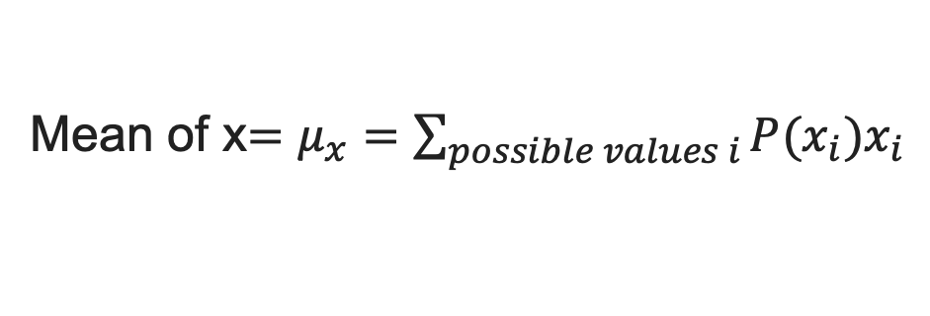
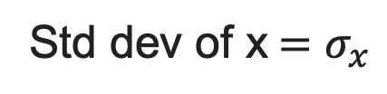
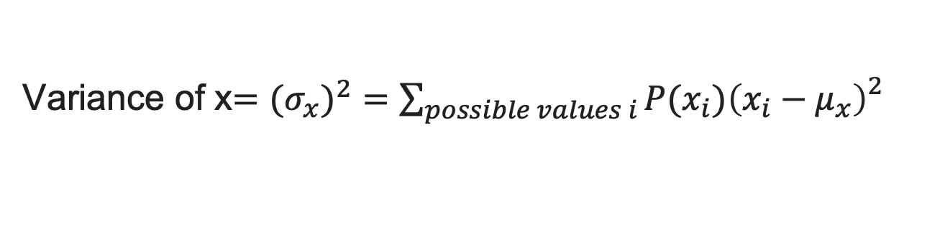
Mean and Standard Deviation of Distribution
There are formula we can use for general (discrete) distributions
Mean of x$=μ_{x}=\sum_{possible values i}{P(x_{i})x_{i}}$
For standard deviation, it is convenient to define the variance first
Variance of x$={{(σ}_{x})}^{2}=\sum_{possible values i}{P(x_{i}){{\left(x_{i}−μ_{x}\right)}_{}^{2}}_{}}$
The standard deviation is then the square root of the variance
Std dev of x$=σ_{x}$
Notes:
You can tell them this is a "cocktail slide": it is so they have seen the defintiions and can impress the boss at cocktail parties. We don't expect them to use these formula.

Slide 20
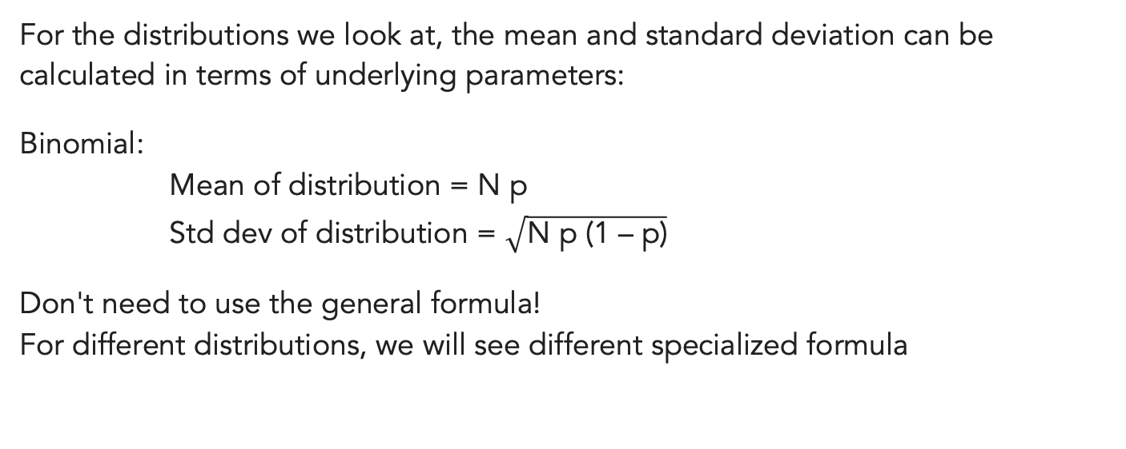
For Binomial Only
For the distributions we look at, the mean and standard deviation can be calculated in terms of underlying parameters:
Binomial: Mean of distribution = N p Std dev of distribution = $\sqrt{\text{N} \text{p}\text{ (1 – }\text{p}\text{)}}$
Don't need to use the general formula! For different distributions, we will see different specialized formula

Slide 21
Inference
The binomial distribution has two parameters, N and p. N is the number of trials (e.g. number of tires ordered). It seems easy to see how we could set that. p is the probability of success. Binomial assumes we know this, but usually we don't set it directly. Solution: For large sample, use the sample Mean ~ Np. If the sample is large, this equation is approximately true. We have use the sample to infer the value of the parameter. p ~ (Sample Mean of successes) / (Number in sample)

Slide 22
Exercise
1. Open tire_binomial.xlsx
2. Go to sheet TireDefects_Ex2
3. Find the total number of defects over the 60 weeks
4. Calculate the total number of tires ordered over the 60 weeks
5. Infer p by taking the total number of defects and dividing it by the total number of tires ordered. Warning: number is different from 4% used in example!
6. If we are ordering 500 tires next week, what is the probability fewer than 30 having defects?
Notes:
Answers: Q3: 4506 defects
Q4: 56250 tires ordered
Q5: roughly 0.08, or 8%
Q6: Roughly 3.6%, using BINOM.DIST(29, 500, <answer to Q5>, TRUE). Note: looking for FEWER than 30, not less than or equal to 30

Slide 23
Descriptive Statistics

Slide 24
Exercise
Open spreadsheet "tire_defects.xlsx"
Make sure you are on sheet "TireDefects_Ex1"
In Column E, there are some cells with FILLIN
In cell E3, enter =AVERAGE(B$2:B$61) This will calculate the average number of defects per week.
Copy and paste this formula into cell E4. Do you get the same number?
Copy and paste this formula into cell F3. Do you get the same number?
What is the $ sign doing?
Remember: Only need to touch cells with yellow backgrounds. Not all cells will be filled in this exercise.
Notes:
This is the first formula that they will be looking at. It is an example of using formulas on arrays, and a gentle introduction to the $ (anchor) sign. The choice was made because the dollar sign looks similar to an anchor – the reference won't get updated if you copy and paste it elsewhere.
For Q4: They should get a number around 7.5
For Q5: They should get the same number (copying and pasting to a different row still uses B$2:B$61 as the numbers are anchored)
For Q6: They should get #DIV/0. The columns are not anchored, so when they copy and paste the CELL, the formula will be updated to the range C$2:C$61. To get the expected behavior, we would need to anchor the column as well: $B$2:$B$61.
Note: if they do get the same number for Q6, it is possible they are interpreting "copy and paste" as "copy the formula (as text) and then paste it into the new cell". This is a good chance to reiterate what the

Slide 25

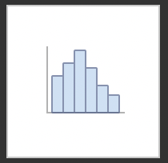
Exercise
In this exercise we are going to visualize the data.
Highlight the cells B2 to B61 (i.e. the sales).
Click "Insert" on the toolbar
Click on the histogram icon
Choose the plain histogram
You will probably need to right click on the graph. Select Format Data Series → Bins --> Bin Width and set the value to 2.0
Notes:
The goal here is just to get them used to making a histogram to visualize the data, so that we have the histogram to introduce the concepts of median, percentiles, IQR, etcetera.
Personally I cannot find how to add labels to the axes (not change the label names from the bins, but to add a legitimate x-axis telling you "number of defective tires"). My old method was to click on the default axis and edit it, but one isn't provided anymore. I have given up – please edit this note if you find how to do it!

Slide 26
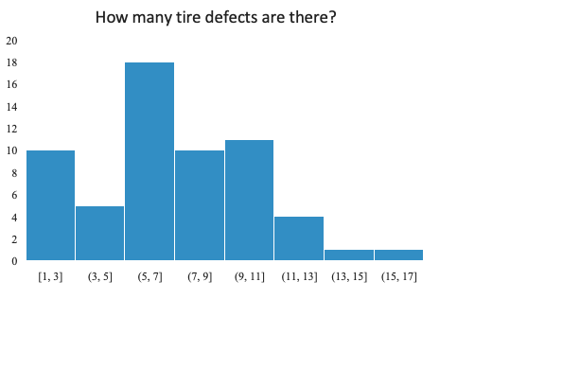
Median and Mean (Average)
Both measures of the location of the "center" of the distribution.
median
mean
Mean: =AVERAGE(…)
If every value in the data set was the mean, you would get the same total. e.g. if we had X defects every week, then the total number of defects are the same
Useful for estimation of costs, amortization
Skewed by outliers
# of weeks with this many defects
Median: =MEDIAN(…)
Half the data is less or equal to median, half is greater than median
Not skewed by outliers
Good for determining what the typical week looks like
Does not amortize correctly
Defects in this week
Notes:
Some good points to make:
if you want to estimate how many defects to anticipate in a typical week (say stock space is limited) then the median is probably more useful, you just have to realize there may be a few weeks where you run short (outliers) and customers are unhappy
When doing budgets, the mean is probably more useful. You can think of $50000 in defective tires being replaced over 61 weeks as having to budget $820 per week (the totals are the same).
Note in this example (no outliers/weird examples) the mean and median are close. It is when we have extreme values in the data they pull apart. It is still worth thinking about whether you are more interested in a _typical_ value (median) or an _amotized_ value (mean) when doing your analysis
In statistics, people will refer to both of these as "averages". In common parlance, "average" almost always means "mean" (as is the case with Excel formulas)
Note that we are giving the Excel formulas as part of the description

Slide 27
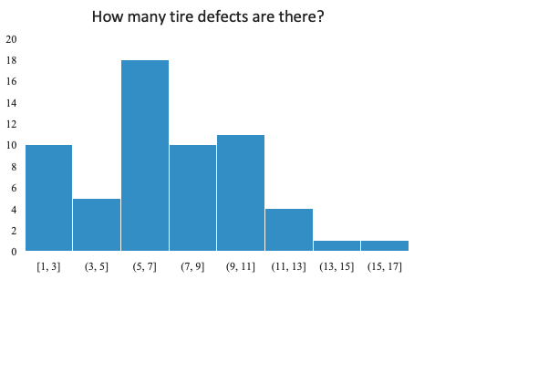
Percentiles and IQR
The Xth percentile is a value that has X% of data less or equal to it.
The median is the 50th percentile. We would find it using either =MEDIAN(…) or =PERCENTILE(…, 0.5)
Two other commonly used percentiles: The 25th percentile (called the lower quartile)
The 75th percentile (called the upper quartile)
LQ
UQ
# of weeks with this many defects
Half the data lie inside the shaded rectangle, gives us an idea of the range of typical values. UQ – LQ is called the Interquartile Range (IQR)
Defects in this week
Other percentile ranges can be used if you want to be more conservative. e.g. Planning stock so that you know 95% of weeks you don't run out, use 95th percentile.
Notes:
The definition at the top is technically correct: there are generally multiple percentiles. For example, in [1,2,3,4,5], 1, 1.1, 1.5, 1.9 are all examples of 20th percentiles. This isn't worth drawing attention to unless someone is objecting to the use of "a value" rather than "the value".
In addition to quartiles, quintiles and deciles are also in common use

Slide 28
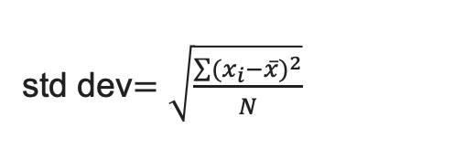
Spread: Standard Deviation
The standard deviation (intuitively) is the average deviation from the mean.
To stop positive deviations and negative deviations from cancelling, we square each deviation in the formula. Also referred to as the Root-Mean Squared deviation
mean
# of weeks with this many defects
std dev$=\sqrt{\frac{\sum{{(x_{i}−\overline{x})}^{2}}}{N}}$
Here xbar is the mean, and N is the number of data points. Excel formula is =stdev(..)
Defects in this week
Std dev large: values spread out from mean Std dev small: values close to mean.
Comparison of IQR (grey)
to +/- 1 std dev from mean (purple)
Notes:
I tell them that I can never remember if the Excel formula is "stdev" or "stddev" (it’s the former)
Mention it is common to measure points as "how many std dev it is from the mean" (z score) as a method of determining how typical the point is.

Slide 29
Descriptive Statistics Summary
Quantity | Formula | Measures | Robust (i.e. not sensitive to outliers)
Mean | =AVERAGE(…) | Centrality | No
Median | =MEDIAN(…) | Centrality | Yes
Percentile | =PERCENTILE(…, x) | Distribution | Yes
IQR | Difference of 75th and 25th percentiles | Spread | Yes
Standard deviation | =STDEV(…) | Spread | No

Slide 30
Exercise
In the sheet tire_defects.xlsx, fill in cells E5-E9
i.e. calculate the median, 25th percentile, 75th percentile, IQR, and standard deviation

Slide 31
Array Formula

Slide 32
Frequency Bin Counts
Array Formula: entering many formula at once!
Highlight E13:E21
Type =FREQUENCY(B$1:B$61, D$13:D$21)
Instead of pressing "return", press "control + shift + return"
You should get the frequency of each bin in column E, with the bins given by column D.
This is dynamic (if the bins change, the frequencies change). If you are okay with static, the Data → Data Analysis → Histogram provides a guided way of creating frequency tables
Notes:
This may take a couple of attempts. Common sources of error are people deselecting the range highlighted in 1 when doing step 2 (e.g. just entering the formula in the first step, or pressing return at the end of step 2

Slide 33
Recap

Slide 34
Takeaways
Measure location of a data set (mean and median)
Measure spread of a data set (IQR and std dev)
Bin by frequency (array formula)
Plot histogram of data
Notes:
2

Slide 35
QUESTIONS?

