Slide 1
Course Overview
Statistics

Slide 2
Learning Objectives & Agenda

Slide 3

What You'll Be able to do
Be able to
Understand the use of branches
Set up branches
Merge conflicting work
Best practices

Slide 4
Agenda
Local vs Remote
Checking the status
Pulling: getting information from the remote to your computer
Pushing: putting information to the remote from your computer
Notes:
2

Slide 5
Motivating Example

Slide 6
Starting A New Day
Janice and Bob both pull the file important.txt from Github into their own repos. Both files are the same.
Sales for 2018 Q3 are 50 M
Sales for 2018 Q4 are 55 M
Sales for 2018 Q3 are 50 M
Sales for 2018 Q4 are 55 M
important.txt in Janice's repo
important.txt in Bob's repo

Slide 7
Starting A New Day: Making changes
Janice and Bob both make changes to important.txt
Bob made a correction to 2018 Q4 as well as adding lines
Sales for 2018 Q1 are 40 M
Sales for 2018 Q2 are 58 M
Sales for 2018 Q3 are 50 M
Sales for 2018 Q4 are 55 M
Sales for 2018 Q3 are 50 M
Sales for 2018 Q4 are 56 M
Sales for 2019 Q1 are 47 M
Sales for 2019 Q2 are 53 M
important.txt in Janice's repo
important.txt in Bob's repo

Slide 8
Git Commit Histories
Janice's repo
Remote Repo
(Github)
Bob's repo
Currently the same version
Sales for 2018 Q3 are 50 M
Sales for 2018 Q4 are 55 M
Janice pulls
Bob pulls
Sales for 2018 Q3 are 50 M
Sales for 2018 Q4 are 55 M
Sales for 2018 Q3 are 50 M
Sales for 2018 Q4 are 55 M

Slide 9
Git Commit Histories
Janice's repo
Remote Repo
(Github)
Bob's repo
Janice makes changes to her repo
Sales for 2018 Q3 are 50 M
Sales for 2018 Q4 are 55 M
Janice pulls
Bob pulls
Sales for 2018 Q1 are 40 M
Sales for 2018 Q2 are 58 M Sales for 2018 Q3 are 50 M
Sales for 2018 Q4 are 55 M
Janice commit changes
Sales for 2018 Q3 are 50 M
Sales for 2018 Q4 are 55 M

Slide 10
Git Commit Histories
Janice's repo
Remote Repo
(Github)
Bob's repo
…and then pushes to Github
Sales for 2018 Q1 are 40 M
Sales for 2018 Q2 are 58 M Sales for 2018 Q3 are 50 M
Sales for 2018 Q4 are 55 M
Janice pulls
Bob pulls
Sales for 2018 Q1 are 40 M
Sales for 2018 Q2 are 58 M Sales for 2018 Q3 are 50 M
Sales for 2018 Q4 are 55 M
Janice commit changes
Sales for 2018 Q3 are 50 M
Sales for 2018 Q4 are 55 M

Slide 11
Git Commit Histories
Janice's repo
Remote Repo
(Github)
Bob's repo
Bob commits his changes.
He UPDATES 2018 Q4
Sales for 2018 Q1 are 40 M
Sales for 2018 Q2 are 58 M Sales for 2018 Q3 are 50 M
Sales for 2018 Q4 are 55 M
Janice pulls
Bob pulls
Sales for 2018 Q1 are 40 M
Sales for 2018 Q2 are 58 M Sales for 2018 Q3 are 50 M
Sales for 2018 Q4 are 55 M
Janice commit changes
Bob commits
Sales for 2018 Q3 are 50 M
Sales for 2018 Q4 are 56 M
Sales for 2019 Q1 are 47 M
Sales for 2019 Q2 are 53 M

Slide 12
Git Commit Histories: Conflict!
Bob's attempt to push to Github fails – his version would Janice's lines (which was commited since he pulled!)
Janice's repo
Remote Repo
(Github)
Bob's repo
Sales for 2018 Q1 are 40 M
Sales for 2018 Q2 are 58 M Sales for 2018 Q3 are 50 M
Sales for 2018 Q4 are 55 M
Janice pulls
Bob pulls
Sales for 2018 Q1 are 40 M
Sales for 2018 Q2 are 58 M Sales for 2018 Q3 are 50 M
Sales for 2018 Q4 are 55 M
Janice commit changes
Bob commits
x
x
Sales for 2018 Q3 are 50 M
Sales for 2018 Q4 are 56 M
Sales for 2019 Q1 are 47 M
Sales for 2019 Q2 are 53 M
Notes:
The changes are only highlighted on Github (the remote's) contents because Git doesn't compare Janice's and Bob's repos directly.
There is a possible point of confusion here (that Github doesn't allow you to change things). It is worth questioning the room at this point.
The conflict occurs because changes have been made (Janice's commit) that were not in Bob's history.
I would worry a little that student's might get the impression that Git won't allow deletion. The next slide is

Slide 13
Git Commit Histories: No conflict
Janice's repo
Remote Repo
(Github)
Bob's repo
If this were the situation, there would be no conflict, even if Bob deleted all the work Janice did.
Git would know Bob saw the changes, and decided to remove them.
You get conflicts where there have been changes that were not there when you pulled.
Git doesn't know whether to use Bob's correction, or Janice's uncorrected version.
Janice pulls
Janice commit changes
Bob pulls
Bob commits
Notes:
Point out that git IS smart enough to automatically merge commits if people haven't touched the SAME files.
Even if people changed the SAME file on DIFFERENT LINES (e.g. if Bob added Q1 and Q2 of 2019, but hadn't changed 2018 Q4 it would work)
The problem occurs if people change the SAME lines in the SAME file, git doesn't know how to do it!

Slide 14
Viewing "Merge Conflicts"
This is what important.txt looks like now
<<<<<<< HEAD
Sales for 2018 Q3 are 50 M
Sales for 2018 Q4 are 56 M
Sales for 2019 Q1 are 47 M
Sales for 2019 Q2 are 53 M
=======
Sales for 2018 Q1 are 40 M
Sales for 2018 Q2 are 58 M
Sales for 2018 Q3 are 50 M
Sales for 2018 Q4 are 55 M
>>>>>>> janice
<<<<<<< HEAD
Bob's changes
======= (divider)
Janice's changes
>>>>>>>> janice
We need to edit the document to choose how to combine sections between <<<<<< and >>>>>> markers, then commit result

Slide 15
Managing Merge Conflicts
Merge conflicts are annoying (and the first few are stressful!)
We will work on branches where our own work lives, and show how to manage potential conflicts there (instead of worrying about messing up other people's work!)
Branches also have the benefit of allowing code review at critical points
New terms: Branches, merging, pull request

Slide 16
Branches

Slide 17
Our branches
We will isolate work on branches
The master branch is created by default. We have seen master a few times already. This is where the production code will live.
The dev (development) branch. We need to create this. It is a not-quite-production ready branch.
Our work will be done on feature branches. This isolates our work from other work during development.
Simplified workflow Take feature branches -> dev branch, ensure dev is stable, then dev -> master

Slide 18
Thinking about branches
Janice's repo
Master
Dev
add_button
Different branches are like having "mini-repos" within one repo.
Your local repo has branches.
Github's repo (the remote) has branches.
Here add_button is a feature branch Janice is working on

Slide 19
Thinking about branches
Janice's repo
We merge feature branches back into dev using pull requests (PRs)
A PR requires someone to do a code review, and check that the changes make sense.
We should merge dev into add_button before doing the PR, to ensure add_button is up-to-date
Master
Dev
add_button

Slide 20
Thinking about branches
Janice's repo
Master
Dev
add_button
After the PR is approved, we create a new commit on Dev.
This requires someone to review the code on the branch and make sure it makes sense
Let's see how we do this in commands

Slide 21
Workflow: setting up a new branch
Terminal:> git fetch
Terminal:> git checkout dev
Terminal:> git pull
Terminal:> git checkout –b add_button
# Do work
# ….
# ….
Terminal:> git add .
Terminal:> git commit –m “made commit on branch”
Terminal:> git push
Update all branches, not overwriting
Go to the dev branch
Update dev from github
Make an add_button branch
Adds changes to staging of add_button
Commits the staging area to local repo
Pushes commits in local repo add_button branch to remote add_button branch
Notes:
Note: the first time they do a push on this new branch, git will actually given them an error because the remote branch hasn't been set up yet. I generally don't spend a lot of time on this, because git tells them what to:
git push –set-upstream origin add_button
After this, a simple "git push" will have the expected behavior. When they try it, tell participants to follow the suggestion git makes

Slide 22
Checking Status: what branch am I on?
Terminal:> git branch
master
dev
* add_button
If you are unsure of which branch you are on, you can use git branch
If you want to be on a different branch, you can use git checkout <branch name>
Terminal:> git checkout dev
Terminal:> git branch
master
* dev
add_button

Slide 23
Exercise
Go to the repo with remote you set up earlier
Create a new branch: git checkout –b name
Add some text to the firstname_lastname.txt file you created earlier
Add, commit and push to the repo. When you do git push, you will get an error message. Type the command it suggests.
Notes:
Encourage them to use
git branch – check which branch they are on
git status – check where the changes are. This is also good for them to see that git status tells them which branch they are on
Make sure everyone has pushed their changes successfully before moving on. Things to check (if the class is small):
Git status indicates
The branch is their branch
There are no changes to be pushed (the branch is up-to-date)

Slide 24
Combining Data To Dev
You can do this on git……..
but it is better to use Github and Pull Requests
A Pull Request allows us to review code, and keep the "dev" branch in a clean state.
Your admin may enforce this by making the dev branch a protected branch
Notes:
2

Slide 25
Pull Requests

Slide 26
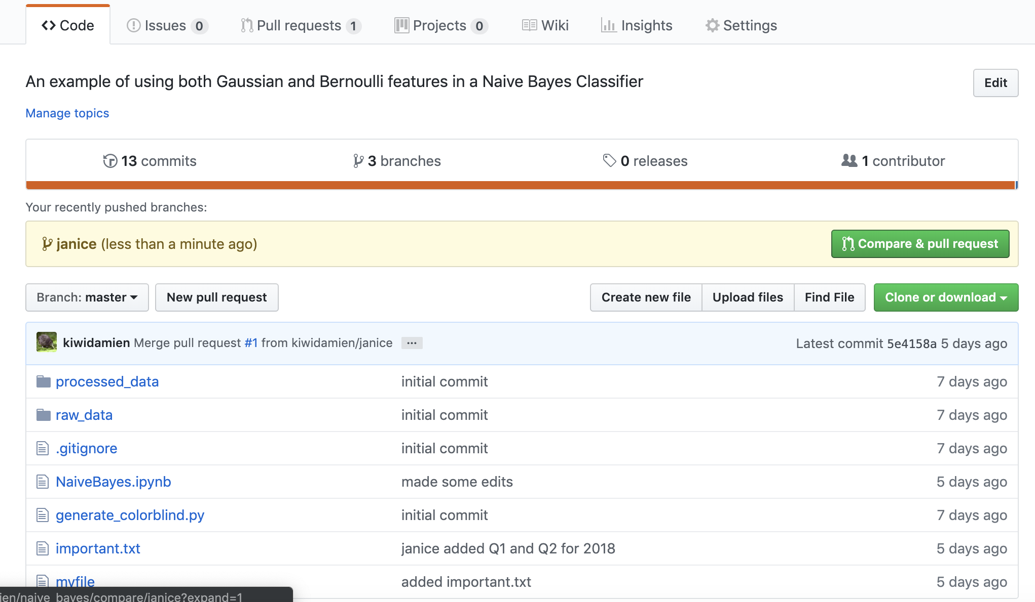
Walking Through a PR
Done on Github
Create a pull request by either
Clicking on the Pull Request tab
Click the Compare & pull request button (only appears for recent PRs)
Notes:
This is a quick slide, have them go through the

Slide 27
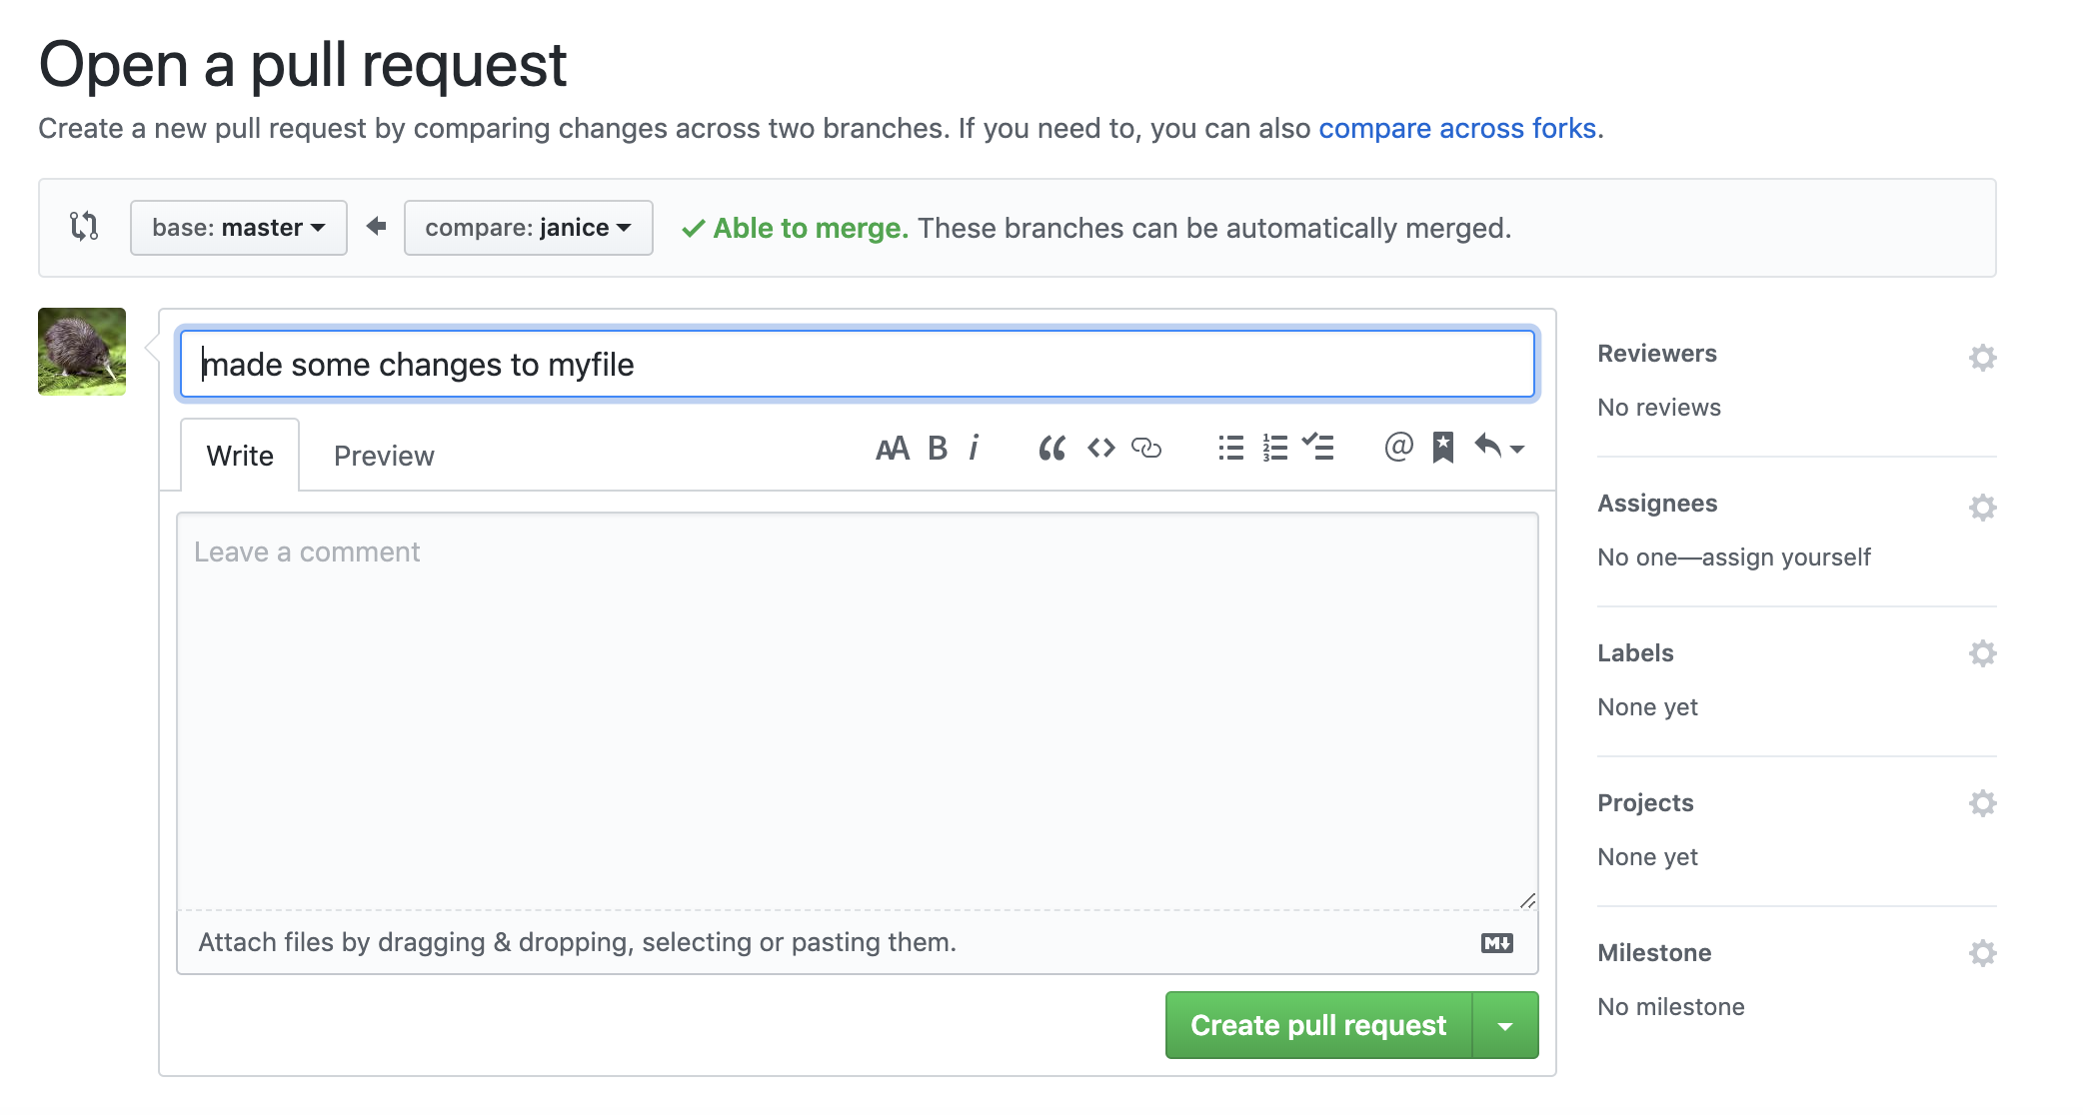
Walking Through a PR
Request someone to review you code
Add additional information about what we have done
Make the pull request

Slide 28
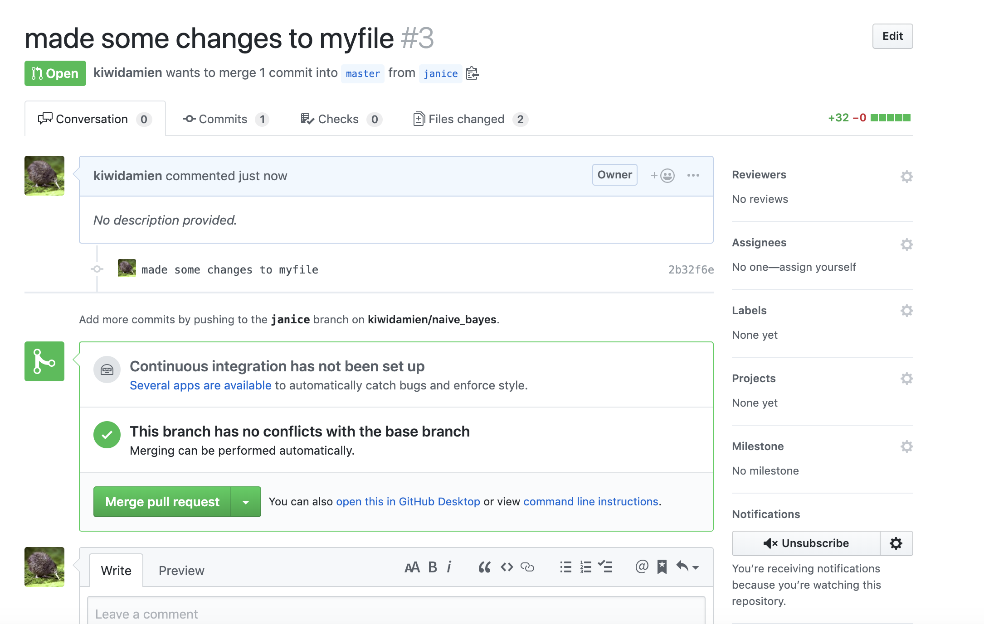
Walking Through a PR
Best practice recommendation: * Set up dev to be protected
* Allow anyone to merge once it passes a review
If the dev branch isn't protected, you can now merge your pull request
If dev is protected, you will need a passing code review before this button is unblocked

Slide 29
Recap

Slide 30
Agenda
Local vs Remote
Checking the status
Pulling: getting information from the remote to your computer
Pushing: putting information to the remote from your computer
Notes:
2

Slide 31
Takeaways
Pull commits from the remote ("origin")
Push commits to the remote
To create a checkpoint of your work, and push it git add . git commit –m "message" git push
Use git status to determine what is staged, committed, and whether we are up-to-date with the remote
Notes:
2

Slide 32
QUESTIONS?

Slide 33
APPENDIX

Slide 34
Getting An Already Setup Repo
A repo already exists on github with URL e.g. https://github.com/company/the_repo.git
git clone <url> creates a directory with the remote set up.
Terminal:> git clone <url>
Remote setup with default name (origin) is created

Slide 35
Starting a new repo
Create a repo on Github
Get the URL (e.g. https://github.com/company/the_repo.git)
git clone <url> creates a directory with the remote set up.
Terminal:> git clone <url>
Remote setup with default name (origin)
You will get a warning about cloning a remote repo. This is okay!

