Slide 1

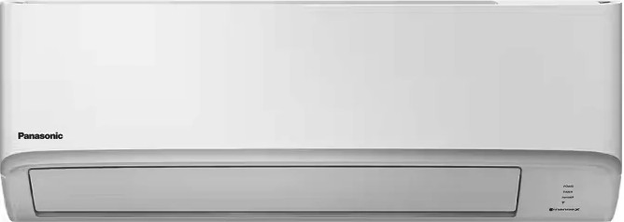

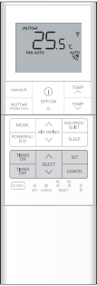
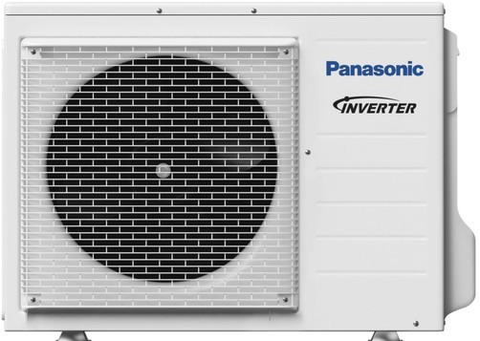




Aero Series
Cooling: 9.5kW
Heating: 10.3kW
Installation Included
PKA Series units are ideal for light commercial use!

