Slide 1
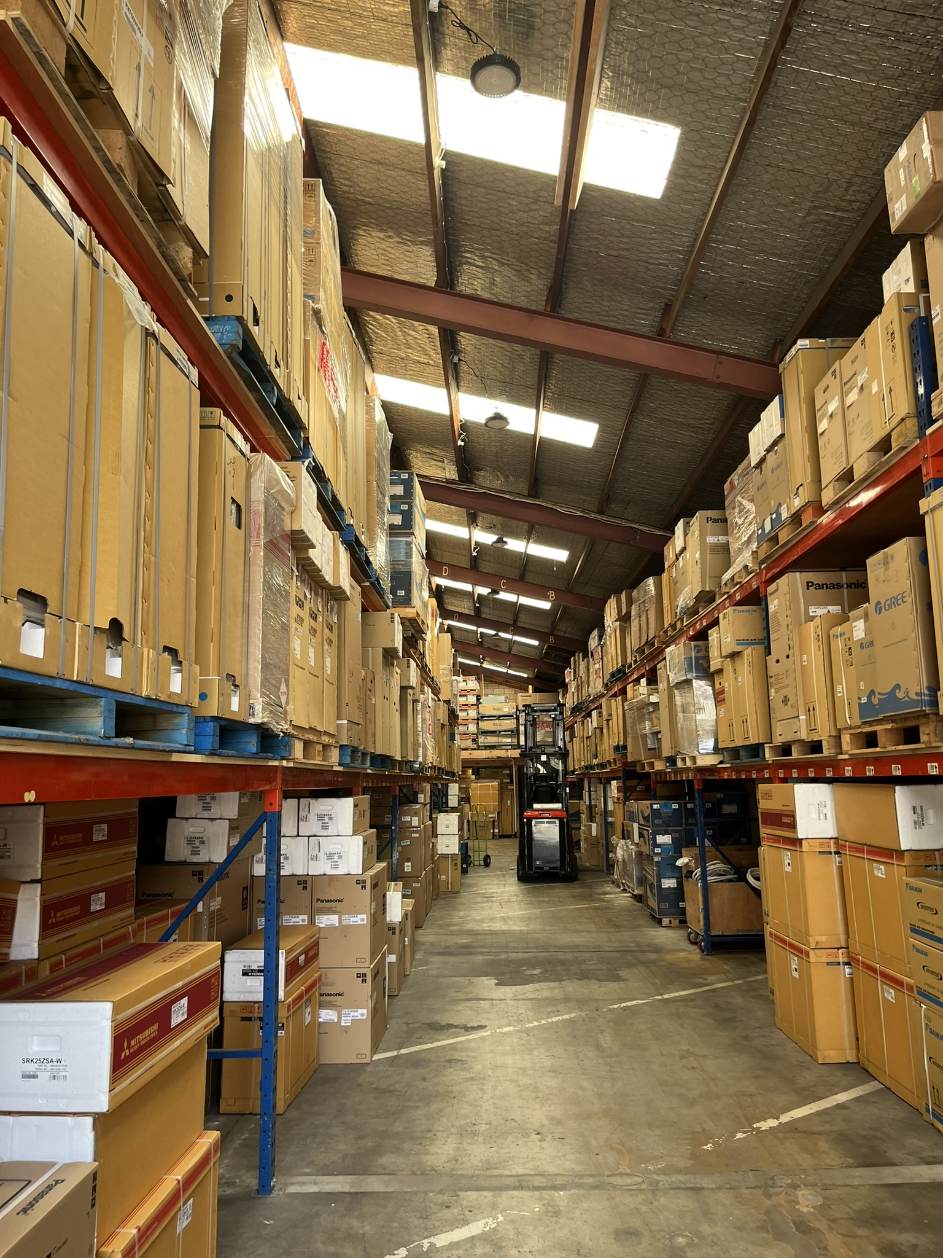
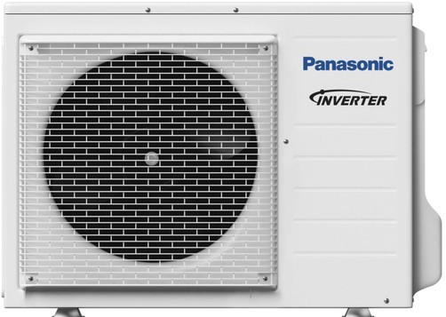

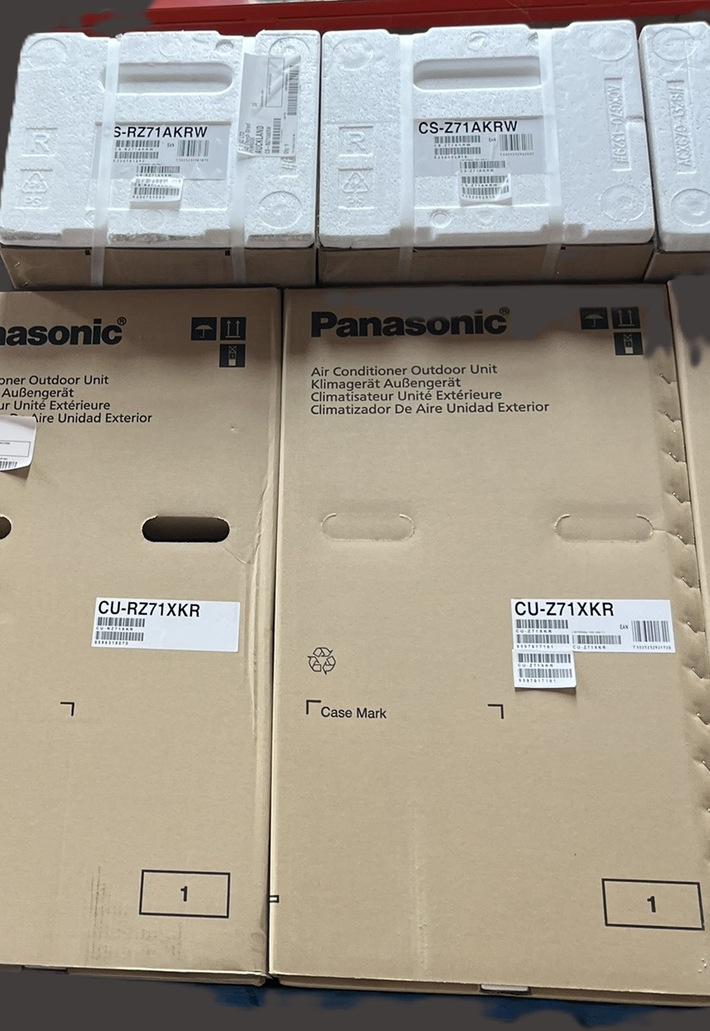
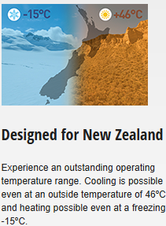


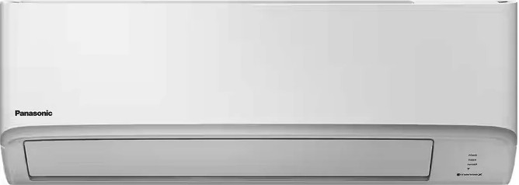
Developer Series
CS-RZ71XKR
Cooling: 7.1kW
Heating: 7.5kW
Installation Included

Slide 2


Open camera and scan this QR code for inquiry or
Call Now
0277 500 999

