Slide 1
Supervised Machine Learning
Red Wine Quality Prediction

Slide 2
Project Inspiration
My past work experiences have been a lot about improving productivity in manufacturing operations. I have realized that using data-driven approaches to identify bottlenecks, streamlining and standardizing processes, could save time and resources and also enhance the overall quality of process delivering better results to customers.
Machine learning it is a great path that could help to go beyond manual efforts and traditional process optimization and achieve results that were previously unattainable. I believe that through automating decision-making, predictive analytics, continuously improving processes and best practices we can empower organizations to achieve greater efficiency, reduce costs, and improve their overall performance.

Slide 3
Project Overview
Variables available in the data set:
fixed acidity, volatile acidity, citric acid, residual sugar, chlorides, free sulfur dioxide, total sulfur dioxide, density, pH, sulphates, alcohol, and quality2
Target variable : quality2
Good quality = 1 , Bad quality = 0
Project Goal:
Optimized the wine quality prediction process using machine learning
Models used to predict wine quality:
Logistic Regression, Random Forest, Support Vector, Naive Bayes, and XGBoost.
Techniques used for tuning parameters:
GridSerachCV and RandomizedSearchCV
Evaluation metrics used:
ROC_AUC - model’s ability to distinguish between high-quality and low-quality wines
Accuracy - calculates the correct predictions made by the model

Slide 4
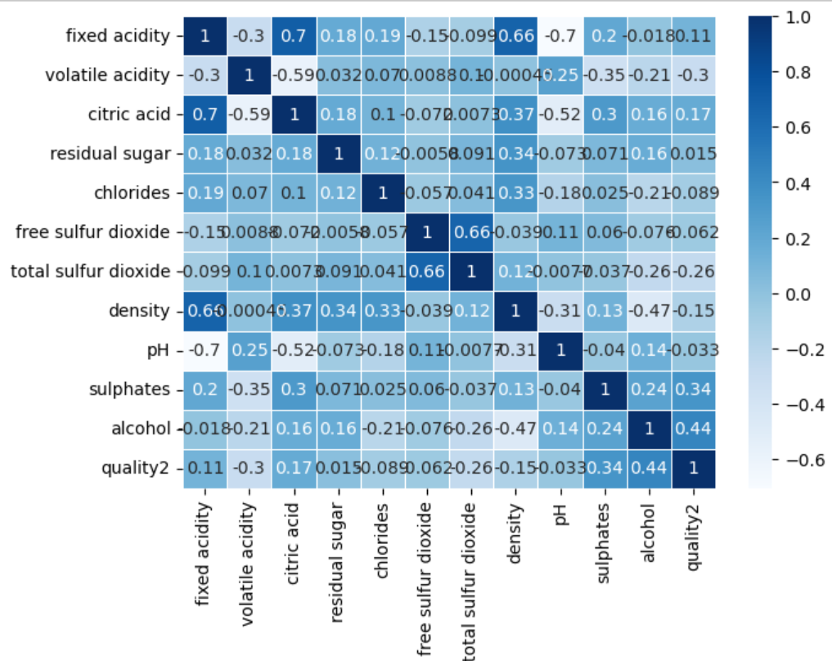
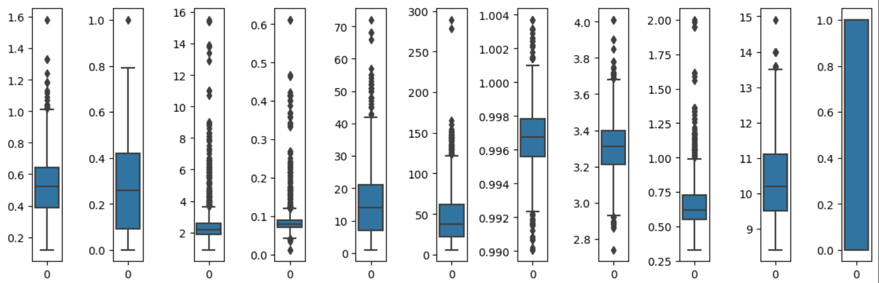
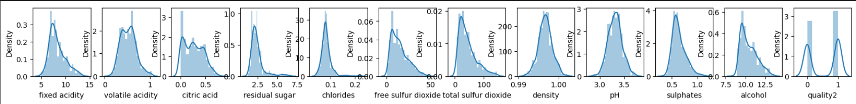
Data Exploration
Correlation
Outliers
Distributions

Slide 5
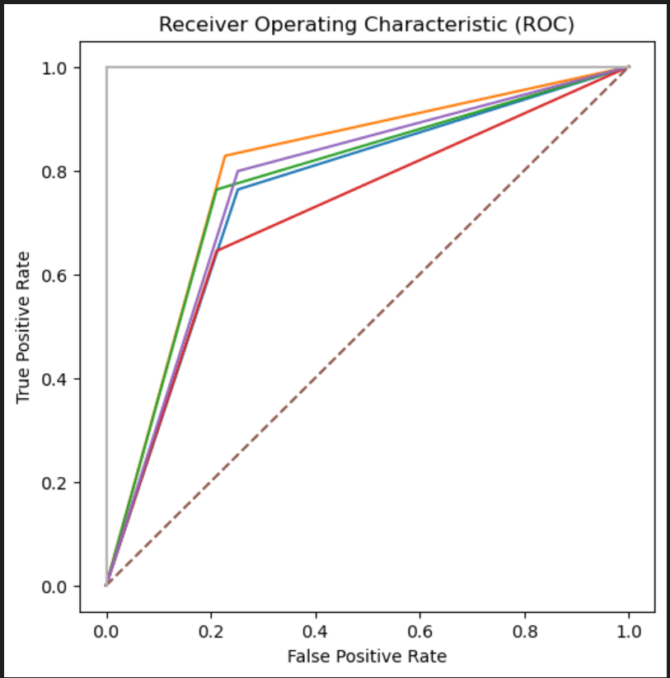
Models
Random Forest
Accuracy: 81%
ROC: 80 %
Accuracy: 77%
ROC: 78 %
Support Vector
XG Boost
Accuracy: 78%
ROC: 77 %
Logistic Regression
Accuracy: 75%
ROC: 75 %
Naive Bayes
Accuracy: 70%
ROC: 71 %

Slide 6
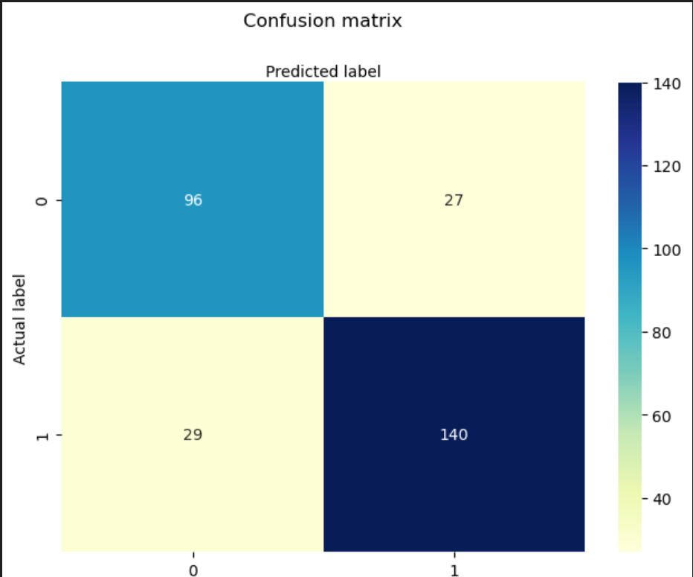
Conclusion
From the dataset 80% was allocated to train the model and 20% to test the model.
From the 292 data points allocated for testing the model :
True Positives (TP): 140 were correctly predicted as high-quality wines.
True Negatives (TN): 96 were correctly predicted low-quality wines.
False Positives (FP): 27 low-quality wines were incorrectly predicted as high-quality.
False Negatives (FN): 29 high-quality wines were incorrectly predicted as low-quality.
Conclusion:
The Random Forest model with 81% accuracy, ROC of 80% and 83% f1-score; has demonstrated that it is effective in predicting wine quality. The analysis also showed that features like alcohol had a higher impact on wine quality prediction.

Slide 7
How can the used of this model can help the wine industry?
01
02
As more data becomes available the model accuracy can increased
Gives room for a better resource allocation
03
04
Predictions can be done in a faster way
Reduce subjectivity that can happen when assessments are done by humans

Slide 8
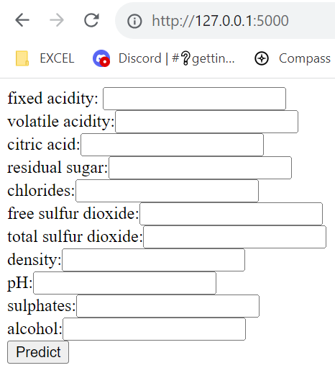
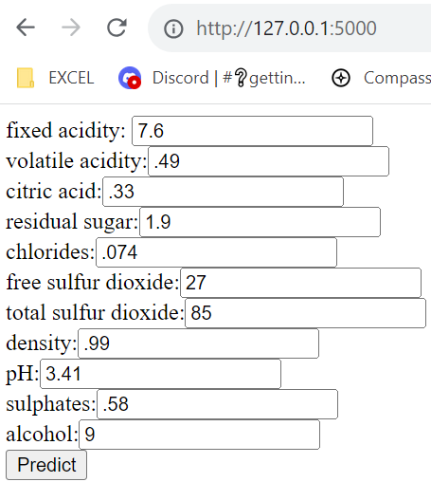
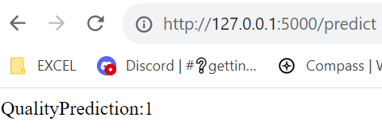
Model Deployment
Step1: Run and Load
Step1: Fill values and press predict
Step3: Output
Quality Prediction 1 = Good wine
Quality Prediction 0 = No good wine

Slide 9
Next Steps
Despite that Random Forest model performed well, there is room for improvement. It is recommended, for the current model, collect additional data and explore more the feature selection to further enhance its accuracy.
Explore more the parameters in some of the other 4 models to try to fine a better tune.

Slide 10
Tech Stack
Data Preparation
1
Pandas
Numpy
Scipy.stats
Models & Tuning
2
Sklearn .model_slection
Sklearn different models
Supervised
machine learning
project
Evaluation
3
Sklearn metrics
Visualization
4
Matplotlib
Seaborn
Model Deployment
5
Pickle
Flasks

