Slide 1

live chatroom project
By Fahim, Mahad

Slide 2
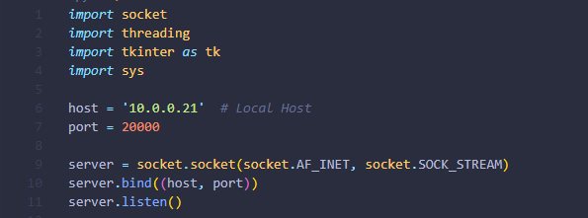
Server side
Initializes a server socket using the socket module.
Binds the socket to the specified host and port.
Begins listening for incoming connections.

Slide 3
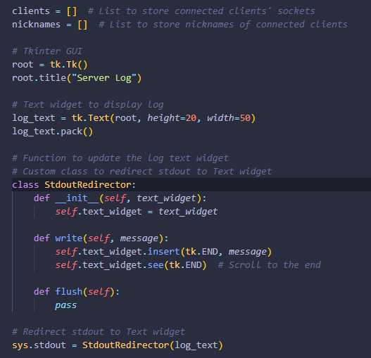
Server side
Clients and Nickname array list to store any new connection and users
Tkinter GUI to display server logs
StdoutRedirector redirects standard output to the Tkinter text widget

Slide 4
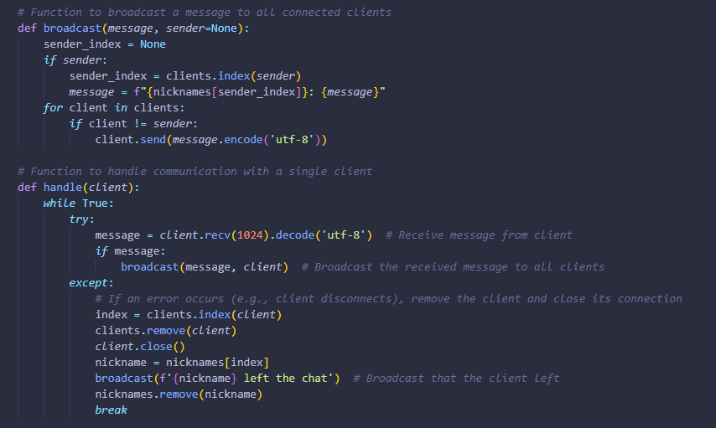
Server side
Broadcast function sends messages to all connected clients.
Handle function manages communication between clients
Continue to receive messages from client and broadcast them to other clients
Broadcast if a client leaves the chat

Slide 5
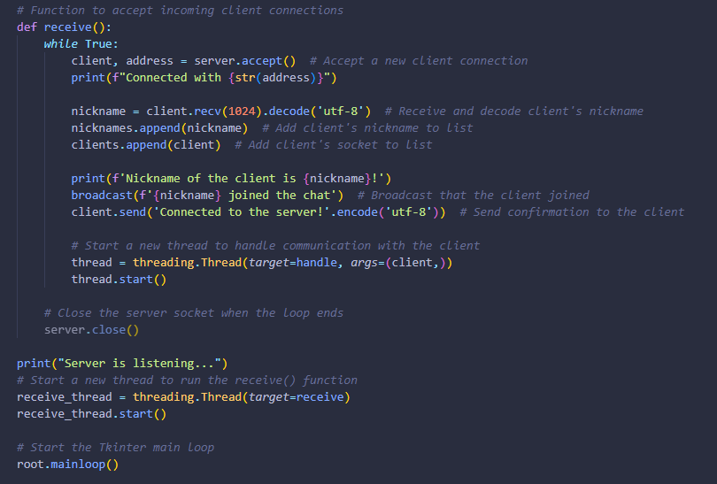
Server side
Receive function accepts incoming connection
Also assigns a nickname to each client by creating a new thread to handle communication with them
Initiates the server to listen for incoming connections.
Starts the Tkinter main loop to run the server log GUI.

Slide 6
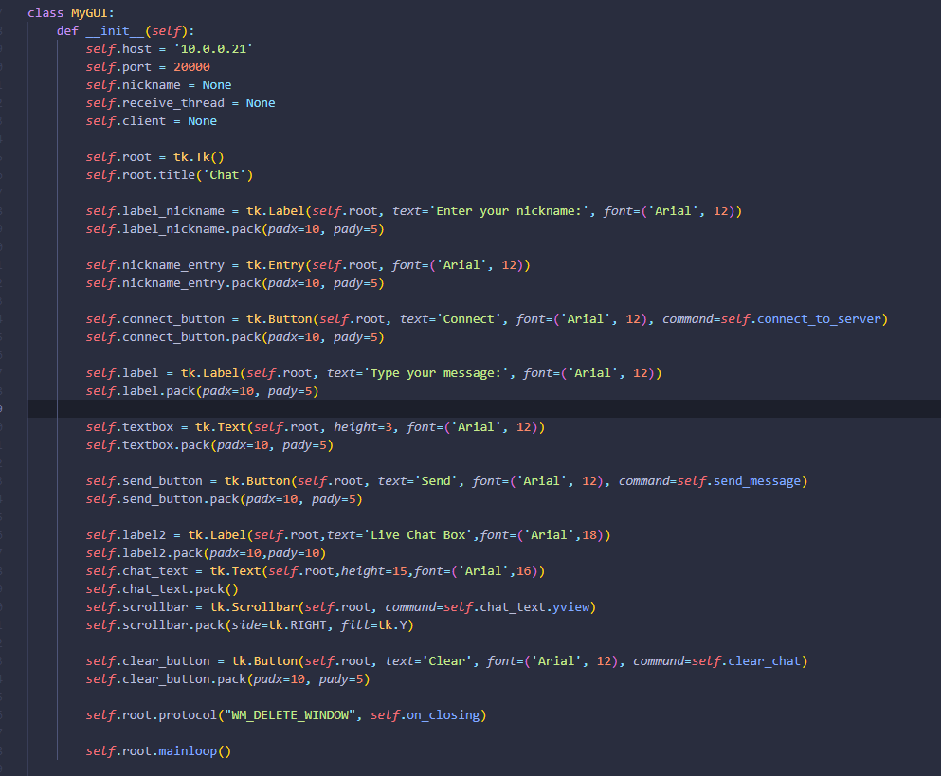
Client side
Interface Component that display everything in GUI
Fields for entering nickname and your messages
Provides buttons for connecting to the server, sending messages, and clearing the chat.

Slide 7
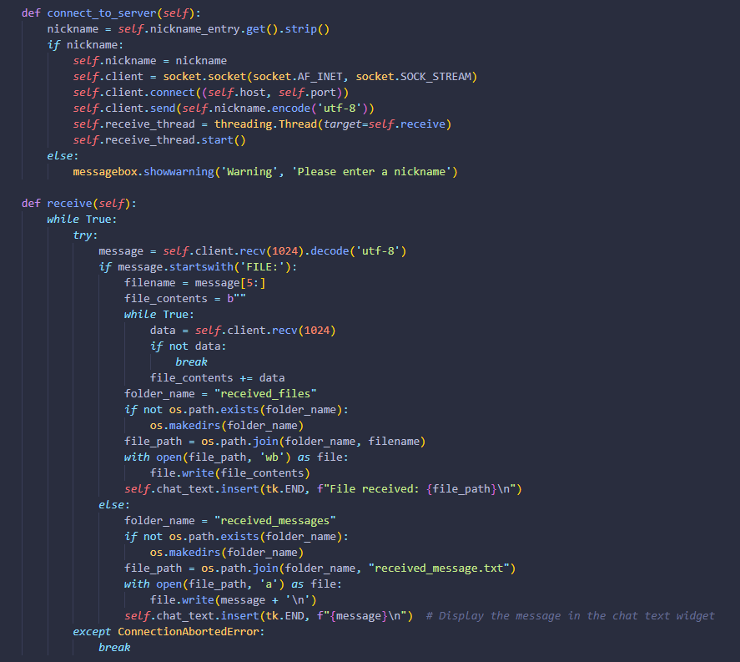
Client side
Connect to the server using specific host and port
Sends the chosen nickname to the server
Runs a continuous loop to receive messages from the server.
Handles both regular text messages and file transfer requests.

Slide 8
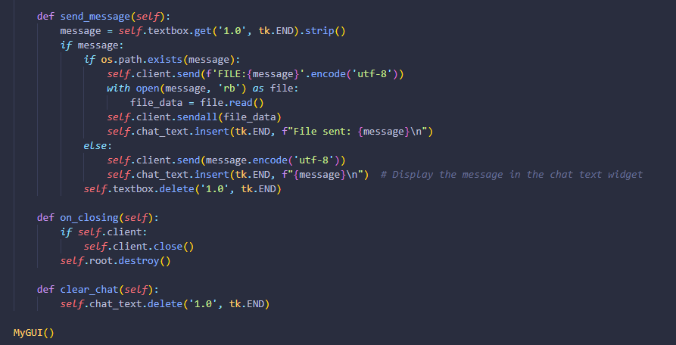
Client side
Allows users to send messages by typing into the text input field and clicking the send button.
Supports sending both text messages and files.
Defines a method to handle the client's window closure event, ensuring proper socket closure.
Clients can clear the chat and start a fresh chat room.

