Slide 1
Cosmology figures — full set for ordering & notes
395 content-unique PNGs • 396 slides total
Duplicates by content were removed before building this deck.
Each figure slide shows its relative path in the title for ordering and notes.
Image source root: /workspace/cosmology
Prepared for Chris
Notes:

Slide 2
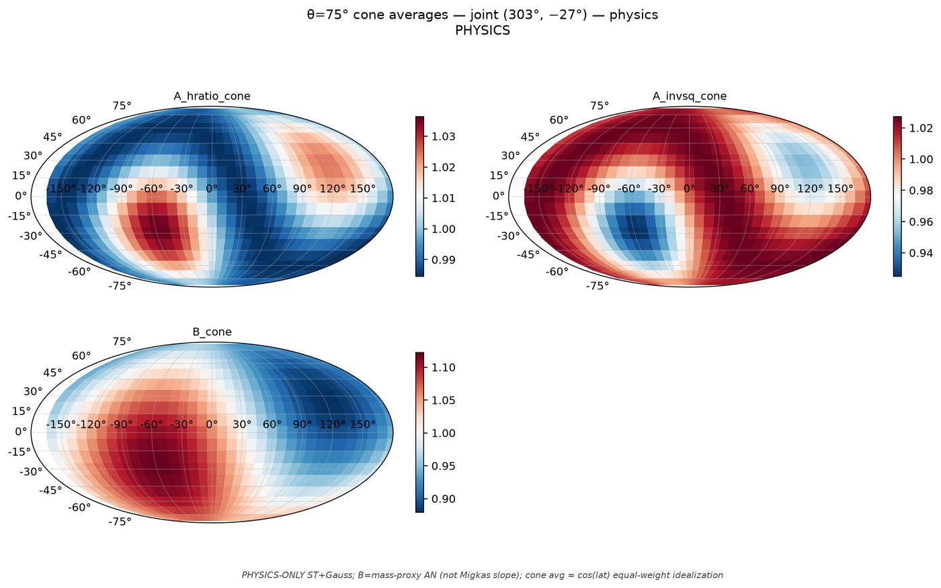
1/395 cone_scan_75/mollweide_cone75_joint_303m27__physics.png
Notes:

Slide 3
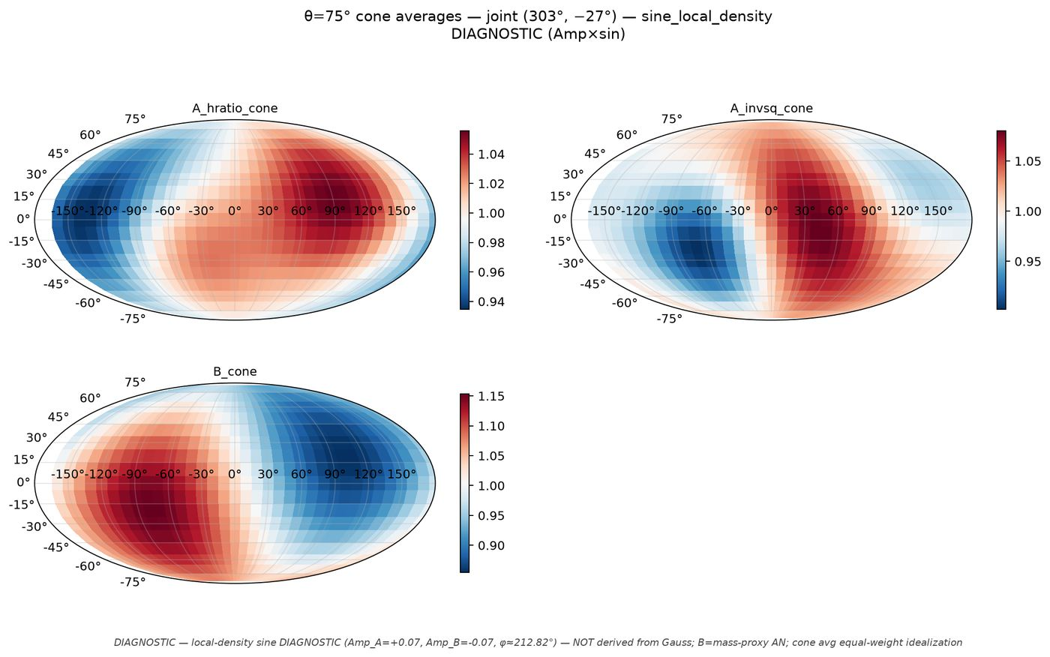
2/395 cone_scan_75/mollweide_cone75_joint_303m27__sine_local_density.png
Notes:

Slide 4
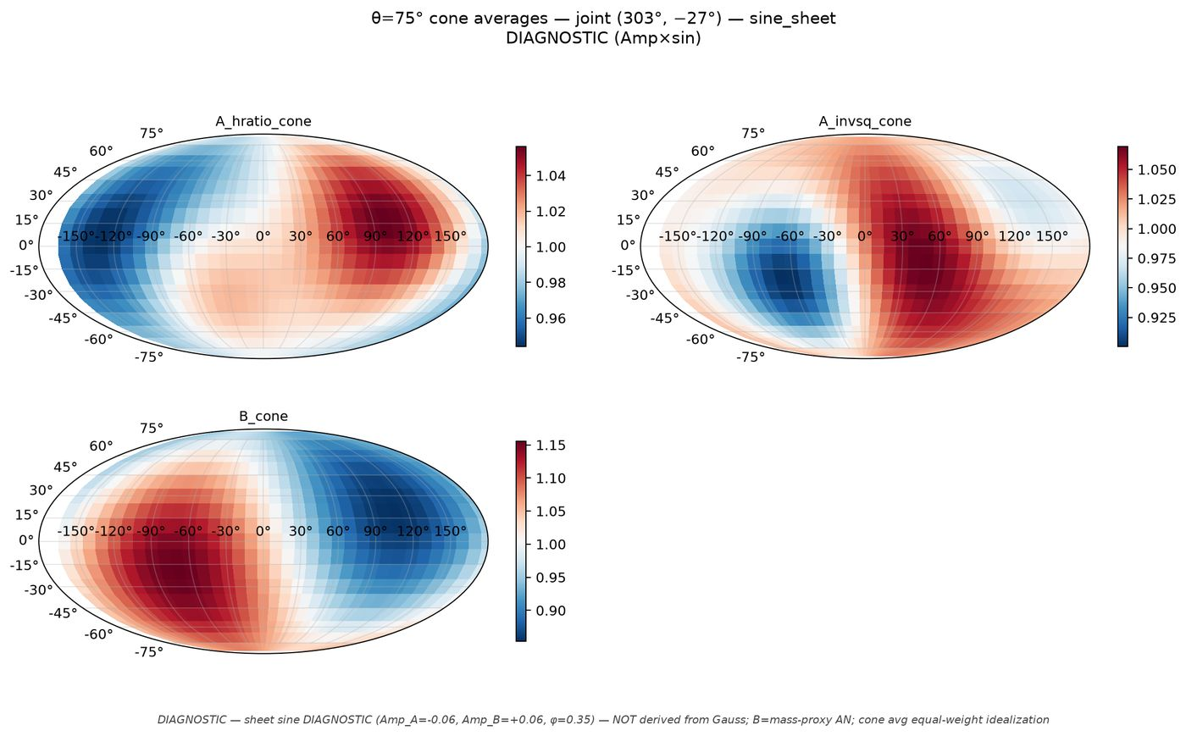
3/395 cone_scan_75/mollweide_cone75_joint_303m27__sine_sheet.png
Notes:

Slide 5
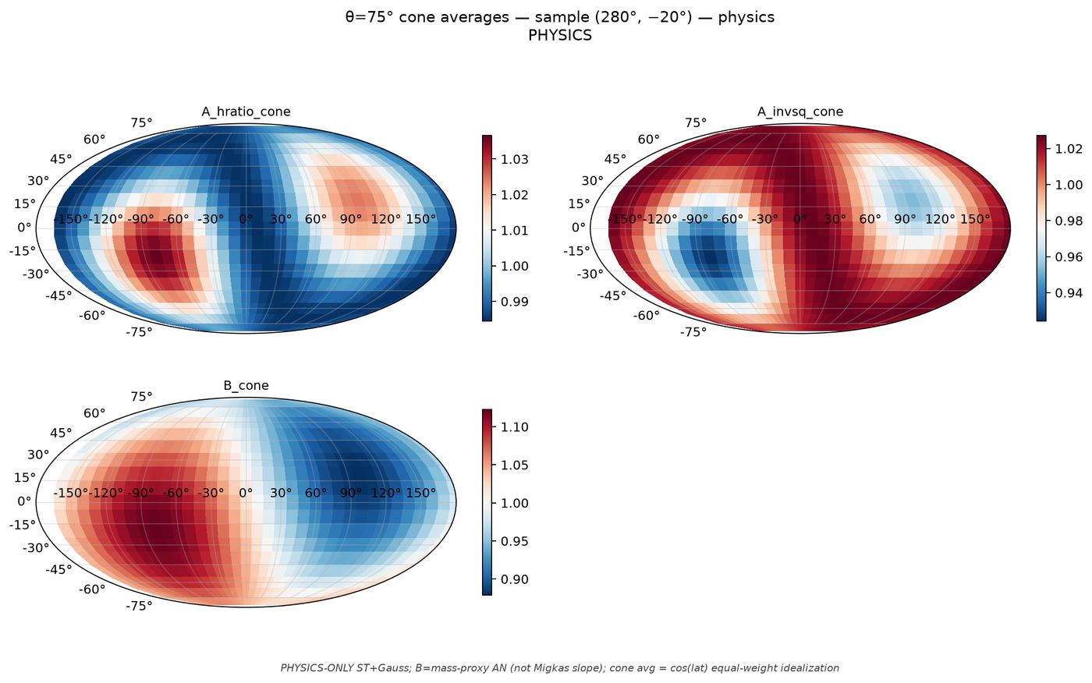
4/395 cone_scan_75/mollweide_cone75_sample_280m20__physics.png
Notes:

Slide 6
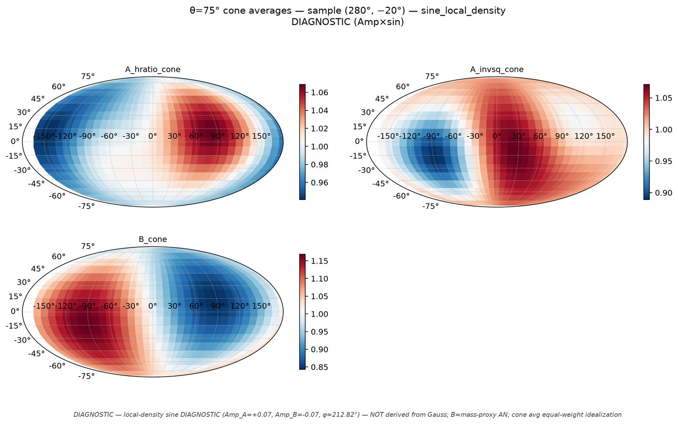
5/395 cone_scan_75/mollweide_cone75_sample_280m20__sine_local_density.png
Notes:

Slide 7
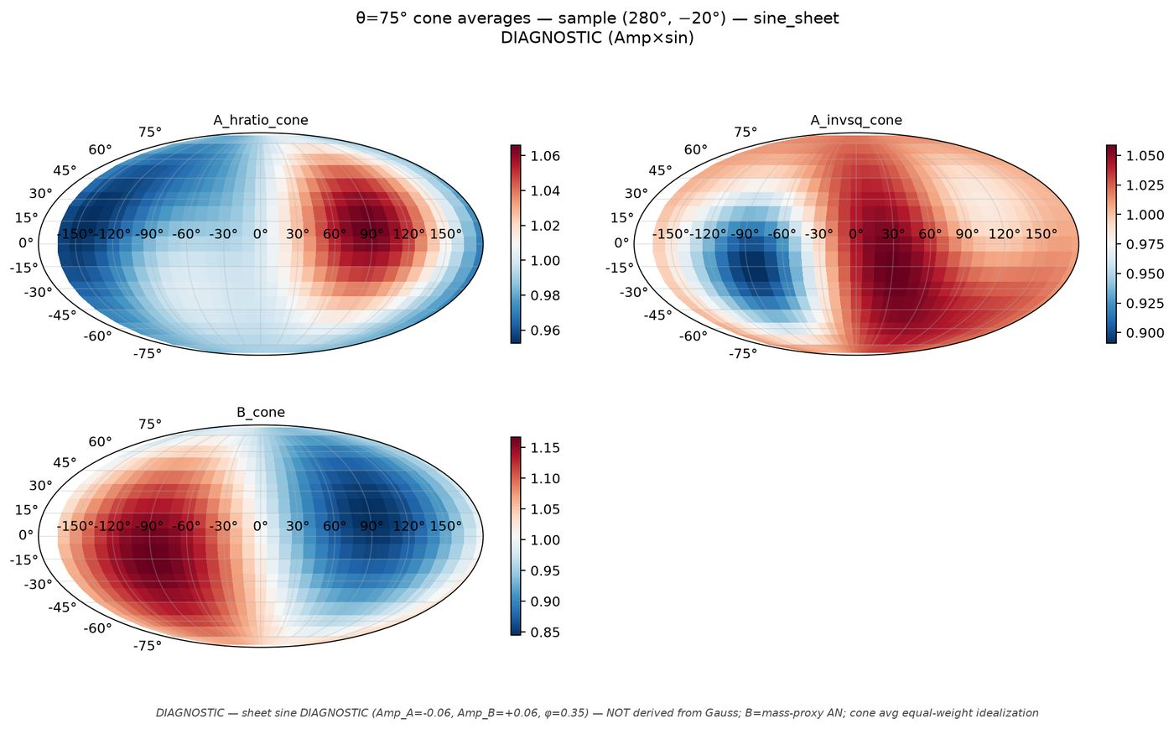
6/395 cone_scan_75/mollweide_cone75_sample_280m20__sine_sheet.png
Notes:

Slide 8
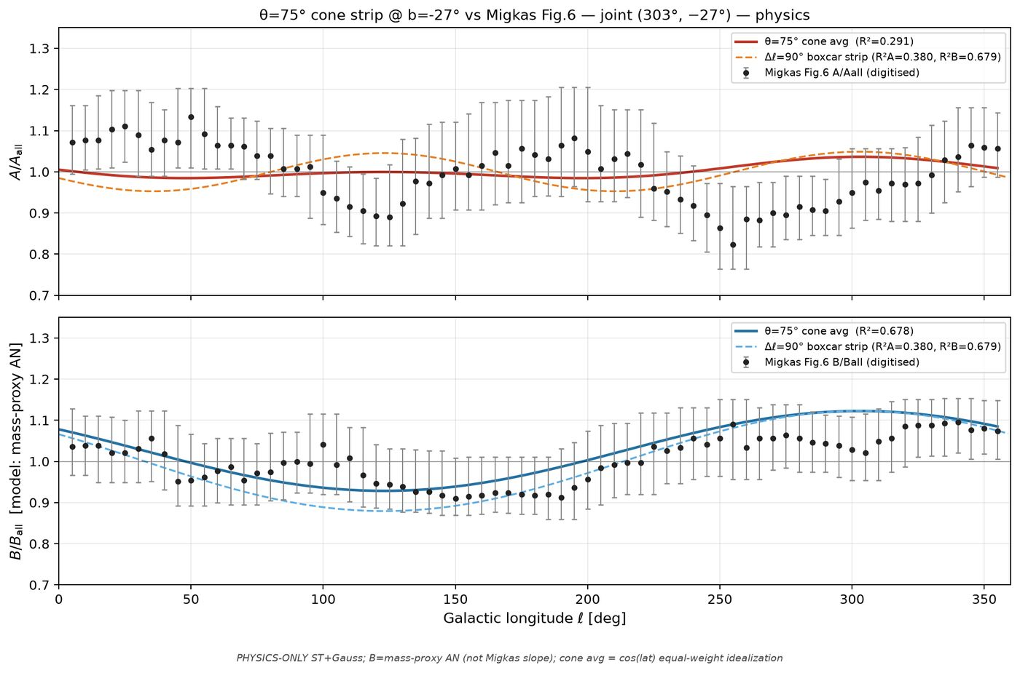
7/395 cone_scan_75/overlay_fig6_cone75_joint_303m27__physics.png
Notes:

Slide 9
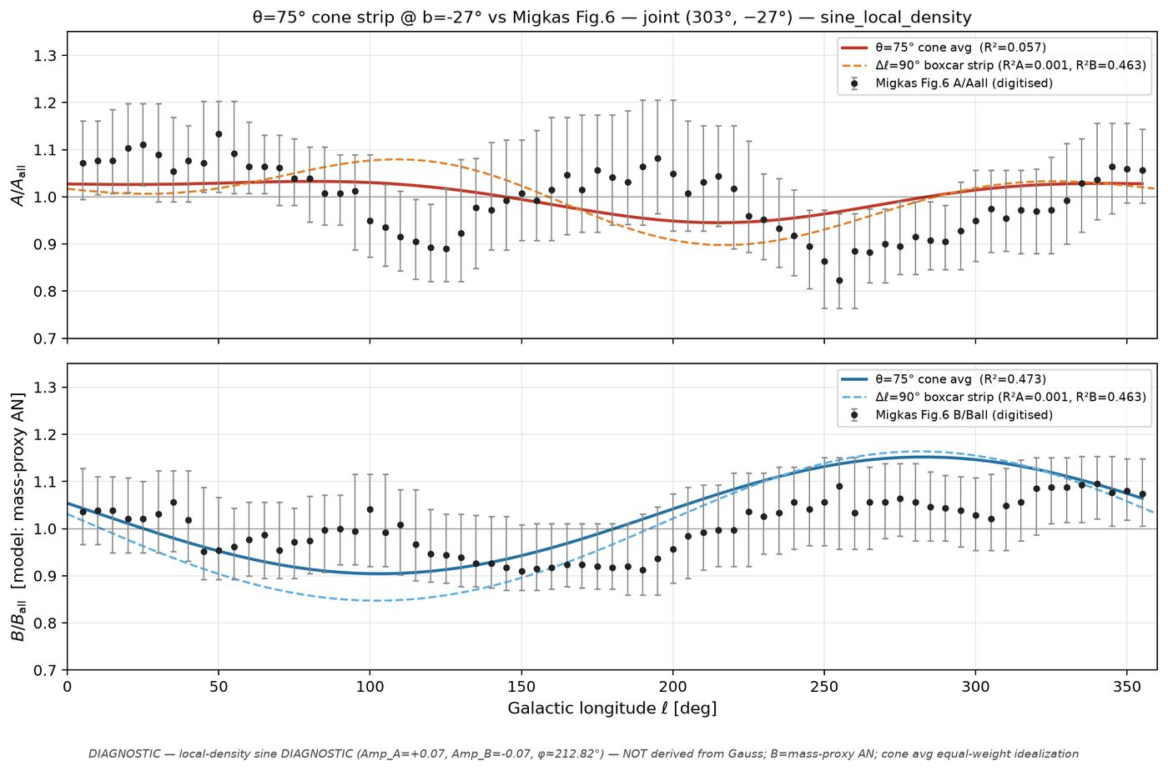
8/395 cone_scan_75/overlay_fig6_cone75_joint_303m27__sine_local_density.png
Notes:

Slide 10
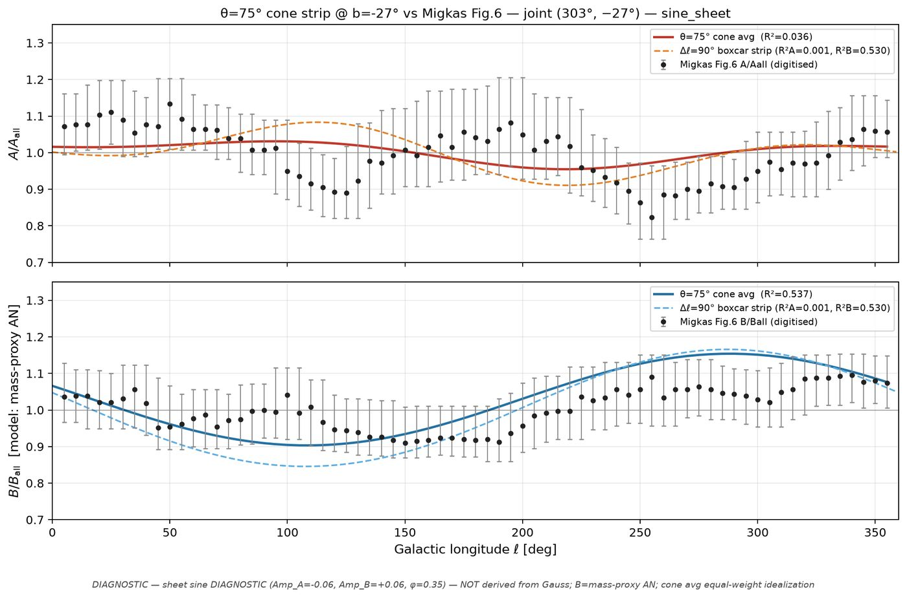
9/395 cone_scan_75/overlay_fig6_cone75_joint_303m27__sine_sheet.png
Notes:

Slide 11
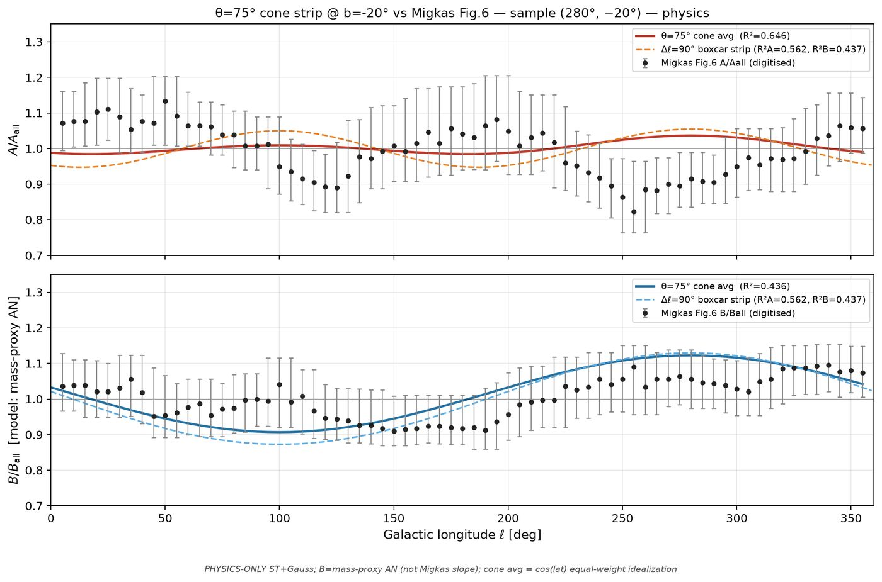
10/395 cone_scan_75/overlay_fig6_cone75_sample_280m20__physics.png
Notes:

Slide 12
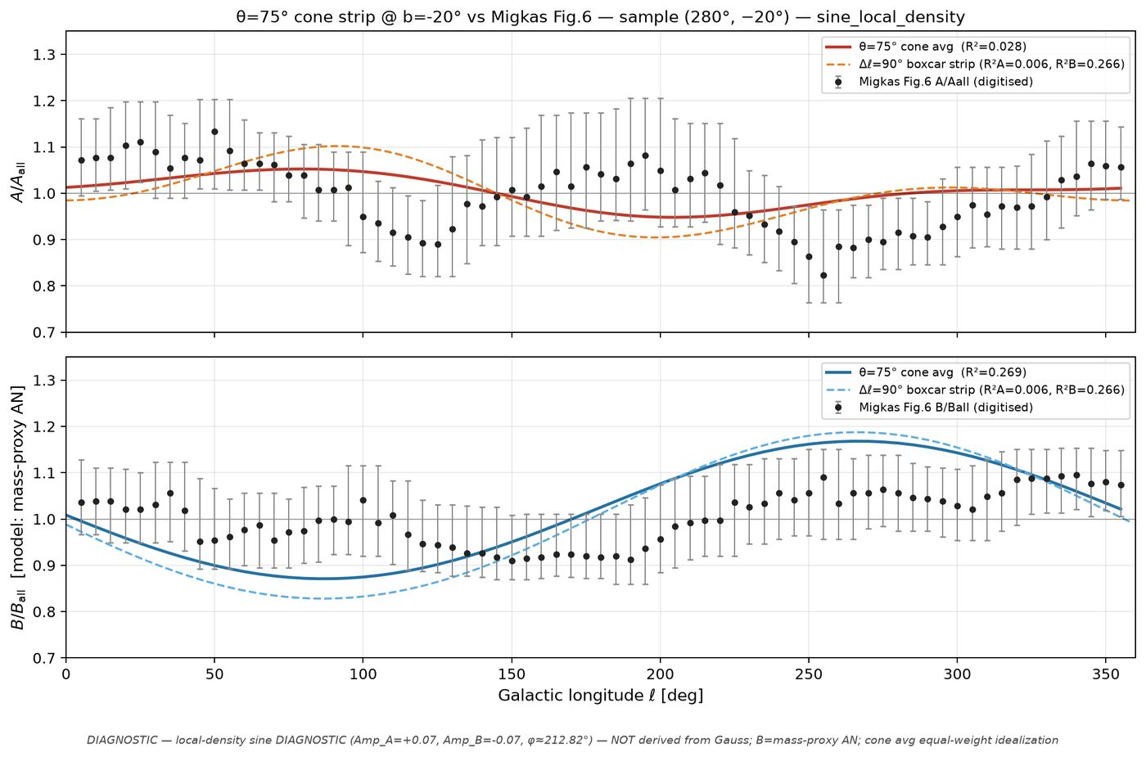
11/395 cone_scan_75/overlay_fig6_cone75_sample_280m20__sine_local_density.png
Notes:

Slide 13
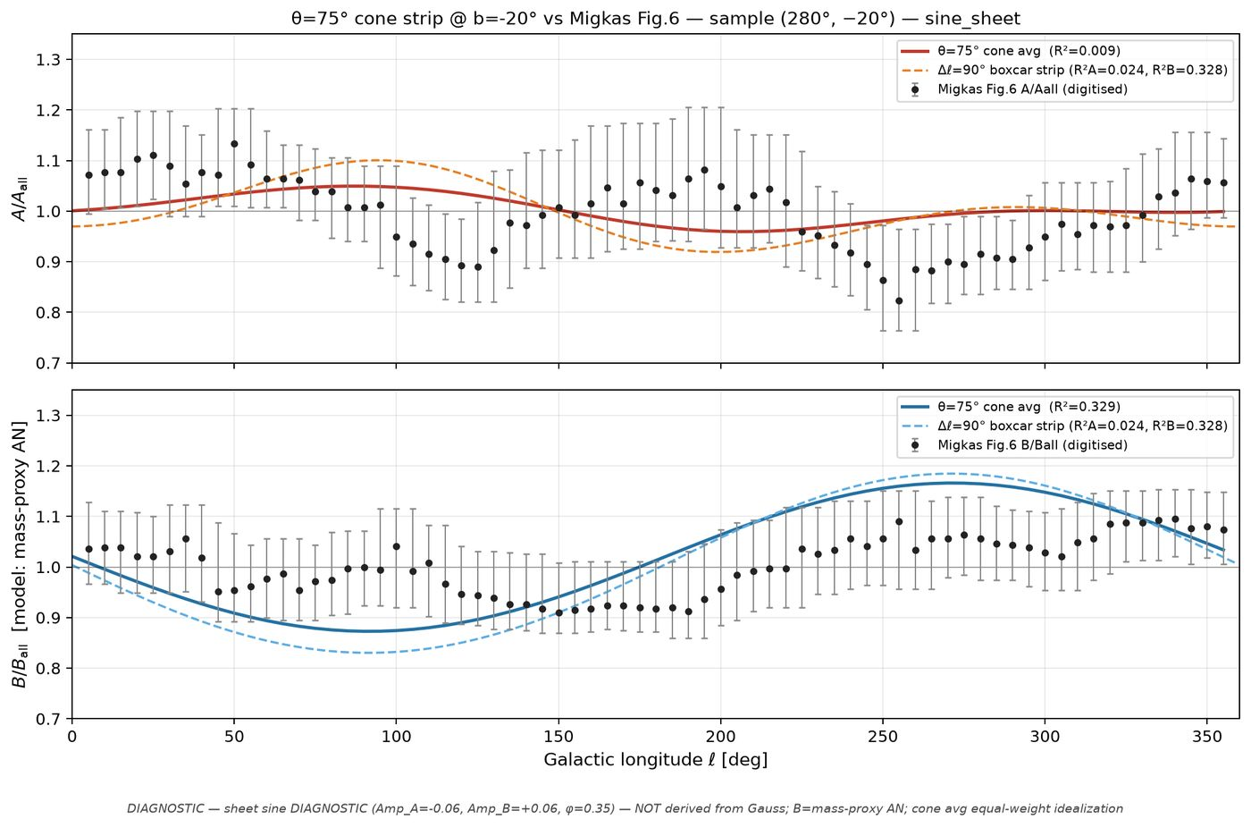
12/395 cone_scan_75/overlay_fig6_cone75_sample_280m20__sine_sheet.png
Notes:

Slide 14
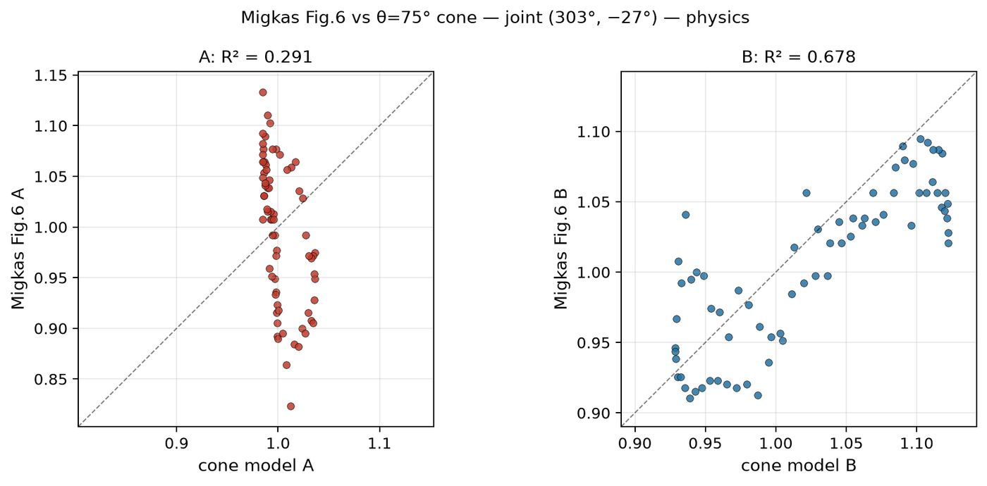
13/395 cone_scan_75/scatter_fig6_vs_cone75_joint_303m27__physics.png
Notes:

Slide 15
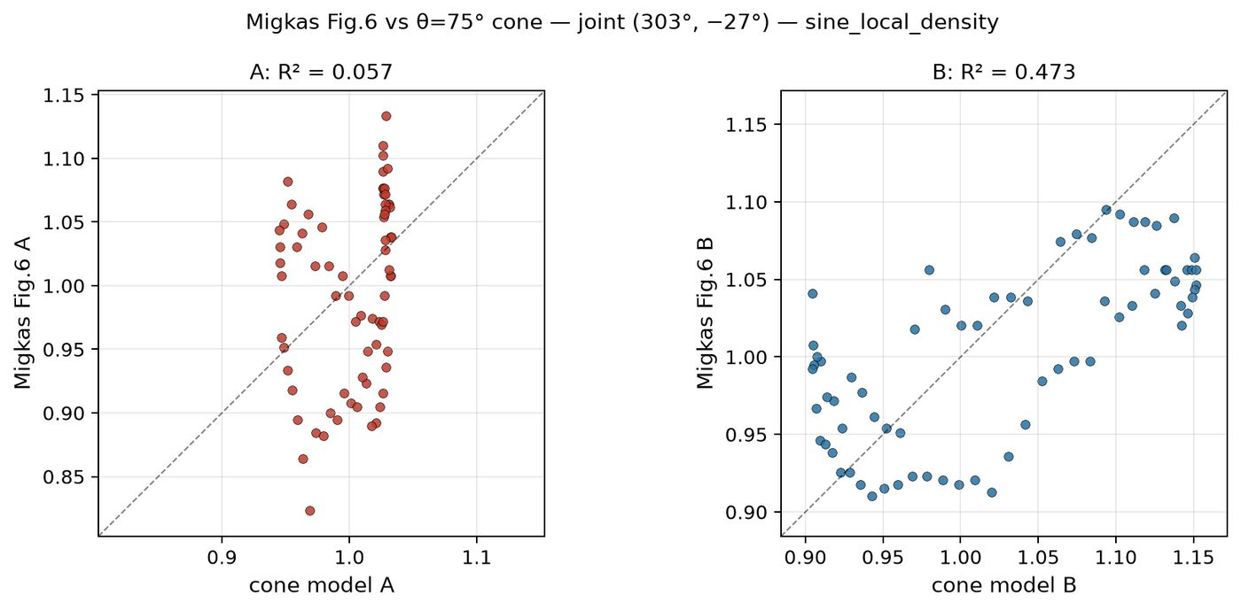
14/395 cone_scan_75/scatter_fig6_vs_cone75_joint_303m27__sine_local_density.png
Notes:

Slide 16
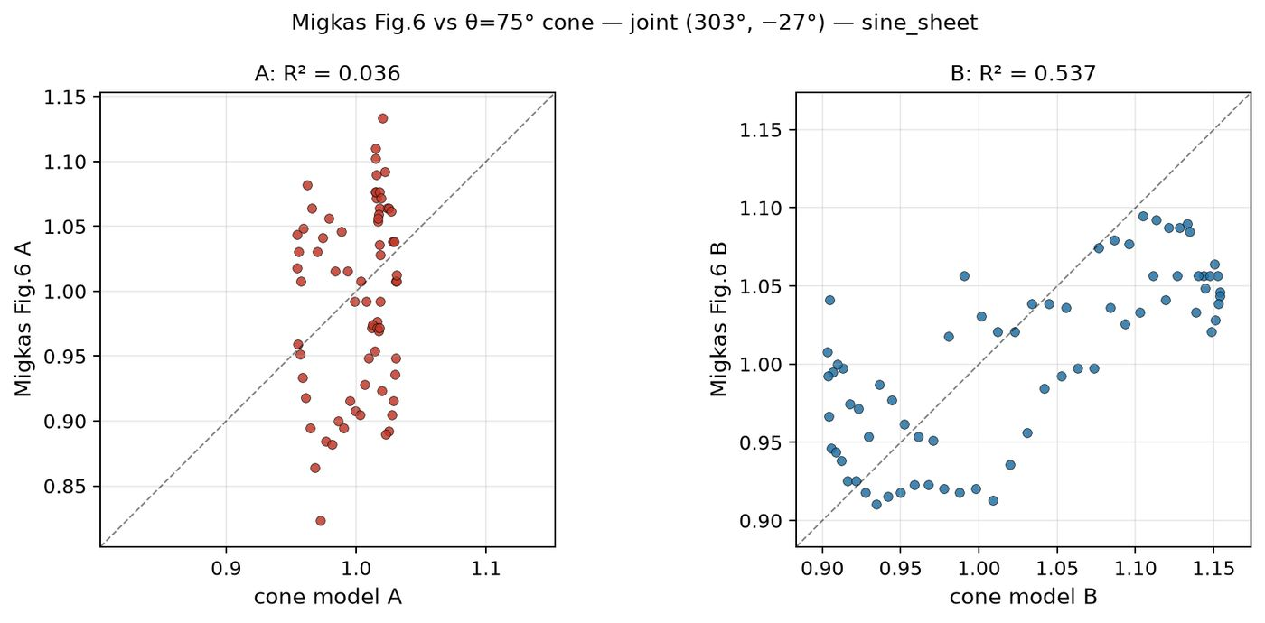
15/395 cone_scan_75/scatter_fig6_vs_cone75_joint_303m27__sine_sheet.png
Notes:

Slide 17
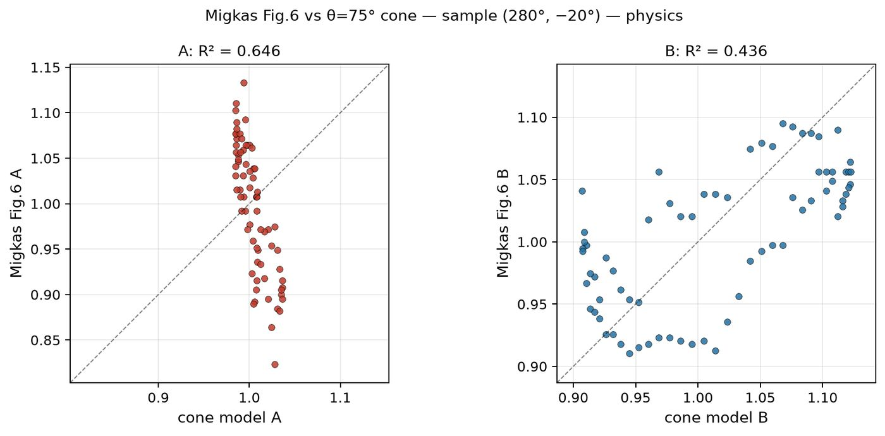
16/395 cone_scan_75/scatter_fig6_vs_cone75_sample_280m20__physics.png
Notes:

Slide 18
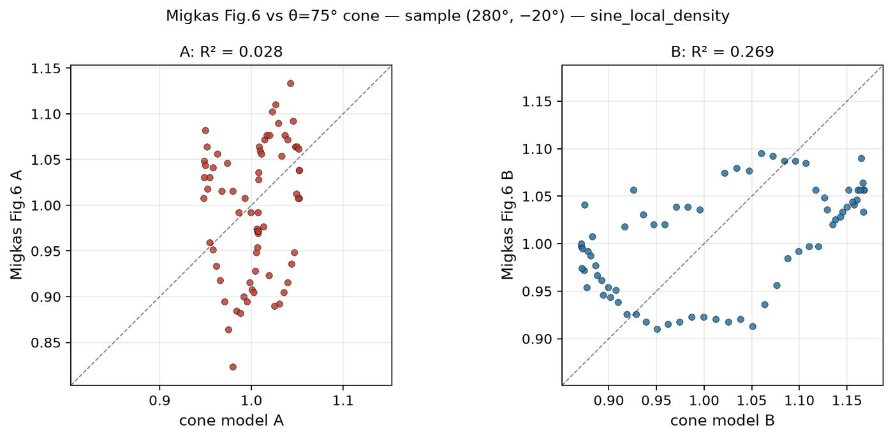
17/395 cone_scan_75/scatter_fig6_vs_cone75_sample_280m20__sine_local_density.png
Notes:

Slide 19
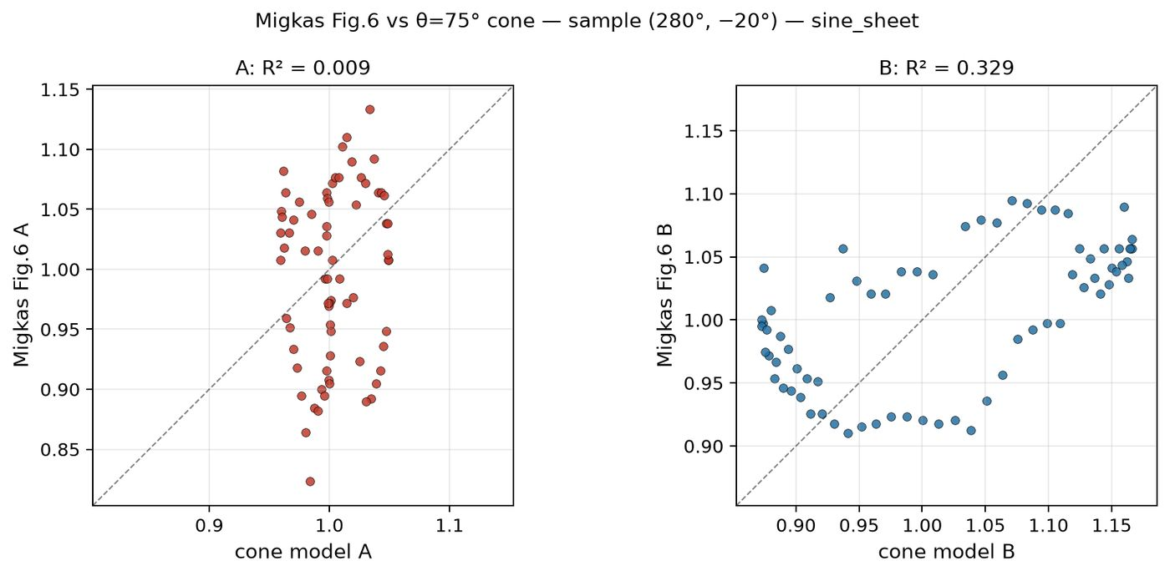
18/395 cone_scan_75/scatter_fig6_vs_cone75_sample_280m20__sine_sheet.png
Notes:

Slide 20
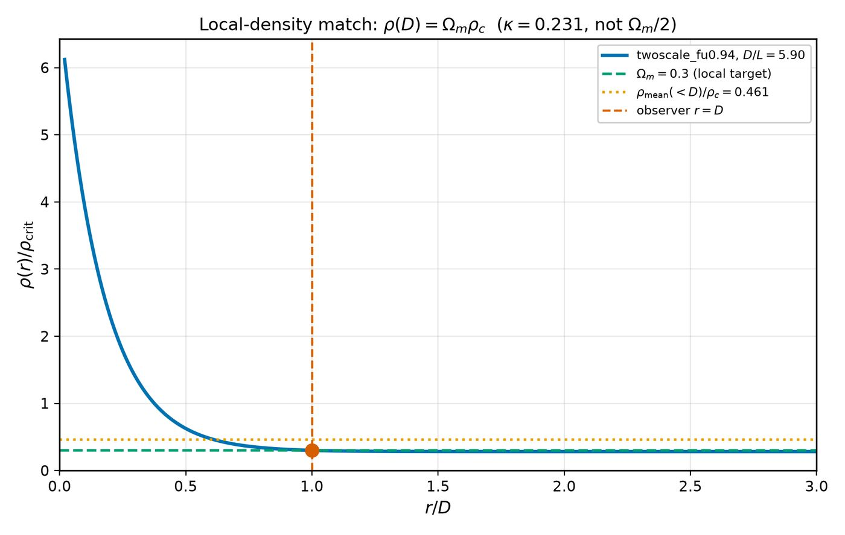
19/395 density_local_match/density_profile_local_match.png
Notes:

Slide 21
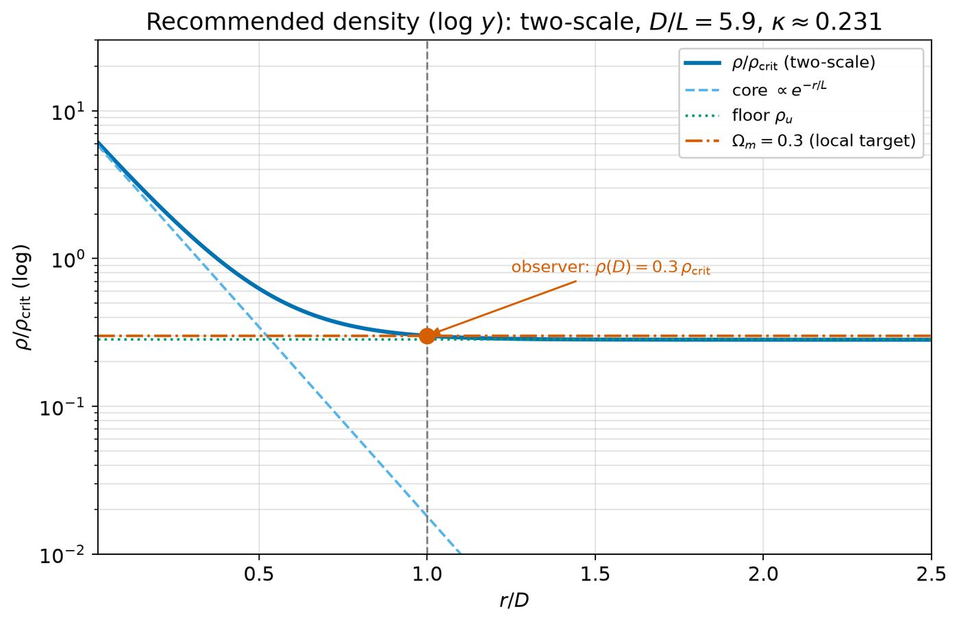
20/395 density_local_match/density_profile_local_match_logy.png
Notes:

Slide 22
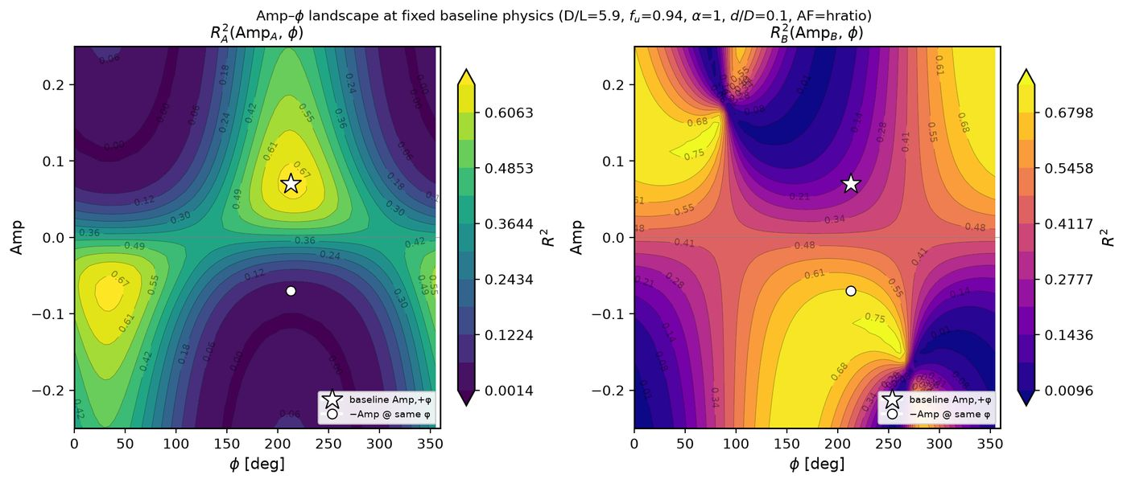
21/395 density_local_match/level_sets/levelsets_Amp_vs_phi.png
Notes:

Slide 23
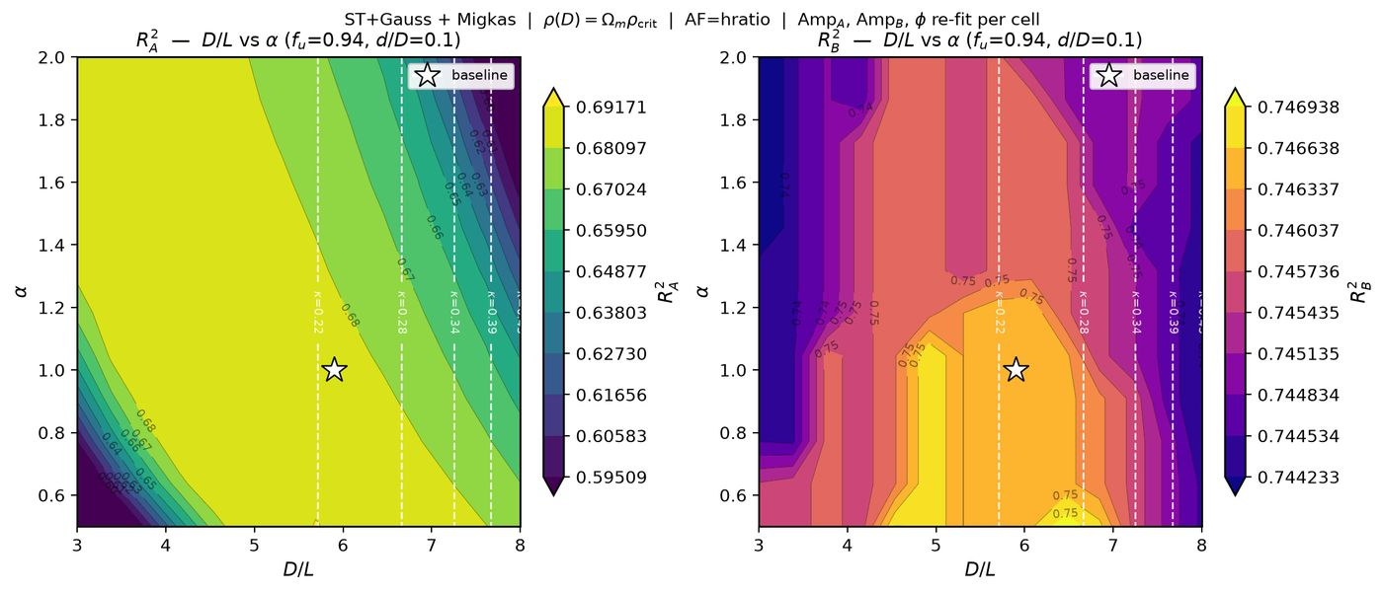
22/395 density_local_match/level_sets/levelsets_DL_vs_alpha.png
Notes:

Slide 24
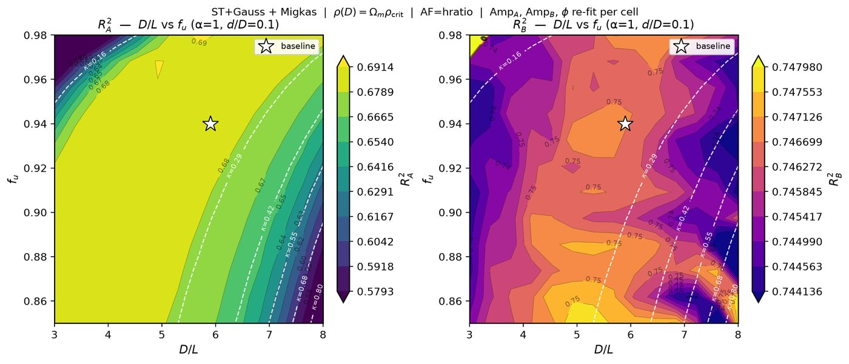
23/395 density_local_match/level_sets/levelsets_DL_vs_fu.png
Notes:

Slide 25
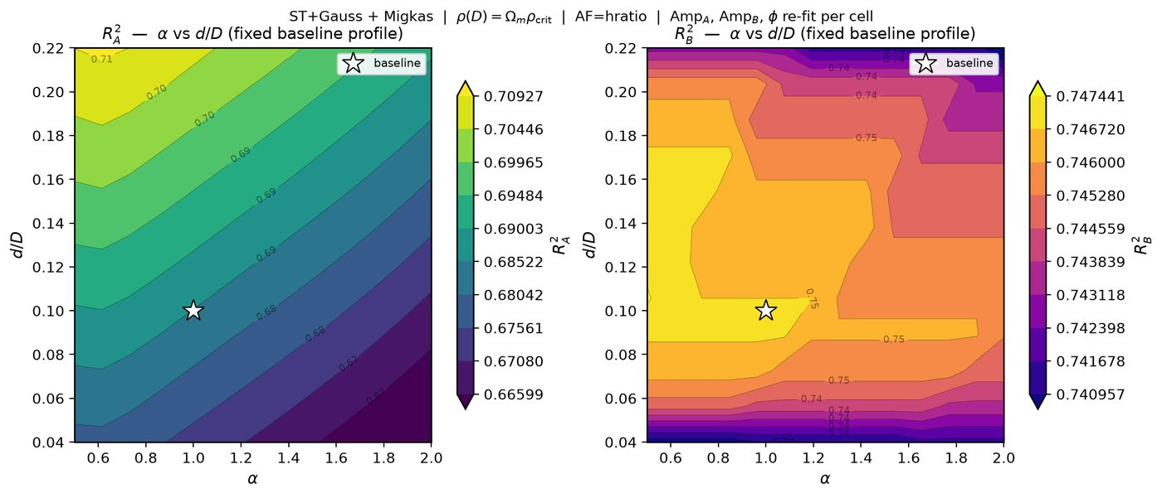
24/395 density_local_match/level_sets/levelsets_alpha_vs_eps.png
Notes:

Slide 26
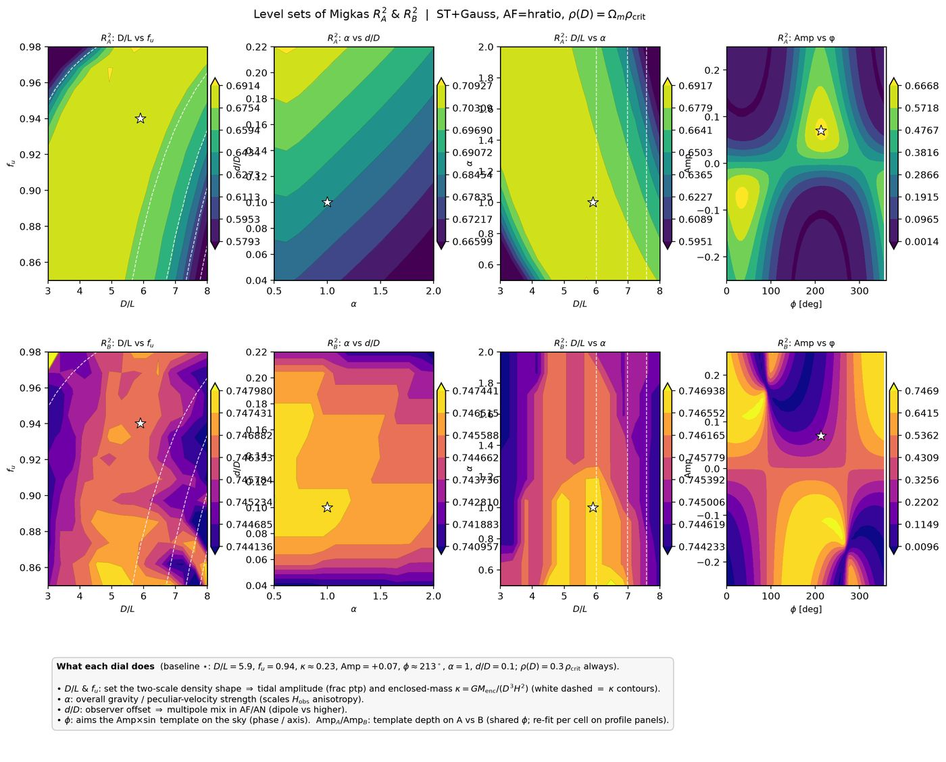
25/395 density_local_match/level_sets/levelsets_summary.png
Notes:

Slide 27
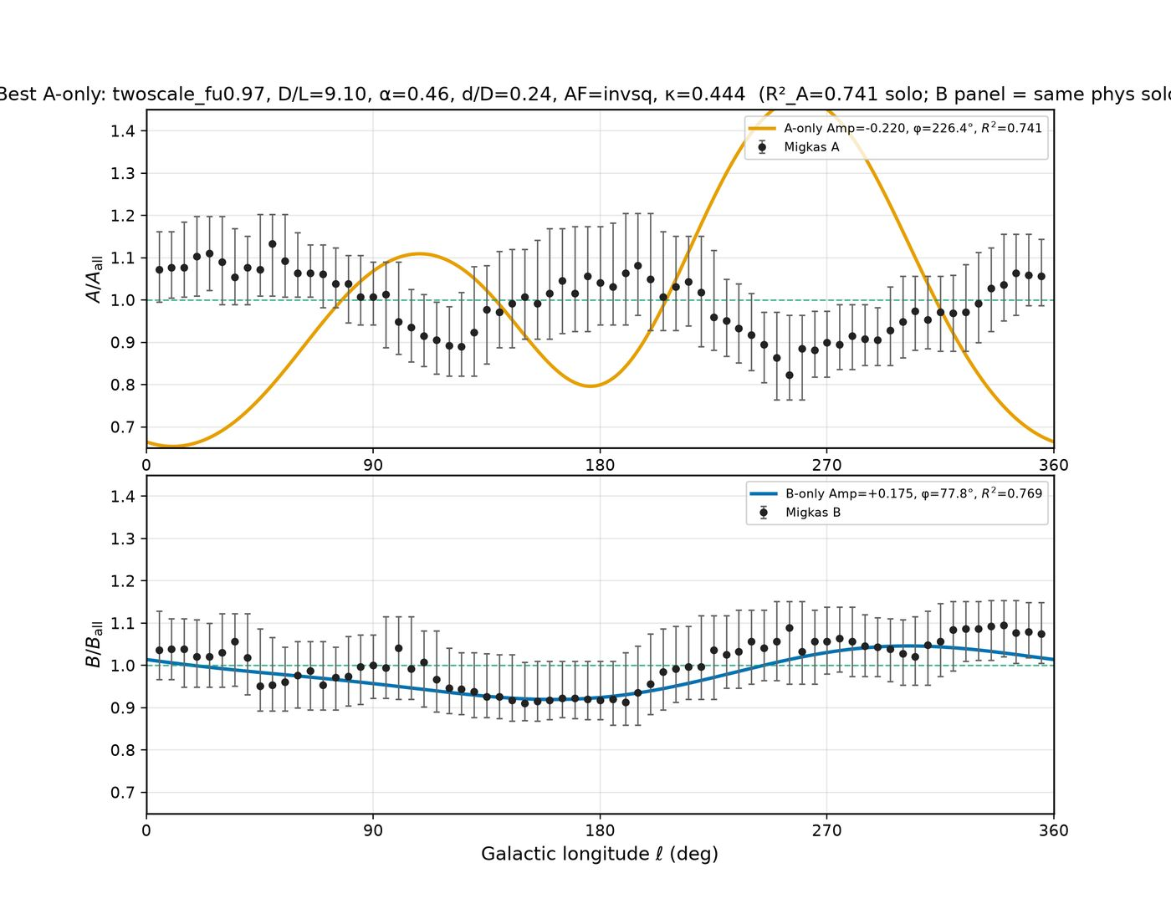
26/395 density_local_match/migkas_best_A_only.png
Notes:

Slide 28
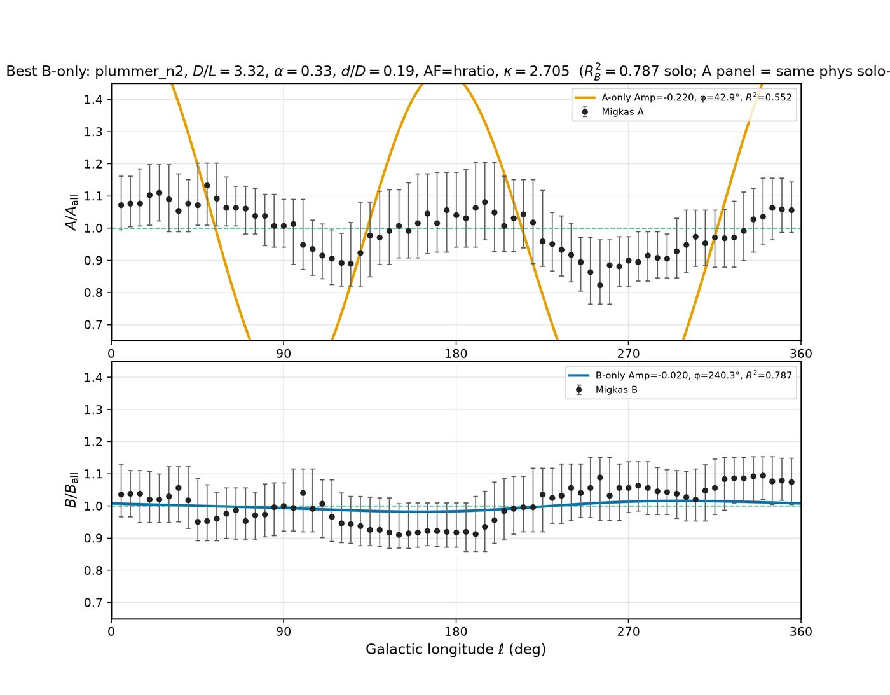
27/395 density_local_match/migkas_best_B_only.png
Notes:

Slide 29
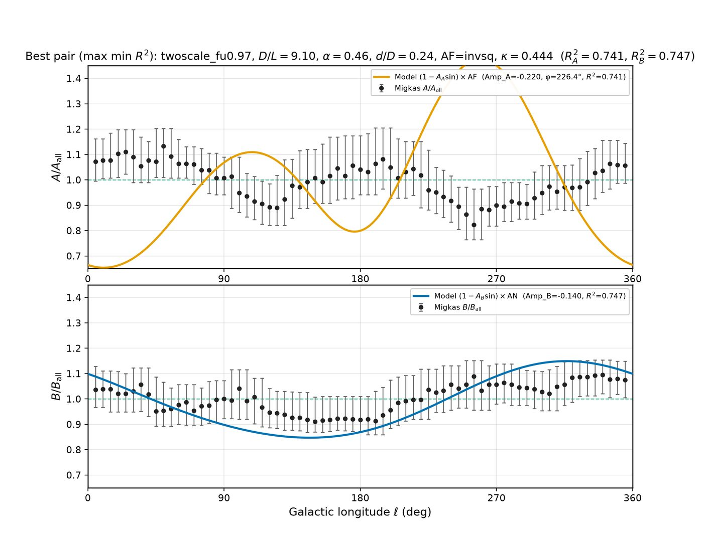
28/395 density_local_match/migkas_best_pair.png
Notes:

Slide 30
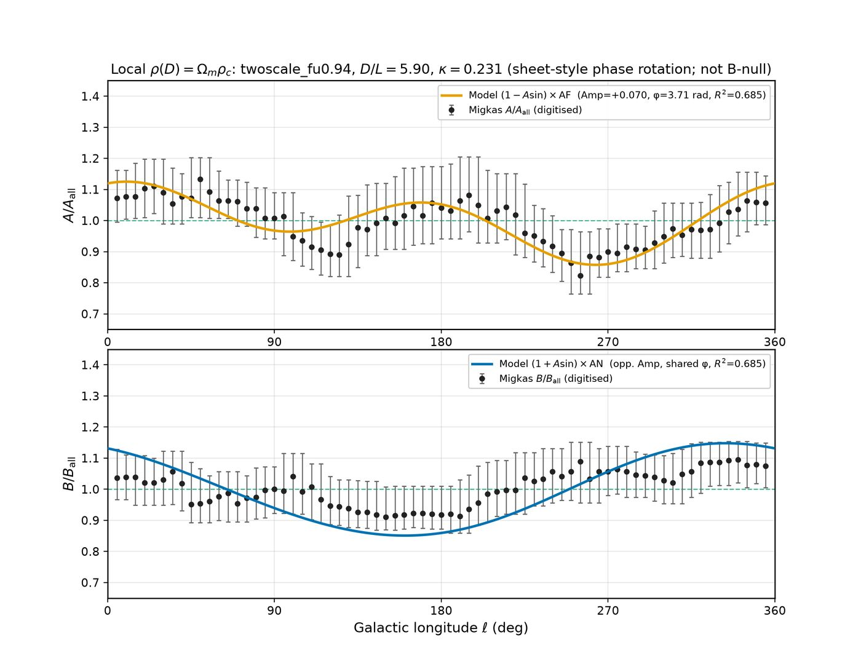
29/395 density_local_match/migkas_overlay_local_density.png
Notes:

Slide 31
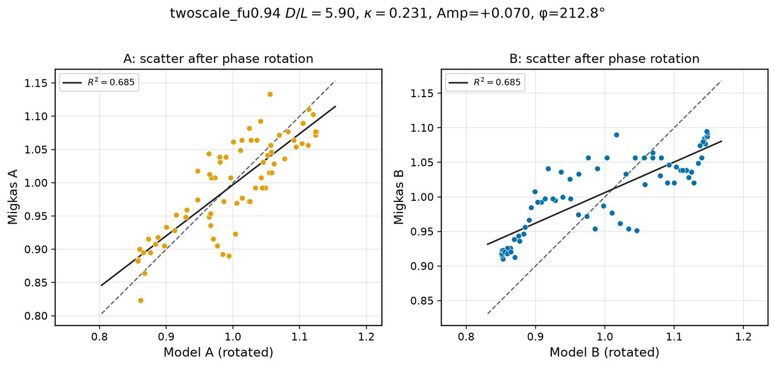
30/395 density_local_match/migkas_scatter_local_density.png
Notes:

Slide 32
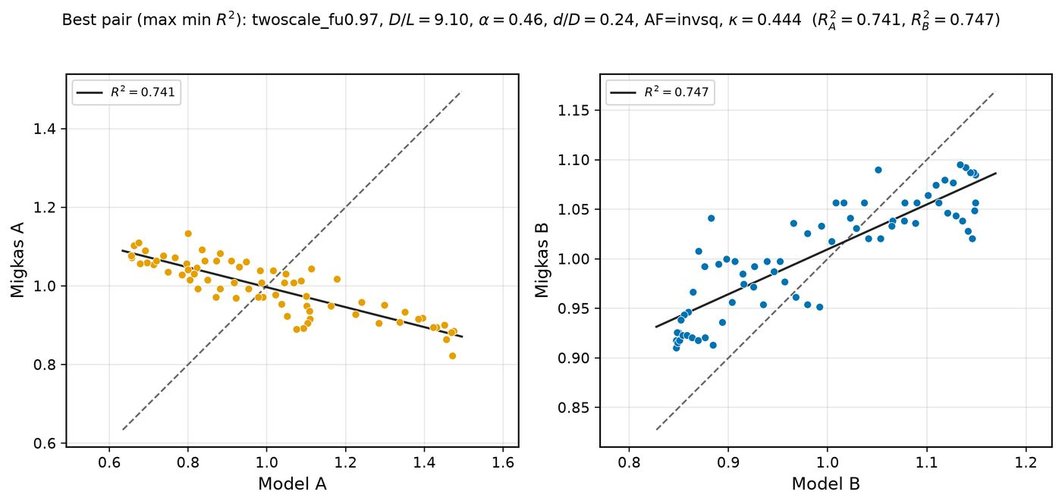
31/395 density_local_match/r2_maximize/migkas_best_pair_scatter.png
Notes:

Slide 33
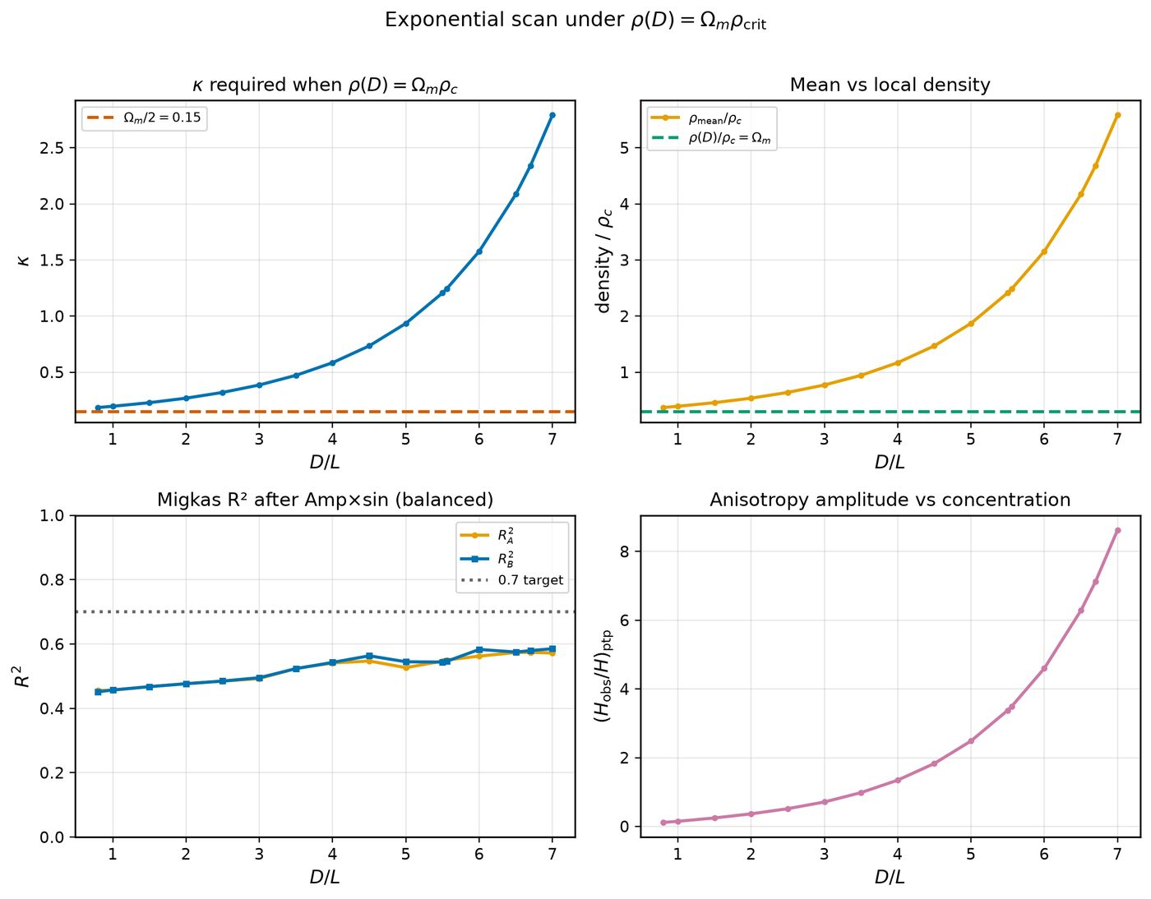
32/395 density_local_match/scan_pareto_local_density.png
Notes:

Slide 34
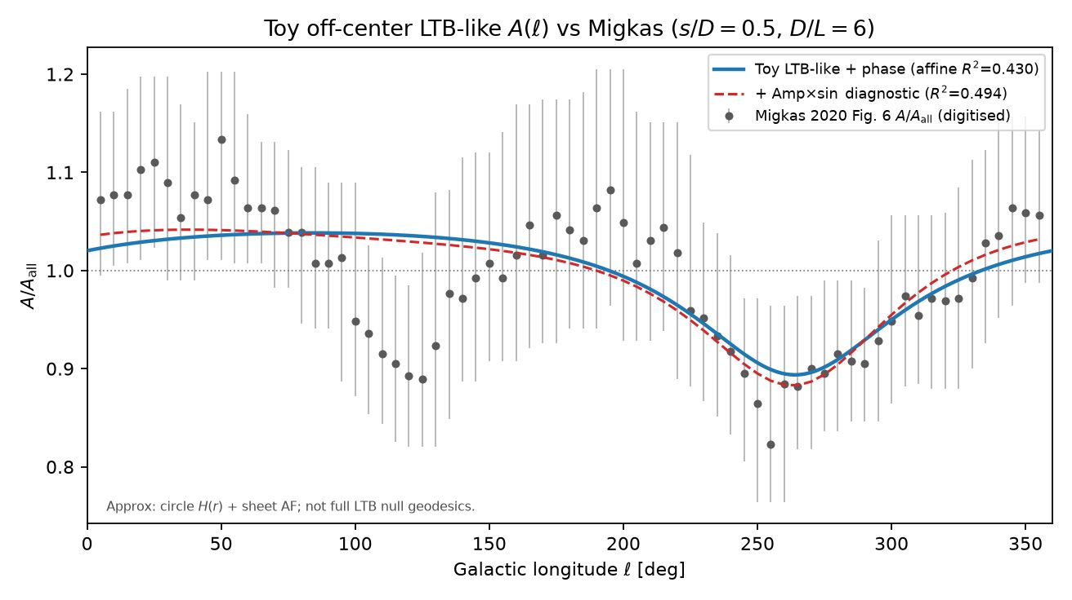
33/395 drive_upload_payloads/papers/gr_ch2_ltb_2026-09-20/figures/A_vs_ell_toy_ltb.png
Notes:

Slide 35
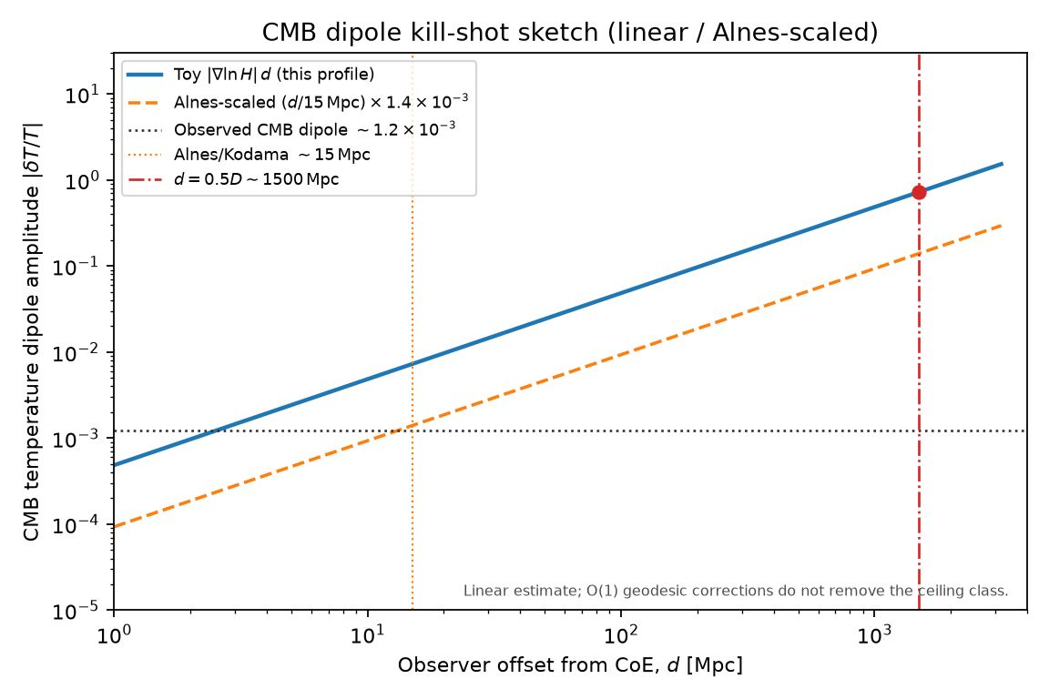
34/395 drive_upload_payloads/papers/gr_ch2_ltb_2026-09-20/figures/cmb_dipole_vs_offset.png
Notes:

Slide 36
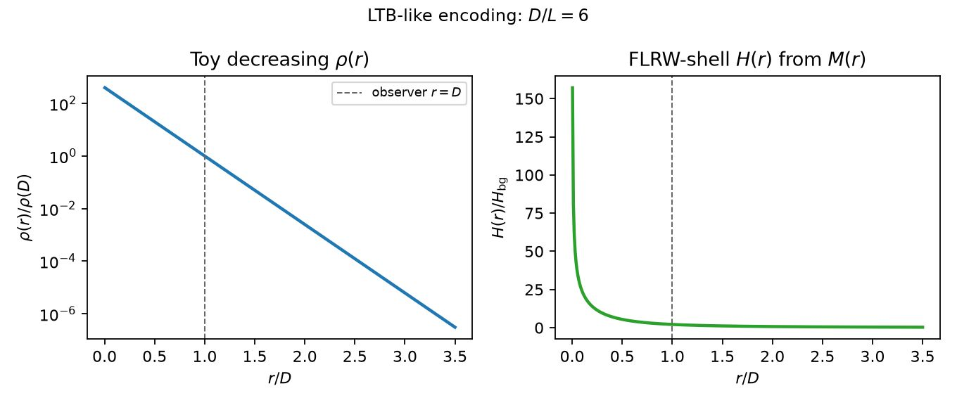
35/395 drive_upload_payloads/papers/gr_ch2_ltb_2026-09-20/figures/toy_density_H_profile.png
Notes:

Slide 37
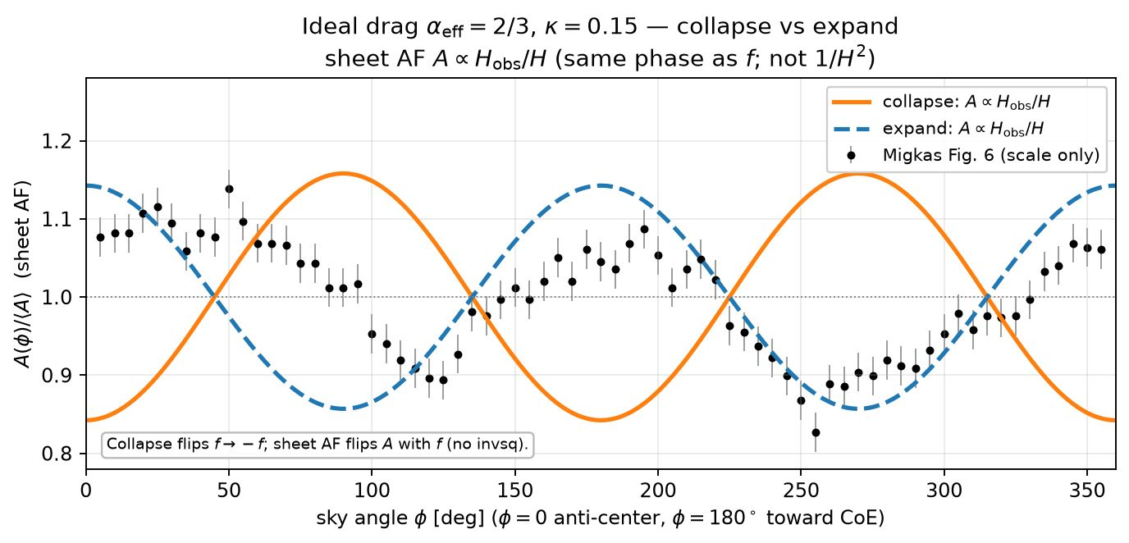
36/395 drive_upload_payloads/papers/st_coe_synthesis_2026-09-19/figures/A_vs_angle_ideal_collapse.png
Notes:

Slide 38
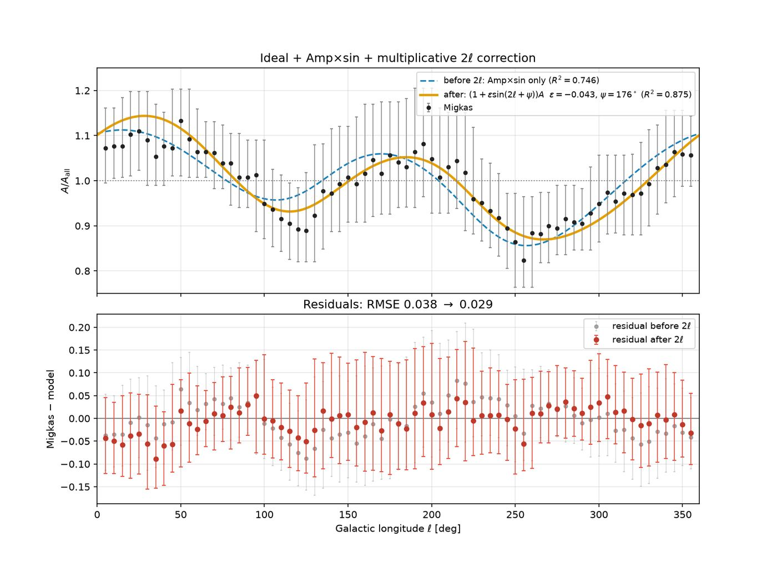
37/395 drive_upload_payloads/papers/stage_setting_2026-09-20/figures/best_fit_with_2ell_multiplier.png
Notes:

Slide 39
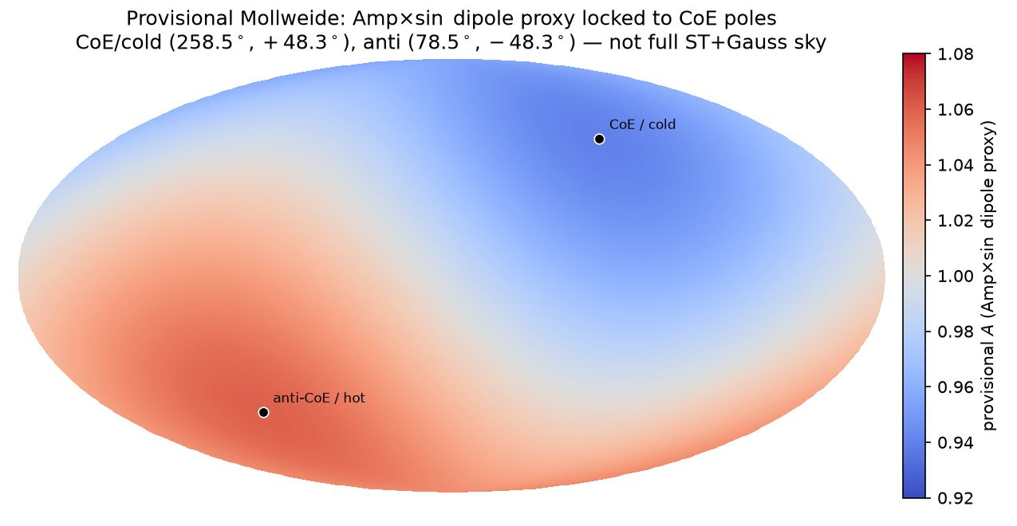
38/395 drive_upload_payloads/papers/stage_setting_2026-09-20/figures/mollweide_amp_sin_coe_axis.png
Notes:

Slide 40
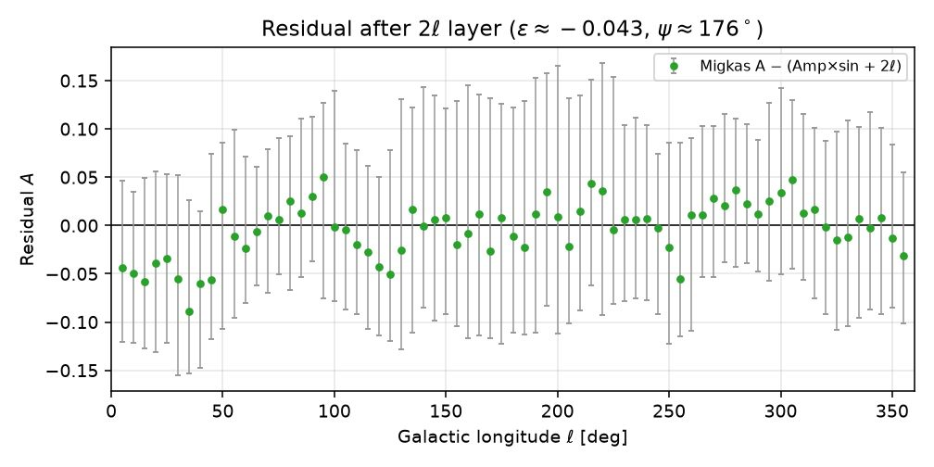
39/395 drive_upload_payloads/papers/stage_setting_2026-09-20/figures/residual_after_2ell.png
Notes:

Slide 41
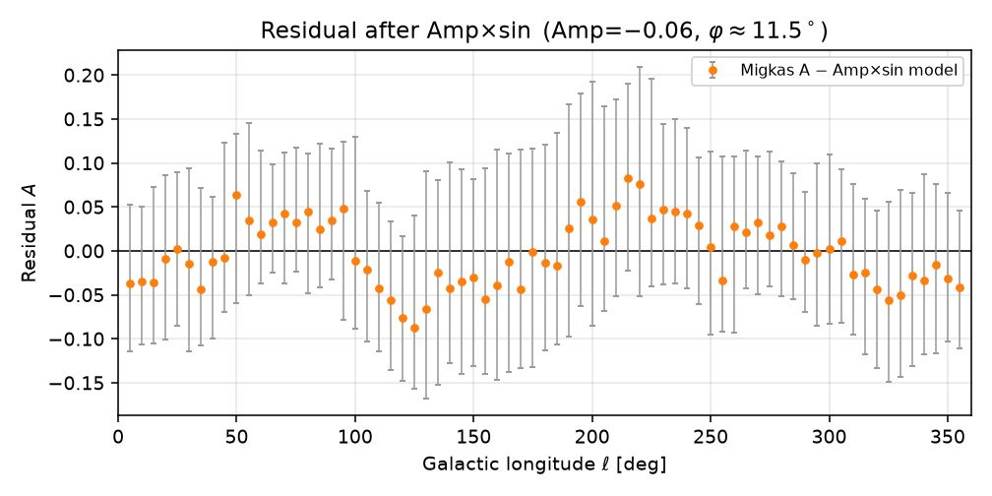
40/395 drive_upload_payloads/papers/stage_setting_2026-09-20/figures/residual_after_rotation.png
Notes:

Slide 42
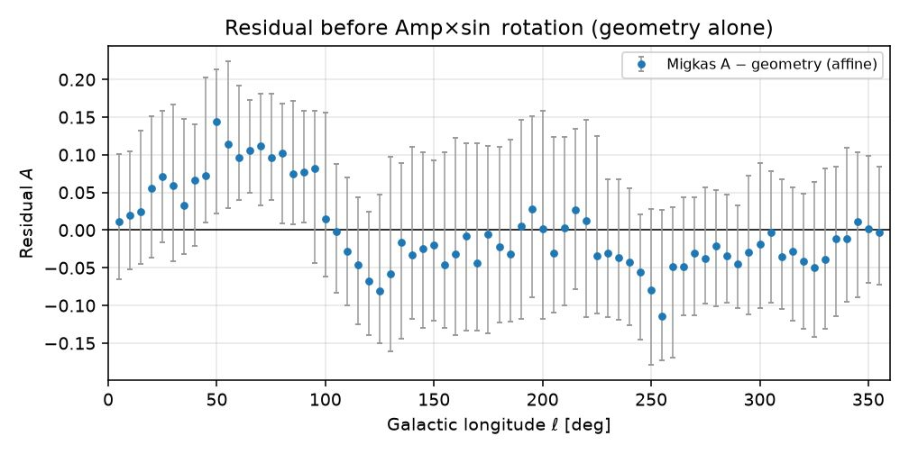
41/395 drive_upload_payloads/papers/stage_setting_2026-09-20/figures/residual_before_rotation.png
Notes:

Slide 43
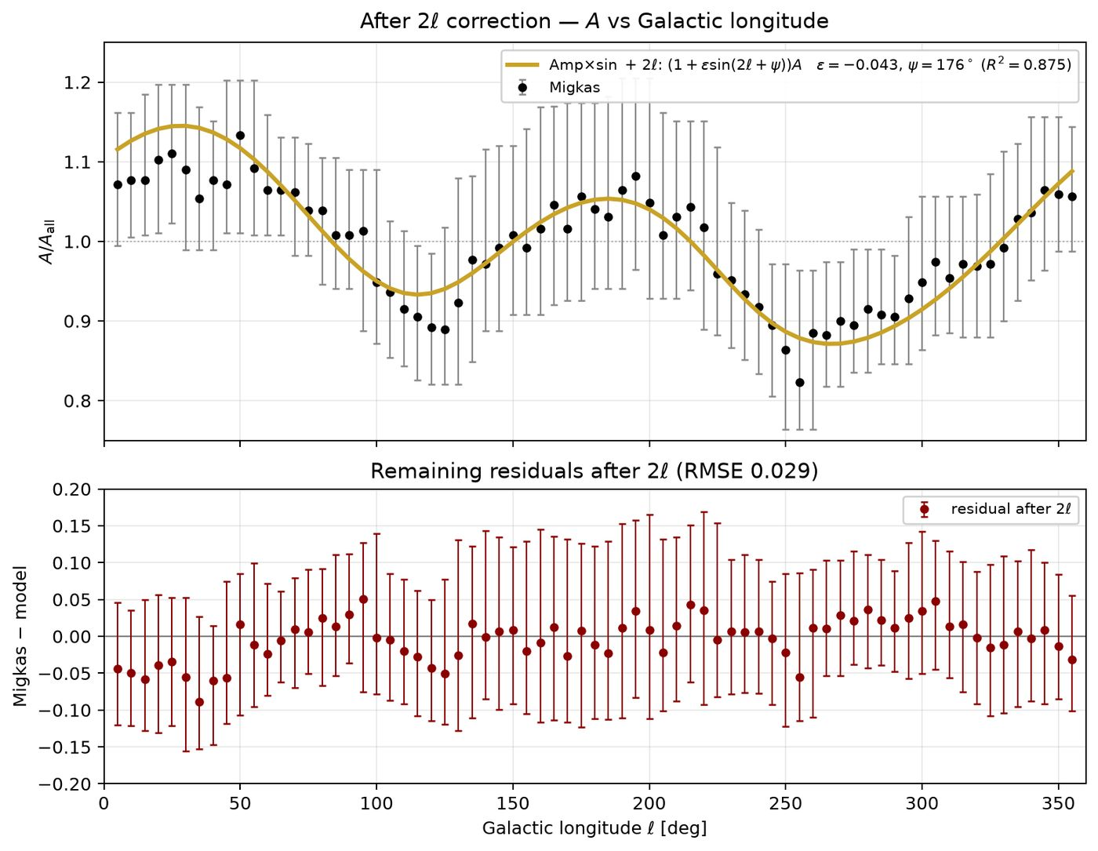
42/395 figures/A_vs_angle_after_2ell_with_residuals.png
Notes:

Slide 44
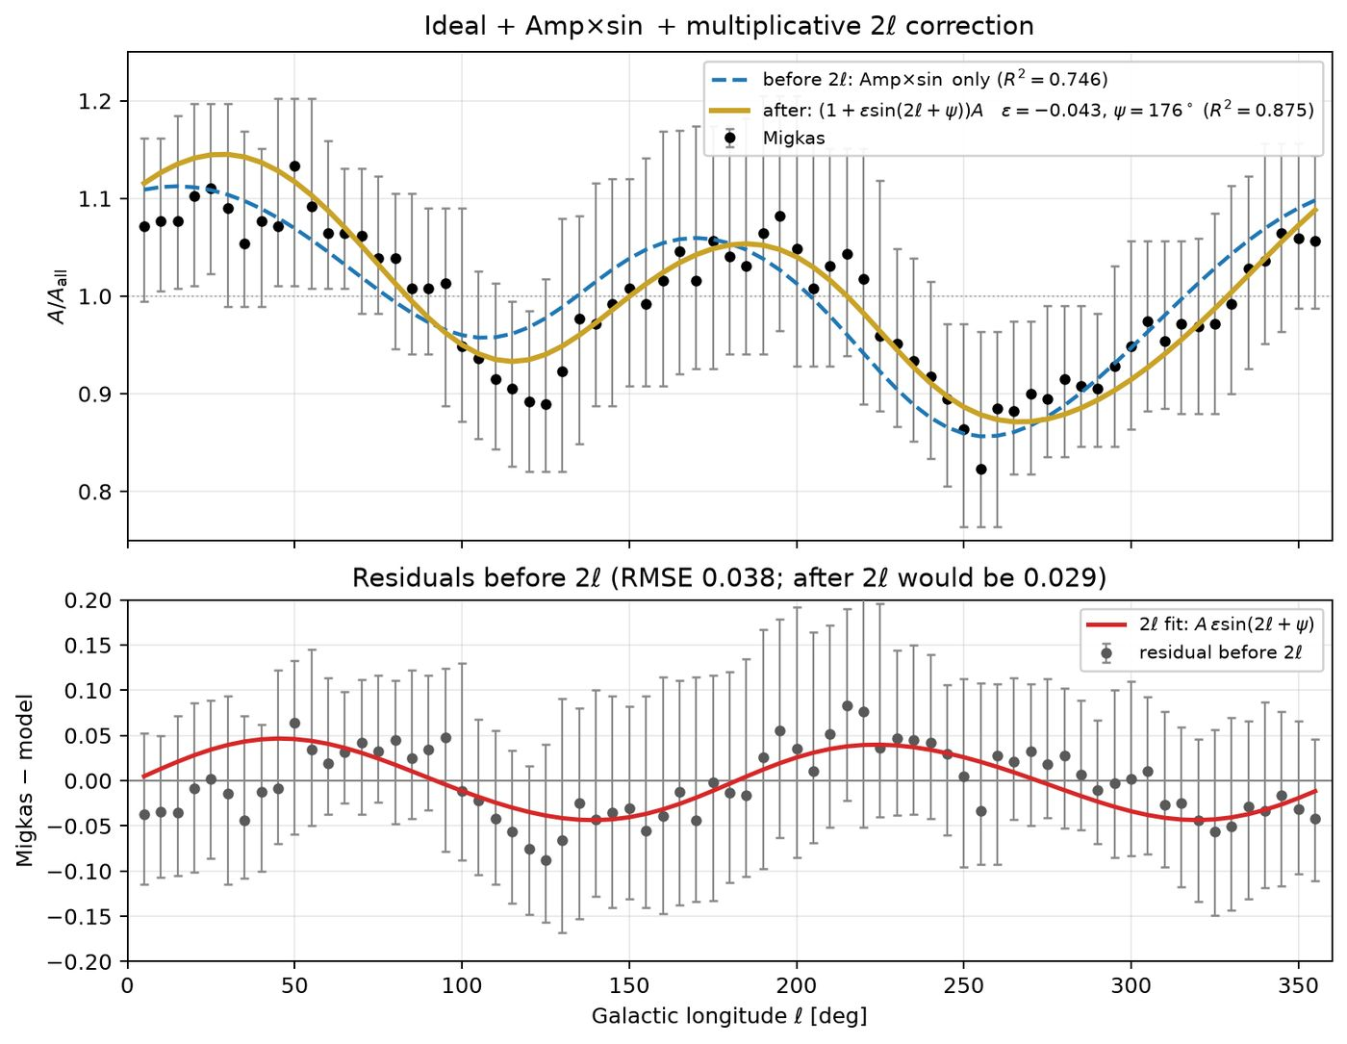
43/395 figures/A_vs_angle_with_residuals_2ell.png
Notes:

Slide 45
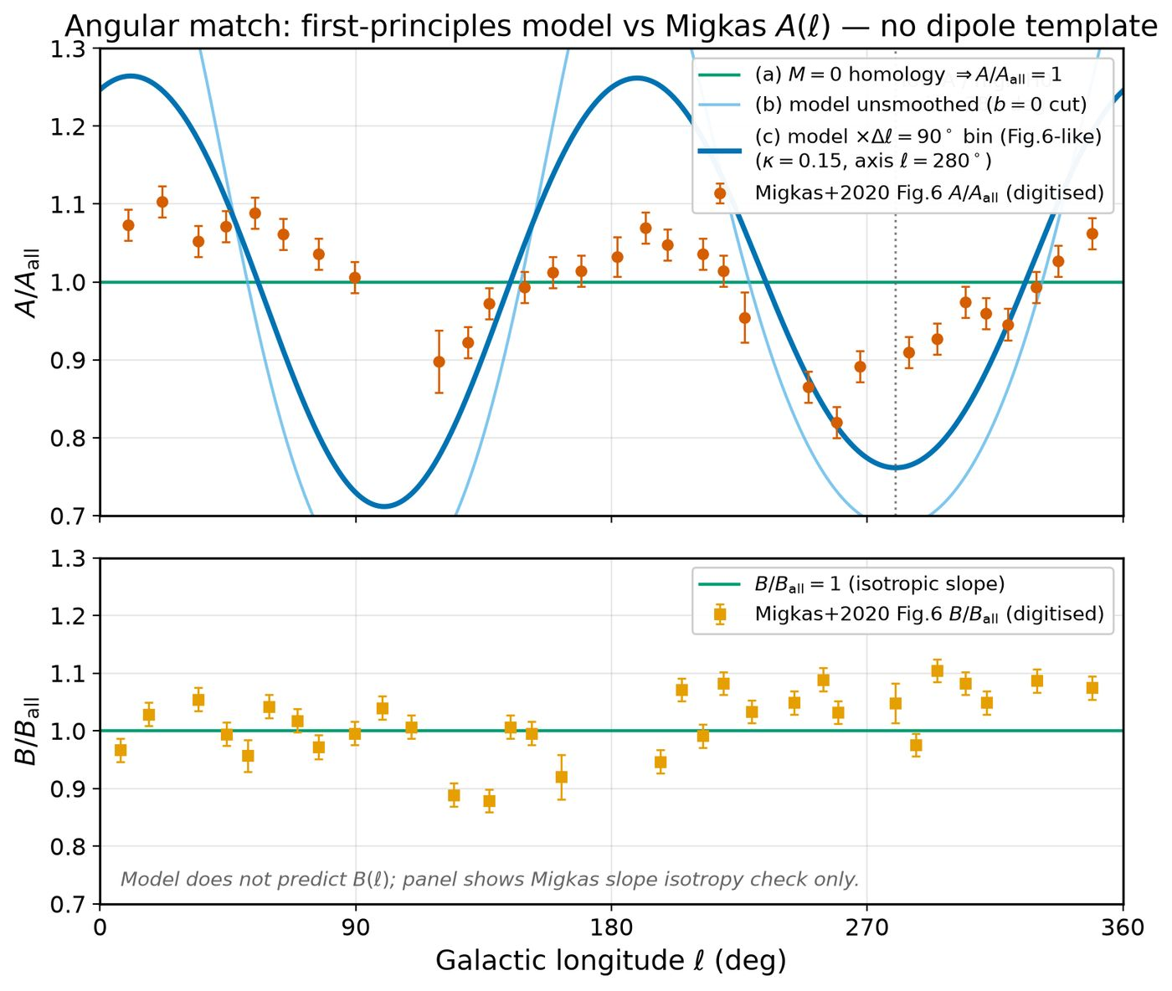
44/395 figures/Hobs_vs_angle.png
Notes:

Slide 46
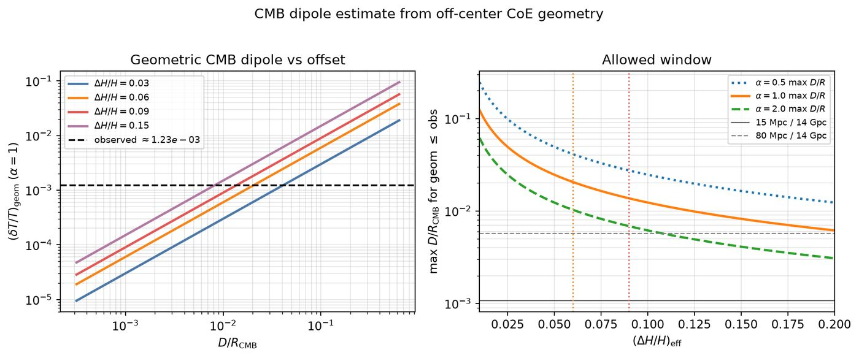
45/395 figures/cmb_dipole_estimate_coe_geometry.png
Notes:

Slide 47
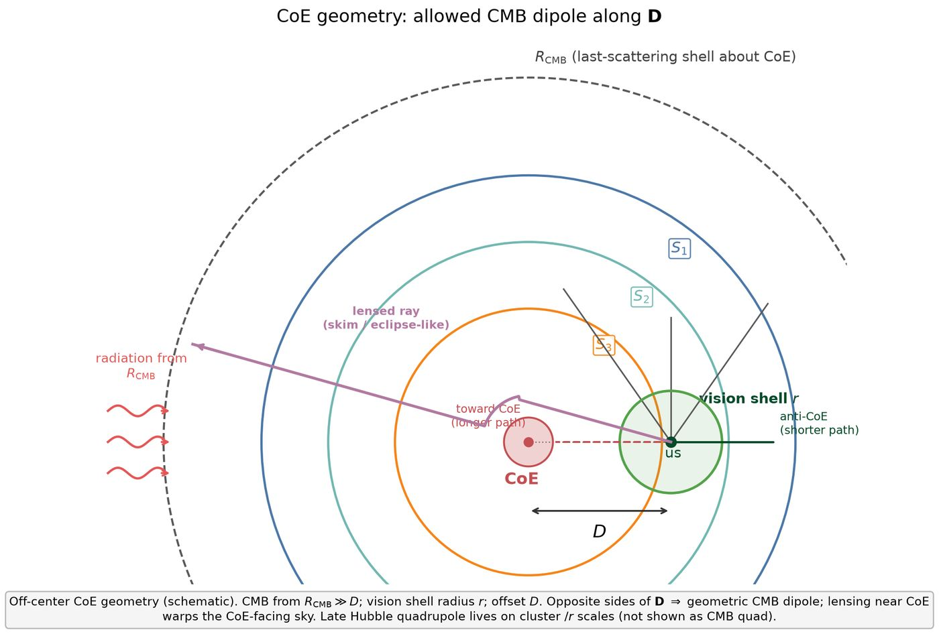
46/395 figures/coe_geometry_cmb_dipole_schematic.png
Notes:

Slide 48
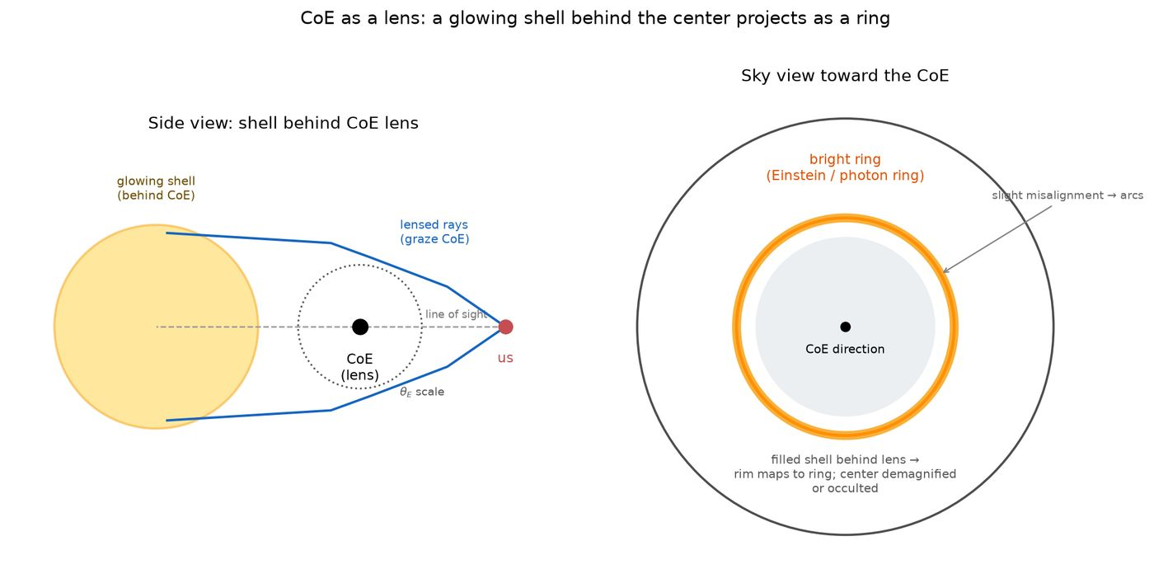
47/395 figures/coe_shell_behind_projects_as_ring.png
Notes:

Slide 49
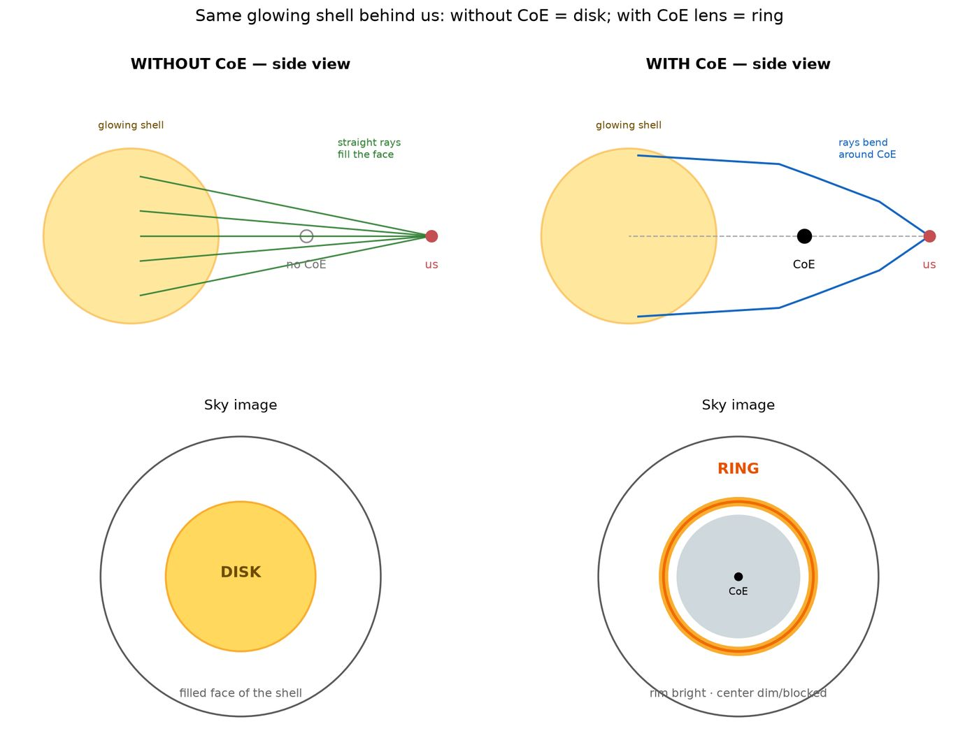
48/395 figures/coe_shell_with_vs_without.png
Notes:

Slide 50
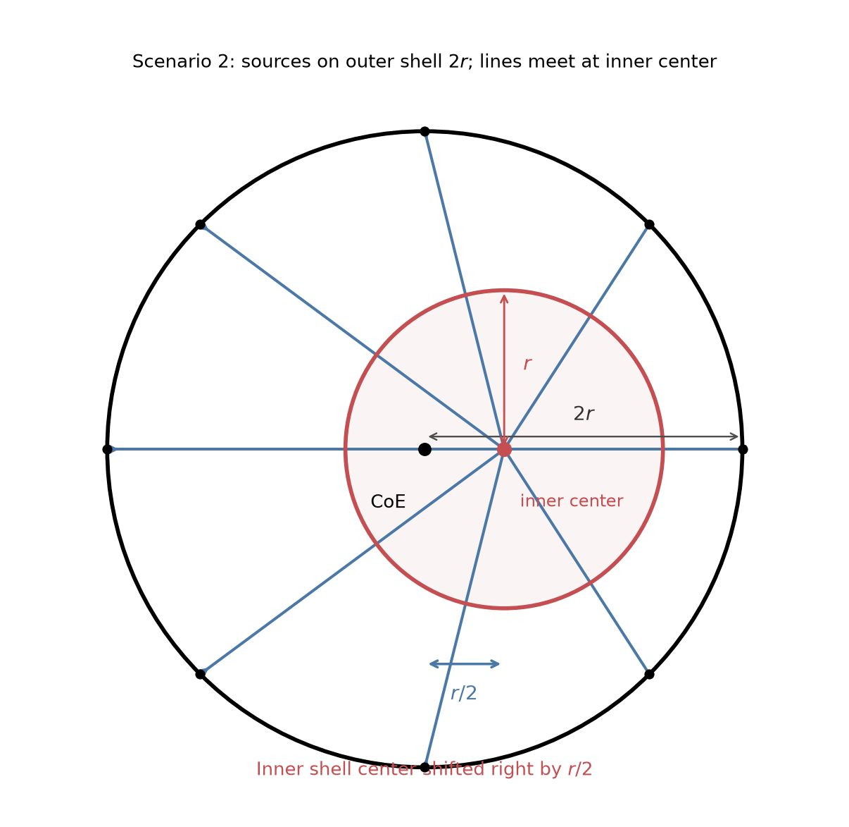
49/395 figures/concentric_scenario2_meet_inner_center.png
Notes:

Slide 51
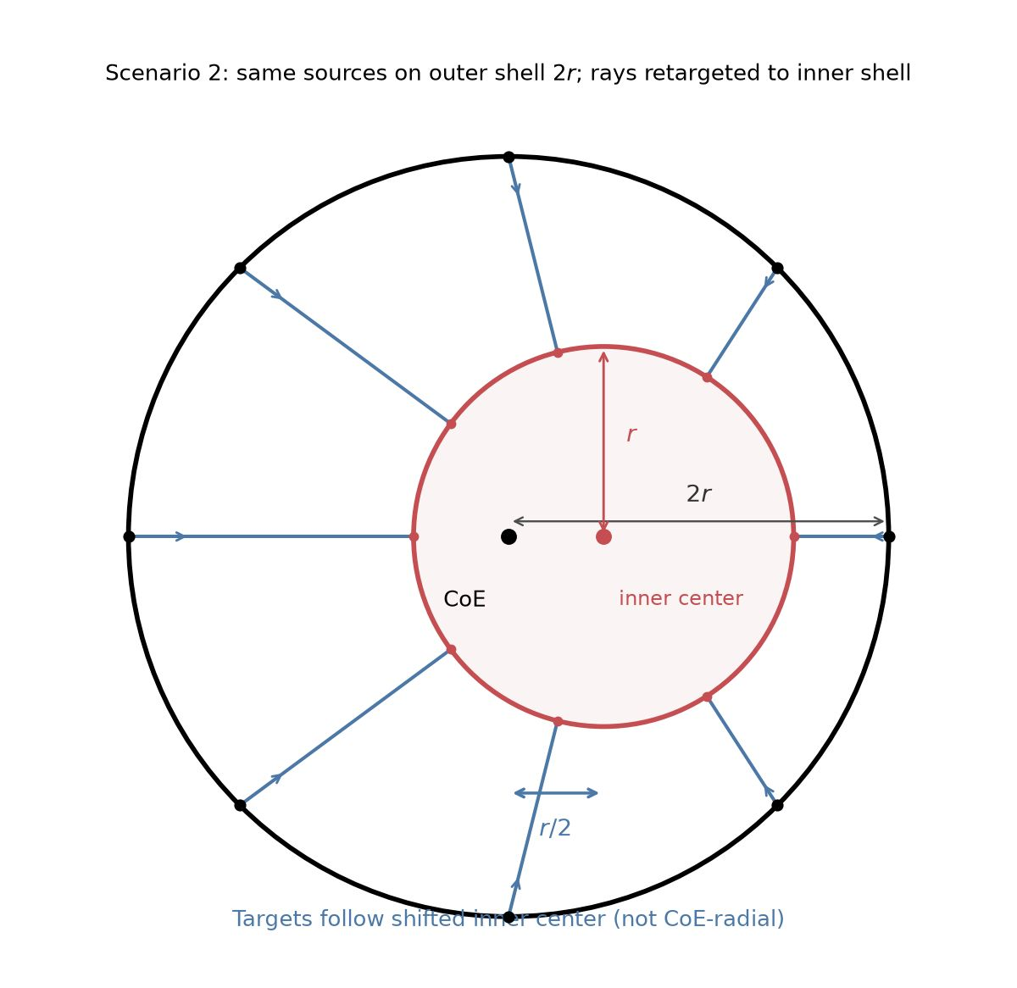
50/395 figures/concentric_scenario2_retarget_inner.png
Notes:

Slide 52

51/395 figures/concentric_shift_r_over_2.png
Notes:

Slide 53

52/395 figures/density_mass.png
Notes:

Slide 54

53/395 figures/expand_vs_collapse_A_migkas.png
Notes:

Slide 55

54/395 figures/expand_vs_collapse_shapes.png
Notes:

Slide 56

55/395 figures/expand_vs_collapse_vs_migkas.png
Notes:

Slide 57

56/395 figures/four_scenarios_R4r_shift2r.png
Notes:

Slide 58

57/395 figures/four_scenarios_overview.png
Notes:

Slide 59

58/395 figures/geometry.png
Notes:

Slide 60

59/395 figures/hubble_from_coe_relative_velocity.png
Notes:

Slide 61

60/395 figures/kappa_amplitude.png
Notes:

Slide 62

61/395 figures/levelset_curves/levelsets_curves_amp.png
Notes:

Slide 63

62/395 figures/levelset_curves/levelsets_curves_phi.png
Notes:

Slide 64

63/395 figures/levelset_curves/levelsets_curves_summary.png
Notes:

Slide 65

64/395 figures/migkas_bars_rotation_overlay.png
Notes:

Slide 66

65/395 figures/migkas_fig6_A_model_overlay.png
Notes:

Slide 67

66/395 figures/migkas_fig6_model_overlay.png
Notes:

Slide 68

67/395 figures/migkas_r2_fit_panels.png
Notes:

Slide 69

68/395 figures/migkas_r2_letter_panels.png
Notes:

Slide 70

69/395 figures/migkas_r2_vs_rotation.png
Notes:

Slide 71

70/395 figures/migkas_sheet_scatter_amp006.png
Notes:

Slide 72

71/395 figures/model_vs_migkas_schematic.png
Notes:

Slide 73

72/395 figures/multipoles.png
Notes:

Slide 74

73/395 figures/photon_hits_per_arc_vs_angle.png
Notes:

Slide 75

74/395 figures/ray_numbering_sc012.png
Notes:

Slide 76

75/395 figures/scenarios_024_R4r_shift2r.png
Notes:

Slide 77

76/395 figures/sky_mollweide.png
Notes:

Slide 78

77/395 figures/three_scenarios_angles_labeled.png
Notes:

Slide 79

78/395 figures/two_concentric_8_radial.png
Notes:

Slide 80

79/395 fullsky_AB/mollweide_AB_model_frame.png
Notes:

Slide 81

80/395 fullsky_AB/mollweide_AB_sky_frame.png
Notes:

Slide 82

81/395 fullsky_AB/mollweide_sine_local_density_A_hratio_DIAGNOSTIC.png
Notes:

Slide 83

82/395 fullsky_AB/mollweide_sine_local_density_B_DIAGNOSTIC.png
Notes:

Slide 84

83/395 fullsky_AB/mollweide_sine_local_density_DIAGNOSTIC.png
Notes:

Slide 85

84/395 fullsky_AB/mollweide_sine_sheet_A_hratio_DIAGNOSTIC.png
Notes:

Slide 86

85/395 fullsky_AB/mollweide_sine_sheet_B_DIAGNOSTIC.png
Notes:

Slide 87

86/395 fullsky_AB/mollweide_sine_sheet_DIAGNOSTIC.png
Notes:

Slide 88

87/395 fullsky_AB/mollweide_sky_A_hratio.png
Notes:

Slide 89

88/395 fullsky_AB/mollweide_sky_A_invsq.png
Notes:

Slide 90

89/395 fullsky_AB/mollweide_sky_B.png
Notes:

Slide 91

90/395 fullsky_AB/mollweide_sky_frac.png
Notes:

Slide 92

91/395 map_compare/01_physics_invsq_A_over_Ai.png
Notes:

Slide 93

92/395 map_compare/02_sheet_rotated_invsq_A_over_Ai.png
Notes:

Slide 94

93/395 map_compare/03_physics_hratio_A_over_Ai.png
Notes:

Slide 95

94/395 map_compare/04_sheet_rotated_hratio_A_over_Ai.png
Notes:

Slide 96

95/395 map_compare/CARD_migkas.png
Notes:

Slide 97

96/395 map_compare/CARD_ours.png
Notes:

Slide 98

97/395 map_compare/CARD_ours_noise_fig6var.png
Notes:

Slide 99

98/395 map_compare/CARD_ours_noise_pm01.png
Notes:

Slide 100

99/395 map_compare/EQUAL_STACK_migkas_vs_ours.png
Notes:

Slide 101

100/395 map_compare/FULL_migkas_theta75.png
Notes:

Slide 102

101/395 map_compare/FULL_ours_cone75_sheet.png
Notes:

Slide 103

102/395 map_compare/STACKED_migkas_vs_ours.png
Notes:

Slide 104

103/395 map_compare/STACK_migkas_mean_noise.png
Notes:

Slide 105

104/395 map_compare/_mig_hi_full.png
Notes:

Slide 106

105/395 map_compare/_mig_nocbar_tmp.png
Notes:

Slide 107

106/395 map_compare/all_our_maps_A_over_Ai.png
Notes:

Slide 108

107/395 map_compare/amp_mean_param_noise/AB_overlay_ideal_rotation_2ell.png
Notes:

Slide 109

108/395 map_compare/amp_mean_param_noise/AB_vs_angle_migkas_fig6.png
Notes:

Slide 110

109/395 map_compare/amp_mean_param_noise/A_overlay_ideal_rotation_2ell.png
Notes:

Slide 111

110/395 map_compare/amp_mean_param_noise/A_vs_angle_clean.png
Notes:

Slide 112

111/395 map_compare/amp_mean_param_noise/A_vs_angle_gap_band.png
Notes:

Slide 113

112/395 map_compare/amp_mean_param_noise/A_vs_angle_ideal_collapse.png
Notes:

Slide 114

113/395 map_compare/amp_mean_param_noise/A_vs_angle_ideal_collapse_only.png
Notes:

Slide 115

114/395 map_compare/amp_mean_param_noise/A_vs_angle_ideal_integration.png
Notes:

Slide 116

115/395 map_compare/amp_mean_param_noise/A_vs_angle_ideal_integration_sheet_AF.png
Notes:

Slide 117

116/395 map_compare/amp_mean_param_noise/A_vs_angle_ideal_plus_chris_rotation.png
Notes:

Slide 118

117/395 map_compare/amp_mean_param_noise/A_vs_angle_integral_matched_to_bolton.png
Notes:

Slide 119

118/395 map_compare/amp_mean_param_noise/A_vs_angle_levelsets_d_over_D.png
Notes:

Slide 120

119/395 map_compare/amp_mean_param_noise/A_vs_angle_levelsets_d_over_D_nosmooth.png
Notes:

Slide 121

120/395 map_compare/amp_mean_param_noise/A_vs_angle_levelsets_d_over_D_six.png
Notes:

Slide 122

121/395 map_compare/amp_mean_param_noise/A_vs_angle_levelsets_d_over_D_to_999.png
Notes:

Slide 123

122/395 map_compare/amp_mean_param_noise/A_vs_angle_levelsets_mass.png
Notes:

Slide 124

123/395 map_compare/amp_mean_param_noise/A_vs_angle_smooth_kick_ONLY.png
Notes:

Slide 125

124/395 map_compare/amp_mean_param_noise/A_vs_angle_smooth_kick_sheet_AF_hratio.png
Notes:

Slide 126

125/395 map_compare/amp_mean_param_noise/A_vs_angle_smooth_model_with_kick.png
Notes:

Slide 127

126/395 map_compare/amp_mean_param_noise/B_overlay_ideal_rotation_2ell.png
Notes:

Slide 128

127/395 map_compare/amp_mean_param_noise/B_vs_angle_migkas_fig6.png
Notes:

Slide 129

128/395 map_compare/amp_mean_param_noise/CARD_ampmean_baseline_invsq.png
Notes:

Slide 130

129/395 map_compare/amp_mean_param_noise/CARD_ampmean_both_invsq.png
Notes:

Slide 131

130/395 map_compare/amp_mean_param_noise/CARD_ampmean_both_minus_baseline.png
Notes:

Slide 132

131/395 map_compare/amp_mean_param_noise/CARD_ampmean_dist_invsq.png
Notes:

Slide 133

132/395 map_compare/amp_mean_param_noise/CARD_ampmean_vel_invsq.png
Notes:

Slide 134

133/395 map_compare/amp_mean_param_noise/CARD_base_baseline_invsq.png
Notes:

Slide 135

134/395 map_compare/amp_mean_param_noise/CARD_base_both_invsq.png
Notes:

Slide 136

135/395 map_compare/amp_mean_param_noise/CARD_base_both_minus_baseline.png
Notes:

Slide 137

136/395 map_compare/amp_mean_param_noise/CARD_base_dist_invsq.png
Notes:

Slide 138

137/395 map_compare/amp_mean_param_noise/CARD_base_vel_invsq.png
Notes:

Slide 139

138/395 map_compare/amp_mean_param_noise/CARD_ladder_baseline_invsq.png
Notes:

Slide 140

139/395 map_compare/amp_mean_param_noise/CARD_ladder_both_d10_invsq.png
Notes:

Slide 141

140/395 map_compare/amp_mean_param_noise/CARD_ladder_both_d20_invsq.png
Notes:

Slide 142

141/395 map_compare/amp_mean_param_noise/CARD_ladder_dist_d10_invsq.png
Notes:

Slide 143

142/395 map_compare/amp_mean_param_noise/CARD_ladder_dist_d20_invsq.png
Notes:

Slide 144

143/395 map_compare/amp_mean_param_noise/CARD_ladder_dist_d25_invsq.png
Notes:

Slide 145

144/395 map_compare/amp_mean_param_noise/CARD_mild_baseline_invsq.png
Notes:

Slide 146

145/395 map_compare/amp_mean_param_noise/CARD_mild_both_d02_invsq.png
Notes:

Slide 147

146/395 map_compare/amp_mean_param_noise/CARD_mild_both_d03_invsq.png
Notes:

Slide 148

147/395 map_compare/amp_mean_param_noise/CARD_mild_dist_d02_invsq.png
Notes:

Slide 149

148/395 map_compare/amp_mean_param_noise/CARD_mild_dist_d03_invsq.png
Notes:

Slide 150

149/395 map_compare/amp_mean_param_noise/CARD_mild_dist_d05_invsq.png
Notes:

Slide 151

150/395 map_compare/amp_mean_param_noise/CARD_mild_vel_invsq.png
Notes:

Slide 152

151/395 map_compare/amp_mean_param_noise/CARD_mixture_both_invsq.png
Notes:

Slide 153

152/395 map_compare/amp_mean_param_noise/CARD_primary_both_d01_invsq.png
Notes:

Slide 154

153/395 map_compare/amp_mean_param_noise/CARD_primary_both_d02_invsq.png
Notes:

Slide 155

154/395 map_compare/amp_mean_param_noise/CARD_primary_dist_d01_invsq.png
Notes:

Slide 156

155/395 map_compare/amp_mean_param_noise/CARD_primary_dist_d02_invsq.png
Notes:

Slide 157

156/395 map_compare/amp_mean_param_noise/CARD_primary_vel_invsq.png
Notes:

Slide 158

157/395 map_compare/amp_mean_param_noise/Cl_A_migkas_smooth_both.png
Notes:

Slide 159

158/395 map_compare/amp_mean_param_noise/HIST_A_features_fix.png
Notes:

Slide 160

159/395 map_compare/amp_mean_param_noise/HIST_A_migkas_smooth_both.png
Notes:

Slide 161

160/395 map_compare/amp_mean_param_noise/HIST_A_migkas_smooth_both_logy.png
Notes:

Slide 162

161/395 map_compare/amp_mean_param_noise/HIST_A_migkas_smooth_both_logy_gap.png
Notes:

Slide 163

162/395 map_compare/amp_mean_param_noise/HIST_A_migkas_smooth_both_percentiles.png
Notes:

Slide 164

163/395 map_compare/amp_mean_param_noise/HIST_A_migkas_smooth_mixture_both.png
Notes:

Slide 165

164/395 map_compare/amp_mean_param_noise/HIST_A_migkas_smooth_mixture_both_logy.png
Notes:

Slide 166

165/395 map_compare/amp_mean_param_noise/HIST_A_vs_ell_fig6.png
Notes:

Slide 167

166/395 map_compare/amp_mean_param_noise/HIST_fig6_over_smooth_stacked.png
Notes:

Slide 168

167/395 map_compare/amp_mean_param_noise/HIST_levelset_amp_family_stacked.png
Notes:

Slide 169

168/395 map_compare/amp_mean_param_noise/HIST_levelset_phi_family_stacked.png
Notes:

Slide 170

169/395 map_compare/amp_mean_param_noise/HIST_migkas_fine_three_peaks.png
Notes:

Slide 171

170/395 map_compare/amp_mean_param_noise/HIST_migkas_logy_1d_gap.png
Notes:

Slide 172

171/395 map_compare/amp_mean_param_noise/HIST_migkas_logy_NS_LR_stacked.png
Notes:

Slide 173

172/395 map_compare/amp_mean_param_noise/HIST_migkas_logy_NS_only.png
Notes:

Slide 174

173/395 map_compare/amp_mean_param_noise/HIST_migkas_logy_N_and_S_separate_stacked.png
Notes:

Slide 175

174/395 map_compare/amp_mean_param_noise/HIST_migkas_logy_identify_peaks_gap.png
Notes:

Slide 176

175/395 map_compare/amp_mean_param_noise/HIST_migkas_logy_identify_peaks_gap_clean.png
Notes:

Slide 177

176/395 map_compare/amp_mean_param_noise/HIST_migkas_logy_peaks_and_gap.png
Notes:

Slide 178

177/395 map_compare/amp_mean_param_noise/HIST_migkas_logy_quadrants_stacked.png
Notes:

Slide 179

178/395 map_compare/amp_mean_param_noise/HIST_migkas_logy_three_peaks.png
Notes:

Slide 180

179/395 map_compare/amp_mean_param_noise/HIST_migkas_measured_peaks_gaps.png
Notes:

Slide 181

180/395 map_compare/amp_mean_param_noise/HIST_migkas_peaks_gaps_table.png
Notes:

Slide 182

181/395 map_compare/amp_mean_param_noise/HIST_overlay_A_migkas_over_model.png
Notes:

Slide 183

182/395 map_compare/amp_mean_param_noise/HIST_smooth_ampmean_alone.png
Notes:

Slide 184

183/395 map_compare/amp_mean_param_noise/HIST_vs_Cl_migkas.png
Notes:

Slide 185

184/395 map_compare/amp_mean_param_noise/R2_table_best_A_B_with_heatmaps.png
Notes:

Slide 186

185/395 map_compare/amp_mean_param_noise/R2_top5_A_B_tables.png
Notes:

Slide 187
186/395 map_compare/amp_mean_param_noise/STRIP_ampmean_baseline_vel_dist_both.png
Notes:

Slide 188
187/395 map_compare/amp_mean_param_noise/STRIP_base_vel_dist_both.png
Notes:

Slide 189
188/395 map_compare/amp_mean_param_noise/STRIP_ladder_baseline_vel_dist20_both.png
Notes:

Slide 190
189/395 map_compare/amp_mean_param_noise/STRIP_ladder_dist_10_20_25.png
Notes:

Slide 191
190/395 map_compare/amp_mean_param_noise/STRIP_mild_baseline_vel_dist03_both.png
Notes:

Slide 192
191/395 map_compare/amp_mean_param_noise/STRIP_mild_dist_02_03_05.png
Notes:

Slide 193
192/395 map_compare/amp_mean_param_noise/STRIP_primary_latest.png
Notes:

Slide 194
193/395 map_compare/amp_mean_param_noise/best_A_vs_angle_with_associated_B.png
Notes:

Slide 195
194/395 map_compare/amp_mean_param_noise/best_A_vs_angle_with_associated_B_2ell.png
Notes:

Slide 196
195/395 map_compare/amp_mean_param_noise/best_A_vs_angle_with_associated_B_2ell_fromB.png
Notes:

Slide 197
196/395 map_compare/amp_mean_param_noise/best_B_vs_angle_with_associated_A.png
Notes:

Slide 198
197/395 map_compare/amp_mean_param_noise/best_B_vs_angle_with_associated_A_2ell.png
Notes:

Slide 199
198/395 map_compare/amp_mean_param_noise/best_B_vs_angle_with_associated_A_2ell_fromB.png
Notes:

Slide 200
199/395 map_compare/amp_mean_param_noise/best_fit_residual_vs_angle.png
Notes:

Slide 201
200/395 map_compare/amp_mean_param_noise/best_fit_with_2ell_multiplier.png
Notes:

Slide 202
201/395 map_compare/amp_mean_param_noise/best_model_minima_check.png
Notes:

Slide 203
202/395 map_compare/amp_mean_param_noise/coe_axis_3d_b_locked.png
Notes:

Slide 204
203/395 map_compare/amp_mean_param_noise/coe_axis_3d_fit_R2_sky.png
Notes:

Slide 205
204/395 map_compare/amp_mean_param_noise/dipole_vs_quadrupole_examples.png
Notes:

Slide 206
205/395 map_compare/amp_mean_param_noise/geometry_CoE_observer.png
Notes:

Slide 207
206/395 map_compare/amp_mean_param_noise/ideal_fit_M_d_D_L_migkas.png
Notes:

Slide 208
207/395 map_compare/amp_mean_param_noise/ideal_levelsets_Amp.png
Notes:

Slide 209
208/395 map_compare/amp_mean_param_noise/ideal_levelsets_L_M35_d05.png
Notes:

Slide 210
209/395 map_compare/amp_mean_param_noise/ideal_levelsets_L_grid_M3-4_d02-08.png
Notes:

Slide 211
210/395 map_compare/amp_mean_param_noise/ideal_levelsets_L_grid_no_highestL.png
Notes:

Slide 212
211/395 map_compare/amp_mean_param_noise/ideal_levelsets_L_grid_no_smallestL.png
Notes:

Slide 213
212/395 map_compare/amp_mean_param_noise/ideal_levelsets_L_grid_rotation_Lmin015.png
Notes:

Slide 214
213/395 map_compare/amp_mean_param_noise/ideal_levelsets_L_grid_rotation_d25-75.png
Notes:

Slide 215
214/395 map_compare/amp_mean_param_noise/ideal_levelsets_L_grid_rotation_dmax07.png
Notes:

Slide 216
215/395 map_compare/amp_mean_param_noise/ideal_levelsets_L_grid_with_rotation.png
Notes:

Slide 217
216/395 map_compare/amp_mean_param_noise/ideal_levelsets_d_over_D.png
Notes:

Slide 218
217/395 map_compare/amp_mean_param_noise/ideal_levelsets_eta.png
Notes:

Slide 219
218/395 map_compare/amp_mean_param_noise/ideal_levelsets_fu.png
Notes:

Slide 220
219/395 map_compare/amp_mean_param_noise/ideal_levelsets_mass.png
Notes:

Slide 221
220/395 map_compare/amp_mean_param_noise/ideal_levelsets_phi.png
Notes:

Slide 222
221/395 map_compare/amp_mean_param_noise/ideal_levelsets_x_DL.png
Notes:

Slide 223
222/395 map_compare/amp_mean_param_noise/ideal_rotation_3x3x5_R2_ranked.png
Notes:

Slide 224
223/395 map_compare/amp_mean_param_noise/ideal_rotation_3x3x5_top_curves.png
Notes:

Slide 225
224/395 map_compare/amp_mean_param_noise/kick_levelsets_L_M35_d05.png
Notes:

Slide 226
225/395 map_compare/amp_mean_param_noise/kick_levelsets_L_grid_M3-4_d02-08.png
Notes:

Slide 227
226/395 map_compare/amp_mean_param_noise/rotation_Amp_phi_AB_shared_heatmaps.png
Notes:

Slide 228
227/395 map_compare/amp_mean_param_noise/rotation_Amp_phi_B_R2_ranked.png
Notes:

Slide 229
228/395 map_compare/amp_mean_param_noise/rotation_Amp_phi_B_top_curves.png
Notes:

Slide 230
229/395 map_compare/amp_mean_param_noise/rotation_Amp_phi_R2_ranked.png
Notes:

Slide 231
230/395 map_compare/amp_mean_param_noise/rotation_Amp_phi_top_curves.png
Notes:

Slide 232
231/395 map_compare/amp_mean_param_noise/rotation_levelsets_Amp.png
Notes:

Slide 233
232/395 map_compare/amp_mean_param_noise/rotation_levelsets_phi.png
Notes:

Slide 234
233/395 map_compare/amp_mean_param_noise/u_radial_integral_matched_to_bolton.png
Notes:

Slide 235
234/395 map_compare/cone_noise_matched_vs_fig6.png
Notes:

Slide 236
235/395 map_compare/cone_noise_variants.png
Notes:

Slide 237
236/395 map_compare/cone_noise_vs_fig6_bars.png
Notes:

Slide 238
237/395 map_compare/cone_param_noise/CARD_cone75_angle_baseline_invsq.png
Notes:

Slide 239
238/395 map_compare/cone_param_noise/CARD_cone75_angle_dist_s15_invsq.png
Notes:

Slide 240
239/395 map_compare/cone_param_noise/CARD_cone75_angle_vel_dist_combined_invsq.png
Notes:

Slide 241
240/395 map_compare/cone_param_noise/CARD_cone75_angle_vel_radial_s05_invsq.png
Notes:

Slide 242
241/395 map_compare/cone_param_noise/CARD_cone75_native_baseline_invsq.png
Notes:

Slide 243
242/395 map_compare/cone_param_noise/CARD_cone75_native_dist_s15_invsq.png
Notes:

Slide 244
243/395 map_compare/cone_param_noise/CARD_cone75_native_dist_s25_invsq.png
Notes:

Slide 245
244/395 map_compare/cone_param_noise/CARD_cone75_native_vel_dist_combined_invsq.png
Notes:

Slide 246
245/395 map_compare/cone_param_noise/CARD_cone75_native_vel_radial_s05_invsq.png
Notes:

Slide 247
246/395 map_compare/cone_param_noise/CARD_cone75_native_vel_radial_s10_invsq.png
Notes:

Slide 248
247/395 map_compare/cone_param_noise/GRID_conenative_vs_angle_invsq.png
Notes:

Slide 249

248/395 map_compare/cone_param_noise/STRIP_angle_baseline_vel_dist_both_invsq.png
Notes:

Slide 250
249/395 map_compare/cone_param_noise/STRIP_baseline_vel_dist_both_invsq.png
Notes:

Slide 251
250/395 map_compare/cone_param_noise/STRIP_conenative_baseline_vel_dist_both_invsq.png
Notes:

Slide 252
251/395 map_compare/cone_thetas/GRID_4x4_cone_thetas.png
Notes:

Slide 253
252/395 map_compare/cone_thetas/GRID_ours_like_fig8_sheet_invsq.png
Notes:

Slide 254
253/395 map_compare/cone_thetas/cards/theta45_phys_hratio.png
Notes:

Slide 255
254/395 map_compare/cone_thetas/cards/theta45_phys_invsq.png
Notes:

Slide 256
255/395 map_compare/cone_thetas/cards/theta45_sheet_hratio.png
Notes:

Slide 257
256/395 map_compare/cone_thetas/cards/theta45_sheet_invsq.png
Notes:

Slide 258
257/395 map_compare/cone_thetas/cards/theta60_phys_hratio.png
Notes:

Slide 259
258/395 map_compare/cone_thetas/cards/theta60_phys_invsq.png
Notes:

Slide 260
259/395 map_compare/cone_thetas/cards/theta60_sheet_hratio.png
Notes:

Slide 261
260/395 map_compare/cone_thetas/cards/theta60_sheet_invsq.png
Notes:

Slide 262
261/395 map_compare/cone_thetas/cards/theta75_phys_hratio.png
Notes:

Slide 263
262/395 map_compare/cone_thetas/cards/theta75_phys_invsq.png
Notes:

Slide 264
263/395 map_compare/cone_thetas/cards/theta75_sheet_hratio.png
Notes:

Slide 265
264/395 map_compare/cone_thetas/cards/theta75_sheet_invsq.png
Notes:

Slide 266
265/395 map_compare/cone_thetas/cards/theta90_phys_hratio.png
Notes:

Slide 267
266/395 map_compare/cone_thetas/cards/theta90_phys_invsq.png
Notes:

Slide 268
267/395 map_compare/cone_thetas/cards/theta90_sheet_hratio.png
Notes:

Slide 269
268/395 map_compare/cone_thetas/cards/theta90_sheet_invsq.png
Notes:

Slide 270
269/395 map_compare/cone_thetas/patchwork16/CARD_patchwork16_draw1_seed20.png
Notes:

Slide 271
270/395 map_compare/cone_thetas/patchwork16/CARD_patchwork16_draw2_seed21.png
Notes:

Slide 272
271/395 map_compare/cone_thetas/patchwork16/CARD_patchwork16_draw3_seed22.png
Notes:

Slide 273
272/395 map_compare/cone_thetas/patchwork16/CARD_patchwork16_draw4_seed23.png
Notes:

Slide 274
273/395 map_compare/cone_thetas/patchwork16/CARD_sources16_draw1_seed20.png
Notes:

Slide 275
274/395 map_compare/cone_thetas/patchwork16/CARD_sources16_draw2_seed21.png
Notes:

Slide 276
275/395 map_compare/cone_thetas/patchwork16/CARD_sources16_draw3_seed22.png
Notes:

Slide 277
276/395 map_compare/cone_thetas/patchwork16/CARD_sources16_draw4_seed23.png
Notes:

Slide 278
277/395 map_compare/cone_thetas/patchwork16/GRID_patchwork16_4draws.png
Notes:

Slide 279
278/395 map_compare/cone_thetas/patchwork16/GRID_sources16_4draws.png
Notes:

Slide 280
279/395 map_compare/cone_thetas/patchwork_sheet4/CARD_sheet4_draw1_seed30.png
Notes:

Slide 281
280/395 map_compare/cone_thetas/patchwork_sheet4/CARD_sheet4_draw2_seed31.png
Notes:

Slide 282
281/395 map_compare/cone_thetas/patchwork_sheet4/CARD_sheet4_draw3_seed32.png
Notes:

Slide 283
282/395 map_compare/cone_thetas/patchwork_sheet4/CARD_sheet4_draw4_seed33.png
Notes:

Slide 284
283/395 map_compare/cone_thetas/patchwork_sheet4/CARD_sheet4_sources_draw1_seed30.png
Notes:

Slide 285
284/395 map_compare/cone_thetas/patchwork_sheet4/CARD_sheet4_sources_draw2_seed31.png
Notes:

Slide 286
285/395 map_compare/cone_thetas/patchwork_sheet4/CARD_sheet4_sources_draw3_seed32.png
Notes:

Slide 287
286/395 map_compare/cone_thetas/patchwork_sheet4/CARD_sheet4_sources_draw4_seed33.png
Notes:

Slide 288
287/395 map_compare/cone_thetas/patchwork_sheet4/GRID_sheet4_4draws.png
Notes:

Slide 289
288/395 map_compare/cone_thetas/patchwork_sheet4/GRID_sheet4_sources_4draws.png
Notes:

Slide 290
289/395 map_compare/debug_crop_tr_loose.png
Notes:

Slide 291
290/395 map_compare/debug_crop_tr_mid.png
Notes:

Slide 292
291/395 map_compare/levelset_maps/CARD_amp_family_MEAN.png
Notes:

Slide 293
292/395 map_compare/levelset_maps/GRID_amp_family.png
Notes:

Slide 294
293/395 map_compare/levelset_maps/GRID_patchwork_4draws.png
Notes:

Slide 295
294/395 map_compare/levelset_maps/GRID_patchwork_4draws_ALL_MARKERS.png
Notes:

Slide 296
295/395 map_compare/levelset_maps/GRID_patchwork_4draws_EXTREMA.png
Notes:

Slide 297
296/395 map_compare/levelset_maps/GRID_patchwork_4draws_MAXES.png
Notes:

Slide 298
297/395 map_compare/levelset_maps/GRID_patchwork_4draws_OWN_EXTREMA.png
Notes:

Slide 299
298/395 map_compare/levelset_maps/GRID_profile_peaks.png
Notes:

Slide 300
299/395 map_compare/levelset_maps/map_01_amp0_physics.png
Notes:

Slide 301
300/395 map_compare/levelset_maps/map_02_amp_p003_phi035.png
Notes:

Slide 302
301/395 map_compare/levelset_maps/map_03_amp_m003_phi035.png
Notes:

Slide 303
302/395 map_compare/levelset_maps/map_04_amp_p006_phi035.png
Notes:

Slide 304
303/395 map_compare/levelset_maps/map_05_amp_m006_phi035_sheet.png
Notes:

Slide 305
304/395 map_compare/levelset_maps/map_06_amp_p010_phi035.png
Notes:

Slide 306
305/395 map_compare/levelset_maps/map_07_amp_m010_phi035.png
Notes:

Slide 307
306/395 map_compare/levelset_maps/map_08_amp_p007_phi213_local.png
Notes:

Slide 308
307/395 map_compare/levelset_maps/map_09_patchwork_draw1_seed10.png
Notes:

Slide 309
308/395 map_compare/levelset_maps/map_09_patchwork_draw1_seed10_ALL_MARKERS.png
Notes:

Slide 310
309/395 map_compare/levelset_maps/map_09_patchwork_draw1_seed10_EXTREMA.png
Notes:

Slide 311
310/395 map_compare/levelset_maps/map_09_patchwork_draw1_seed10_MAXES.png
Notes:

Slide 312
311/395 map_compare/levelset_maps/map_09_patchwork_draw1_seed10_OWN_EXTREMA.png
Notes:

Slide 313
312/395 map_compare/levelset_maps/map_09_patchwork_draw2_seed11.png
Notes:

Slide 314
313/395 map_compare/levelset_maps/map_09_patchwork_draw2_seed11_ALL_MARKERS.png
Notes:

Slide 315
314/395 map_compare/levelset_maps/map_09_patchwork_draw2_seed11_EXTREMA.png
Notes:

Slide 316
315/395 map_compare/levelset_maps/map_09_patchwork_draw2_seed11_MAXES.png
Notes:

Slide 317
316/395 map_compare/levelset_maps/map_09_patchwork_draw2_seed11_OWN_EXTREMA.png
Notes:

Slide 318
317/395 map_compare/levelset_maps/map_09_patchwork_draw3_seed12.png
Notes:

Slide 319
318/395 map_compare/levelset_maps/map_09_patchwork_draw3_seed12_ALL_MARKERS.png
Notes:

Slide 320
319/395 map_compare/levelset_maps/map_09_patchwork_draw3_seed12_EXTREMA.png
Notes:

Slide 321
320/395 map_compare/levelset_maps/map_09_patchwork_draw3_seed12_MAXES.png
Notes:

Slide 322
321/395 map_compare/levelset_maps/map_09_patchwork_draw3_seed12_OWN_EXTREMA.png
Notes:

Slide 323
322/395 map_compare/levelset_maps/map_09_patchwork_draw4_seed13.png
Notes:

Slide 324
323/395 map_compare/levelset_maps/map_09_patchwork_draw4_seed13_ALL_MARKERS.png
Notes:

Slide 325
324/395 map_compare/levelset_maps/map_09_patchwork_draw4_seed13_EXTREMA.png
Notes:

Slide 326
325/395 map_compare/levelset_maps/map_09_patchwork_draw4_seed13_MAXES.png
Notes:

Slide 327
326/395 map_compare/levelset_maps/map_09_patchwork_draw4_seed13_OWN_EXTREMA.png
Notes:

Slide 328
327/395 map_compare/levelset_maps/map_09_patchwork_random.png
Notes:

Slide 329
328/395 map_compare/levelset_maps/map_09_patchwork_sources.png
Notes:

Slide 330
329/395 map_compare/levelset_maps/map_09_peak_baseline_rec.png
Notes:

Slide 331
330/395 map_compare/levelset_maps/map_10_peak_DL_fu.png
Notes:

Slide 332
331/395 map_compare/levelset_maps/map_11_peak_alpha_eps.png
Notes:

Slide 333
332/395 map_compare/levelset_maps/map_12_peak_DL_alpha.png
Notes:

Slide 334
333/395 map_compare/migkas_fig8_full.png
Notes:

Slide 335
334/395 map_compare/migkas_fig8_theta75_crop.png
Notes:

Slide 336
335/395 map_compare/migkas_fig8_uncropped.png
Notes:

Slide 337
336/395 map_compare/migkas_p12-12.png
Notes:

Slide 338
337/395 map_compare/migkas_theta75_fullpanel.png
Notes:

Slide 339
338/395 map_compare/migkas_theta75_only.png
Notes:

Slide 340
339/395 map_compare/migkas_theta75_panel_hires.png
Notes:

Slide 341
340/395 map_compare/migkas_theta75_with_cbar.png
Notes:

Slide 342
341/395 map_compare/ours_cone75_physics_standalone.png
Notes:

Slide 343
342/395 map_compare/ours_cone75_sheet_CORRECT_COORDS.png
Notes:

Slide 344
343/395 map_compare/ours_cone75_sheet_SHARED_SCALE.png
Notes:

Slide 345
344/395 map_compare/ours_cone75_sheet_standalone.png
Notes:

Slide 346
345/395 map_compare/sbs_SAME_COORDS_cone75_sheet.png
Notes:

Slide 347
346/395 map_compare/sbs_SAME_TYPE_cone75_physics.png
Notes:

Slide 348
347/395 map_compare/sbs_SAME_TYPE_cone75_sheet.png
Notes:

Slide 349
348/395 map_compare/sbs_SHARED_SCALE_FIXED.png
Notes:

Slide 350
349/395 map_compare/sbs_SHARED_SCALE_both_mollweide.png
Notes:

Slide 351
350/395 map_compare/sbs_SHARED_SCALE_cone75_sheet.png
Notes:

Slide 352
351/395 map_compare/sbs_cone_noise_demo.png
Notes:

Slide 353
352/395 map_compare/sbs_migkas75_vs_physics_hratio.png
Notes:

Slide 354
353/395 map_compare/sbs_migkas75_vs_physics_invsq.png
Notes:

Slide 355
354/395 map_compare/sbs_migkas75_vs_sheet_hratio.png
Notes:

Slide 356
355/395 map_compare/sbs_migkas75_vs_sheet_invsq.png
Notes:

Slide 357
356/395 map_compare/side_by_side_A_over_Ai.png
Notes:

Slide 358
357/395 map_compare/side_by_side_directions.png
Notes:

Slide 359
358/395 map_compare/side_by_side_full_fig8.png
Notes:

Slide 360
359/395 map_compare/side_by_side_migkas_vs_ours.png
Notes:

Slide 361
360/395 map_compare/side_by_side_theta75_rotated.png
Notes:

Slide 362
361/395 map_compare/surface_R2_ours_vs_migkas.png
Notes:

Slide 363
362/395 map_compare/surface_R2_scatter.png
Notes:

Slide 364
363/395 migkas/debug_digitized.png
Notes:

Slide 365
364/395 migkas/debug_digitized2.png
Notes:

Slide 366
365/395 migkas/debug_digitized3.png
Notes:

Slide 367
366/395 migkas/debug_digitized4.png
Notes:

Slide 368
367/395 migkas/debug_green_A.png
Notes:

Slide 369
368/395 migkas/debug_points.png
Notes:

Slide 370
369/395 migkas/debug_red_A.png
Notes:

Slide 371
370/395 migkas/digitised/digitisation_check_fig6.png
Notes:

Slide 372
371/395 migkas/digitised/digitisation_check_fig7_TL.png
Notes:

Slide 373
372/395 migkas/digitised/digitisation_markers_on_page.png
Notes:

Slide 374
373/395 migkas/digitised/fig7_TL_crop.png
Notes:

Slide 375
374/395 migkas/fig6_digitized_sanity.png
Notes:

Slide 376
375/395 migkas/pub_maps/Fig10_11_subsamples.png
Notes:

Slide 377
376/395 migkas/pub_maps/Fig1_cluster_sky.png
Notes:

Slide 378
377/395 migkas/pub_maps/Fig20_page_region.png
Notes:

Slide 379
378/395 migkas/pub_maps/Fig21_H0_map.png
Notes:

Slide 380
379/395 migkas/pub_maps/Fig21_page_region.png
Notes:

Slide 381
380/395 migkas/pub_maps/Fig22_ACC_XCS_H0.png
Notes:

Slide 382
381/395 migkas/pub_maps/Fig8_A_cones_all_theta.png
Notes:

Slide 383
382/395 migkas/pub_maps/Fig9_significance_all_theta.png
Notes:

Slide 384
383/395 migkas/pub_maps/early-03.png
Notes:

Slide 385
384/395 migkas/pub_maps/early-05.png
Notes:

Slide 386
385/395 migkas/pub_maps/h0-23.png
Notes:

Slide 387
386/395 migkas/pub_maps/h0-24.png
Notes:

Slide 388
387/395 migkas/pub_maps/p-12.png
Notes:

Slide 389
388/395 migkas/pub_maps/p-13.png
Notes:

Slide 390
389/395 migkas/pub_maps/p-14.png
Notes:

Slide 391
390/395 migkas/pub_maps/p-15.png
Notes:

Slide 392
391/395 migkas/pub_maps/p-16.png
Notes:

Slide 393
392/395 migkas/pub_maps/p-21.png
Notes:

Slide 394
393/395 migkas/pub_maps/p-22.png
Notes:

Slide 395
394/395 migkas/pub_maps/p-23.png
Notes:

Slide 396
395/395 migkas/pub_maps/sky-04.png
Notes:

