Slide 1
Cosmology figures — Part 1 of 5 (by PNG creation order)
PNG slides 1–79 of 395 | mtime range: 2026-09-20 20:05:50 CDT – 2026-09-20 20:05:51 CDT
79 PNG image slides

Slide 2
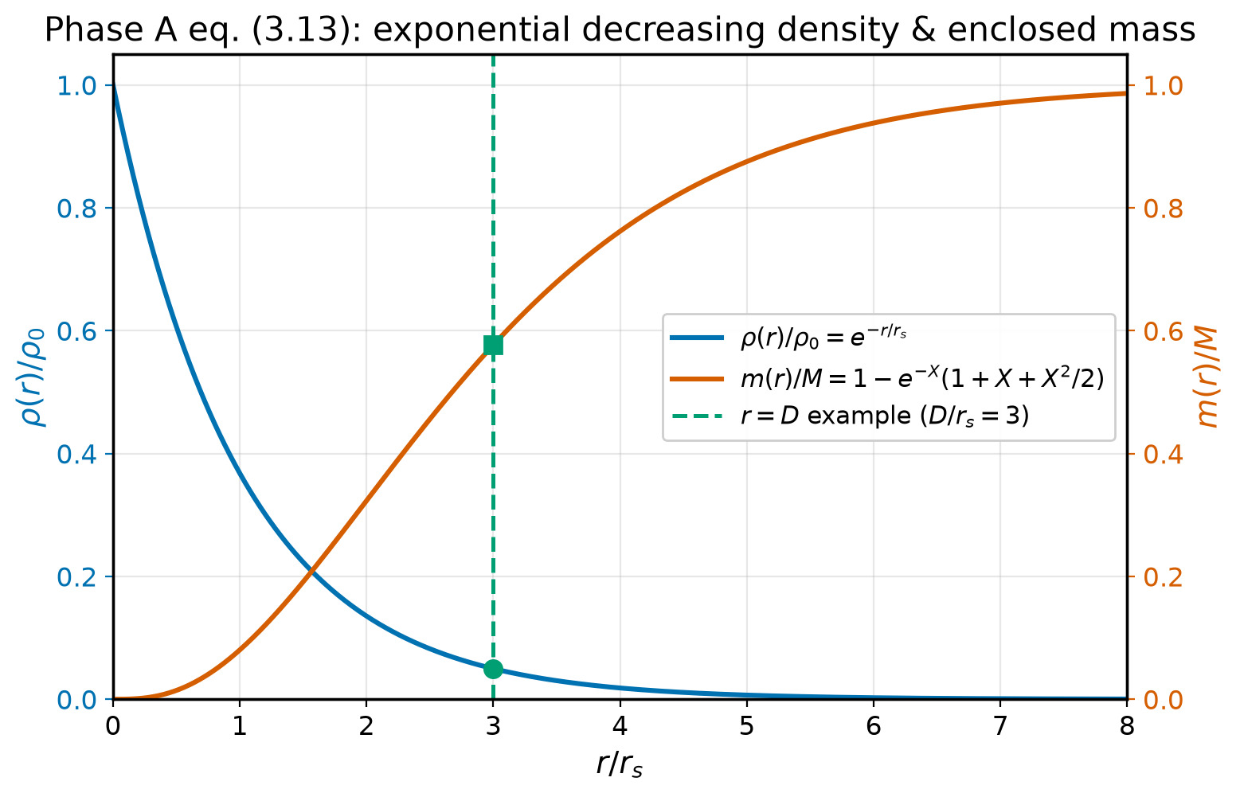
1/395 figures/density_mass.png

Slide 3
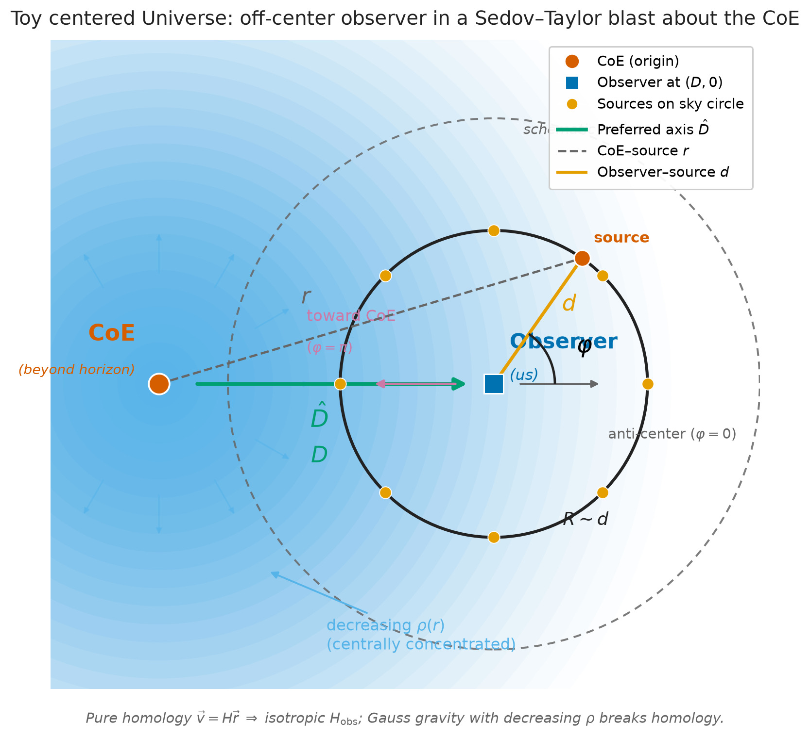
2/395 figures/geometry.png

Slide 4
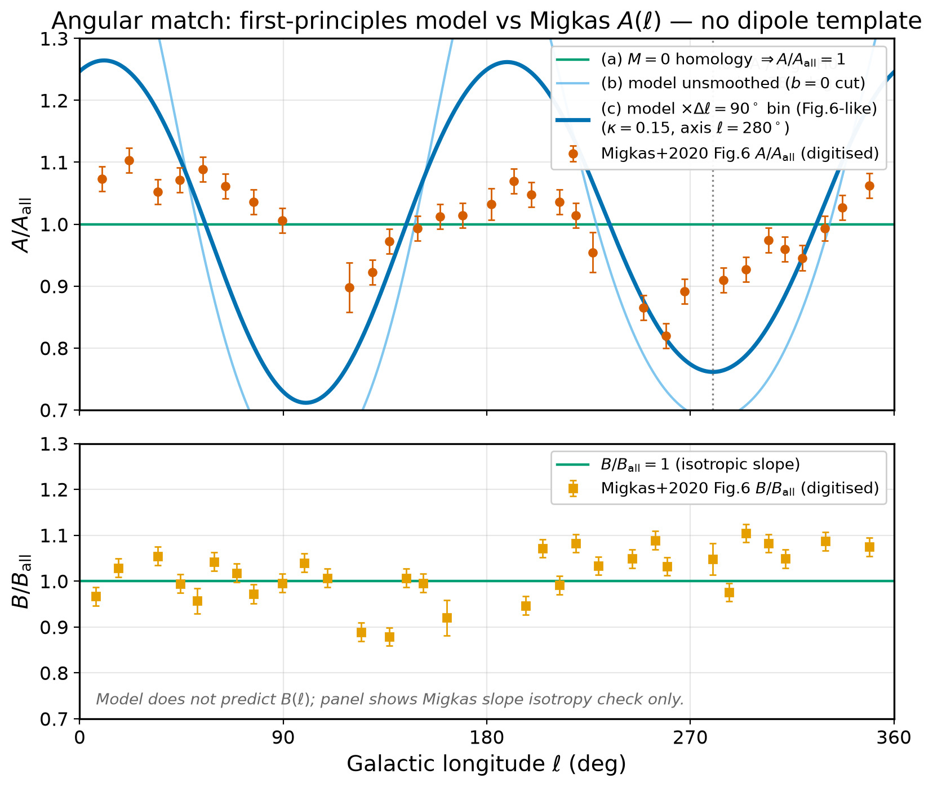
3/395 figures/Hobs_vs_angle.png

Slide 5
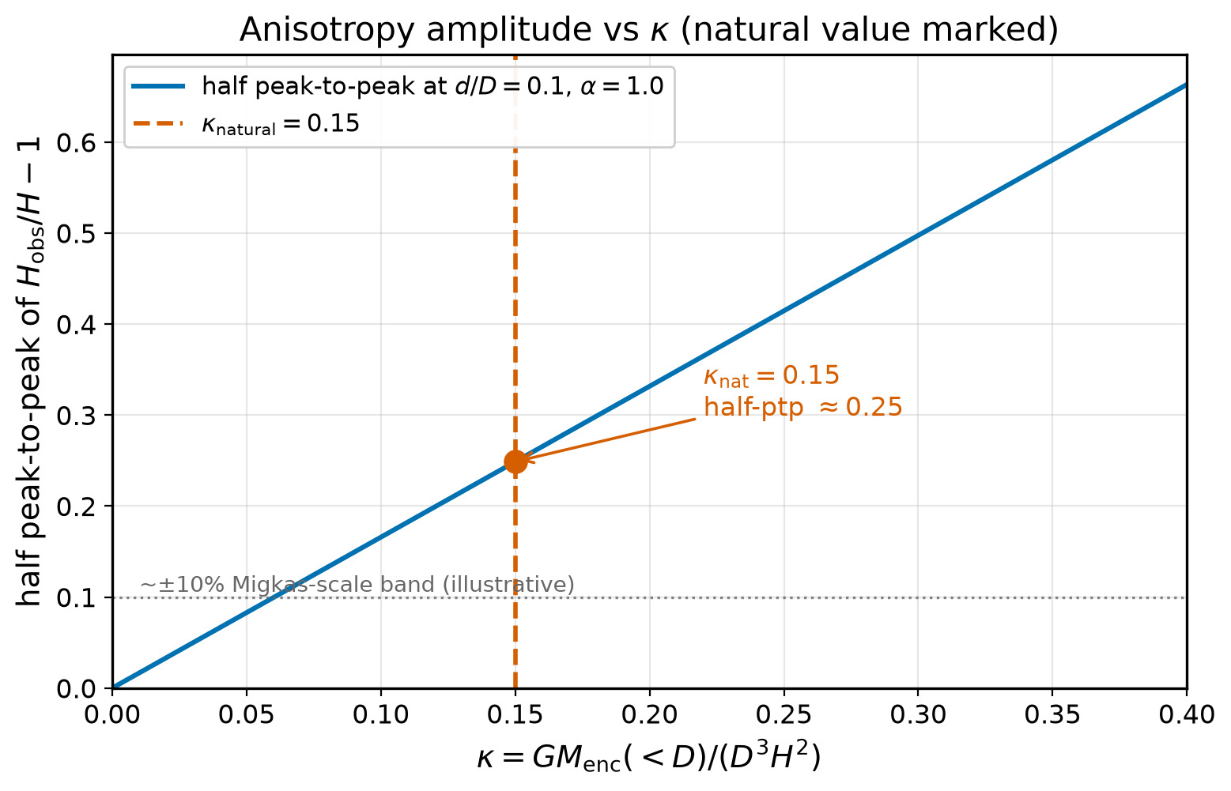
4/395 figures/kappa_amplitude.png

Slide 6
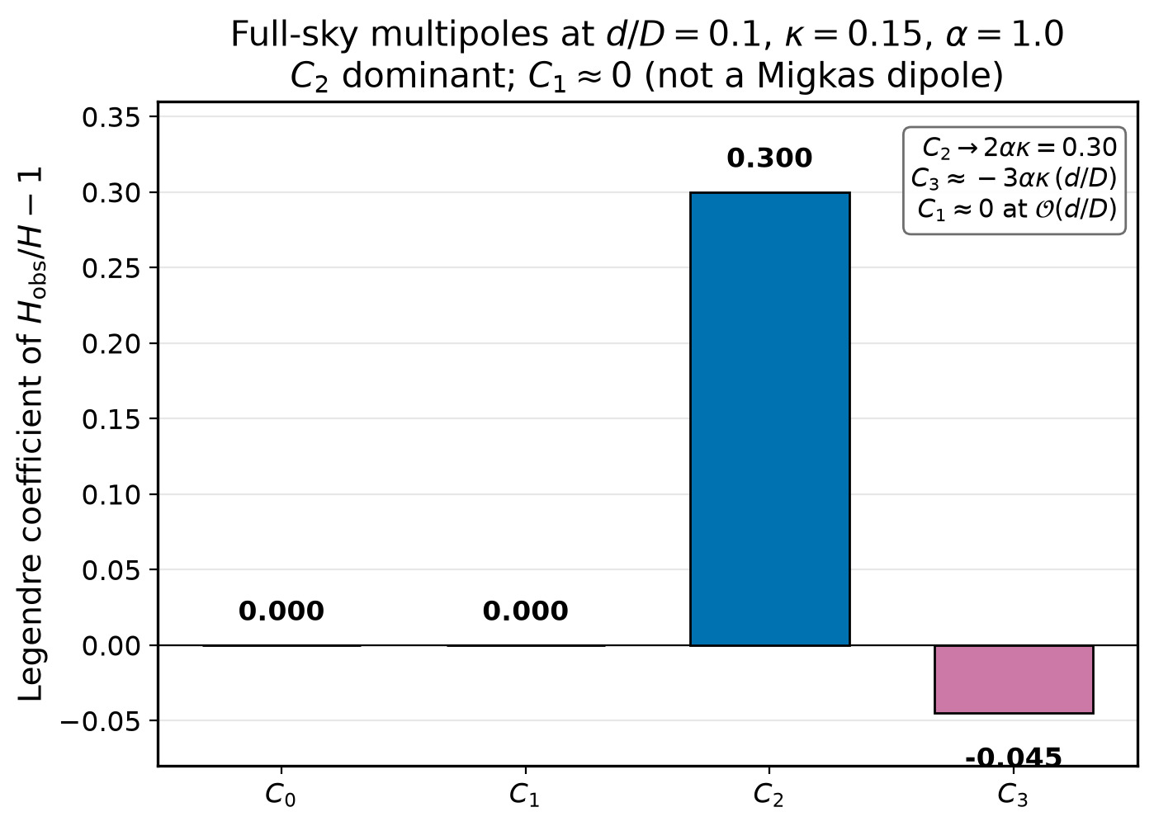
5/395 figures/multipoles.png

Slide 7
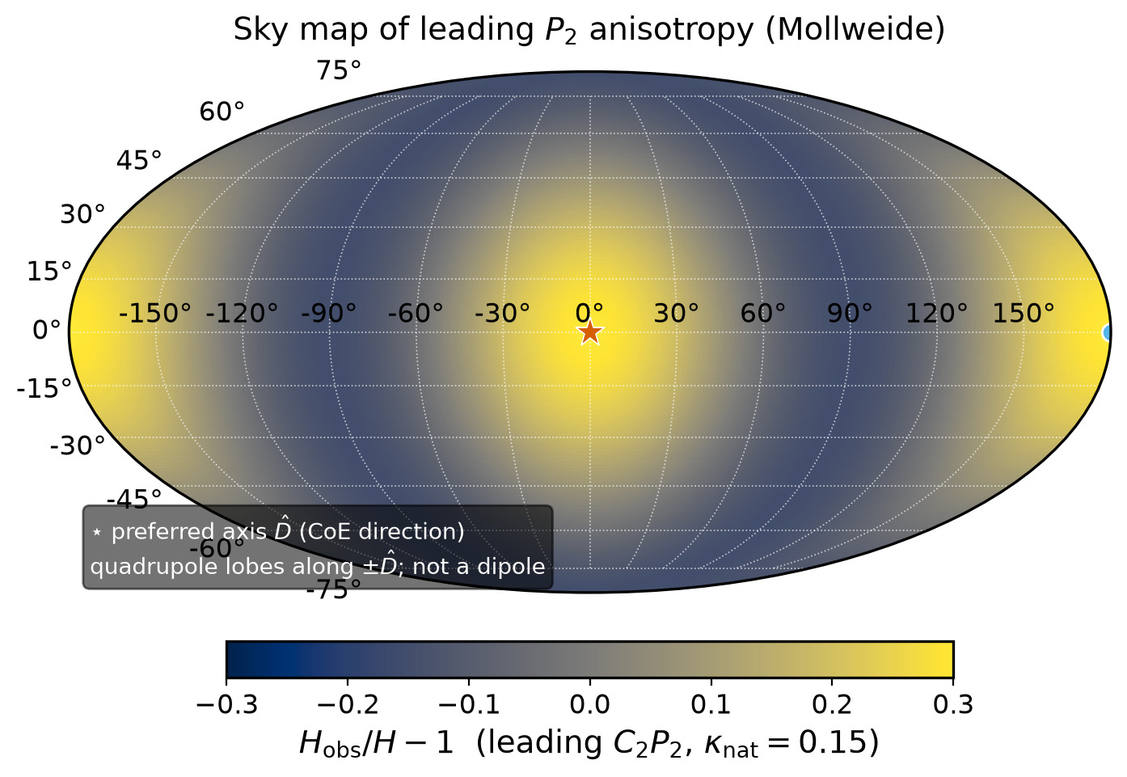
6/395 figures/sky_mollweide.png

Slide 8
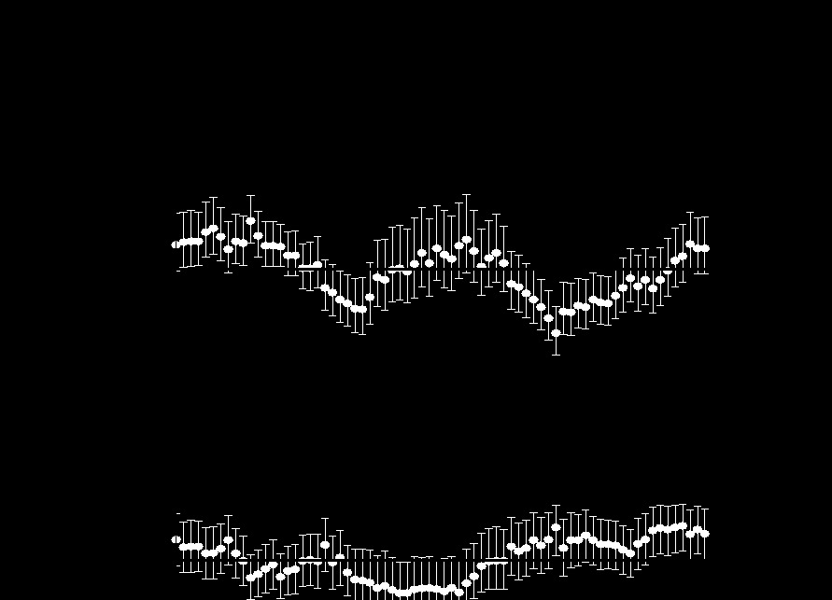
7/395 migkas/debug_red_A.png

Slide 9
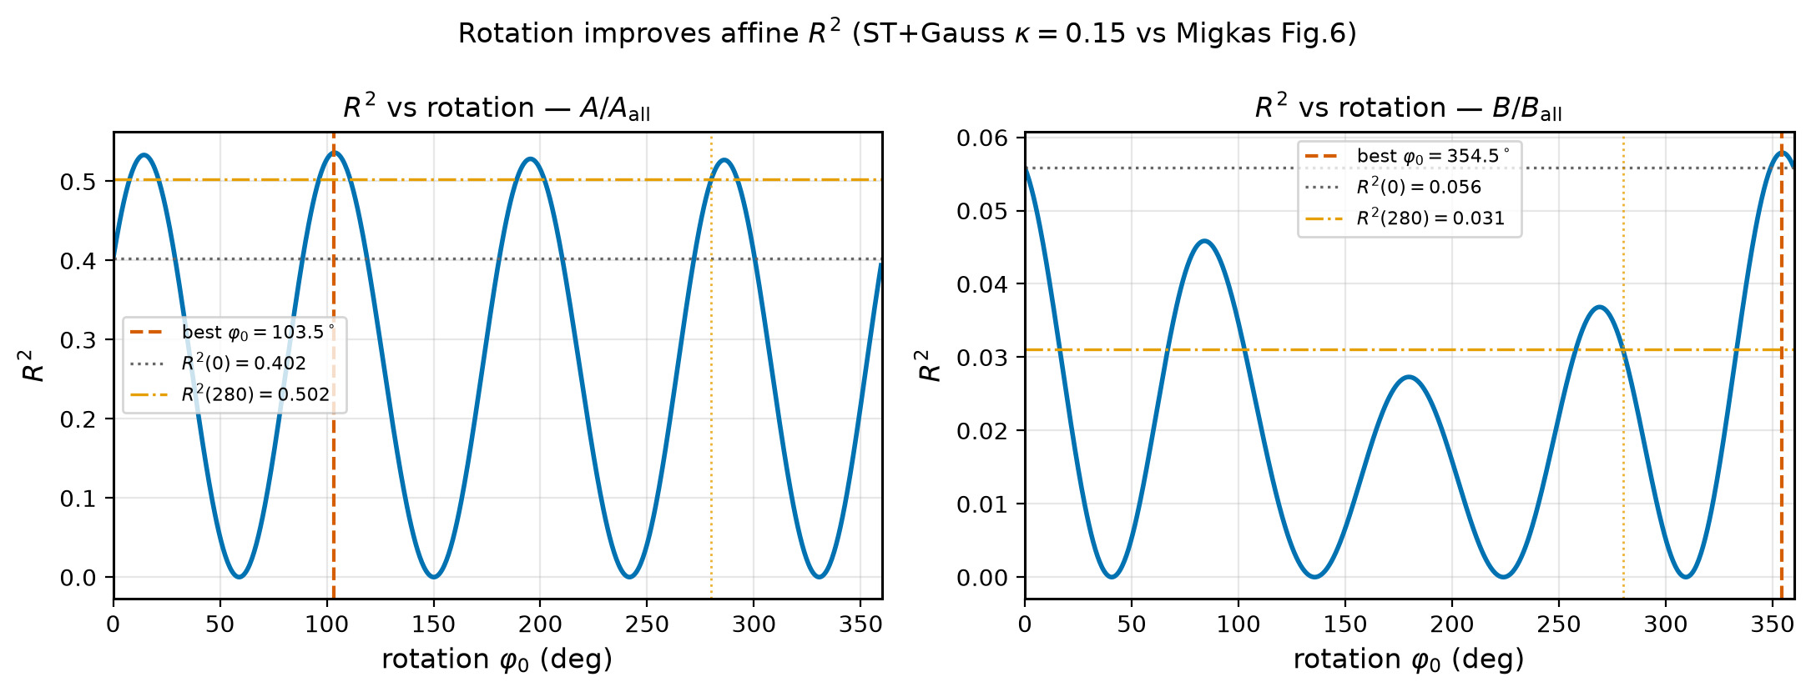
8/395 figures/migkas_r2_vs_rotation.png

Slide 10
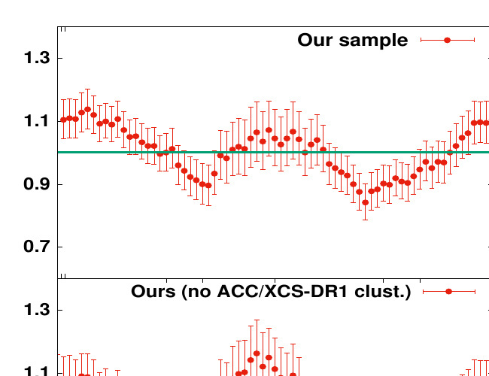
9/395 migkas/digitised/fig7_TL_crop.png

Slide 11
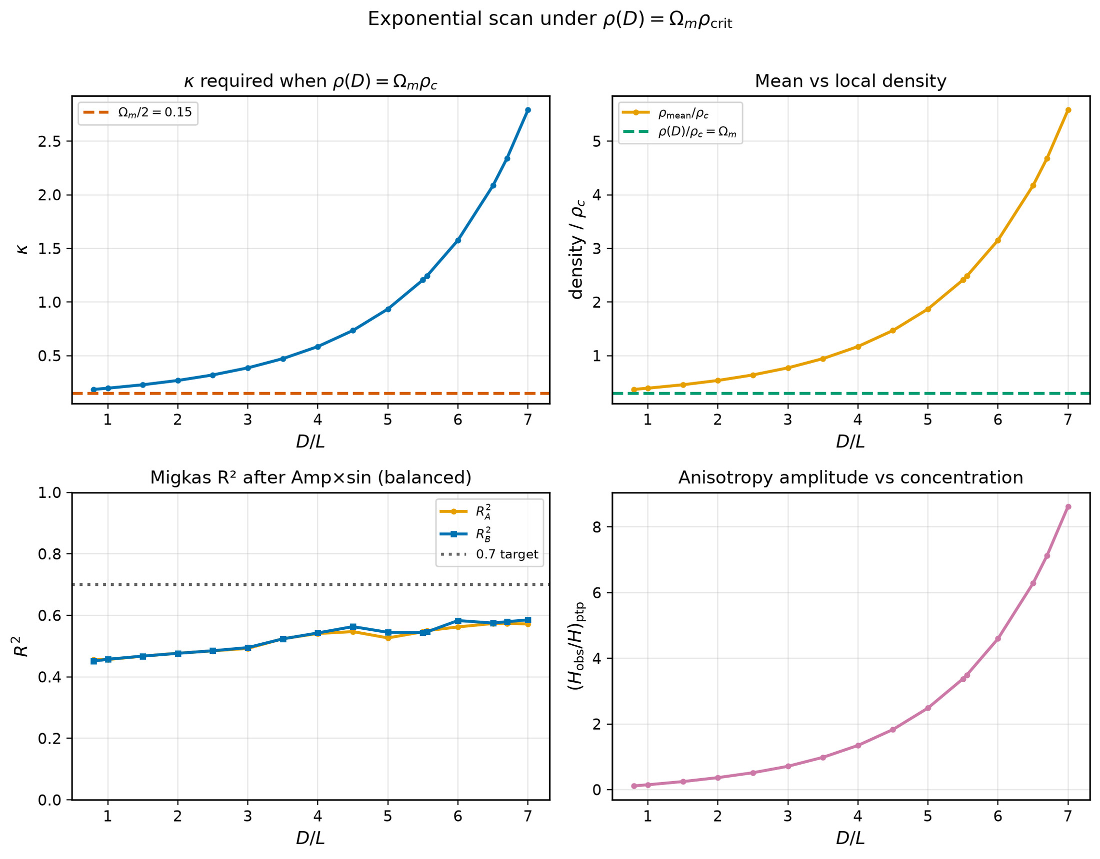
10/395 density_local_match/scan_pareto_local_density.png

Slide 12
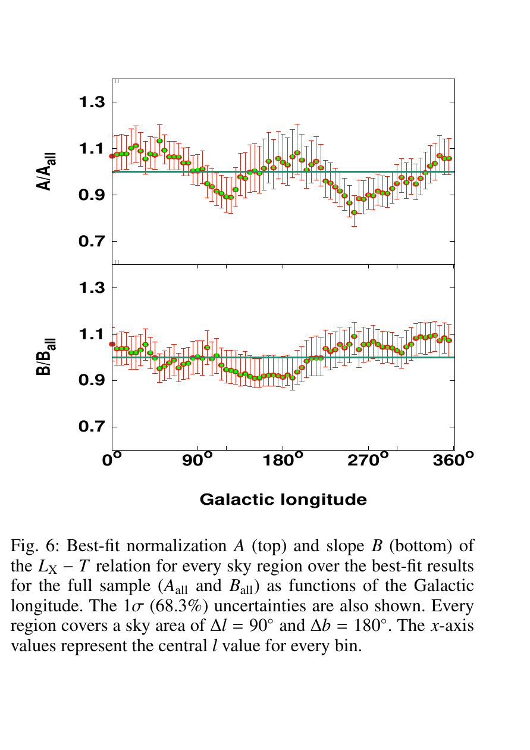
11/395 migkas/debug_digitized2.png

Slide 13
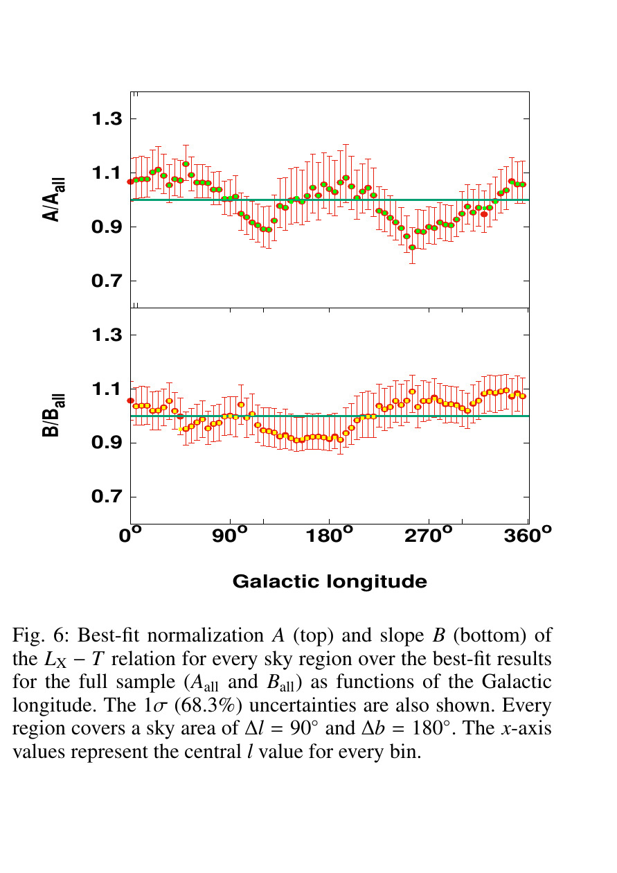
12/395 migkas/debug_digitized4.png

Slide 14

13/395 migkas/debug_points.png

Slide 15
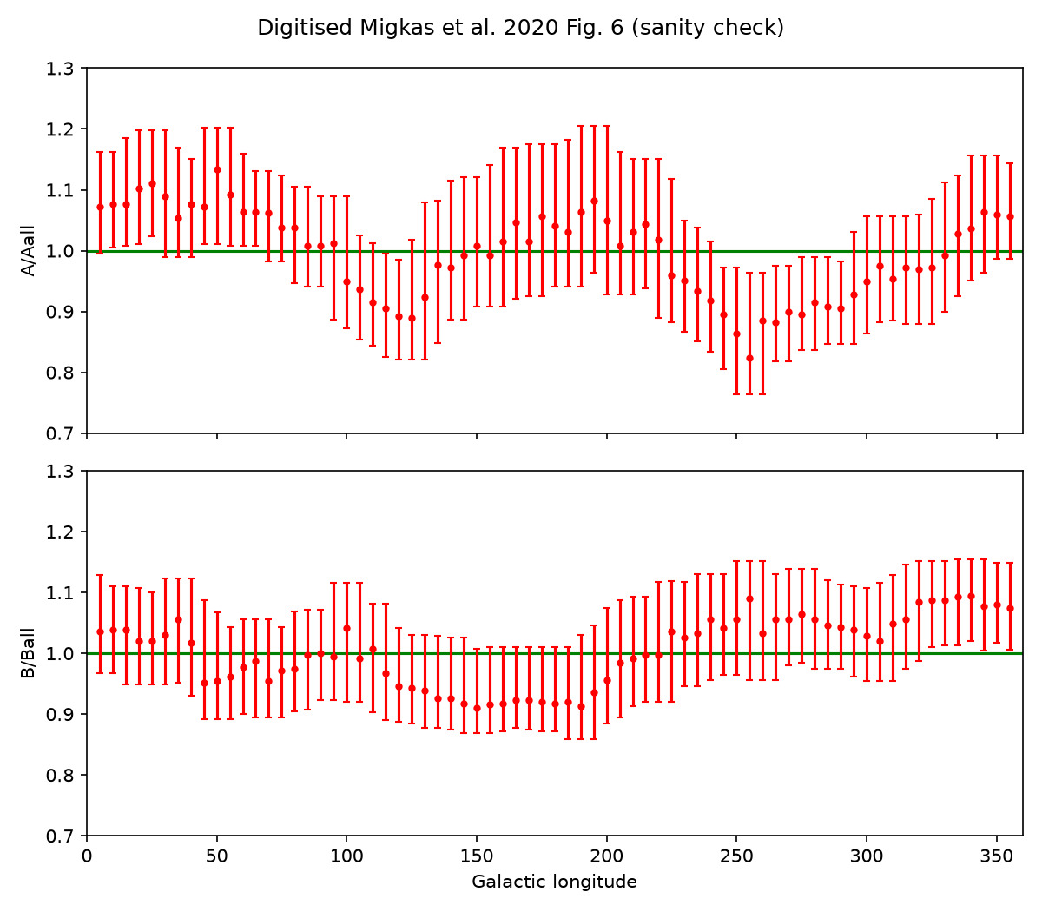
14/395 migkas/fig6_digitized_sanity.png

Slide 16
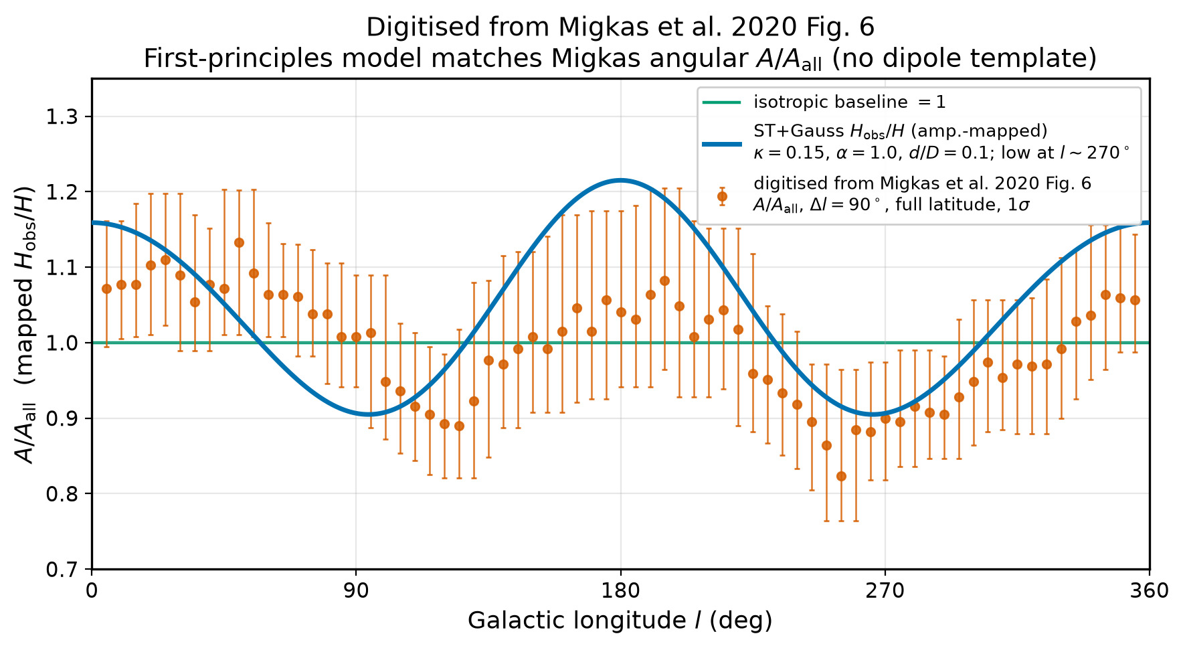
15/395 figures/migkas_fig6_A_model_overlay.png

Slide 17
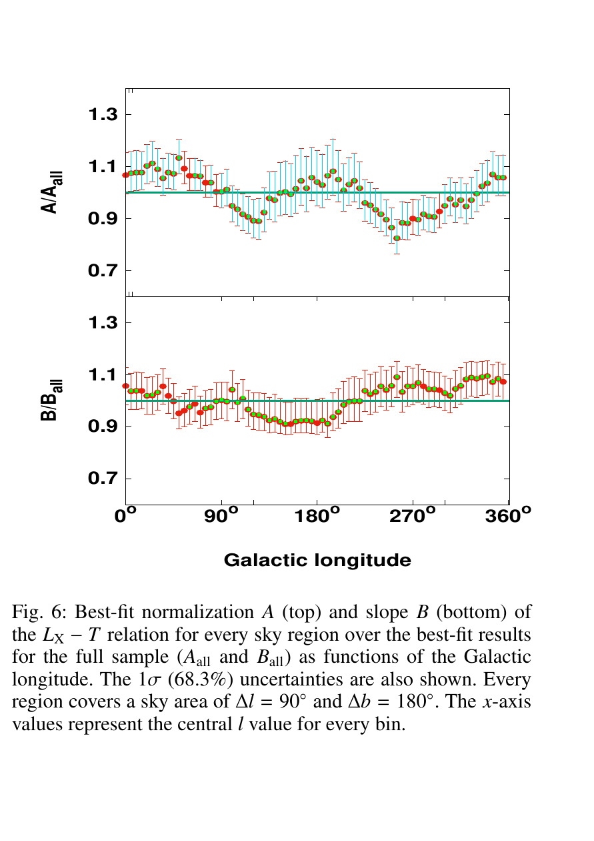
16/395 migkas/debug_digitized.png

Slide 18

17/395 migkas/debug_digitized3.png

Slide 19
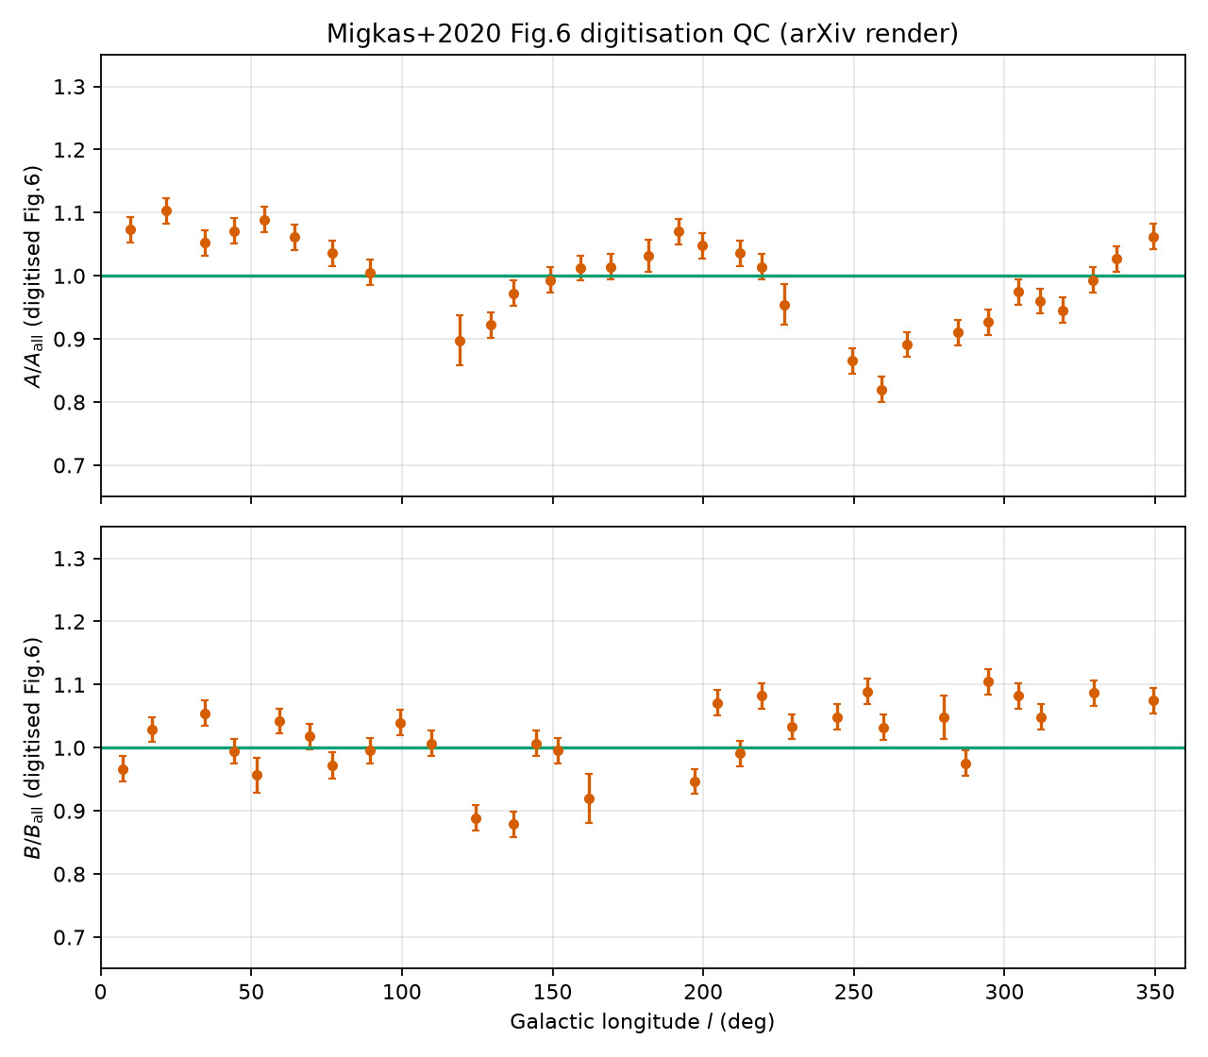
18/395 migkas/digitised/digitisation_check_fig6.png

Slide 20
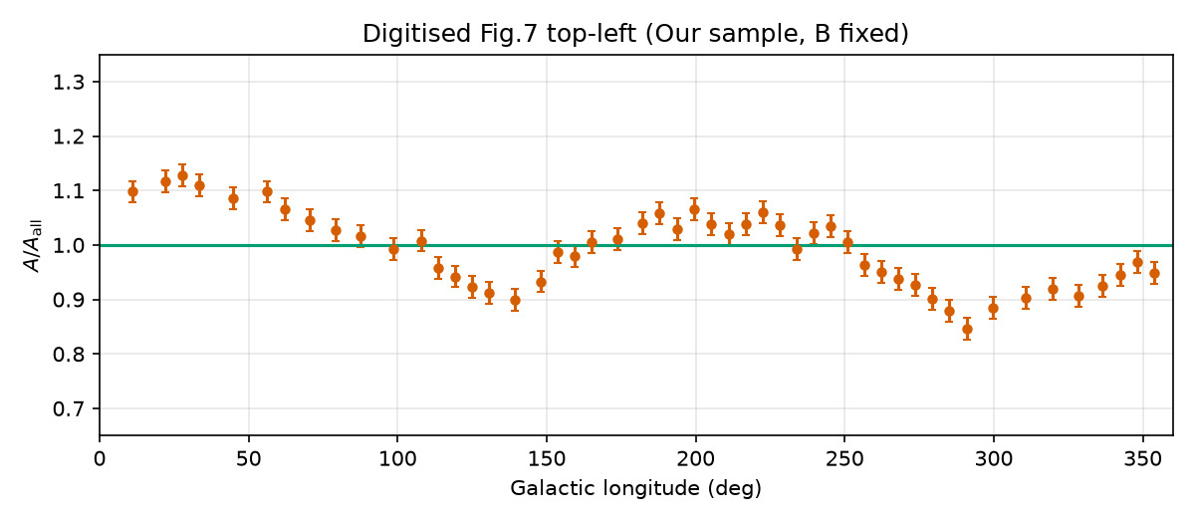
19/395 migkas/digitised/digitisation_check_fig7_TL.png

Slide 21
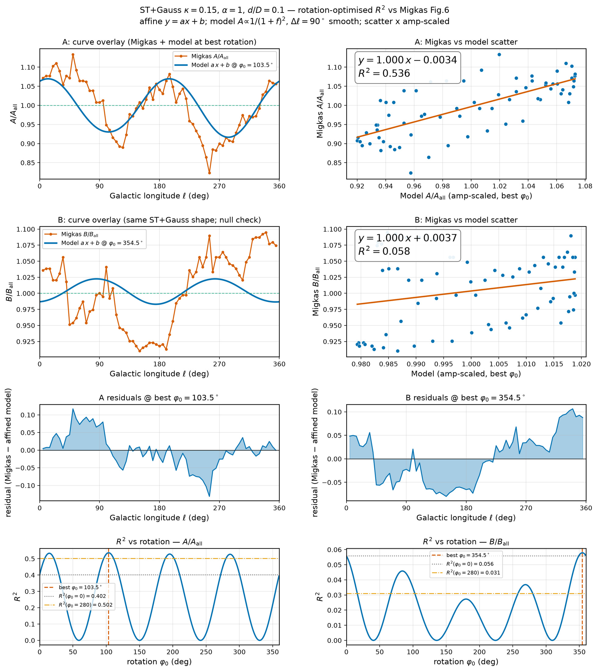
20/395 figures/migkas_r2_fit_panels.png

Slide 22

21/395 migkas/debug_green_A.png

Slide 23
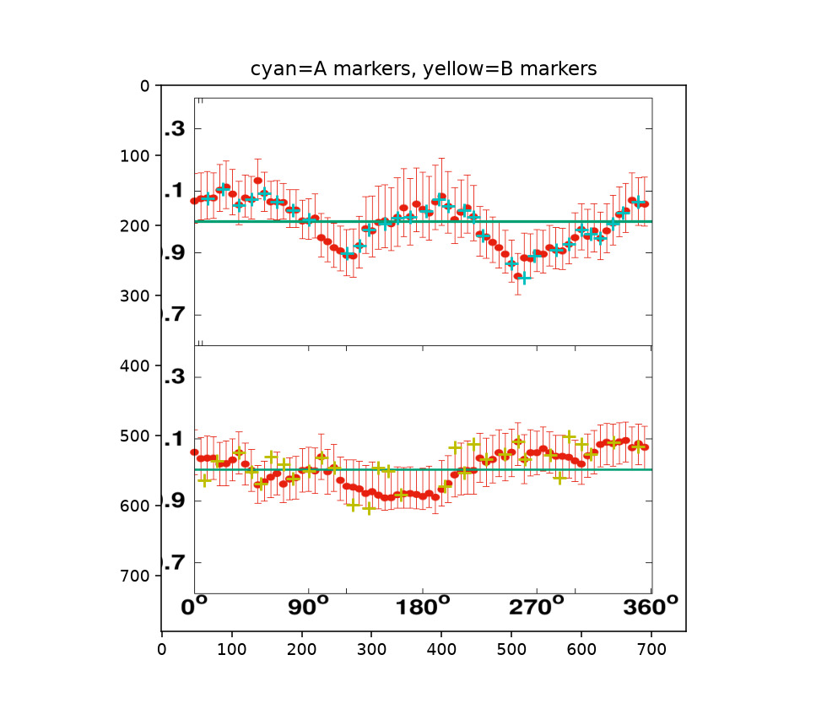
22/395 migkas/digitised/digitisation_markers_on_page.png

Slide 24
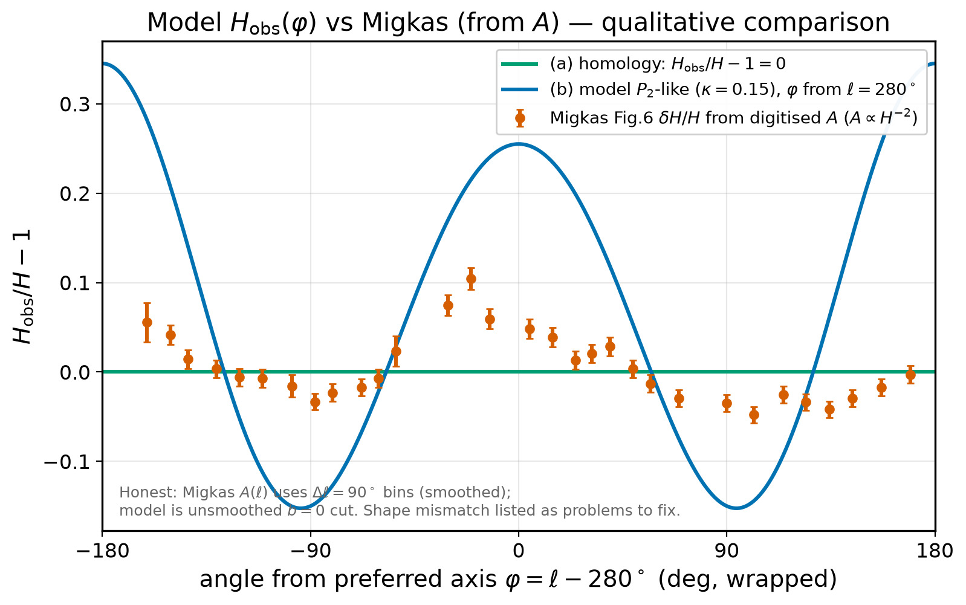
23/395 figures/model_vs_migkas_schematic.png

Slide 25
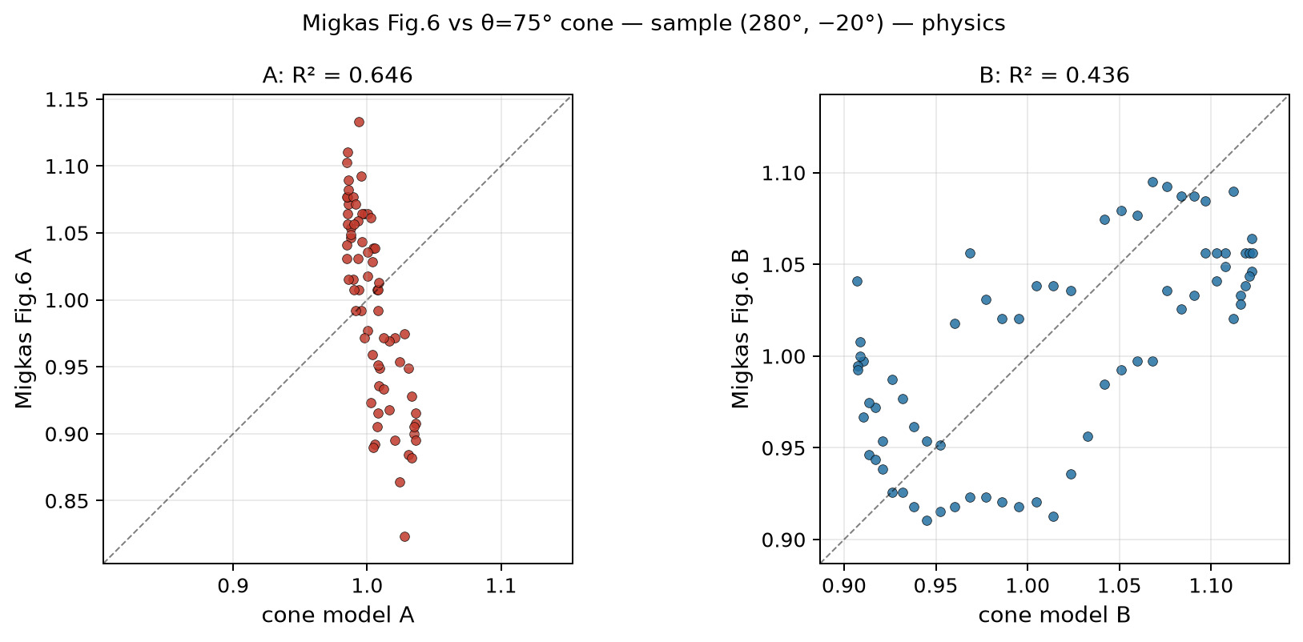
24/395 cone_scan_75/scatter_fig6_vs_cone75_sample_280m20__physics.png

Slide 26
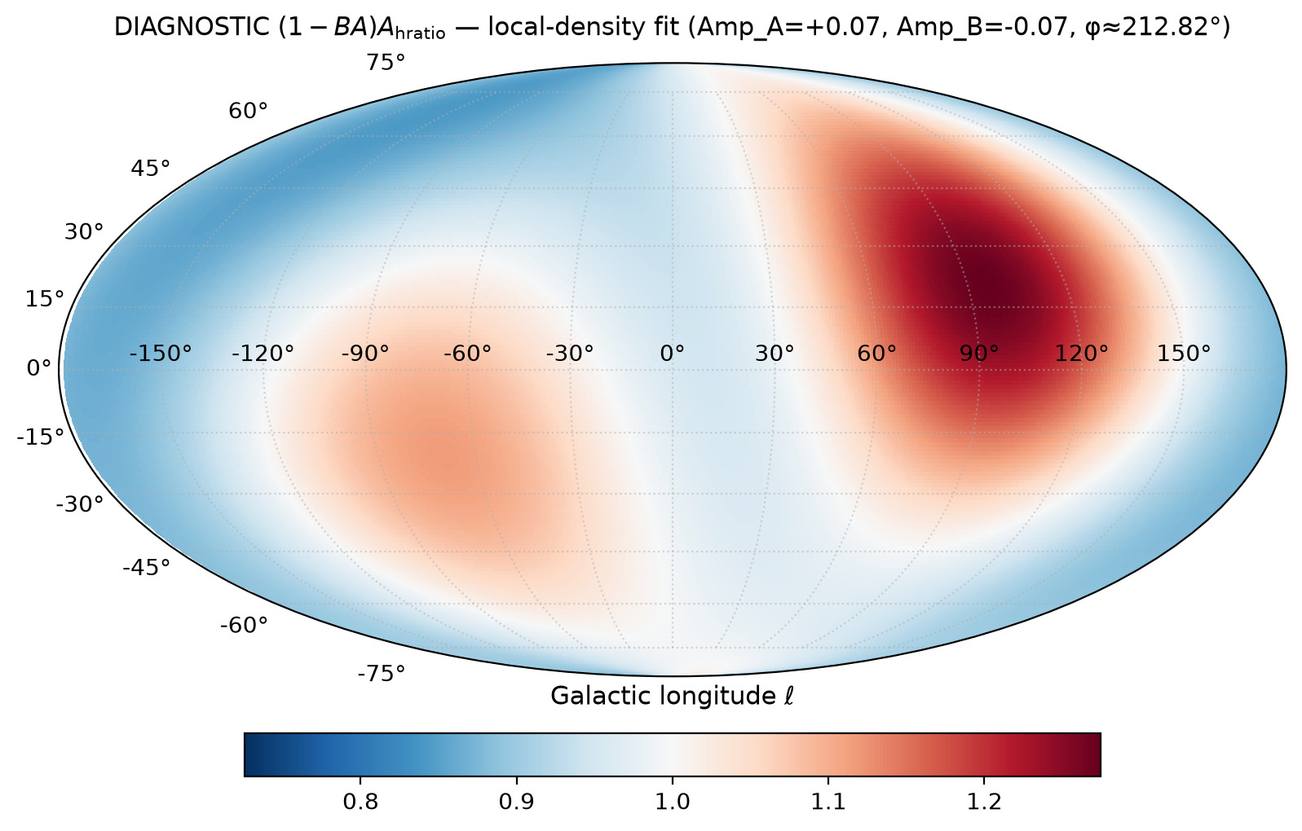
25/395 fullsky_AB/mollweide_sine_local_density_A_hratio_DIAGNOSTIC.png

Slide 27
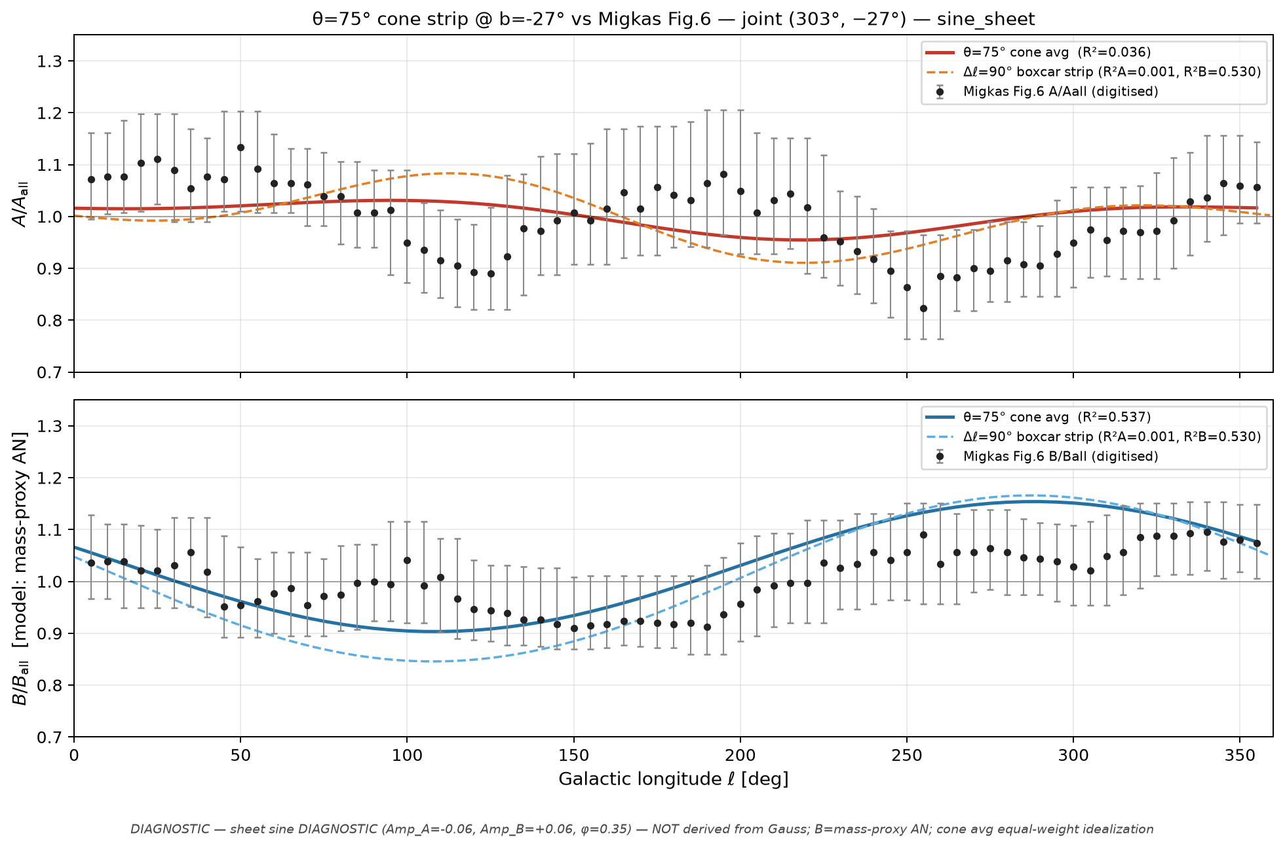
26/395 cone_scan_75/overlay_fig6_cone75_joint_303m27__sine_sheet.png

Slide 28
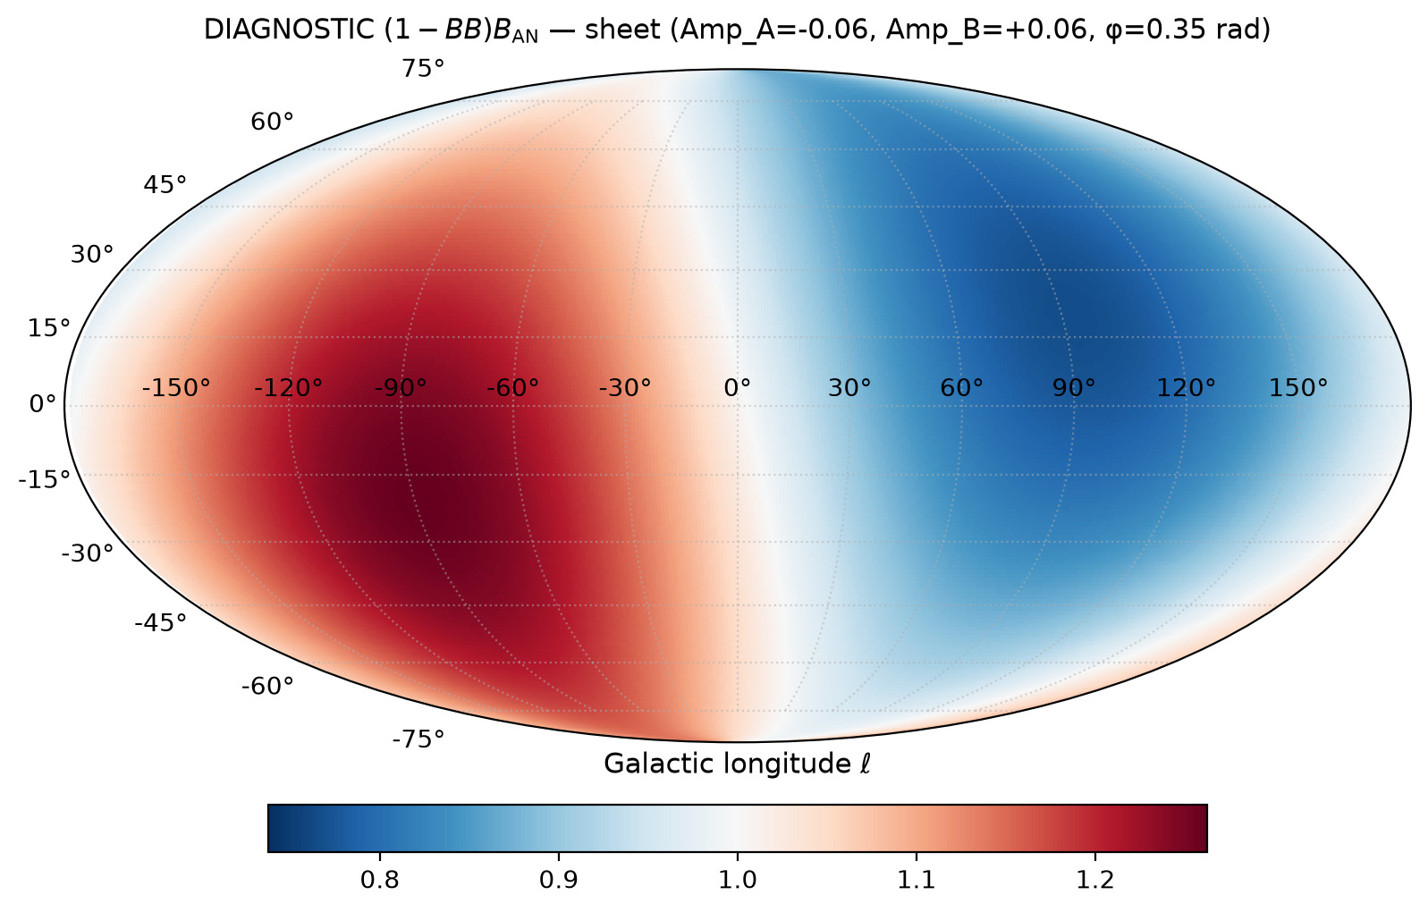
27/395 fullsky_AB/mollweide_sine_sheet_B_DIAGNOSTIC.png

Slide 29
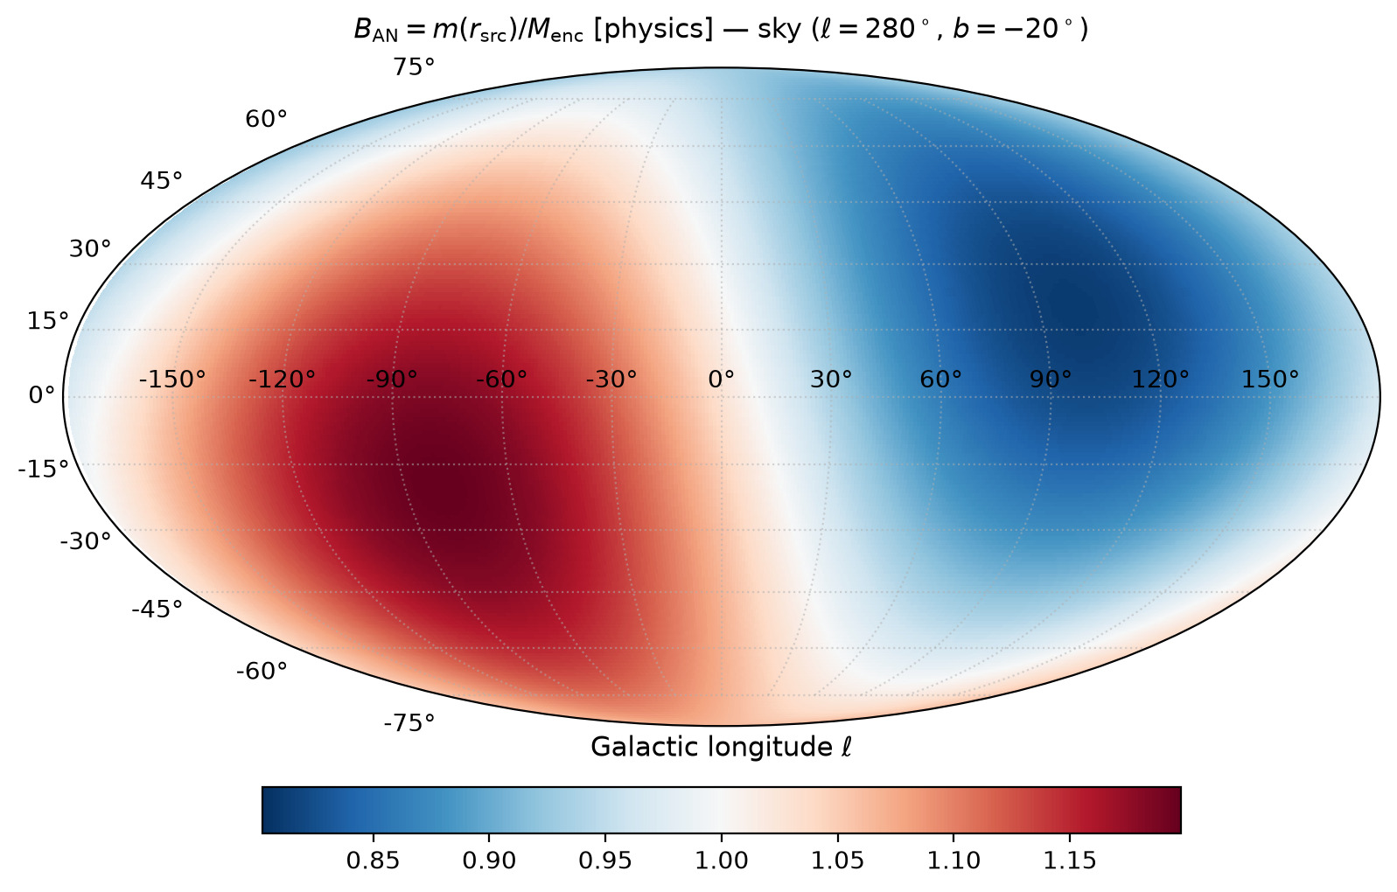
28/395 fullsky_AB/mollweide_sky_B.png

Slide 30
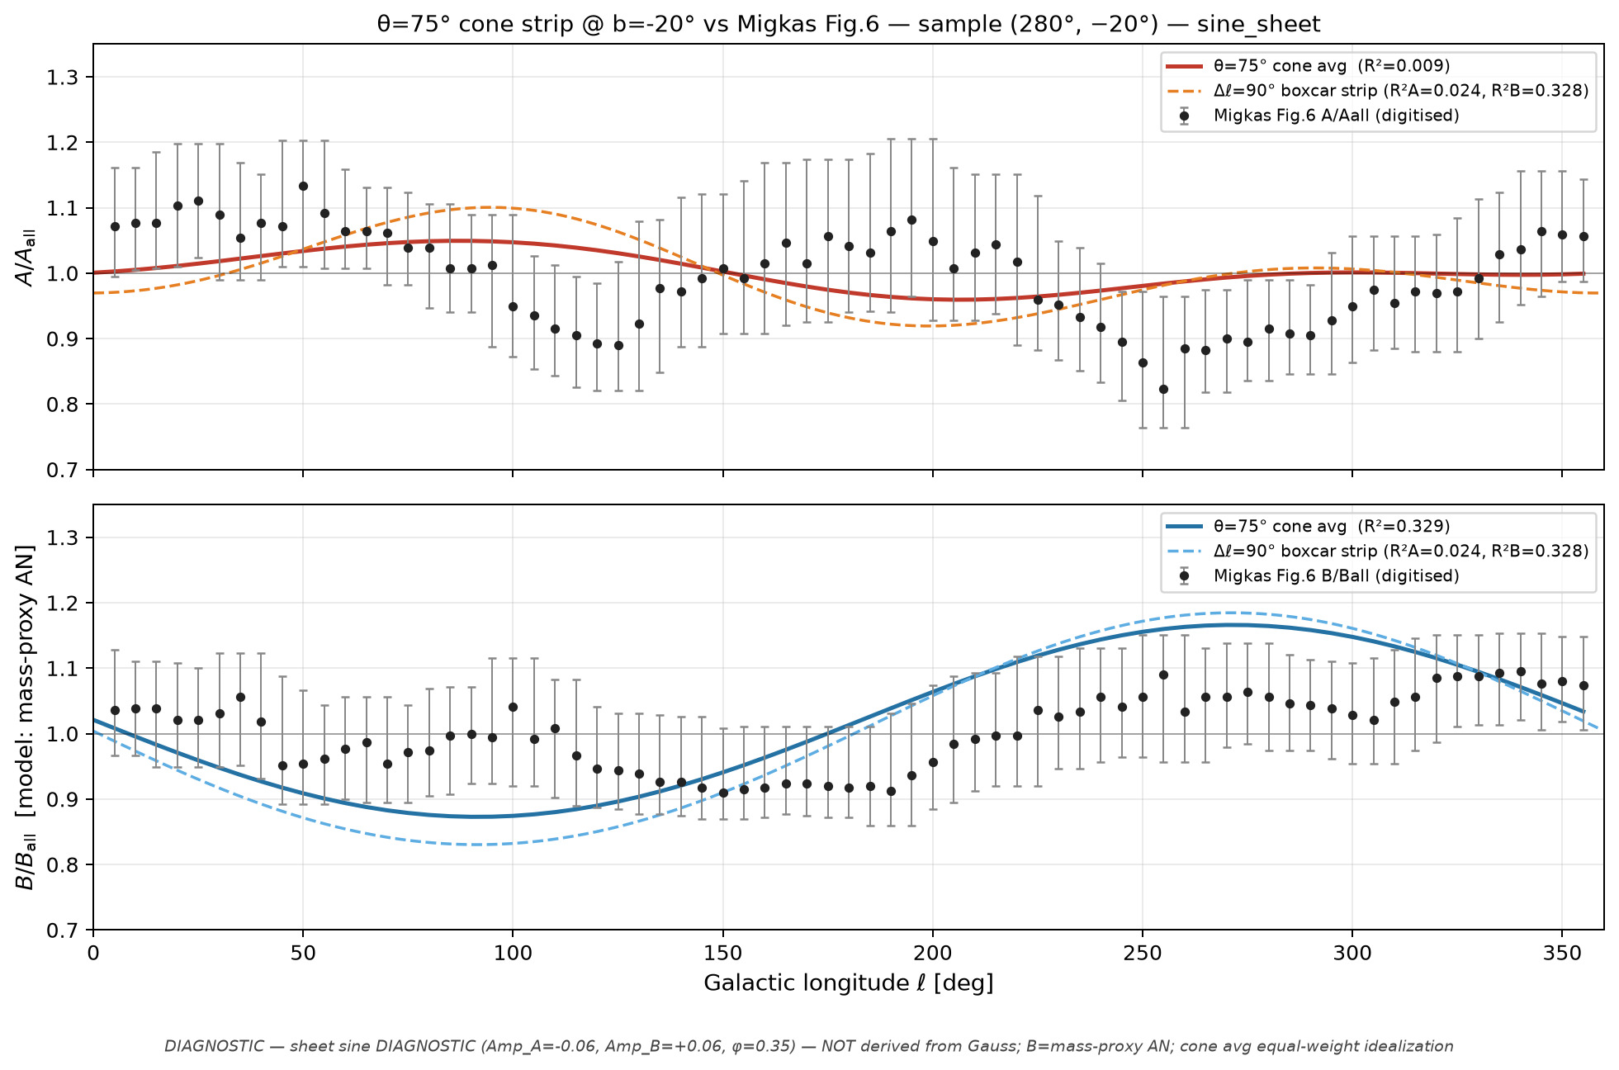
29/395 cone_scan_75/overlay_fig6_cone75_sample_280m20__sine_sheet.png

Slide 31
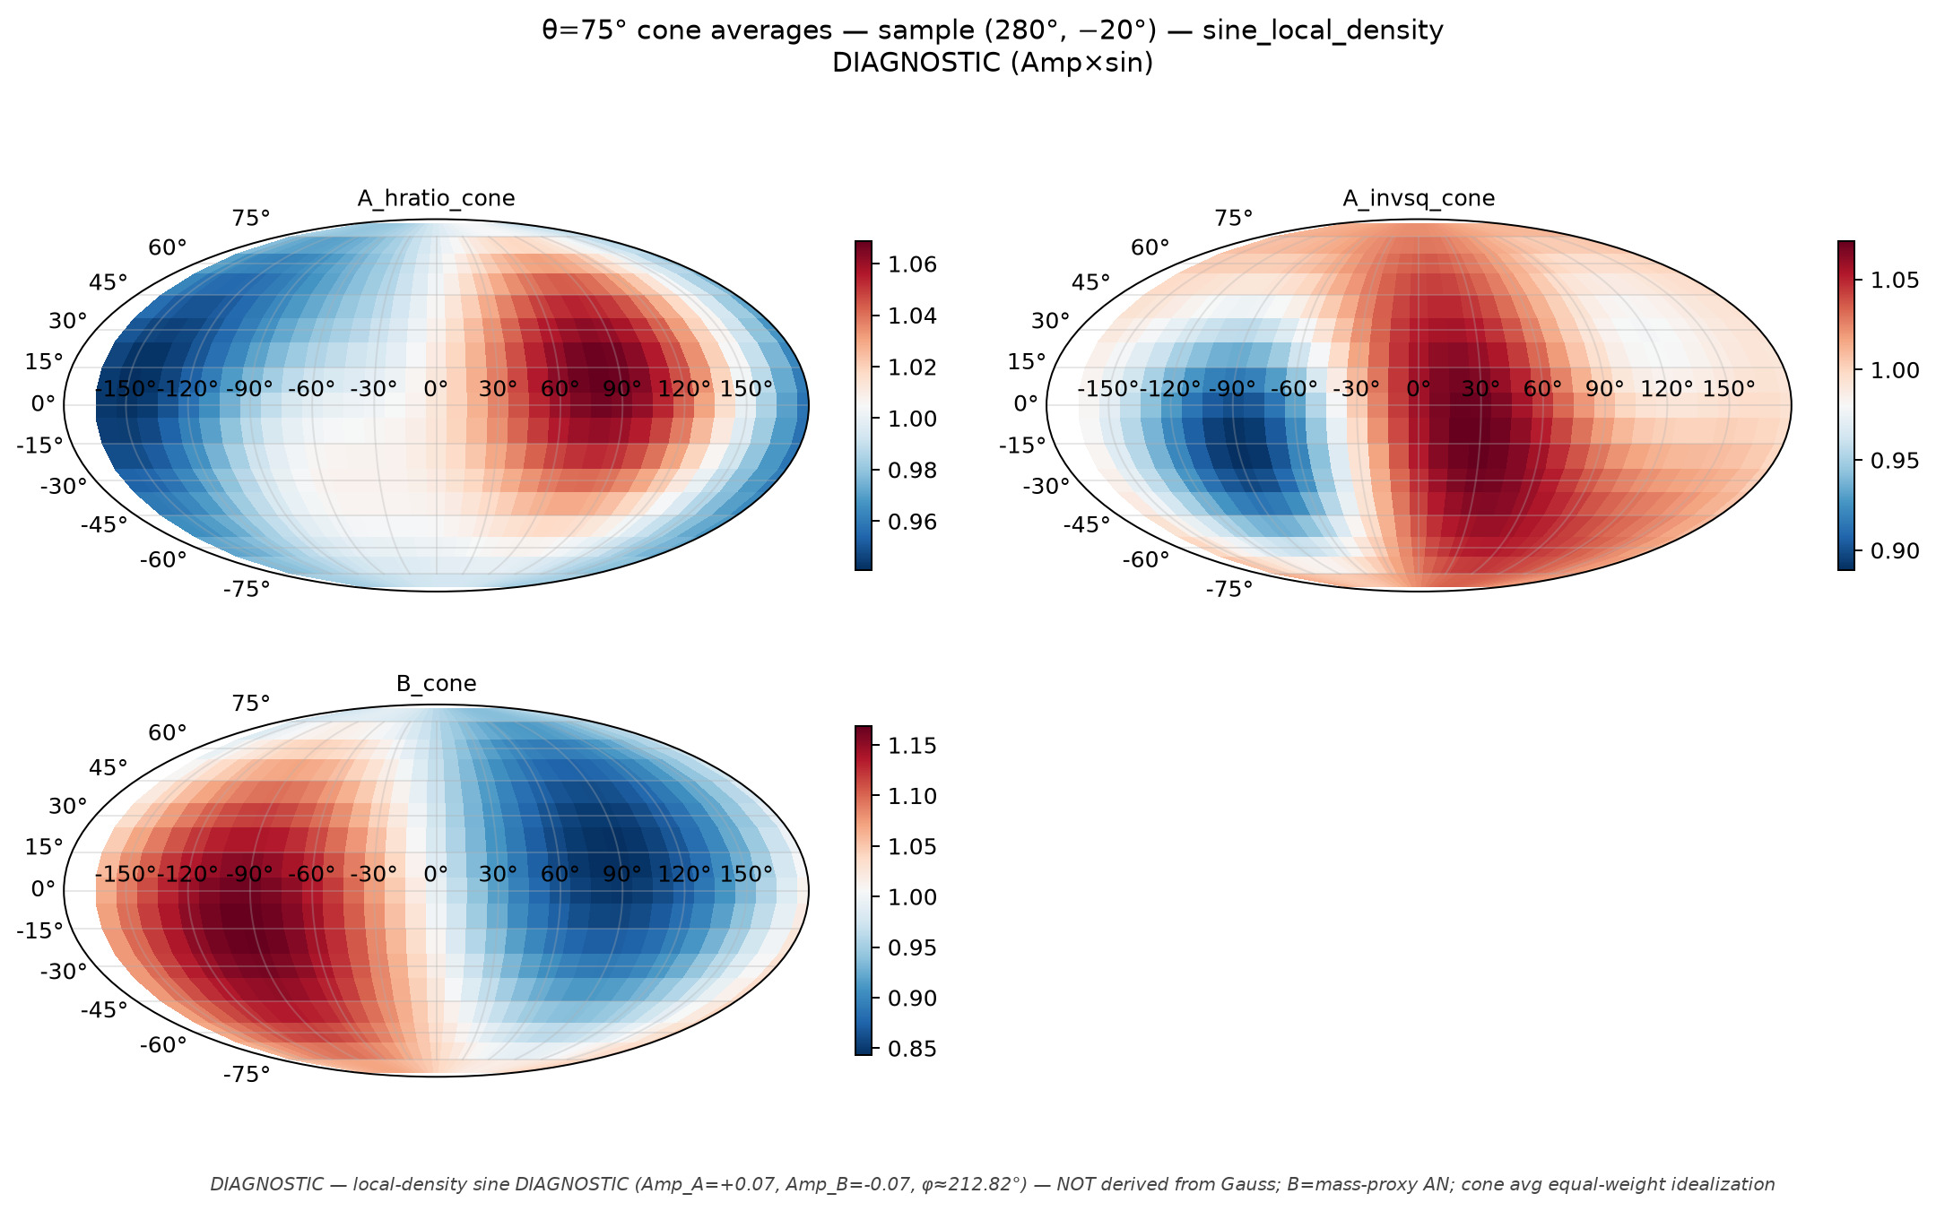
30/395 cone_scan_75/mollweide_cone75_sample_280m20__sine_local_density.png

Slide 32
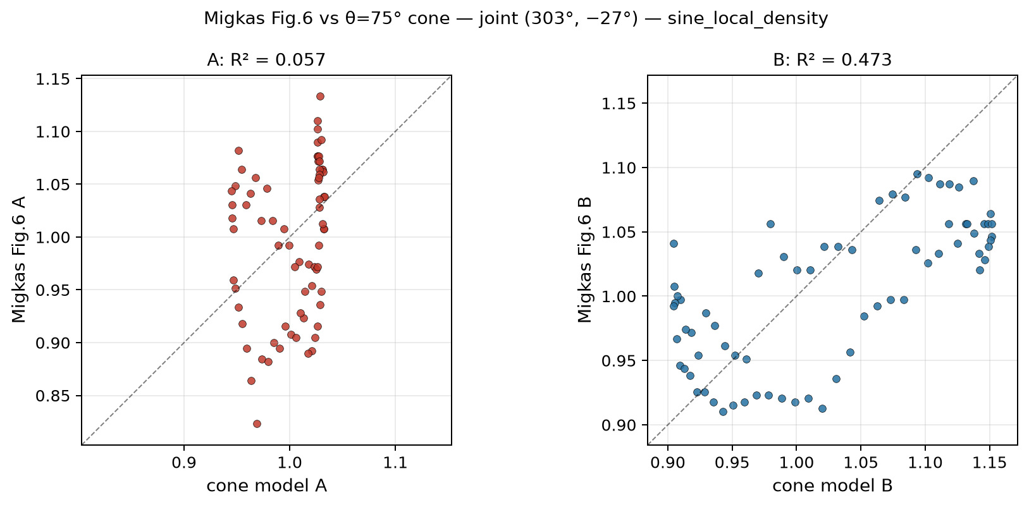
31/395 cone_scan_75/scatter_fig6_vs_cone75_joint_303m27__sine_local_density.png

Slide 33
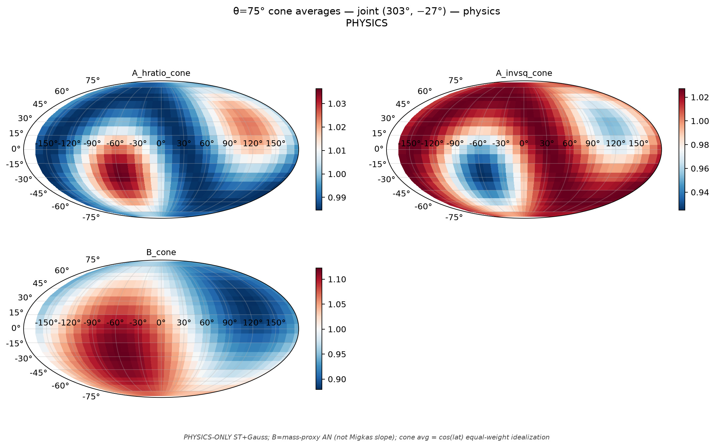
32/395 cone_scan_75/mollweide_cone75_joint_303m27__physics.png

Slide 34
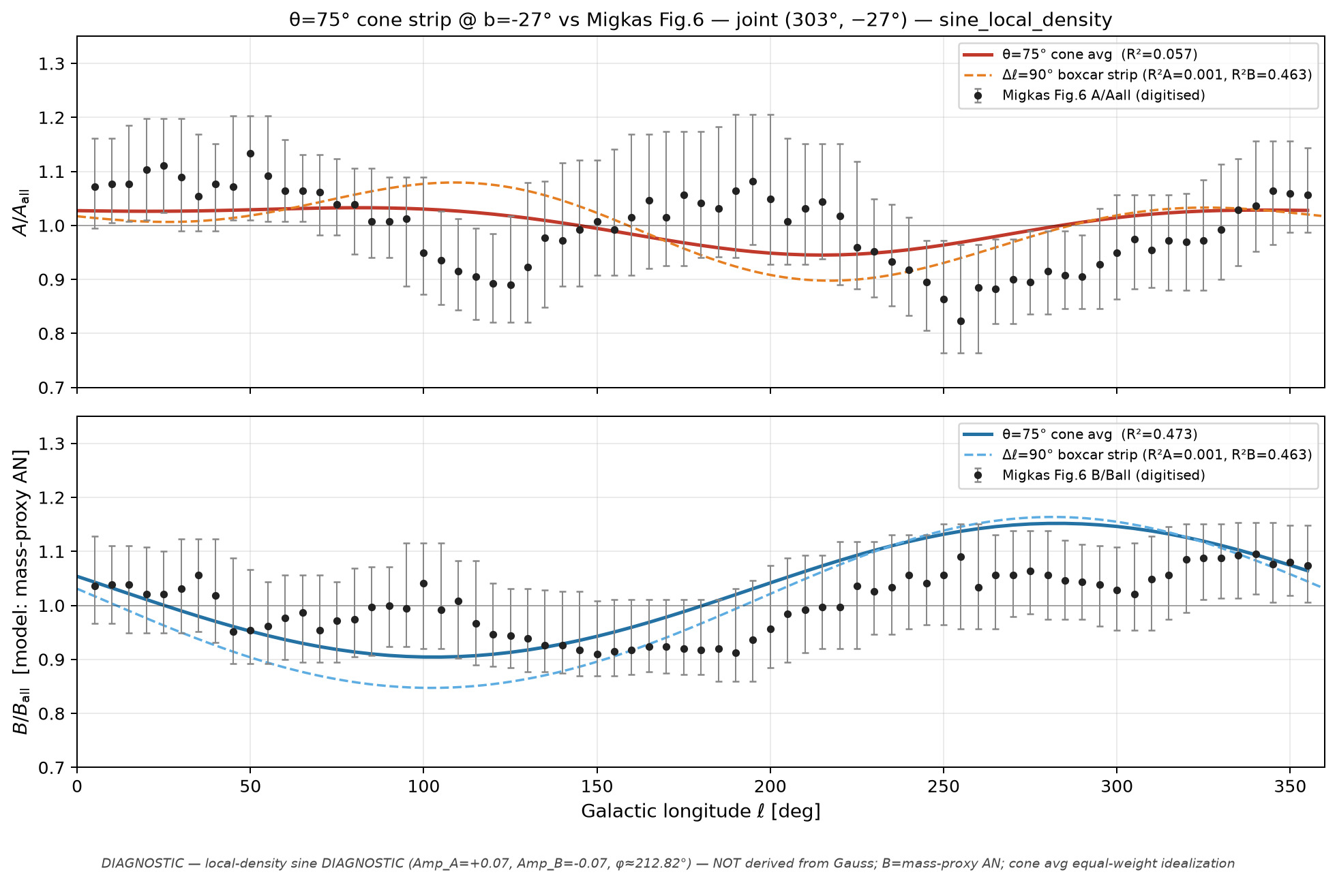
33/395 cone_scan_75/overlay_fig6_cone75_joint_303m27__sine_local_density.png

Slide 35
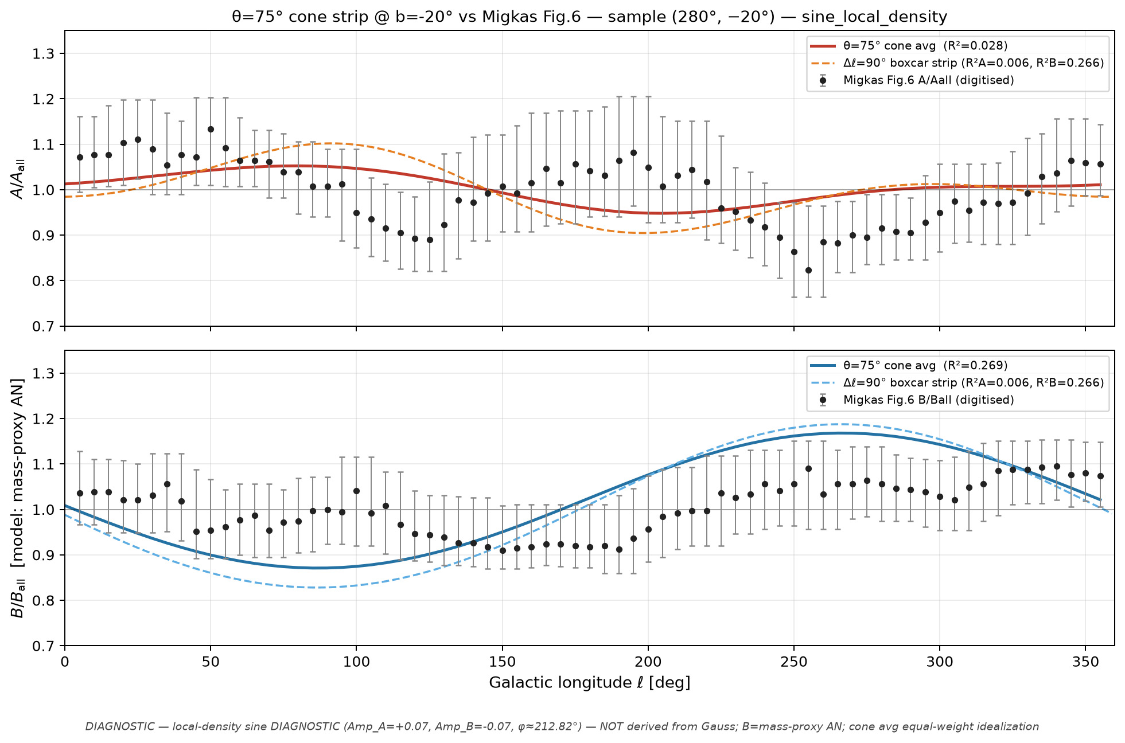
34/395 cone_scan_75/overlay_fig6_cone75_sample_280m20__sine_local_density.png

Slide 36
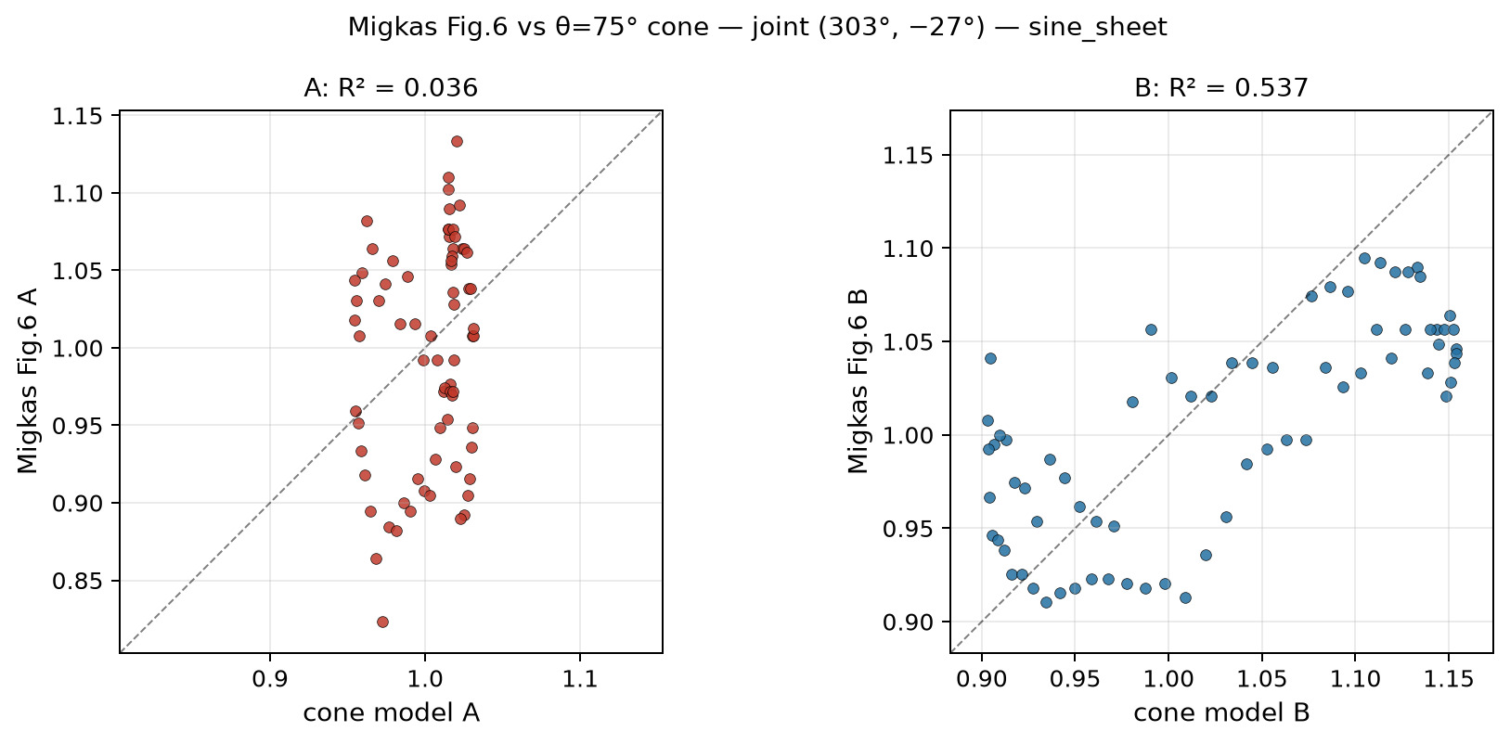
35/395 cone_scan_75/scatter_fig6_vs_cone75_joint_303m27__sine_sheet.png

Slide 37
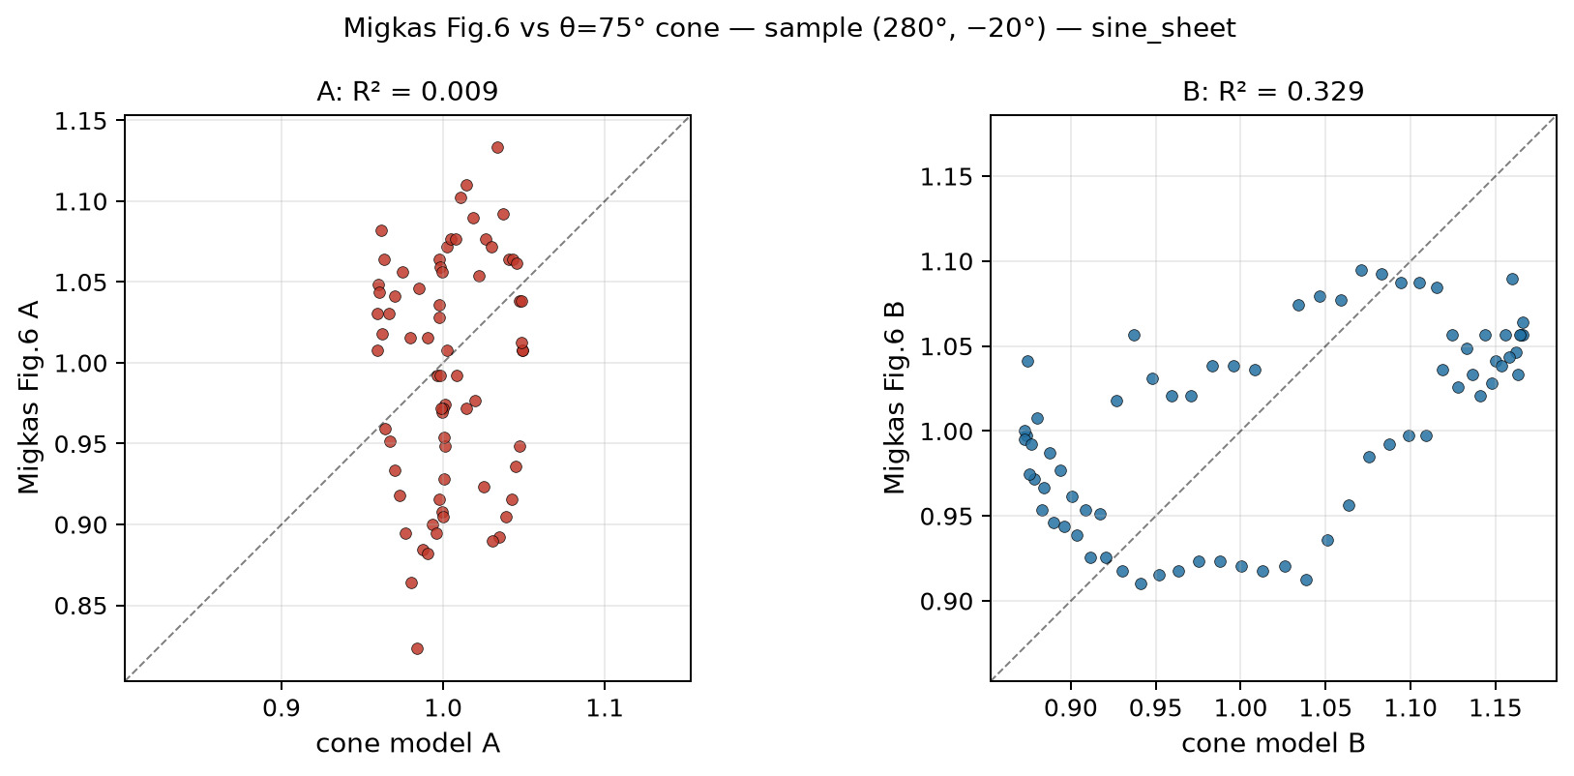
36/395 cone_scan_75/scatter_fig6_vs_cone75_sample_280m20__sine_sheet.png

Slide 38
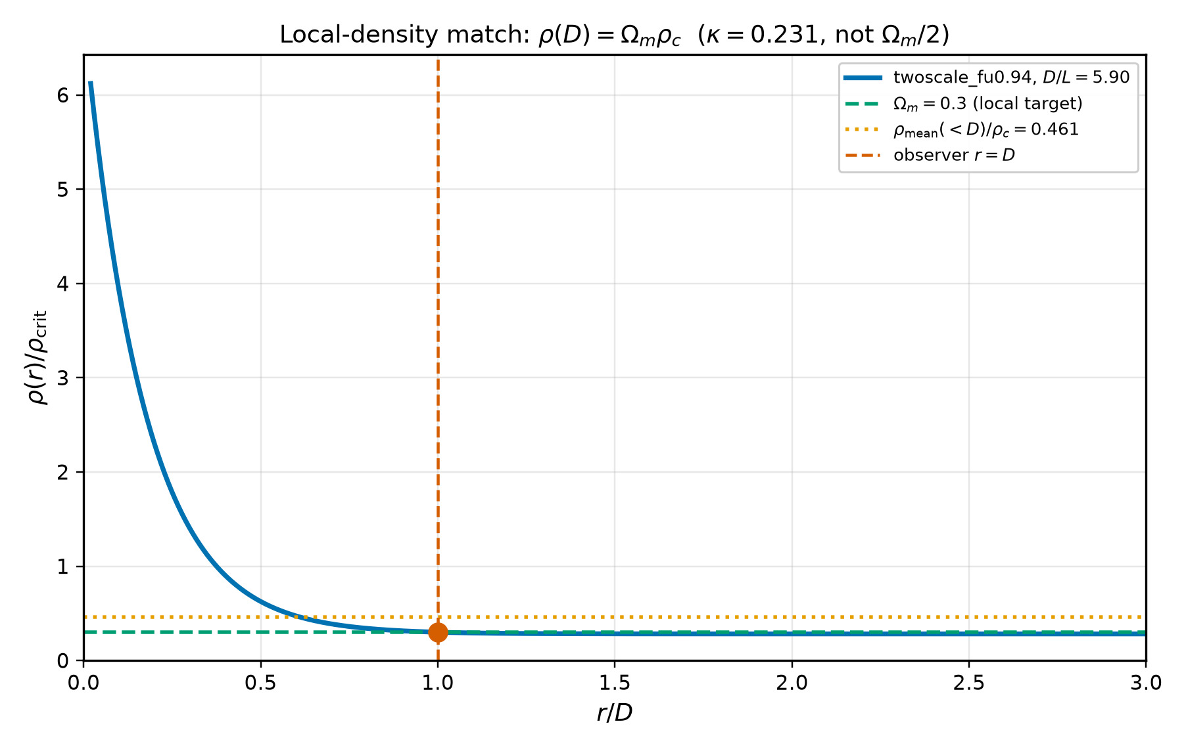
37/395 density_local_match/density_profile_local_match.png

Slide 39
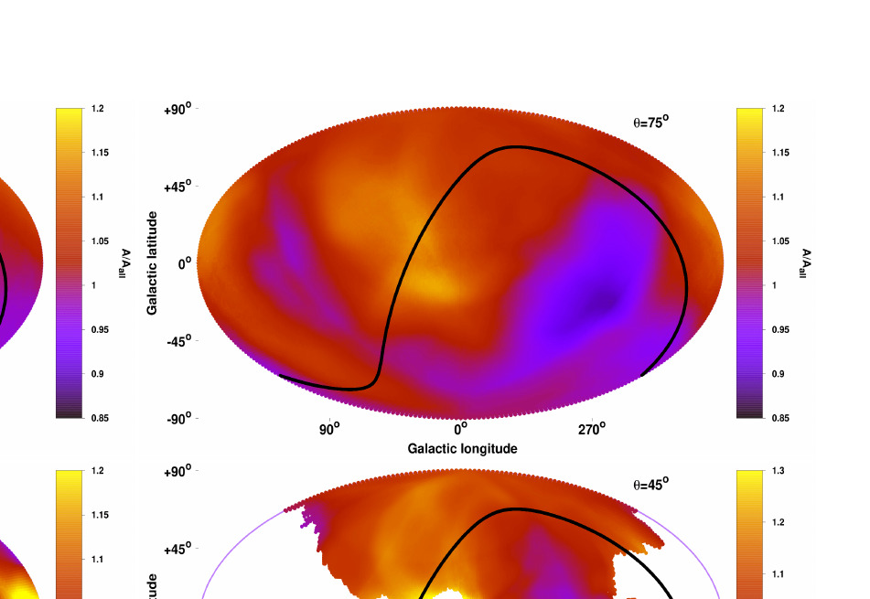
38/395 map_compare/debug_crop_tr_loose.png

Slide 40
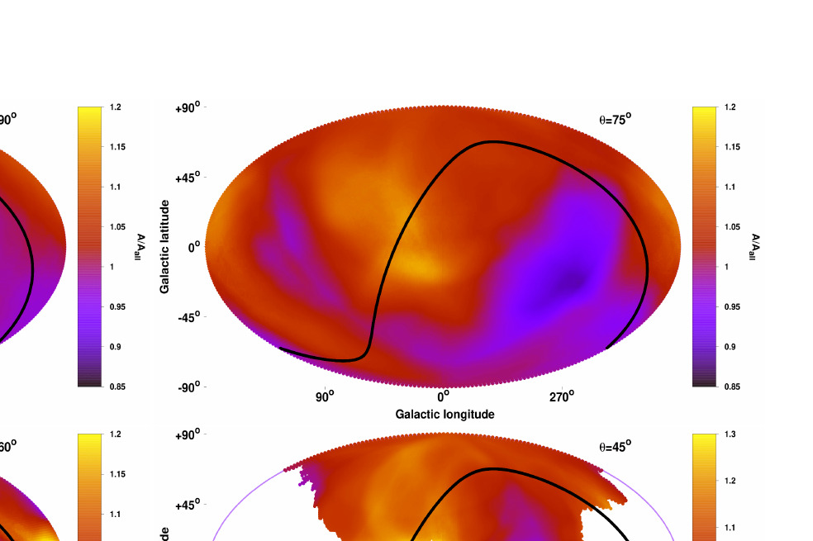
39/395 map_compare/migkas_theta75_fullpanel.png

Slide 41
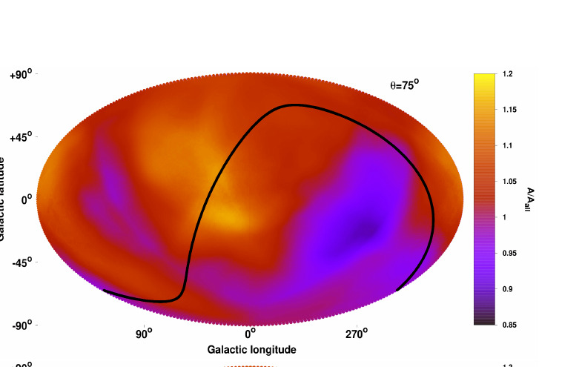
40/395 map_compare/migkas_theta75_with_cbar.png

Slide 42
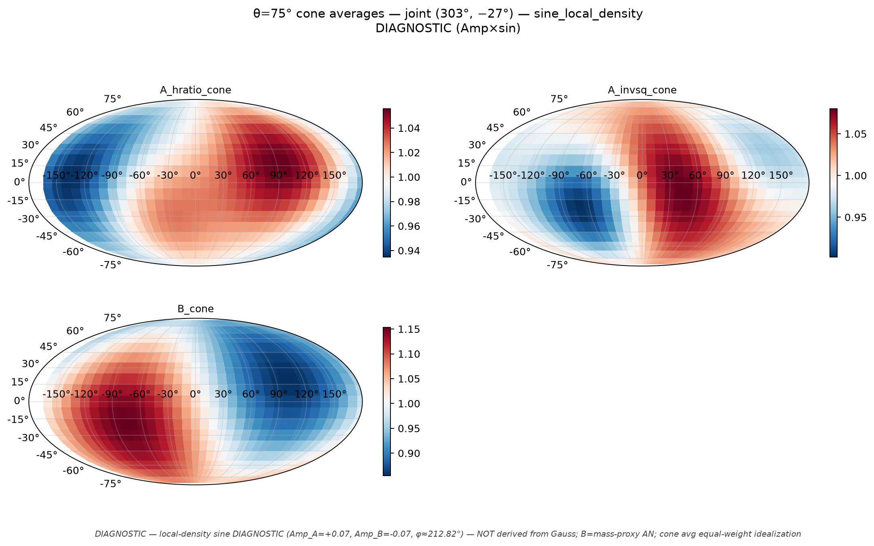
41/395 cone_scan_75/mollweide_cone75_joint_303m27__sine_local_density.png

Slide 43
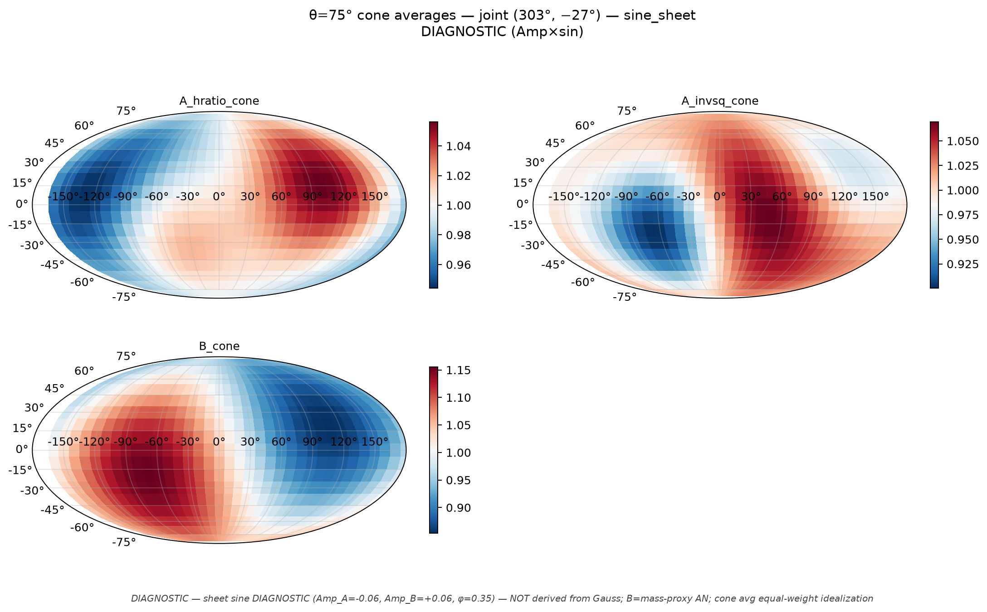
42/395 cone_scan_75/mollweide_cone75_joint_303m27__sine_sheet.png

Slide 44
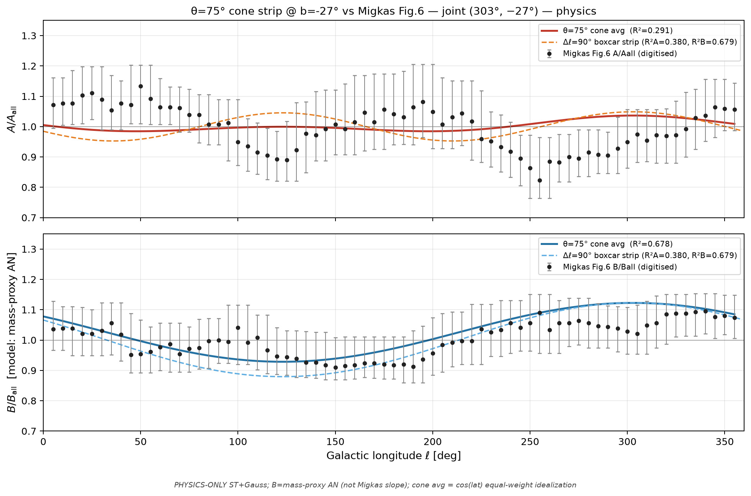
43/395 cone_scan_75/overlay_fig6_cone75_joint_303m27__physics.png

Slide 45
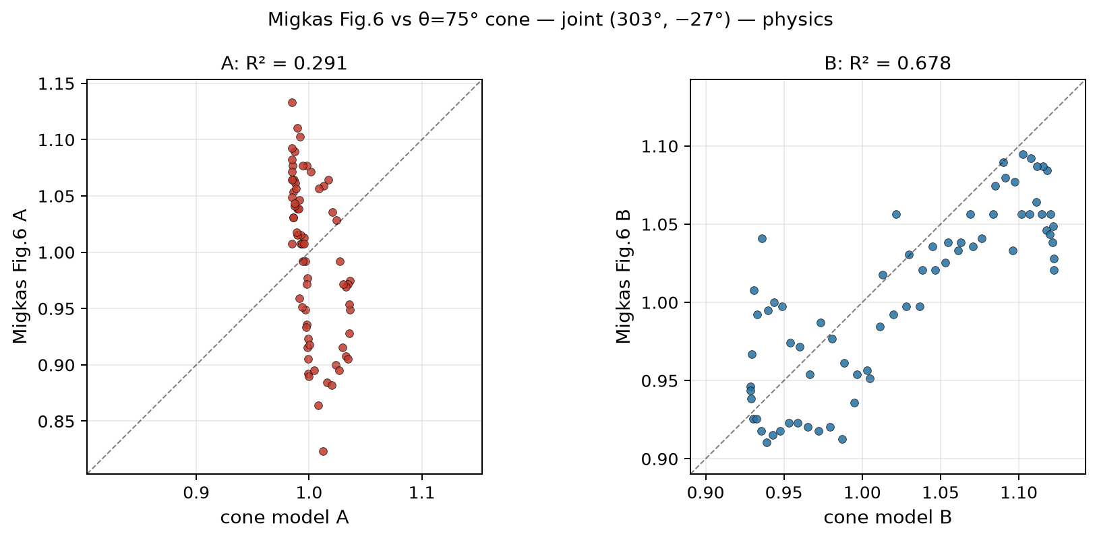
44/395 cone_scan_75/scatter_fig6_vs_cone75_joint_303m27__physics.png

Slide 46
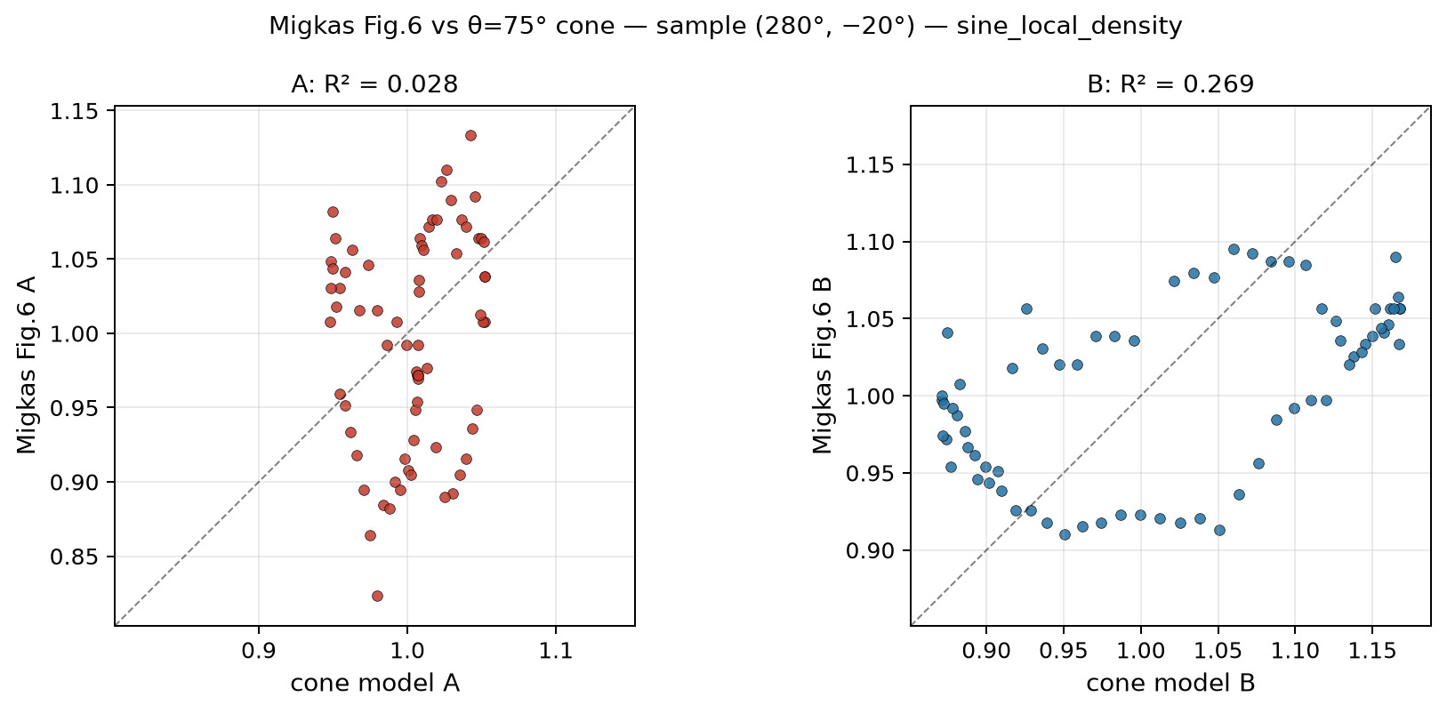
45/395 cone_scan_75/scatter_fig6_vs_cone75_sample_280m20__sine_local_density.png

Slide 47
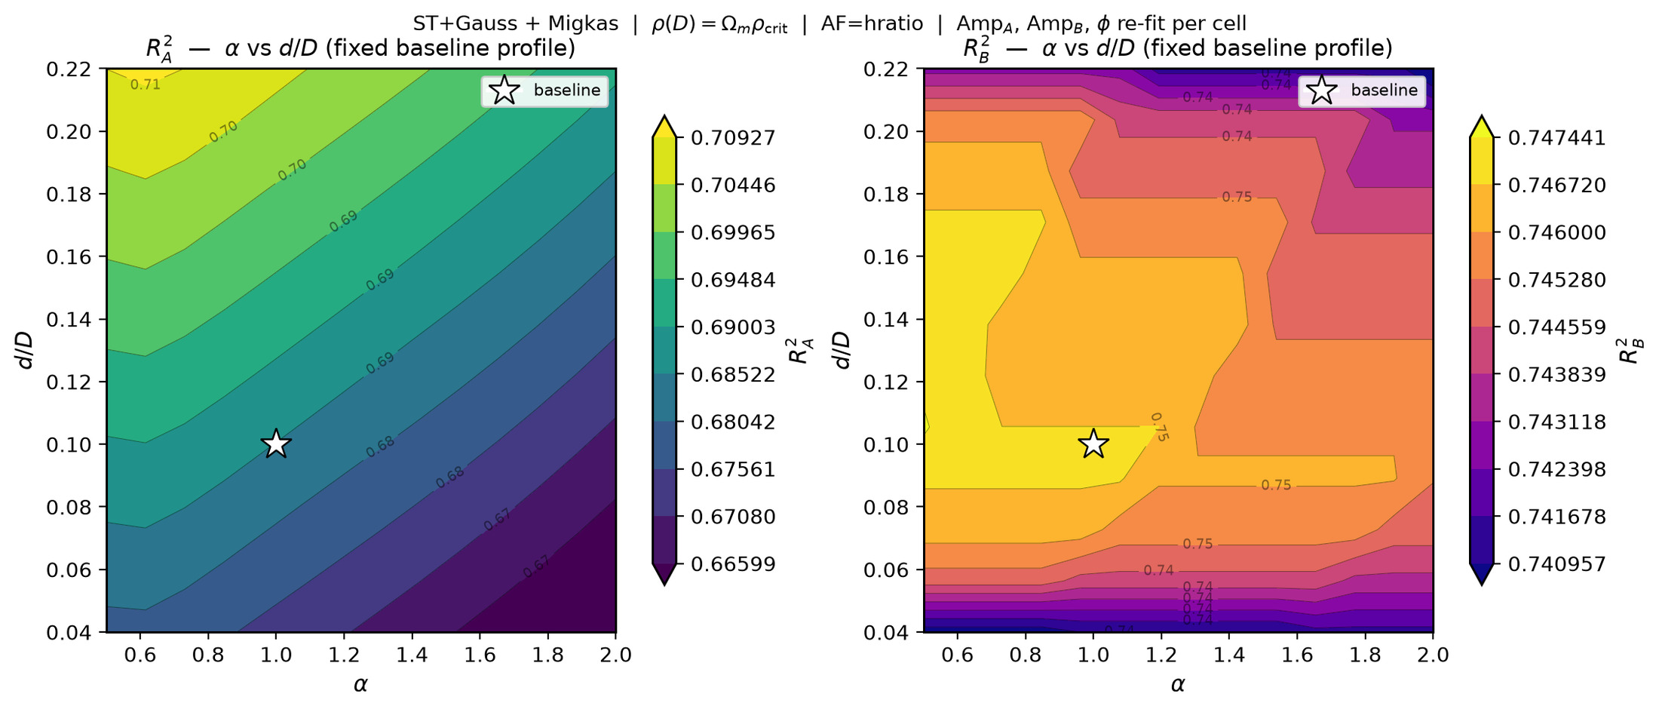
46/395 density_local_match/level_sets/levelsets_alpha_vs_eps.png

Slide 48
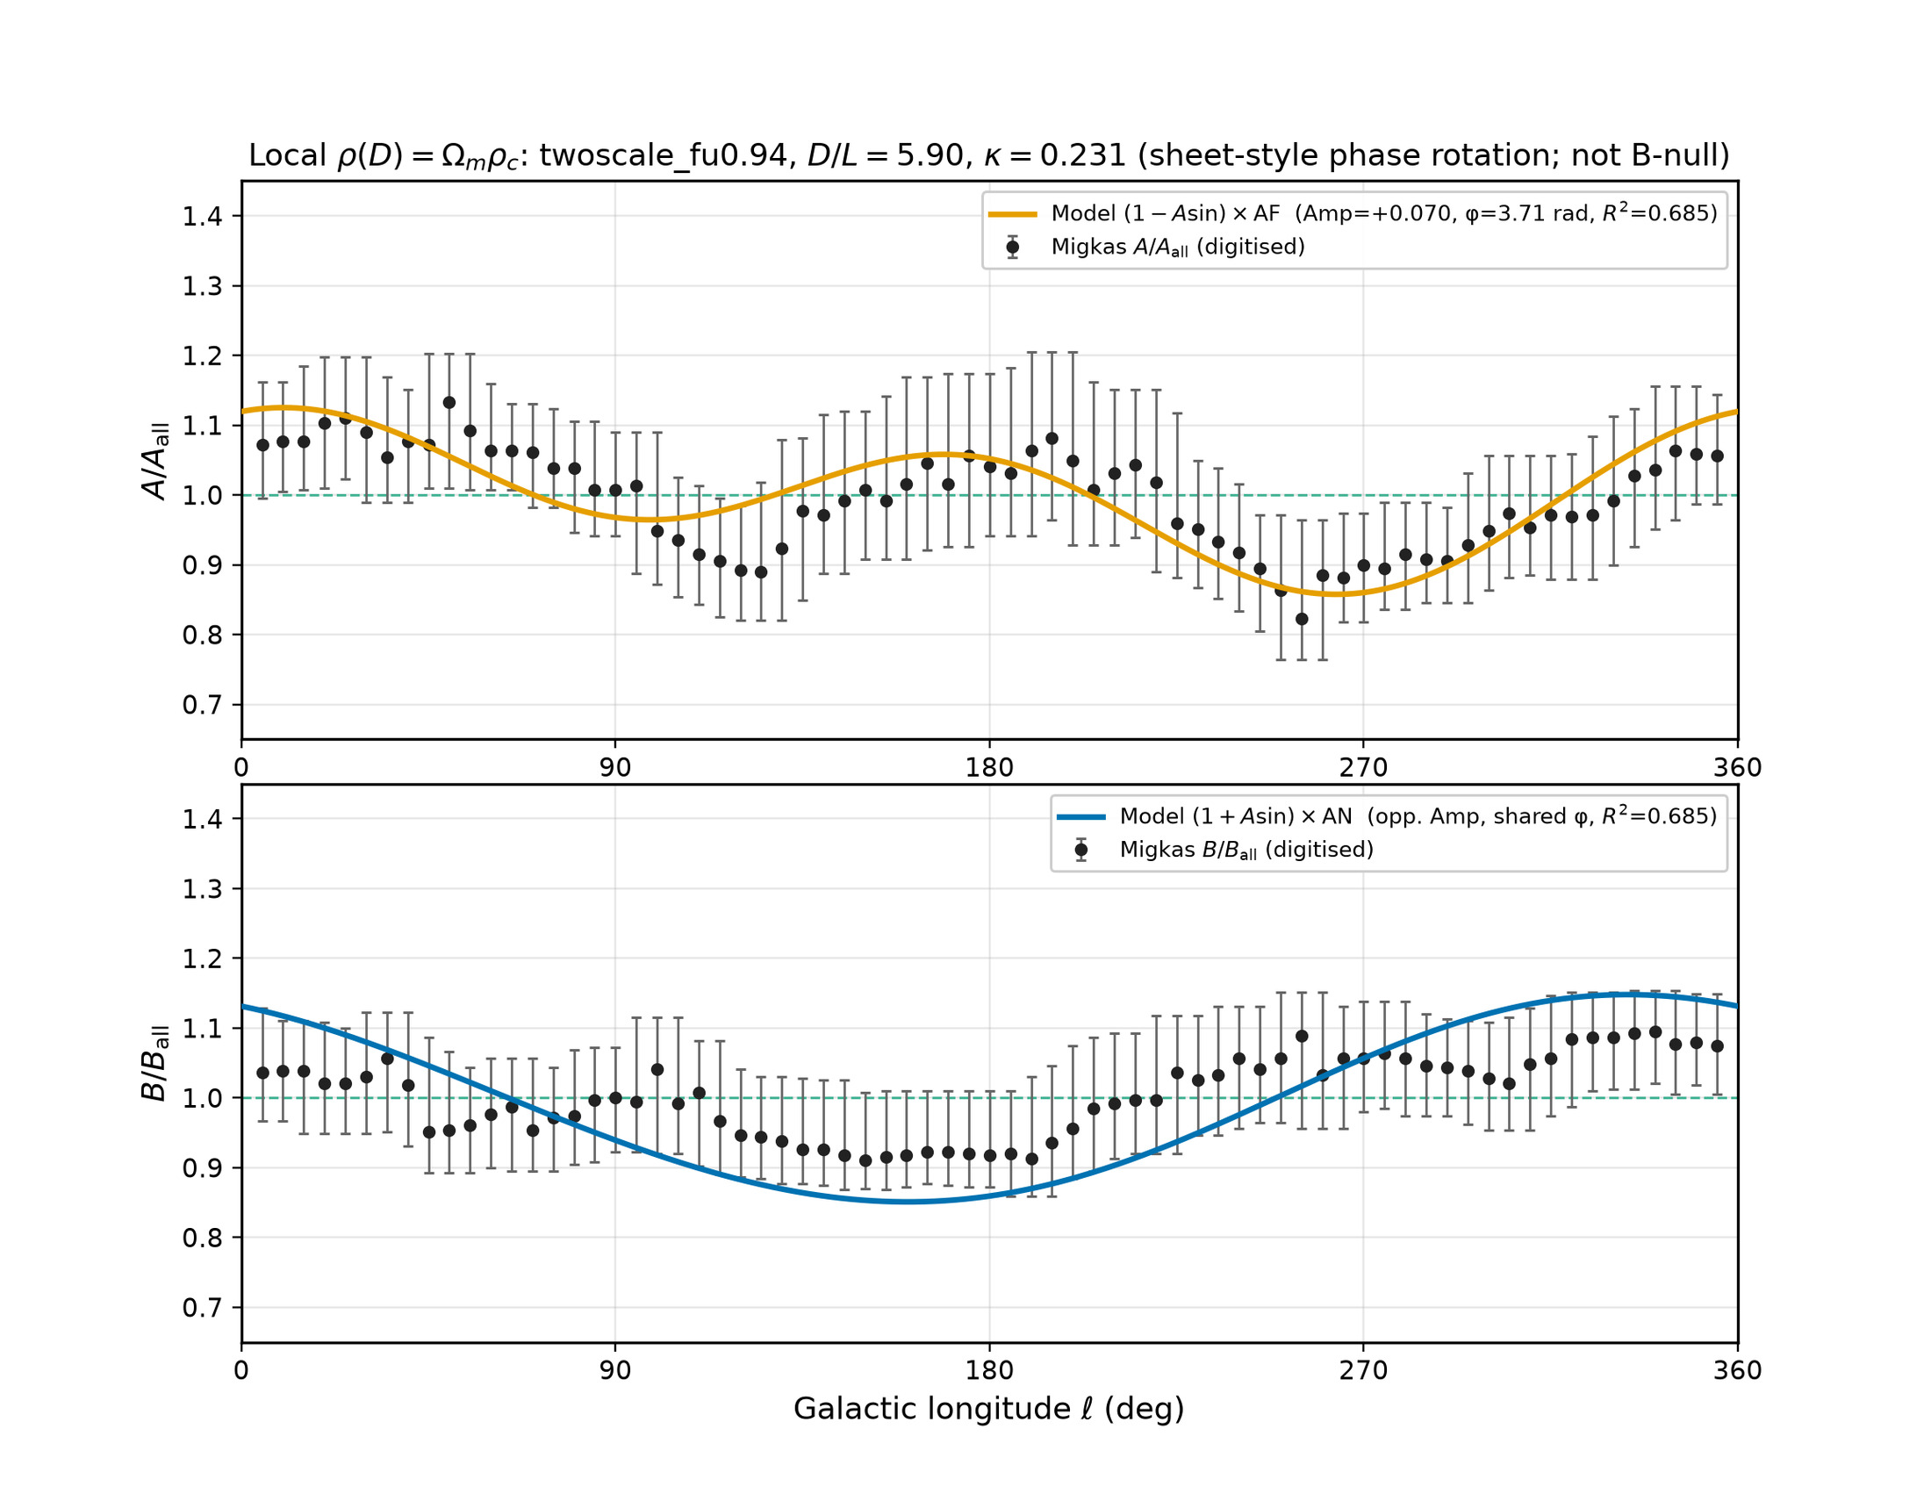
47/395 density_local_match/migkas_overlay_local_density.png

Slide 49
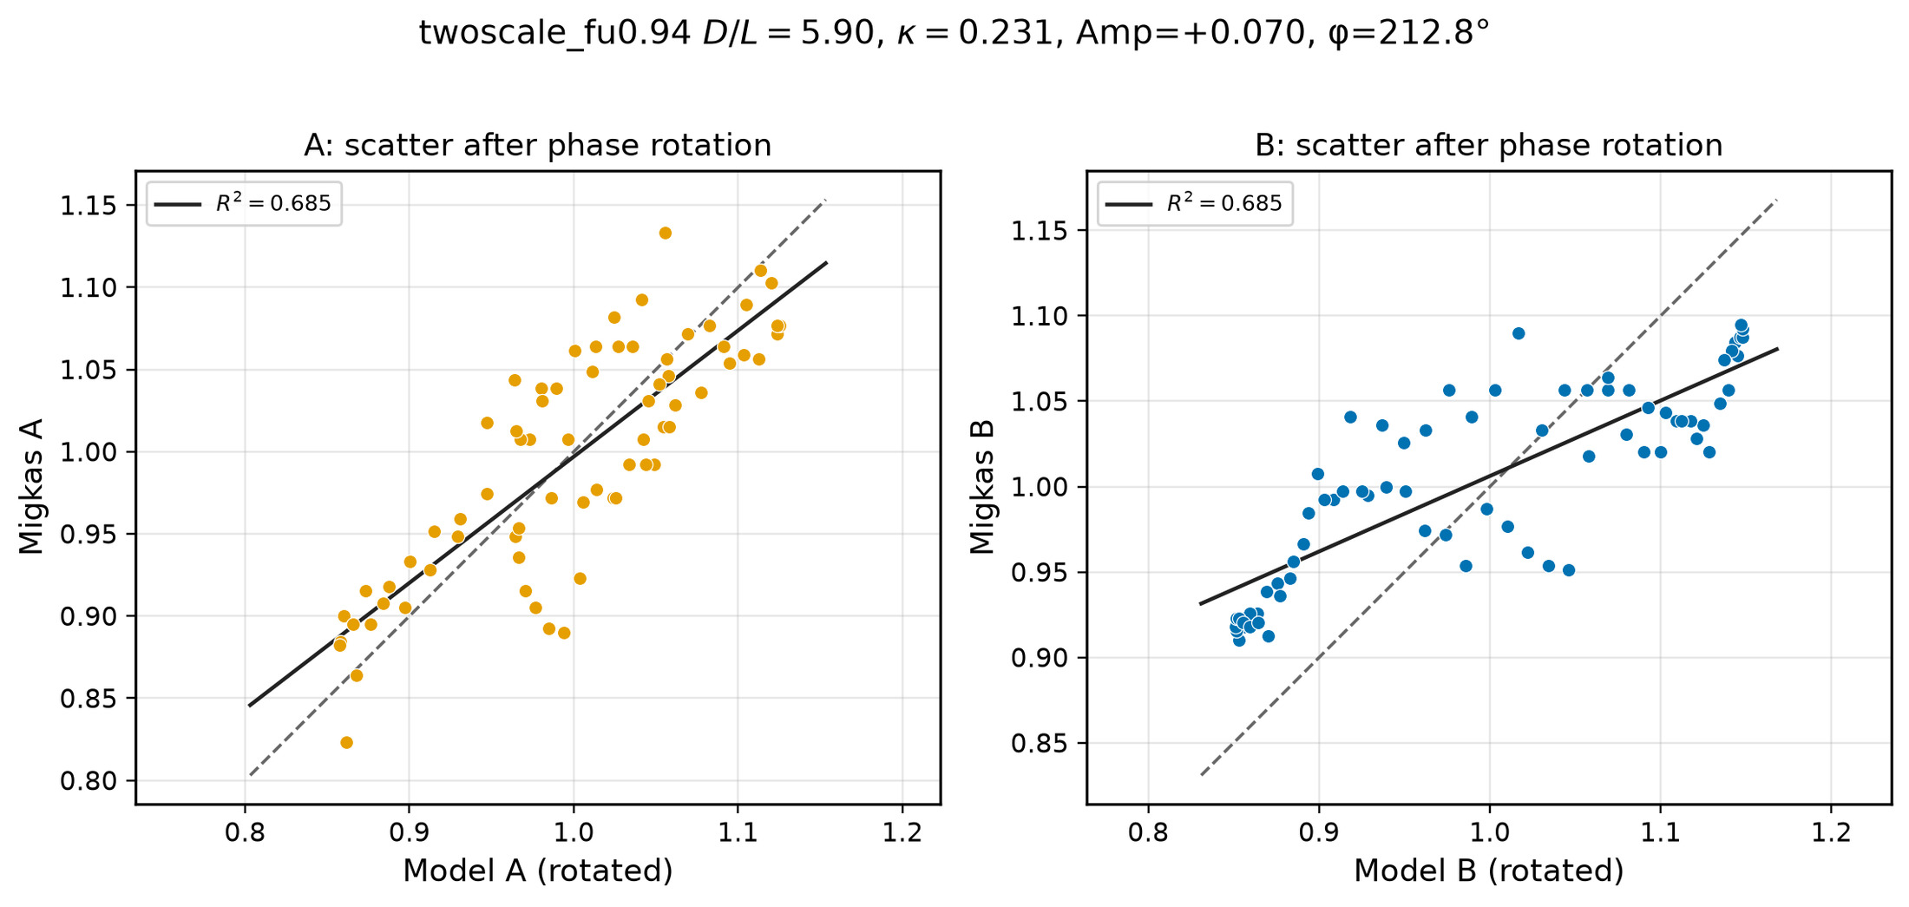
48/395 density_local_match/migkas_scatter_local_density.png

Slide 50
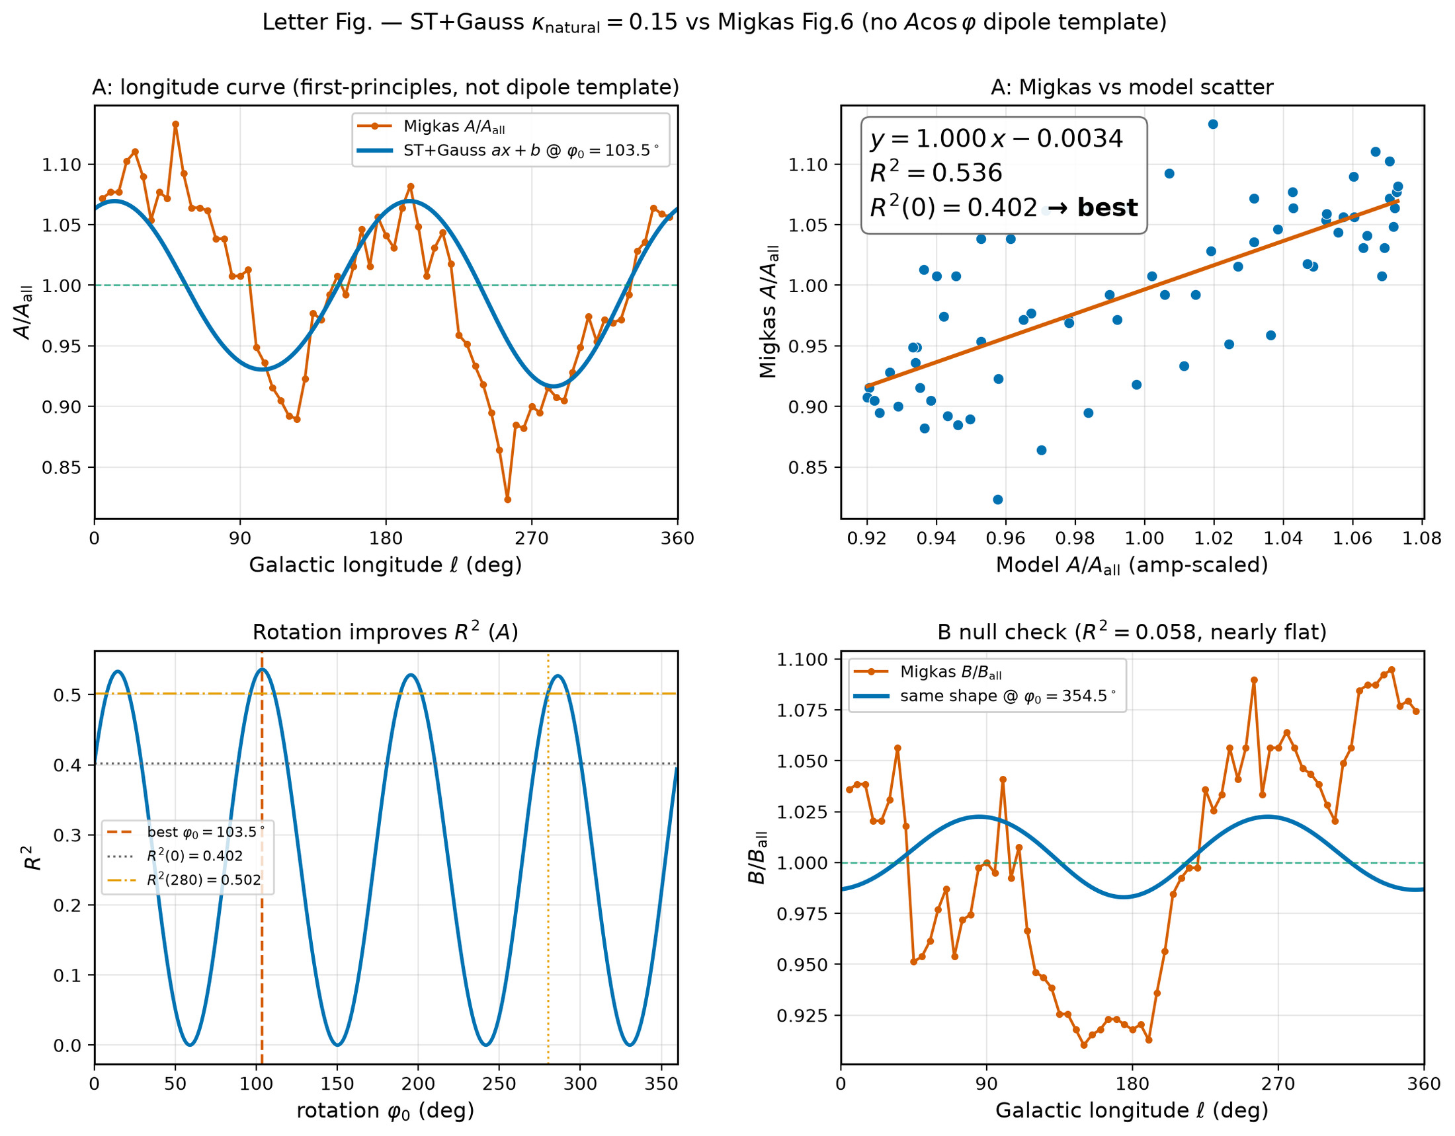
49/395 figures/migkas_r2_letter_panels.png

Slide 51
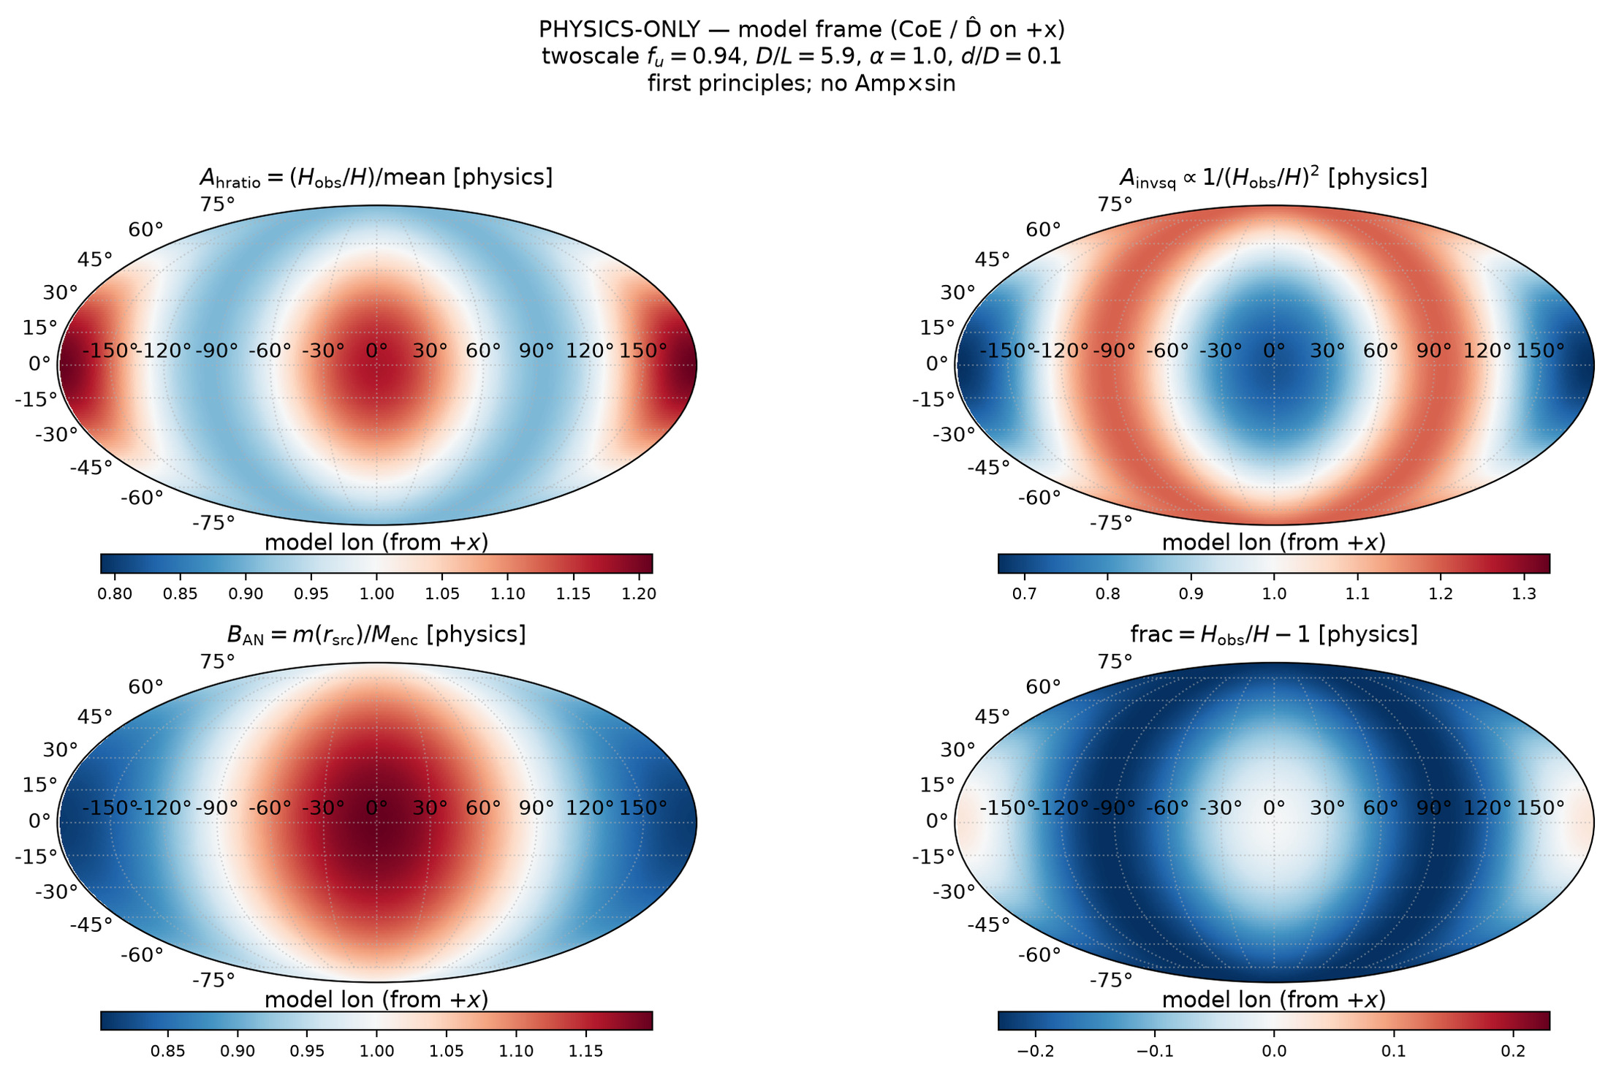
50/395 fullsky_AB/mollweide_AB_model_frame.png

Slide 52
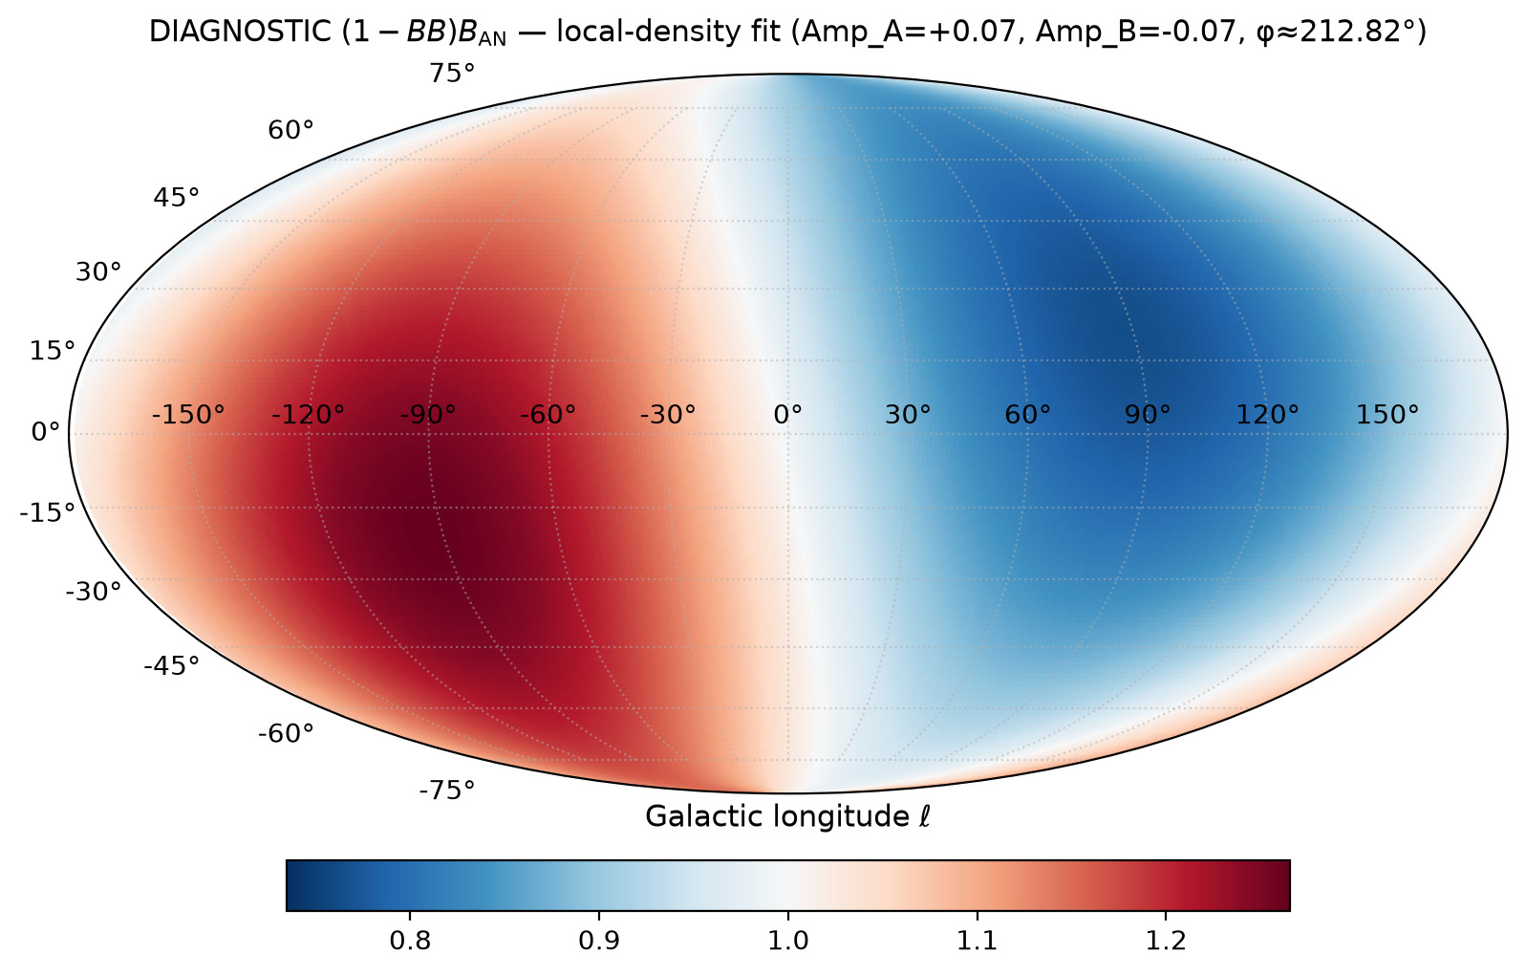
51/395 fullsky_AB/mollweide_sine_local_density_B_DIAGNOSTIC.png

Slide 53
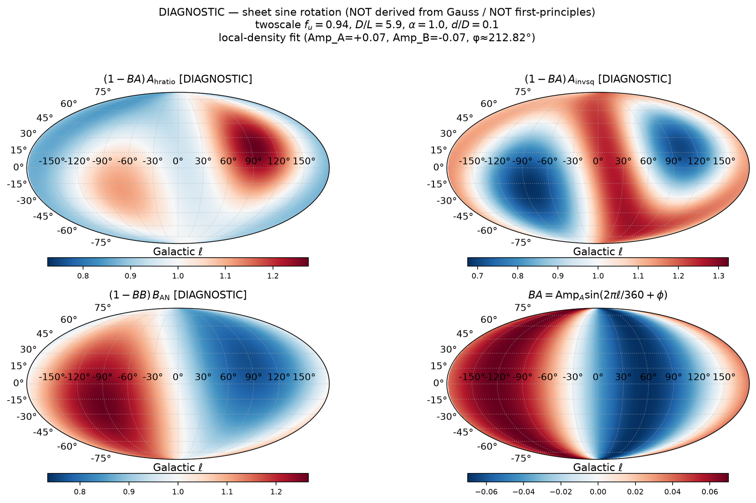
52/395 fullsky_AB/mollweide_sine_local_density_DIAGNOSTIC.png

Slide 54
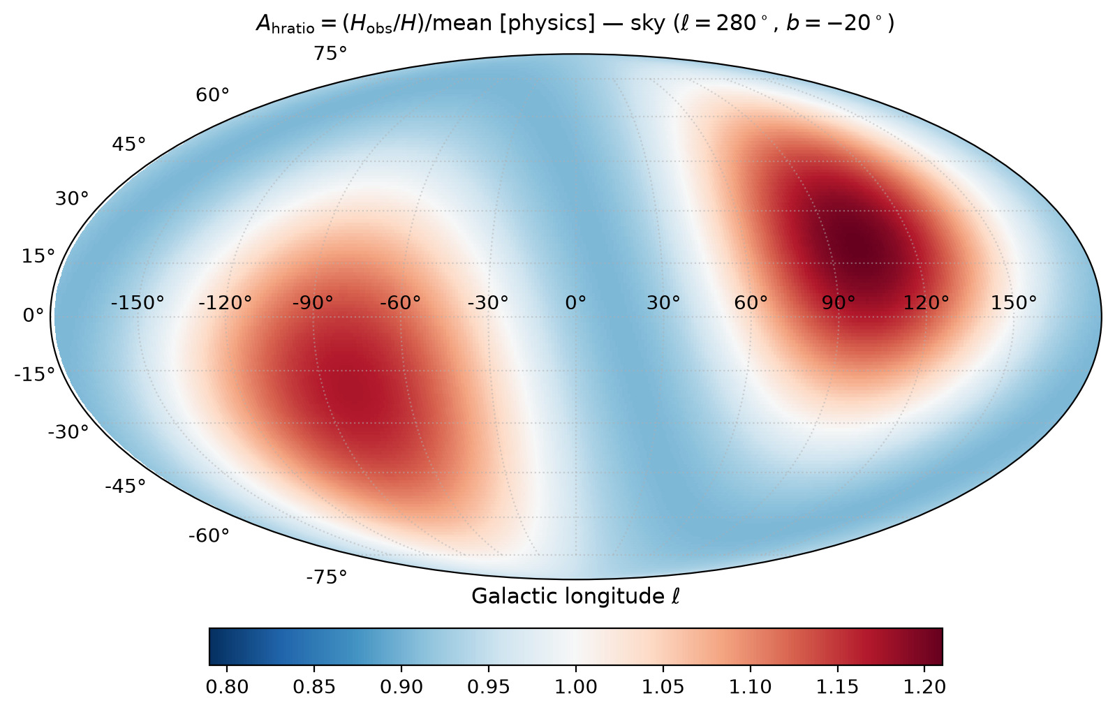
53/395 fullsky_AB/mollweide_sky_A_hratio.png

Slide 55

54/395 fullsky_AB/mollweide_sky_A_invsq.png

Slide 56

55/395 fullsky_AB/mollweide_sky_frac.png

Slide 57

56/395 map_compare/CARD_ours_noise_pm01.png

Slide 58

57/395 map_compare/_mig_nocbar_tmp.png

Slide 59

58/395 map_compare/migkas_fig8_theta75_crop.png

Slide 60

59/395 map_compare/migkas_theta75_only.png

Slide 61

60/395 map_compare/migkas_theta75_panel_hires.png

Slide 62

61/395 map_compare/ours_cone75_physics_standalone.png

Slide 63

62/395 map_compare/ours_cone75_sheet_SHARED_SCALE.png

Slide 64

63/395 cone_scan_75/mollweide_cone75_sample_280m20__sine_sheet.png

Slide 65

64/395 density_local_match/level_sets/levelsets_DL_vs_alpha.png

Slide 66

65/395 density_local_match/level_sets/levelsets_DL_vs_fu.png

Slide 67

66/395 density_local_match/r2_maximize/migkas_best_pair_scatter.png

Slide 68

67/395 fullsky_AB/mollweide_sine_sheet_A_hratio_DIAGNOSTIC.png

Slide 69

68/395 map_compare/_mig_hi_full.png

Slide 70

69/395 map_compare/cone_noise_variants.png

Slide 71

70/395 map_compare/cone_noise_vs_fig6_bars.png

Slide 72

71/395 map_compare/debug_crop_tr_mid.png

Slide 73

72/395 map_compare/ours_cone75_sheet_standalone.png

Slide 74

73/395 density_local_match/level_sets/levelsets_Amp_vs_phi.png

Slide 75

74/395 map_compare/EQUAL_STACK_migkas_vs_ours.png

Slide 76

75/395 map_compare/STACK_migkas_mean_noise.png

Slide 77

76/395 map_compare/sbs_SAME_TYPE_cone75_physics.png

Slide 78

77/395 map_compare/sbs_SAME_TYPE_cone75_sheet.png

Slide 79

78/395 map_compare/sbs_cone_noise_demo.png

Slide 80

79/395 map_compare/side_by_side_theta75_rotated.png

