Slide 1
Cosmology figures — Part 2 of 5 (by PNG creation order)
PNG slides 80–158 of 395 | mtime range: 2026-09-20 20:05:51 CDT – 2026-09-20 20:05:52 CDT
79 PNG image slides

Slide 2
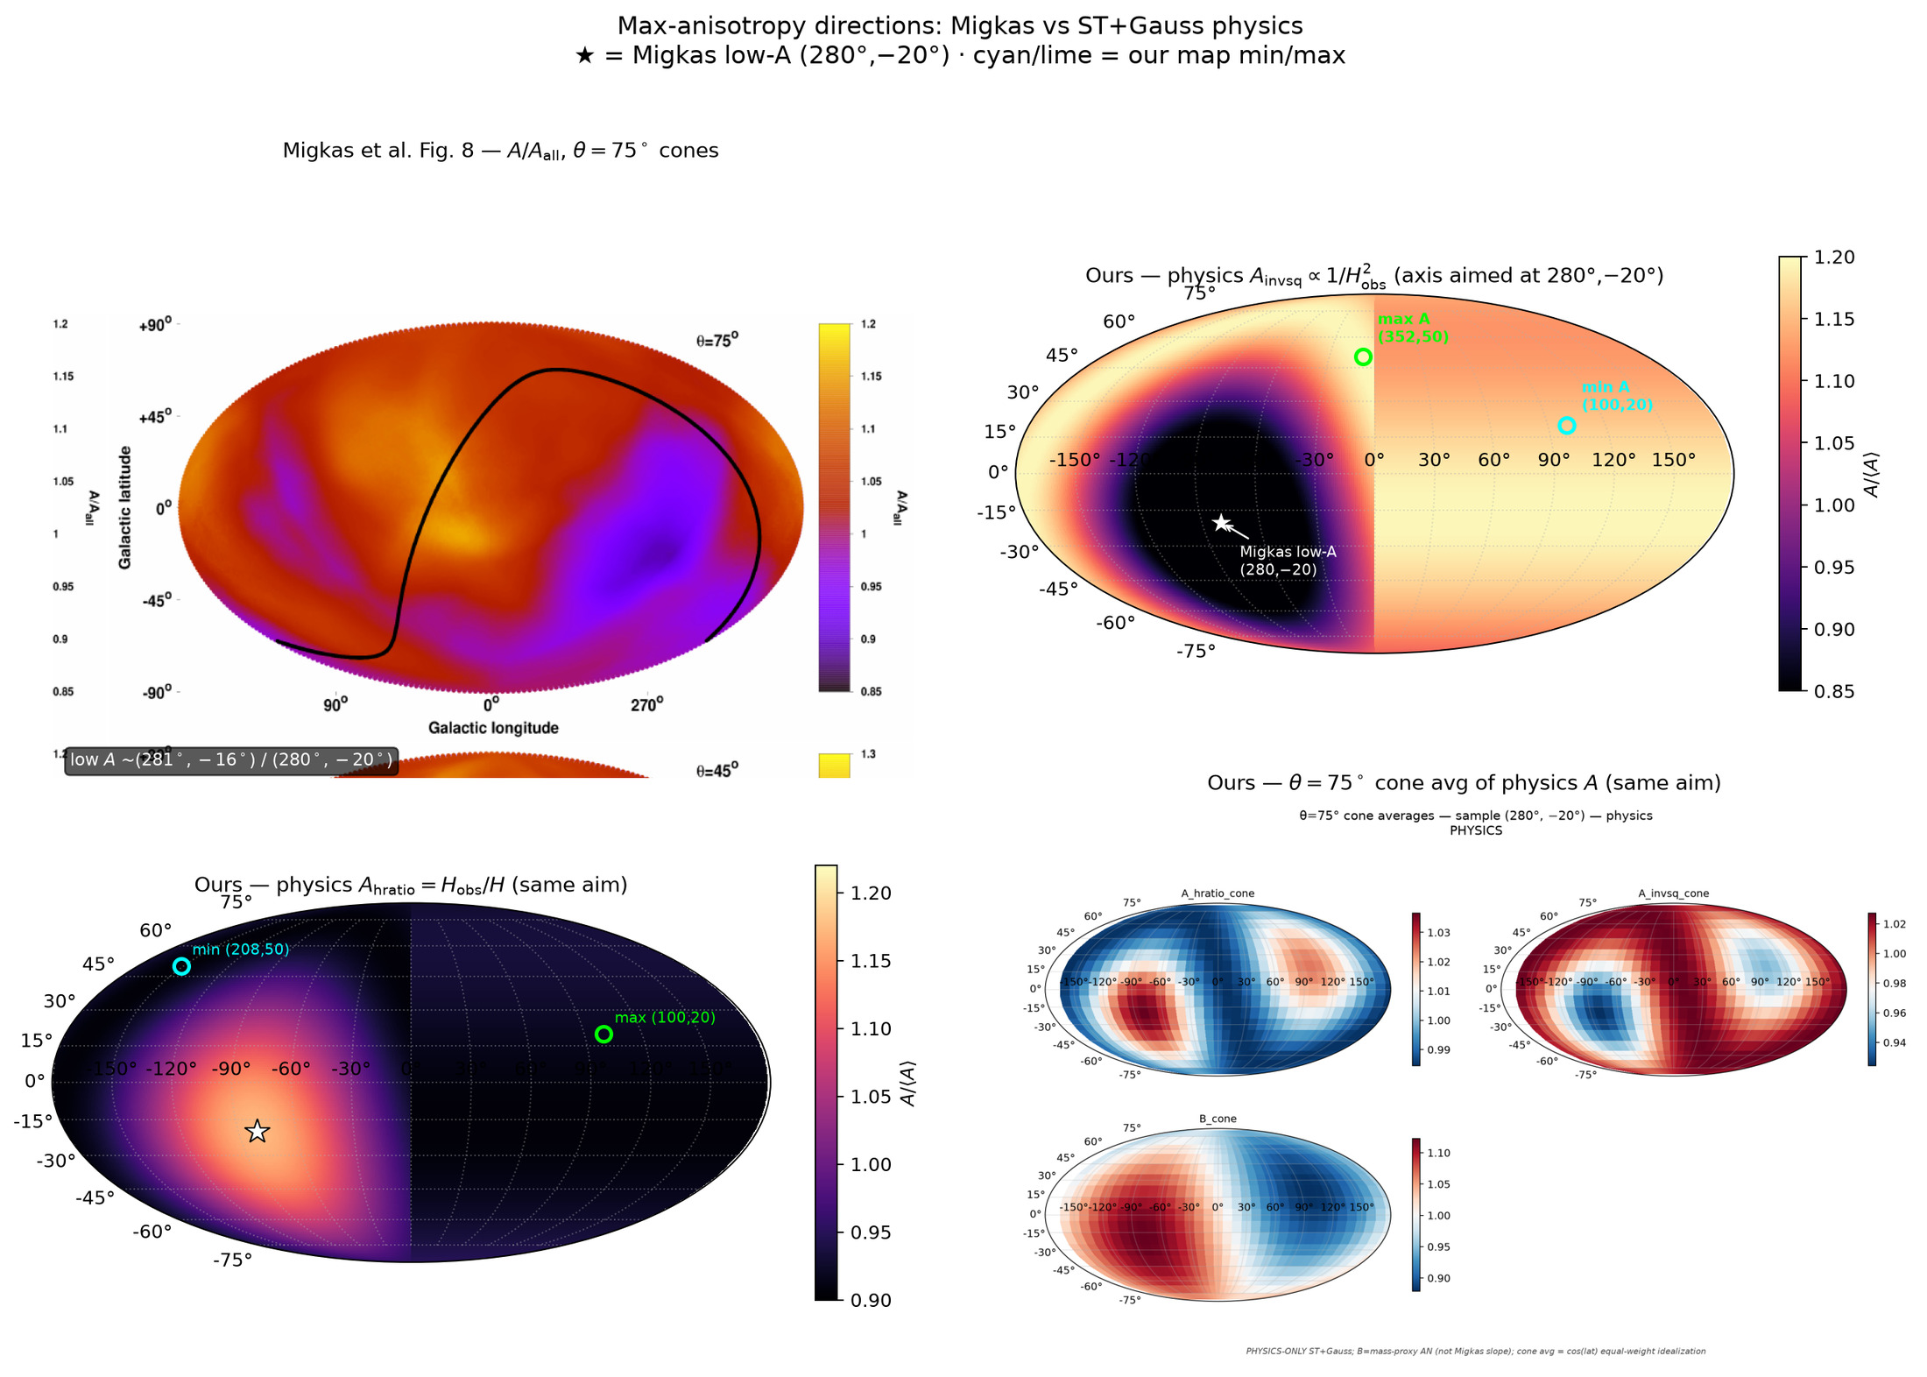
80/395 map_compare/side_by_side_migkas_vs_ours.png

Slide 3
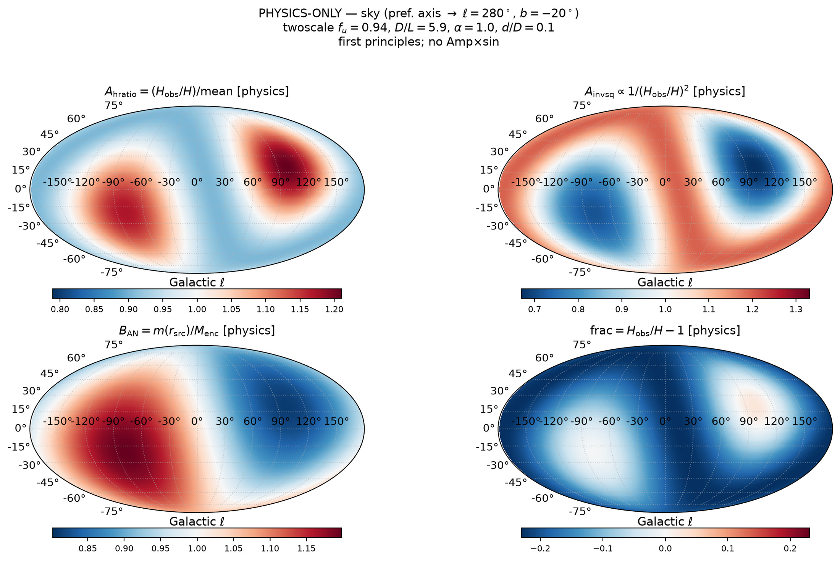
81/395 fullsky_AB/mollweide_AB_sky_frame.png

Slide 4
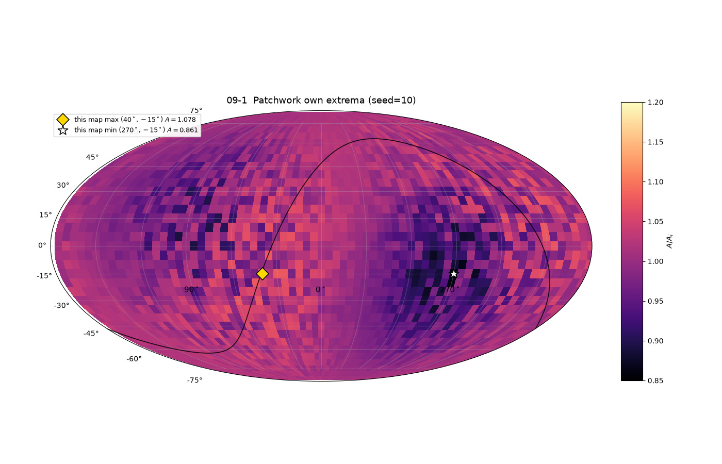
82/395 map_compare/levelset_maps/map_09_patchwork_draw1_seed10_OWN_EXTREMA.png

Slide 5

83/395 map_compare/levelset_maps/map_09_patchwork_draw2_seed11_OWN_EXTREMA.png

Slide 6
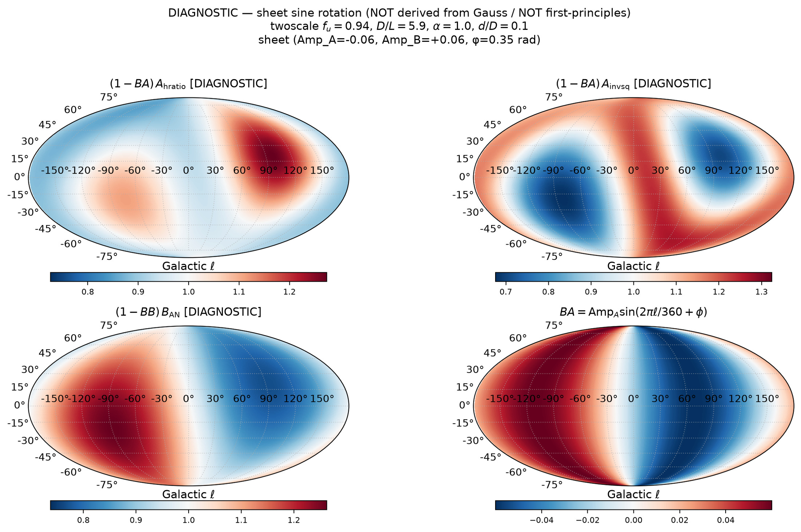
84/395 fullsky_AB/mollweide_sine_sheet_DIAGNOSTIC.png

Slide 7
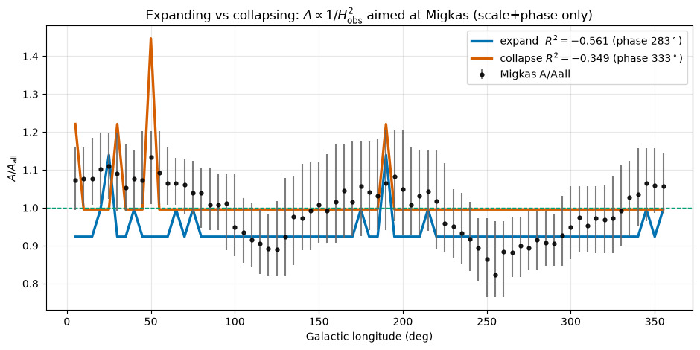
85/395 figures/expand_vs_collapse_A_migkas.png

Slide 8
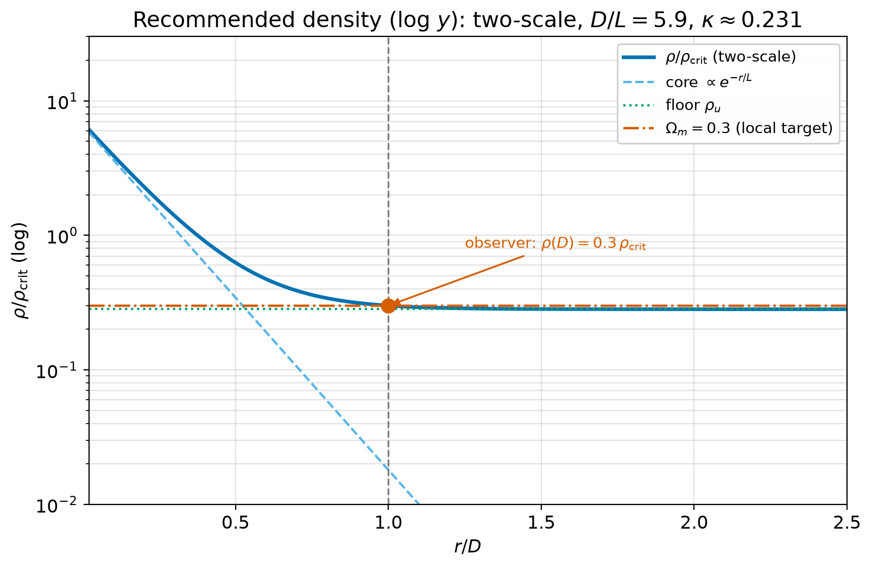
86/395 density_local_match/density_profile_local_match_logy.png

Slide 9
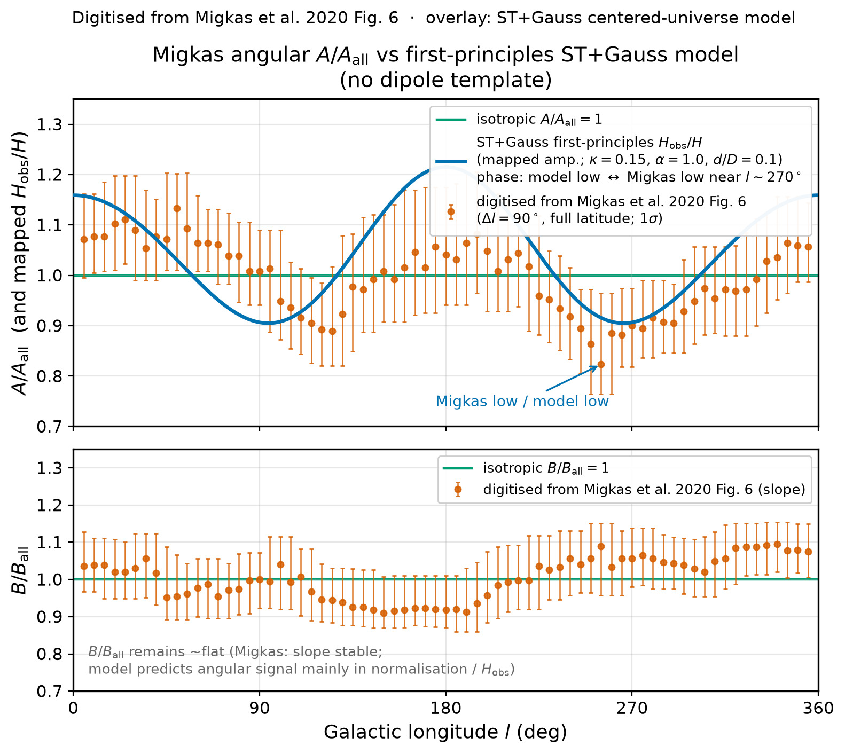
87/395 figures/migkas_fig6_model_overlay.png

Slide 10
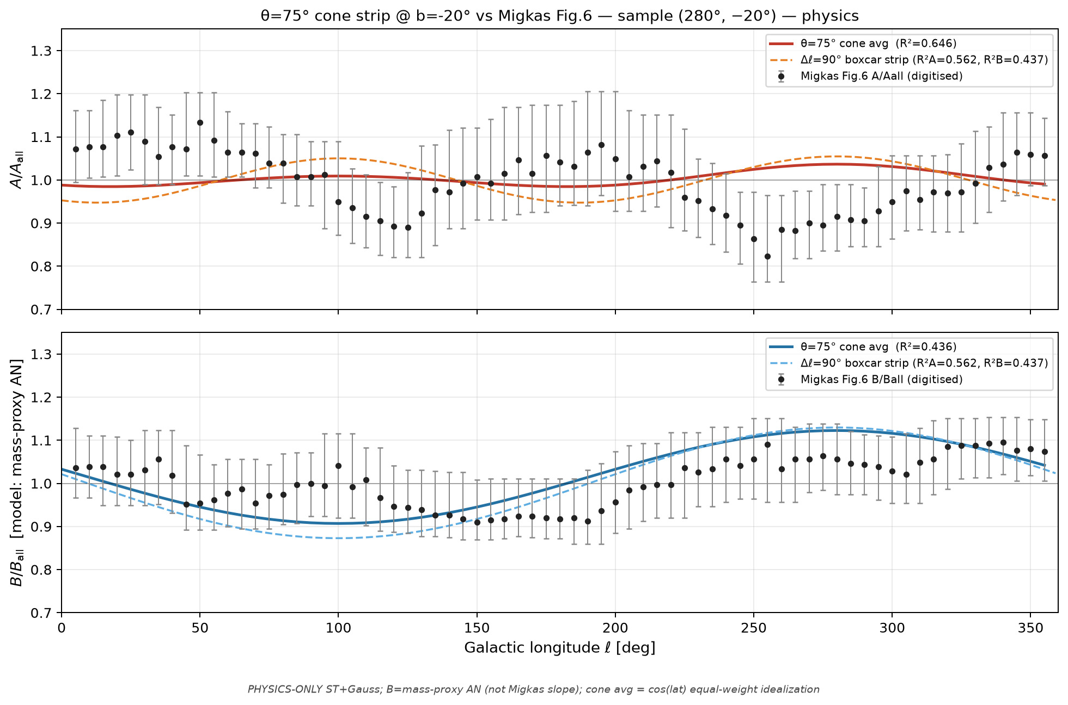
88/395 cone_scan_75/overlay_fig6_cone75_sample_280m20__physics.png

Slide 11
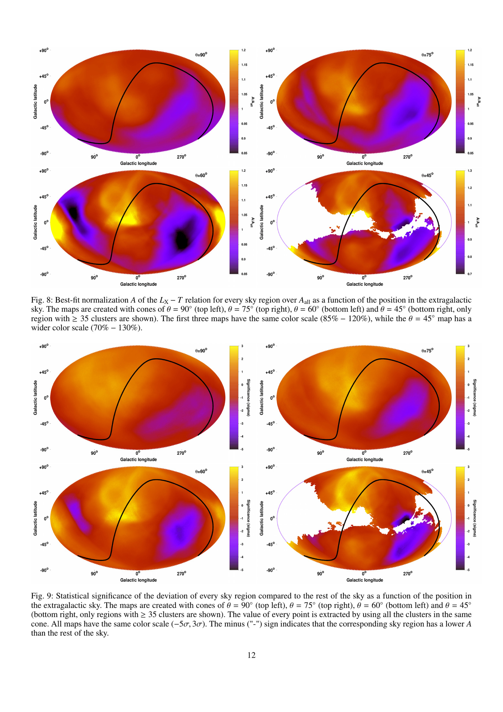
89/395 map_compare/migkas_p12-12.png

Slide 12
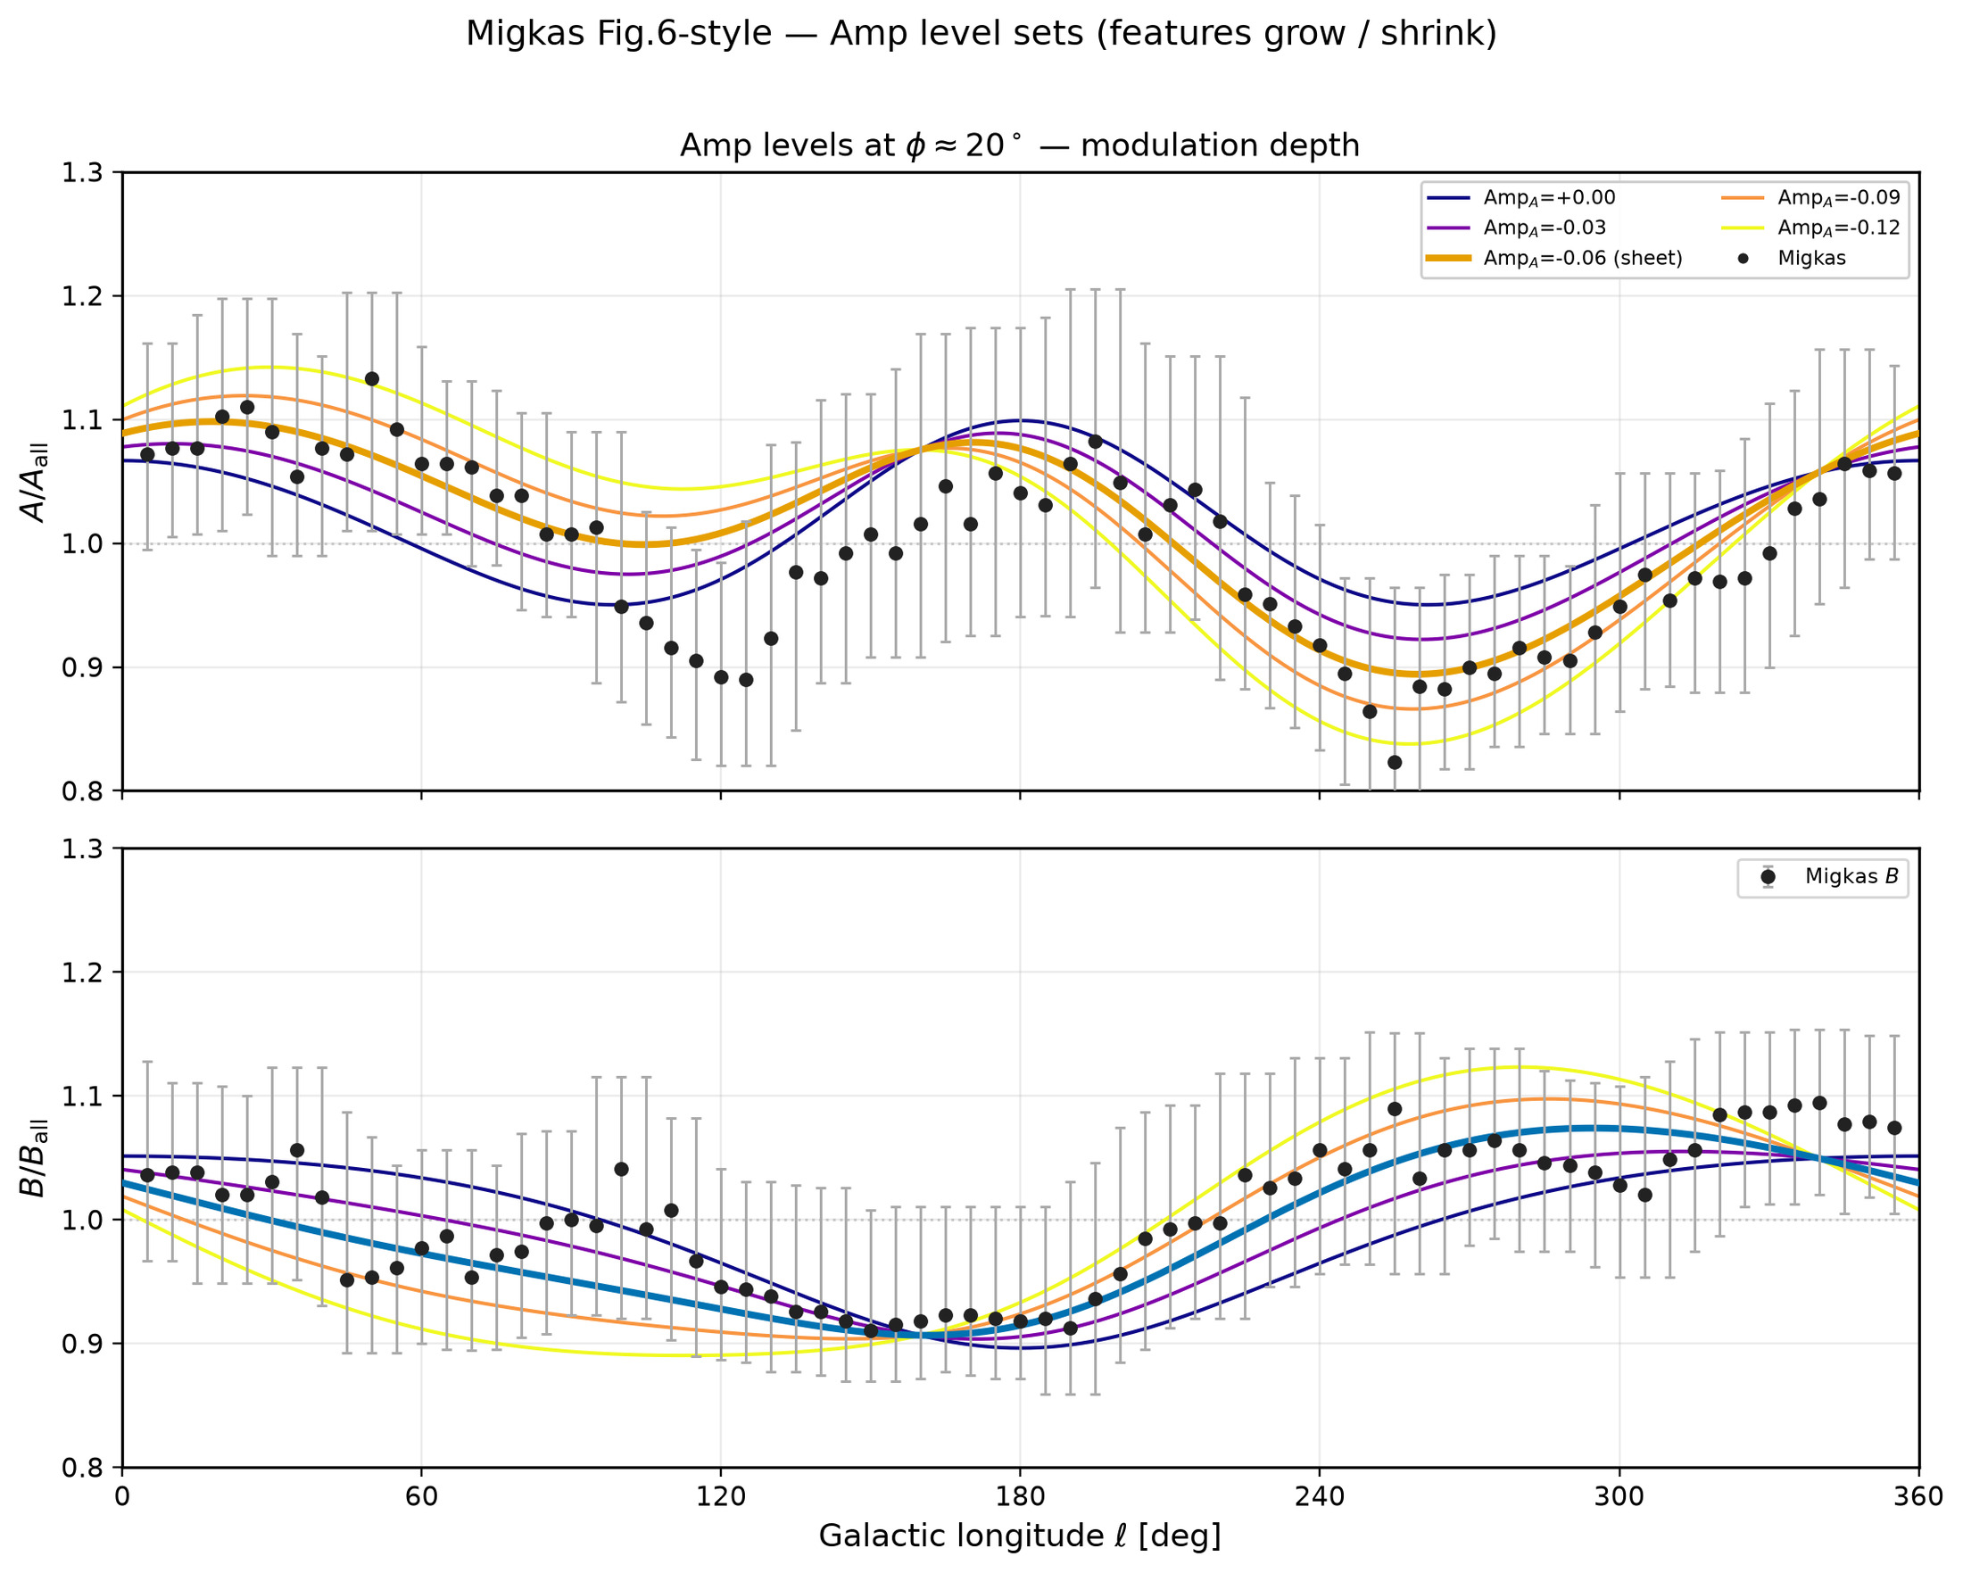
90/395 figures/levelset_curves/levelsets_curves_amp.png

Slide 13
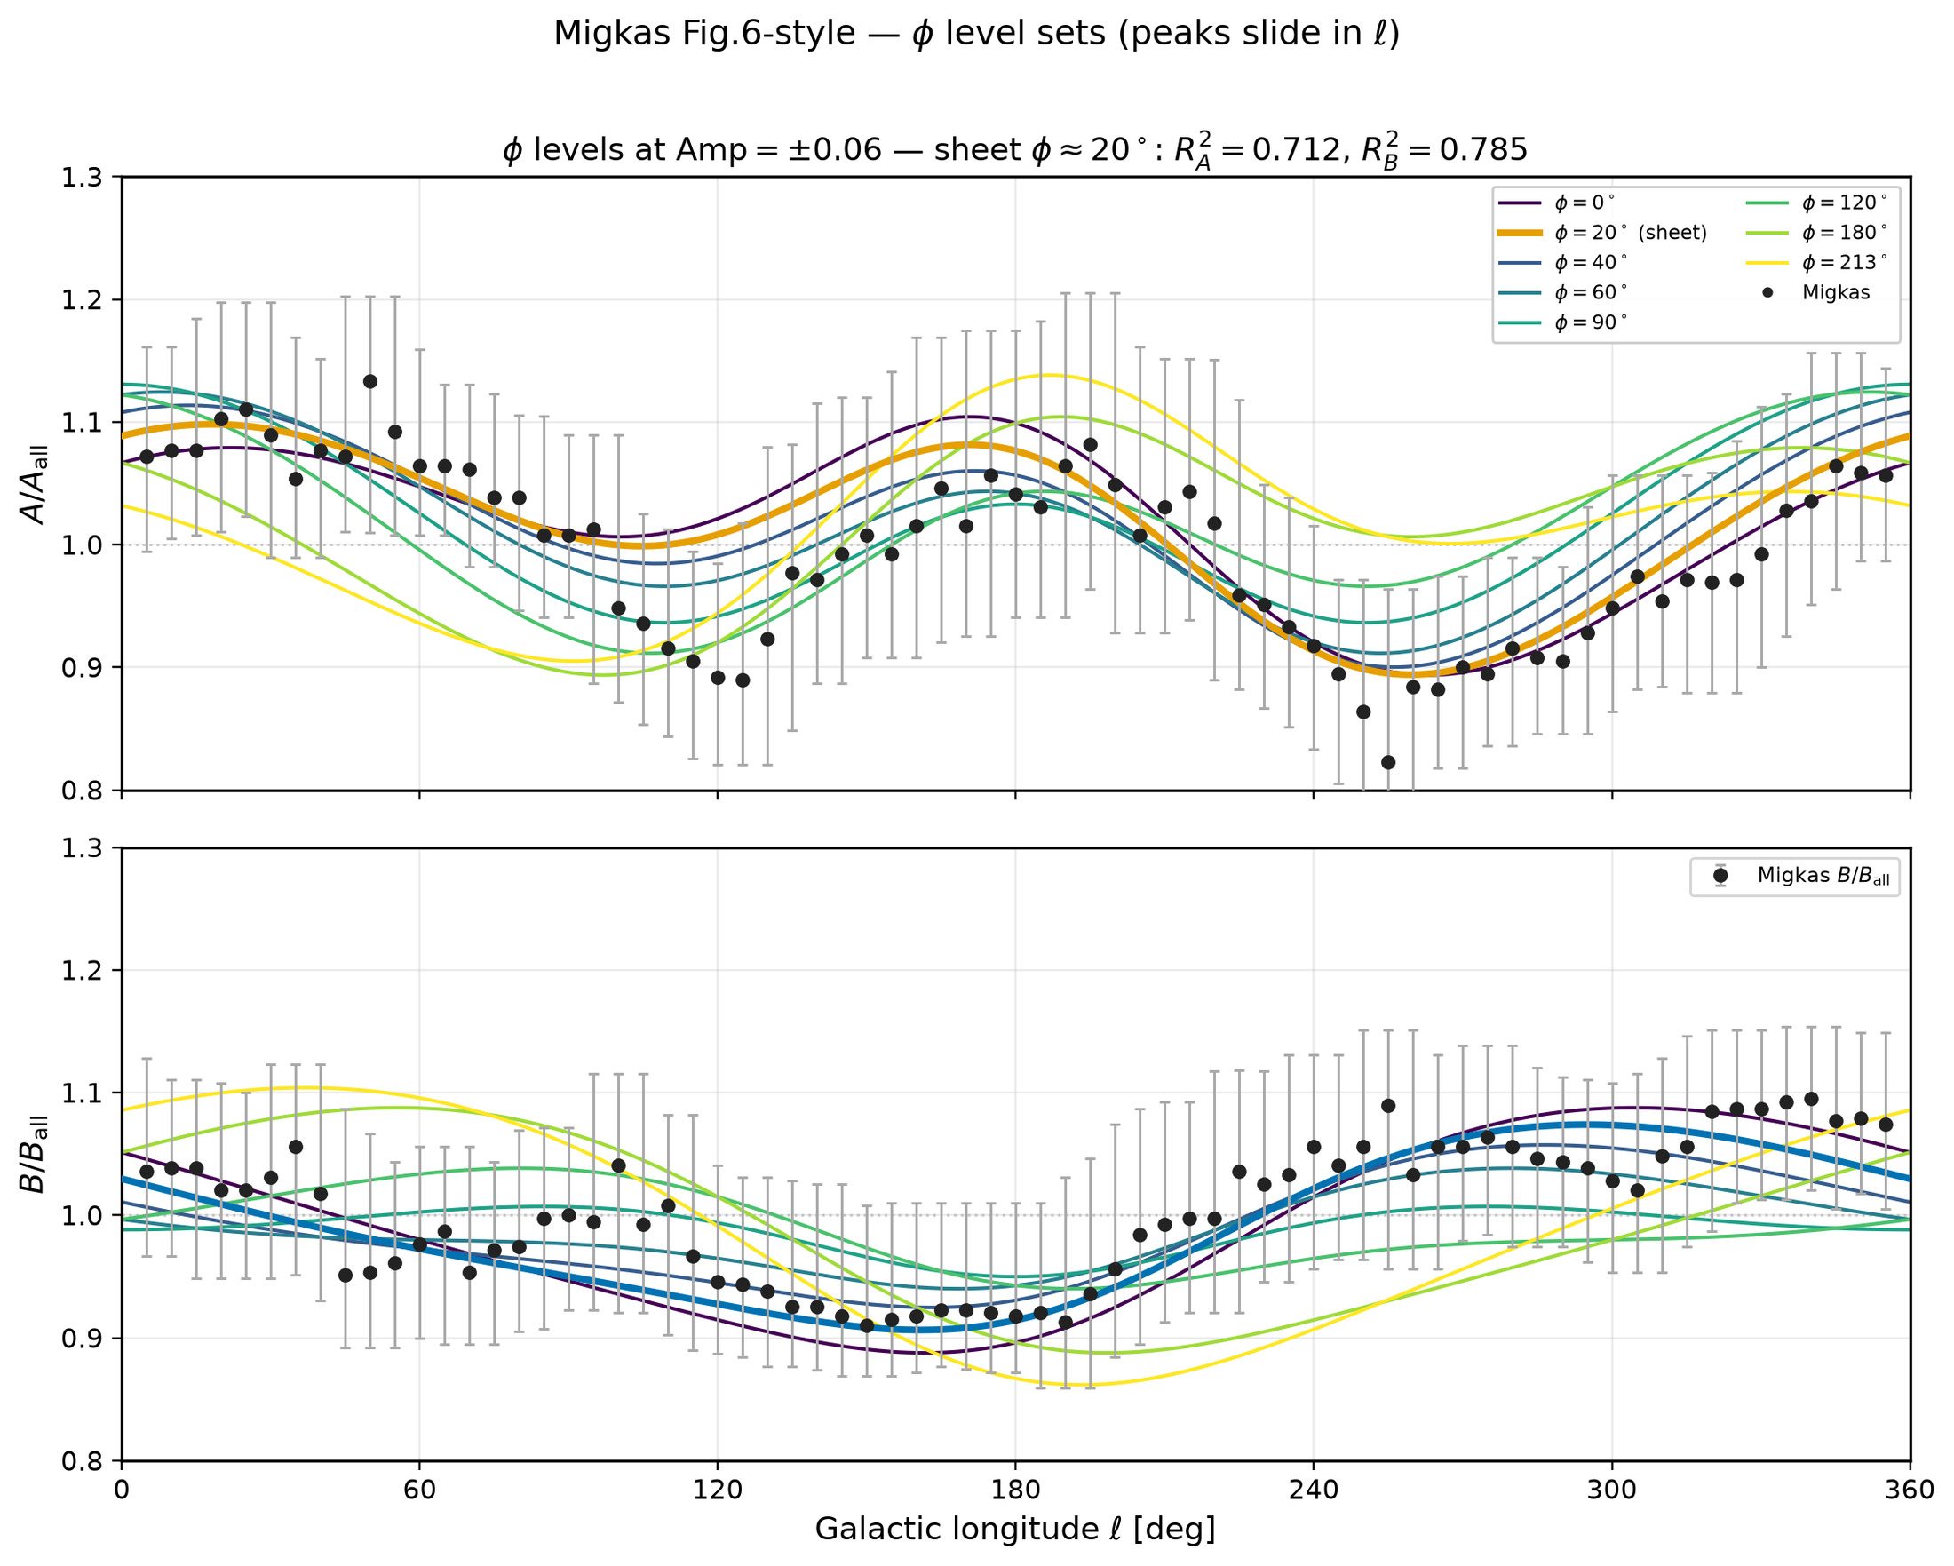
91/395 figures/levelset_curves/levelsets_curves_phi.png

Slide 14
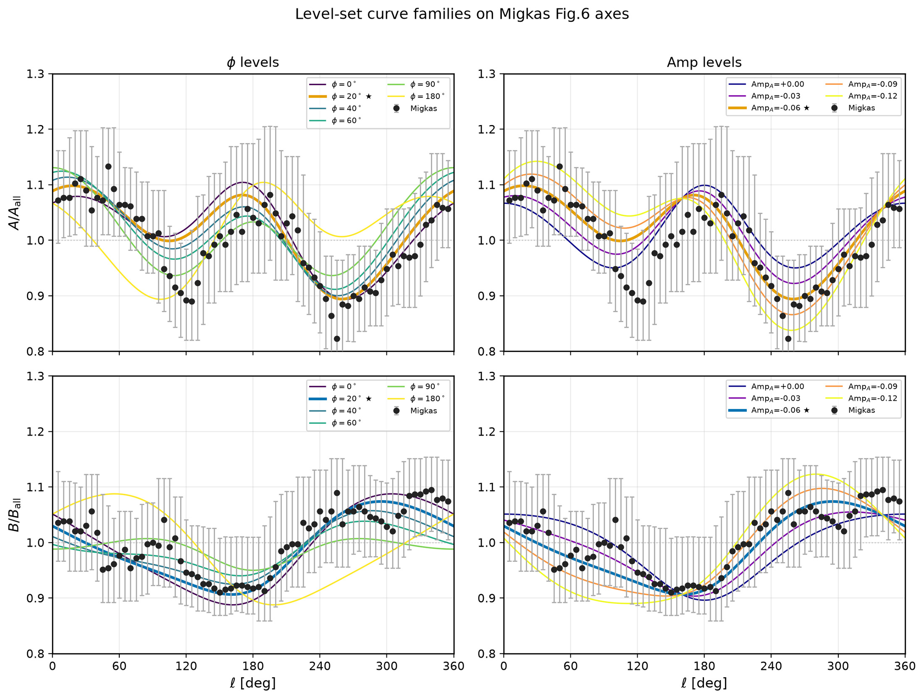
92/395 figures/levelset_curves/levelsets_curves_summary.png

Slide 15
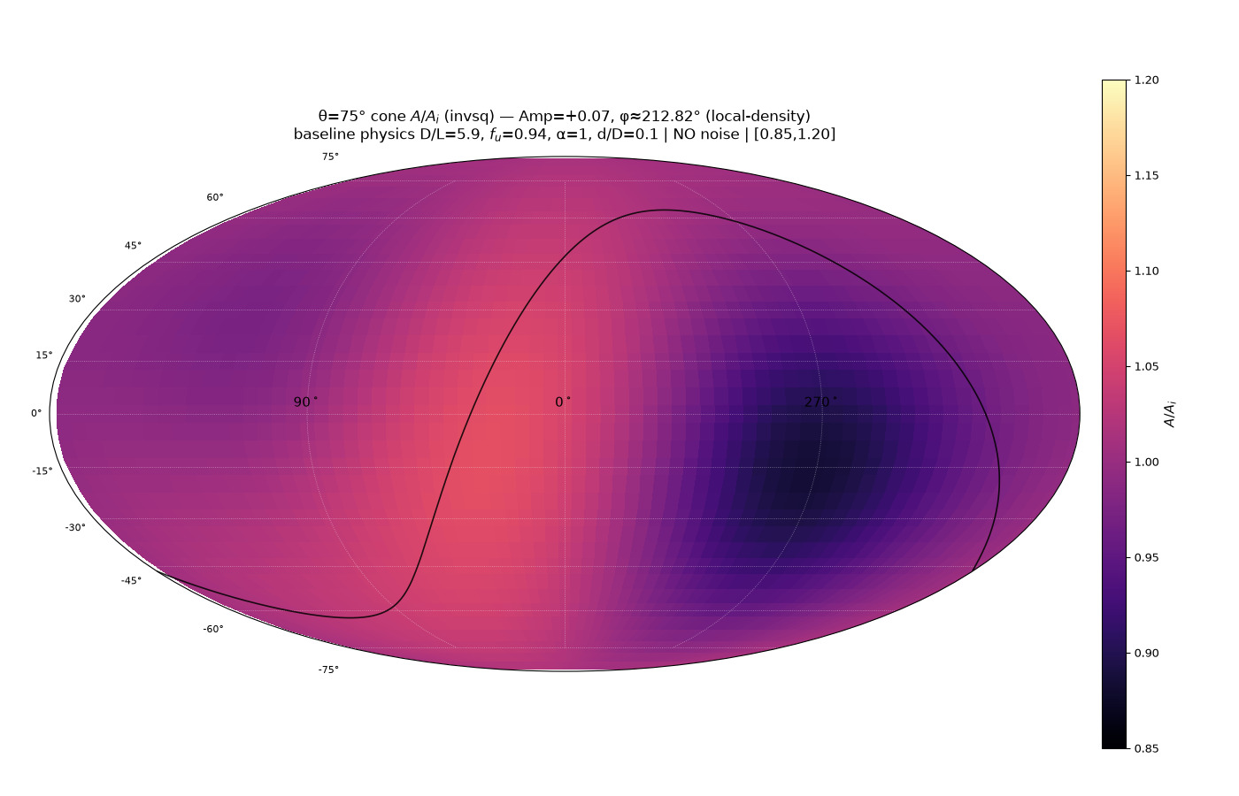
93/395 map_compare/levelset_maps/map_08_amp_p007_phi213_local.png

Slide 16
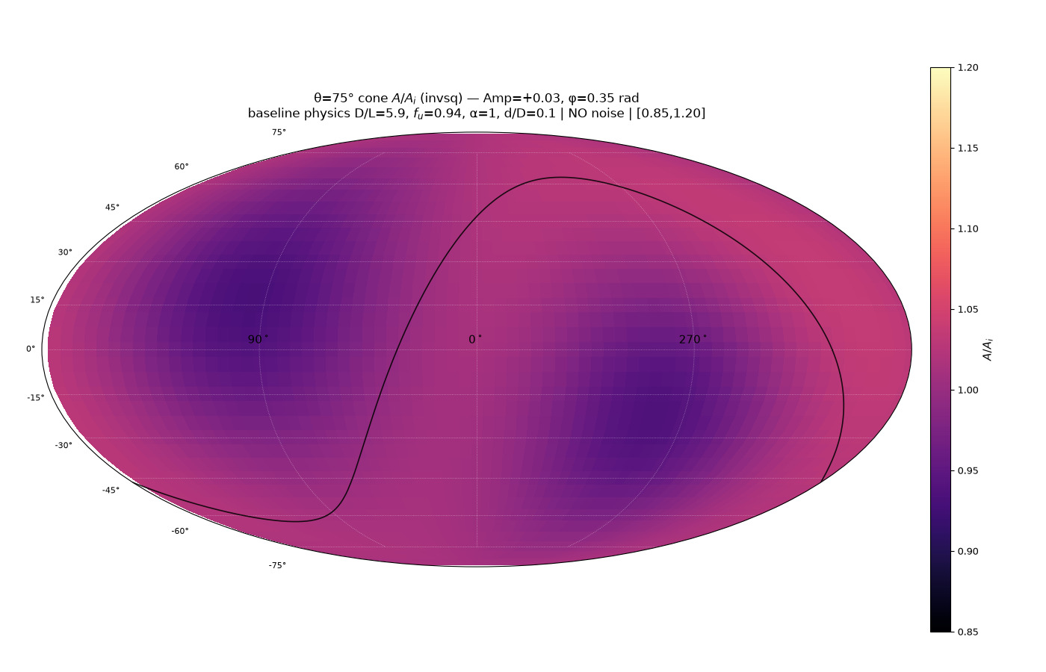
94/395 map_compare/levelset_maps/map_02_amp_p003_phi035.png

Slide 17
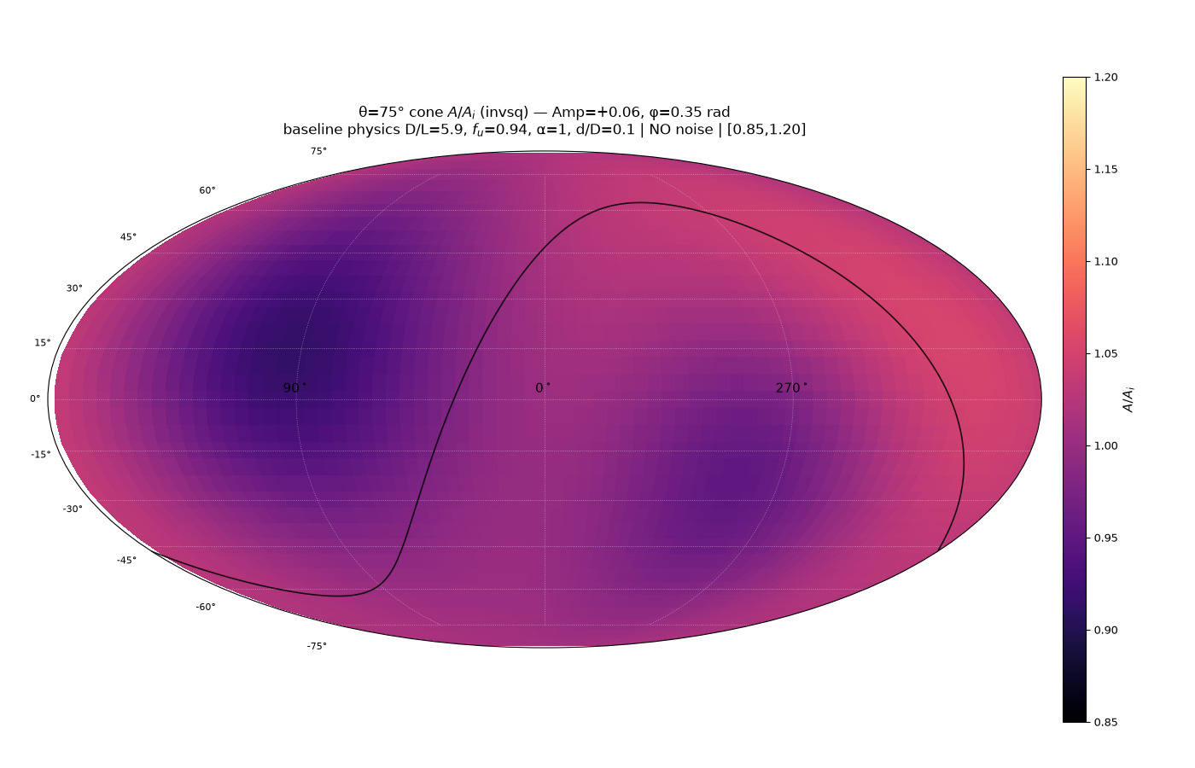
95/395 map_compare/levelset_maps/map_04_amp_p006_phi035.png

Slide 18
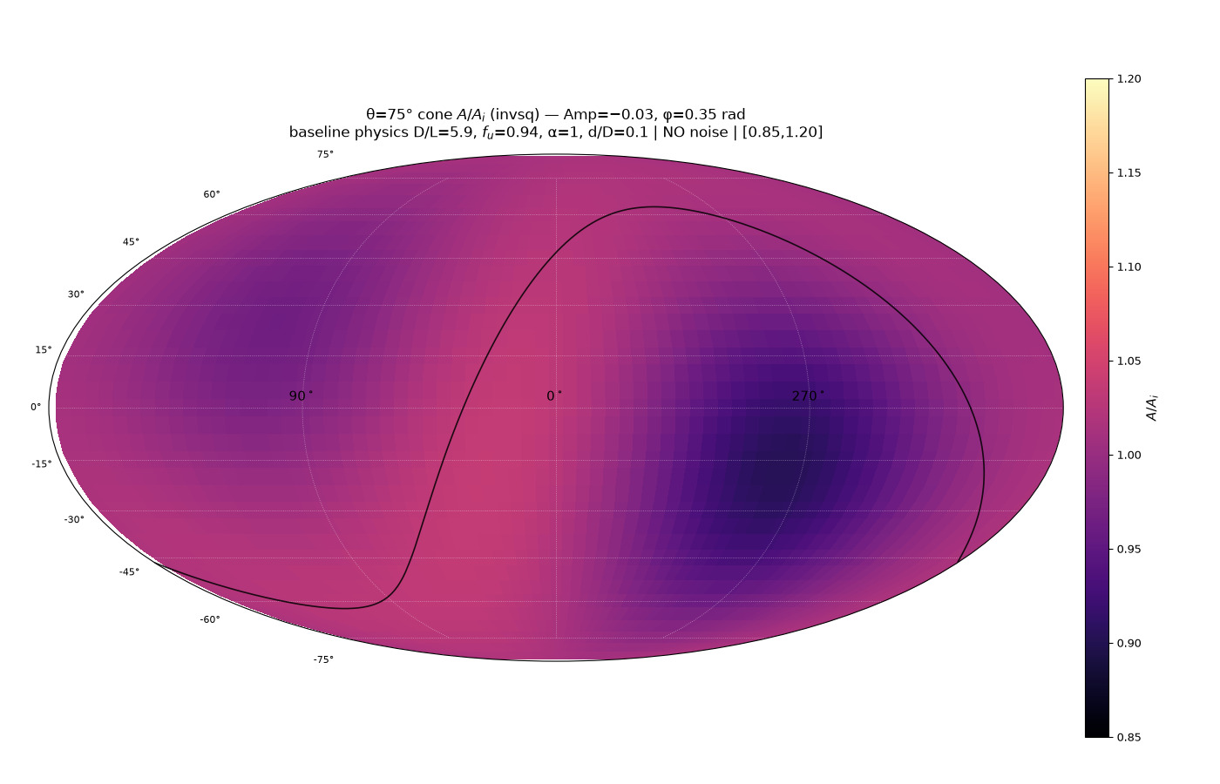
96/395 map_compare/levelset_maps/map_03_amp_m003_phi035.png

Slide 19
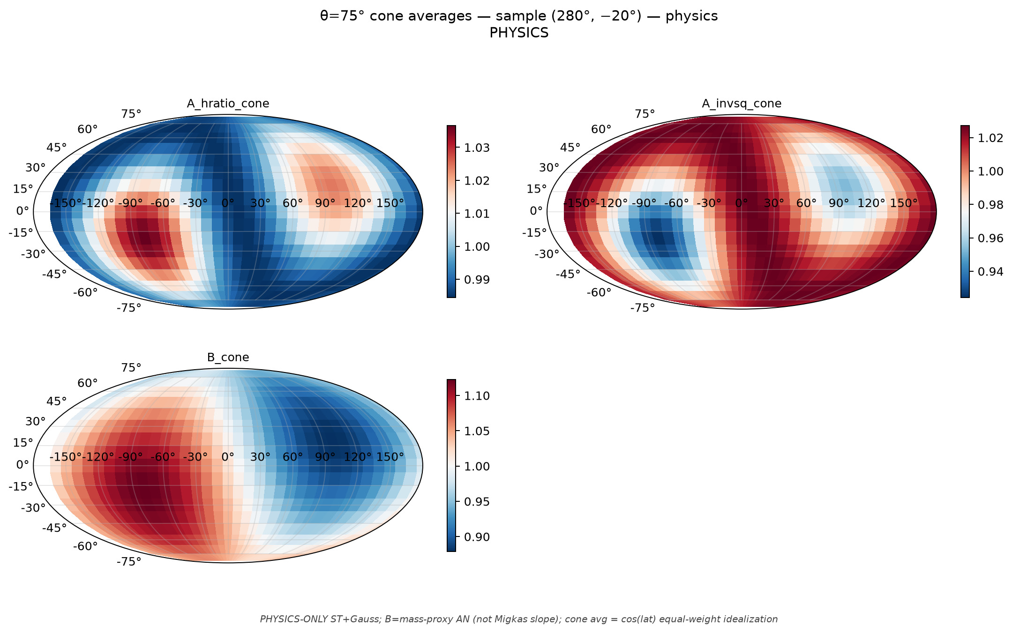
97/395 cone_scan_75/mollweide_cone75_sample_280m20__physics.png

Slide 20
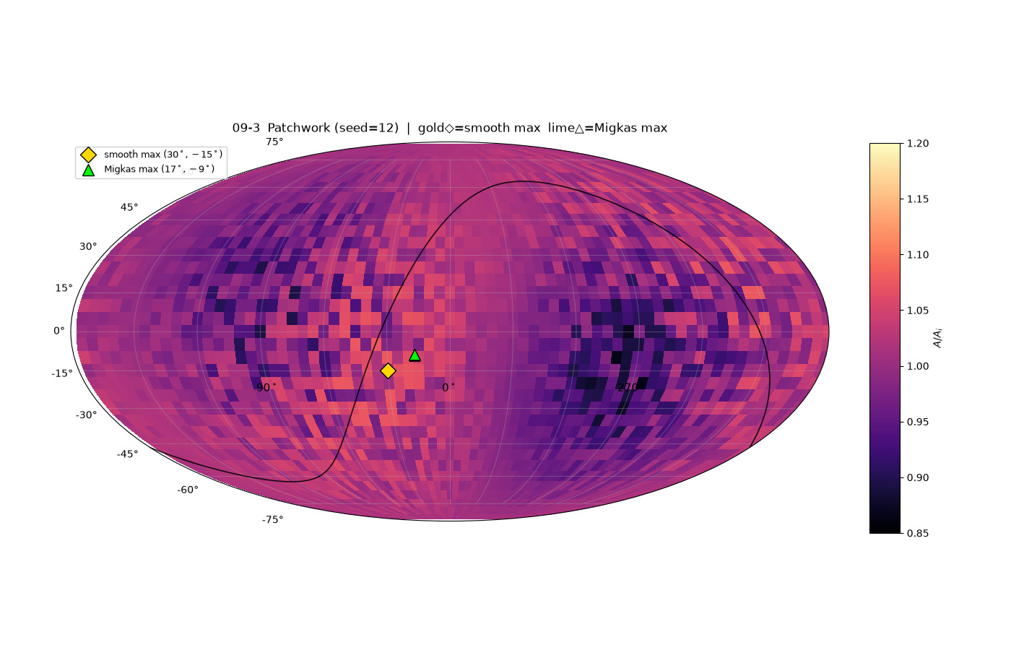
98/395 map_compare/levelset_maps/map_09_patchwork_draw3_seed12_MAXES.png

Slide 21
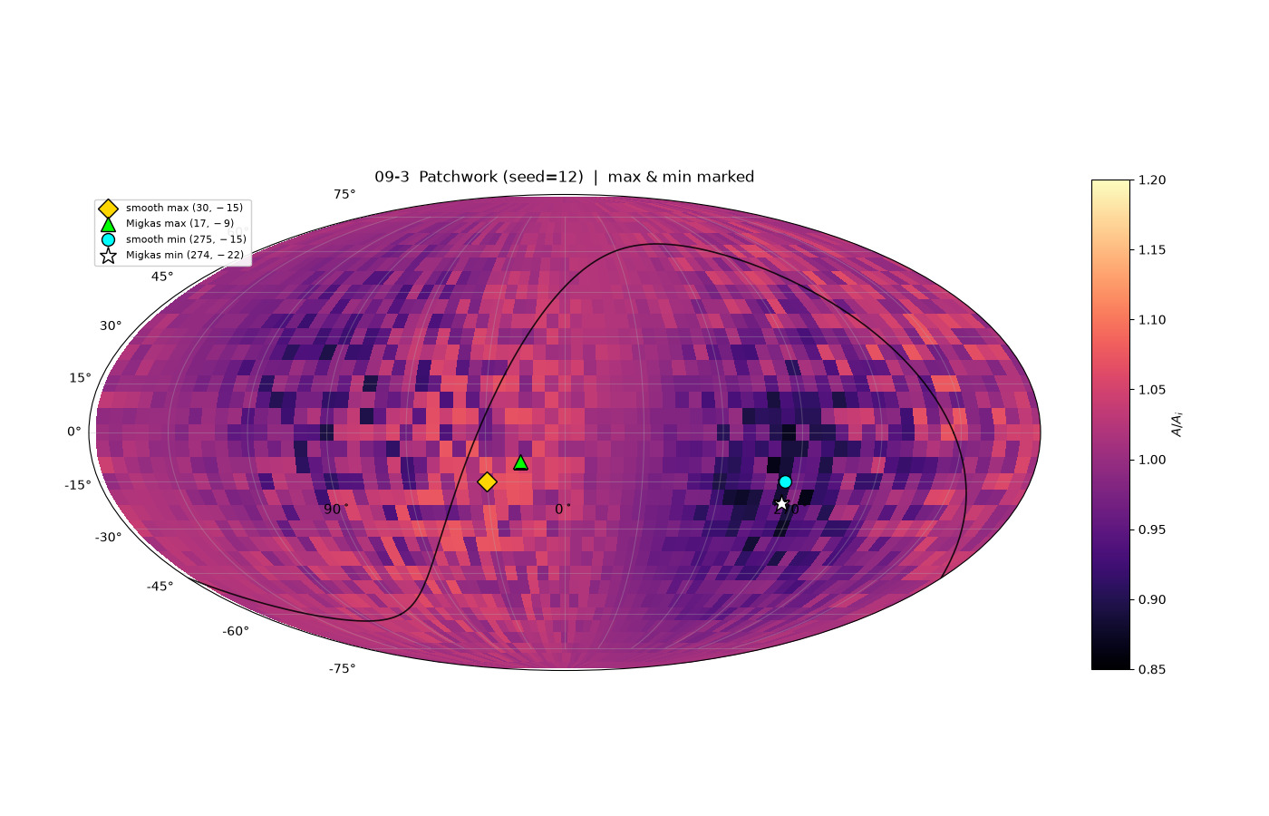
99/395 map_compare/levelset_maps/map_09_patchwork_draw3_seed12_EXTREMA.png

Slide 22
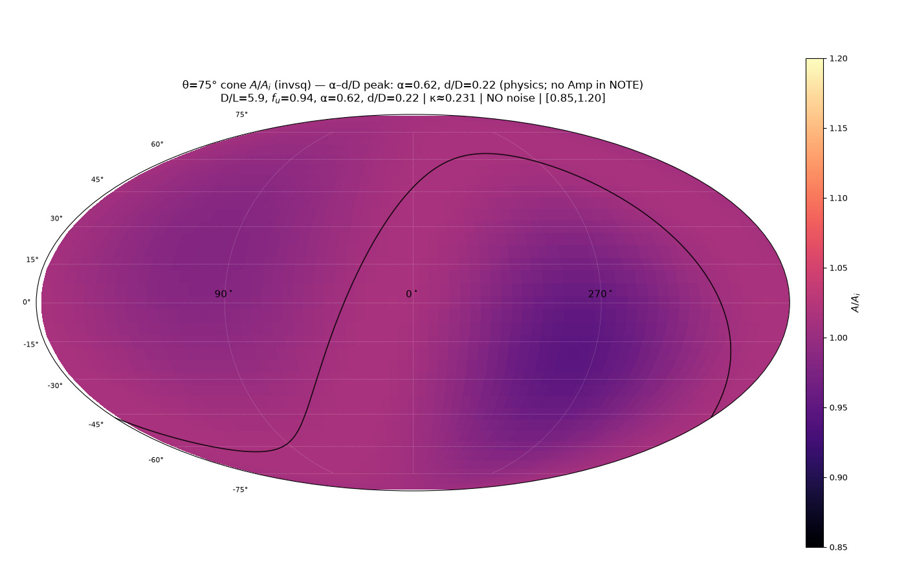
100/395 map_compare/levelset_maps/map_11_peak_alpha_eps.png

Slide 23
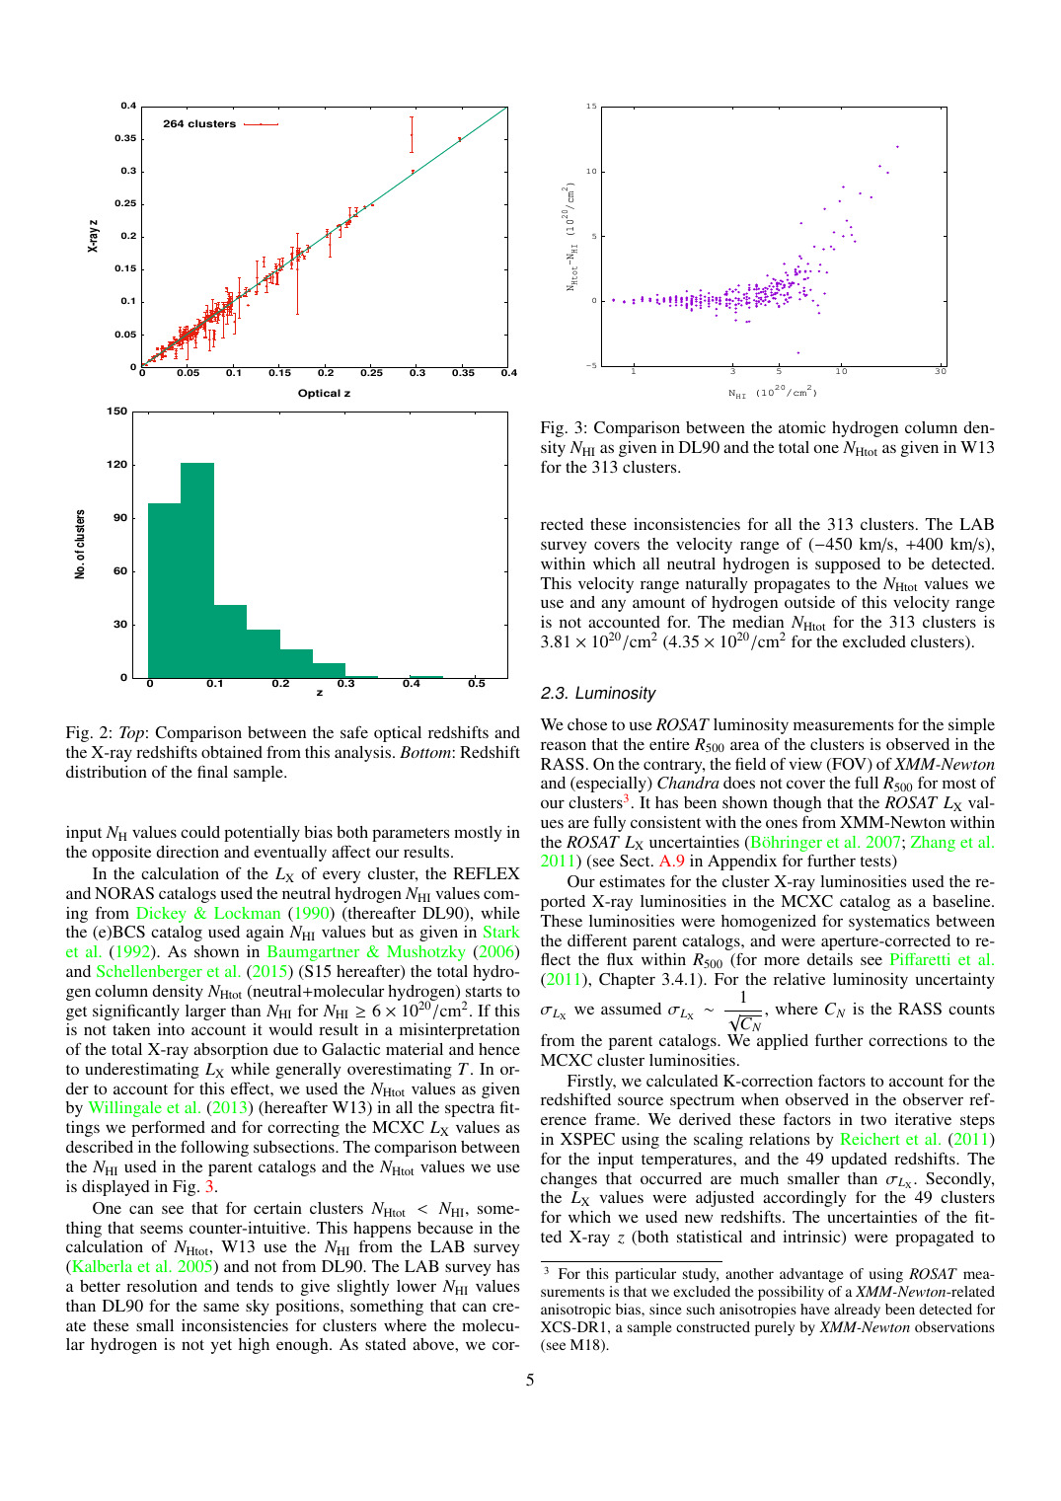
101/395 migkas/pub_maps/early-05.png

Slide 24
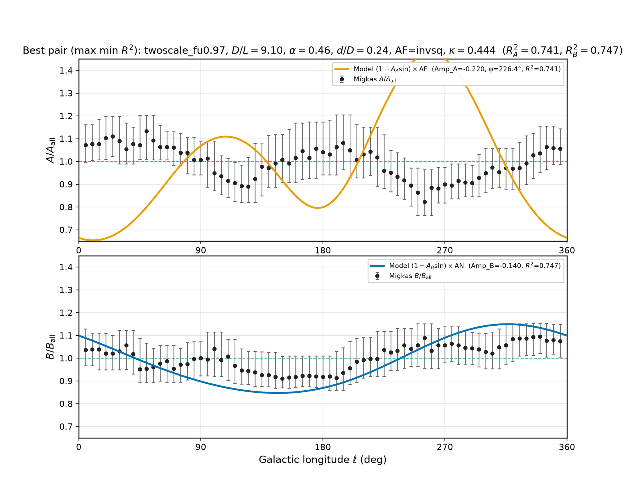
102/395 density_local_match/migkas_best_pair.png

Slide 25
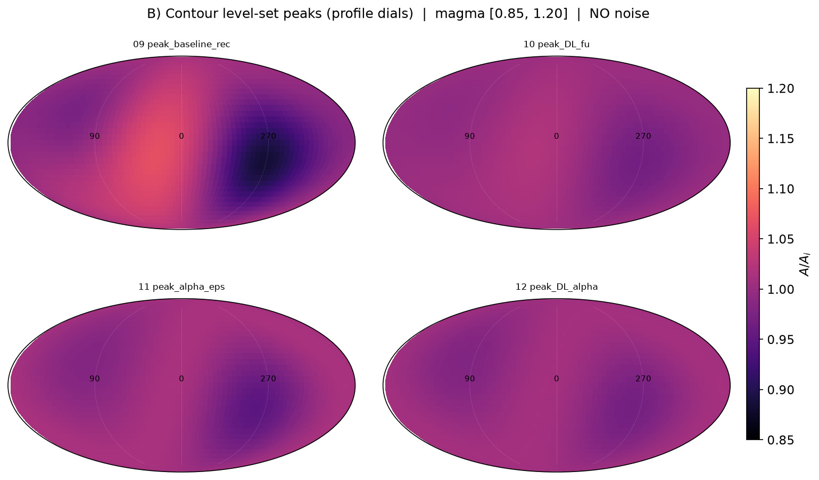
103/395 map_compare/levelset_maps/GRID_profile_peaks.png

Slide 26
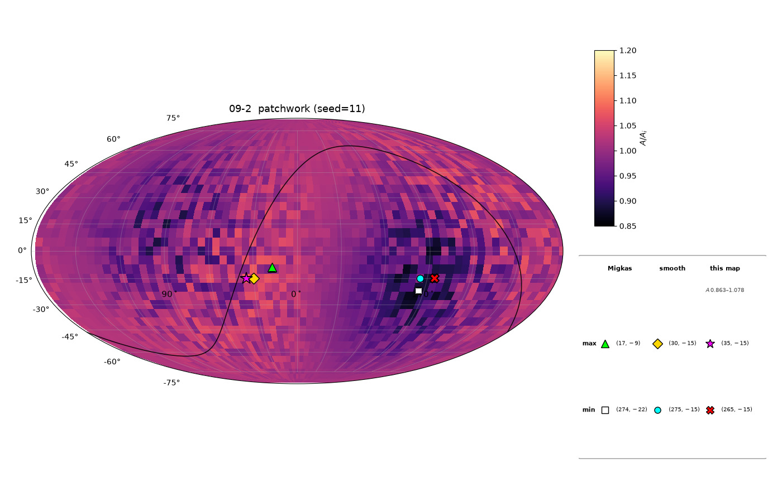
104/395 map_compare/levelset_maps/map_09_patchwork_draw2_seed11_ALL_MARKERS.png

Slide 27
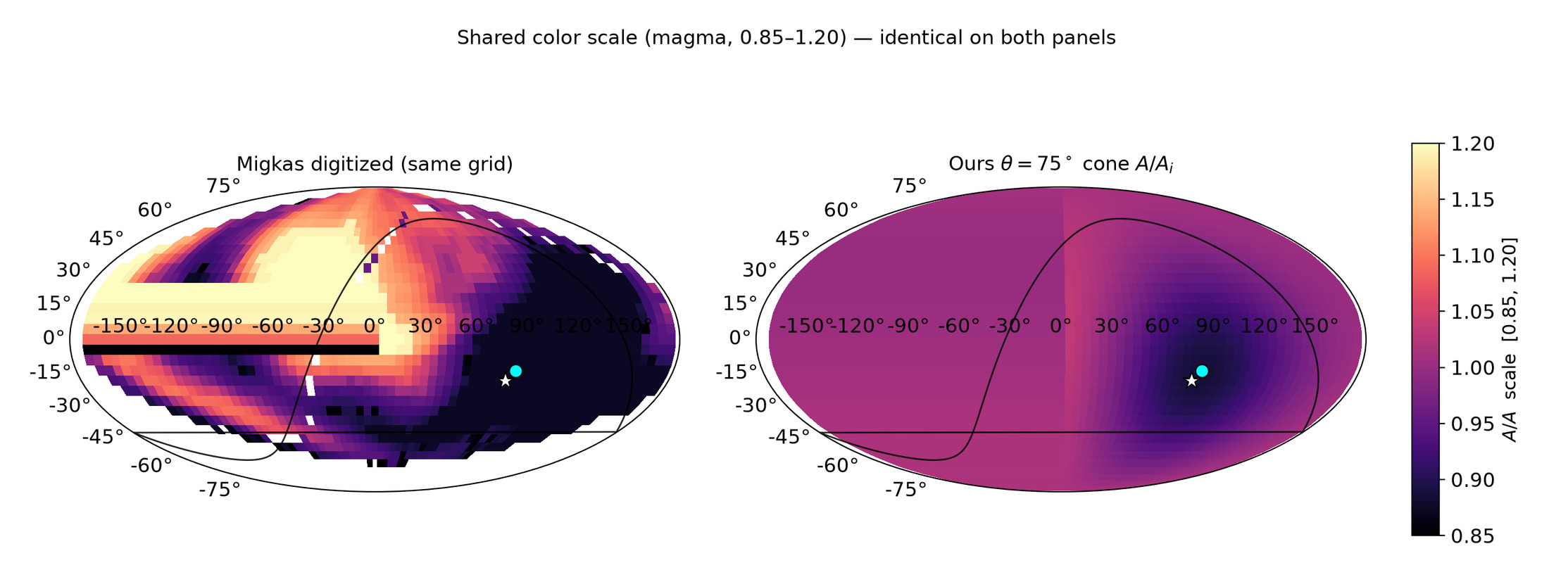
105/395 map_compare/sbs_SHARED_SCALE_both_mollweide.png

Slide 28
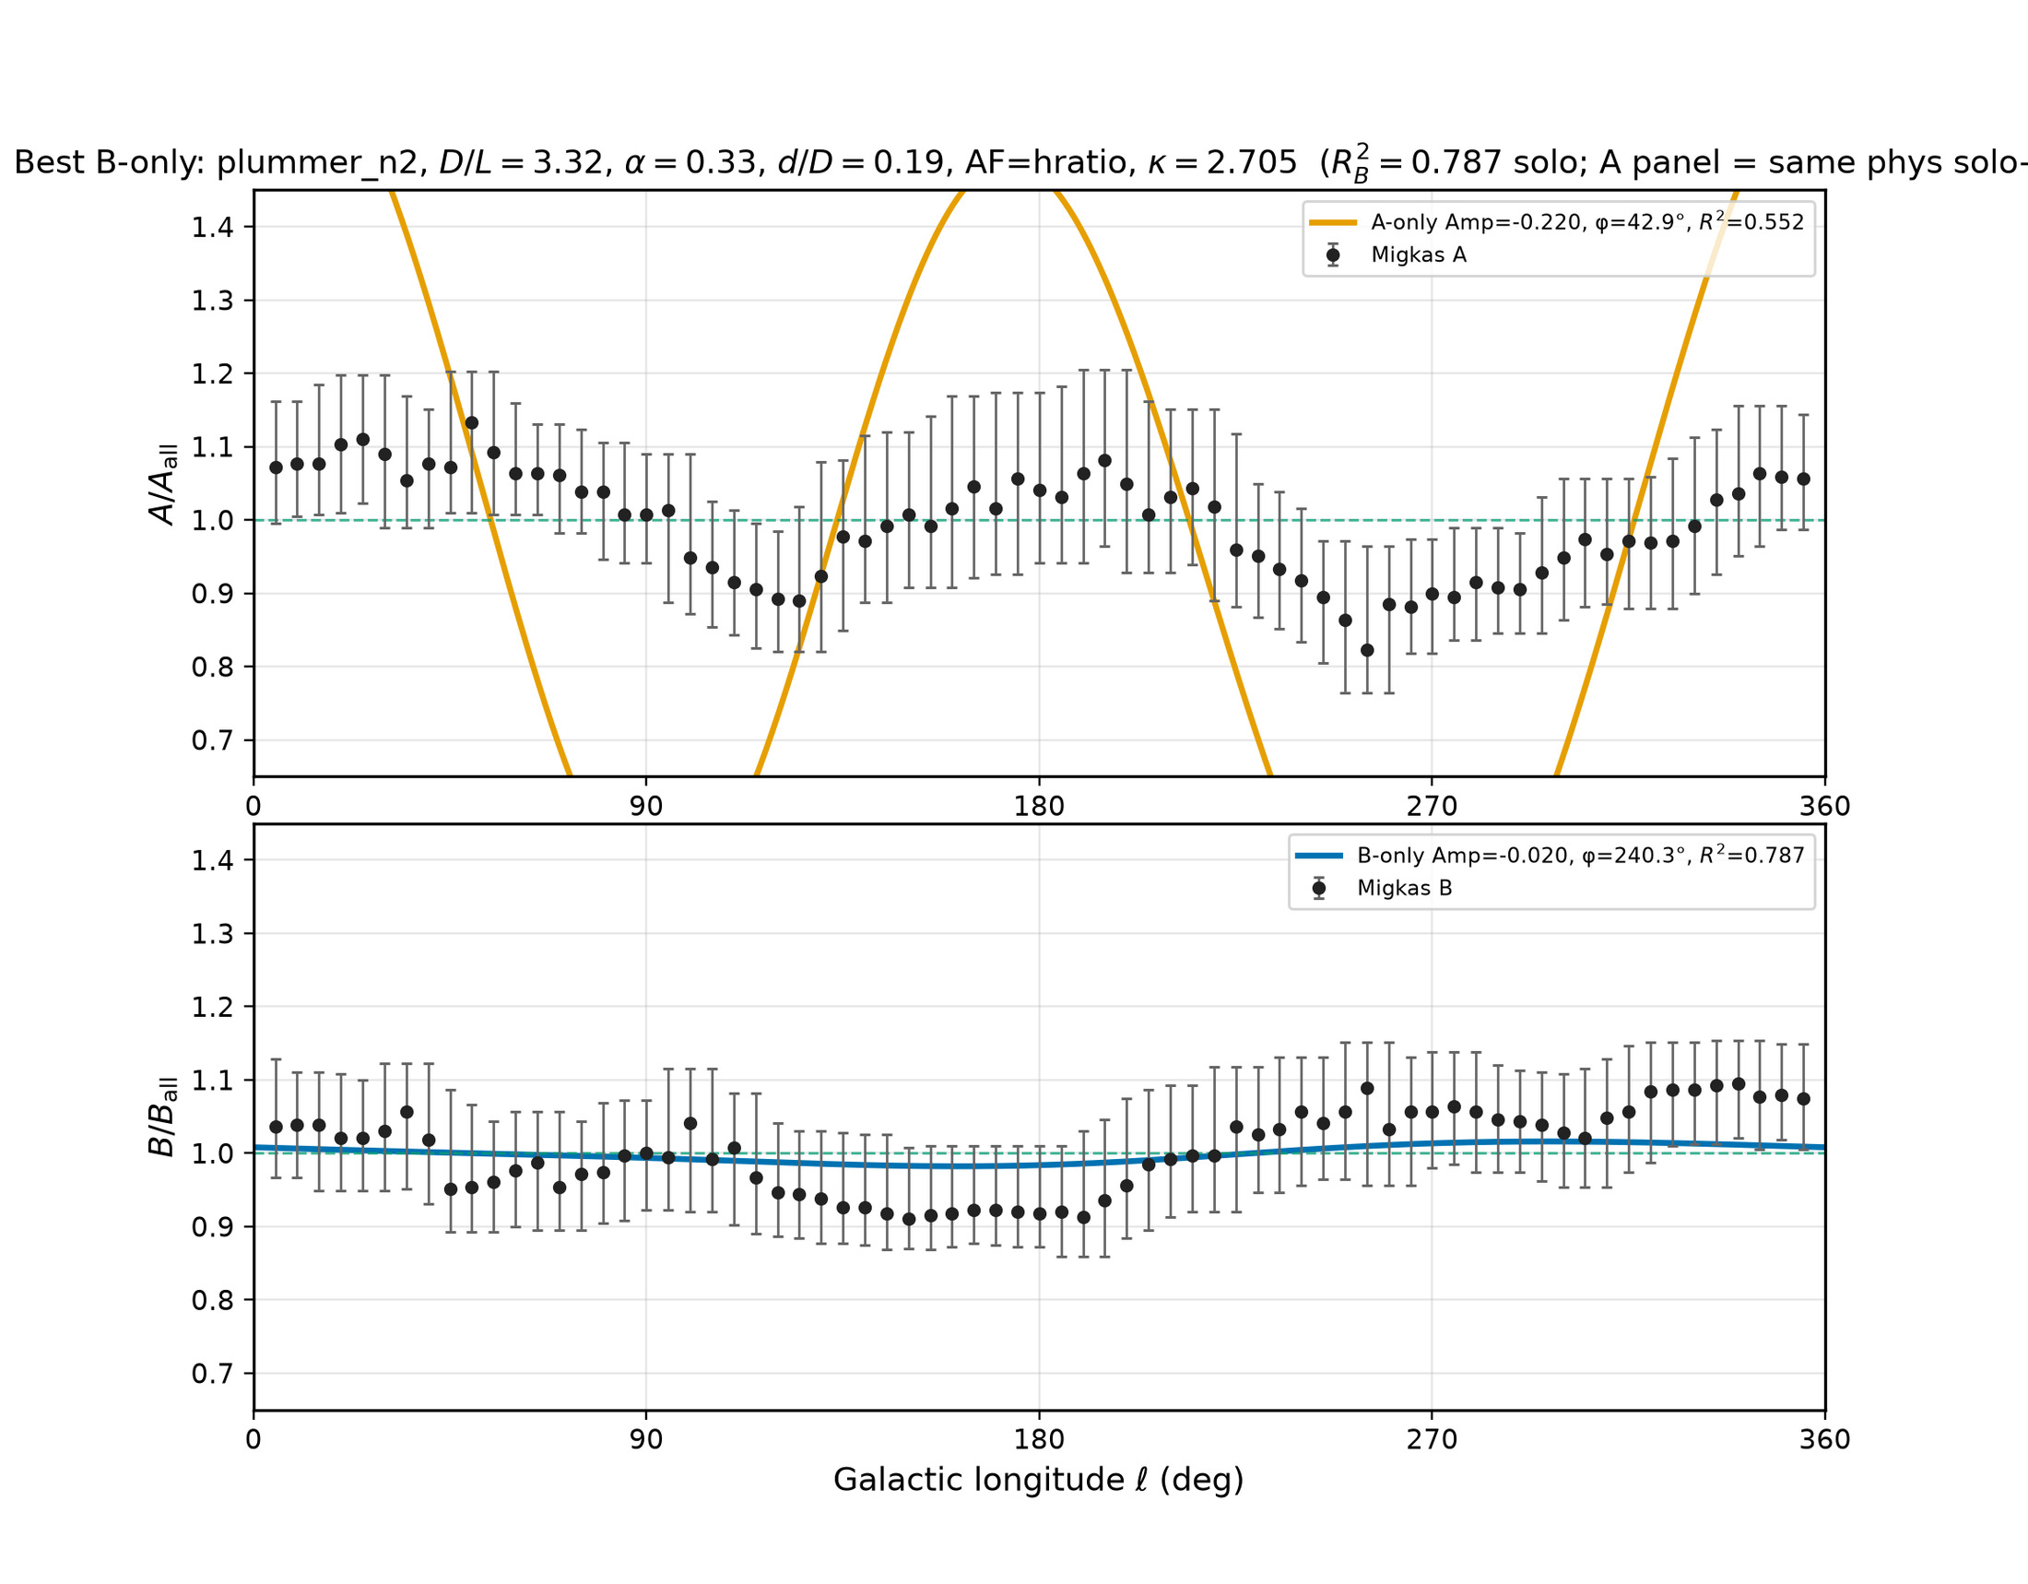
106/395 density_local_match/migkas_best_B_only.png

Slide 29
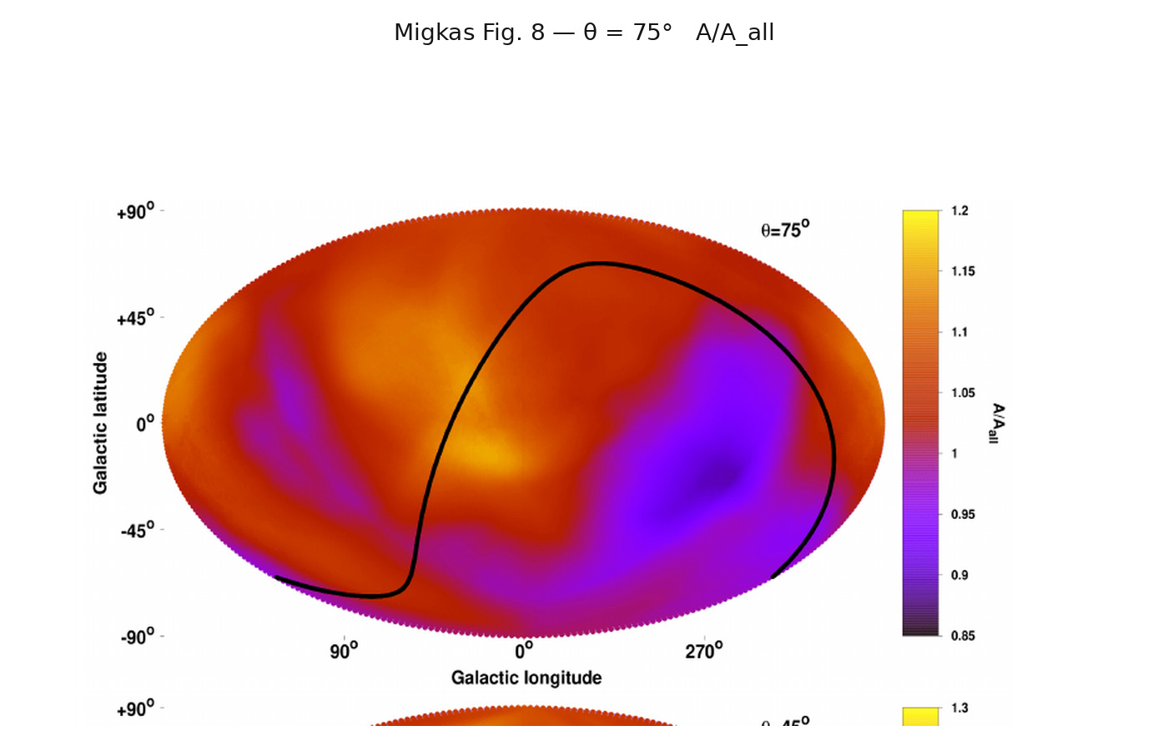
107/395 map_compare/CARD_migkas.png

Slide 30
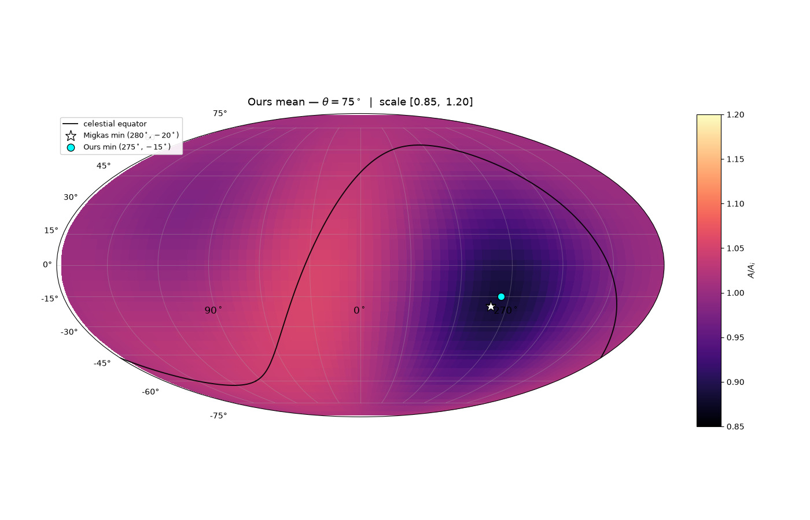
108/395 map_compare/CARD_ours.png

Slide 31
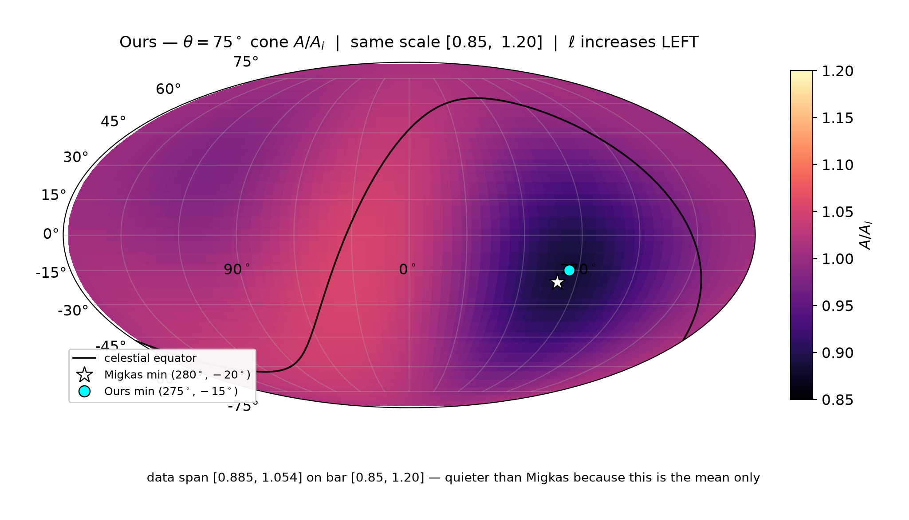
109/395 map_compare/FULL_ours_cone75_sheet.png

Slide 32
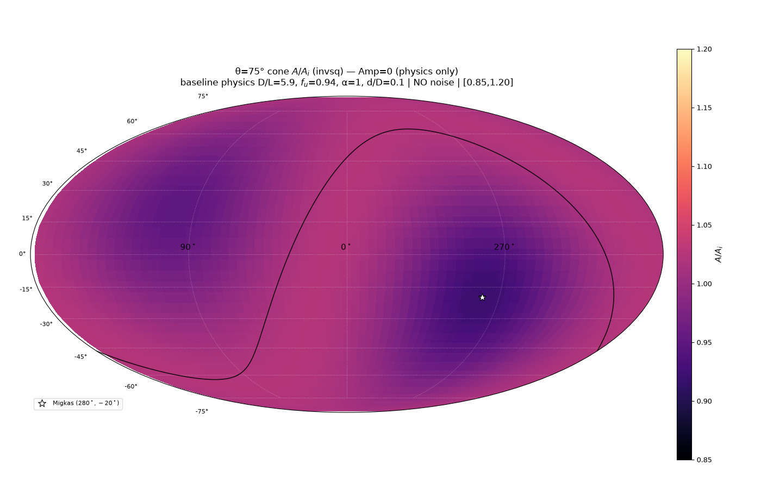
110/395 map_compare/levelset_maps/map_01_amp0_physics.png

Slide 33
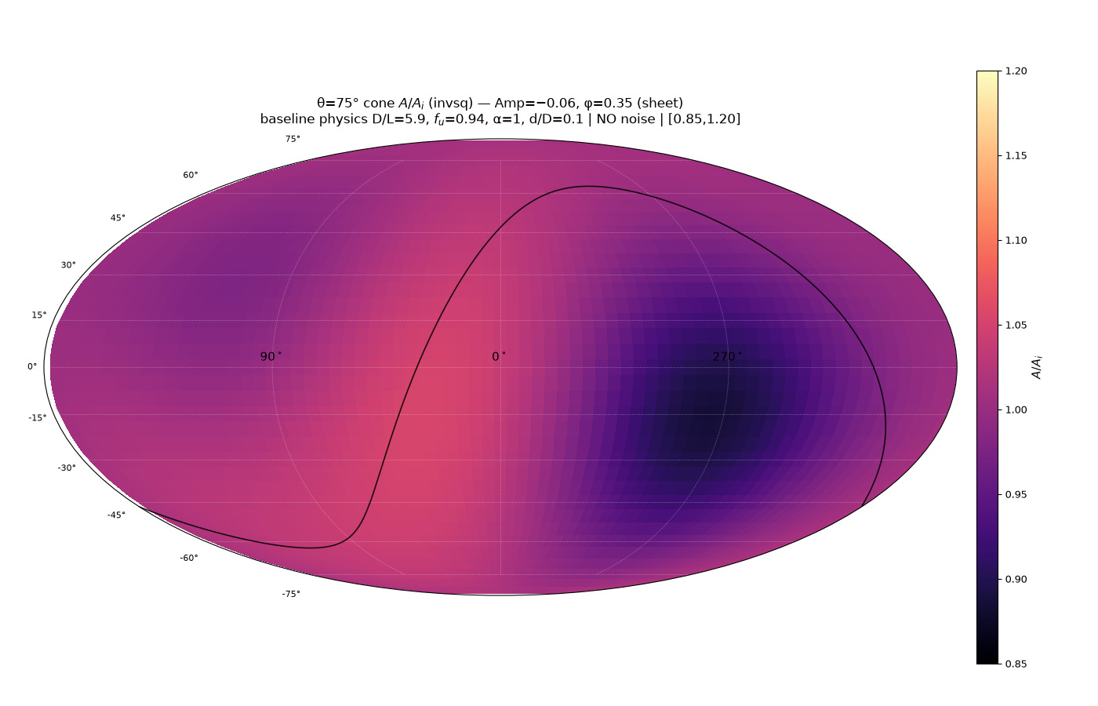
111/395 map_compare/levelset_maps/map_05_amp_m006_phi035_sheet.png

Slide 34
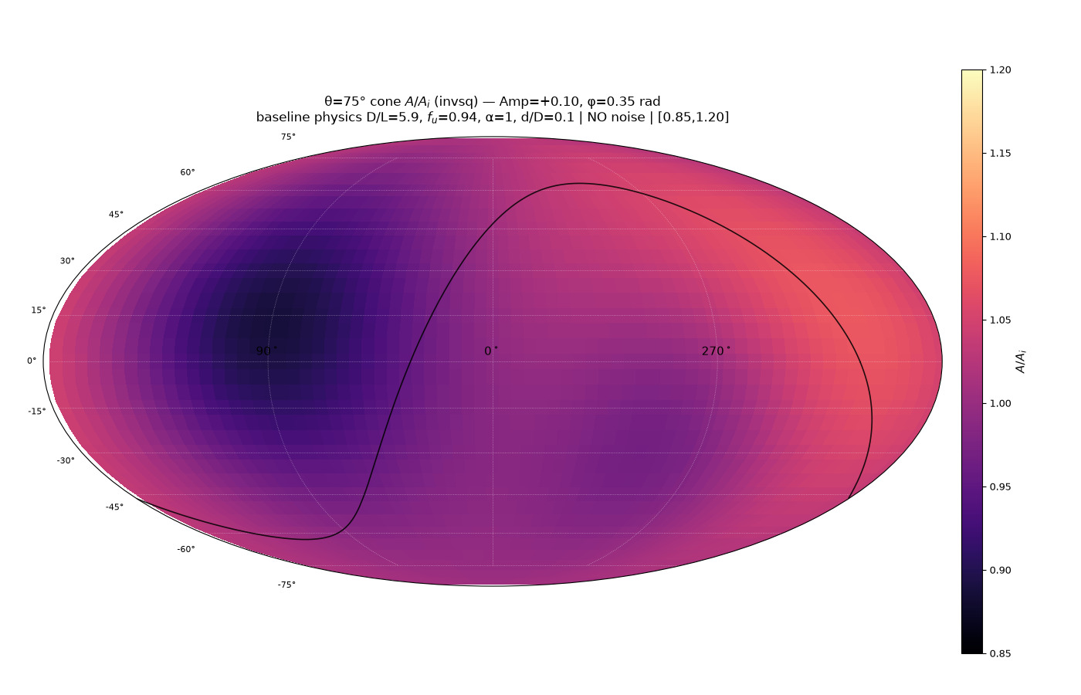
112/395 map_compare/levelset_maps/map_06_amp_p010_phi035.png

Slide 35
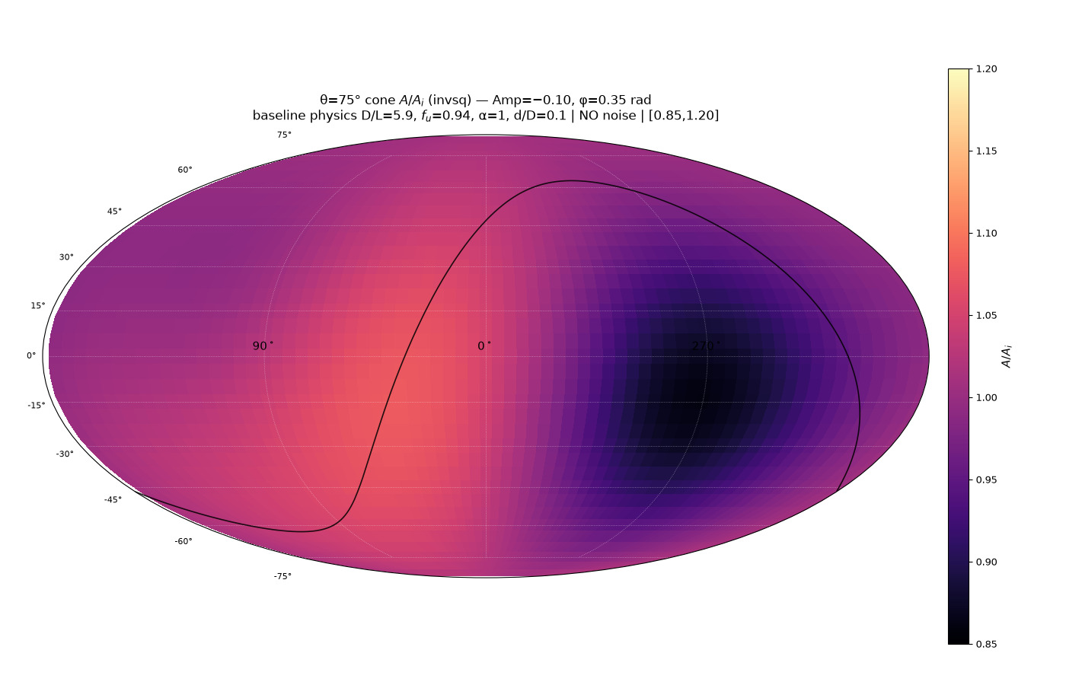
113/395 map_compare/levelset_maps/map_07_amp_m010_phi035.png

Slide 36
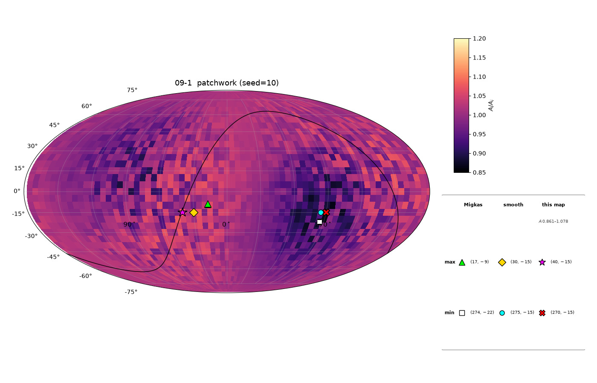
114/395 map_compare/levelset_maps/map_09_patchwork_draw1_seed10_ALL_MARKERS.png

Slide 37

115/395 map_compare/levelset_maps/map_09_patchwork_draw1_seed10_MAXES.png

Slide 38
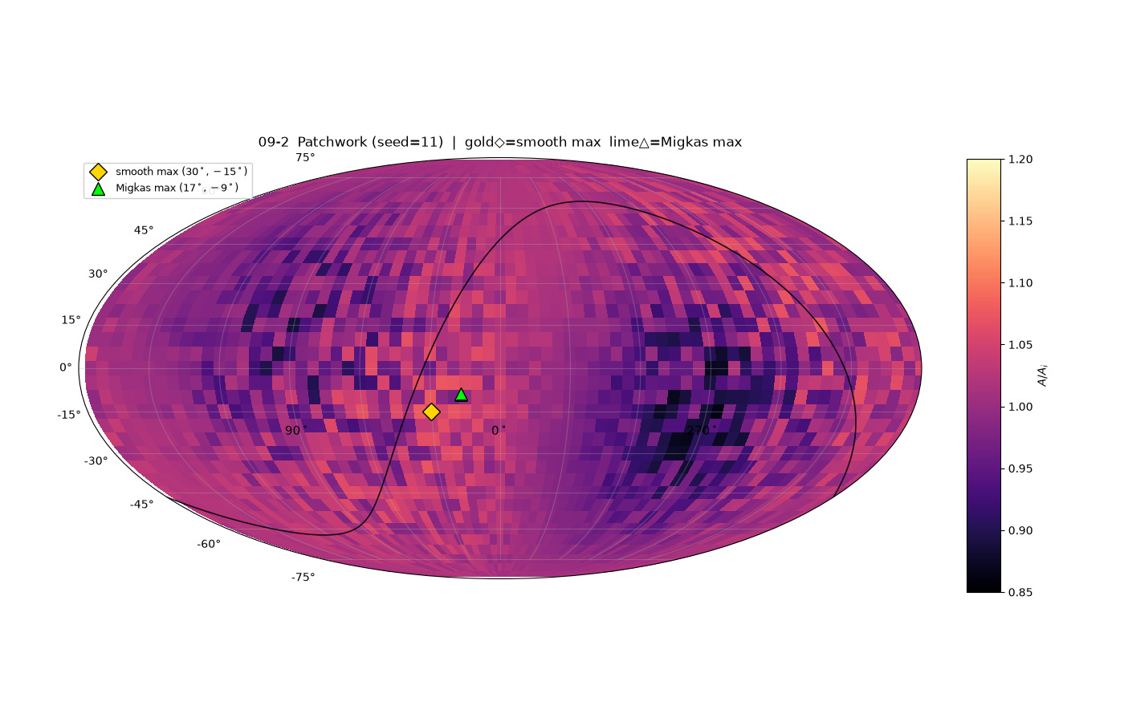
116/395 map_compare/levelset_maps/map_09_patchwork_draw2_seed11_MAXES.png

Slide 39

117/395 map_compare/levelset_maps/map_09_patchwork_draw4_seed13_ALL_MARKERS.png

Slide 40
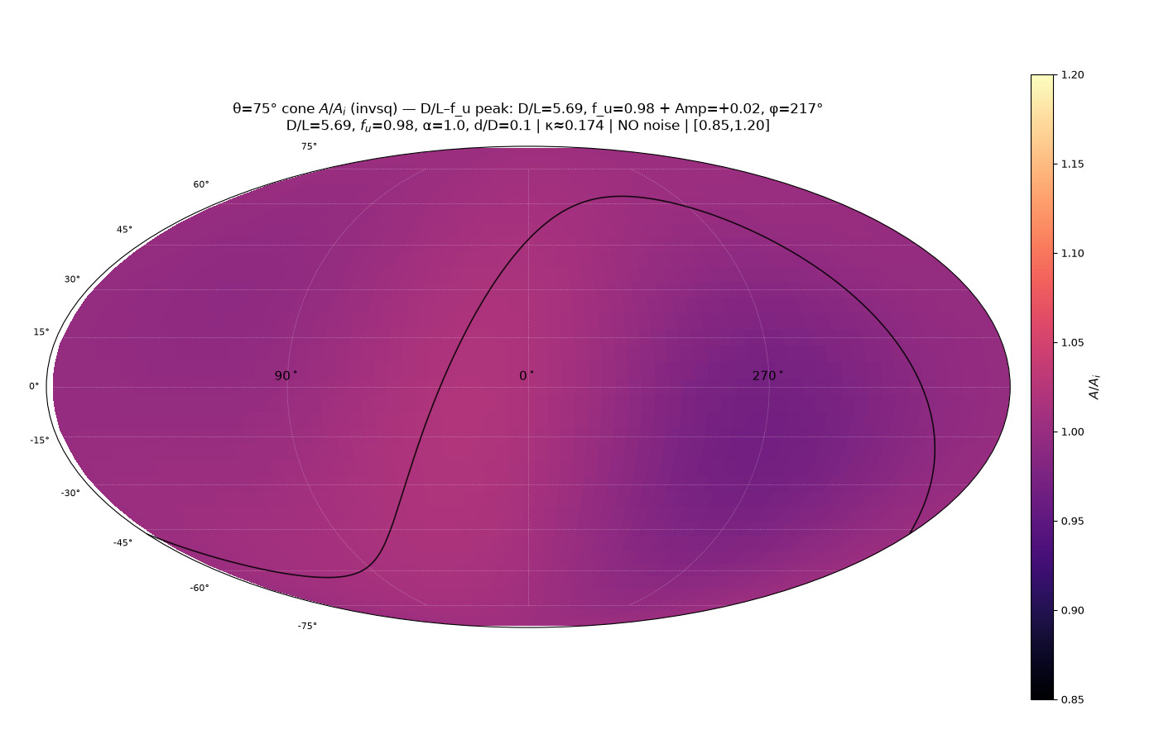
118/395 map_compare/levelset_maps/map_10_peak_DL_fu.png

Slide 41
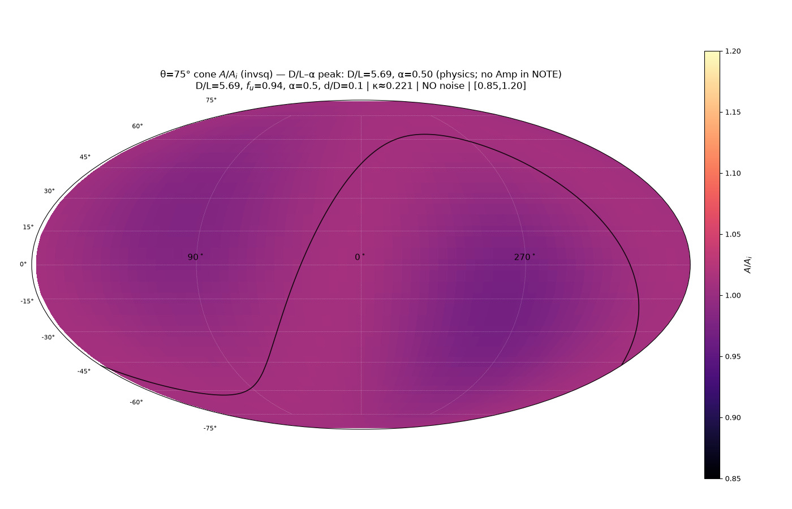
119/395 map_compare/levelset_maps/map_12_peak_DL_alpha.png

Slide 42
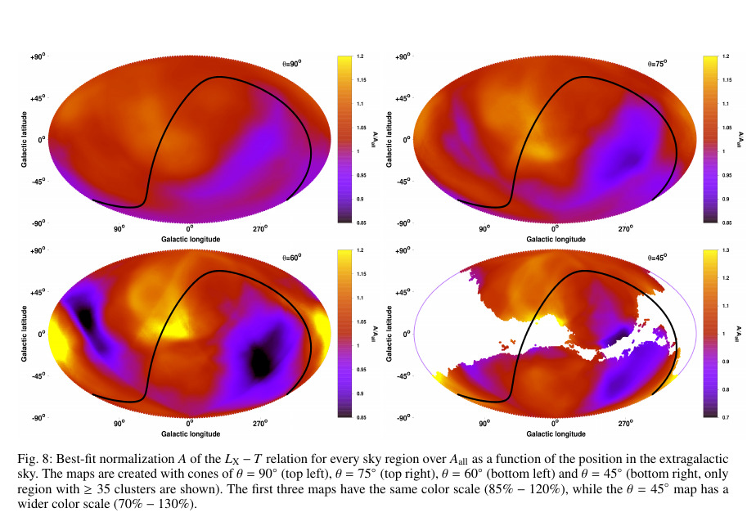
120/395 migkas/pub_maps/Fig8_A_cones_all_theta.png

Slide 43
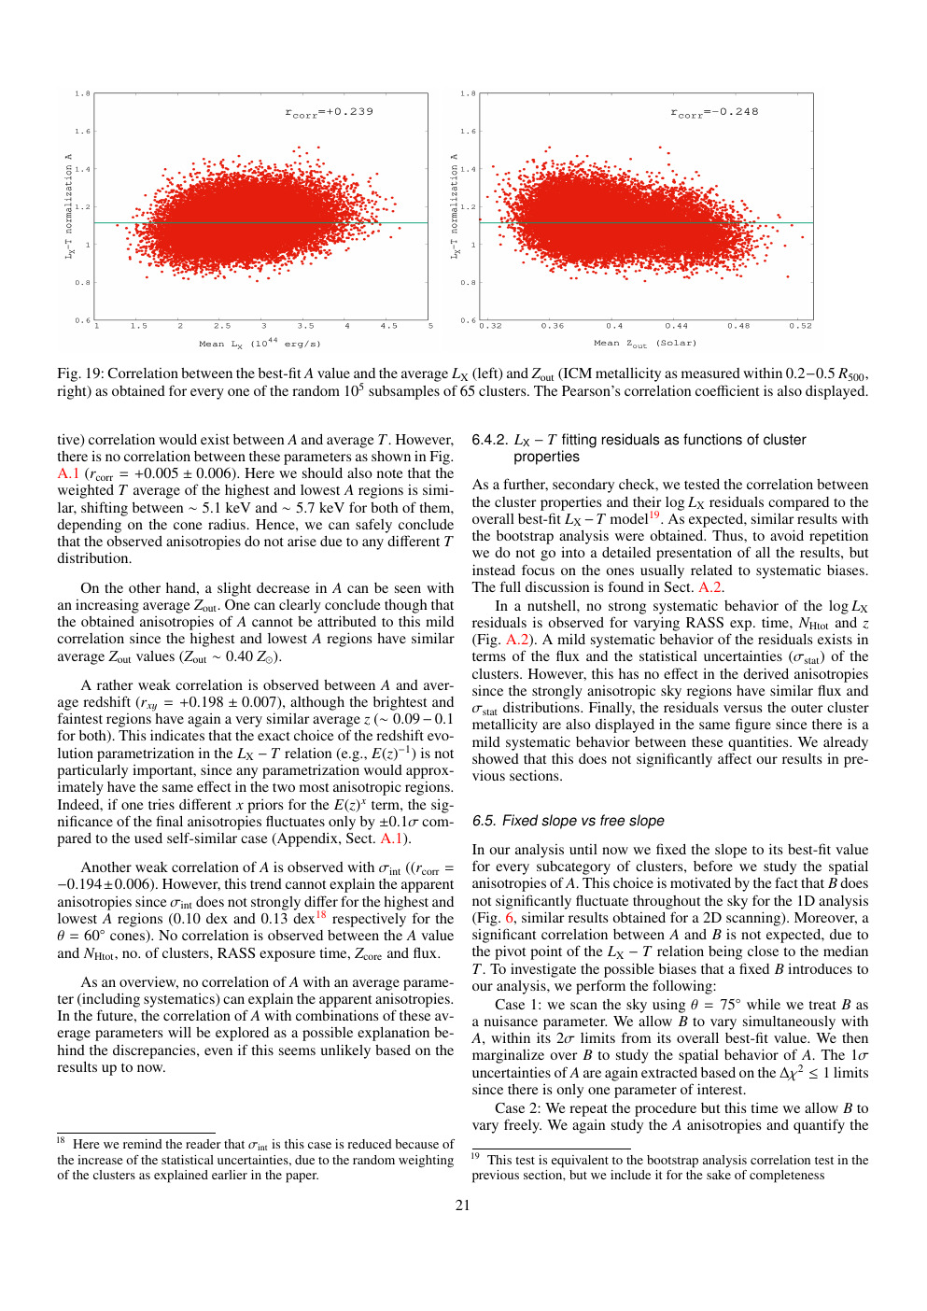
121/395 migkas/pub_maps/p-21.png

Slide 44
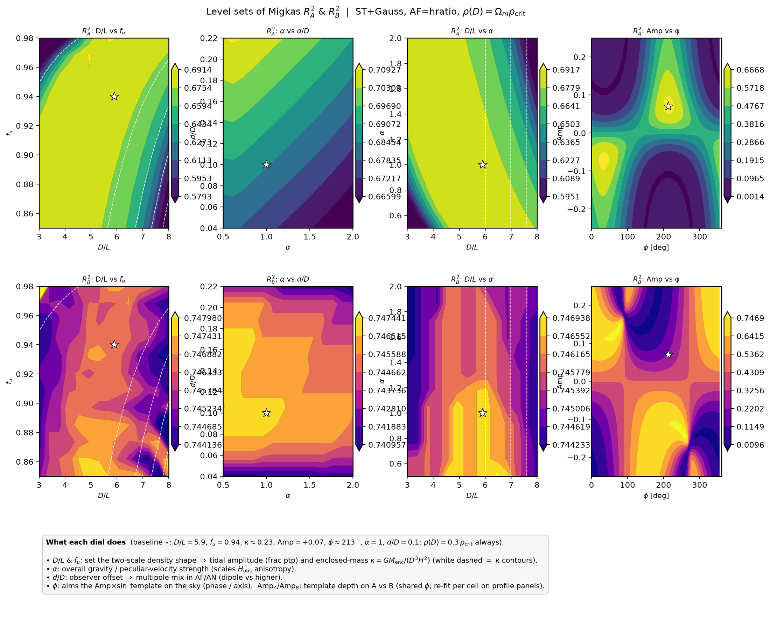
122/395 density_local_match/level_sets/levelsets_summary.png

Slide 45
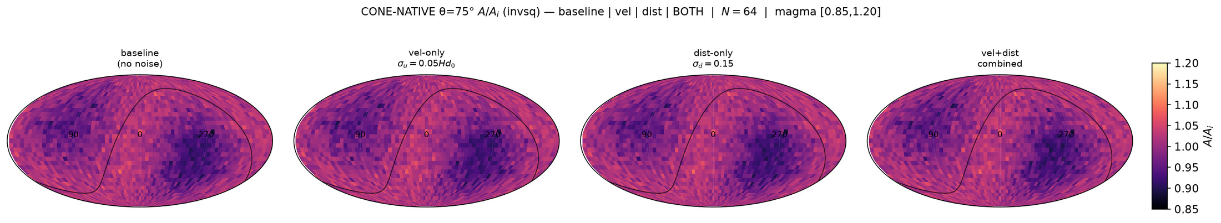
123/395 map_compare/cone_param_noise/STRIP_baseline_vel_dist_both_invsq.png

Slide 46
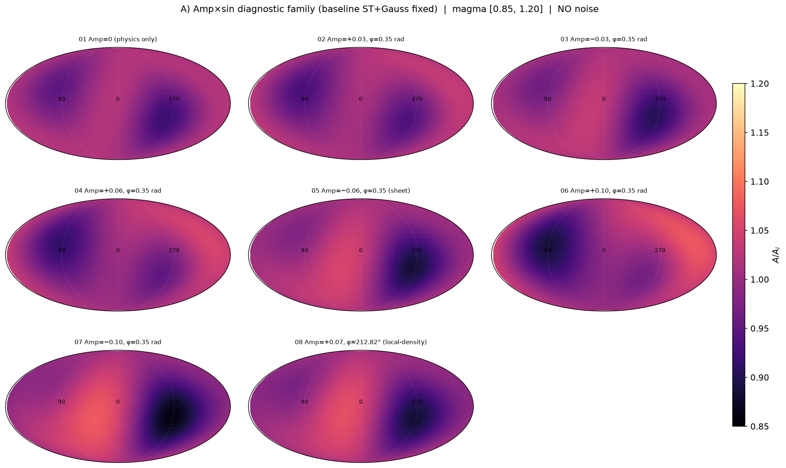
124/395 map_compare/levelset_maps/GRID_amp_family.png

Slide 47

125/395 map_compare/levelset_maps/map_09_patchwork_draw1_seed10_EXTREMA.png

Slide 48

126/395 map_compare/levelset_maps/map_09_patchwork_draw3_seed12_ALL_MARKERS.png

Slide 49

127/395 map_compare/levelset_maps/map_09_patchwork_draw3_seed12_OWN_EXTREMA.png

Slide 50

128/395 map_compare/levelset_maps/map_09_patchwork_draw4_seed13_EXTREMA.png

Slide 51

129/395 map_compare/levelset_maps/map_09_patchwork_draw4_seed13_MAXES.png

Slide 52

130/395 map_compare/levelset_maps/map_09_patchwork_draw4_seed13_OWN_EXTREMA.png

Slide 53

131/395 map_compare/levelset_maps/map_09_peak_baseline_rec.png

Slide 54
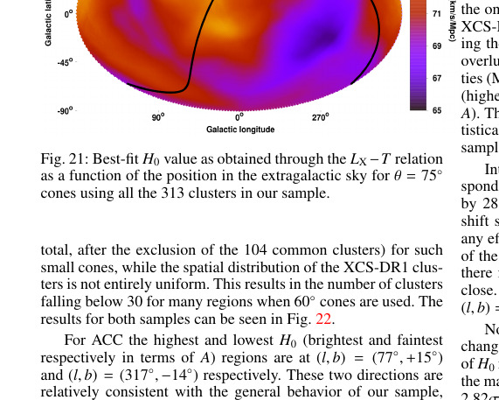
132/395 migkas/pub_maps/Fig21_H0_map.png

Slide 55
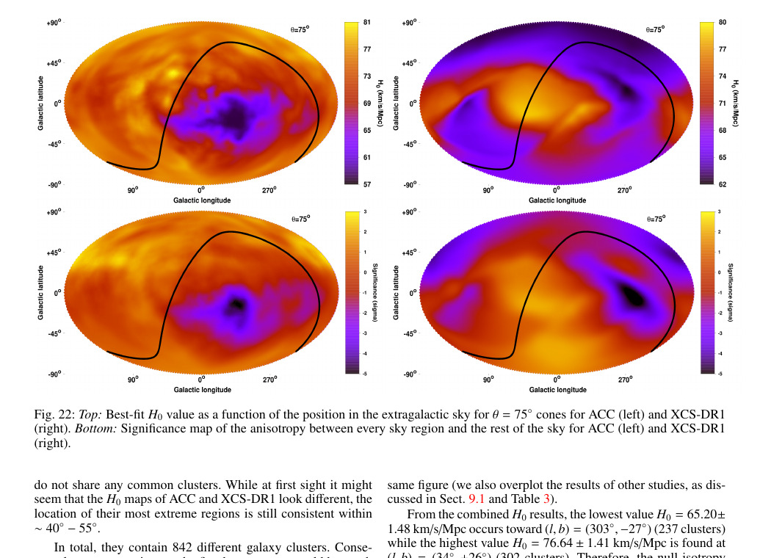
133/395 migkas/pub_maps/Fig21_page_region.png

Slide 56
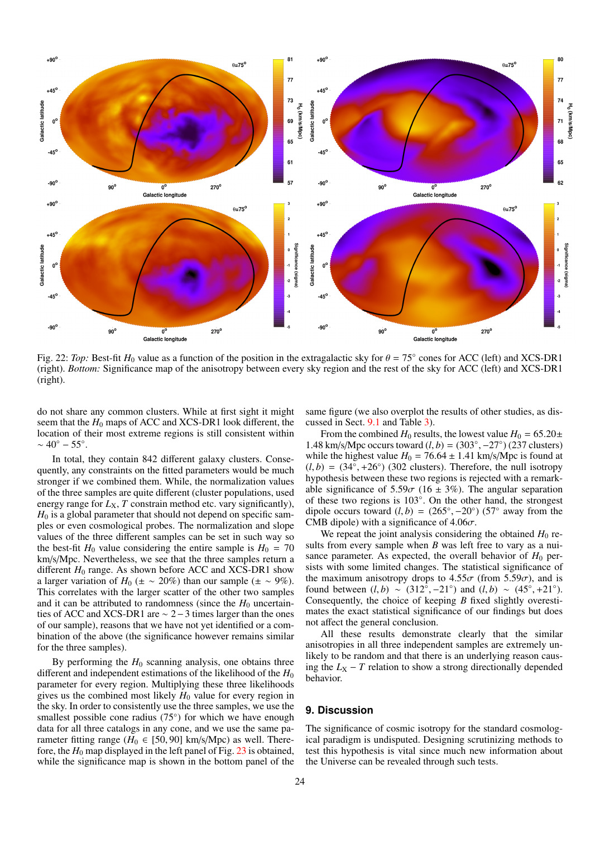
134/395 migkas/pub_maps/h0-24.png

Slide 57
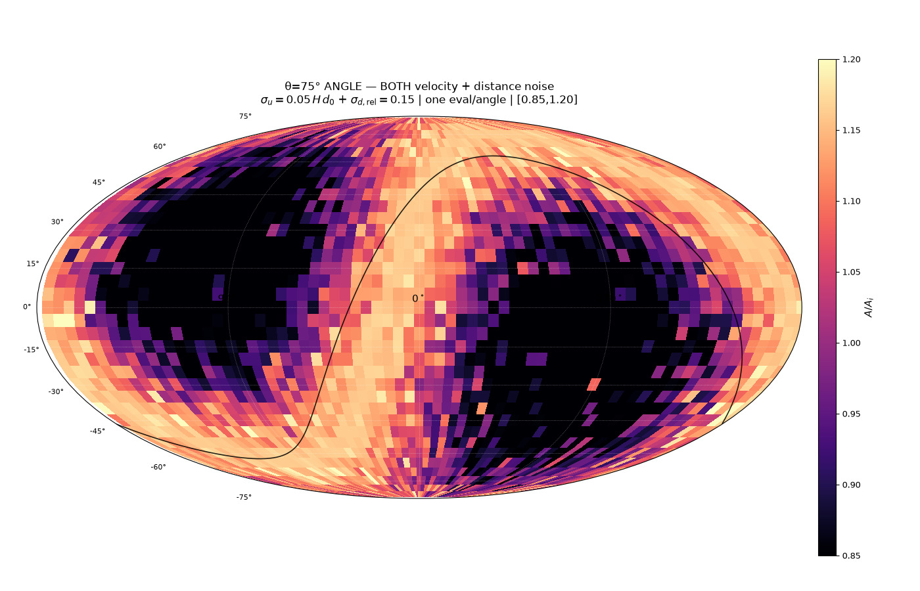
135/395 map_compare/cone_param_noise/CARD_cone75_angle_vel_dist_combined_invsq.png

Slide 58
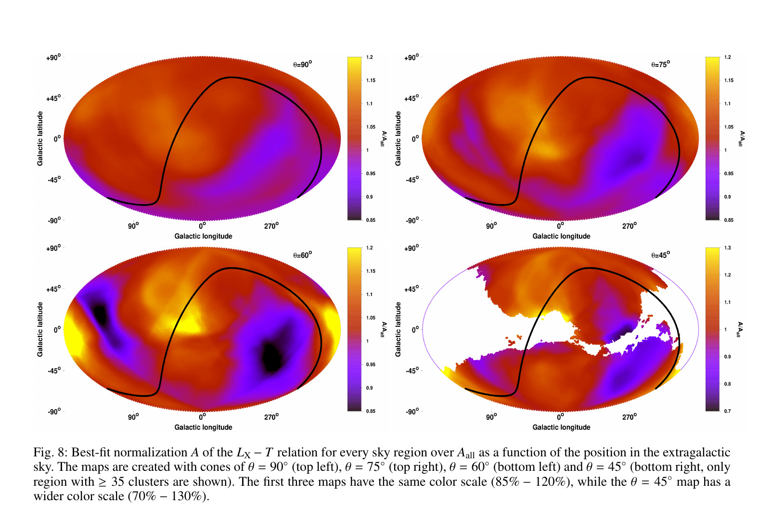
136/395 map_compare/migkas_fig8_uncropped.png

Slide 59
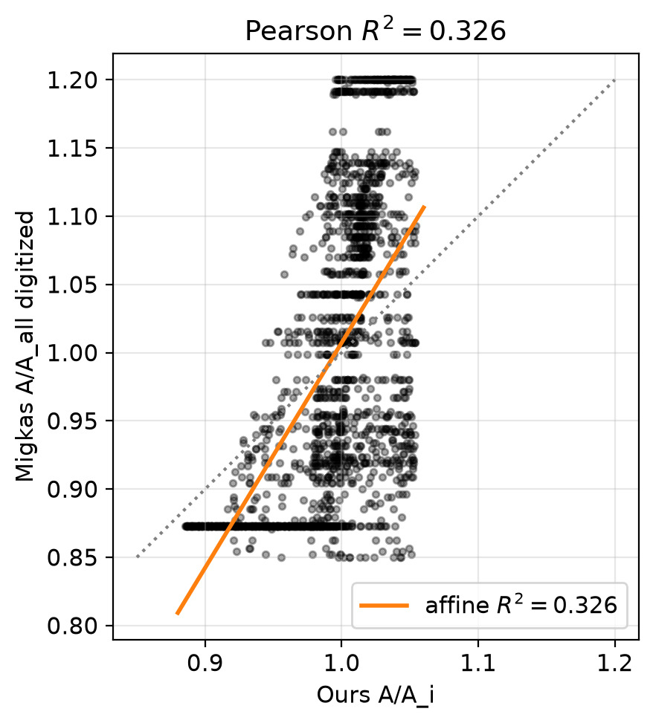
137/395 map_compare/surface_R2_scatter.png

Slide 60
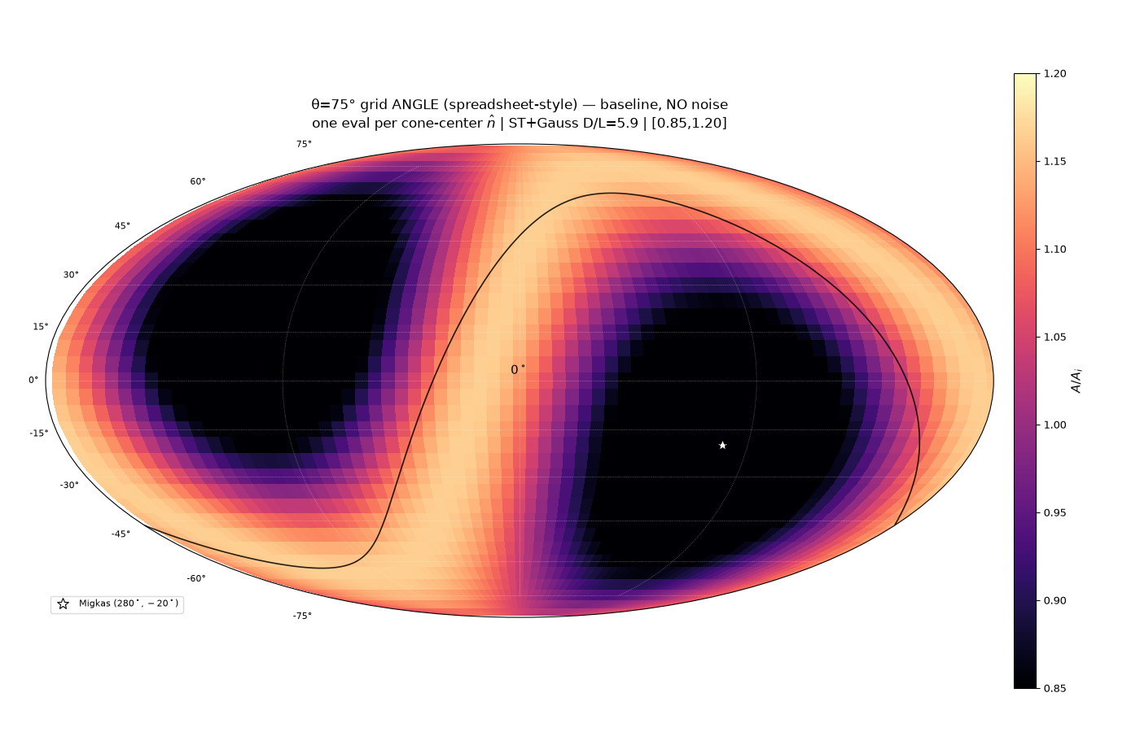
138/395 map_compare/cone_param_noise/CARD_cone75_angle_baseline_invsq.png

Slide 61
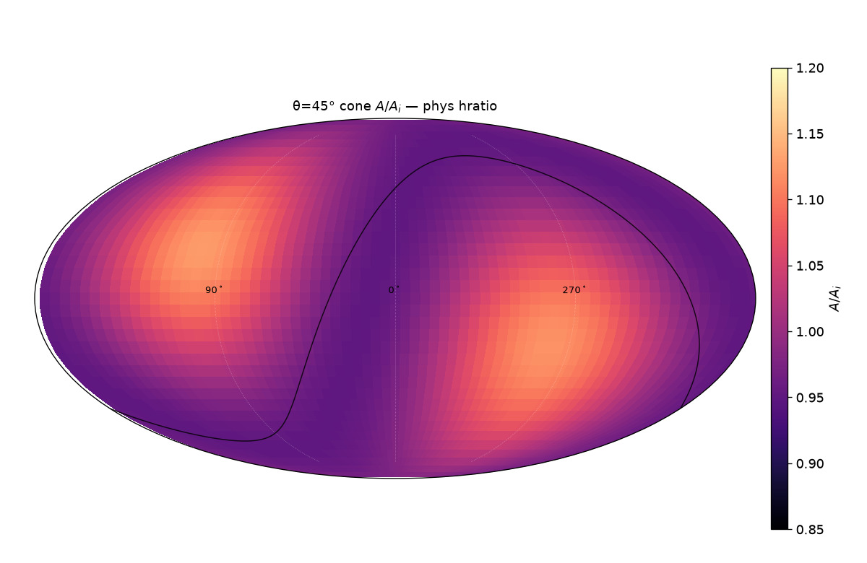
139/395 map_compare/cone_thetas/cards/theta45_phys_hratio.png

Slide 62

140/395 map_compare/cone_thetas/cards/theta75_phys_hratio.png

Slide 63

141/395 migkas/pub_maps/early-03.png

Slide 64

142/395 migkas/pub_maps/p-12.png

Slide 65

143/395 migkas/pub_maps/p-13.png

Slide 66

144/395 migkas/pub_maps/p-14.png

Slide 67

145/395 migkas/pub_maps/p-23.png

Slide 68

146/395 map_compare/FULL_migkas_theta75.png

Slide 69

147/395 map_compare/STACKED_migkas_vs_ours.png

Slide 70

148/395 map_compare/cone_param_noise/CARD_cone75_angle_dist_s15_invsq.png

Slide 71

149/395 map_compare/cone_param_noise/CARD_cone75_angle_vel_radial_s05_invsq.png

Slide 72

150/395 map_compare/levelset_maps/map_09_patchwork_draw2_seed11_EXTREMA.png

Slide 73

151/395 migkas/pub_maps/h0-23.png

Slide 74

152/395 migkas/pub_maps/p-15.png

Slide 75

153/395 migkas/pub_maps/p-22.png

Slide 76

154/395 map_compare/cone_thetas/cards/theta45_sheet_hratio.png

Slide 77

155/395 map_compare/cone_thetas/cards/theta60_phys_invsq.png

Slide 78

156/395 map_compare/cone_thetas/cards/theta60_sheet_hratio.png

Slide 79

157/395 map_compare/cone_thetas/cards/theta75_sheet_invsq.png

Slide 80

158/395 migkas/pub_maps/p-16.png

