Slide 1
Cosmology figures — Part 3 of 5 (by PNG creation order)
PNG slides 159–237 of 395 | mtime range: 2026-09-20 20:05:52 CDT – 2026-09-20 20:05:52 CDT
79 PNG image slides

Slide 2
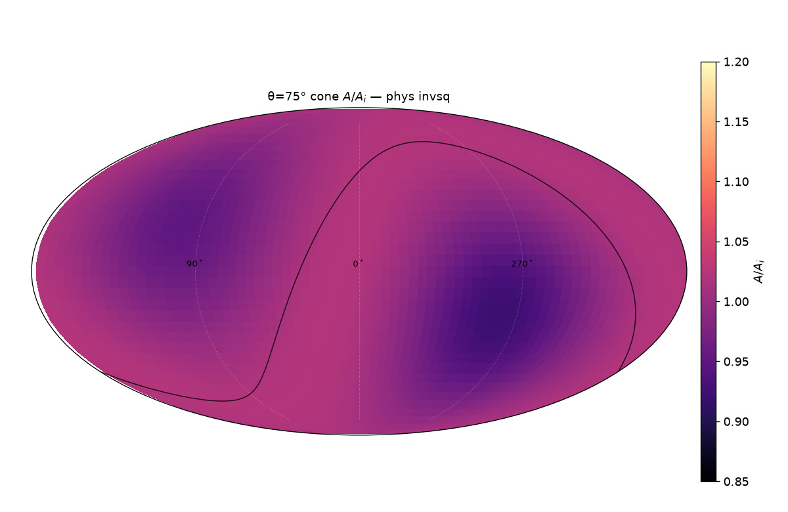
159/395 map_compare/cone_thetas/cards/theta75_phys_invsq.png

Slide 3
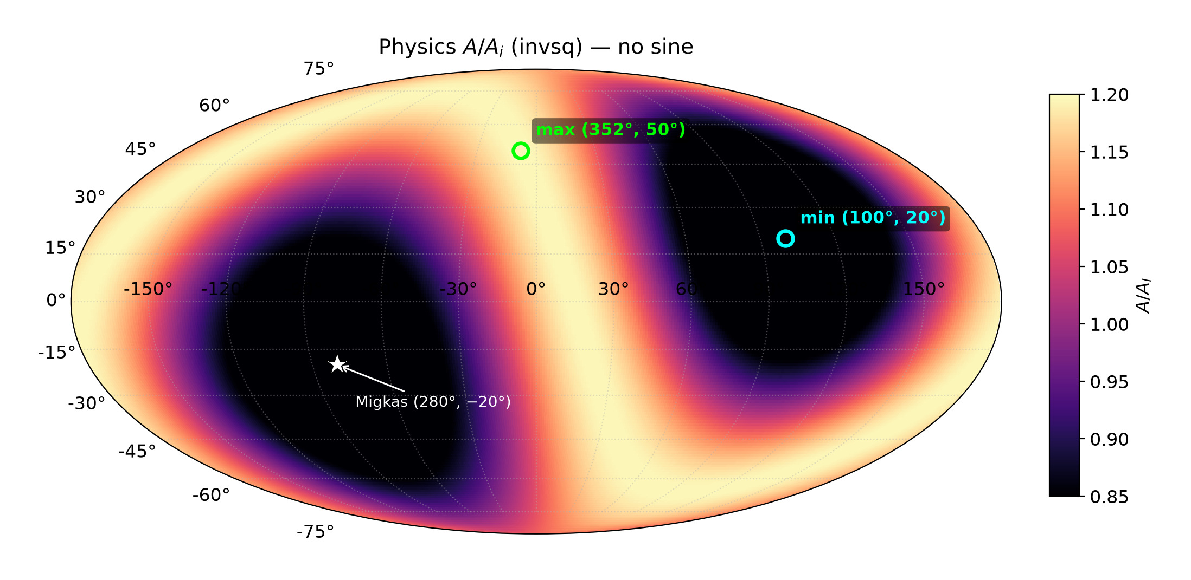
160/395 map_compare/01_physics_invsq_A_over_Ai.png

Slide 4
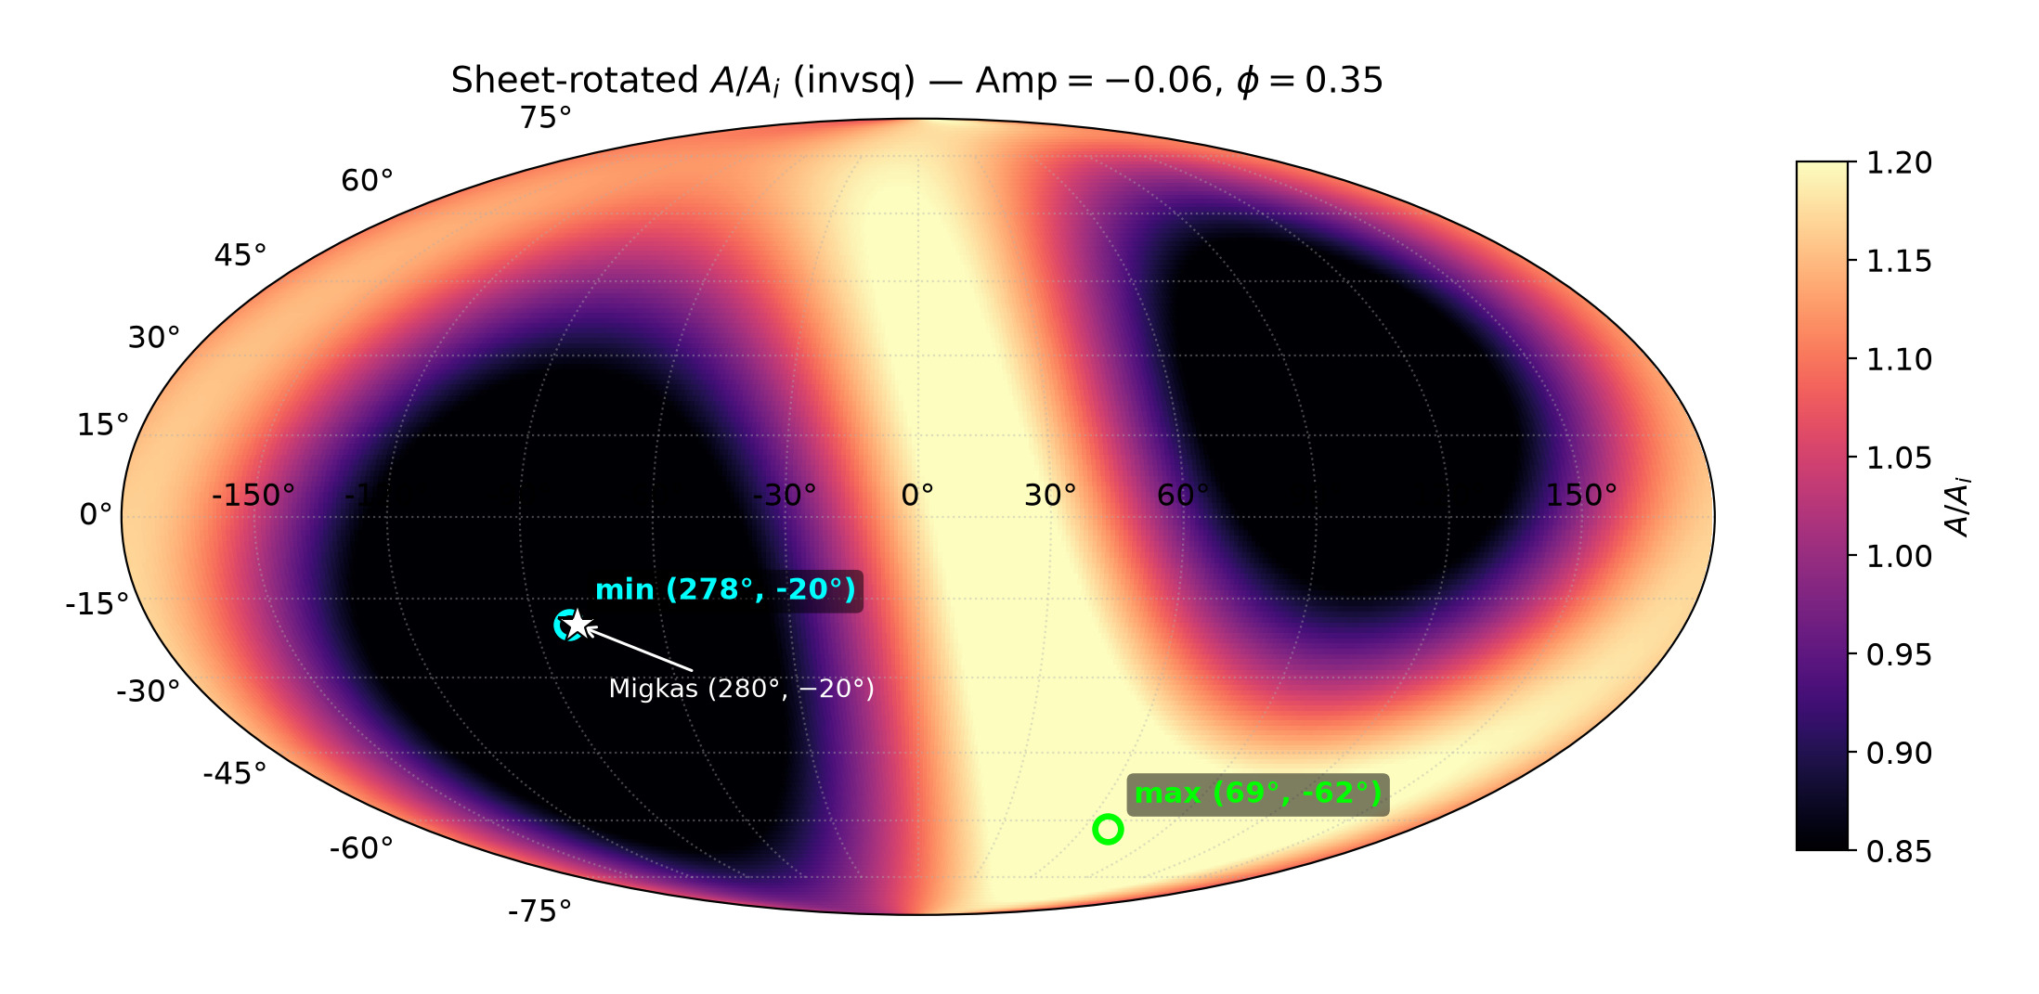
161/395 map_compare/02_sheet_rotated_invsq_A_over_Ai.png

Slide 5
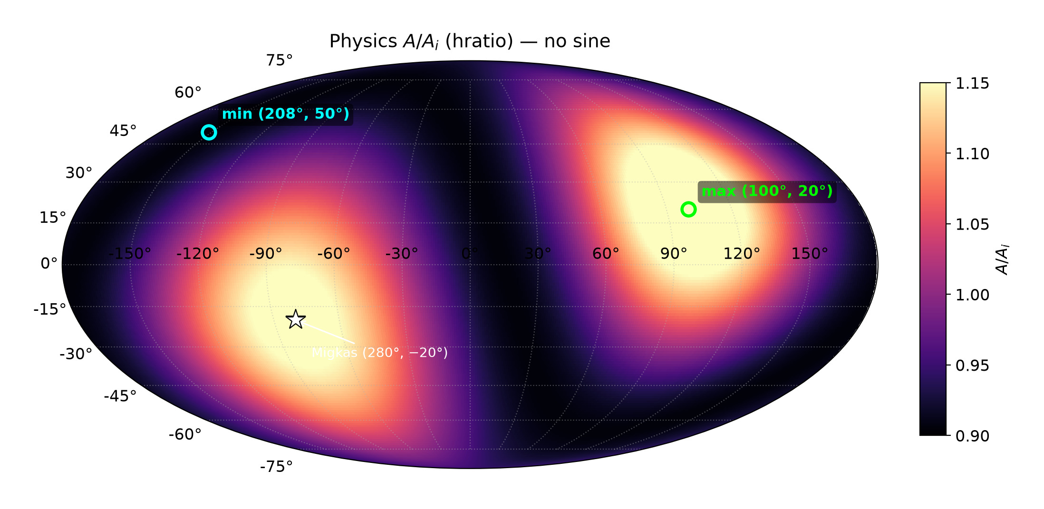
162/395 map_compare/03_physics_hratio_A_over_Ai.png

Slide 6
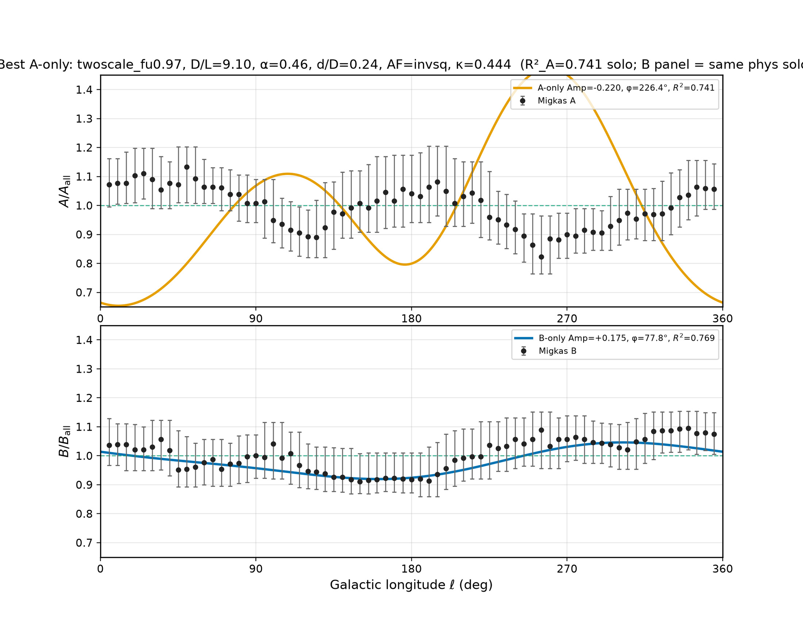
163/395 density_local_match/migkas_best_A_only.png

Slide 7
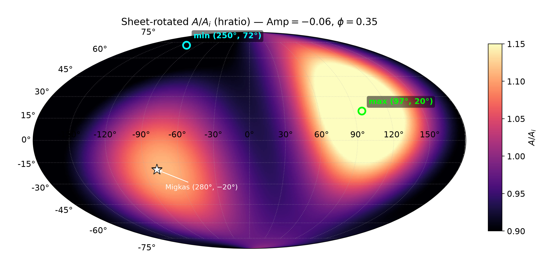
164/395 map_compare/04_sheet_rotated_hratio_A_over_Ai.png

Slide 8
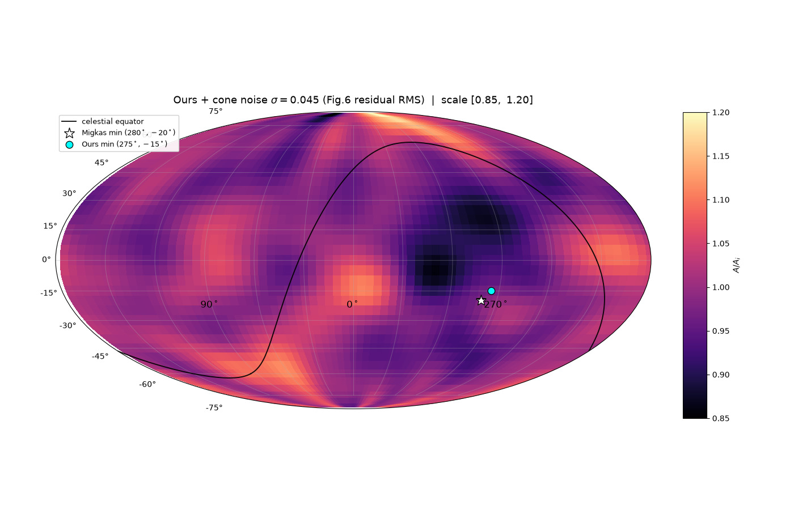
165/395 map_compare/CARD_ours_noise_fig6var.png

Slide 9
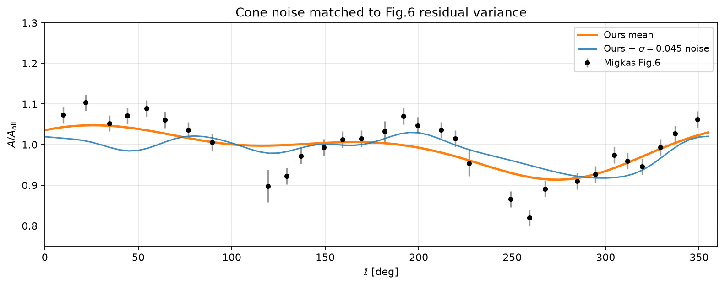
166/395 map_compare/cone_noise_matched_vs_fig6.png

Slide 10
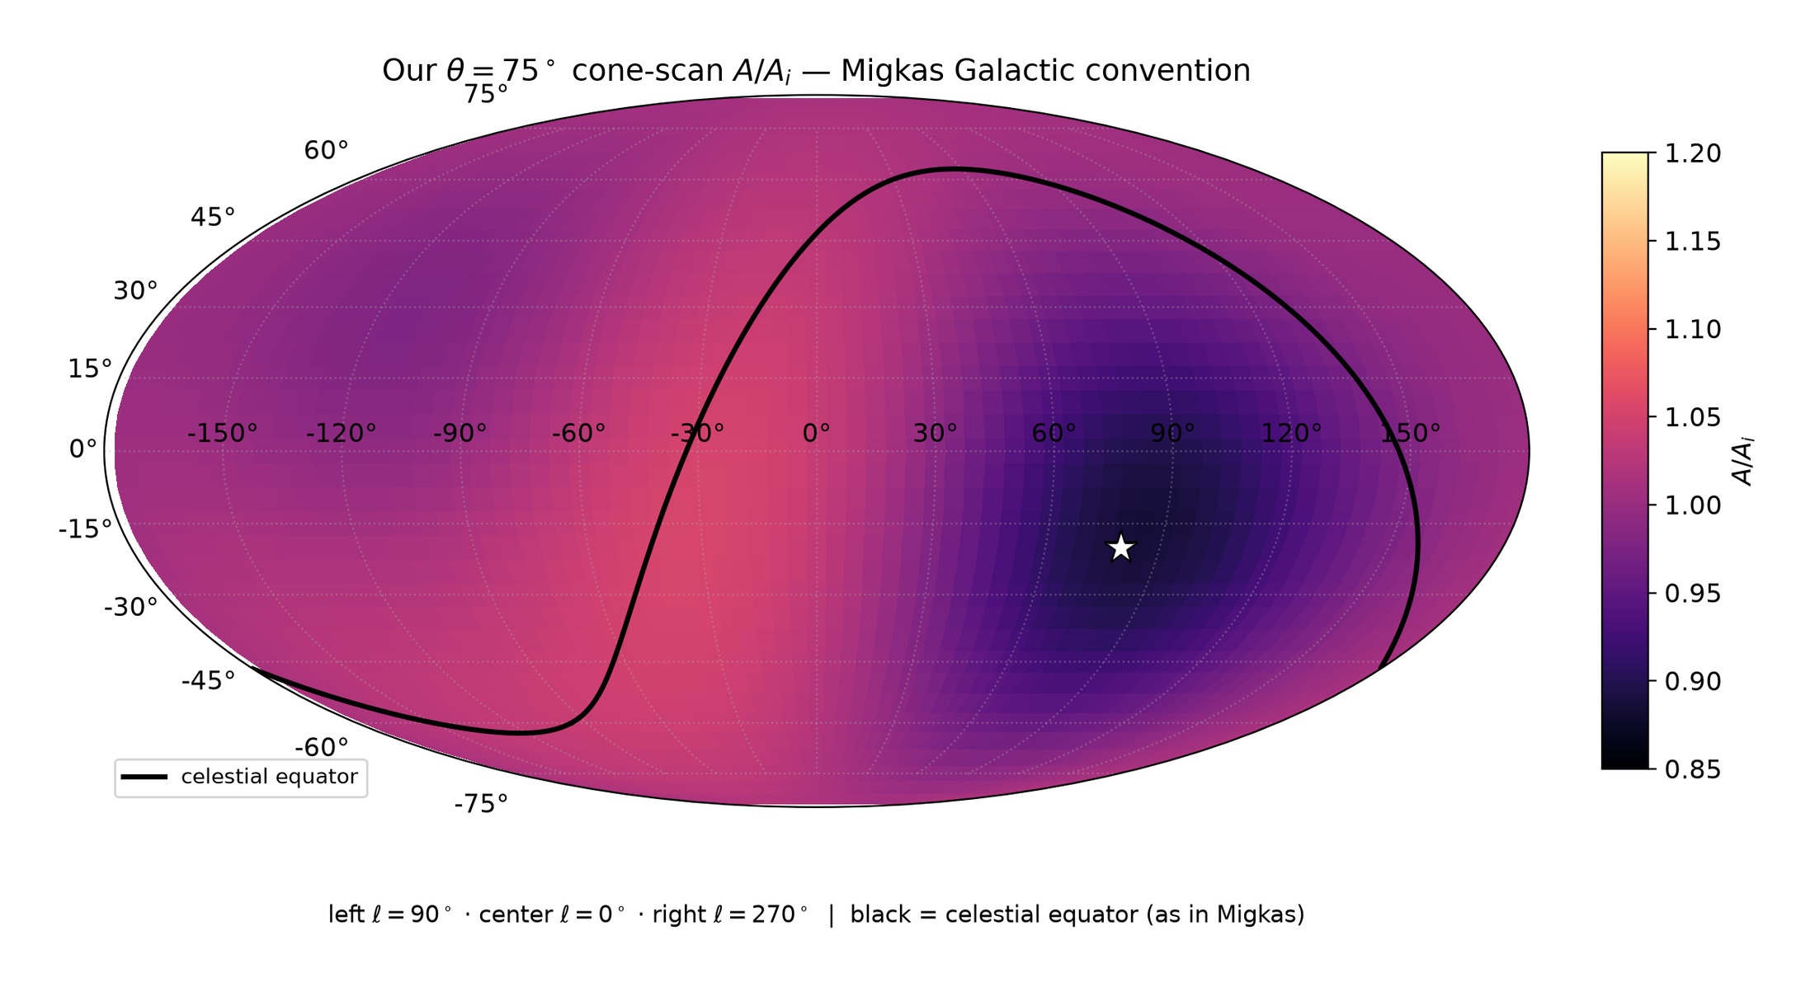
167/395 map_compare/ours_cone75_sheet_CORRECT_COORDS.png

Slide 11
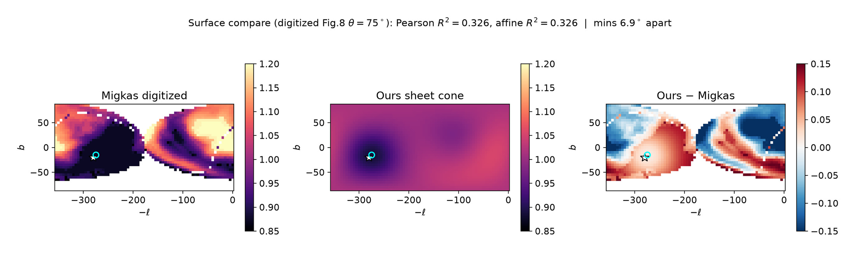
168/395 map_compare/surface_R2_ours_vs_migkas.png

Slide 12
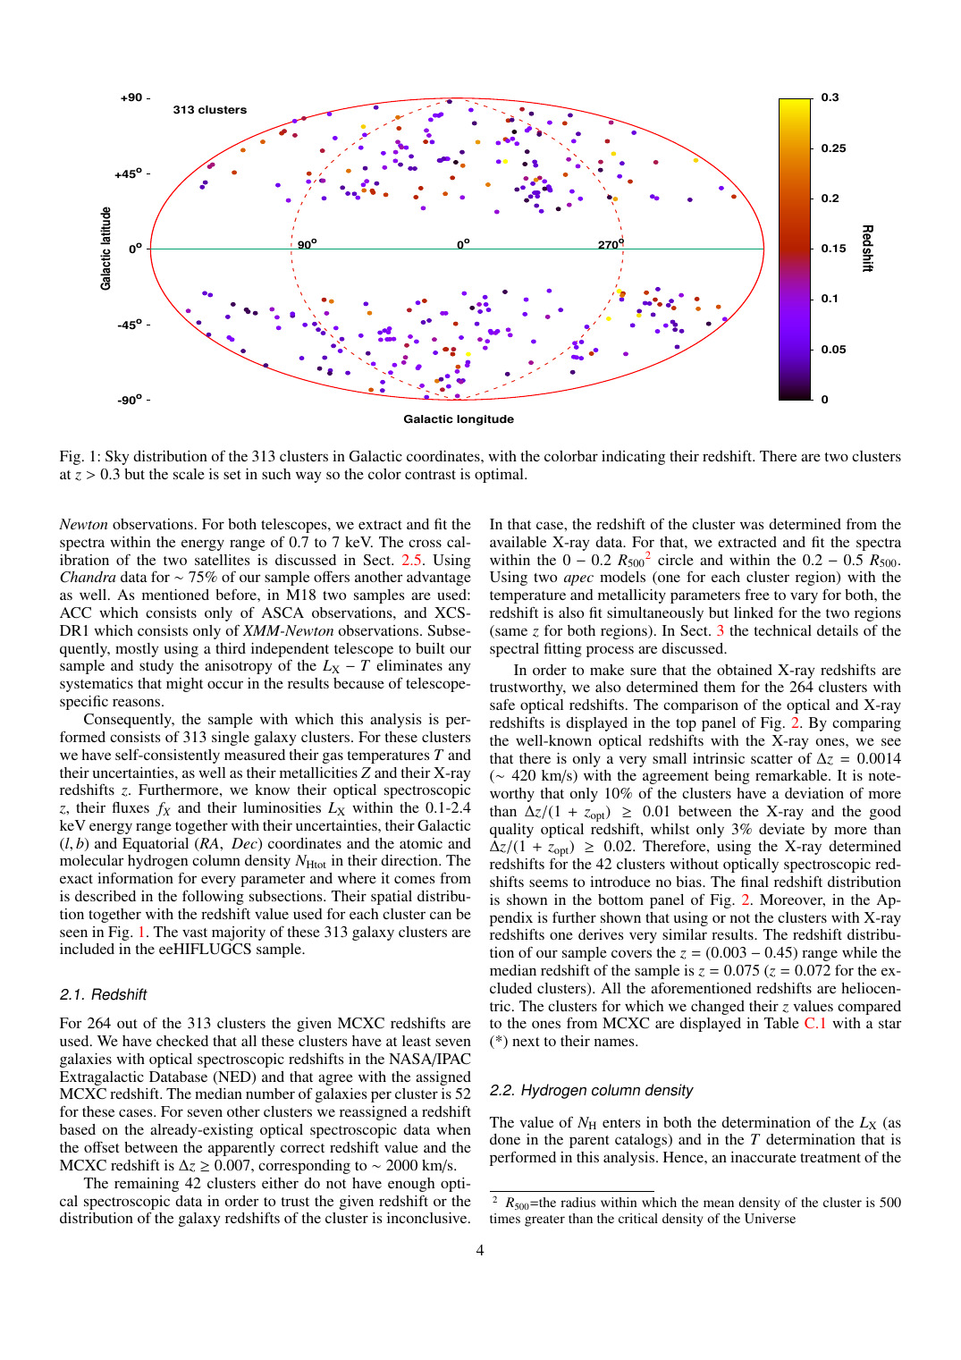
169/395 migkas/pub_maps/sky-04.png

Slide 13
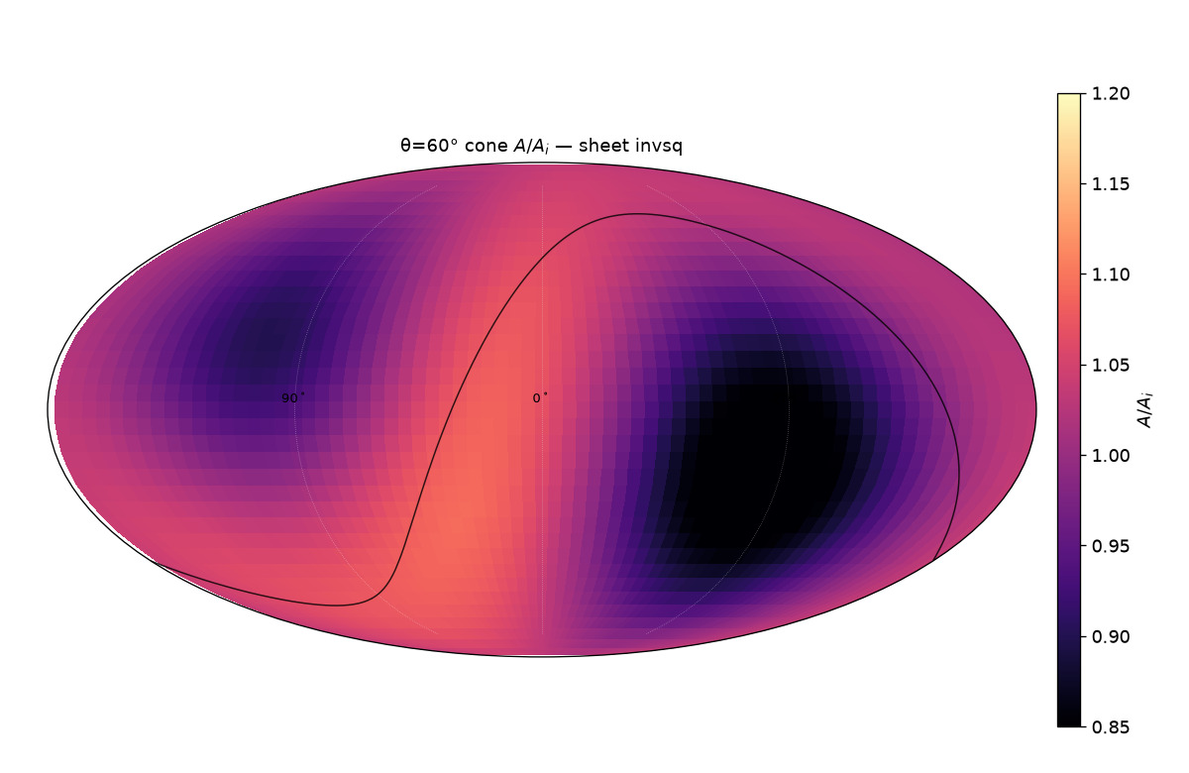
170/395 map_compare/cone_thetas/cards/theta60_sheet_invsq.png

Slide 14
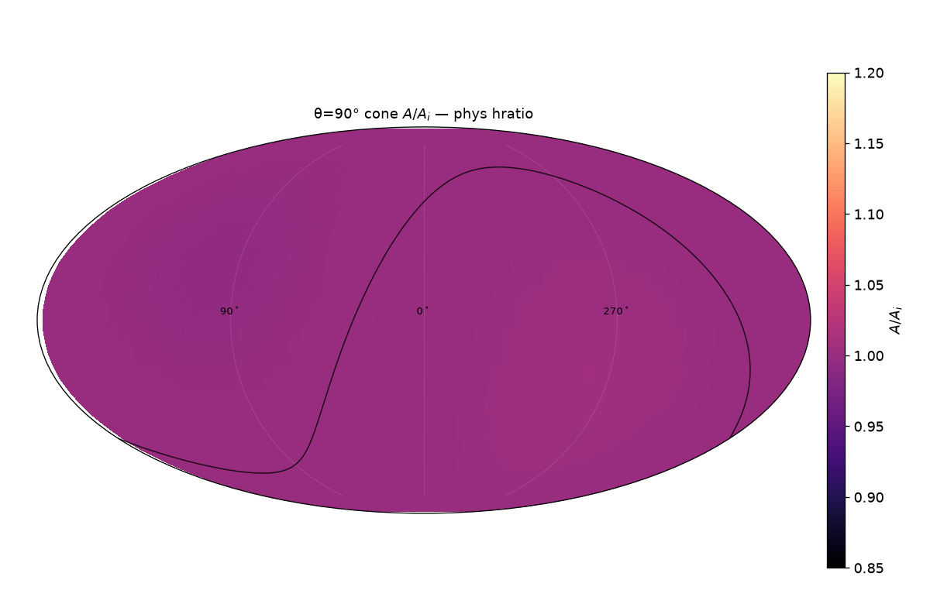
171/395 map_compare/cone_thetas/cards/theta90_phys_hratio.png

Slide 15
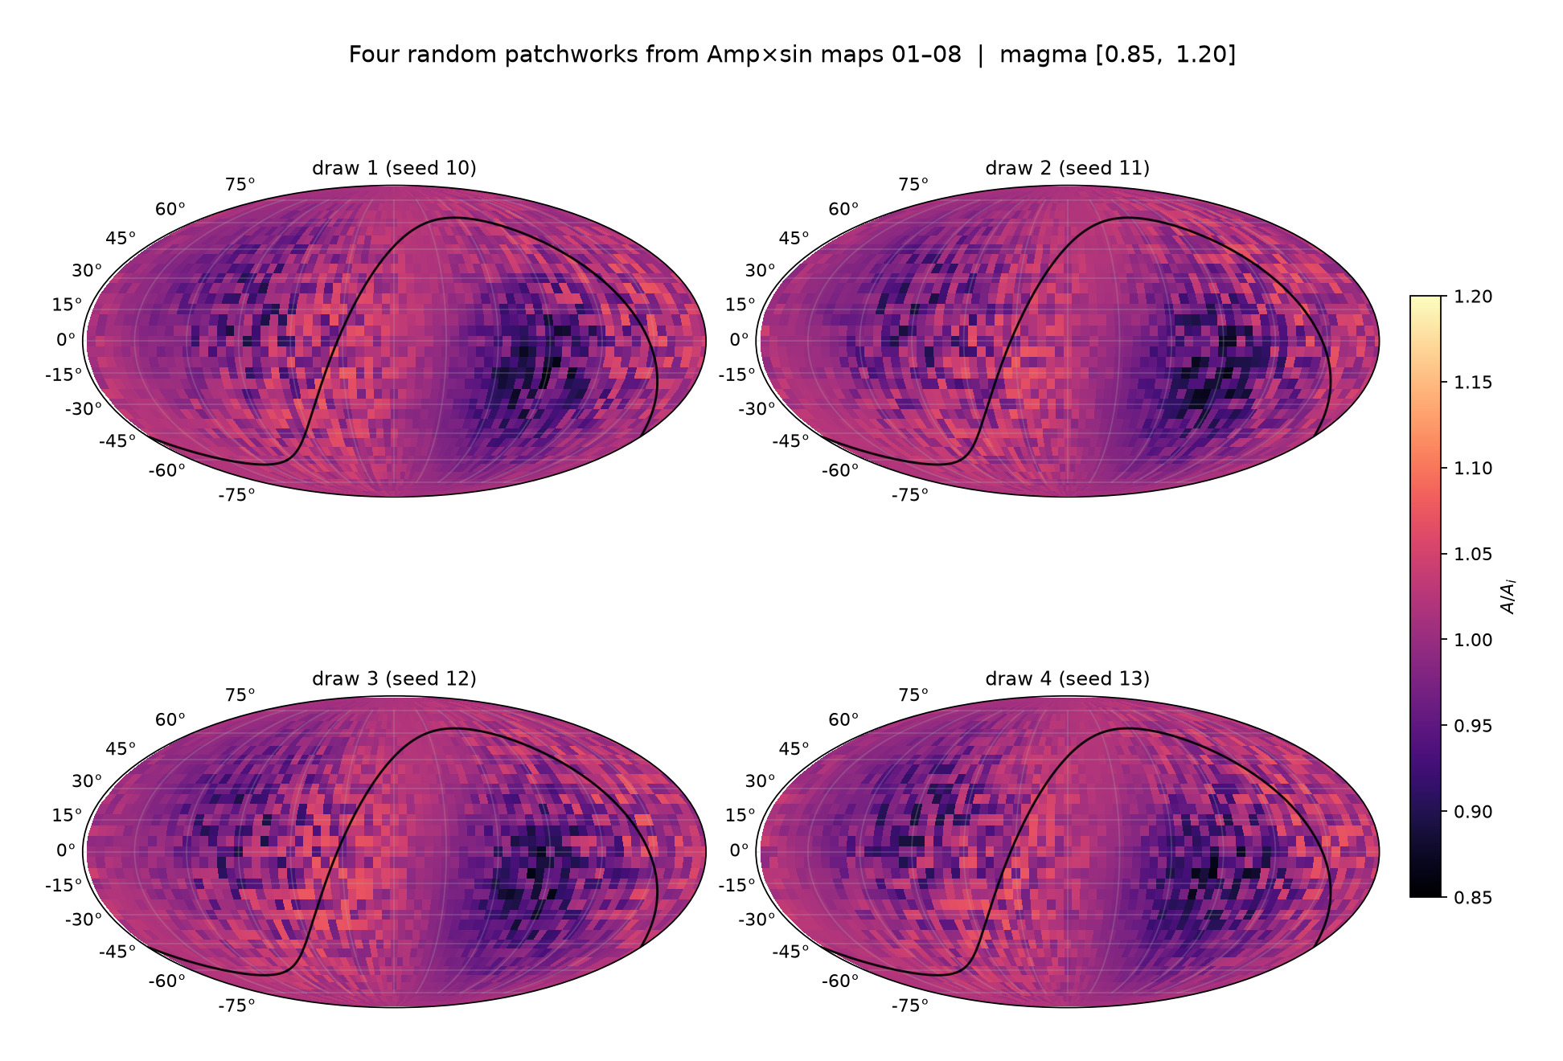
172/395 map_compare/levelset_maps/GRID_patchwork_4draws.png

Slide 16
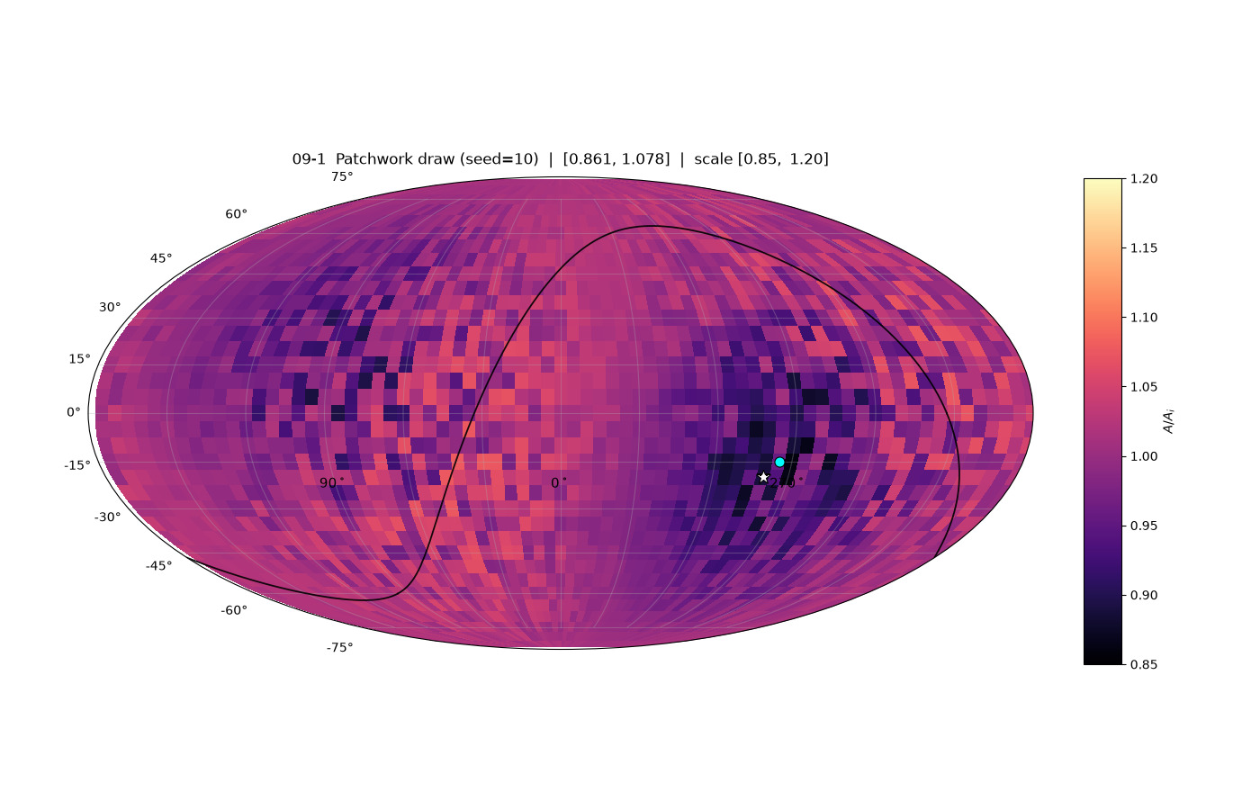
173/395 map_compare/levelset_maps/map_09_patchwork_draw1_seed10.png

Slide 17
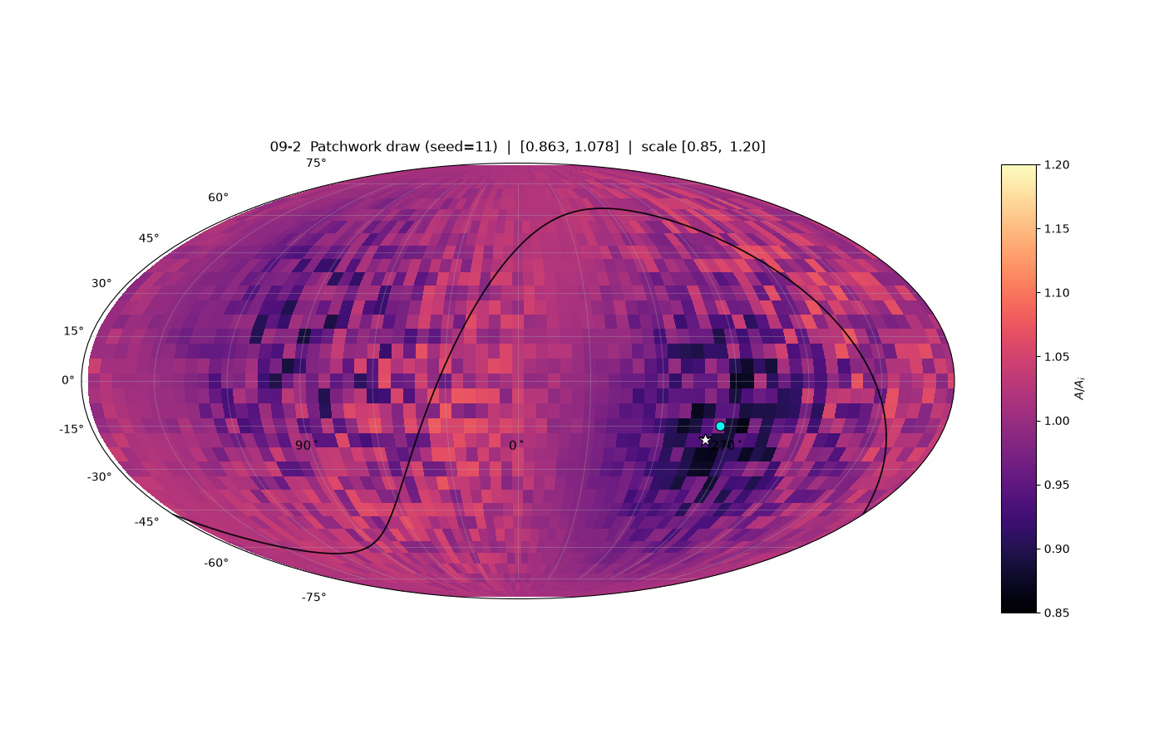
174/395 map_compare/levelset_maps/map_09_patchwork_draw2_seed11.png

Slide 18

175/395 map_compare/levelset_maps/map_09_patchwork_draw3_seed12.png

Slide 19
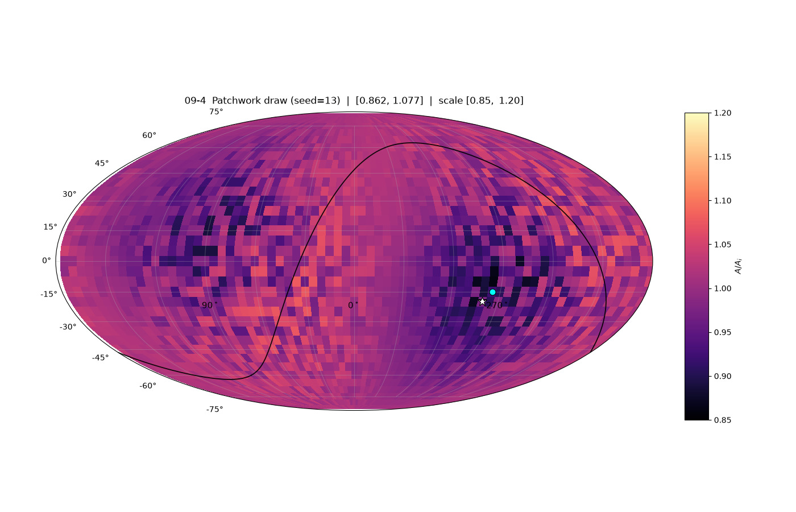
176/395 map_compare/levelset_maps/map_09_patchwork_draw4_seed13.png

Slide 20

177/395 map_compare/levelset_maps/map_09_patchwork_random.png

Slide 21
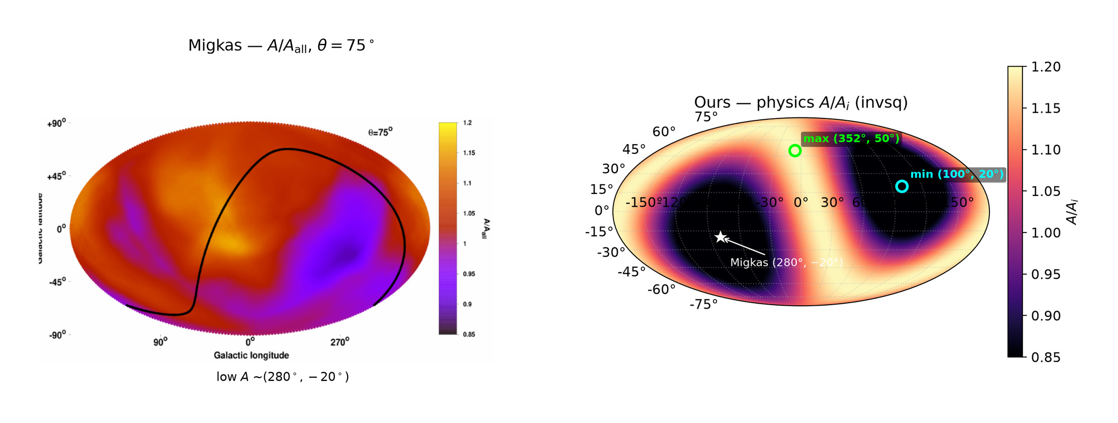
178/395 map_compare/sbs_migkas75_vs_physics_invsq.png

Slide 22
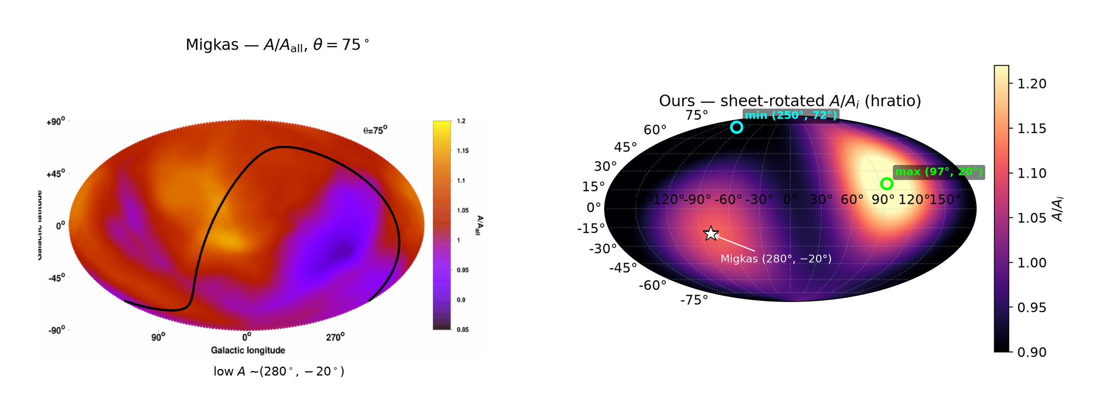
179/395 map_compare/sbs_migkas75_vs_sheet_hratio.png

Slide 23
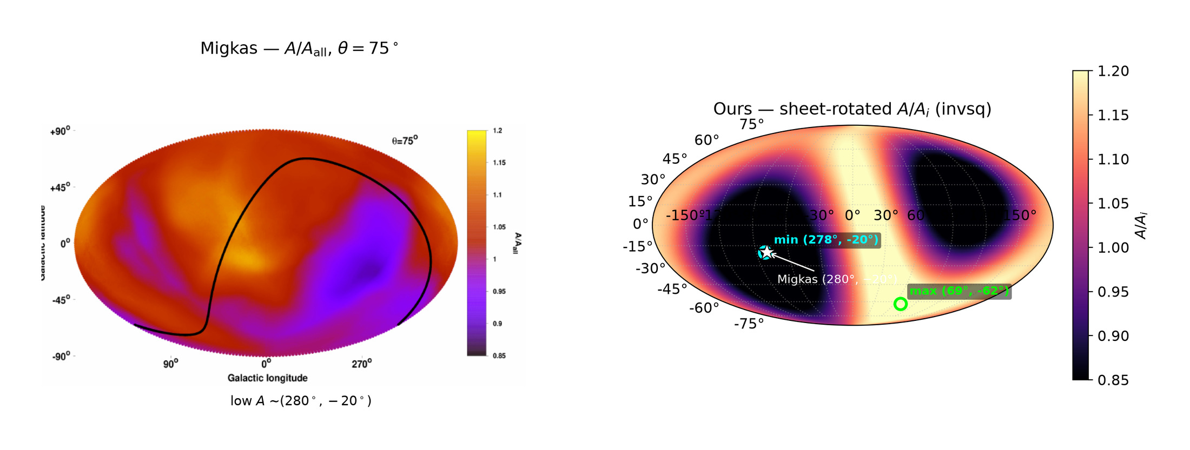
180/395 map_compare/sbs_migkas75_vs_sheet_invsq.png

Slide 24
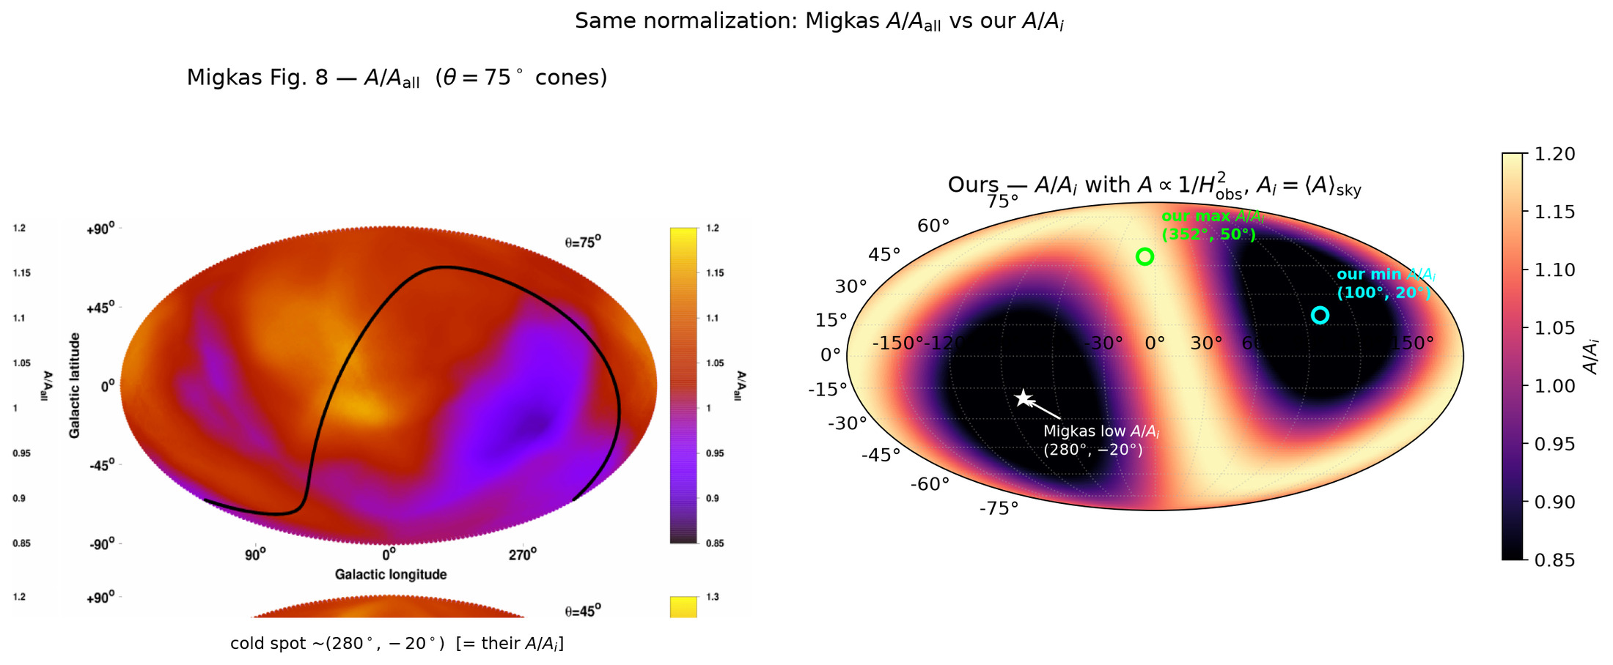
181/395 map_compare/side_by_side_A_over_Ai.png

Slide 25
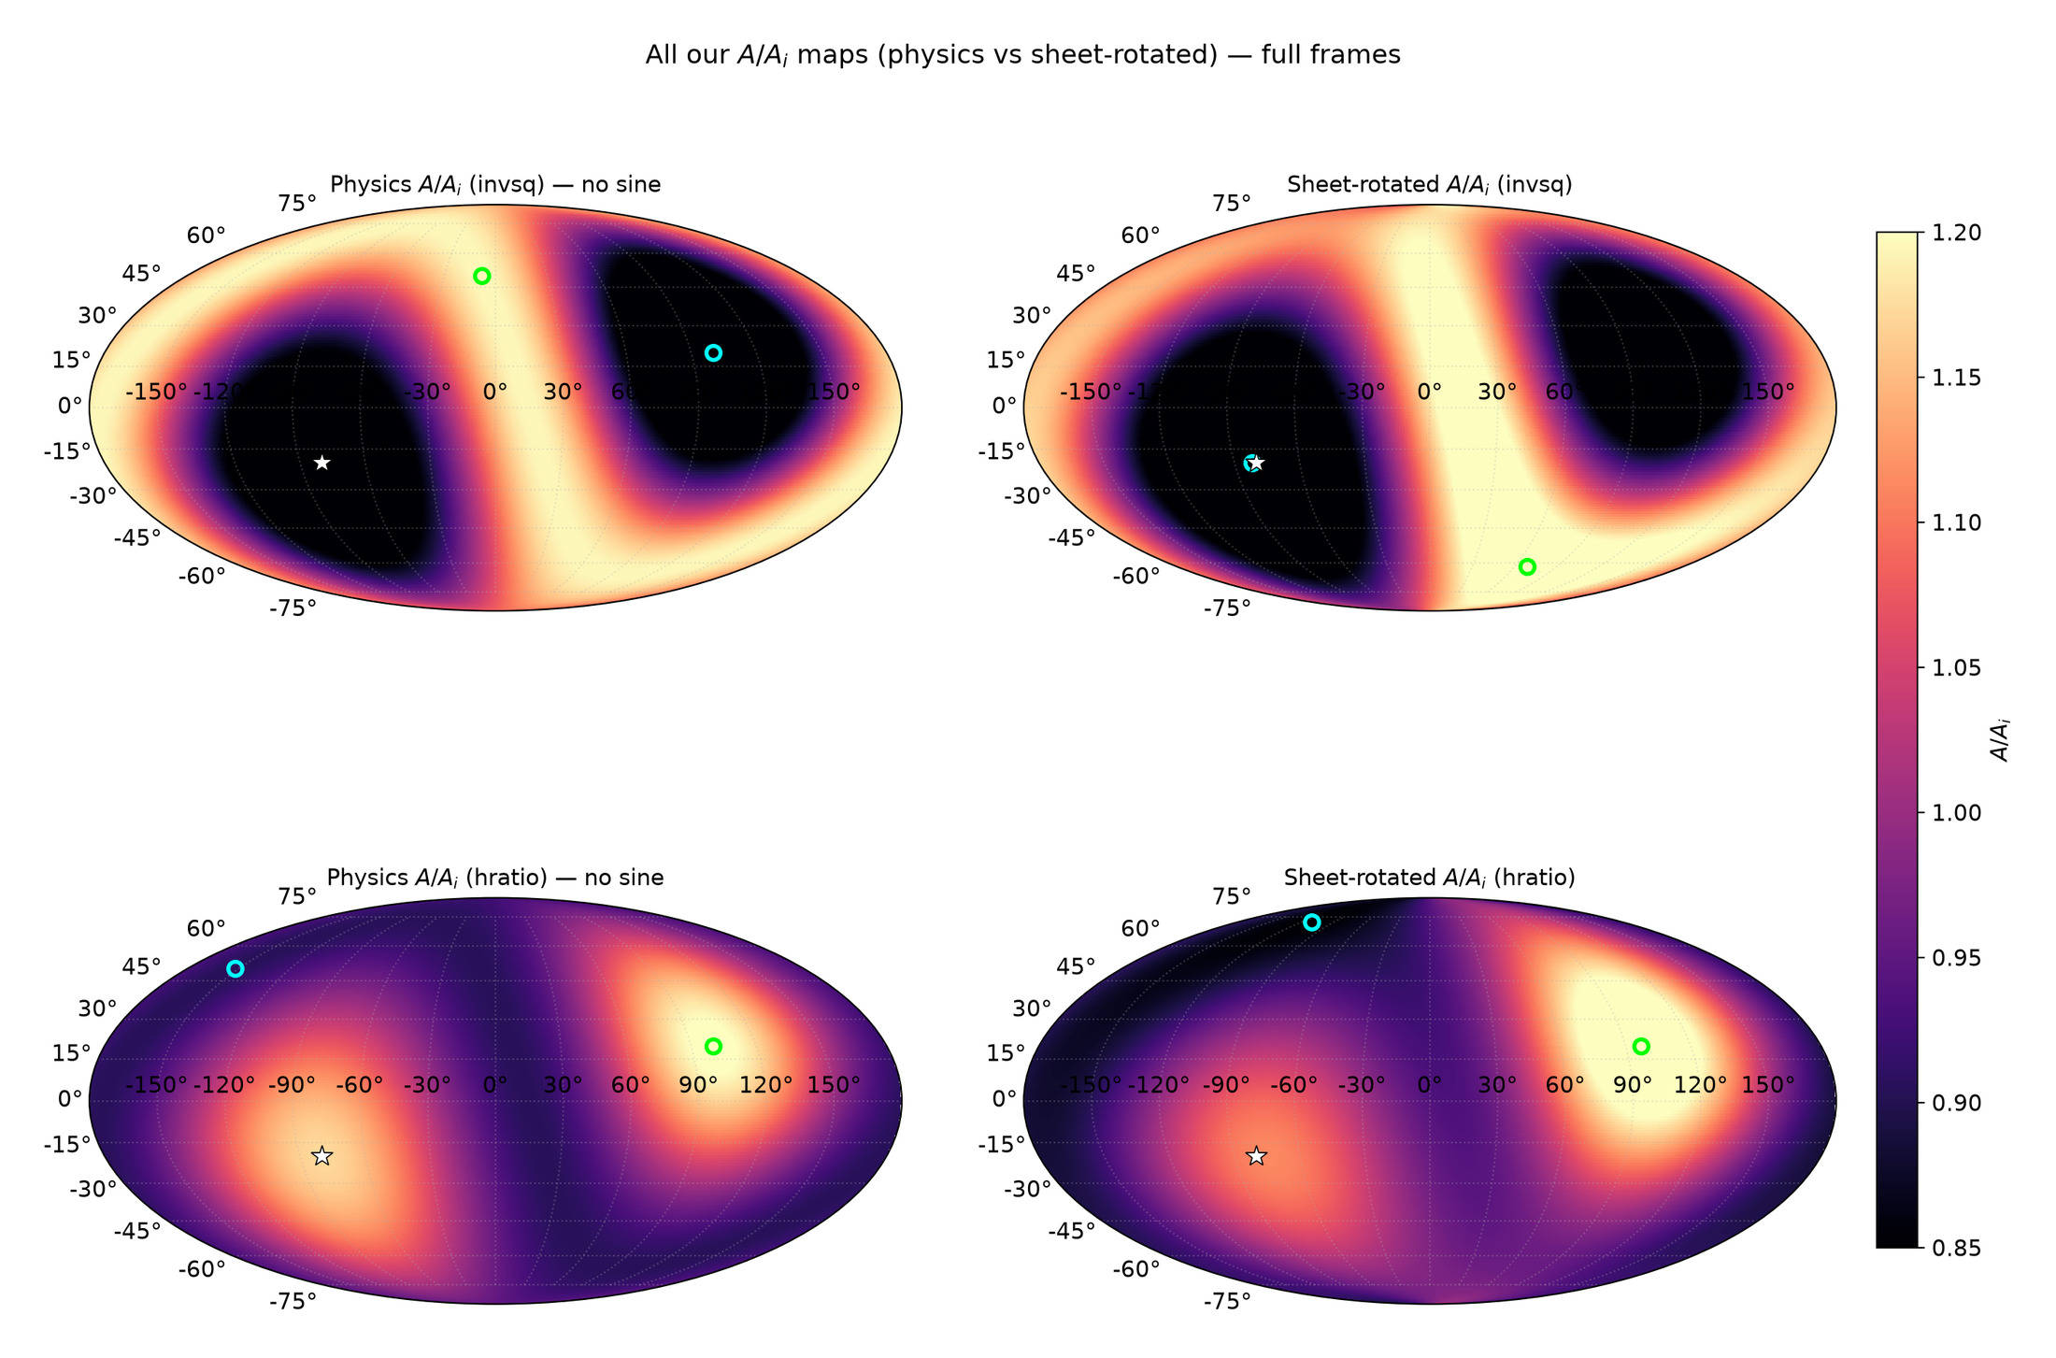
182/395 map_compare/all_our_maps_A_over_Ai.png

Slide 26
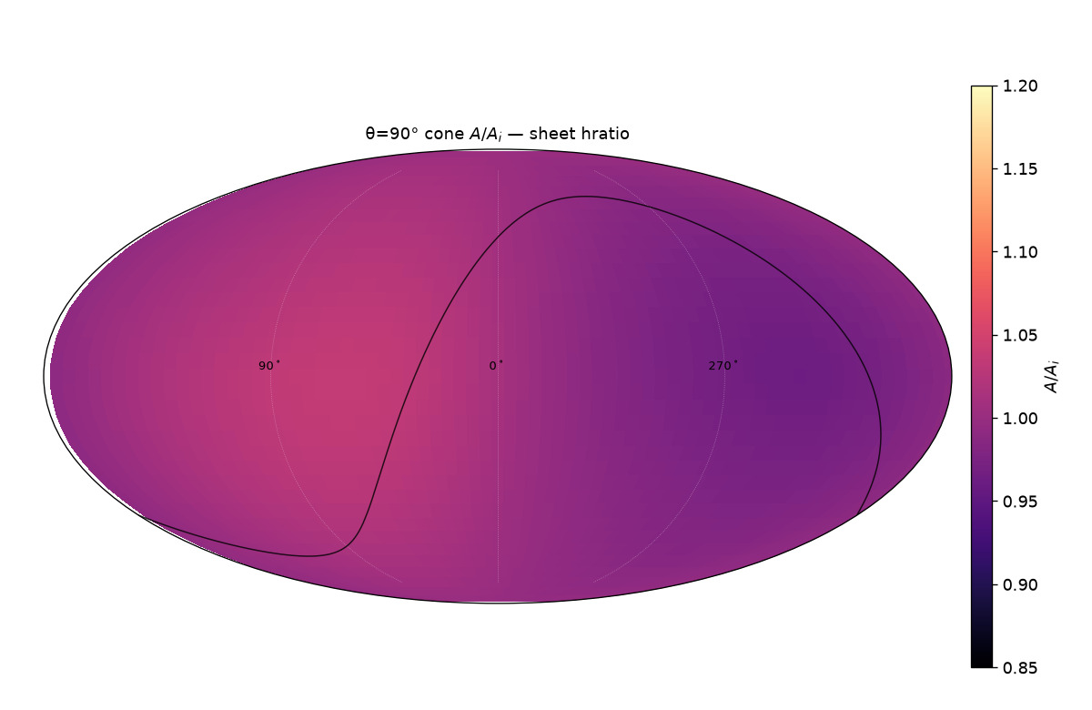
183/395 map_compare/cone_thetas/cards/theta90_sheet_hratio.png

Slide 27
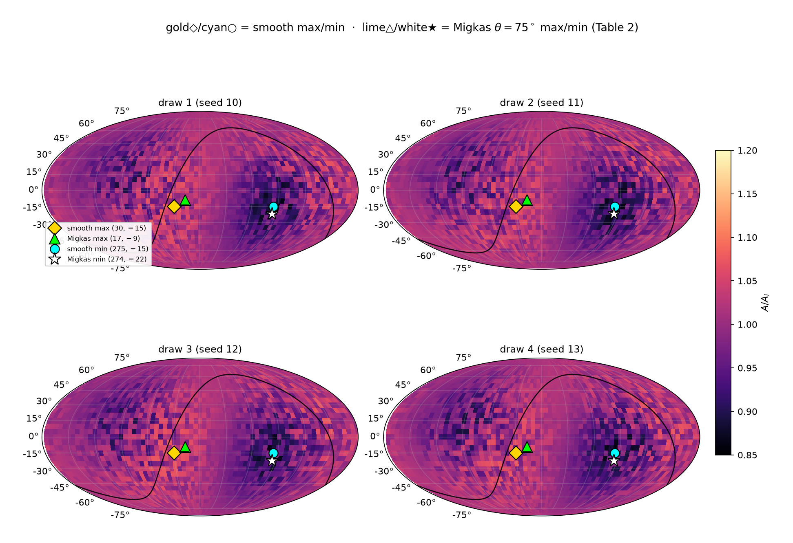
184/395 map_compare/levelset_maps/GRID_patchwork_4draws_EXTREMA.png

Slide 28
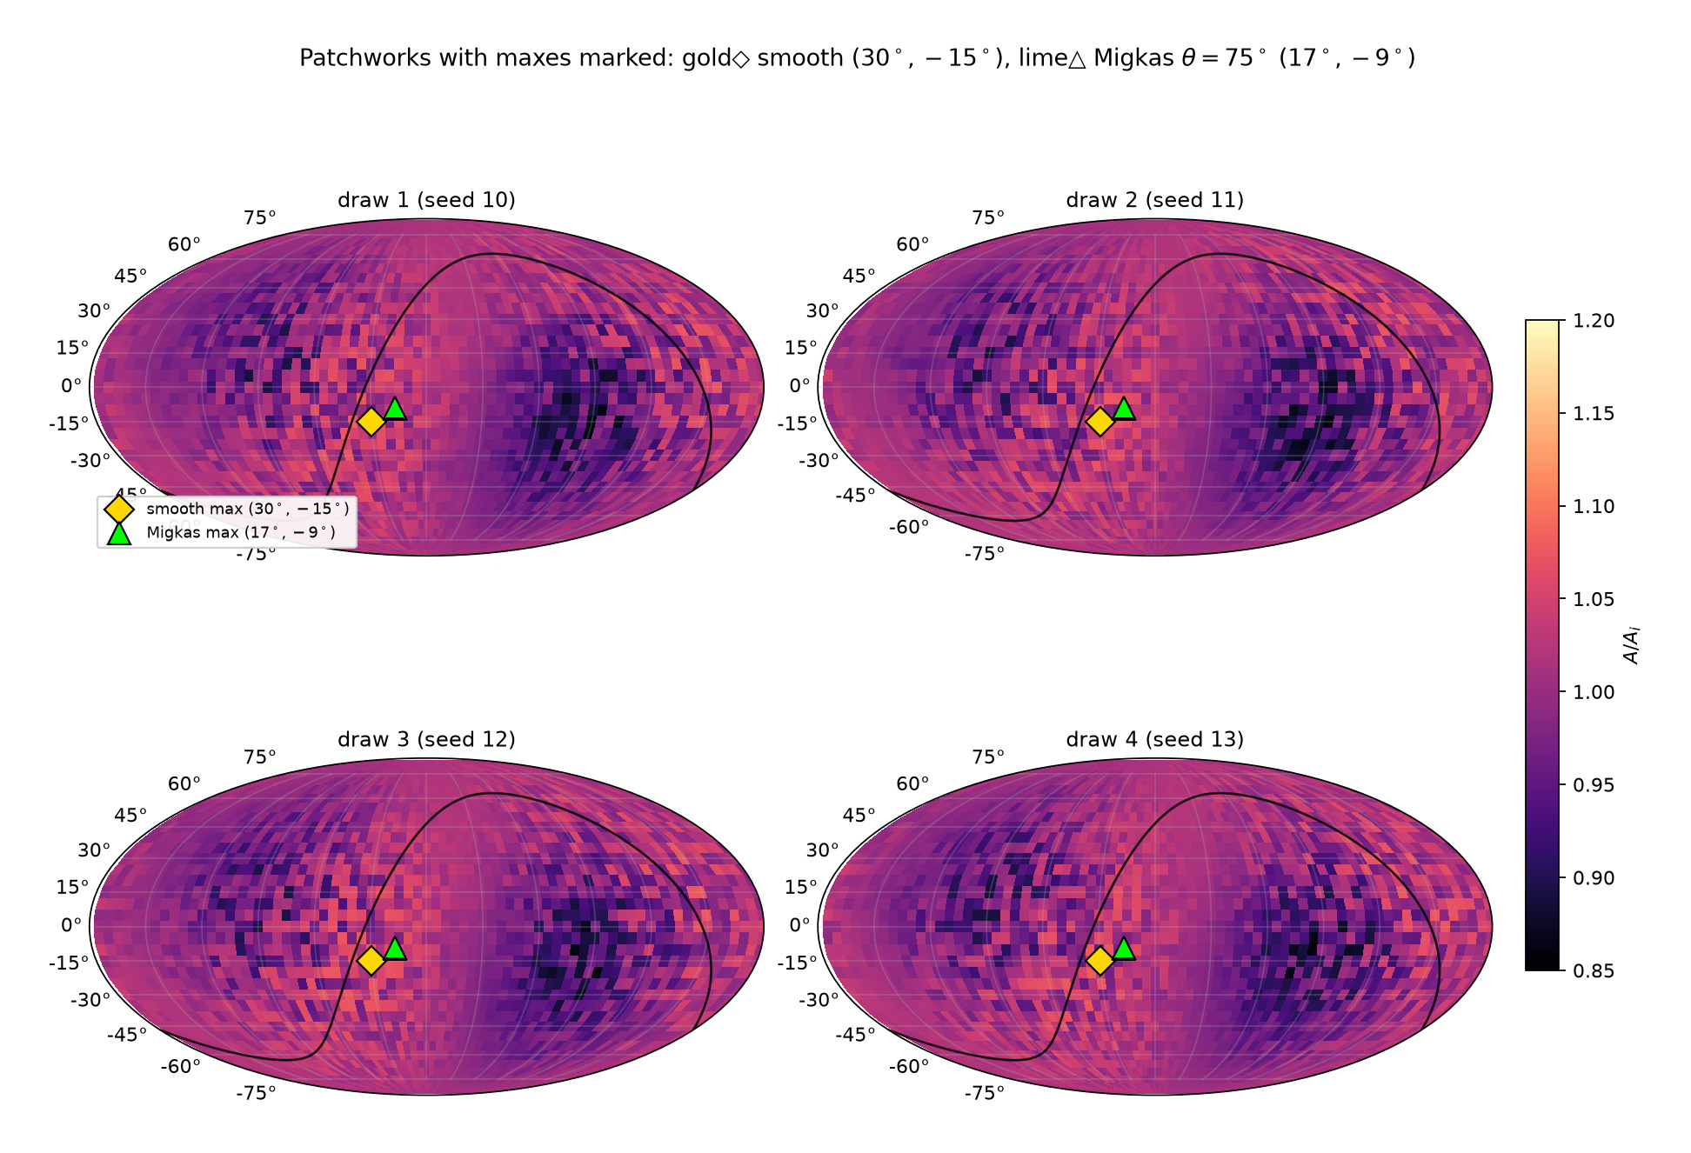
185/395 map_compare/levelset_maps/GRID_patchwork_4draws_MAXES.png

Slide 29
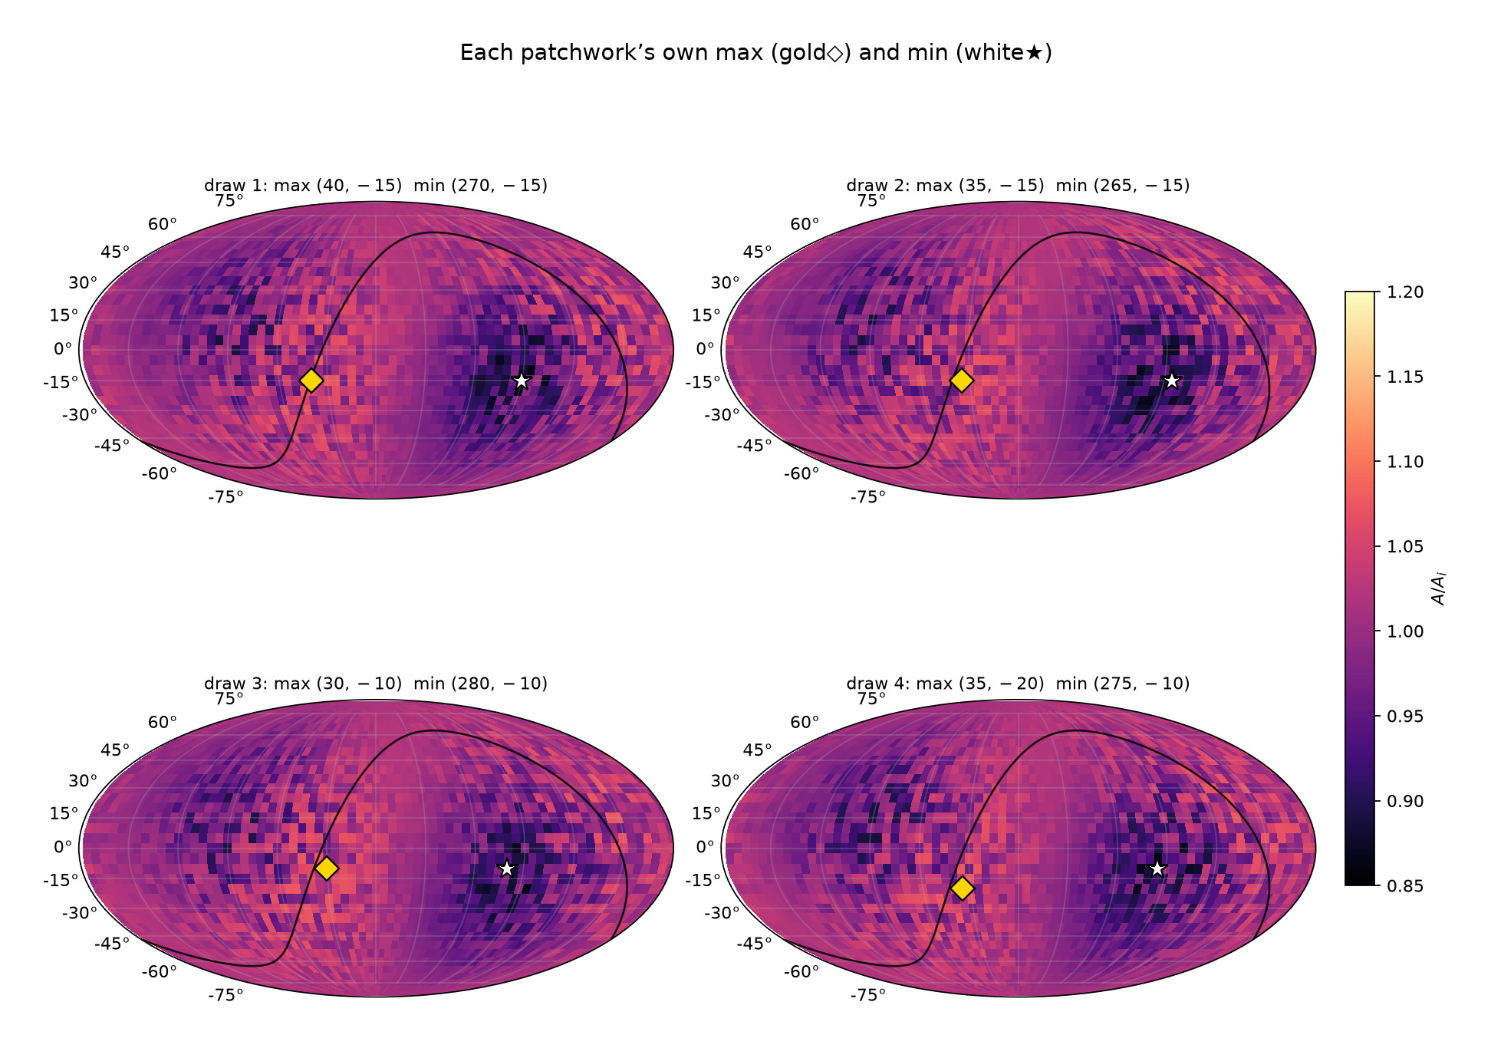
186/395 map_compare/levelset_maps/GRID_patchwork_4draws_OWN_EXTREMA.png

Slide 30
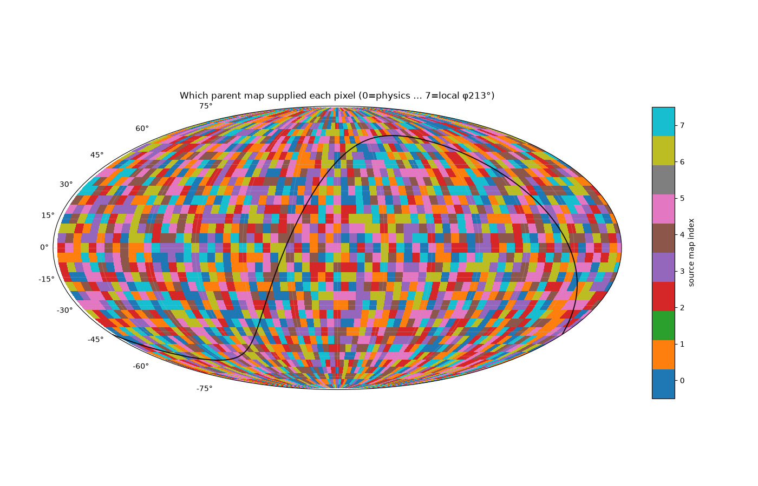
187/395 map_compare/levelset_maps/map_09_patchwork_sources.png

Slide 31
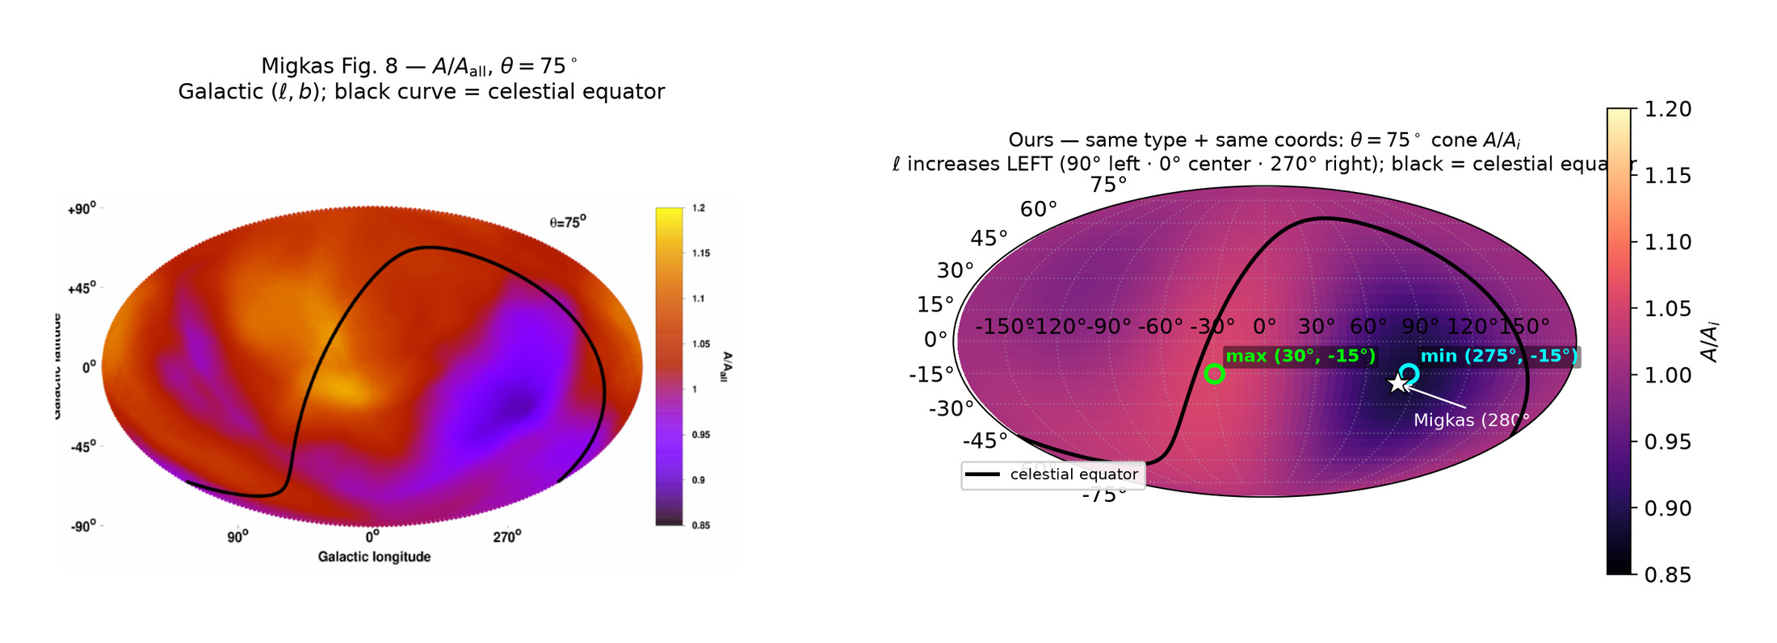
188/395 map_compare/sbs_SAME_COORDS_cone75_sheet.png

Slide 32
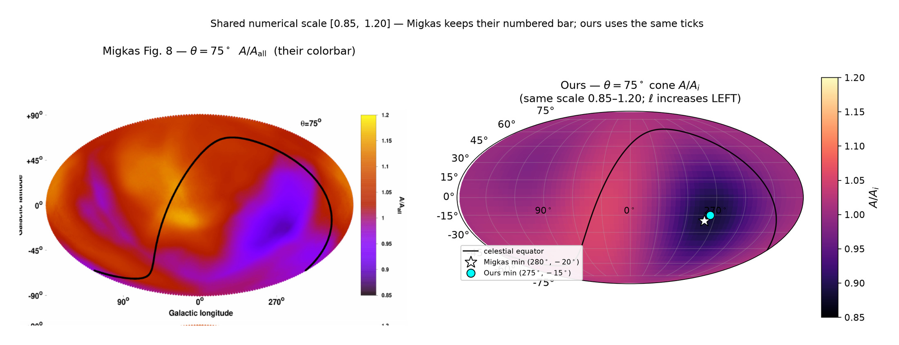
189/395 map_compare/sbs_SHARED_SCALE_FIXED.png

Slide 33
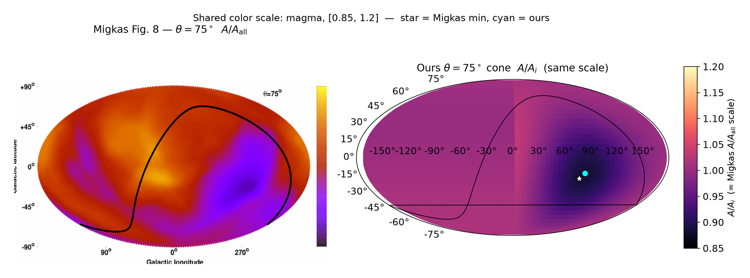
190/395 map_compare/sbs_SHARED_SCALE_cone75_sheet.png

Slide 34
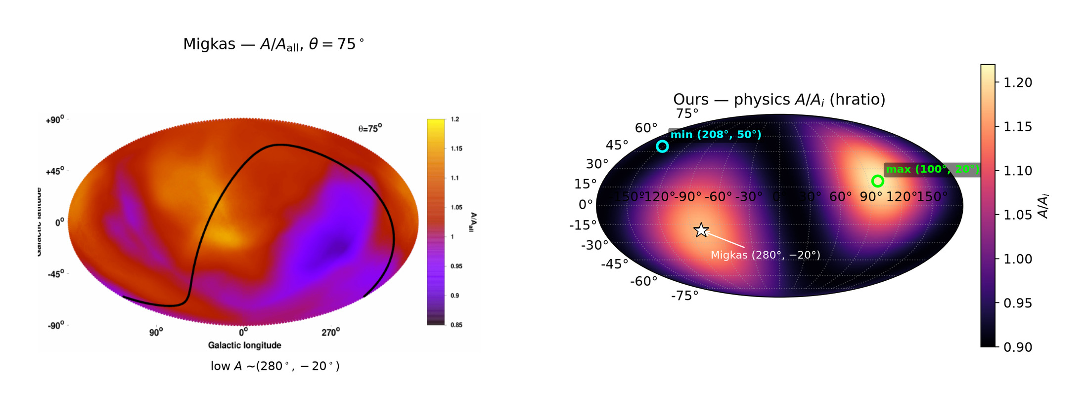
191/395 map_compare/sbs_migkas75_vs_physics_hratio.png

Slide 35
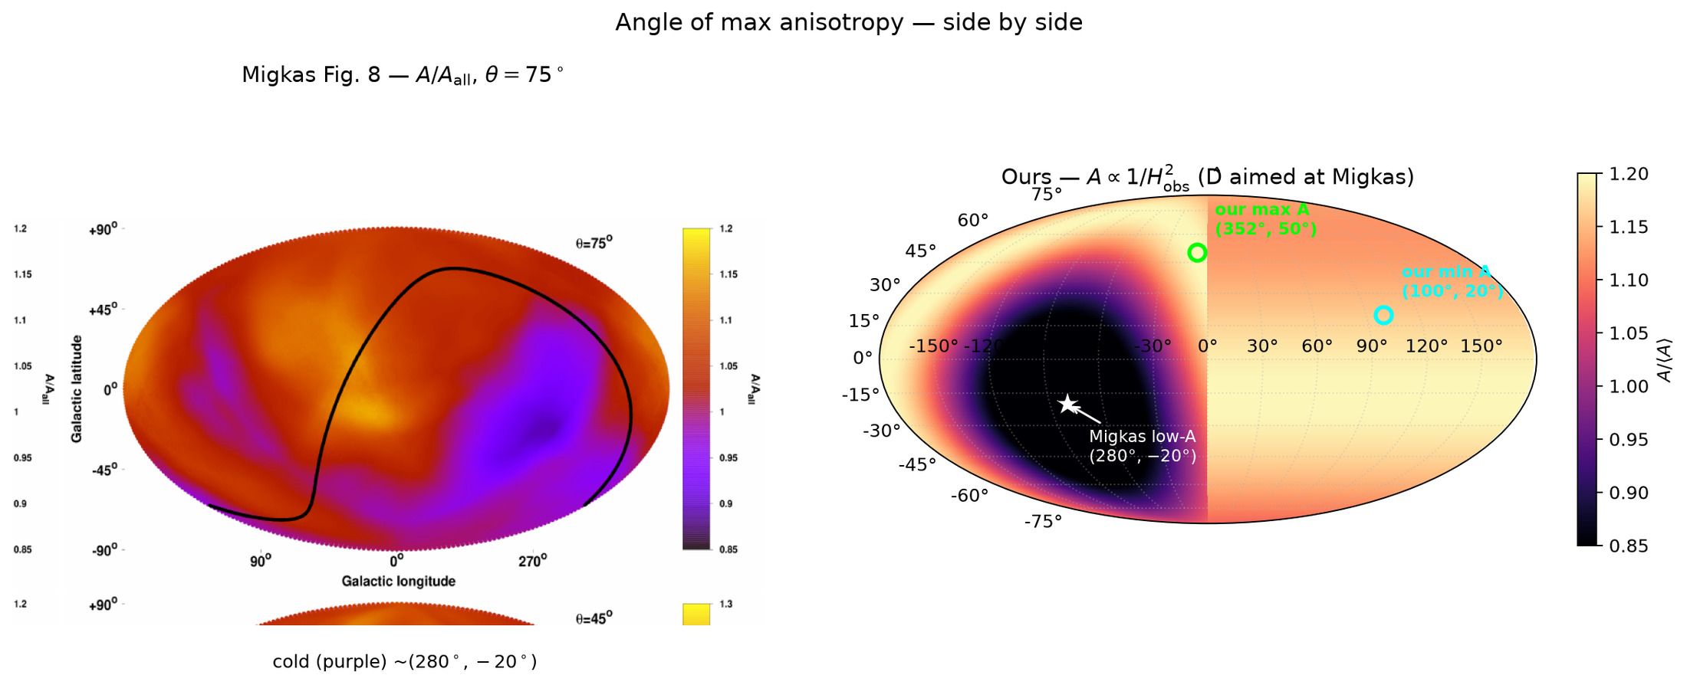
192/395 map_compare/side_by_side_directions.png

Slide 36
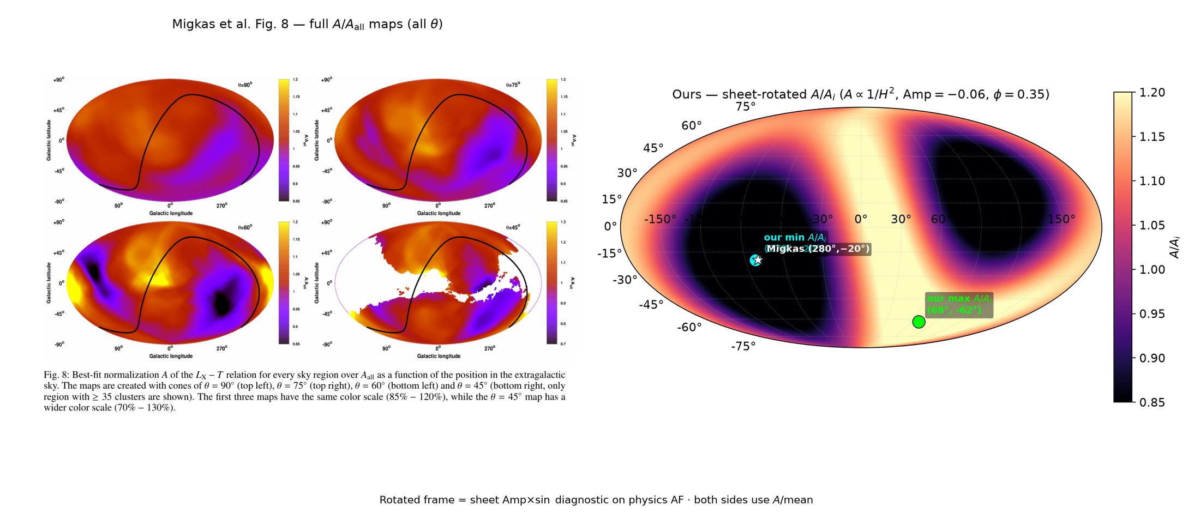
193/395 map_compare/side_by_side_full_fig8.png

Slide 37
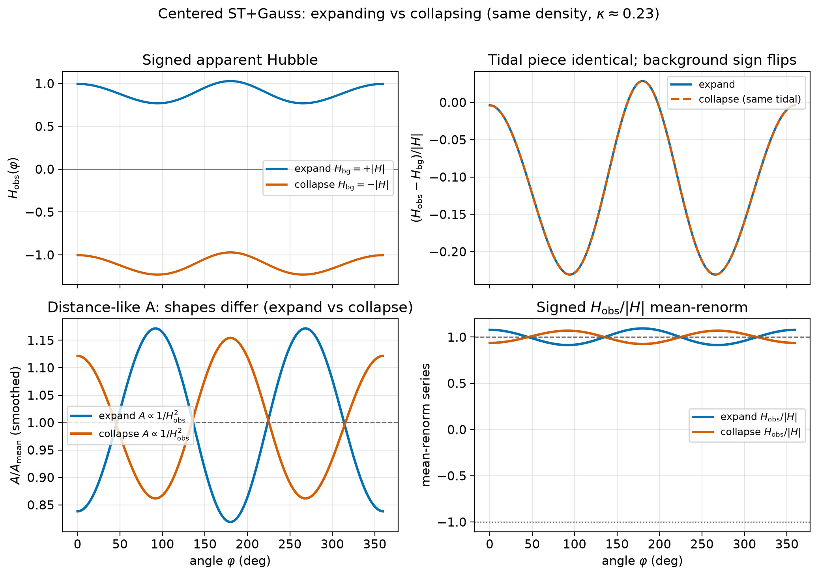
194/395 figures/expand_vs_collapse_shapes.png

Slide 38
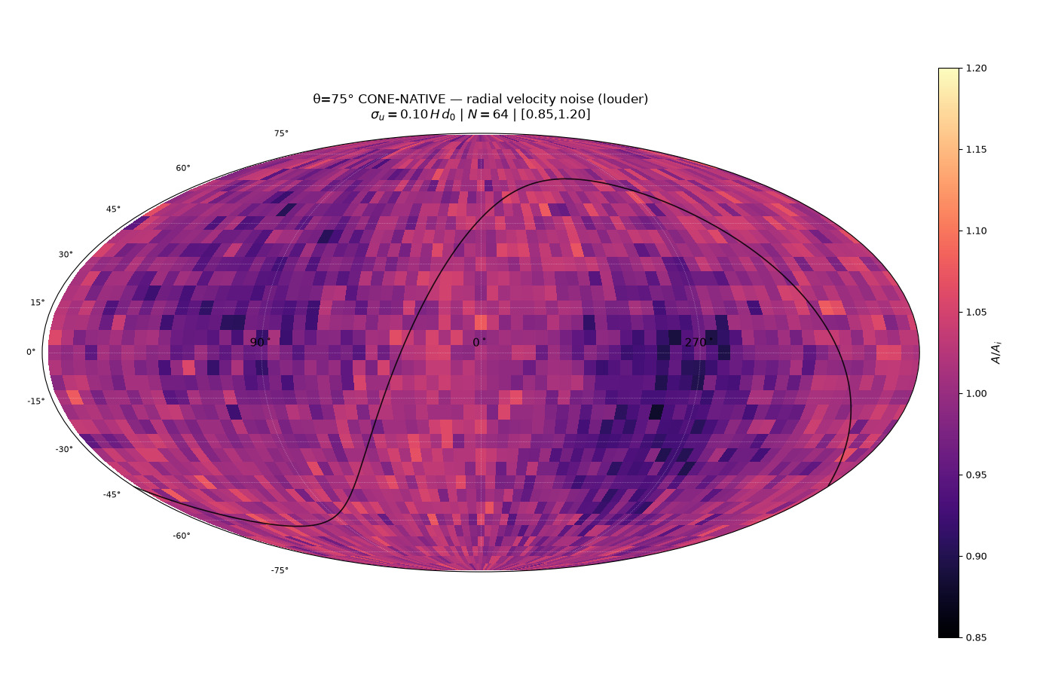
195/395 map_compare/cone_param_noise/CARD_cone75_native_vel_radial_s10_invsq.png

Slide 39
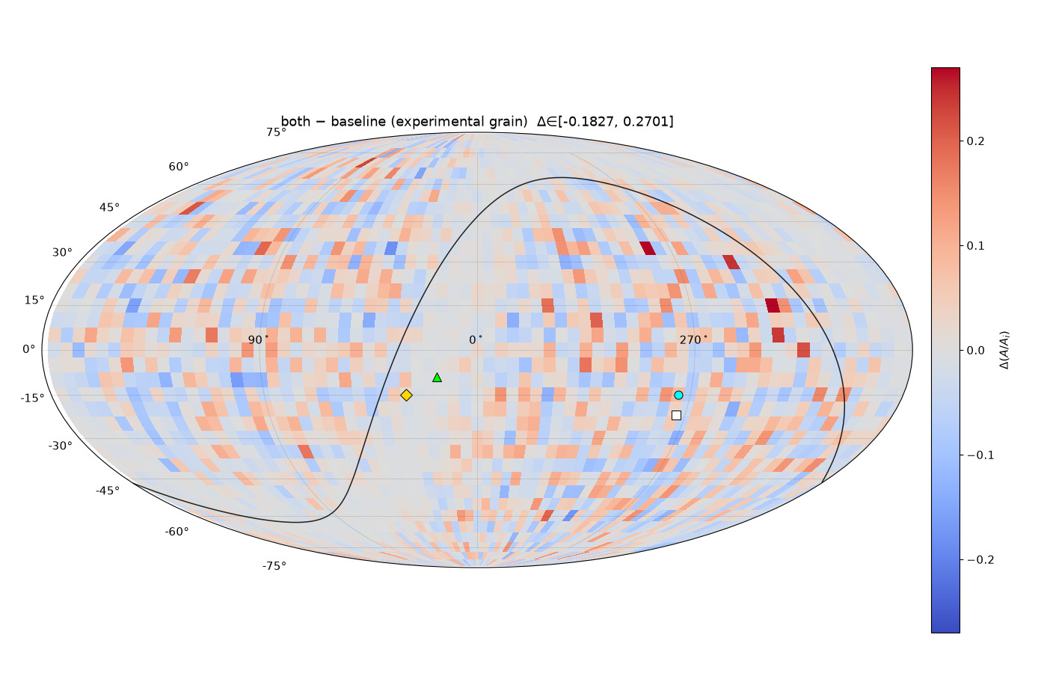
196/395 map_compare/amp_mean_param_noise/CARD_ampmean_both_minus_baseline.png

Slide 40
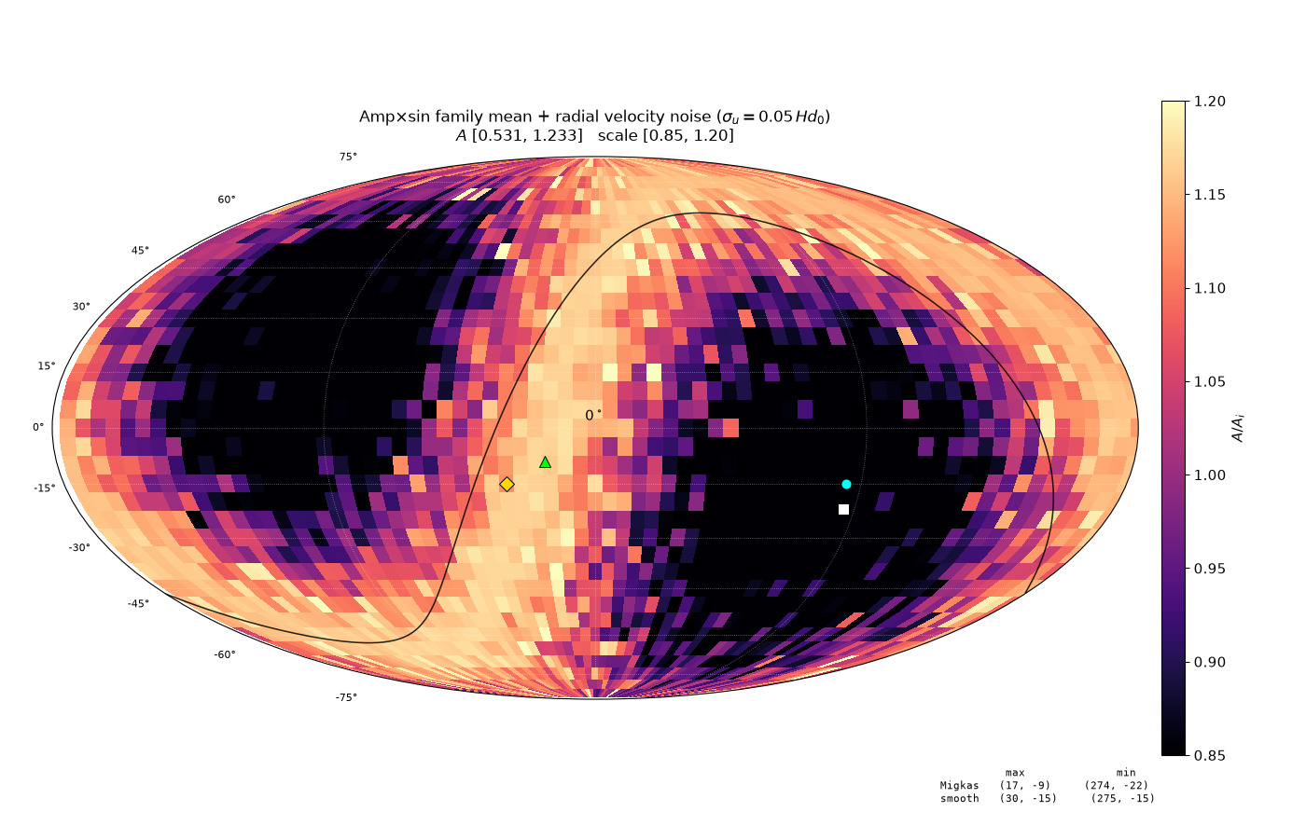
197/395 map_compare/amp_mean_param_noise/CARD_ampmean_vel_invsq.png

Slide 41
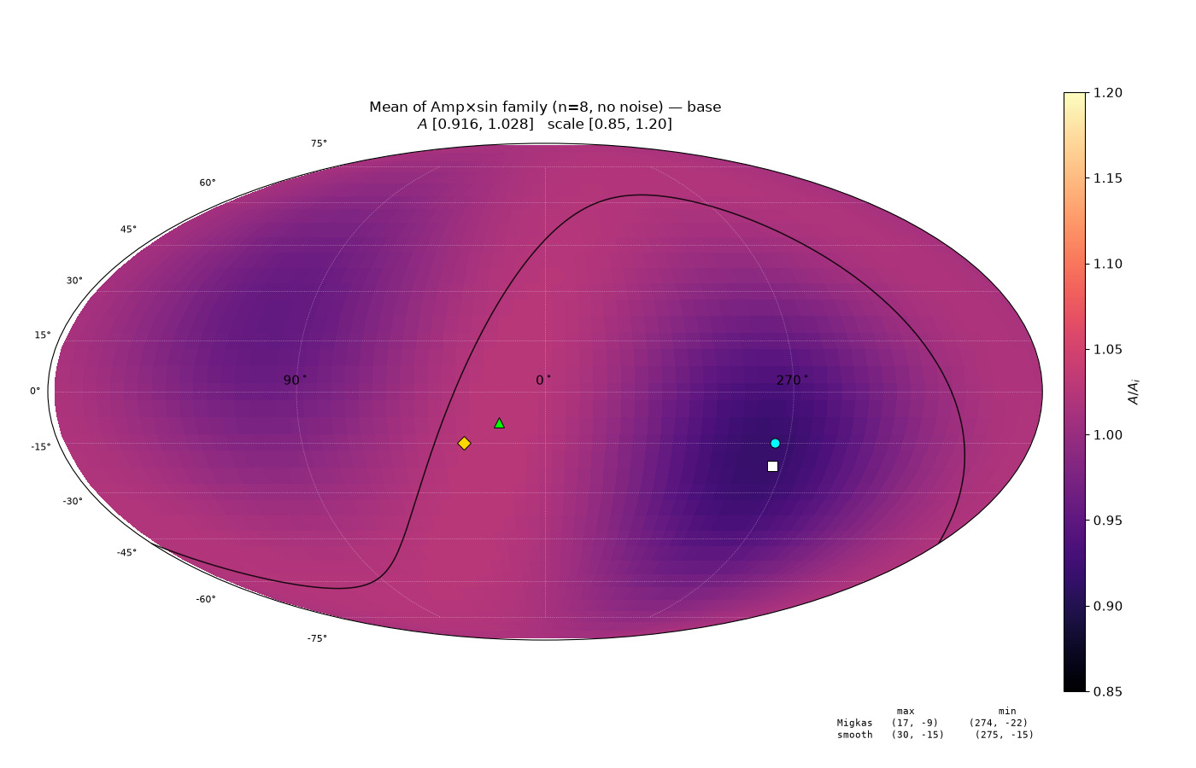
198/395 map_compare/amp_mean_param_noise/CARD_base_baseline_invsq.png

Slide 42
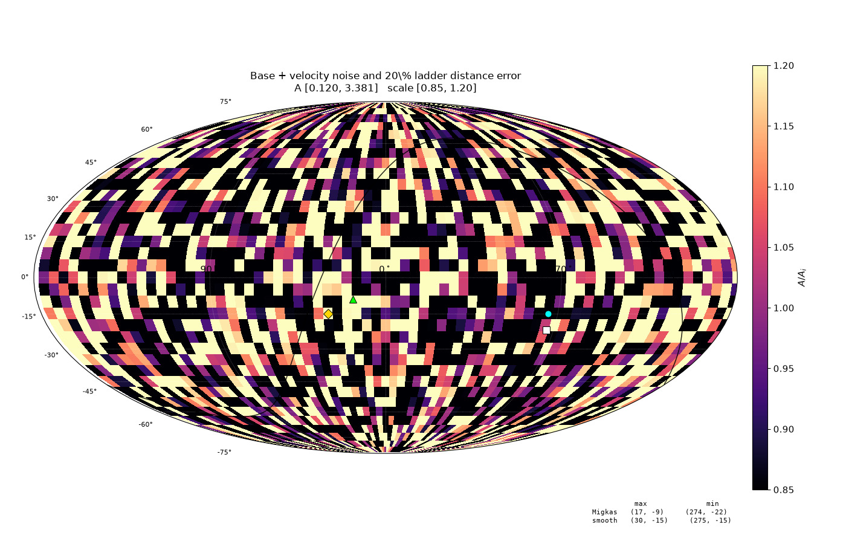
199/395 map_compare/amp_mean_param_noise/CARD_ladder_both_d20_invsq.png

Slide 43
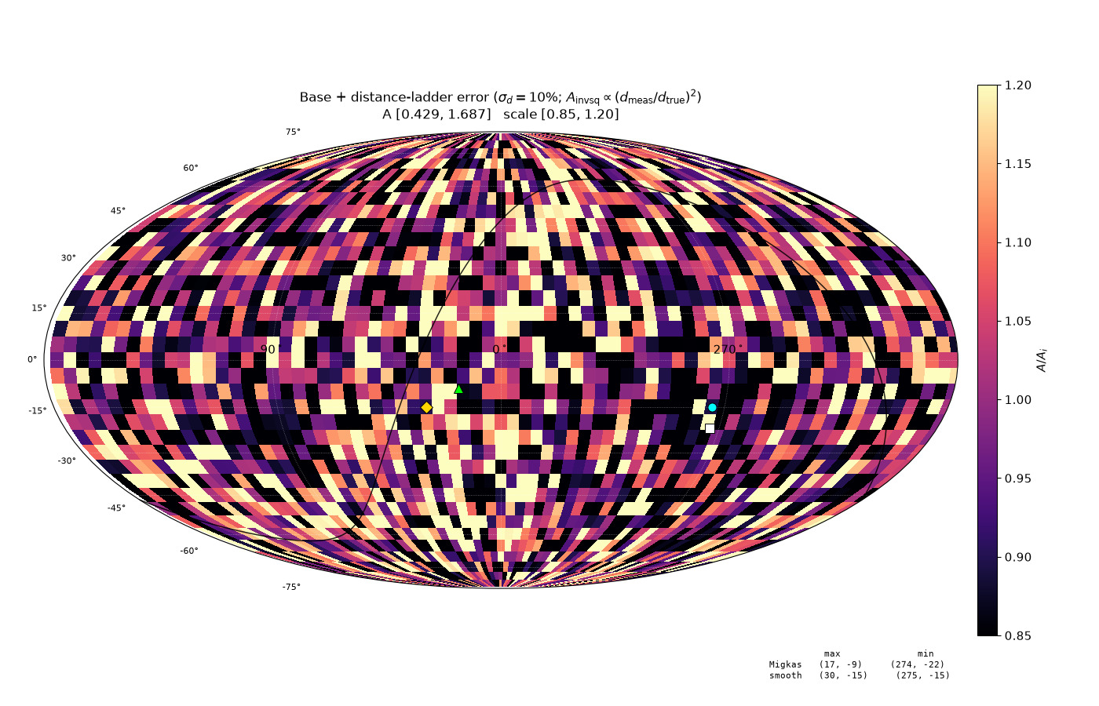
200/395 map_compare/amp_mean_param_noise/CARD_ladder_dist_d10_invsq.png

Slide 44
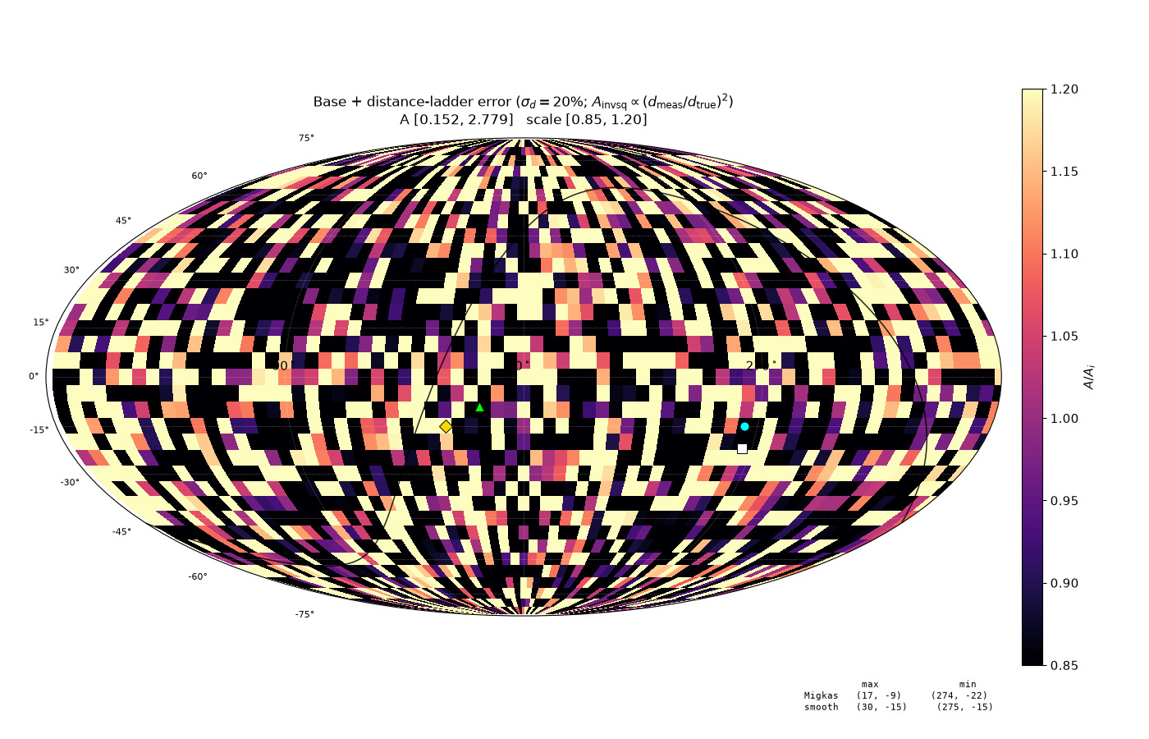
201/395 map_compare/amp_mean_param_noise/CARD_ladder_dist_d20_invsq.png

Slide 45
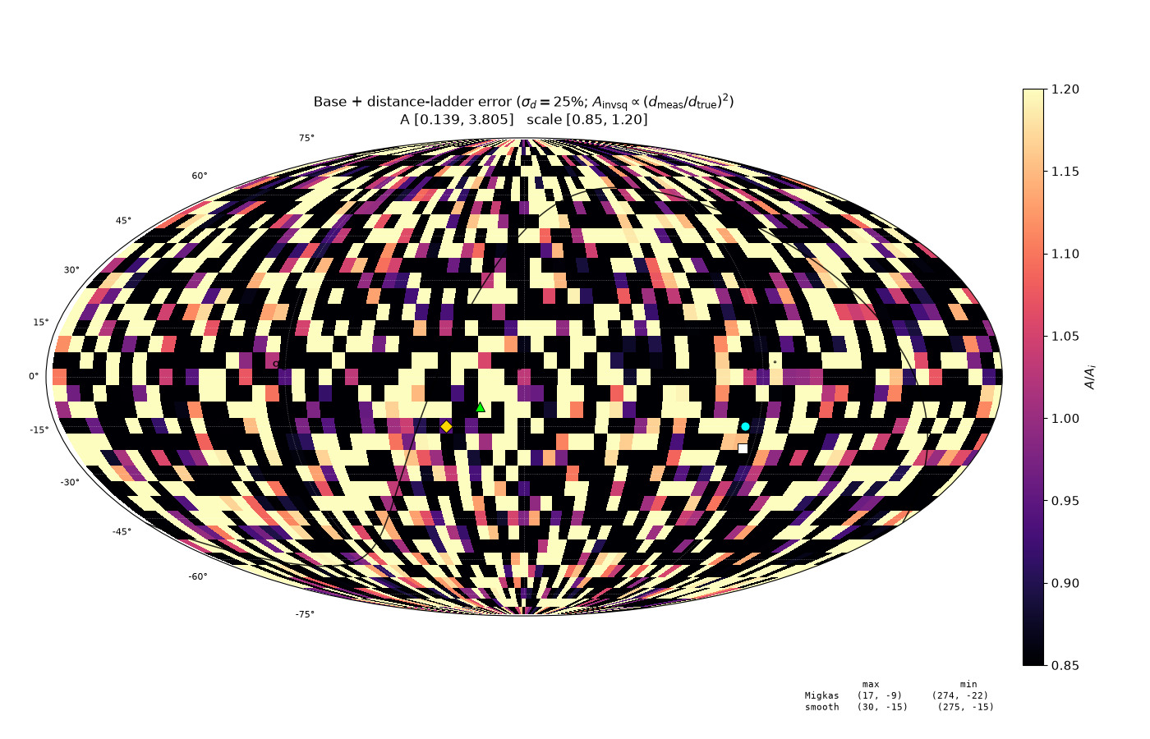
202/395 map_compare/amp_mean_param_noise/CARD_ladder_dist_d25_invsq.png

Slide 46
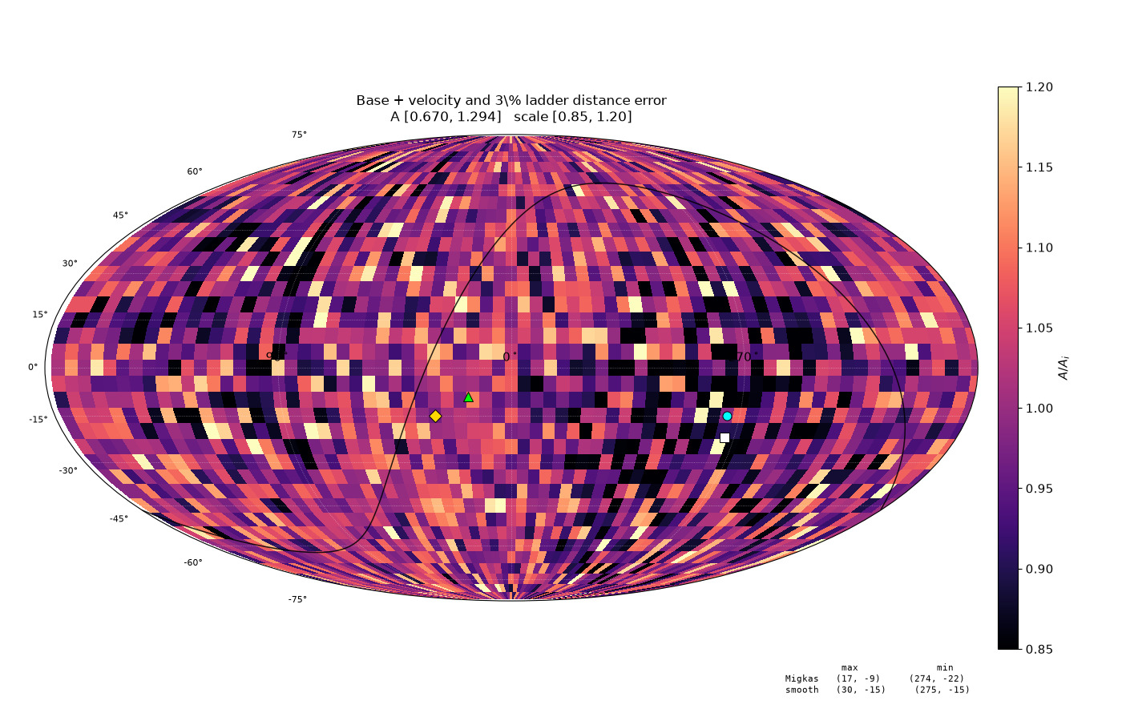
203/395 map_compare/amp_mean_param_noise/CARD_mild_both_d03_invsq.png

Slide 47
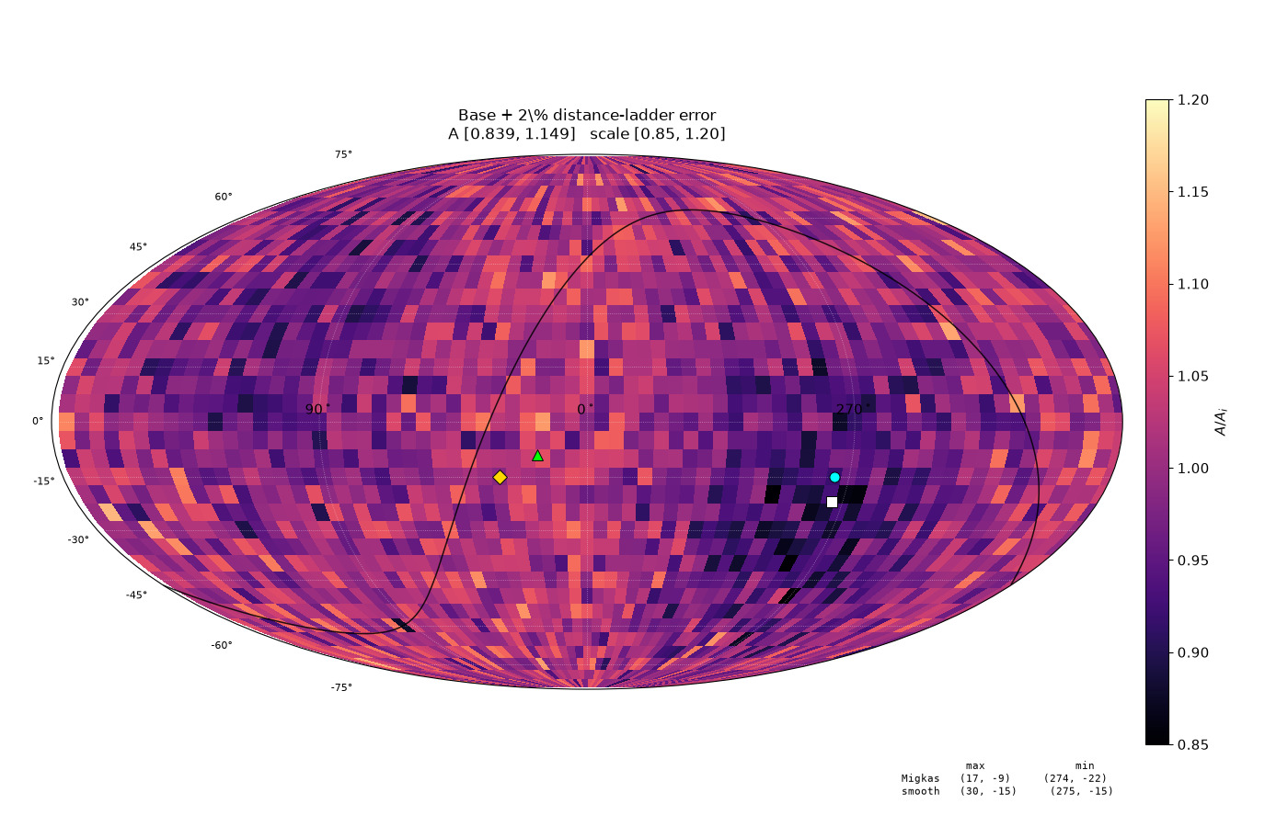
204/395 map_compare/amp_mean_param_noise/CARD_primary_dist_d02_invsq.png

Slide 48

205/395 map_compare/amp_mean_param_noise/CARD_primary_vel_invsq.png

Slide 49

206/395 map_compare/cone_param_noise/CARD_cone75_native_baseline_invsq.png

Slide 50

207/395 map_compare/cone_param_noise/CARD_cone75_native_dist_s15_invsq.png

Slide 51

208/395 map_compare/cone_param_noise/CARD_cone75_native_dist_s25_invsq.png

Slide 52

209/395 map_compare/cone_param_noise/CARD_cone75_native_vel_dist_combined_invsq.png

Slide 53
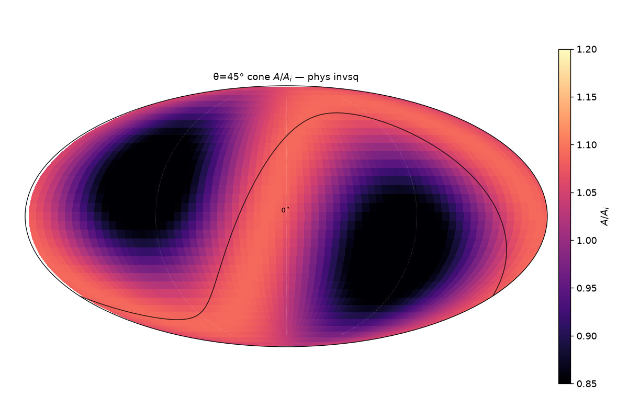
210/395 map_compare/cone_thetas/cards/theta45_phys_invsq.png

Slide 54
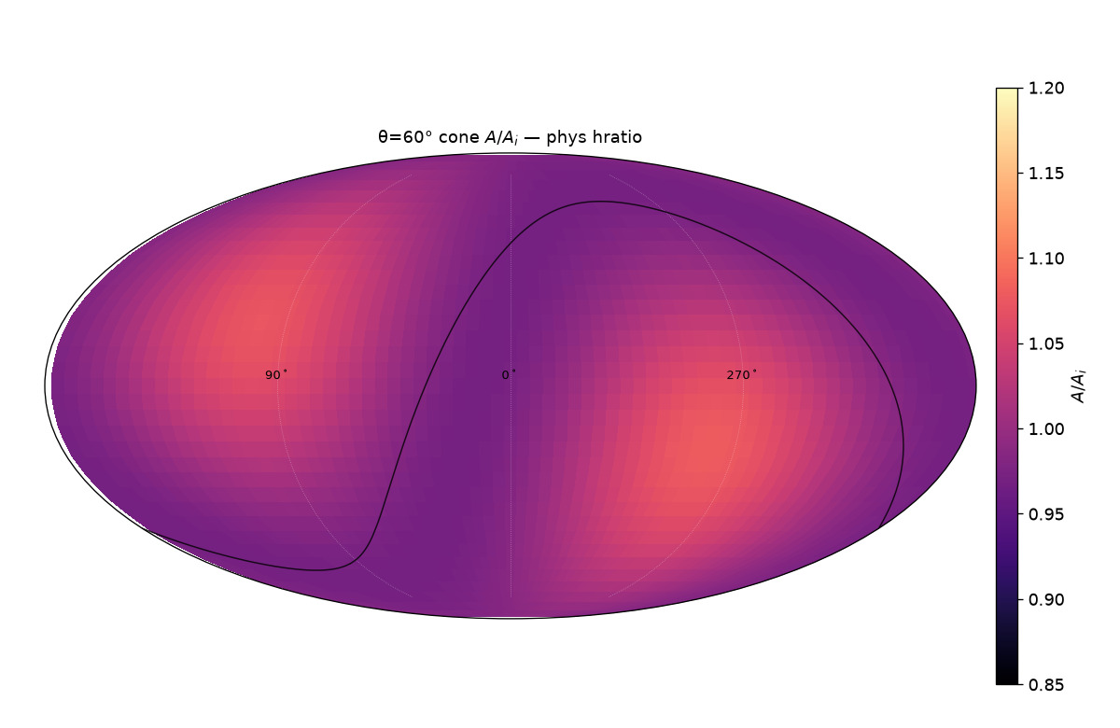
211/395 map_compare/cone_thetas/cards/theta60_phys_hratio.png

Slide 55
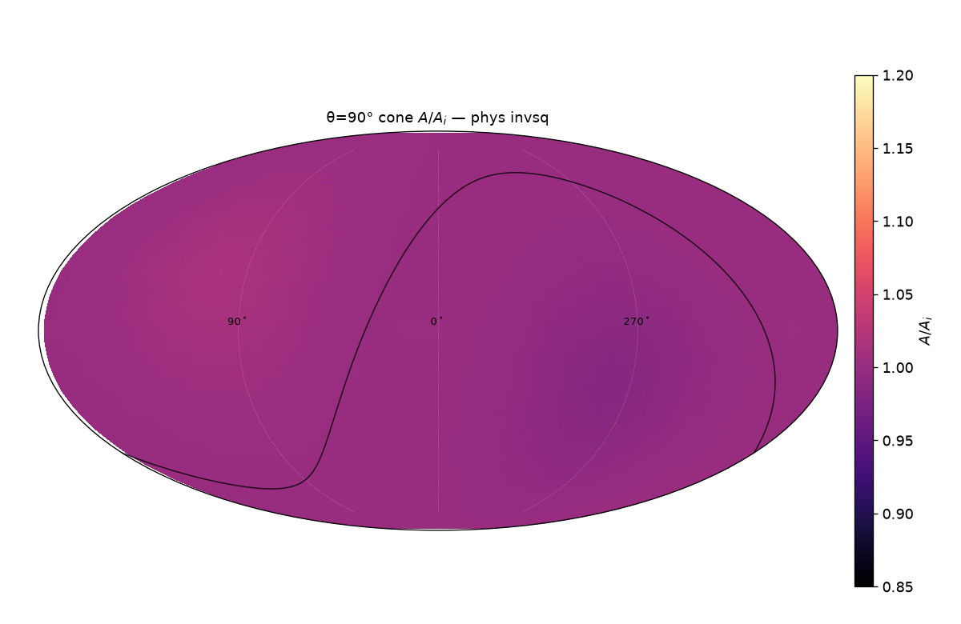
212/395 map_compare/cone_thetas/cards/theta90_phys_invsq.png

Slide 56
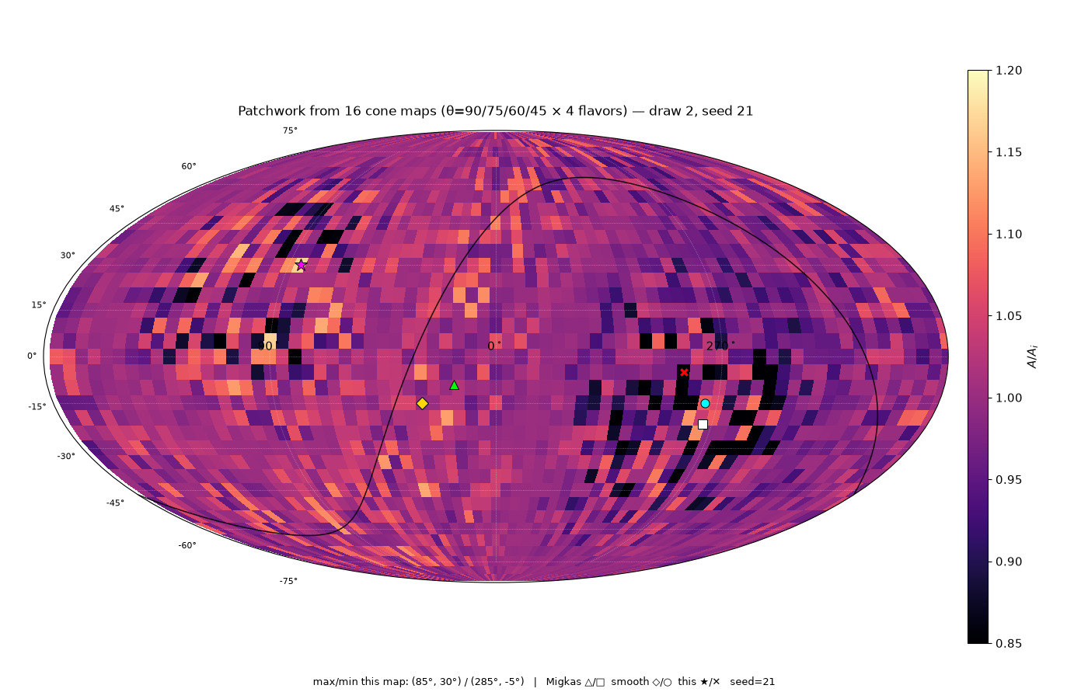
213/395 map_compare/cone_thetas/patchwork16/CARD_patchwork16_draw2_seed21.png

Slide 57
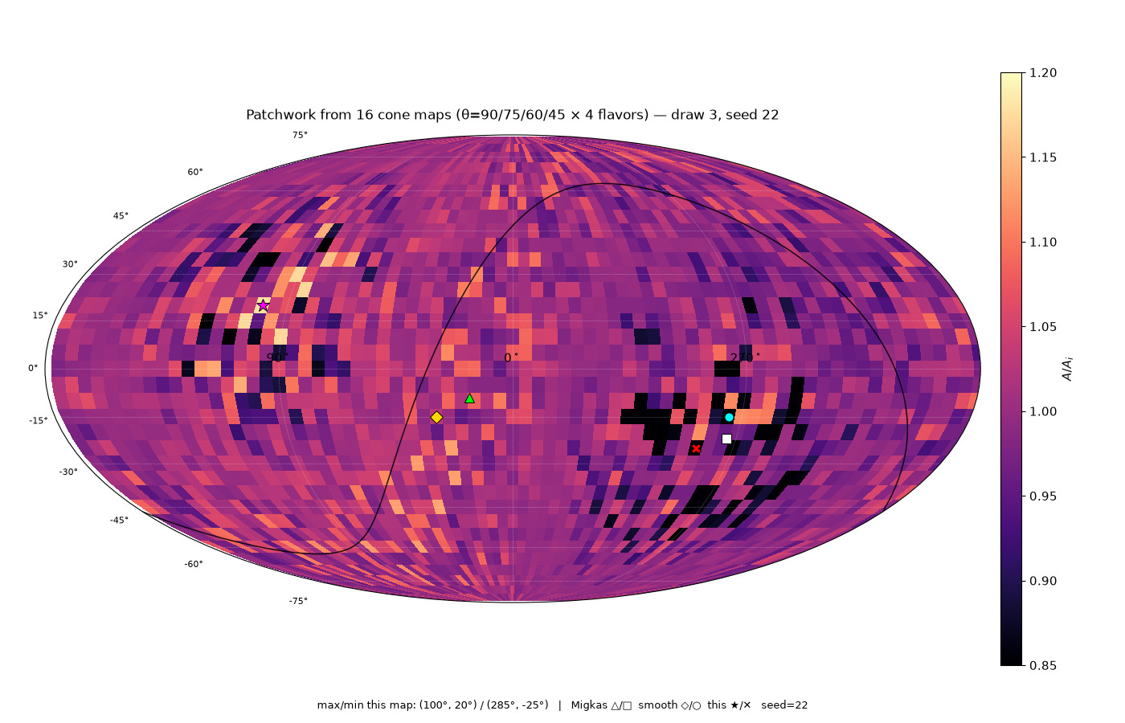
214/395 map_compare/cone_thetas/patchwork16/CARD_patchwork16_draw3_seed22.png

Slide 58
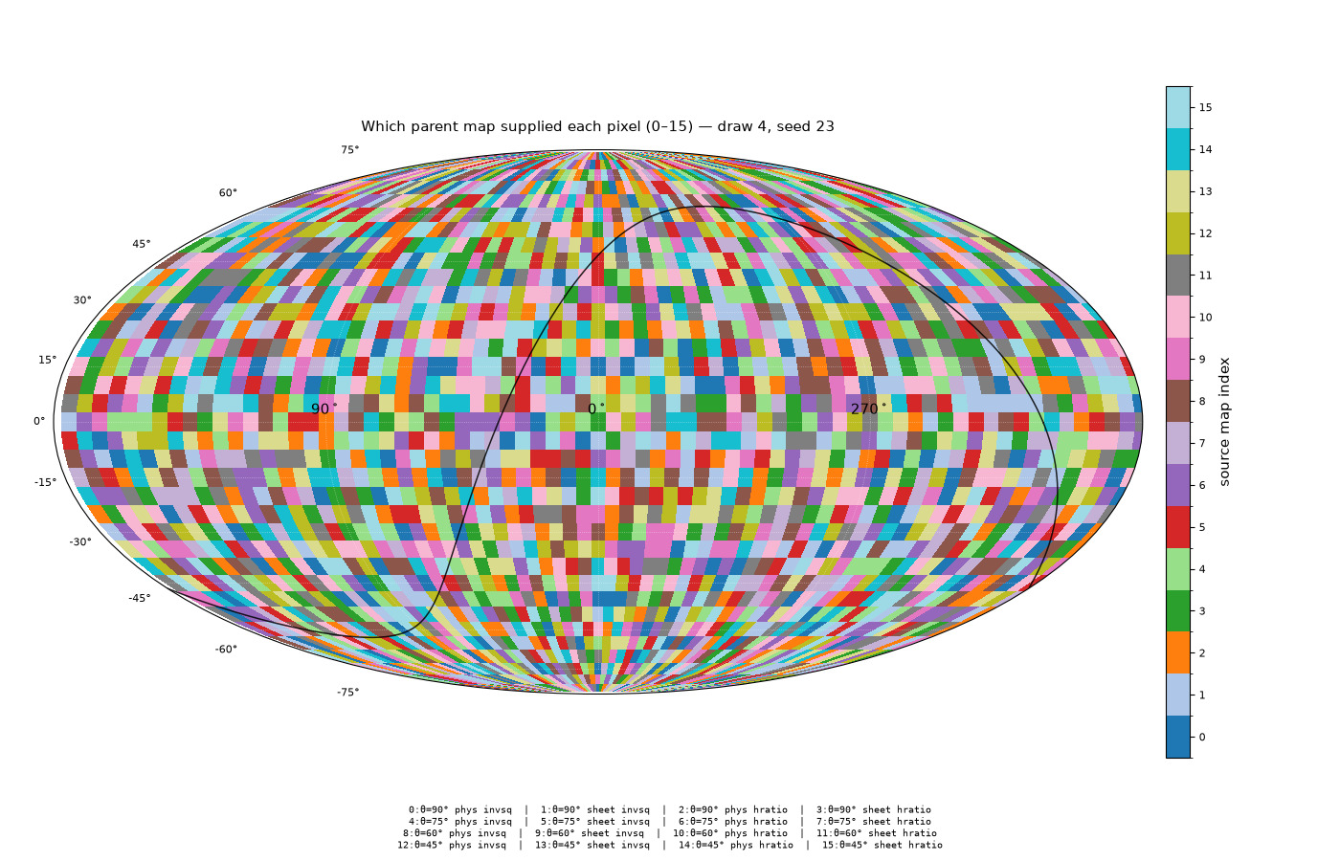
215/395 map_compare/cone_thetas/patchwork16/CARD_sources16_draw4_seed23.png

Slide 59

216/395 map_compare/cone_thetas/patchwork_sheet4/CARD_sheet4_draw2_seed31.png

Slide 60

217/395 map_compare/cone_thetas/patchwork_sheet4/CARD_sheet4_draw3_seed32.png

Slide 61

218/395 map_compare/cone_thetas/patchwork_sheet4/CARD_sheet4_draw4_seed33.png

Slide 62

219/395 map_compare/cone_thetas/patchwork_sheet4/CARD_sheet4_sources_draw2_seed31.png

Slide 63

220/395 map_compare/cone_thetas/patchwork_sheet4/CARD_sheet4_sources_draw3_seed32.png

Slide 64

221/395 map_compare/cone_thetas/patchwork_sheet4/GRID_sheet4_sources_4draws.png

Slide 65

222/395 figures/migkas_bars_rotation_overlay.png

Slide 66

223/395 map_compare/amp_mean_param_noise/CARD_ampmean_baseline_invsq.png

Slide 67

224/395 map_compare/amp_mean_param_noise/CARD_ampmean_both_invsq.png

Slide 68

225/395 map_compare/amp_mean_param_noise/CARD_ampmean_dist_invsq.png

Slide 69

226/395 map_compare/amp_mean_param_noise/CARD_base_both_invsq.png

Slide 70

227/395 map_compare/amp_mean_param_noise/CARD_base_both_minus_baseline.png

Slide 71

228/395 map_compare/amp_mean_param_noise/CARD_base_dist_invsq.png

Slide 72

229/395 map_compare/amp_mean_param_noise/CARD_ladder_baseline_invsq.png

Slide 73

230/395 map_compare/amp_mean_param_noise/CARD_ladder_both_d10_invsq.png

Slide 74

231/395 map_compare/amp_mean_param_noise/CARD_mild_baseline_invsq.png

Slide 75

232/395 map_compare/amp_mean_param_noise/CARD_mild_both_d02_invsq.png

Slide 76

233/395 map_compare/amp_mean_param_noise/CARD_mild_dist_d02_invsq.png

Slide 77

234/395 map_compare/amp_mean_param_noise/CARD_mild_dist_d03_invsq.png

Slide 78

235/395 map_compare/amp_mean_param_noise/CARD_mild_dist_d05_invsq.png

Slide 79

236/395 map_compare/amp_mean_param_noise/CARD_mixture_both_invsq.png

Slide 80

237/395 map_compare/amp_mean_param_noise/CARD_primary_both_d02_invsq.png

