Slide 1
Cosmology figures — Part 4 of 5 (by PNG creation order)
PNG slides 238–316 of 395 | mtime range: 2026-09-20 20:05:52 CDT – 2026-09-20 20:05:52 CDT
79 PNG image slides

Slide 2
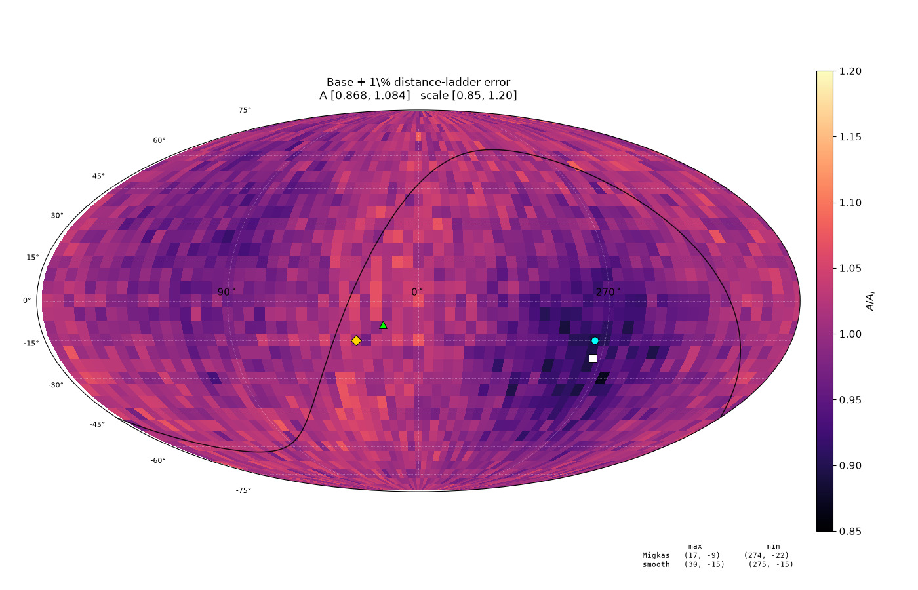
238/395 map_compare/amp_mean_param_noise/CARD_primary_dist_d01_invsq.png

Slide 3
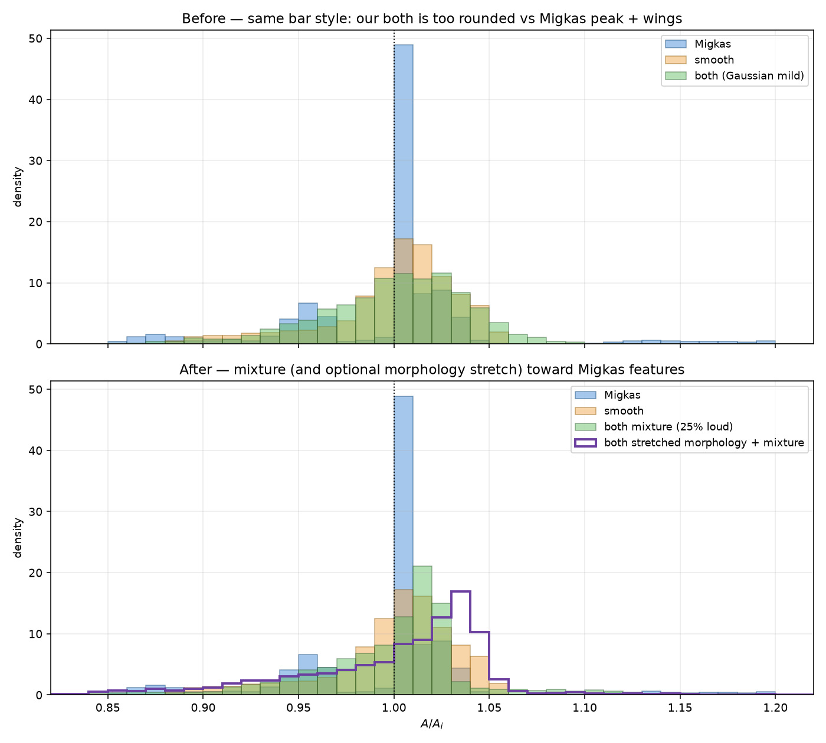
239/395 map_compare/amp_mean_param_noise/HIST_A_features_fix.png

Slide 4
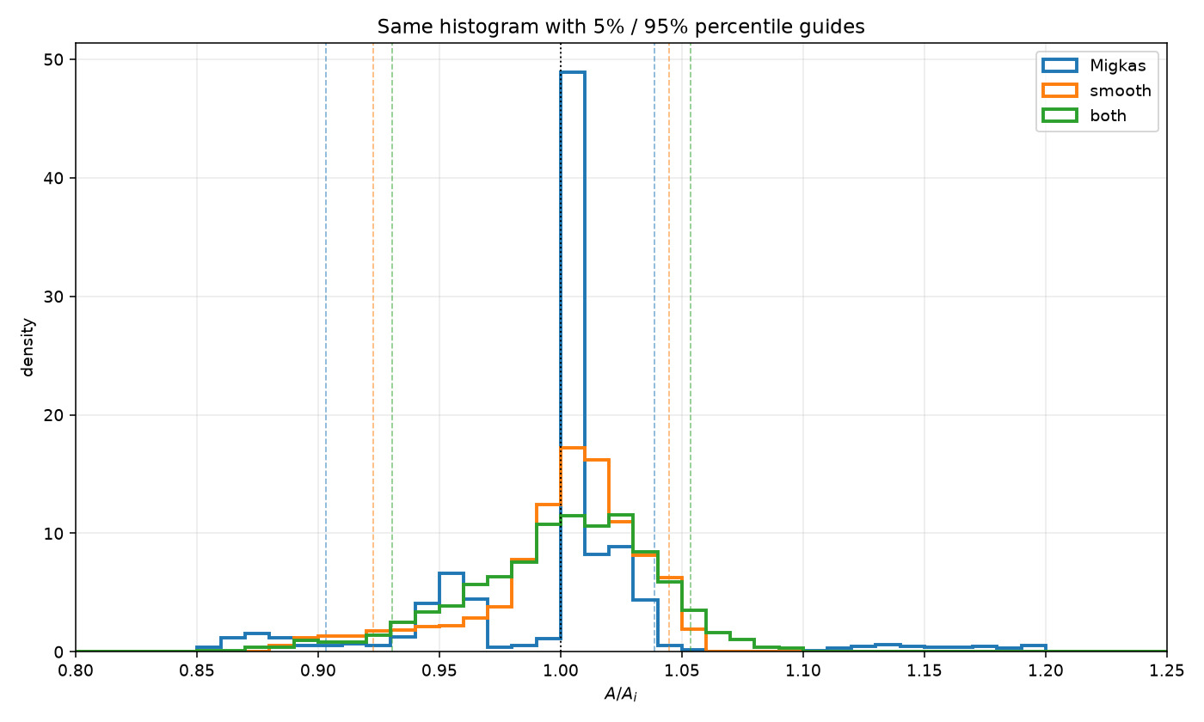
240/395 map_compare/amp_mean_param_noise/HIST_A_migkas_smooth_both_percentiles.png

Slide 5
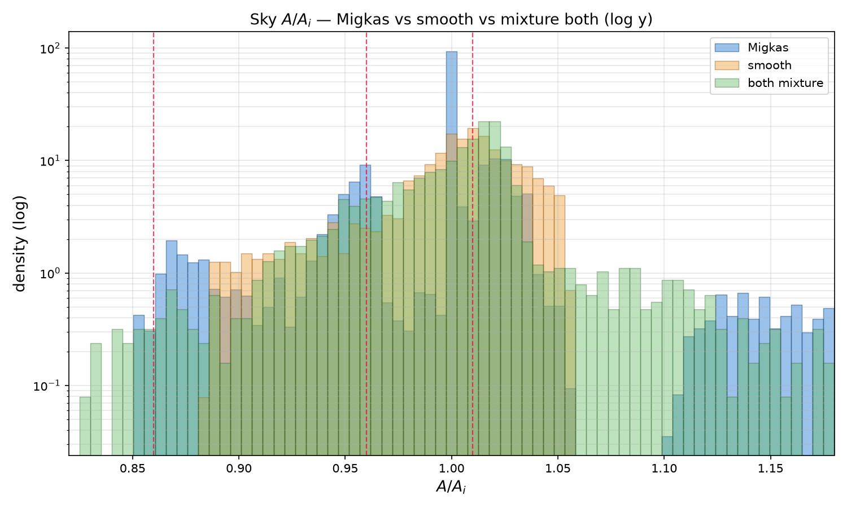
241/395 map_compare/amp_mean_param_noise/HIST_A_migkas_smooth_mixture_both_logy.png

Slide 6
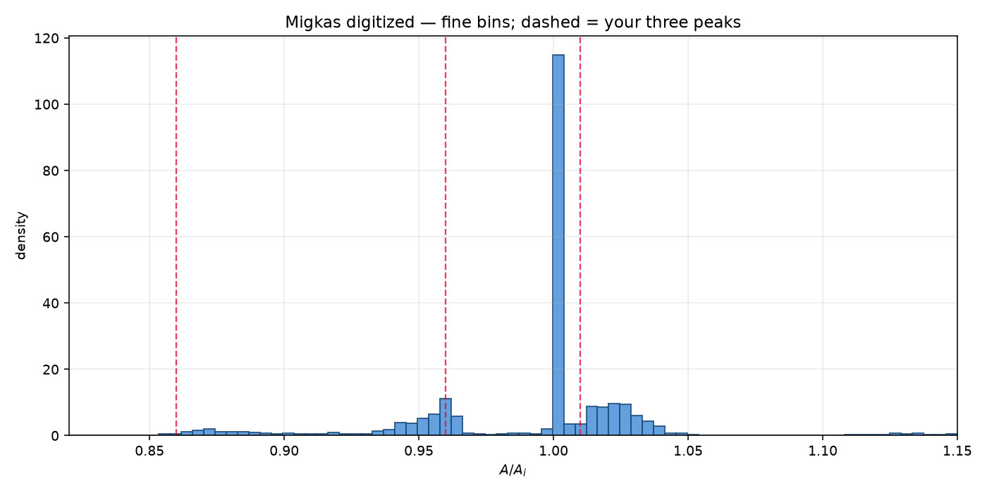
242/395 map_compare/amp_mean_param_noise/HIST_migkas_fine_three_peaks.png

Slide 7
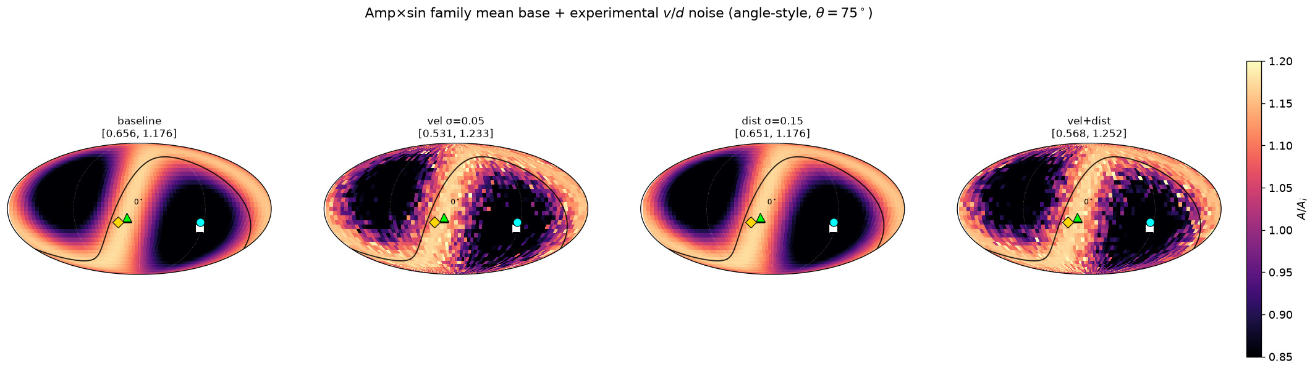
243/395 map_compare/amp_mean_param_noise/STRIP_ampmean_baseline_vel_dist_both.png

Slide 8
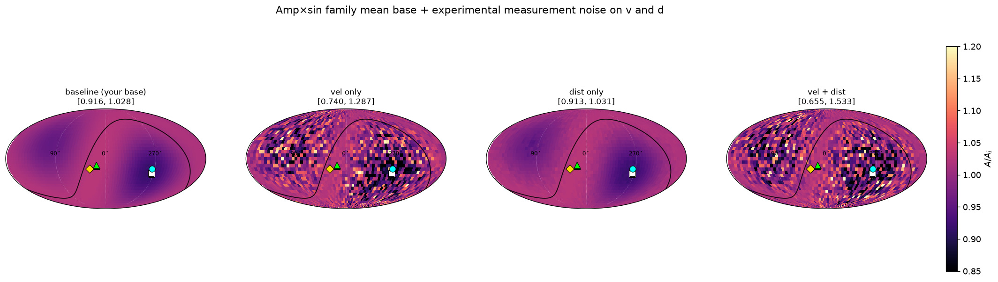
244/395 map_compare/amp_mean_param_noise/STRIP_base_vel_dist_both.png

Slide 9
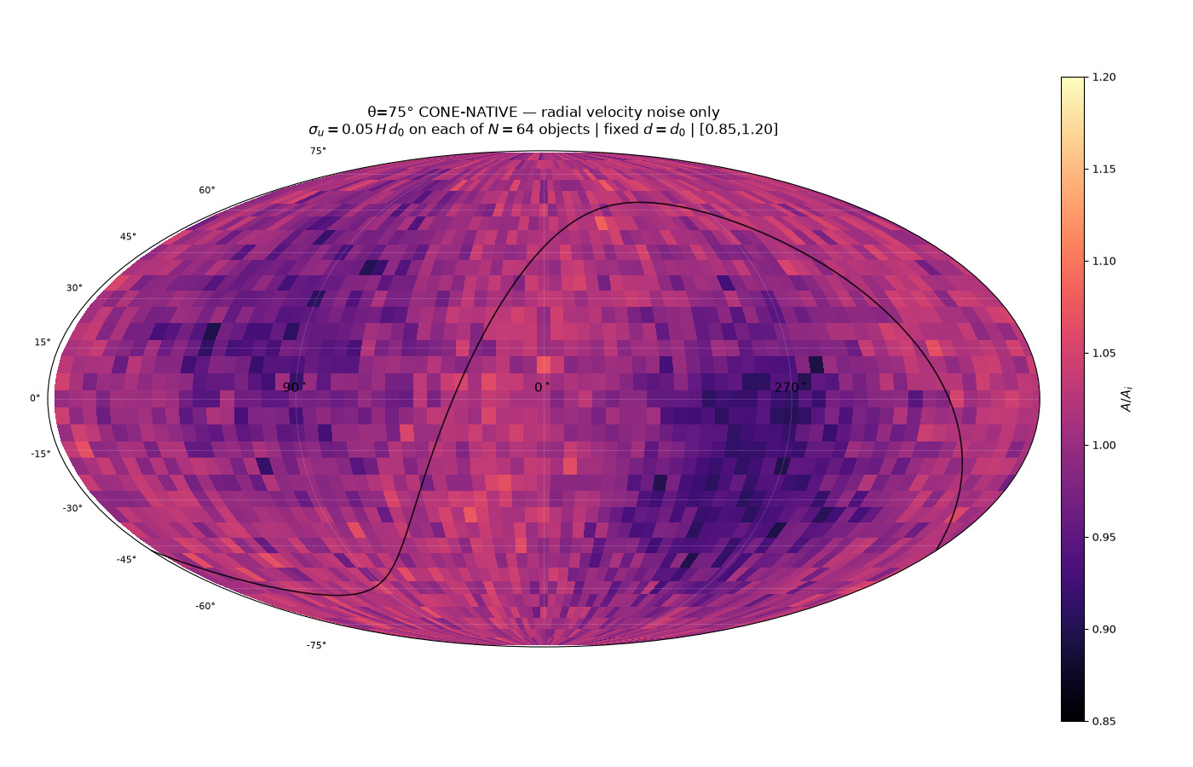
245/395 map_compare/cone_param_noise/CARD_cone75_native_vel_radial_s05_invsq.png

Slide 10
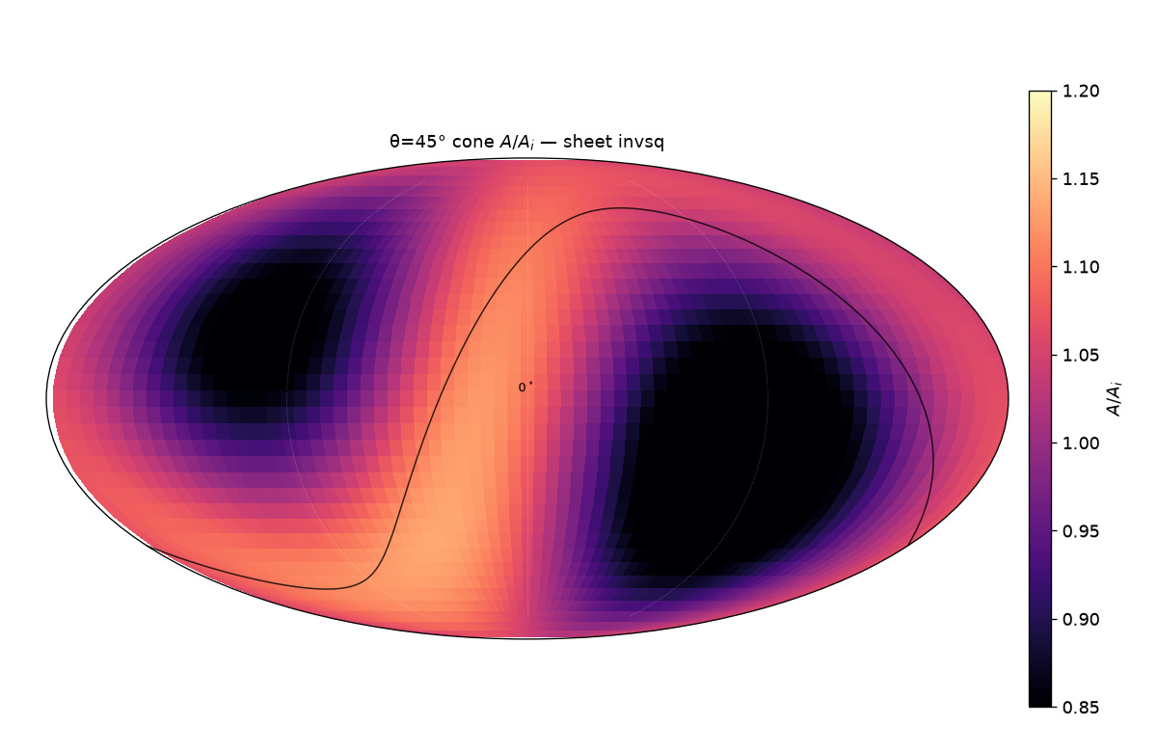
246/395 map_compare/cone_thetas/cards/theta45_sheet_invsq.png

Slide 11
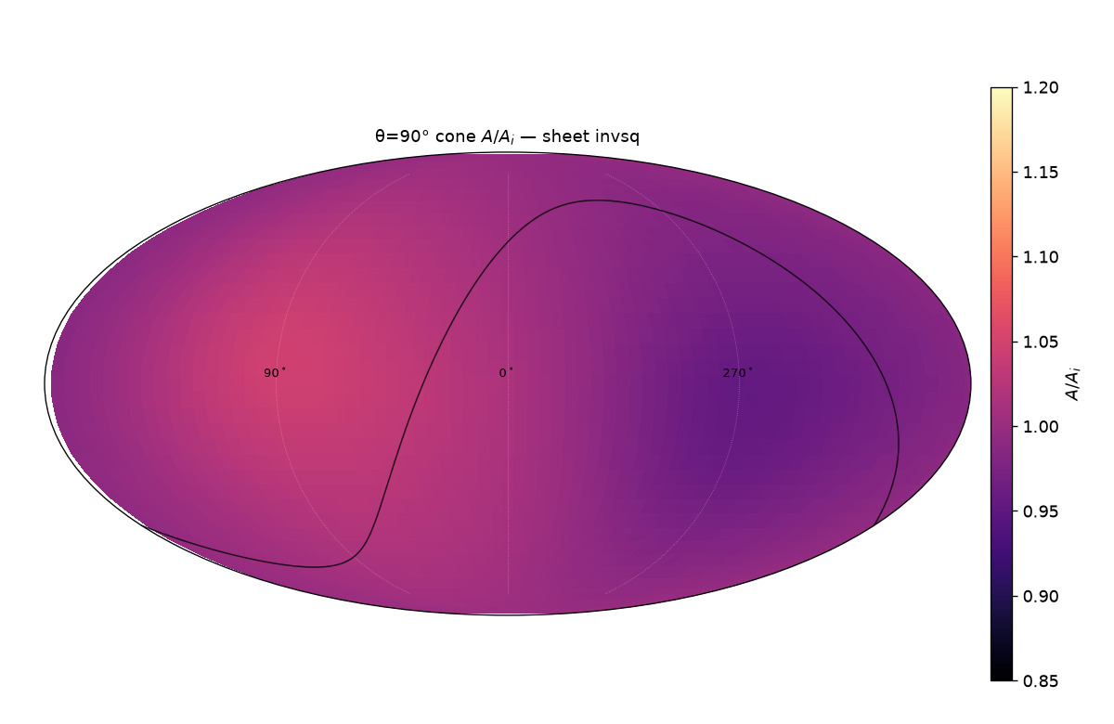
247/395 map_compare/cone_thetas/cards/theta90_sheet_invsq.png

Slide 12
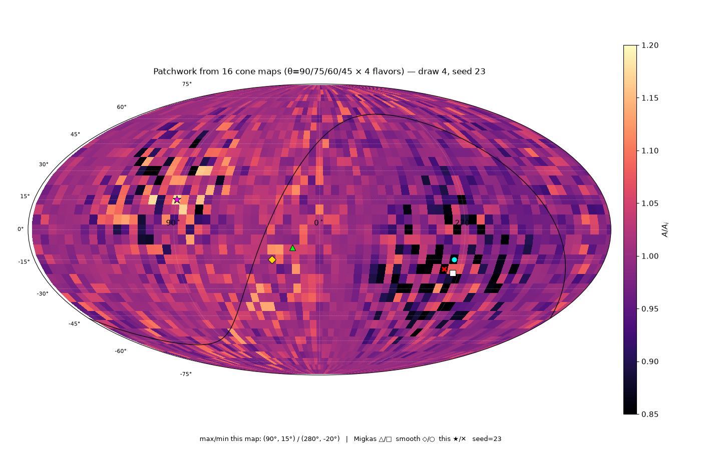
248/395 map_compare/cone_thetas/patchwork16/CARD_patchwork16_draw4_seed23.png

Slide 13
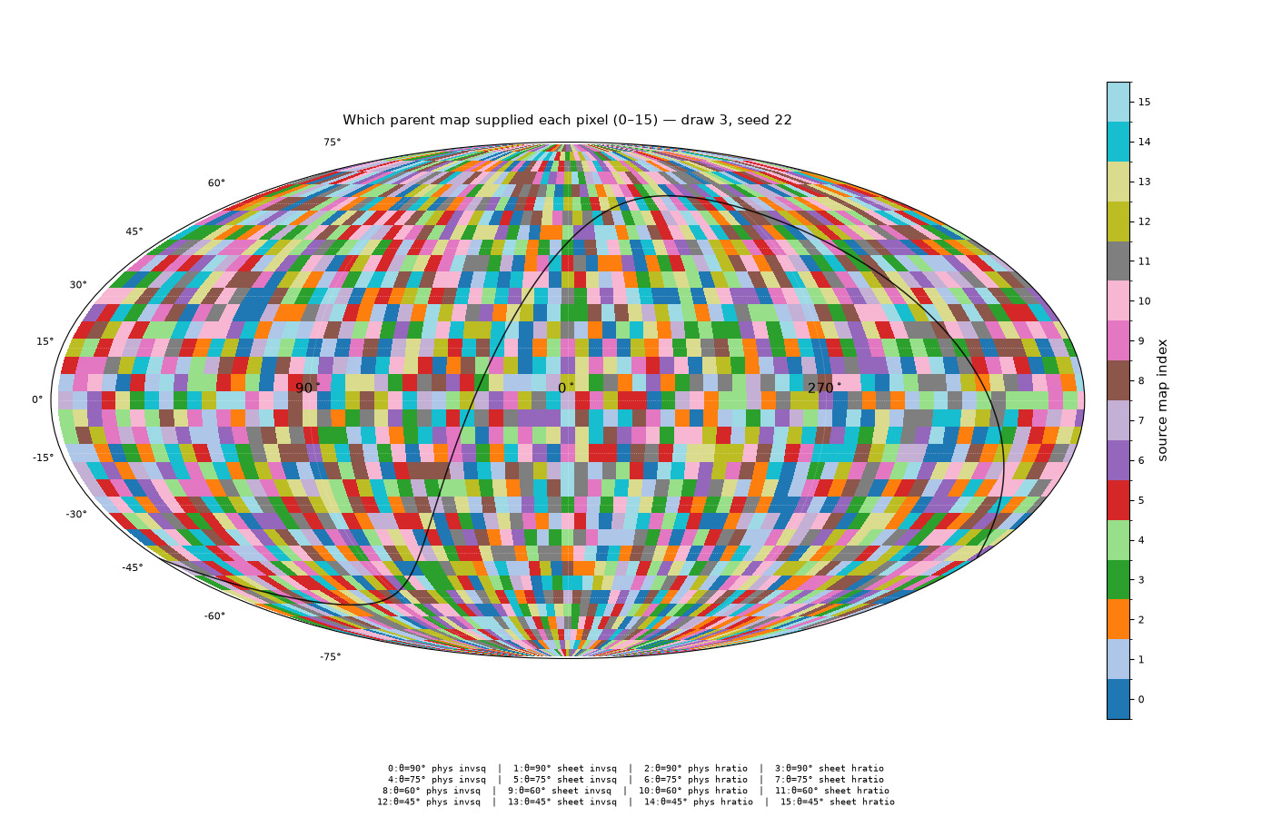
249/395 map_compare/cone_thetas/patchwork16/CARD_sources16_draw3_seed22.png

Slide 14
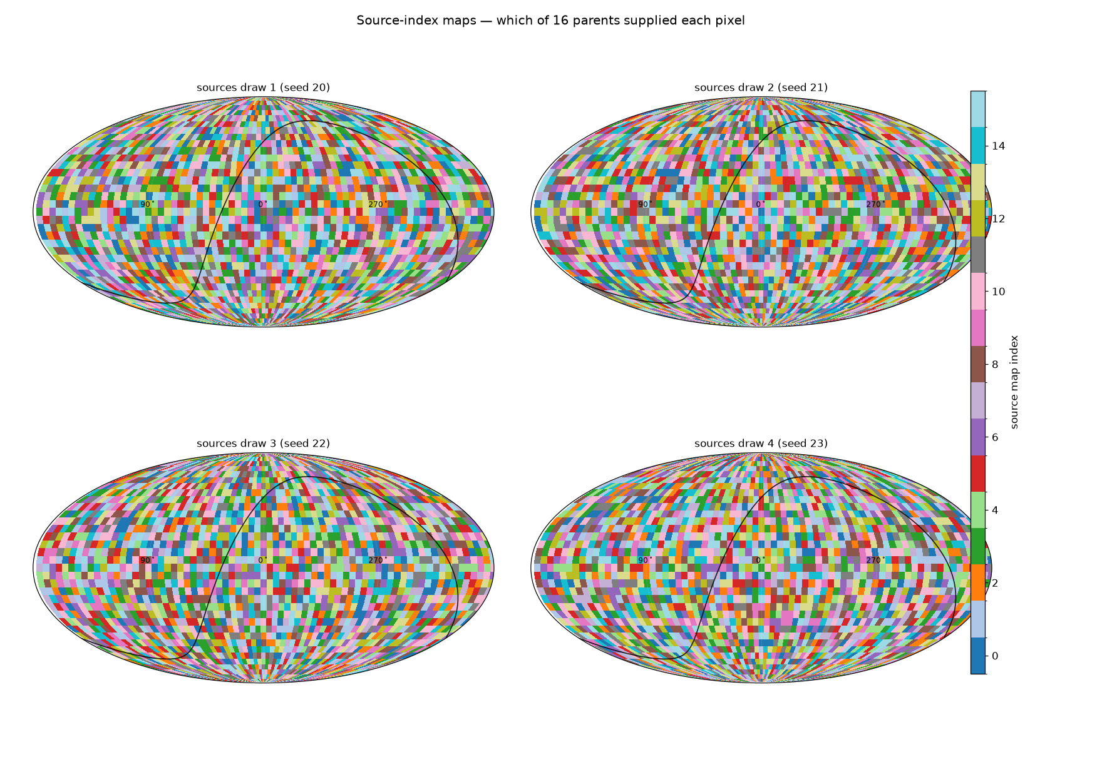
250/395 map_compare/cone_thetas/patchwork16/GRID_sources16_4draws.png

Slide 15
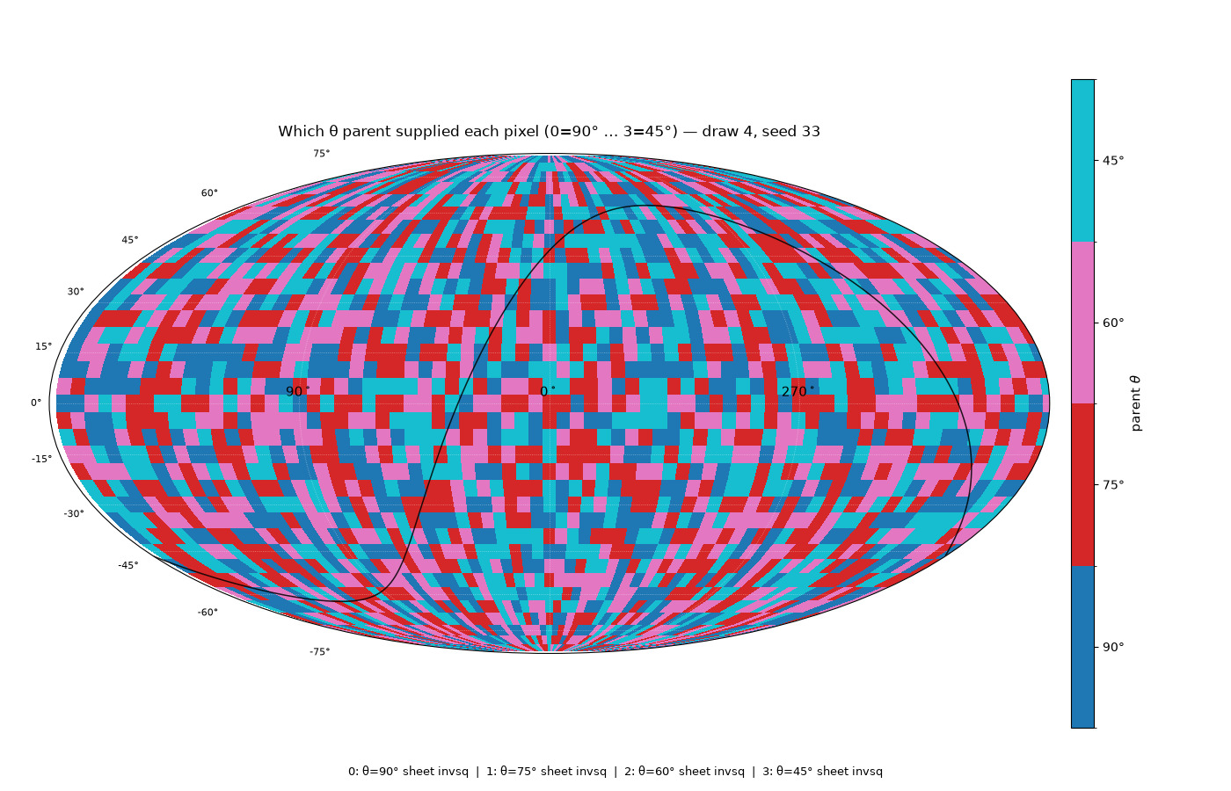
251/395 map_compare/cone_thetas/patchwork_sheet4/CARD_sheet4_sources_draw4_seed33.png

Slide 16
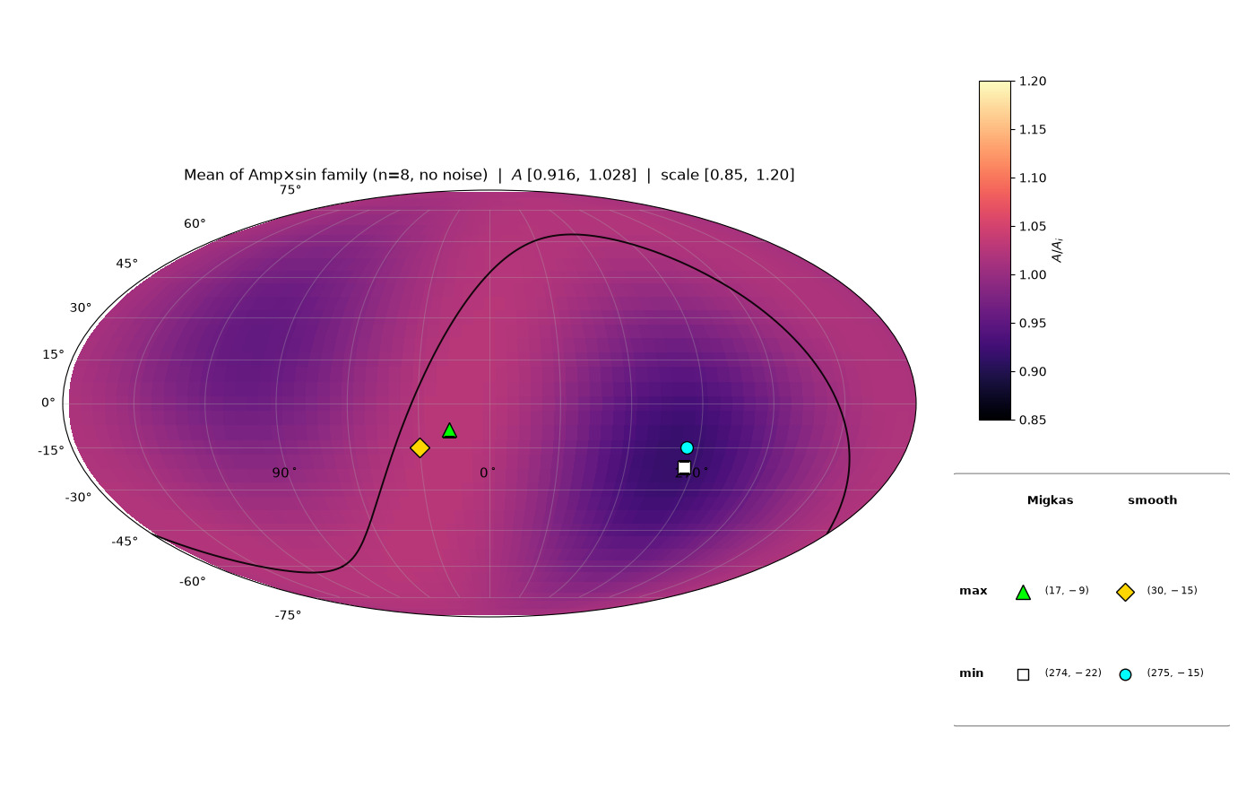
252/395 map_compare/levelset_maps/CARD_amp_family_MEAN.png

Slide 17
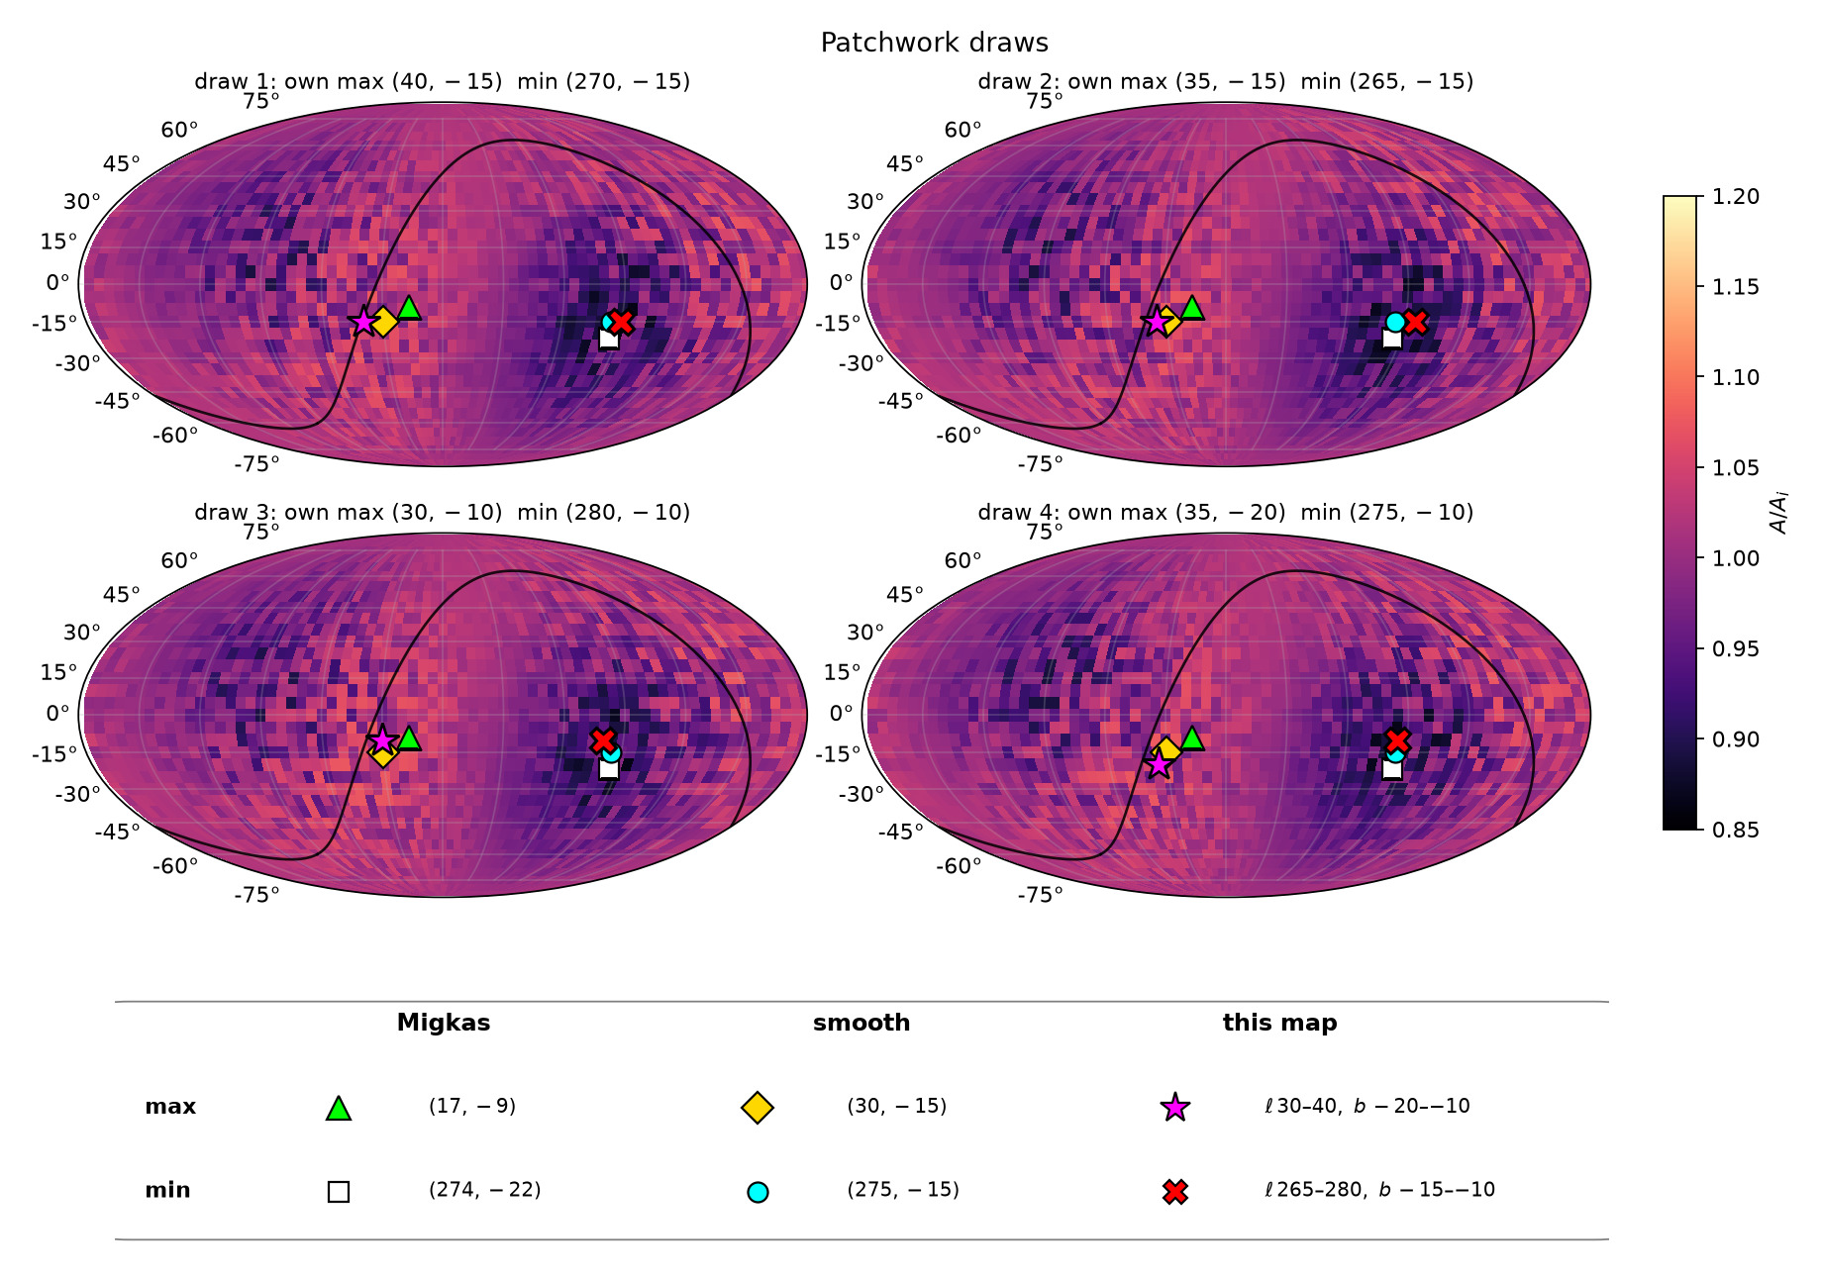
253/395 map_compare/levelset_maps/GRID_patchwork_4draws_ALL_MARKERS.png

Slide 18
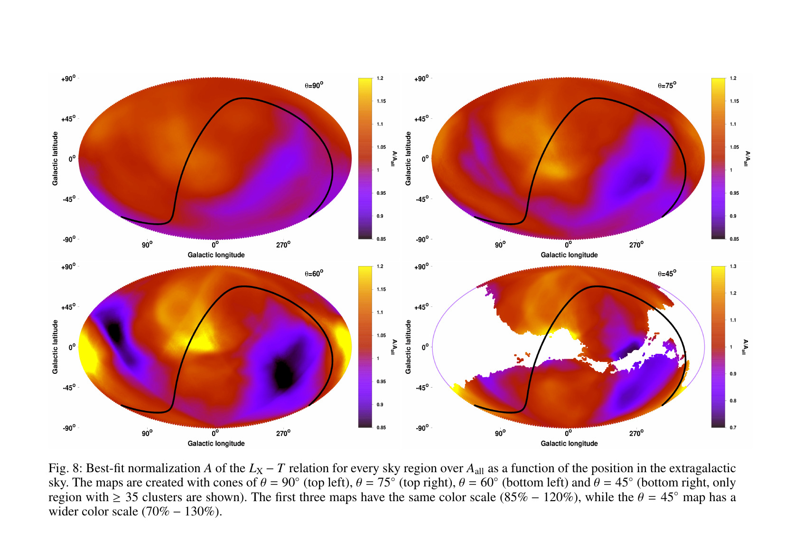
254/395 map_compare/migkas_fig8_full.png

Slide 19
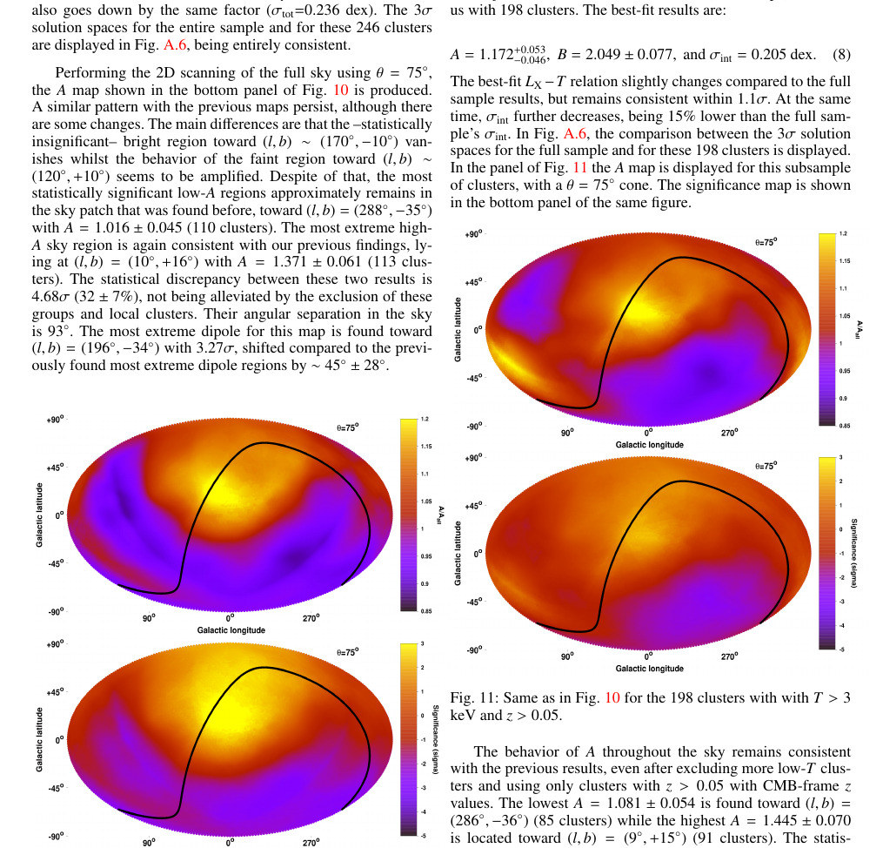
255/395 migkas/pub_maps/Fig10_11_subsamples.png

Slide 20
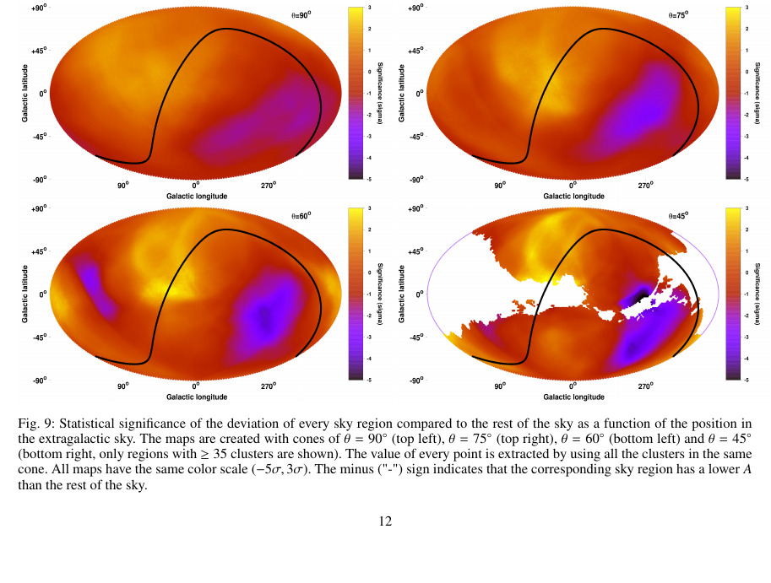
256/395 migkas/pub_maps/Fig9_significance_all_theta.png

Slide 21
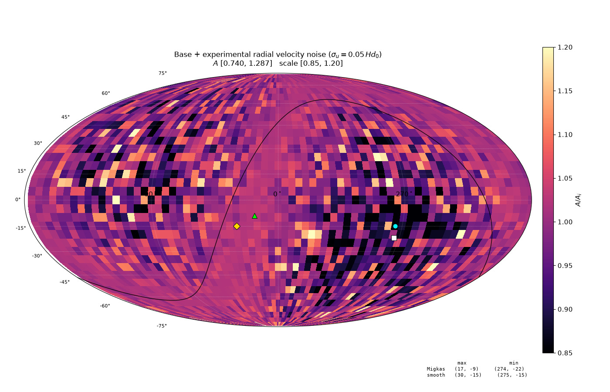
257/395 map_compare/amp_mean_param_noise/CARD_base_vel_invsq.png

Slide 22
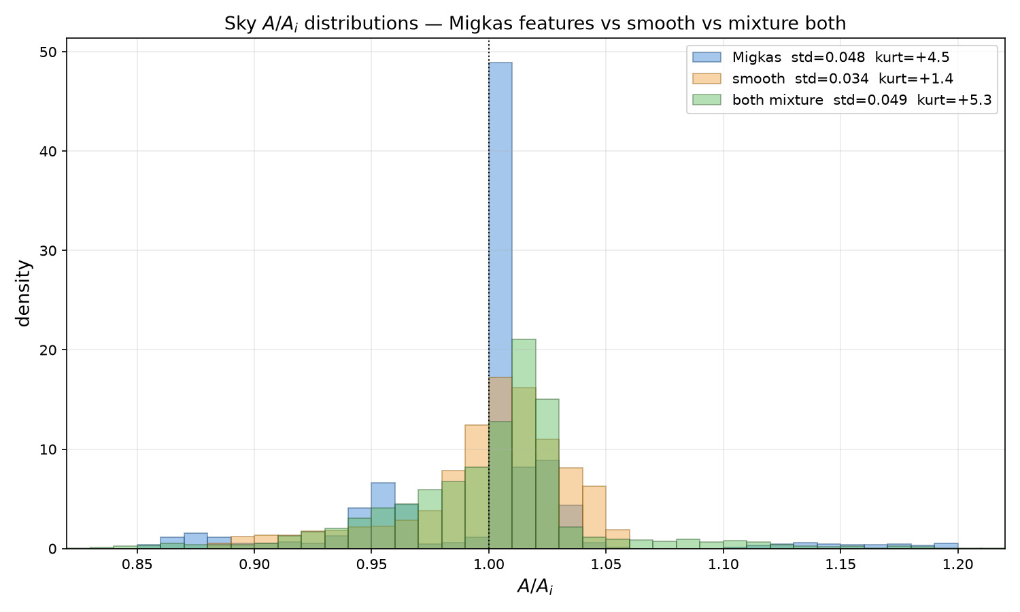
258/395 map_compare/amp_mean_param_noise/HIST_A_migkas_smooth_mixture_both.png

Slide 23
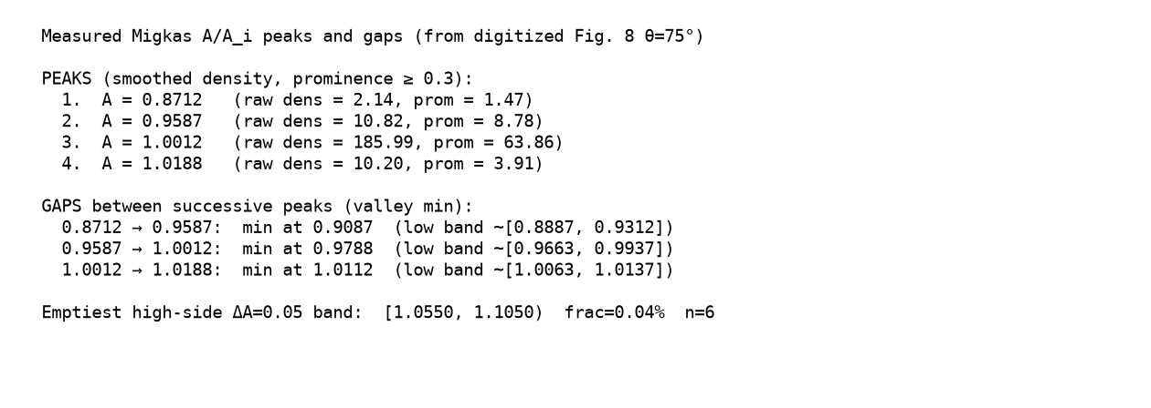
259/395 map_compare/amp_mean_param_noise/HIST_migkas_peaks_gaps_table.png

Slide 24
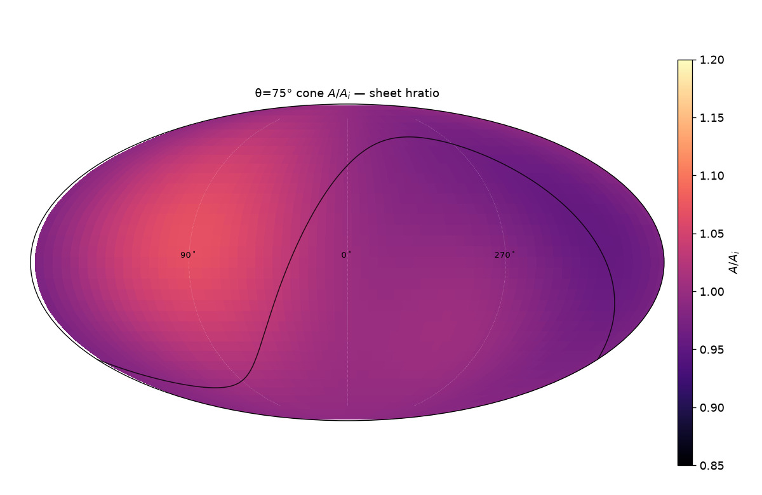
260/395 map_compare/cone_thetas/cards/theta75_sheet_hratio.png

Slide 25
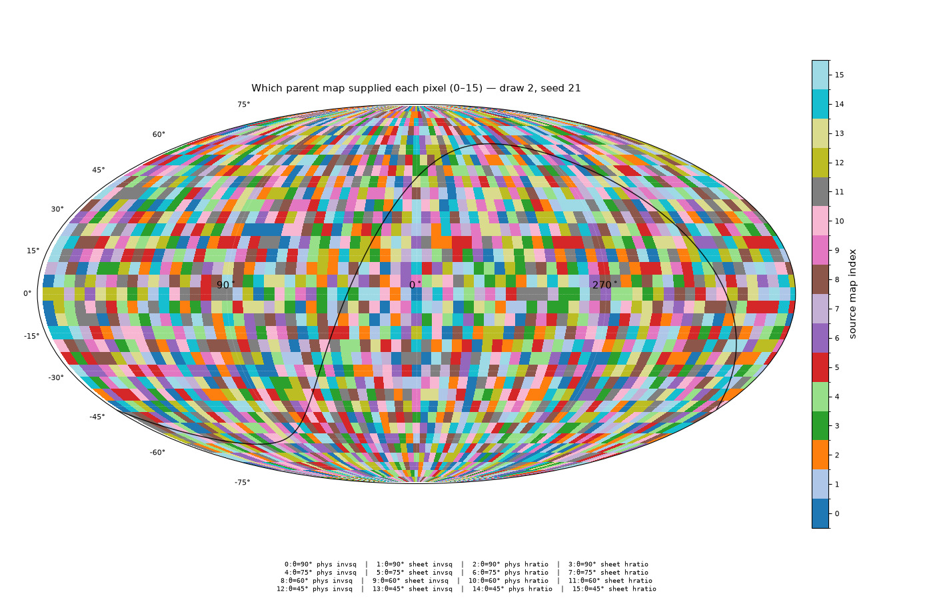
261/395 map_compare/cone_thetas/patchwork16/CARD_sources16_draw2_seed21.png

Slide 26
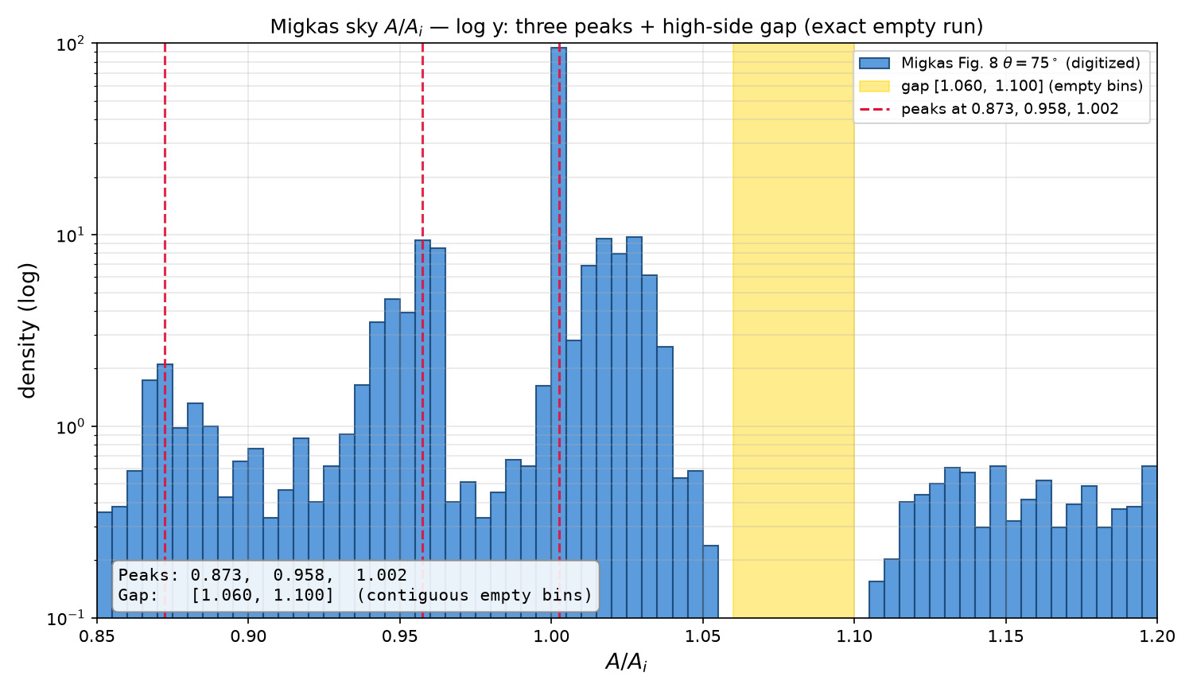
262/395 map_compare/amp_mean_param_noise/HIST_migkas_logy_identify_peaks_gap_clean.png

Slide 27
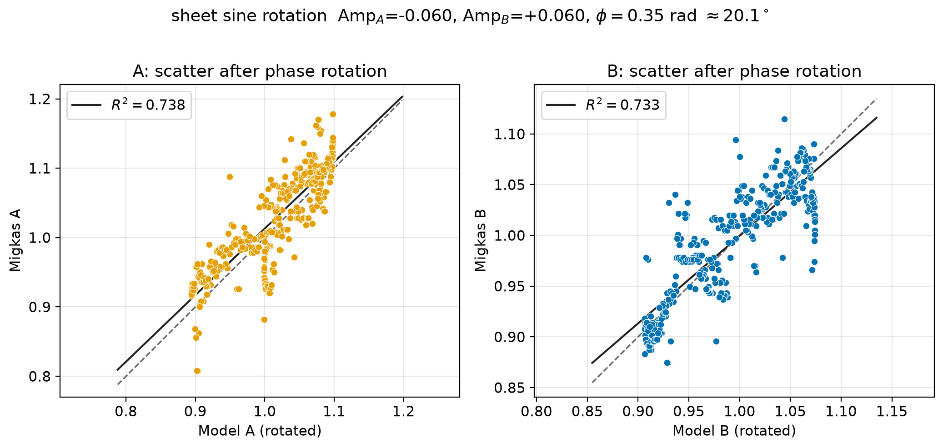
263/395 figures/migkas_sheet_scatter_amp006.png

Slide 28
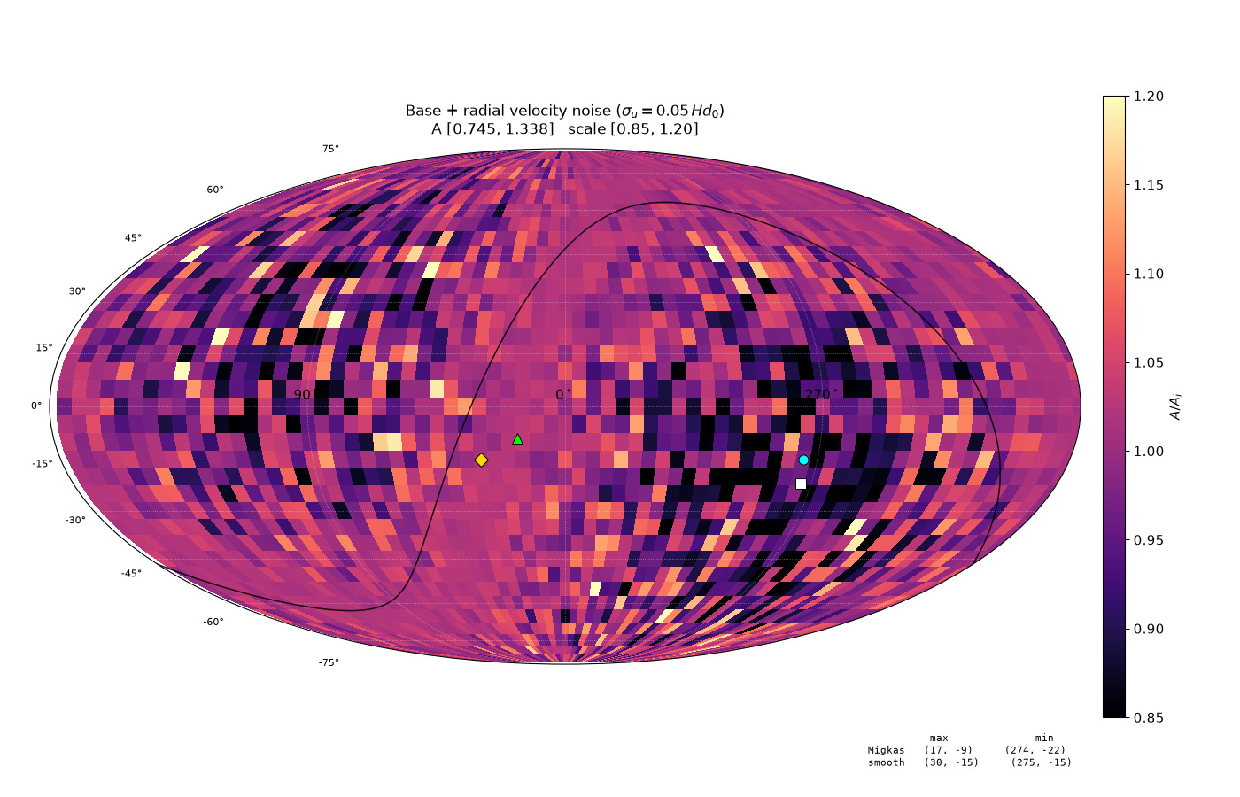
264/395 map_compare/amp_mean_param_noise/CARD_mild_vel_invsq.png

Slide 29
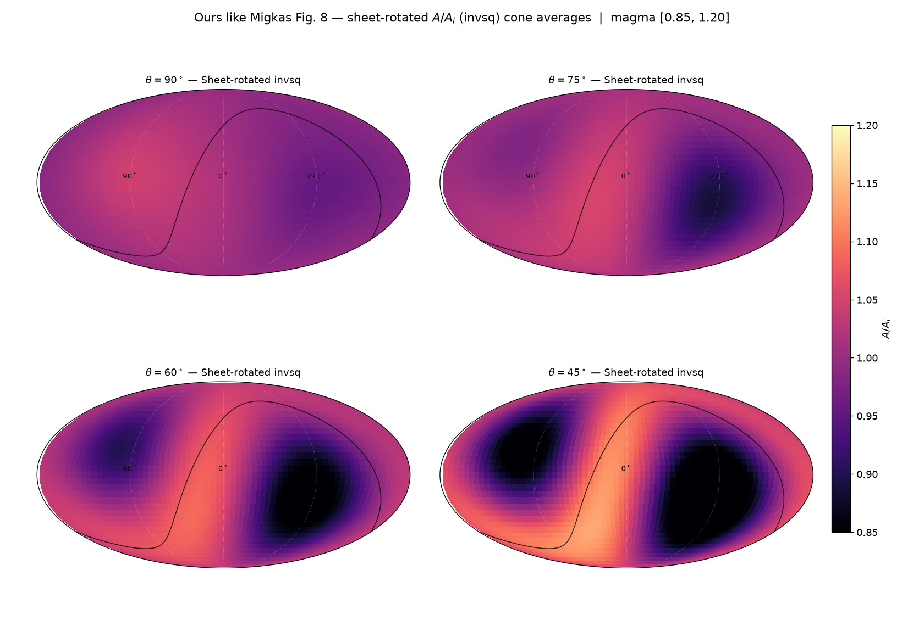
265/395 map_compare/cone_thetas/GRID_ours_like_fig8_sheet_invsq.png

Slide 30
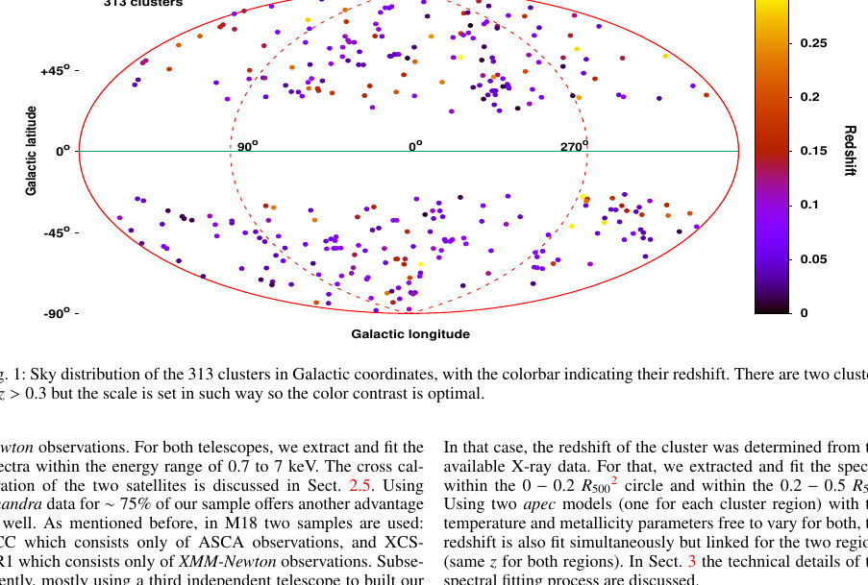
266/395 migkas/pub_maps/Fig1_cluster_sky.png

Slide 31
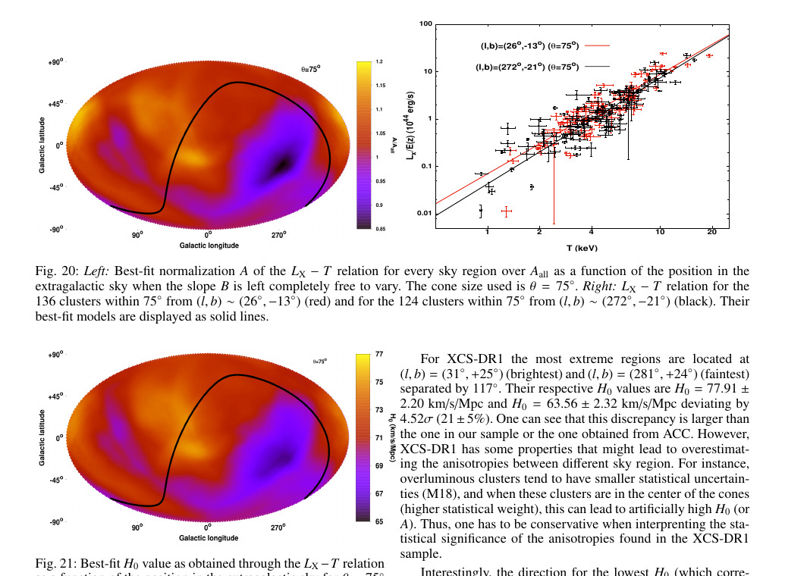
267/395 migkas/pub_maps/Fig20_page_region.png

Slide 32
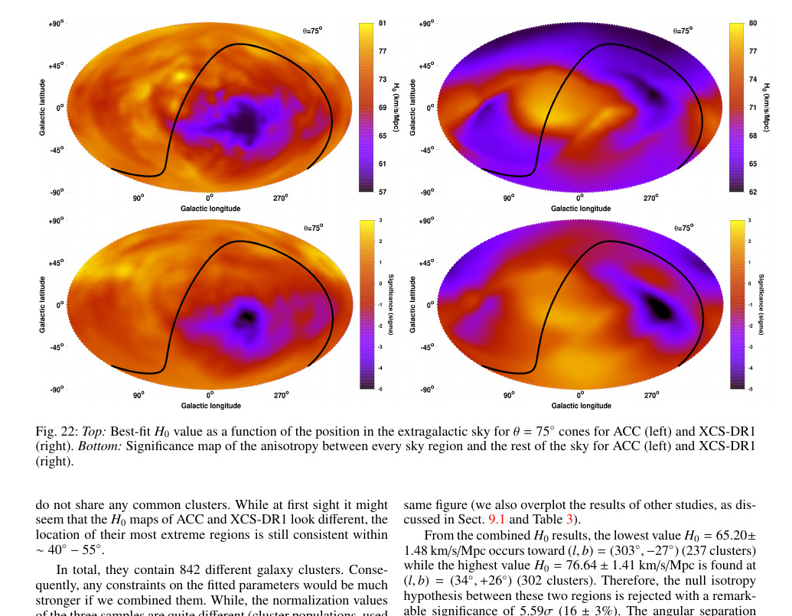
268/395 migkas/pub_maps/Fig22_ACC_XCS_H0.png

Slide 33
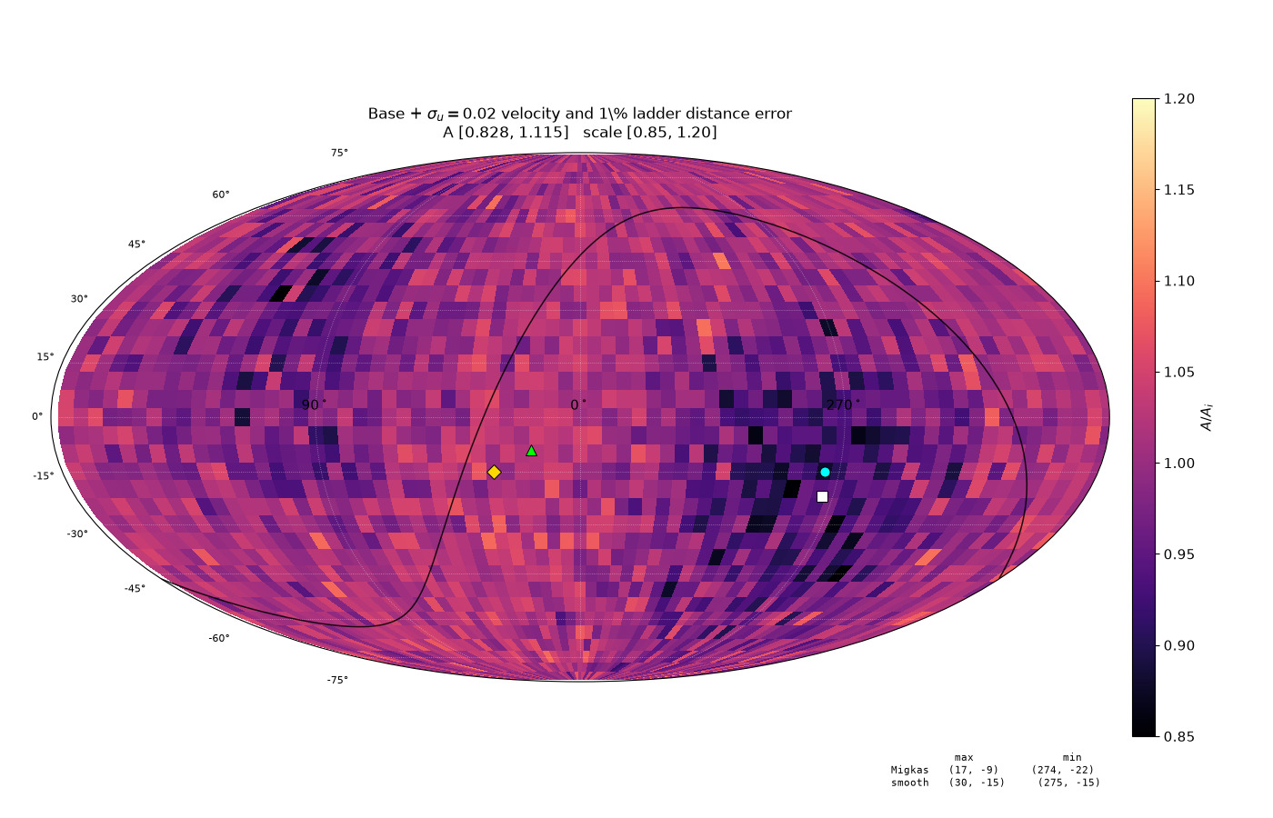
269/395 map_compare/amp_mean_param_noise/CARD_primary_both_d01_invsq.png

Slide 34
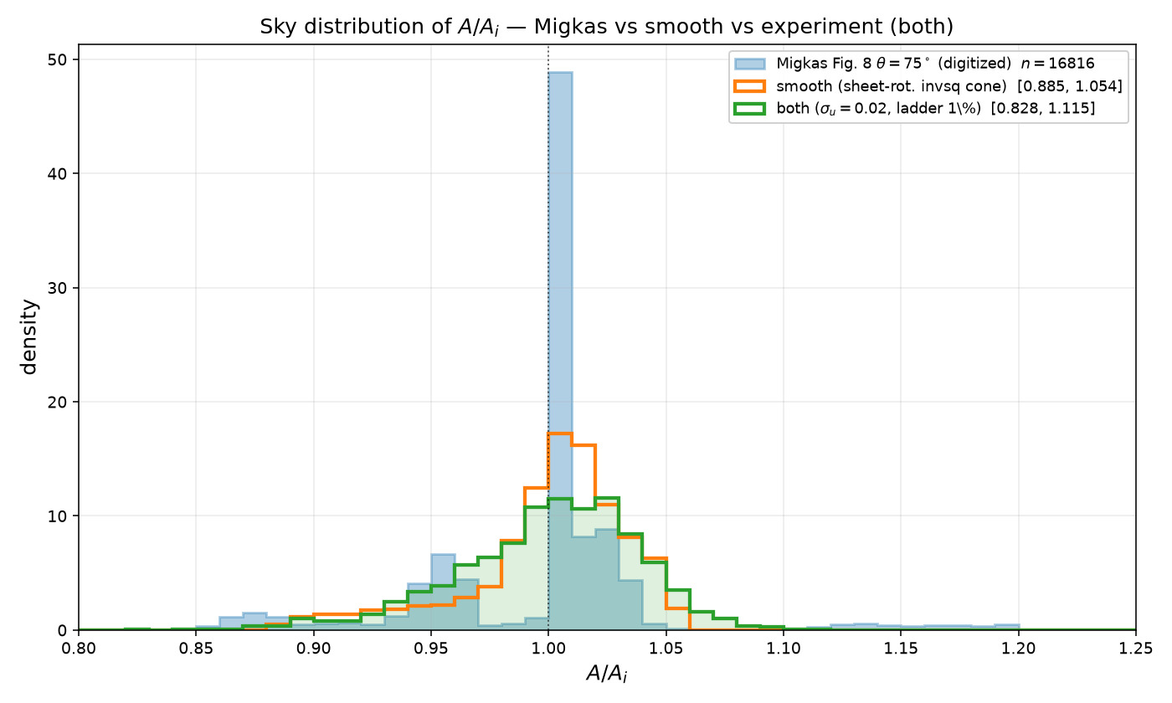
270/395 map_compare/amp_mean_param_noise/HIST_A_migkas_smooth_both.png

Slide 35
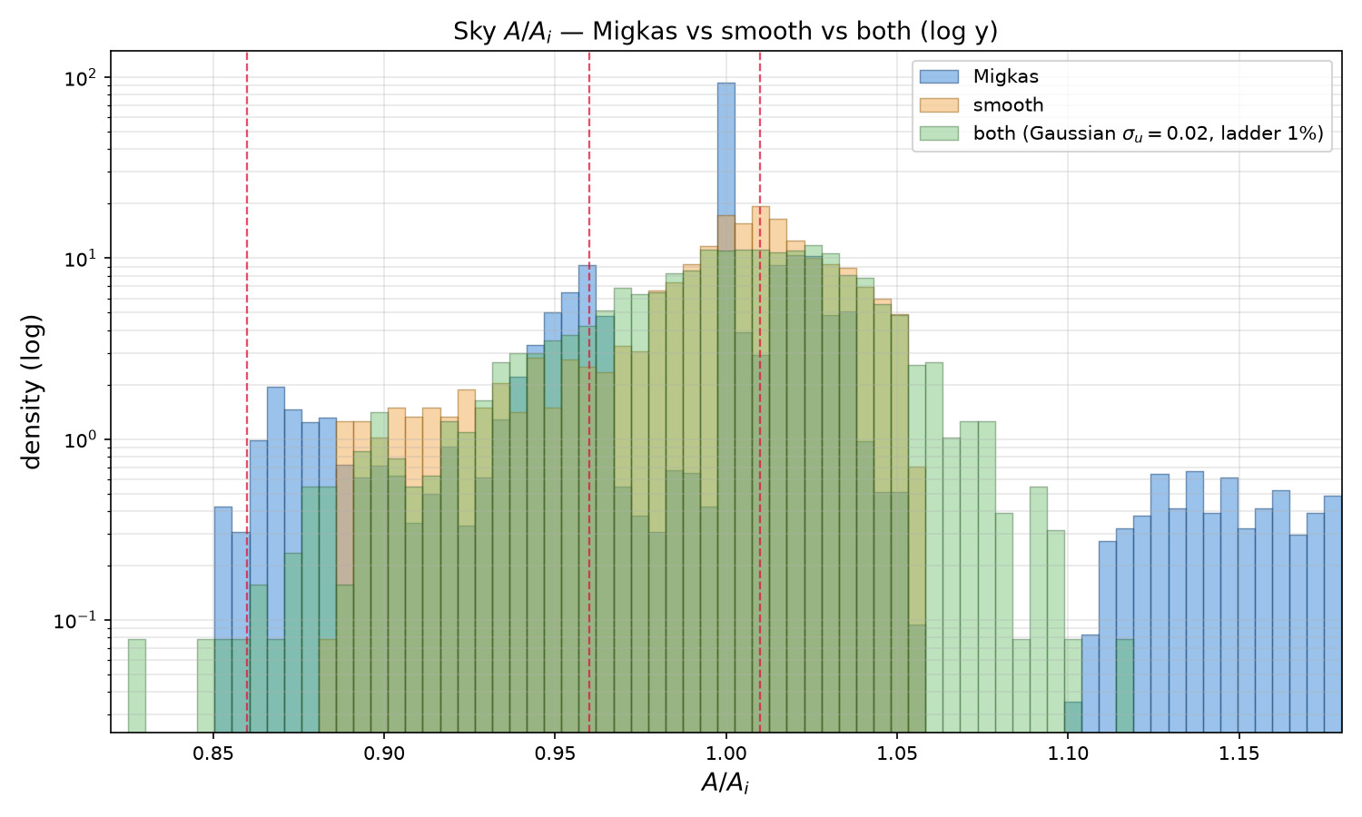
271/395 map_compare/amp_mean_param_noise/HIST_A_migkas_smooth_both_logy.png

Slide 36
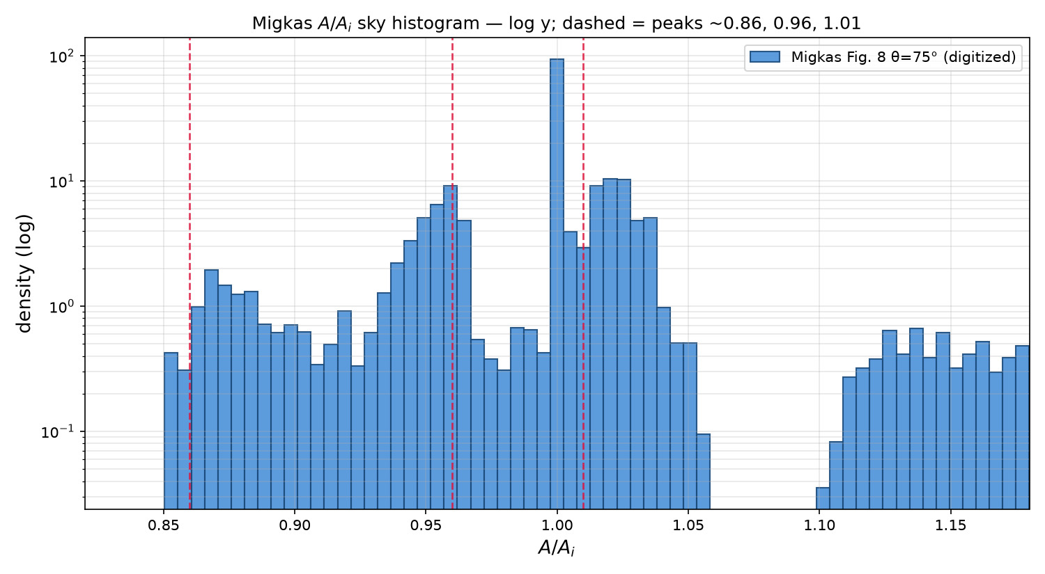
272/395 map_compare/amp_mean_param_noise/HIST_migkas_logy_three_peaks.png

Slide 37
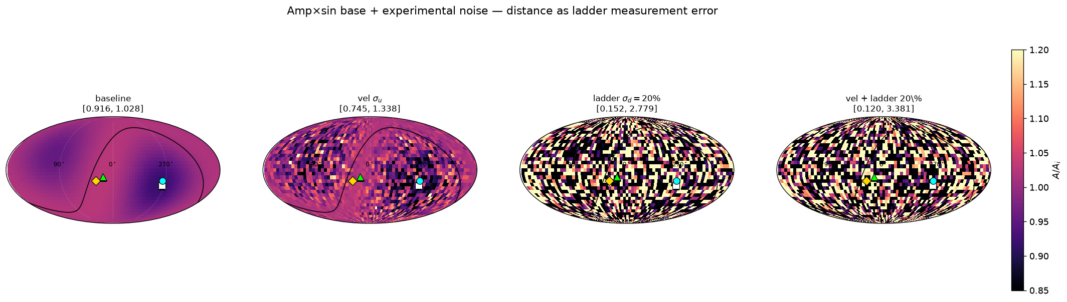
273/395 map_compare/amp_mean_param_noise/STRIP_ladder_baseline_vel_dist20_both.png

Slide 38
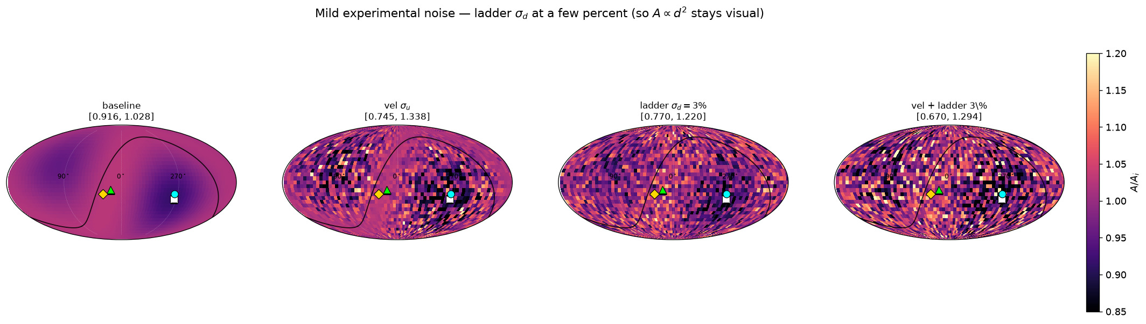
274/395 map_compare/amp_mean_param_noise/STRIP_mild_baseline_vel_dist03_both.png

Slide 39
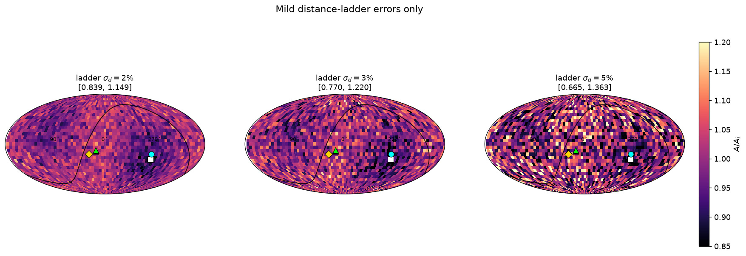
275/395 map_compare/amp_mean_param_noise/STRIP_mild_dist_02_03_05.png

Slide 40
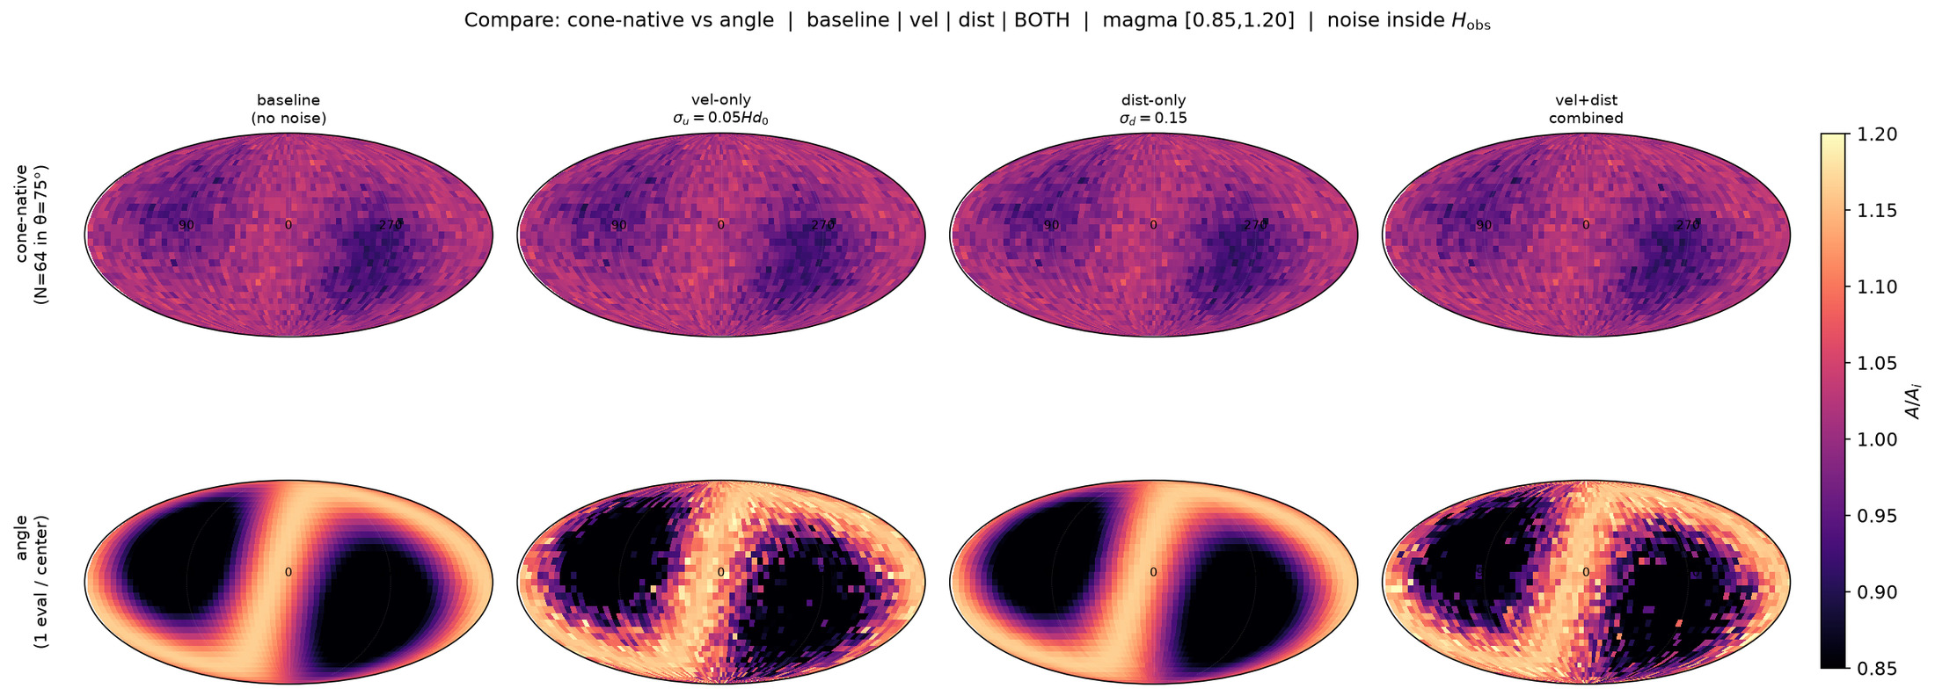
276/395 map_compare/cone_param_noise/GRID_conenative_vs_angle_invsq.png

Slide 41
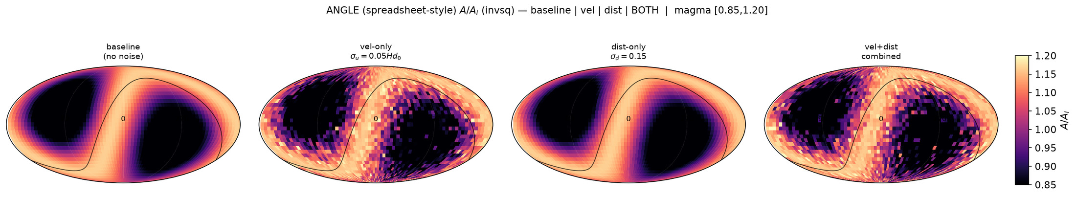
277/395 map_compare/cone_param_noise/STRIP_angle_baseline_vel_dist_both_invsq.png

Slide 42
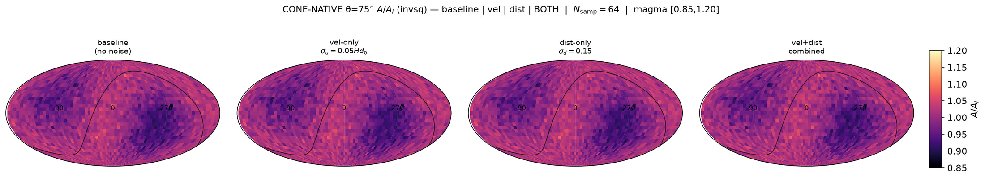
278/395 map_compare/cone_param_noise/STRIP_conenative_baseline_vel_dist_both_invsq.png

Slide 43
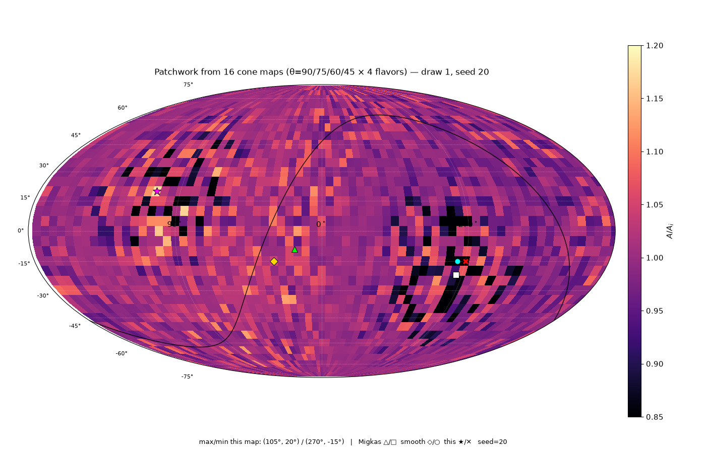
279/395 map_compare/cone_thetas/patchwork16/CARD_patchwork16_draw1_seed20.png

Slide 44
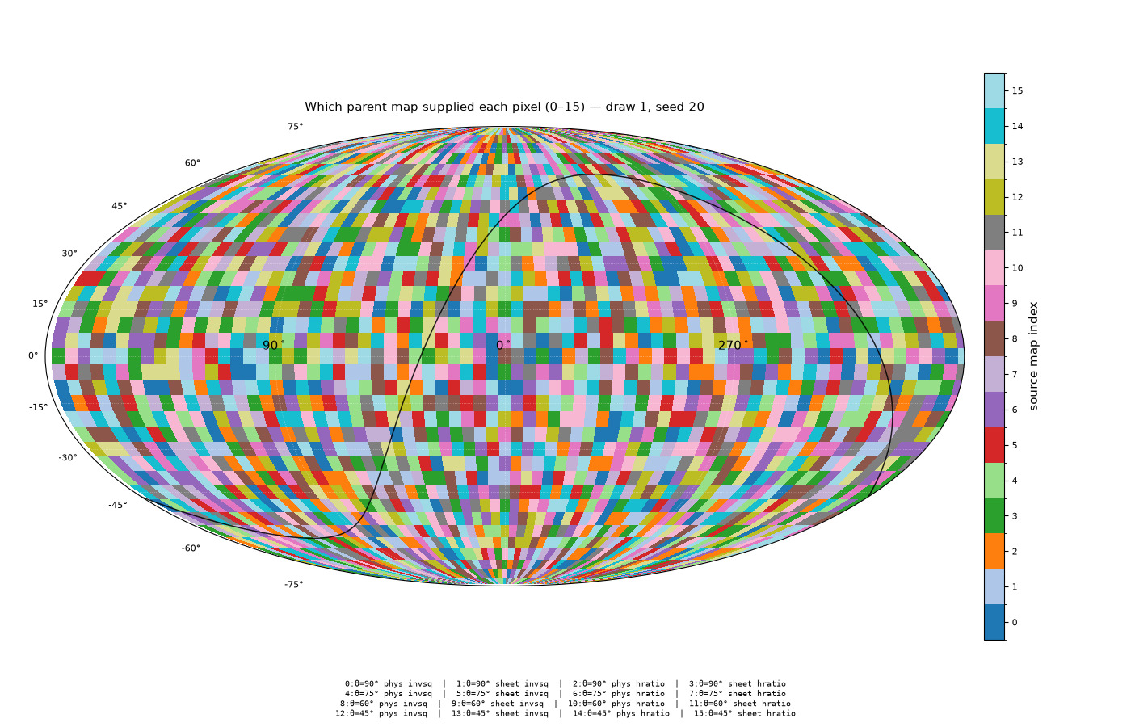
280/395 map_compare/cone_thetas/patchwork16/CARD_sources16_draw1_seed20.png

Slide 45
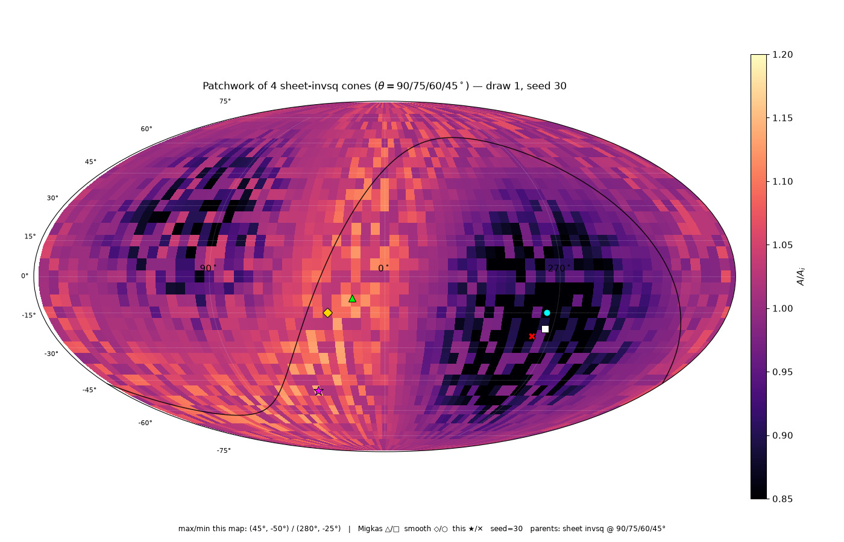
281/395 map_compare/cone_thetas/patchwork_sheet4/CARD_sheet4_draw1_seed30.png

Slide 46
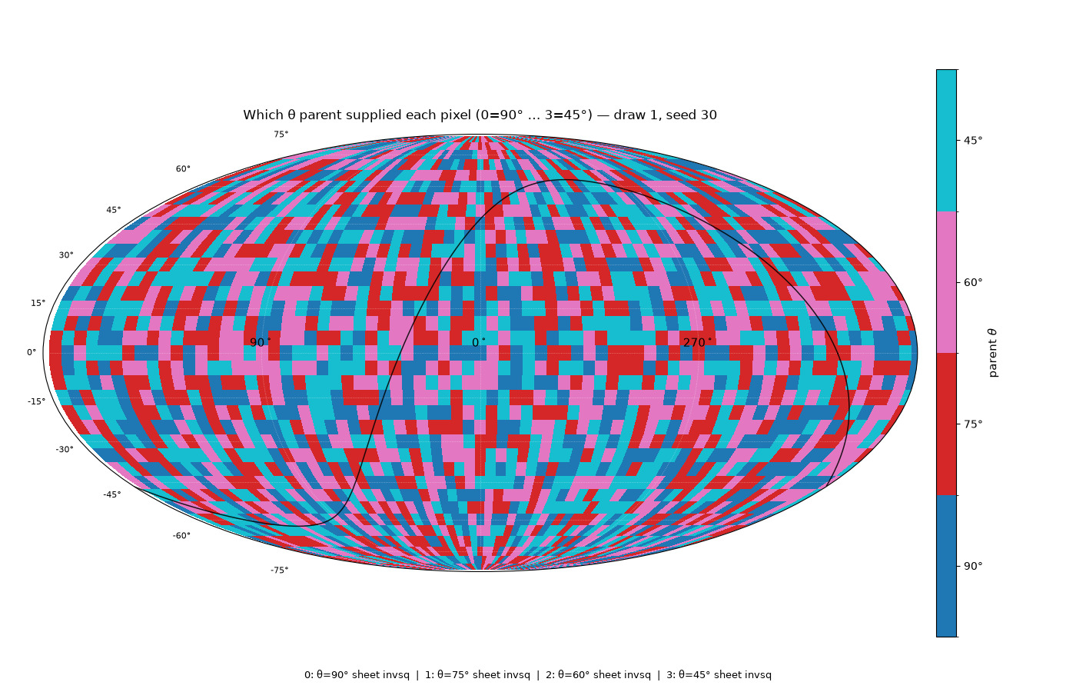
282/395 map_compare/cone_thetas/patchwork_sheet4/CARD_sheet4_sources_draw1_seed30.png

Slide 47
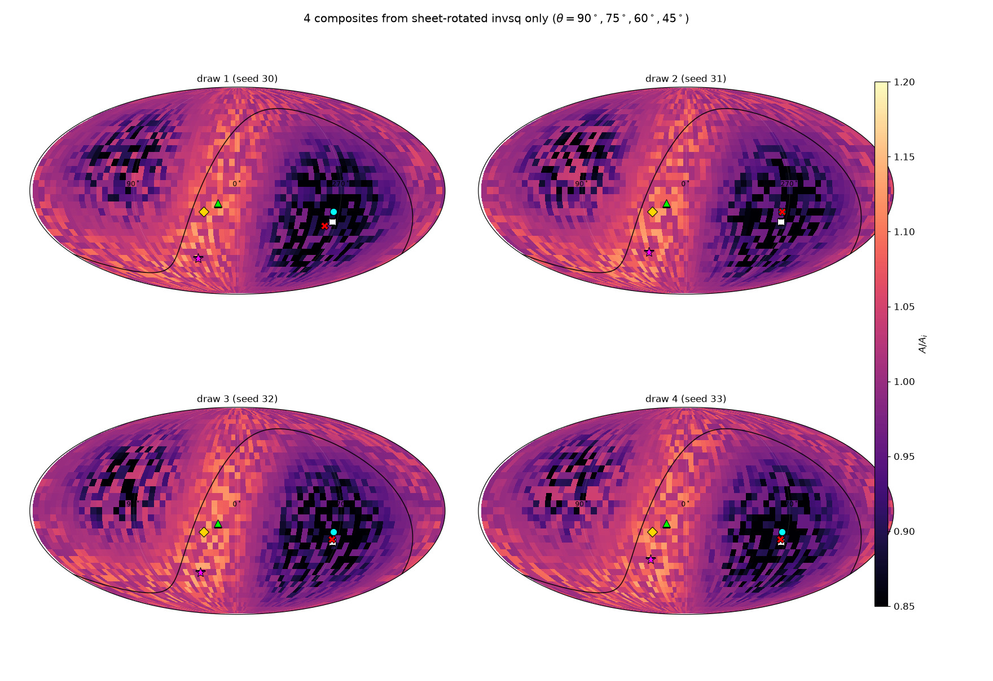
283/395 map_compare/cone_thetas/patchwork_sheet4/GRID_sheet4_4draws.png

Slide 48
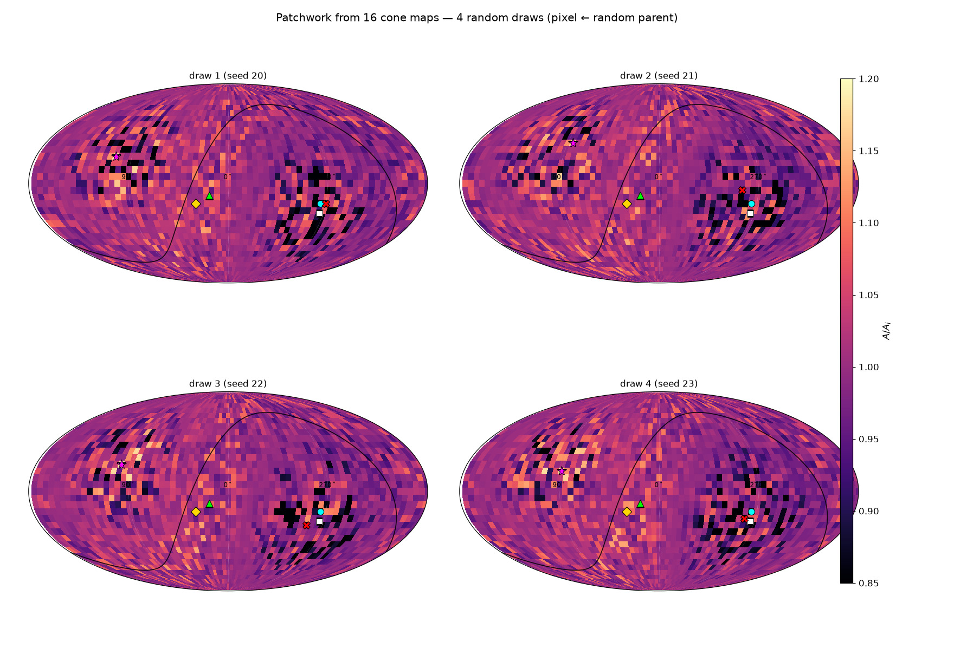
284/395 map_compare/cone_thetas/patchwork16/GRID_patchwork16_4draws.png

Slide 49
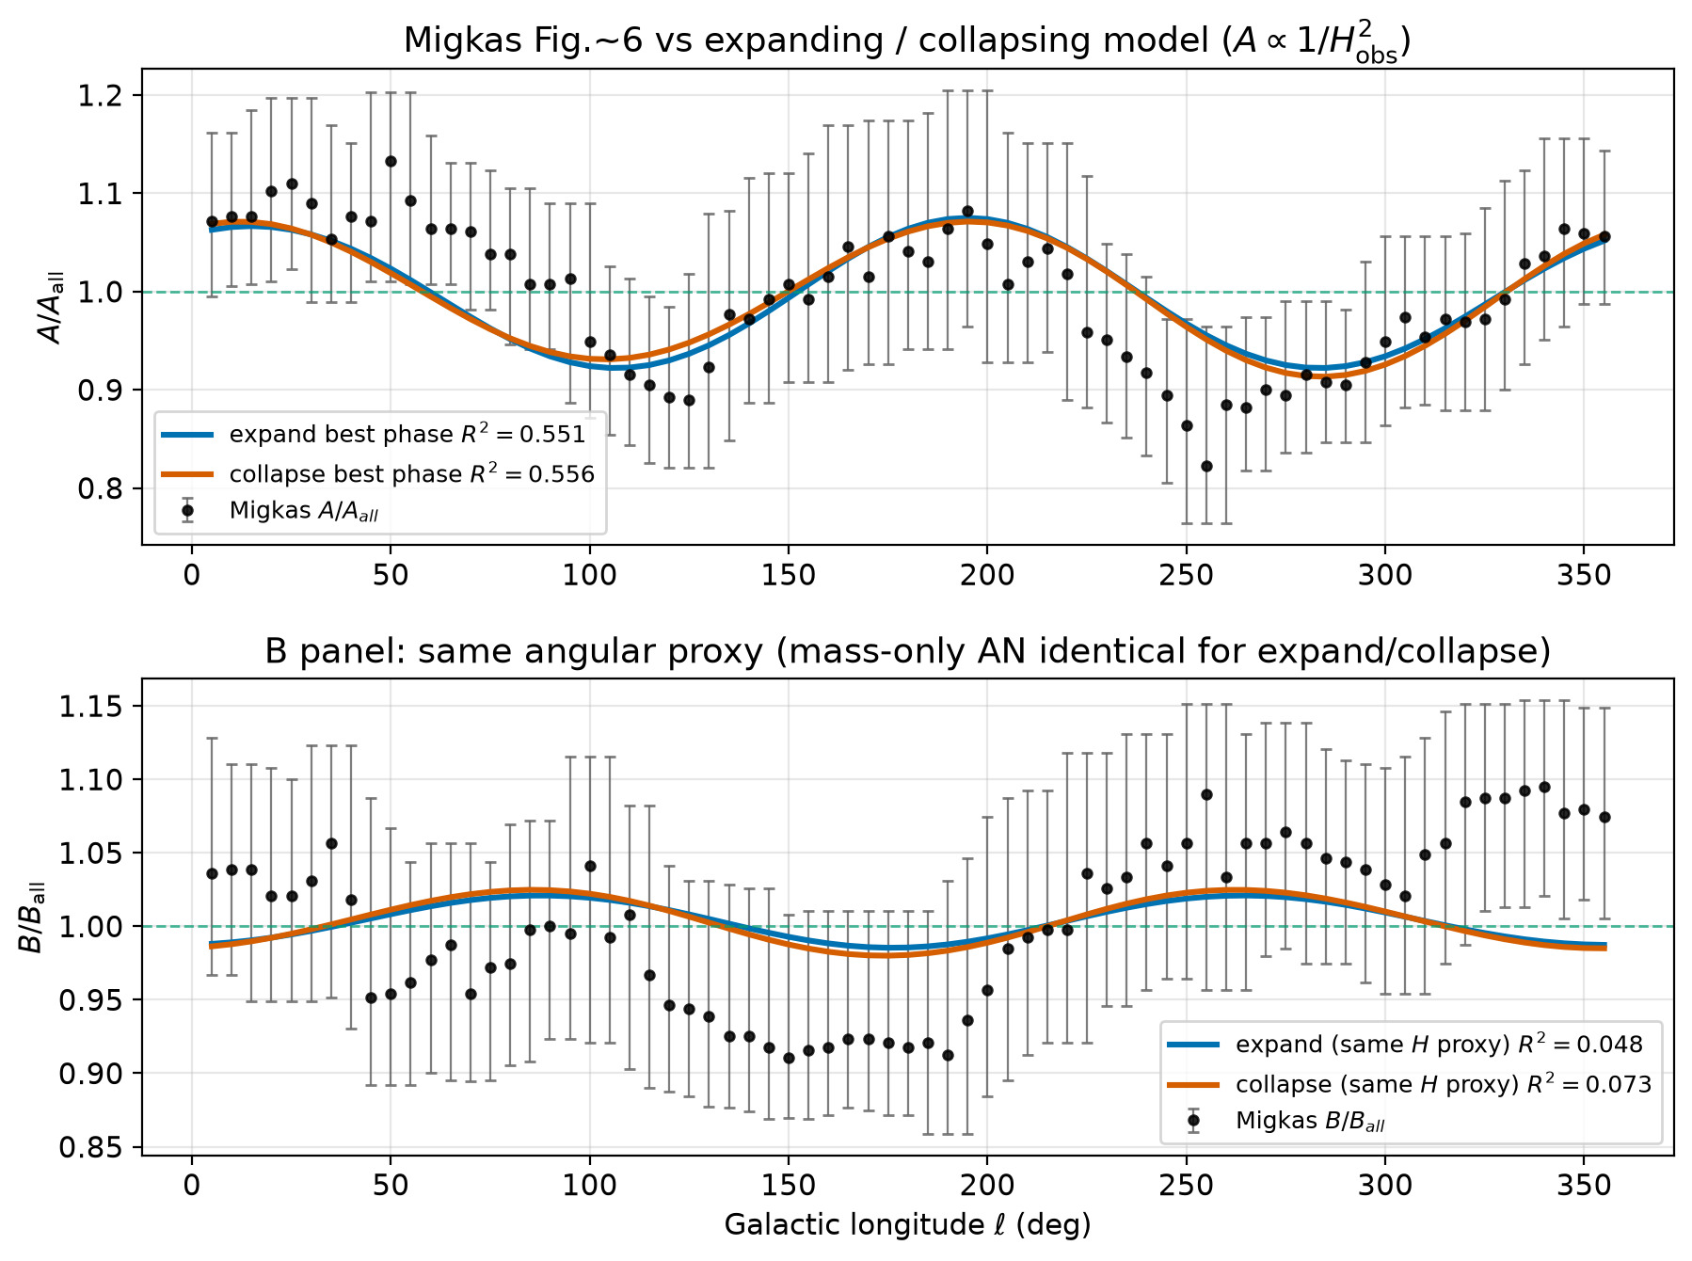
285/395 figures/expand_vs_collapse_vs_migkas.png

Slide 50
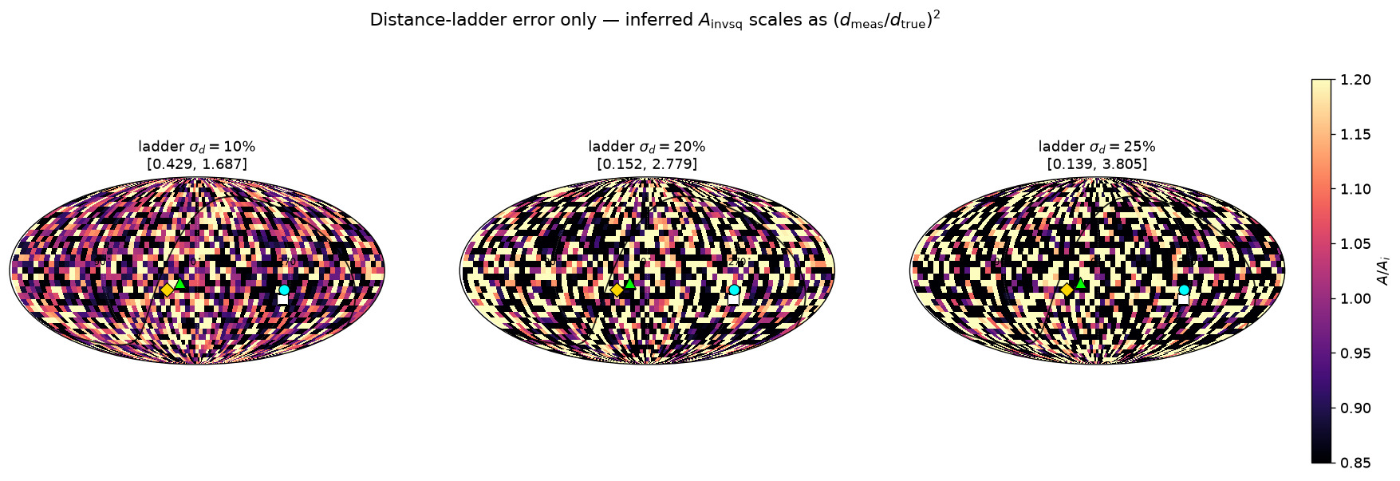
286/395 map_compare/amp_mean_param_noise/STRIP_ladder_dist_10_20_25.png

Slide 51
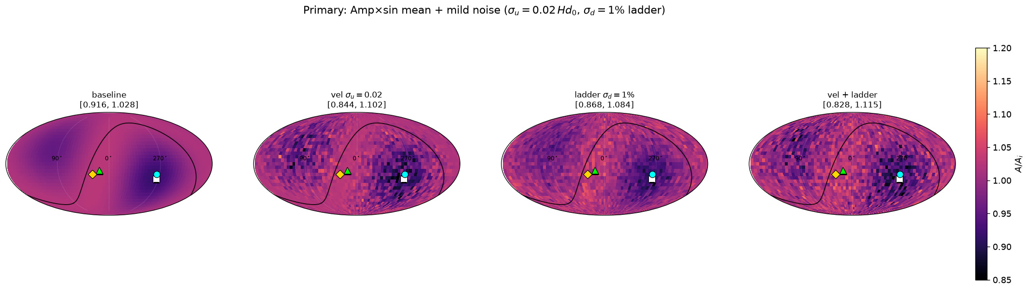
287/395 map_compare/amp_mean_param_noise/STRIP_primary_latest.png

Slide 52

288/395 map_compare/amp_mean_param_noise/HIST_vs_Cl_migkas.png

Slide 53

289/395 map_compare/amp_mean_param_noise/A_vs_angle_levelsets_d_over_D_nosmooth.png

Slide 54

290/395 map_compare/amp_mean_param_noise/ideal_fit_M_d_D_L_migkas.png

Slide 55

291/395 map_compare/amp_mean_param_noise/HIST_migkas_logy_identify_peaks_gap.png

Slide 56

292/395 map_compare/amp_mean_param_noise/kick_levelsets_L_M35_d05.png

Slide 57

293/395 map_compare/amp_mean_param_noise/Cl_A_migkas_smooth_both.png

Slide 58

294/395 map_compare/amp_mean_param_noise/HIST_migkas_logy_quadrants_stacked.png

Slide 59

295/395 map_compare/amp_mean_param_noise/HIST_migkas_logy_NS_LR_stacked.png

Slide 60

296/395 map_compare/amp_mean_param_noise/A_vs_angle_ideal_collapse_only.png

Slide 61

297/395 map_compare/amp_mean_param_noise/A_vs_angle_smooth_kick_sheet_AF_hratio.png

Slide 62

298/395 map_compare/amp_mean_param_noise/HIST_A_migkas_smooth_both_logy_gap.png

Slide 63

299/395 map_compare/amp_mean_param_noise/A_vs_angle_clean.png

Slide 64

300/395 map_compare/amp_mean_param_noise/A_vs_angle_gap_band.png

Slide 65

301/395 map_compare/amp_mean_param_noise/HIST_fig6_over_smooth_stacked.png

Slide 66

302/395 map_compare/amp_mean_param_noise/HIST_levelset_amp_family_stacked.png

Slide 67

303/395 map_compare/amp_mean_param_noise/HIST_migkas_logy_1d_gap.png

Slide 68

304/395 map_compare/amp_mean_param_noise/HIST_migkas_logy_peaks_and_gap.png

Slide 69

305/395 map_compare/amp_mean_param_noise/u_radial_integral_matched_to_bolton.png

Slide 70

306/395 map_compare/amp_mean_param_noise/A_vs_angle_levelsets_d_over_D_to_999.png

Slide 71

307/395 map_compare/amp_mean_param_noise/HIST_levelset_phi_family_stacked.png

Slide 72

308/395 map_compare/amp_mean_param_noise/ideal_levelsets_L_M35_d05.png

Slide 73

309/395 map_compare/amp_mean_param_noise/ideal_levelsets_fu.png

Slide 74

310/395 map_compare/amp_mean_param_noise/ideal_levelsets_phi.png

Slide 75

311/395 map_compare/amp_mean_param_noise/ideal_levelsets_x_DL.png

Slide 76

312/395 map_compare/amp_mean_param_noise/A_vs_angle_ideal_integration.png

Slide 77

313/395 map_compare/amp_mean_param_noise/A_vs_angle_levelsets_d_over_D_six.png

Slide 78

314/395 map_compare/amp_mean_param_noise/A_vs_angle_smooth_kick_ONLY.png

Slide 79

315/395 map_compare/amp_mean_param_noise/HIST_migkas_logy_NS_only.png

Slide 80

316/395 map_compare/amp_mean_param_noise/HIST_migkas_logy_N_and_S_separate_stacked.png

