Slide 1
Cosmology figures — Part 5 of 5 (by PNG creation order)
PNG slides 317–395 of 395 | mtime range: 2026-09-20 20:05:52 CDT – 2026-09-21 10:11:44 CDT
79 PNG image slides

Slide 2
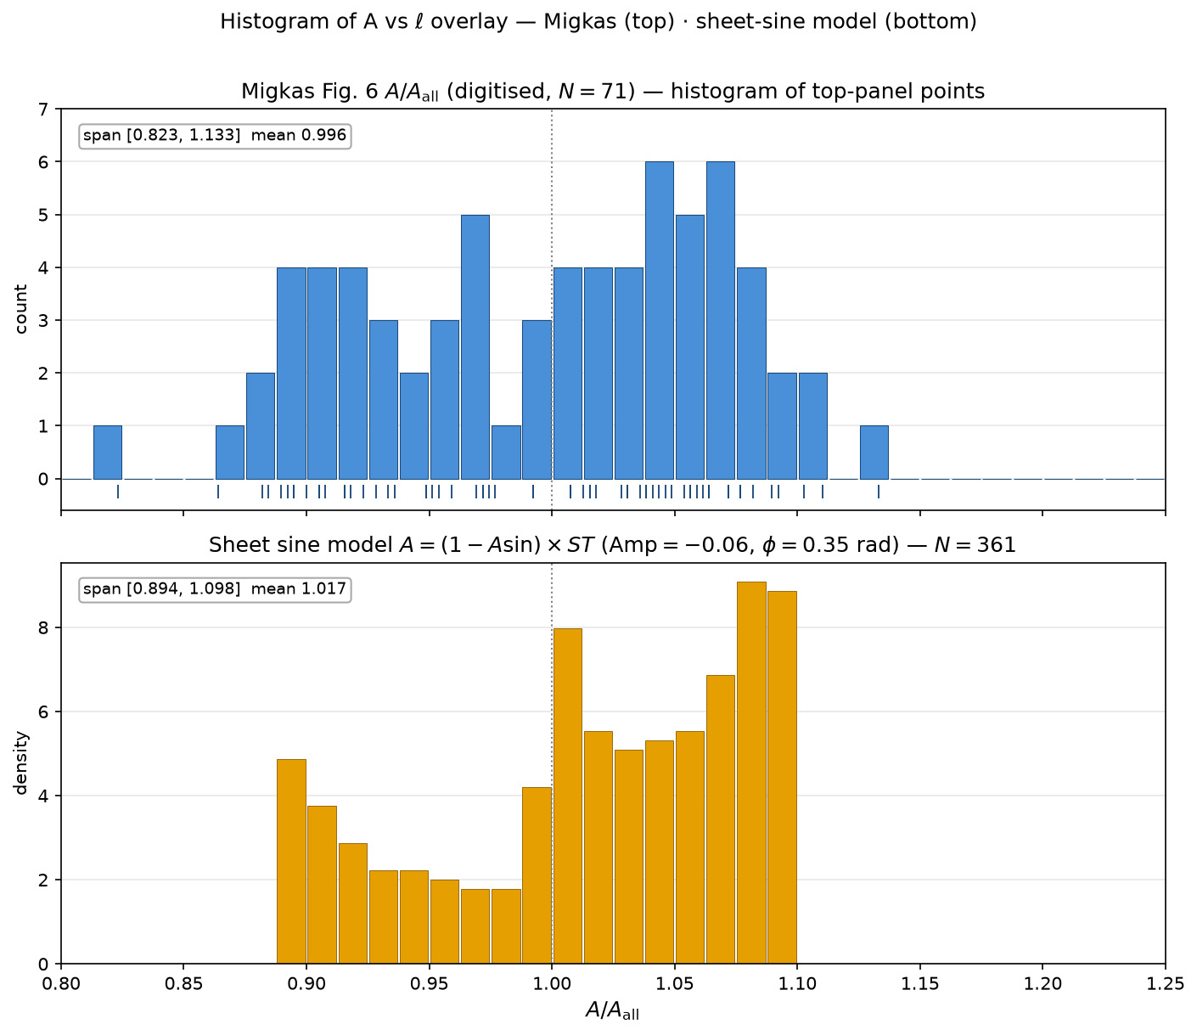
317/395 map_compare/amp_mean_param_noise/HIST_overlay_A_migkas_over_model.png

Slide 3
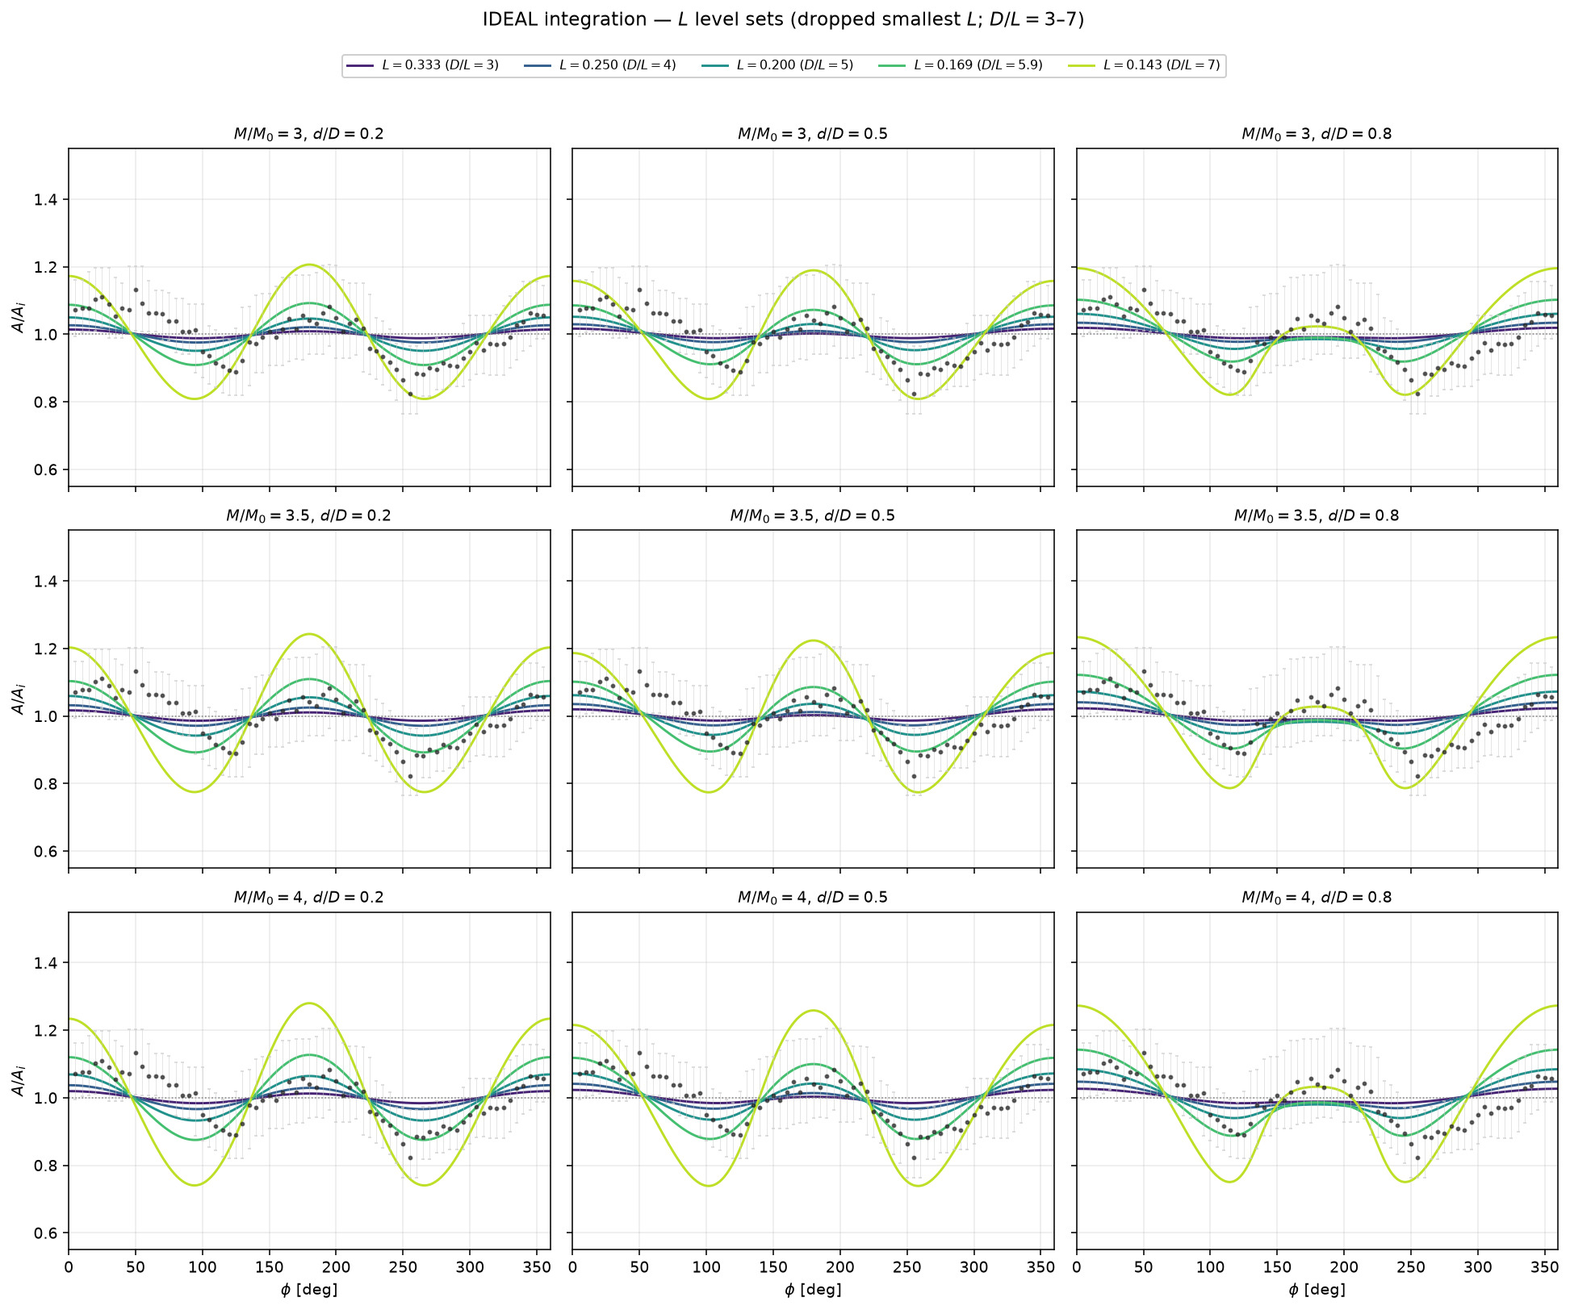
318/395 map_compare/amp_mean_param_noise/ideal_levelsets_L_grid_no_smallestL.png

Slide 4
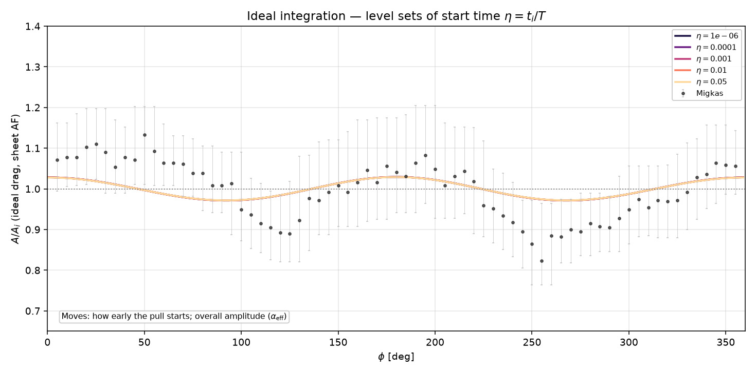
319/395 map_compare/amp_mean_param_noise/ideal_levelsets_eta.png

Slide 5
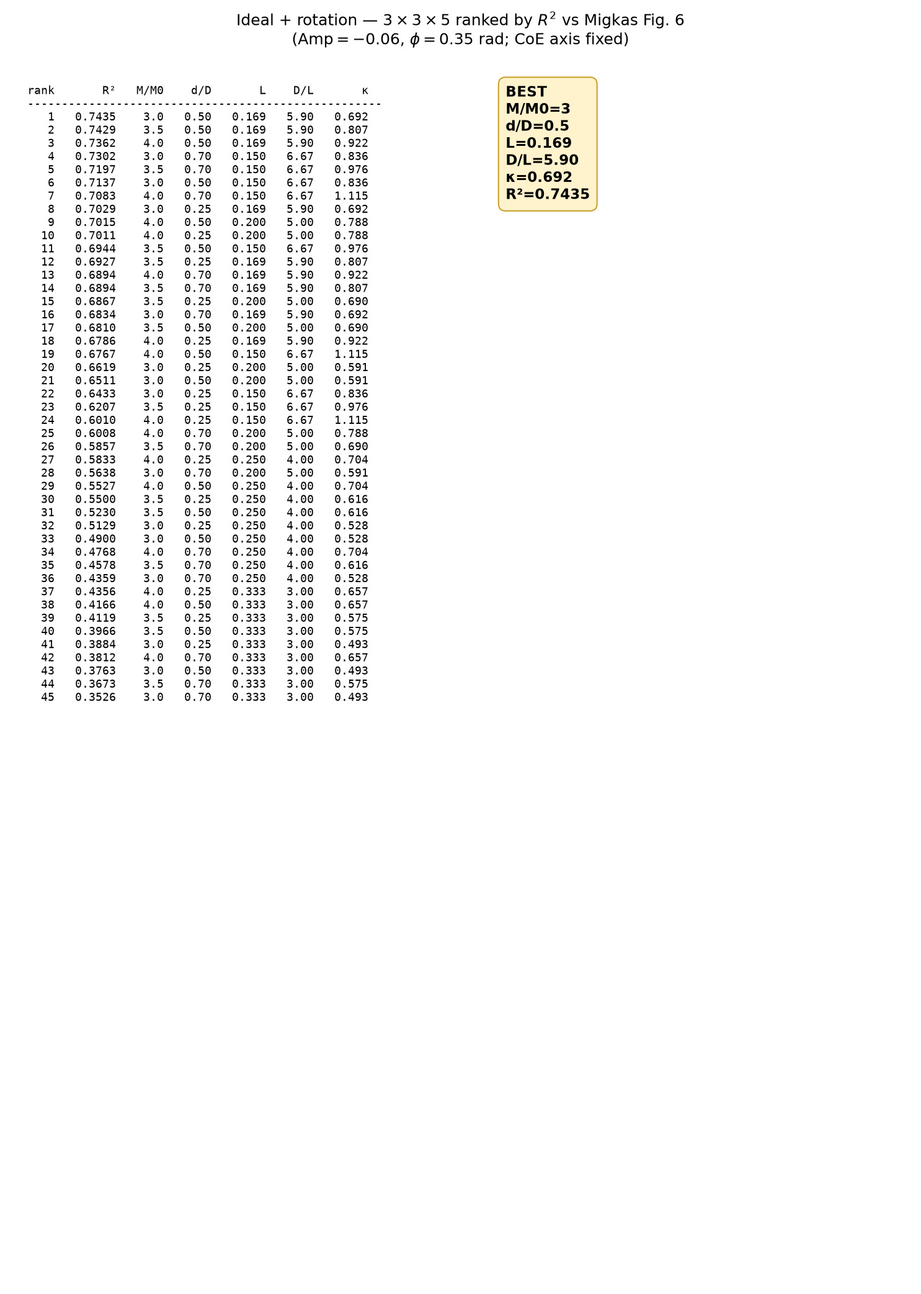
320/395 map_compare/amp_mean_param_noise/ideal_rotation_3x3x5_R2_ranked.png

Slide 6
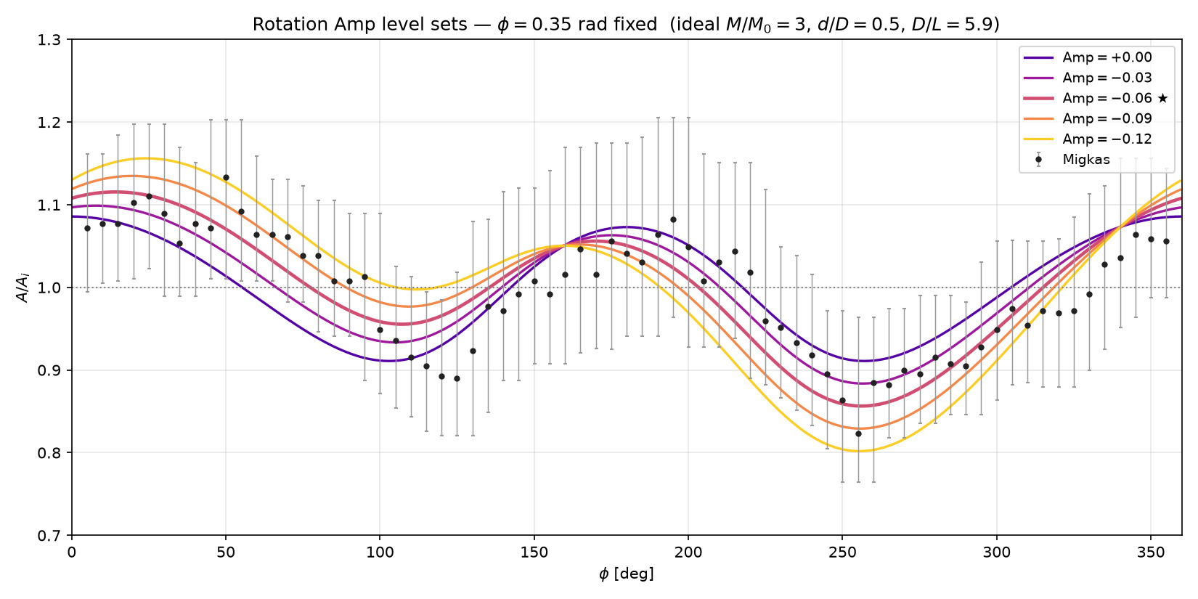
321/395 map_compare/amp_mean_param_noise/rotation_levelsets_Amp.png

Slide 7
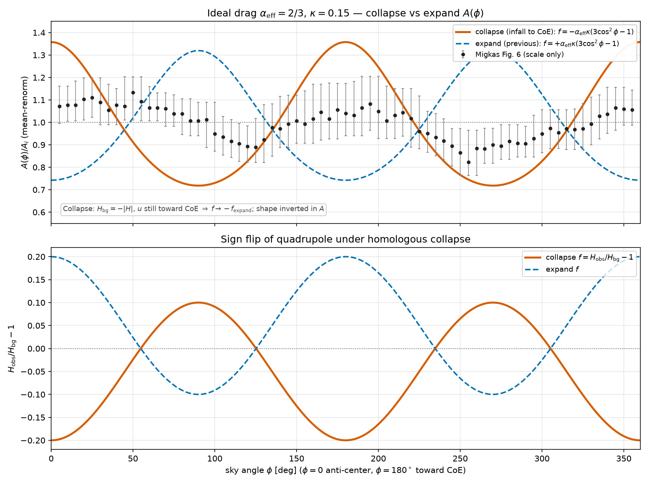
322/395 map_compare/amp_mean_param_noise/A_vs_angle_ideal_collapse.png

Slide 8
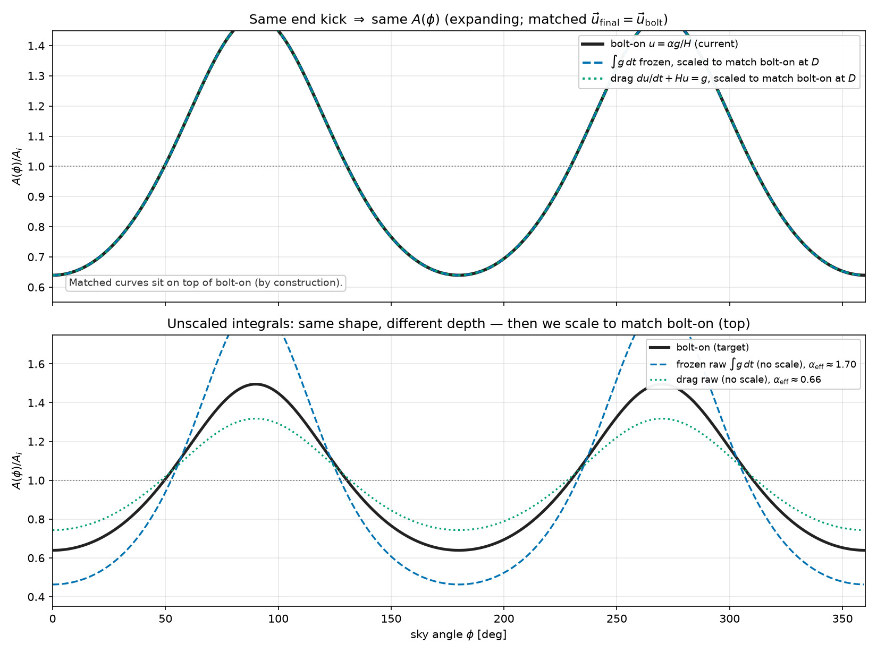
323/395 map_compare/amp_mean_param_noise/A_vs_angle_integral_matched_to_bolton.png

Slide 9
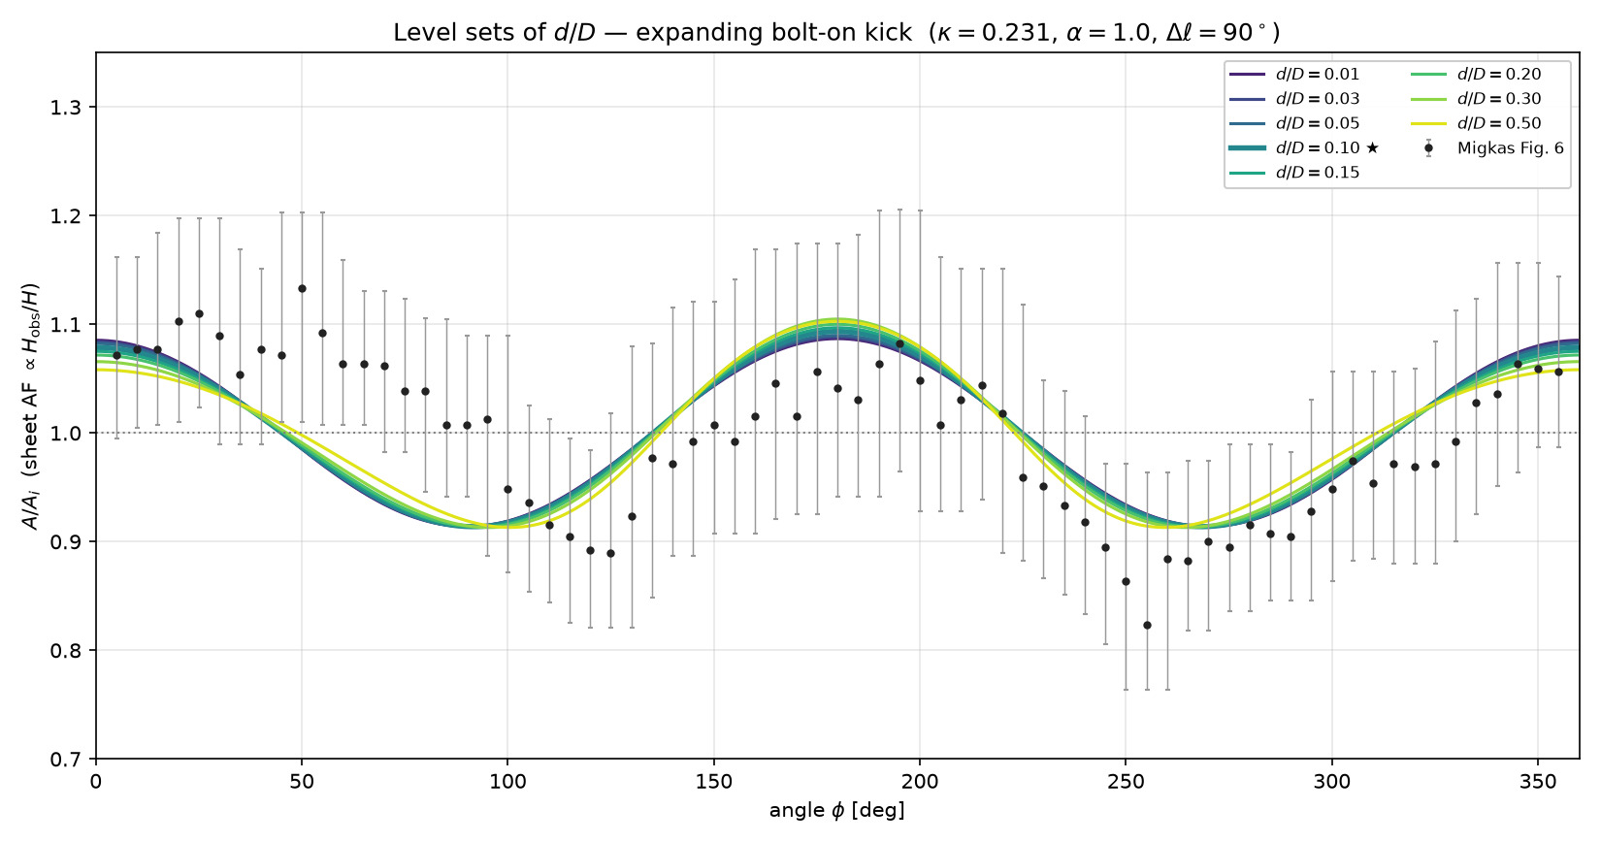
324/395 map_compare/amp_mean_param_noise/A_vs_angle_levelsets_d_over_D.png

Slide 10
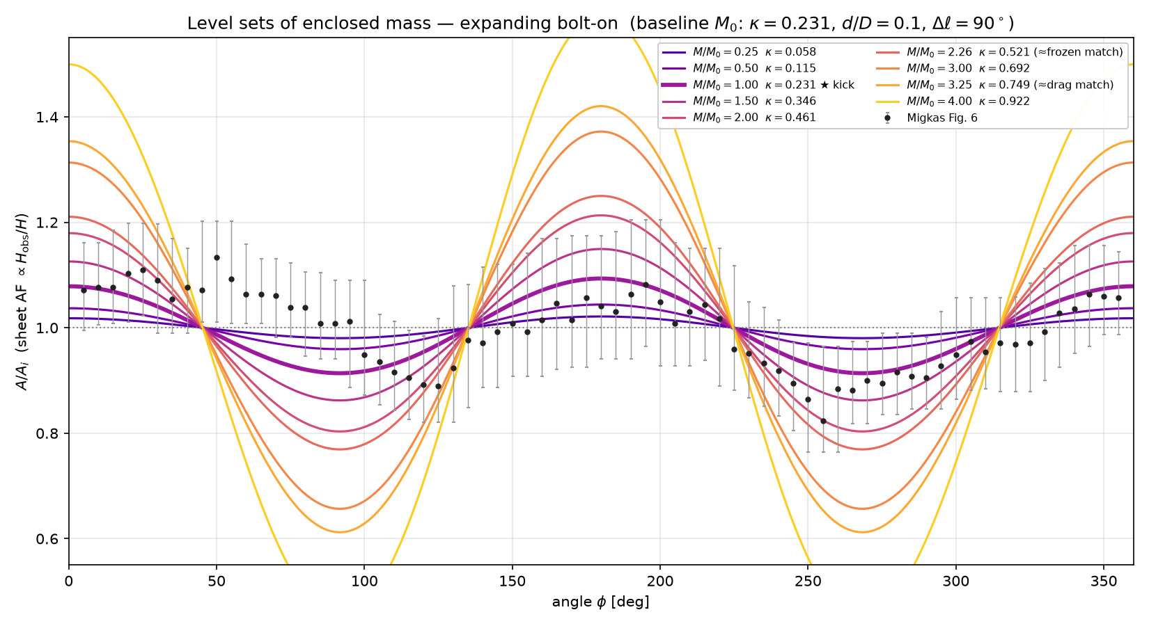
325/395 map_compare/amp_mean_param_noise/A_vs_angle_levelsets_mass.png

Slide 11
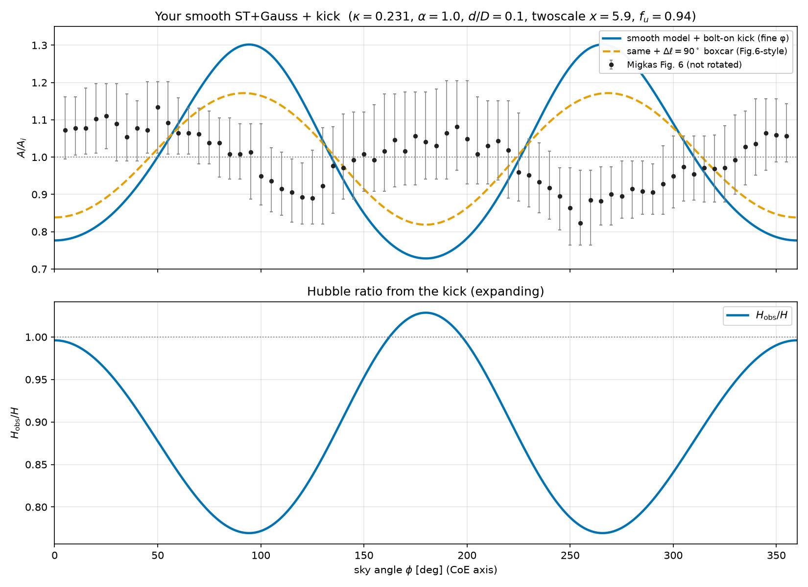
326/395 map_compare/amp_mean_param_noise/A_vs_angle_smooth_model_with_kick.png

Slide 12
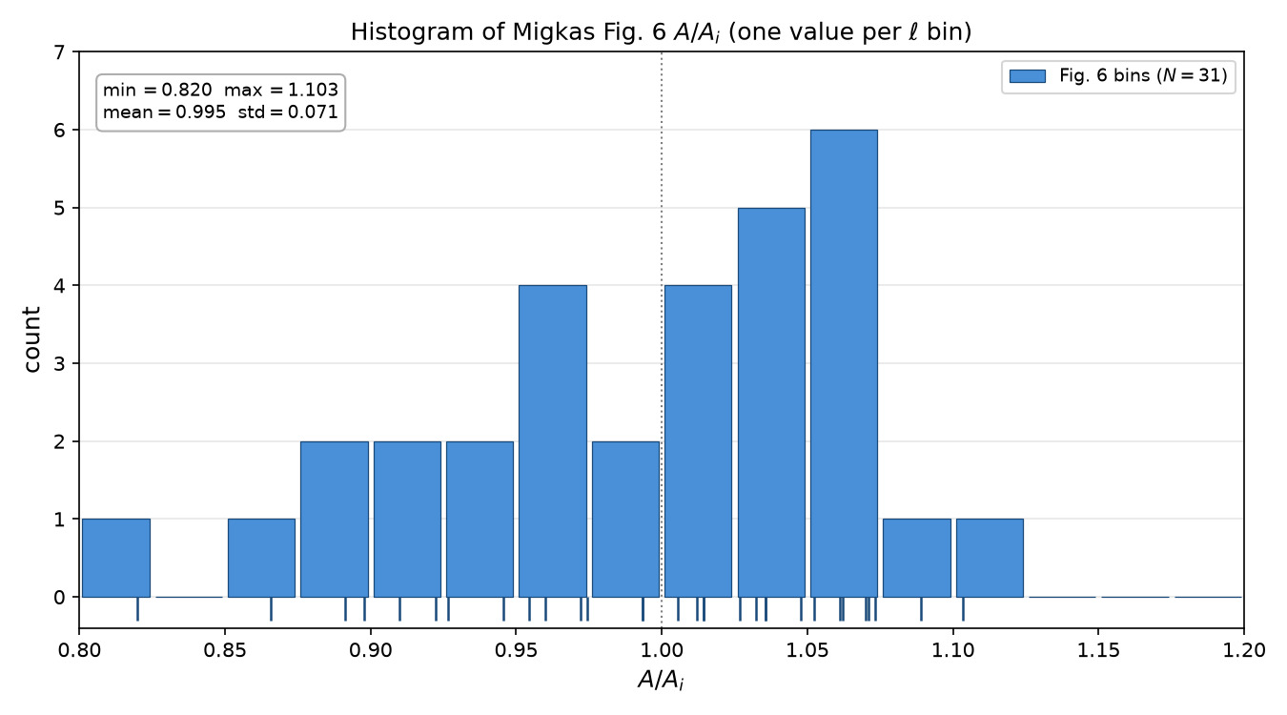
327/395 map_compare/amp_mean_param_noise/HIST_A_vs_ell_fig6.png

Slide 13
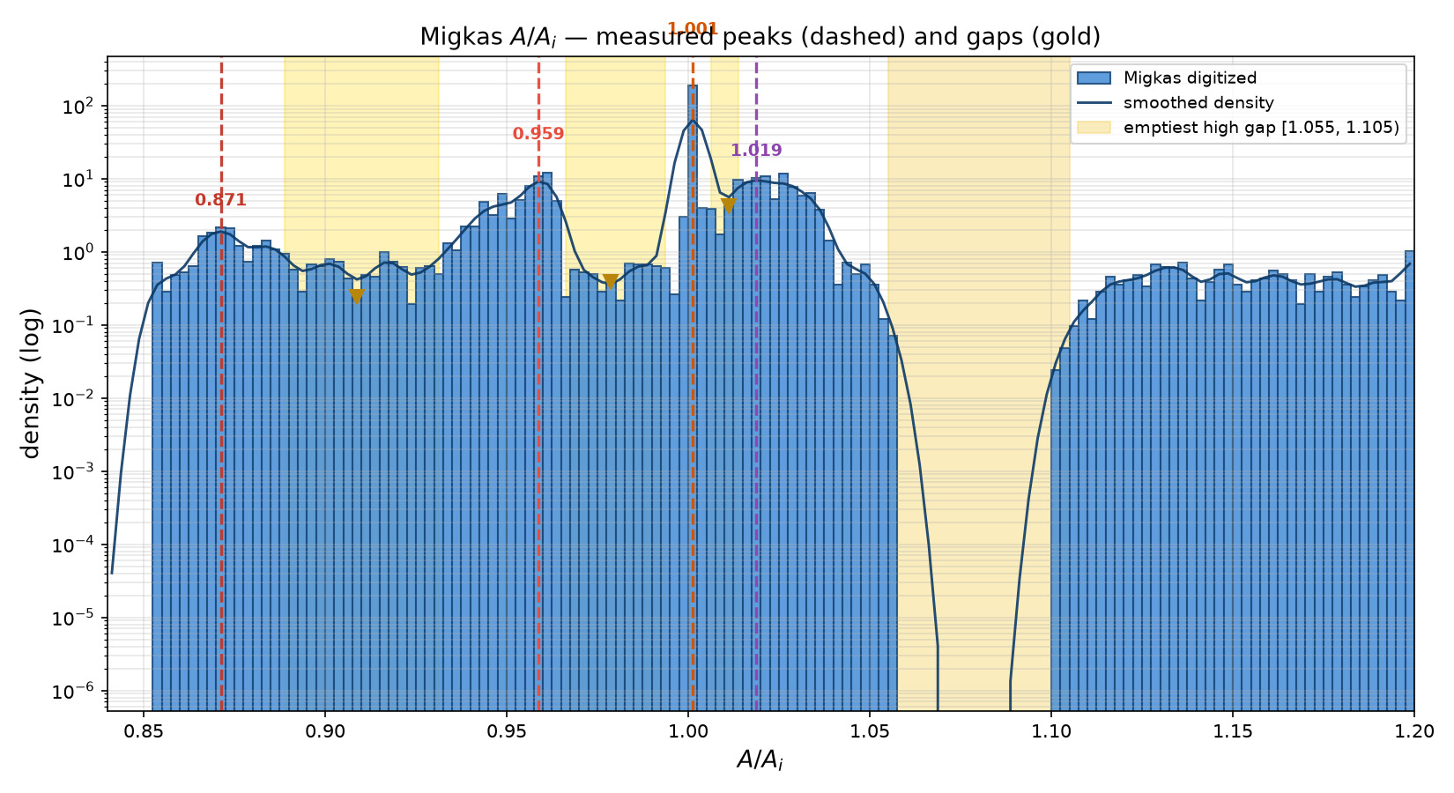
328/395 map_compare/amp_mean_param_noise/HIST_migkas_measured_peaks_gaps.png

Slide 14
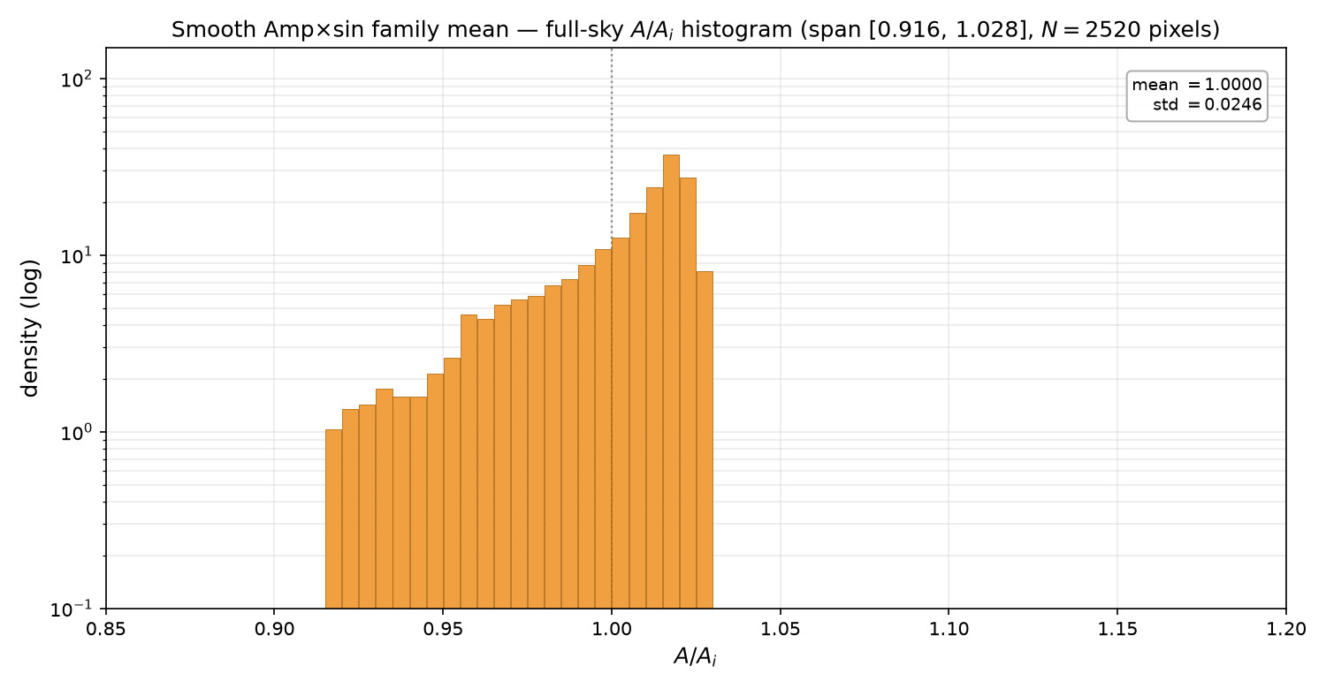
329/395 map_compare/amp_mean_param_noise/HIST_smooth_ampmean_alone.png

Slide 15
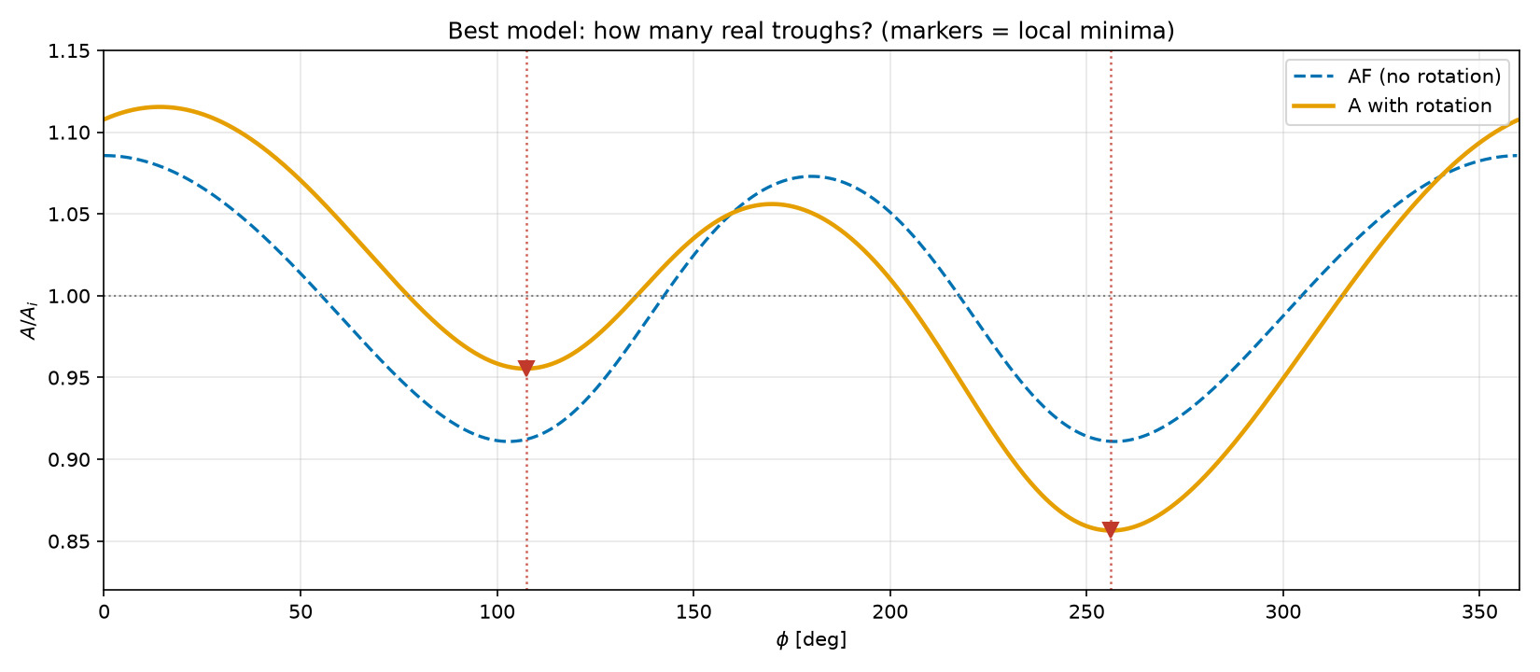
330/395 map_compare/amp_mean_param_noise/best_model_minima_check.png

Slide 16
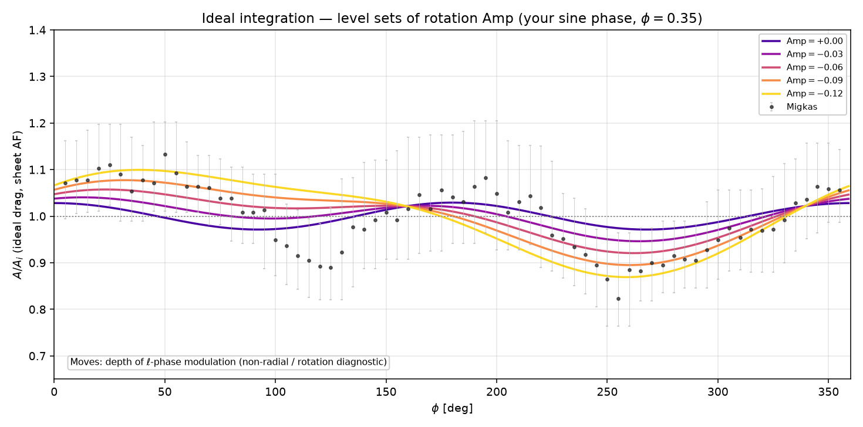
331/395 map_compare/amp_mean_param_noise/ideal_levelsets_Amp.png

Slide 17
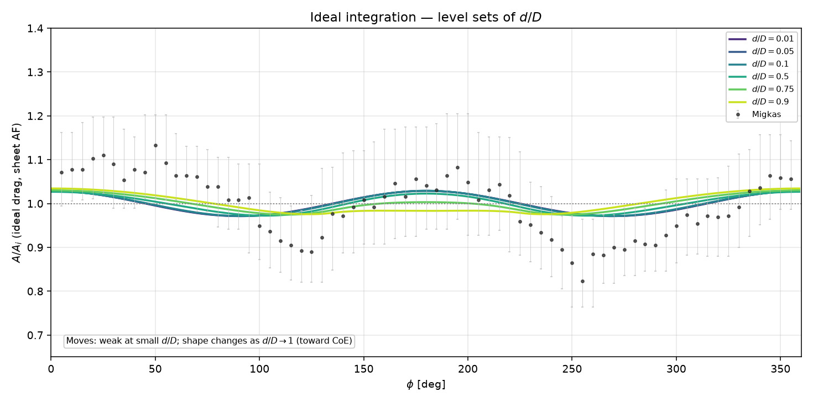
332/395 map_compare/amp_mean_param_noise/ideal_levelsets_d_over_D.png

Slide 18
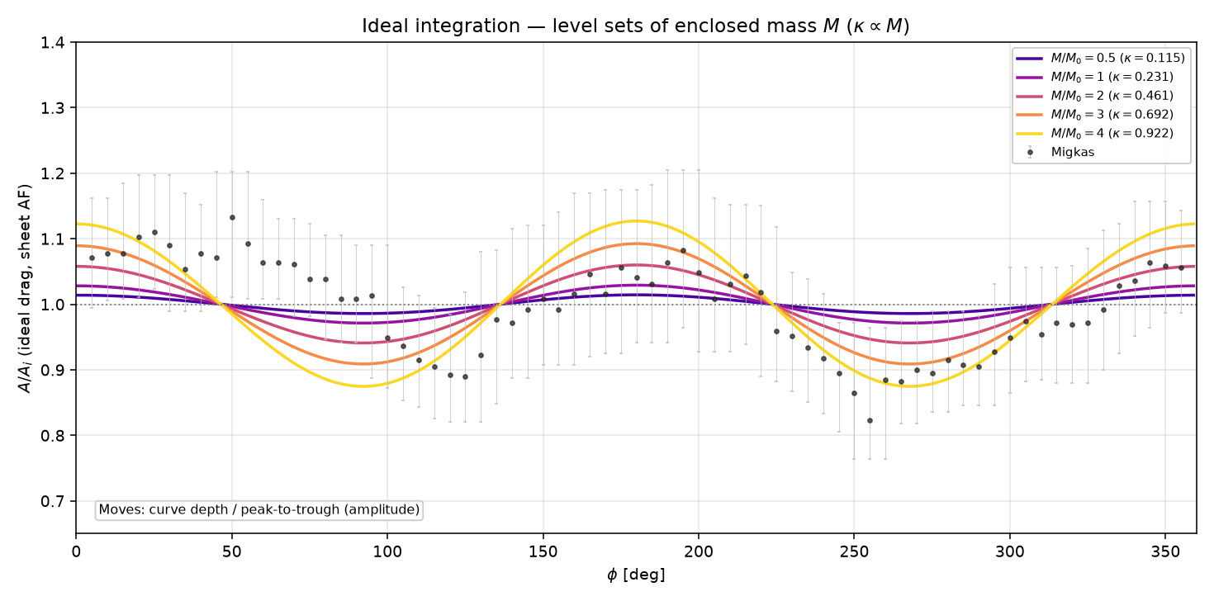
333/395 map_compare/amp_mean_param_noise/ideal_levelsets_mass.png

Slide 19
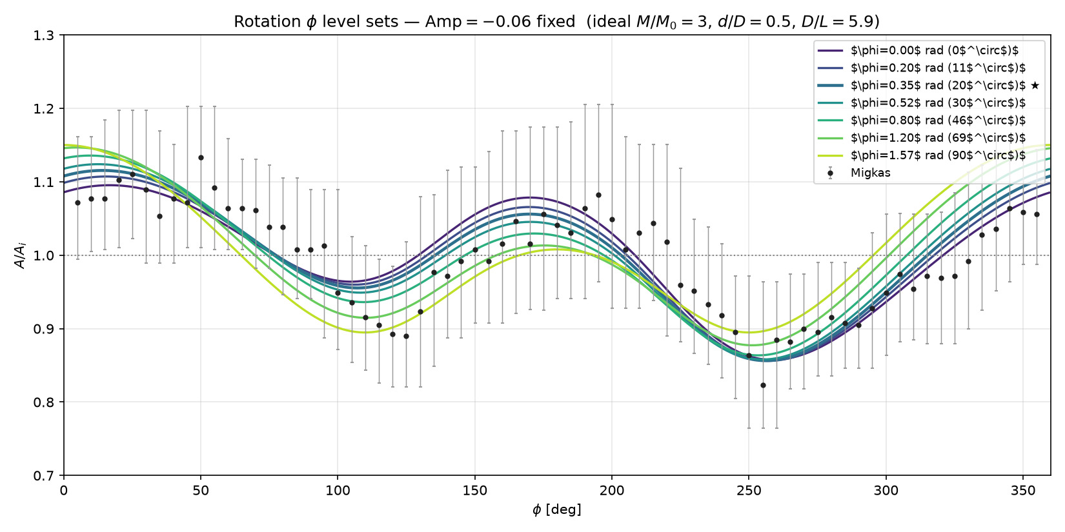
334/395 map_compare/amp_mean_param_noise/rotation_levelsets_phi.png

Slide 20
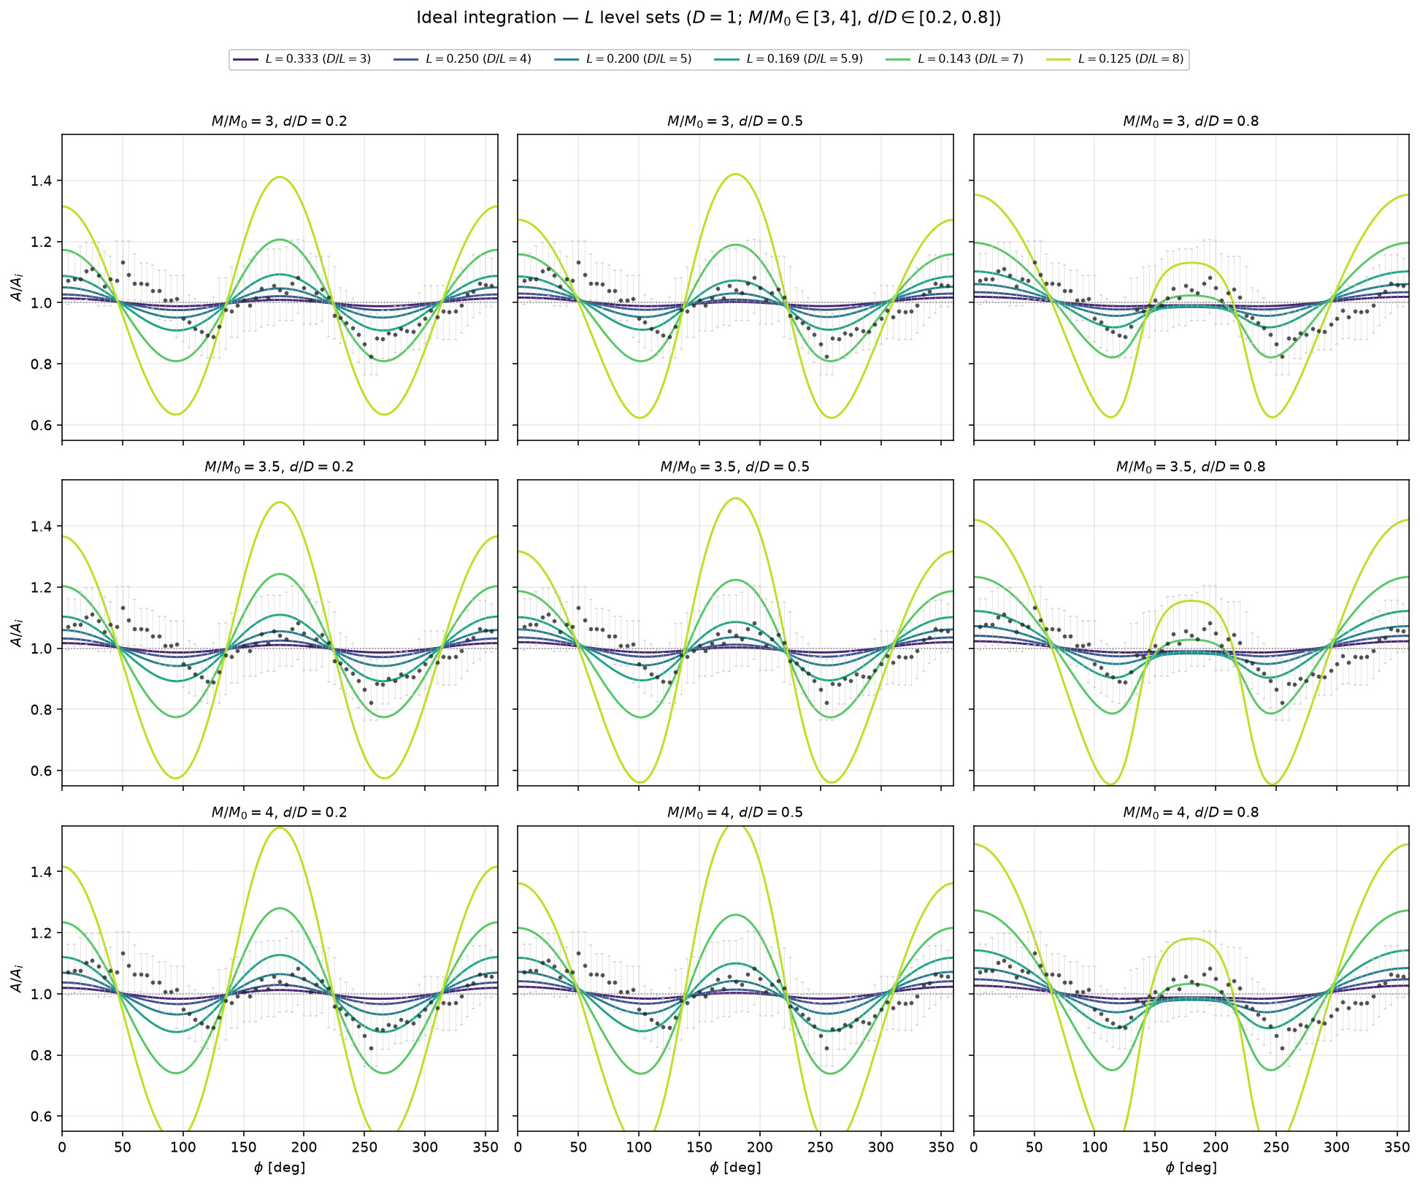
335/395 map_compare/amp_mean_param_noise/ideal_levelsets_L_grid_M3-4_d02-08.png

Slide 21
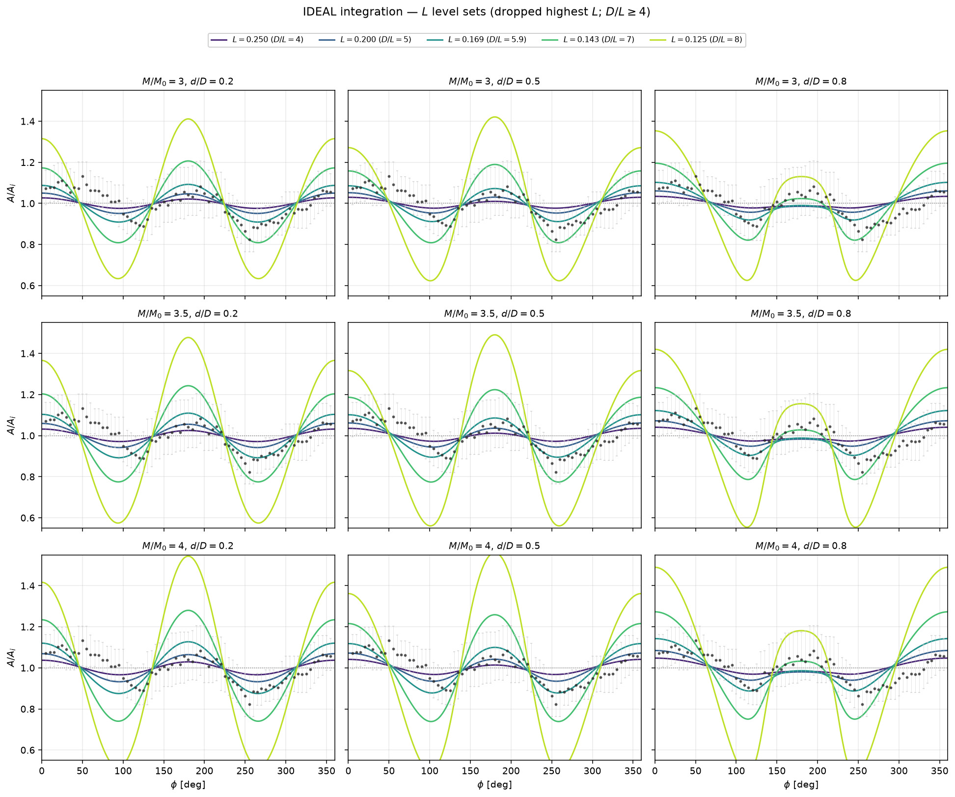
336/395 map_compare/amp_mean_param_noise/ideal_levelsets_L_grid_no_highestL.png

Slide 22
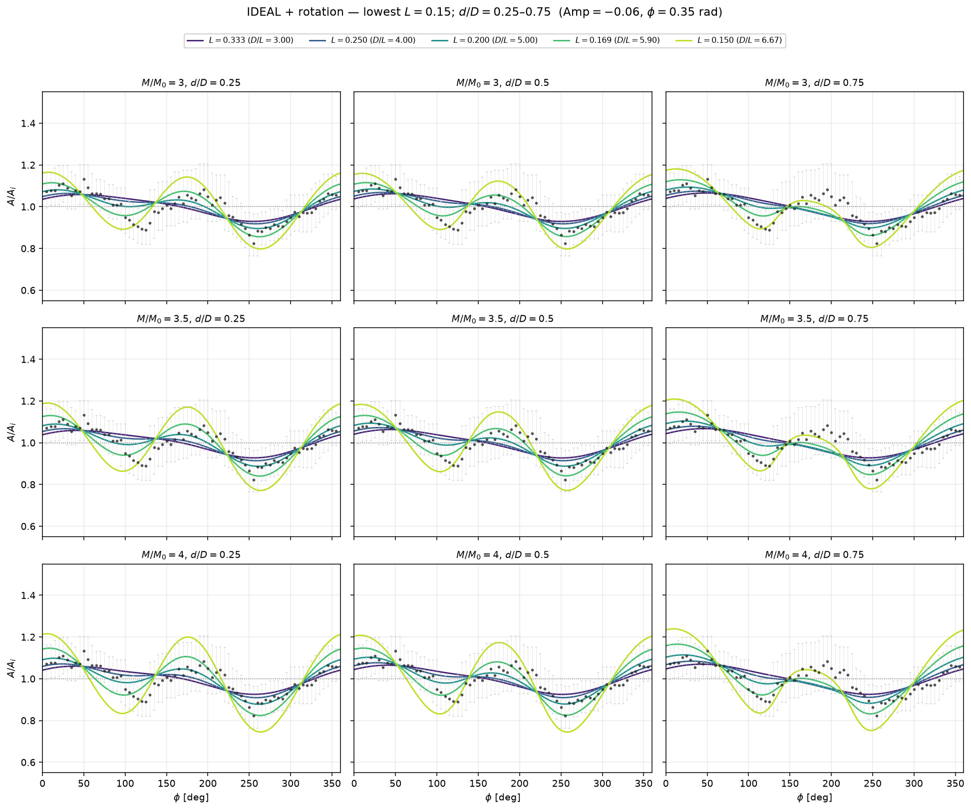
337/395 map_compare/amp_mean_param_noise/ideal_levelsets_L_grid_rotation_Lmin015.png

Slide 23
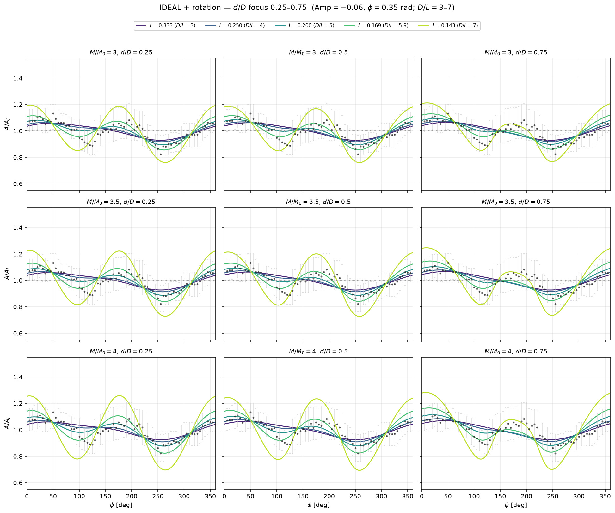
338/395 map_compare/amp_mean_param_noise/ideal_levelsets_L_grid_rotation_d25-75.png

Slide 24
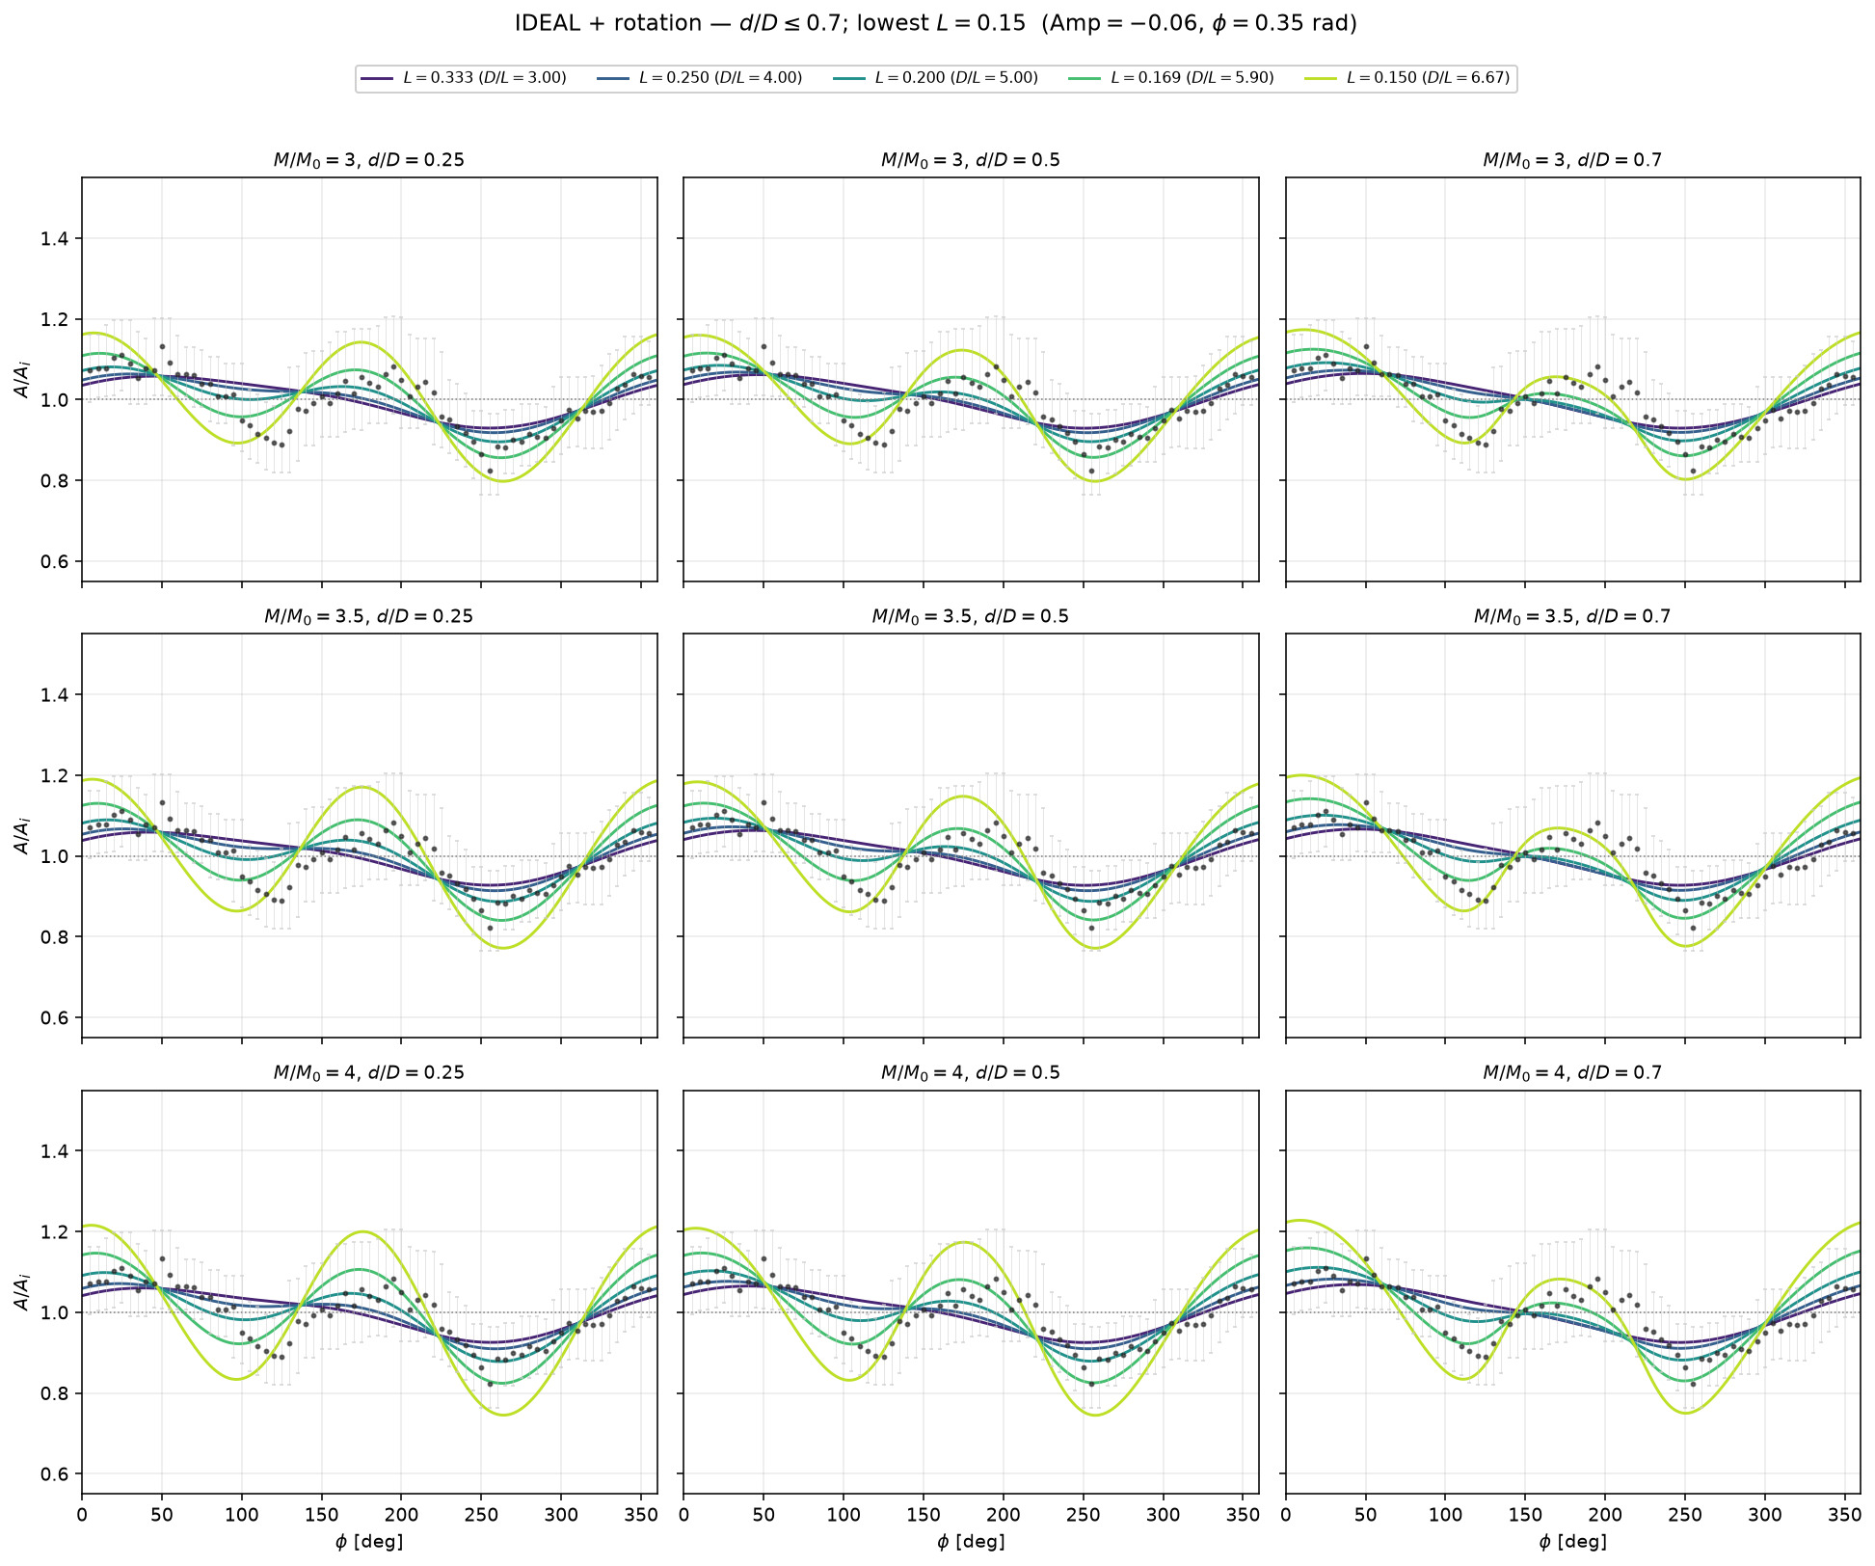
339/395 map_compare/amp_mean_param_noise/ideal_levelsets_L_grid_rotation_dmax07.png

Slide 25
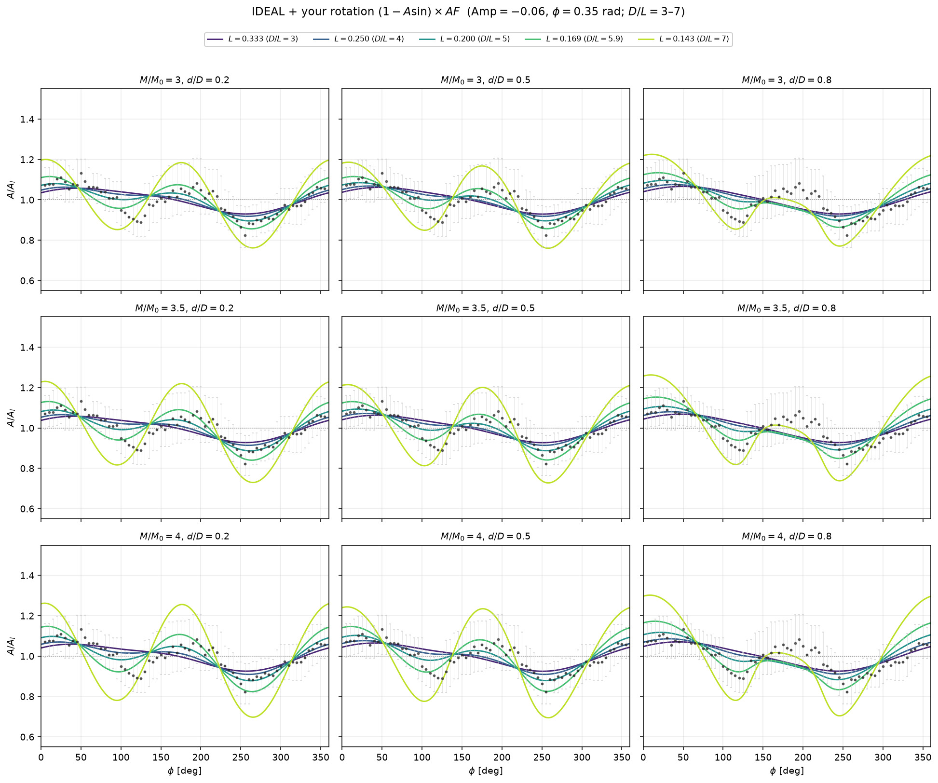
340/395 map_compare/amp_mean_param_noise/ideal_levelsets_L_grid_with_rotation.png

Slide 26
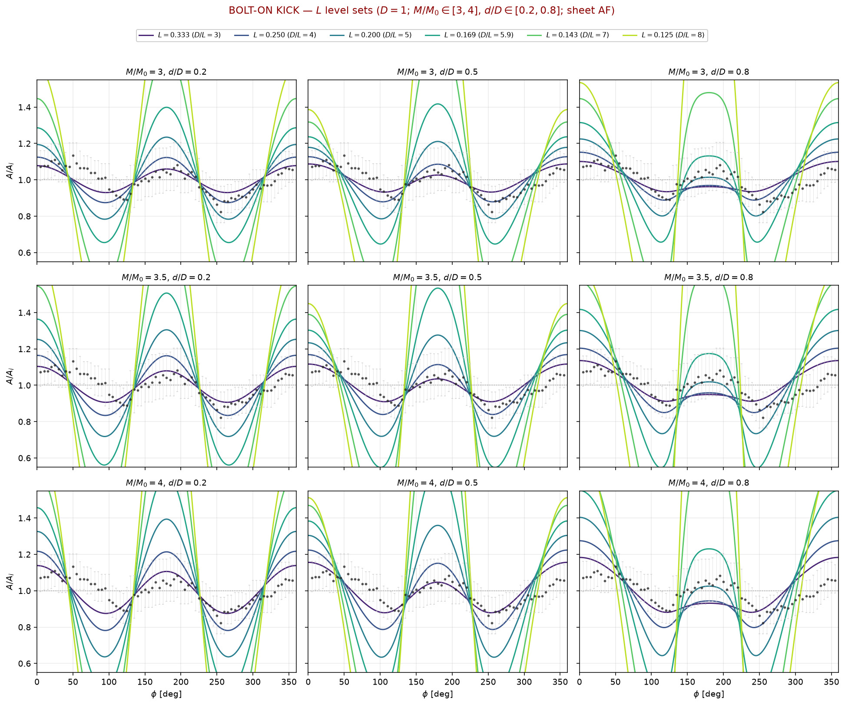
341/395 map_compare/amp_mean_param_noise/kick_levelsets_L_grid_M3-4_d02-08.png

Slide 27
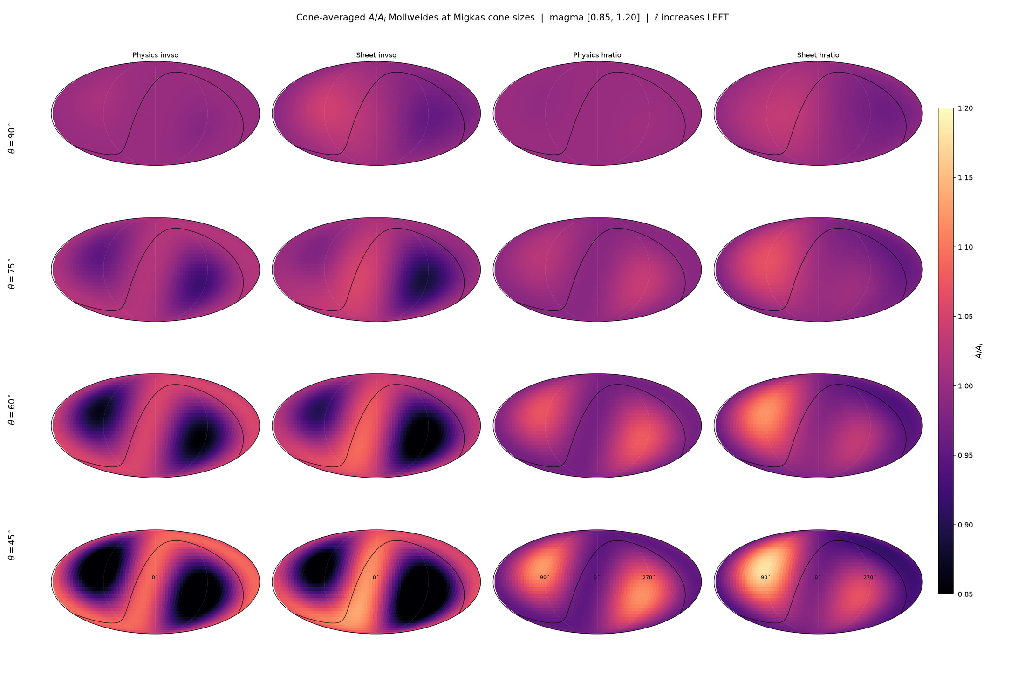
342/395 map_compare/cone_thetas/GRID_4x4_cone_thetas.png

Slide 28
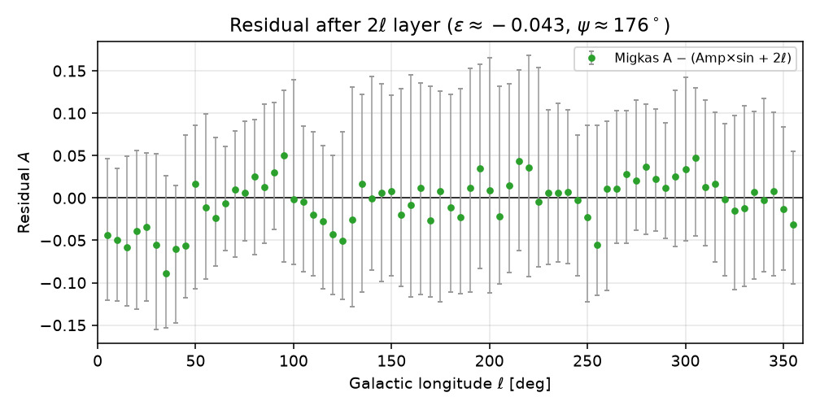
343/395 drive_upload_payloads/papers/stage_setting_2026-09-20/figures/residual_after_2ell.png

Slide 29
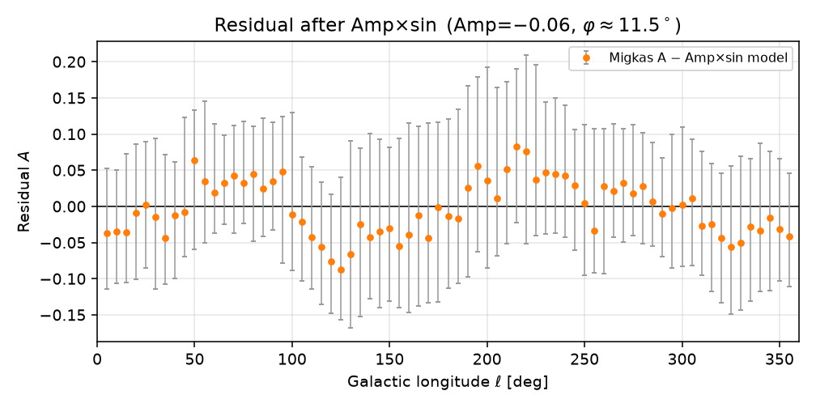
344/395 drive_upload_payloads/papers/stage_setting_2026-09-20/figures/residual_after_rotation.png

Slide 30
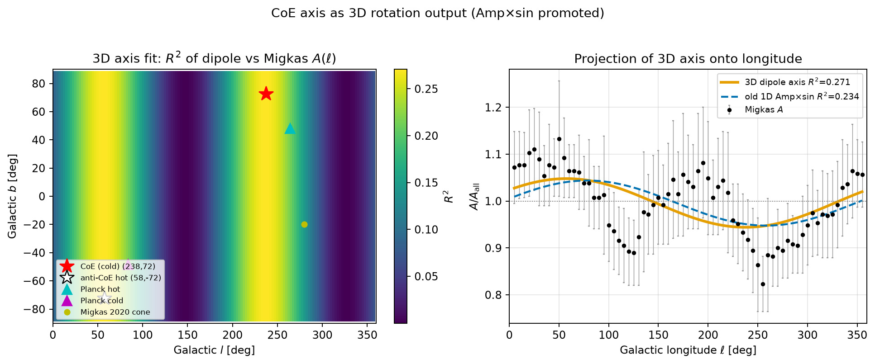
345/395 map_compare/amp_mean_param_noise/coe_axis_3d_fit_R2_sky.png

Slide 31
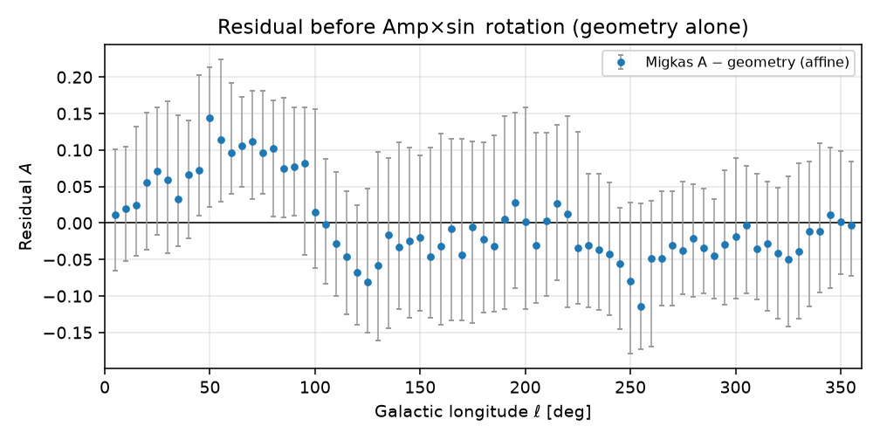
346/395 drive_upload_payloads/papers/stage_setting_2026-09-20/figures/residual_before_rotation.png

Slide 32
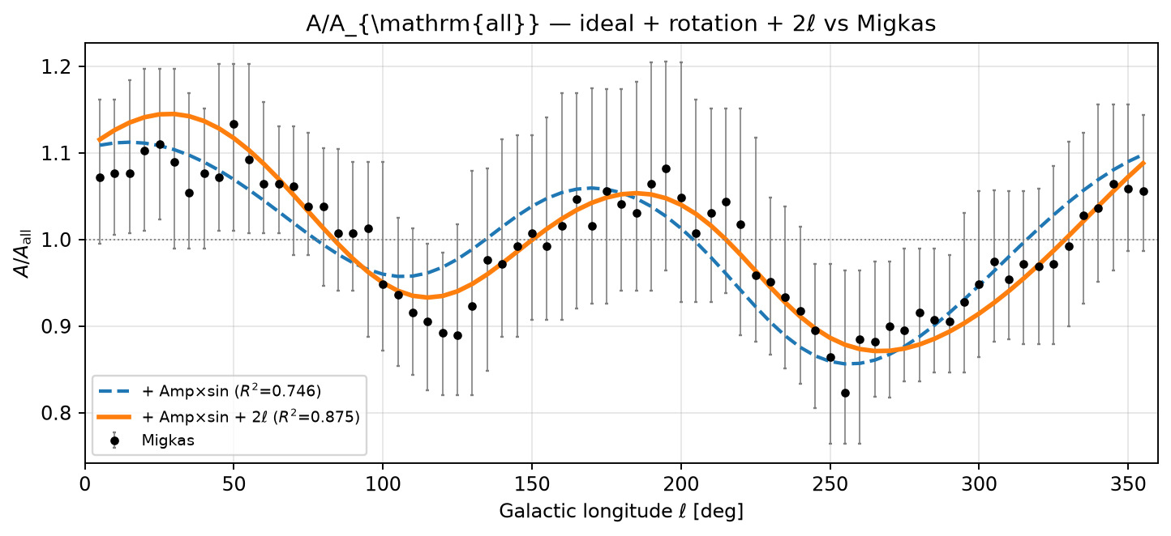
347/395 map_compare/amp_mean_param_noise/A_overlay_ideal_rotation_2ell.png

Slide 33
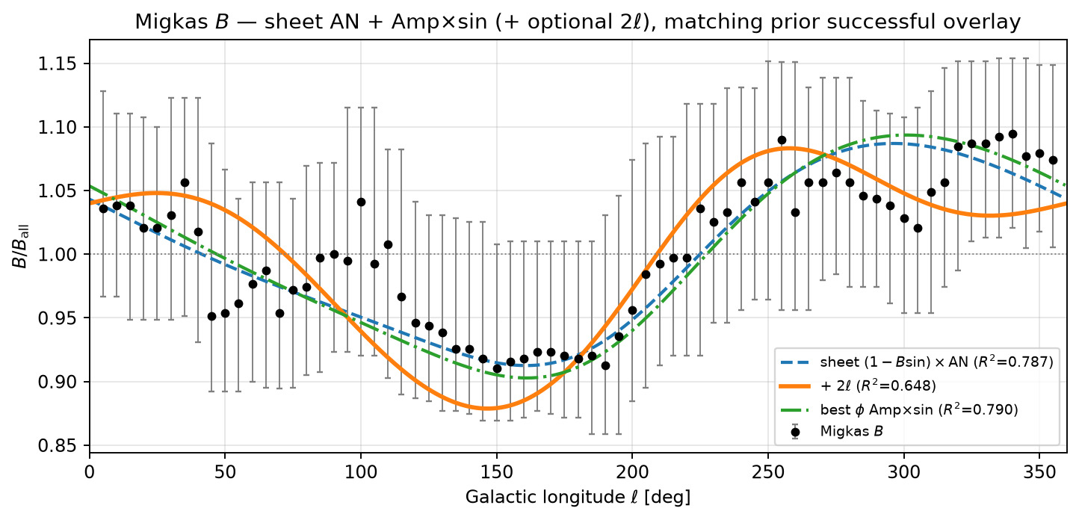
348/395 map_compare/amp_mean_param_noise/B_overlay_ideal_rotation_2ell.png

Slide 34
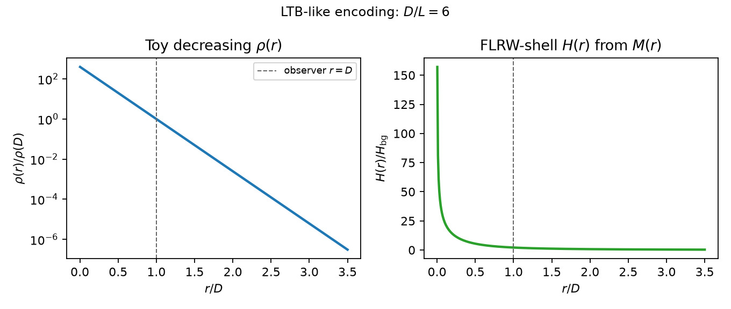
349/395 drive_upload_payloads/papers/gr_ch2_ltb_2026-09-20/figures/toy_density_H_profile.png

Slide 35
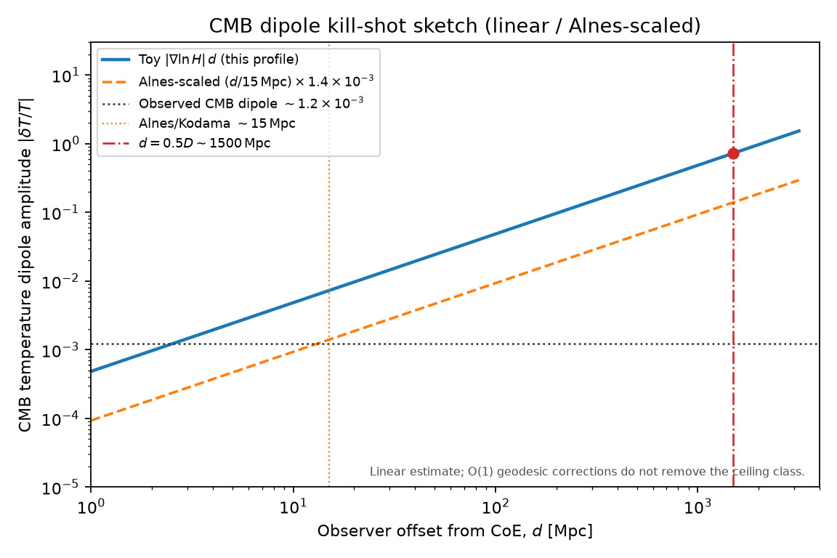
350/395 drive_upload_payloads/papers/gr_ch2_ltb_2026-09-20/figures/cmb_dipole_vs_offset.png

Slide 36
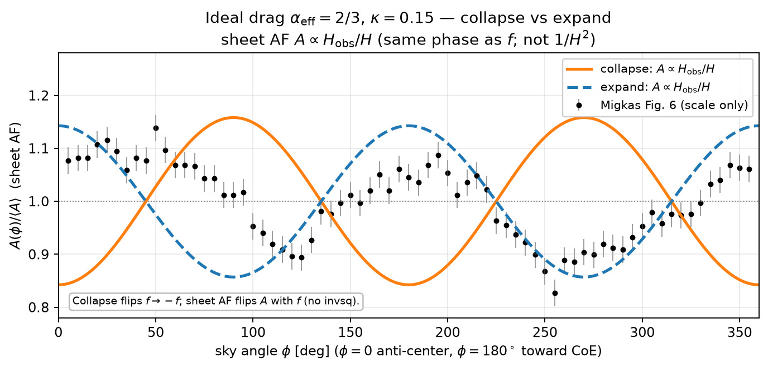
351/395 drive_upload_payloads/papers/st_coe_synthesis_2026-09-19/figures/A_vs_angle_ideal_collapse.png

Slide 37
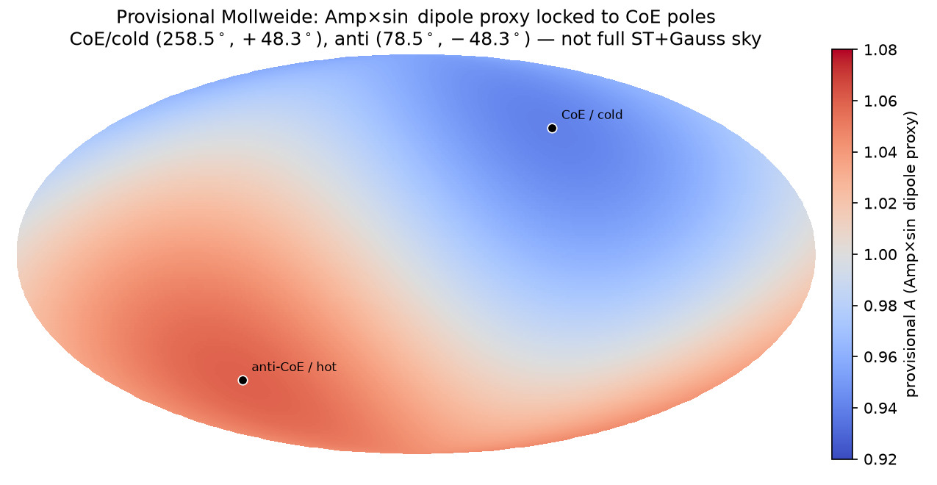
352/395 drive_upload_payloads/papers/stage_setting_2026-09-20/figures/mollweide_amp_sin_coe_axis.png

Slide 38
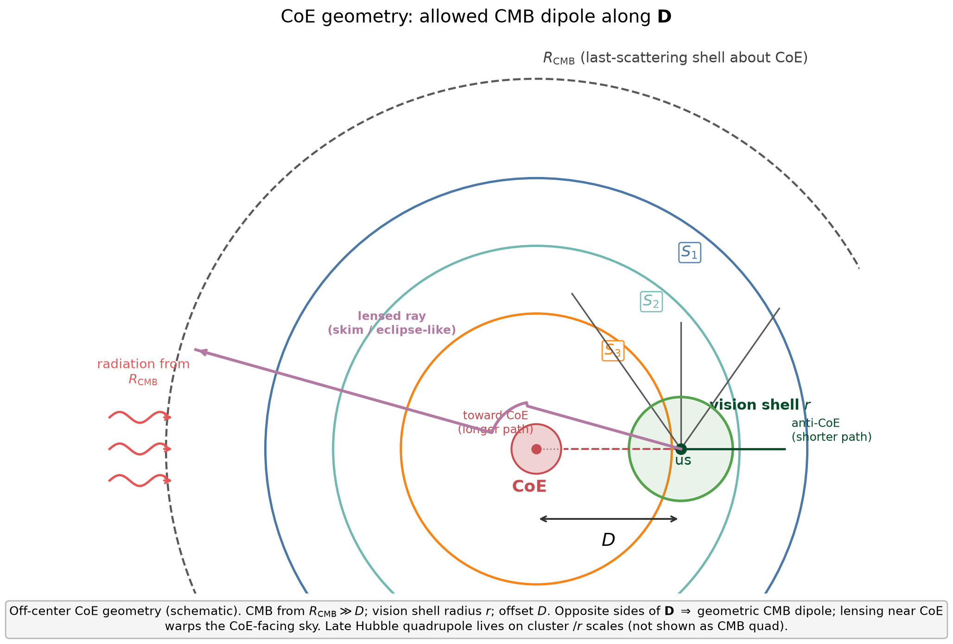
353/395 figures/coe_geometry_cmb_dipole_schematic.png

Slide 39
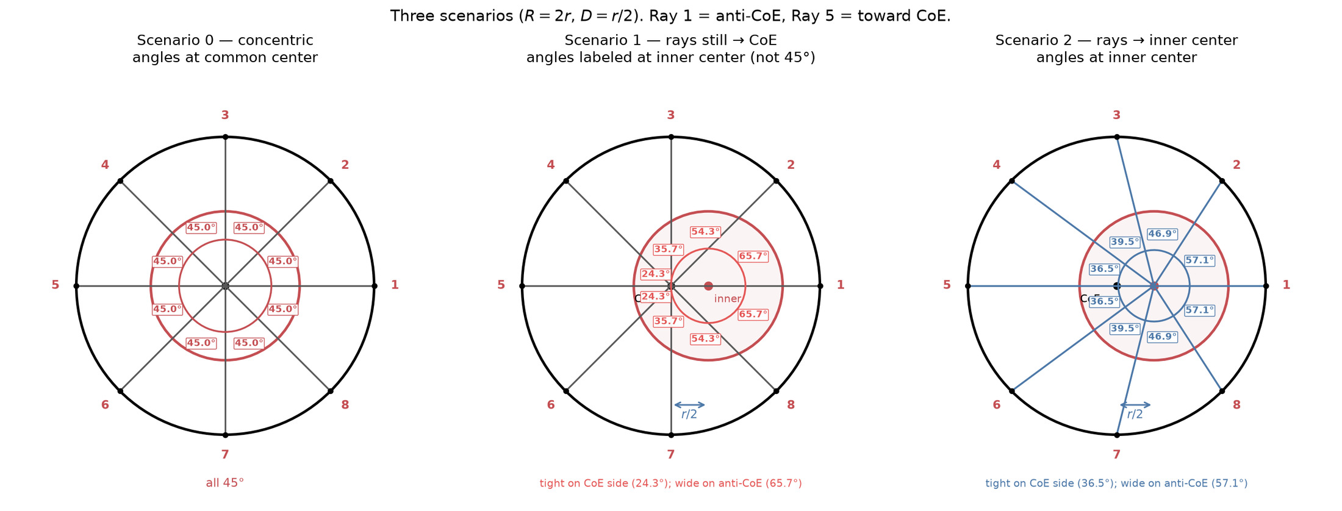
354/395 figures/three_scenarios_angles_labeled.png

Slide 40
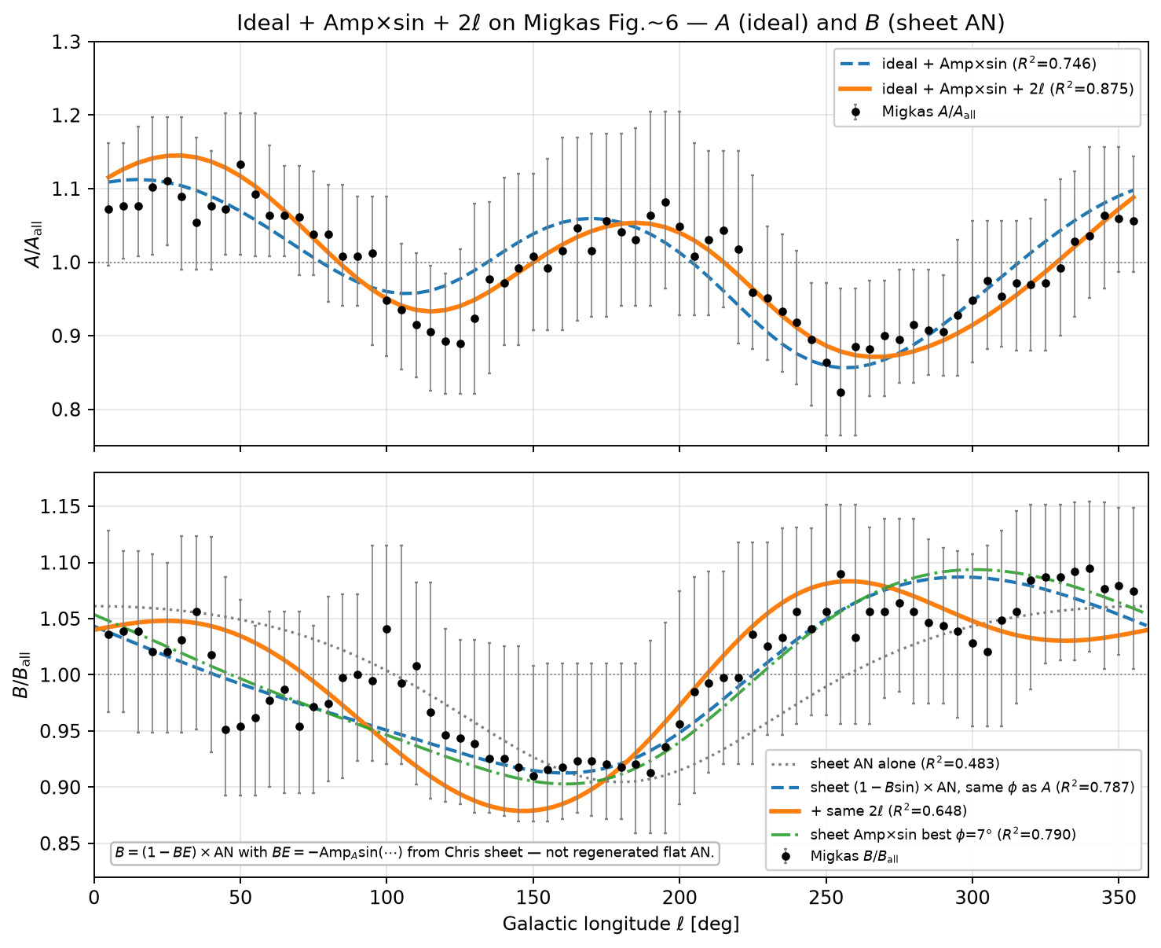
355/395 map_compare/amp_mean_param_noise/AB_overlay_ideal_rotation_2ell.png

Slide 41
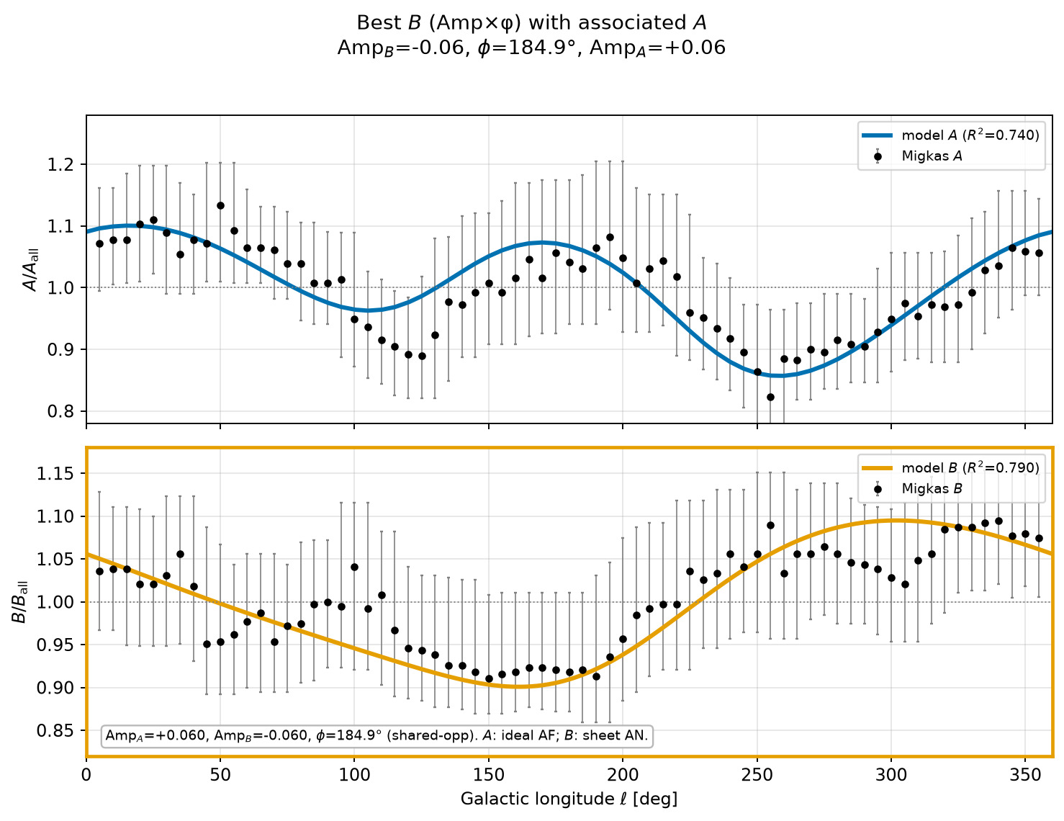
356/395 map_compare/amp_mean_param_noise/best_B_vs_angle_with_associated_A.png

Slide 42
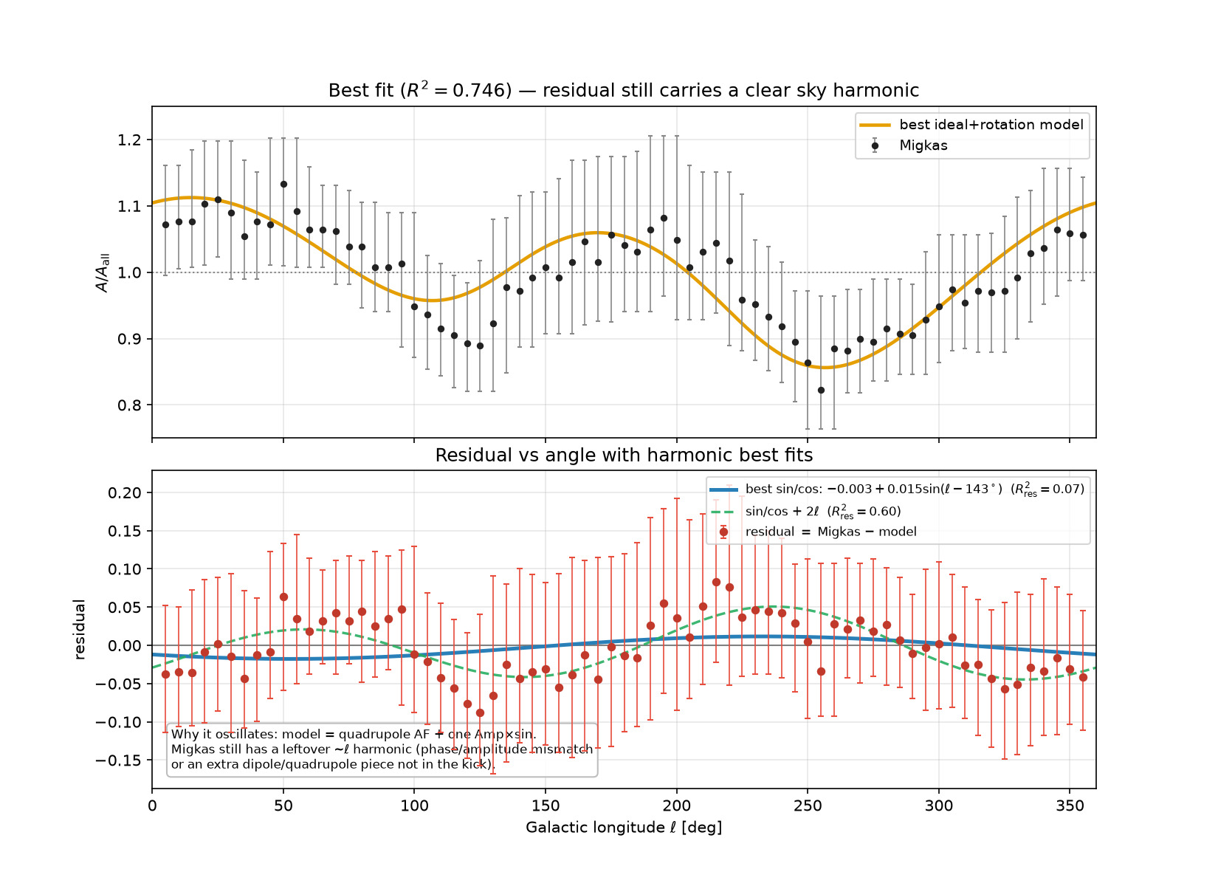
357/395 map_compare/amp_mean_param_noise/best_fit_residual_vs_angle.png

Slide 43
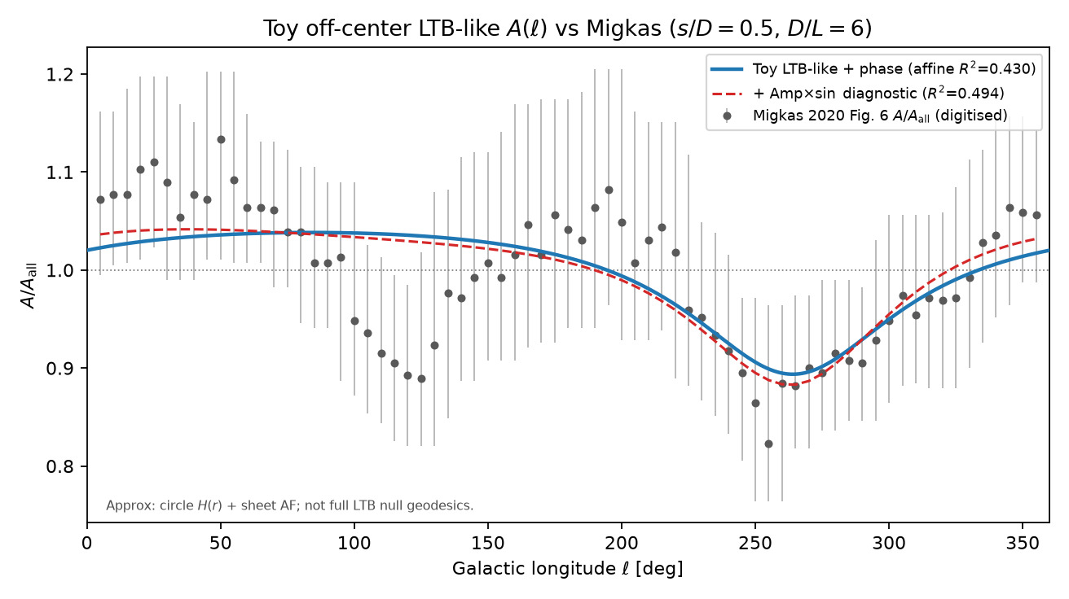
358/395 drive_upload_payloads/papers/gr_ch2_ltb_2026-09-20/figures/A_vs_ell_toy_ltb.png

Slide 44
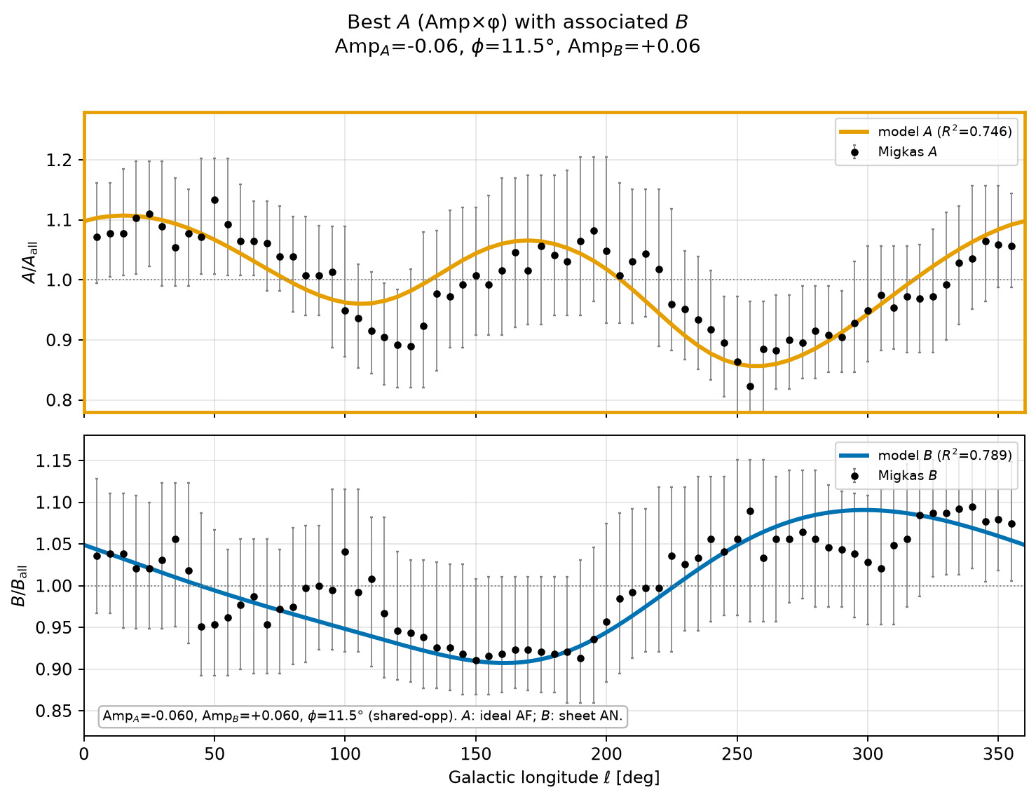
359/395 map_compare/amp_mean_param_noise/best_A_vs_angle_with_associated_B.png

Slide 45
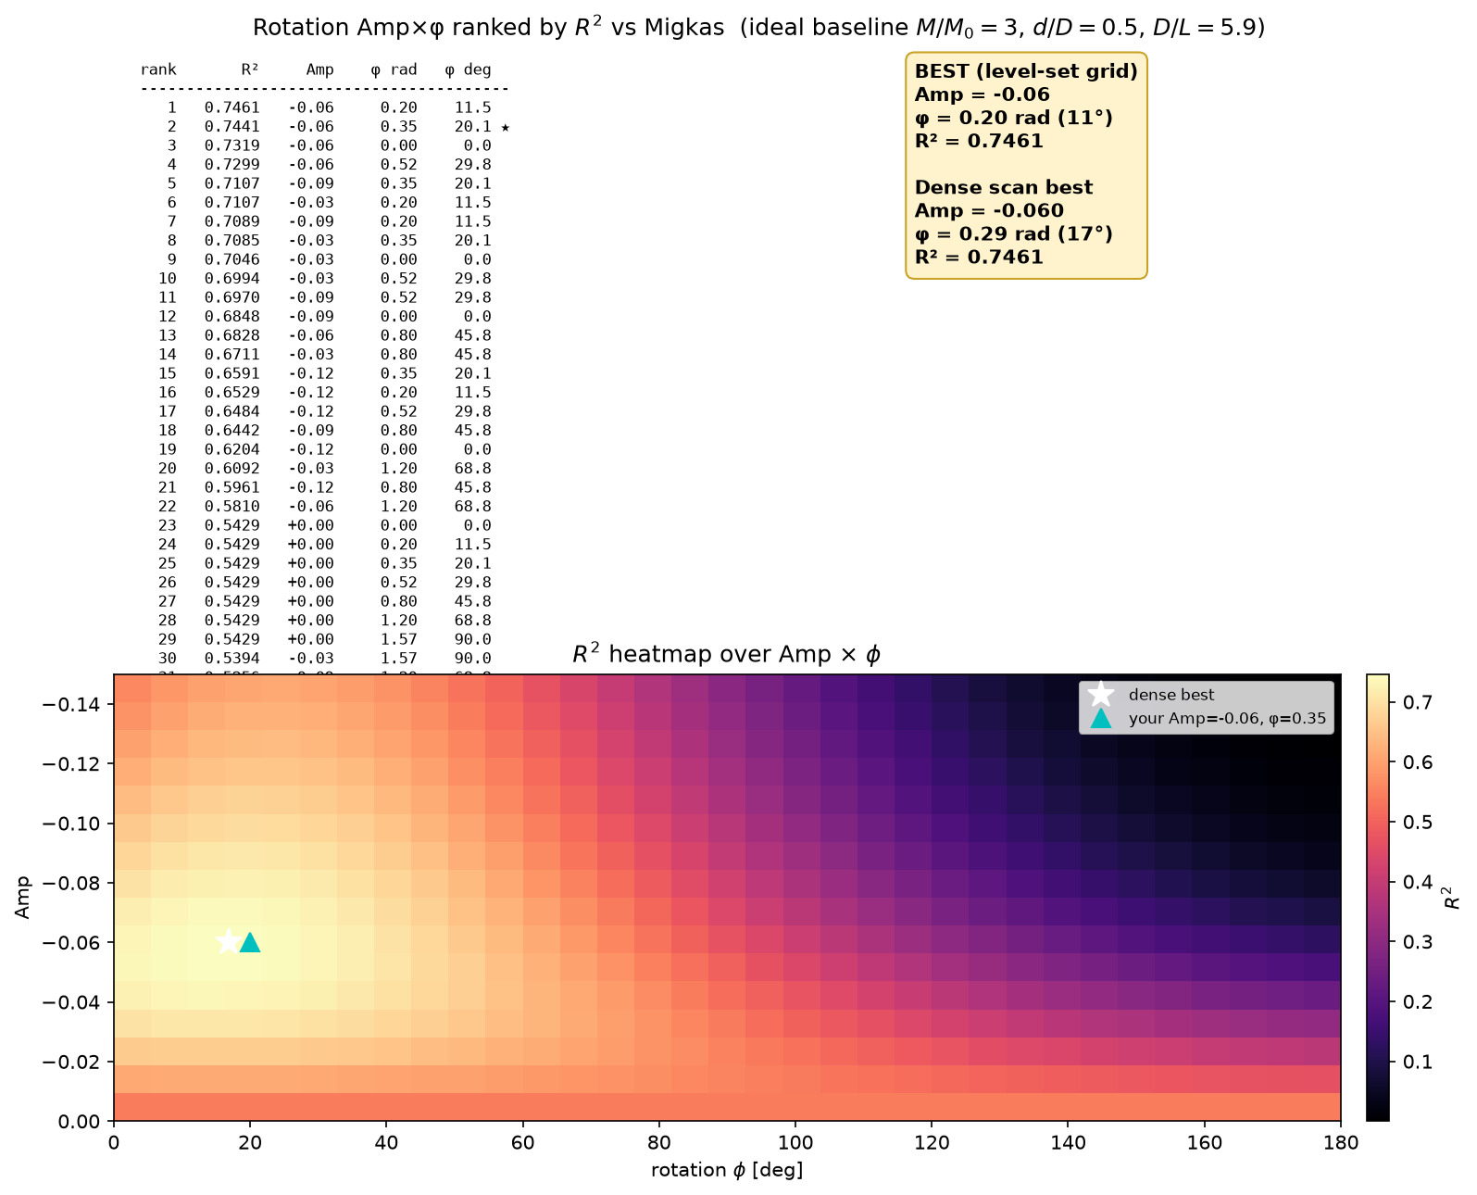
360/395 map_compare/amp_mean_param_noise/rotation_Amp_phi_R2_ranked.png

Slide 46
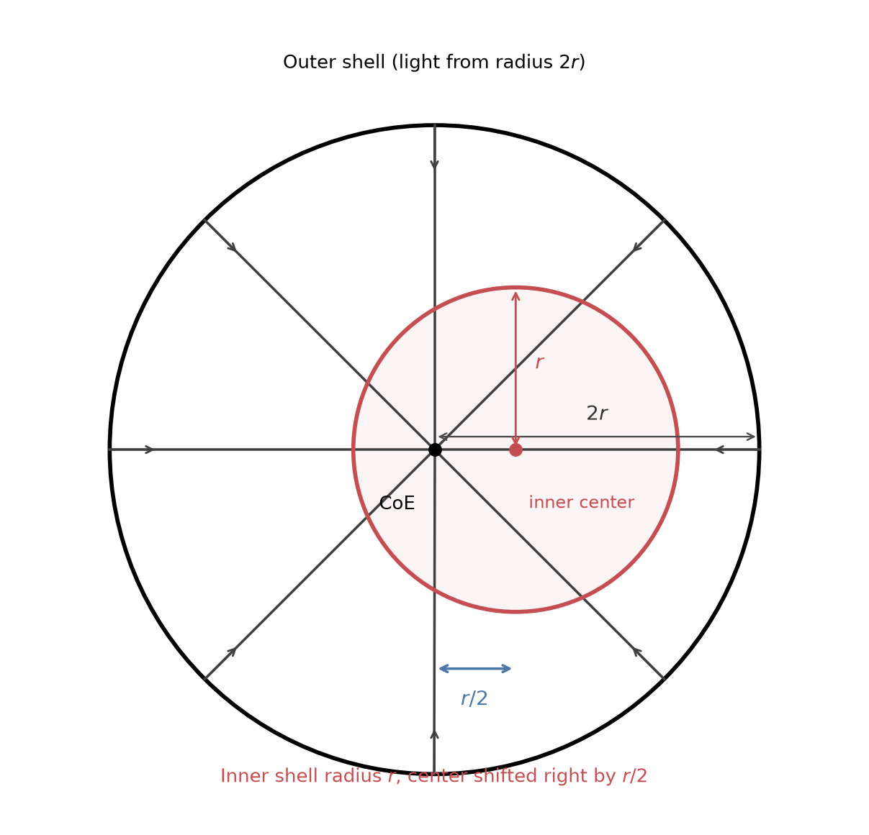
361/395 figures/concentric_shift_r_over_2.png

Slide 47
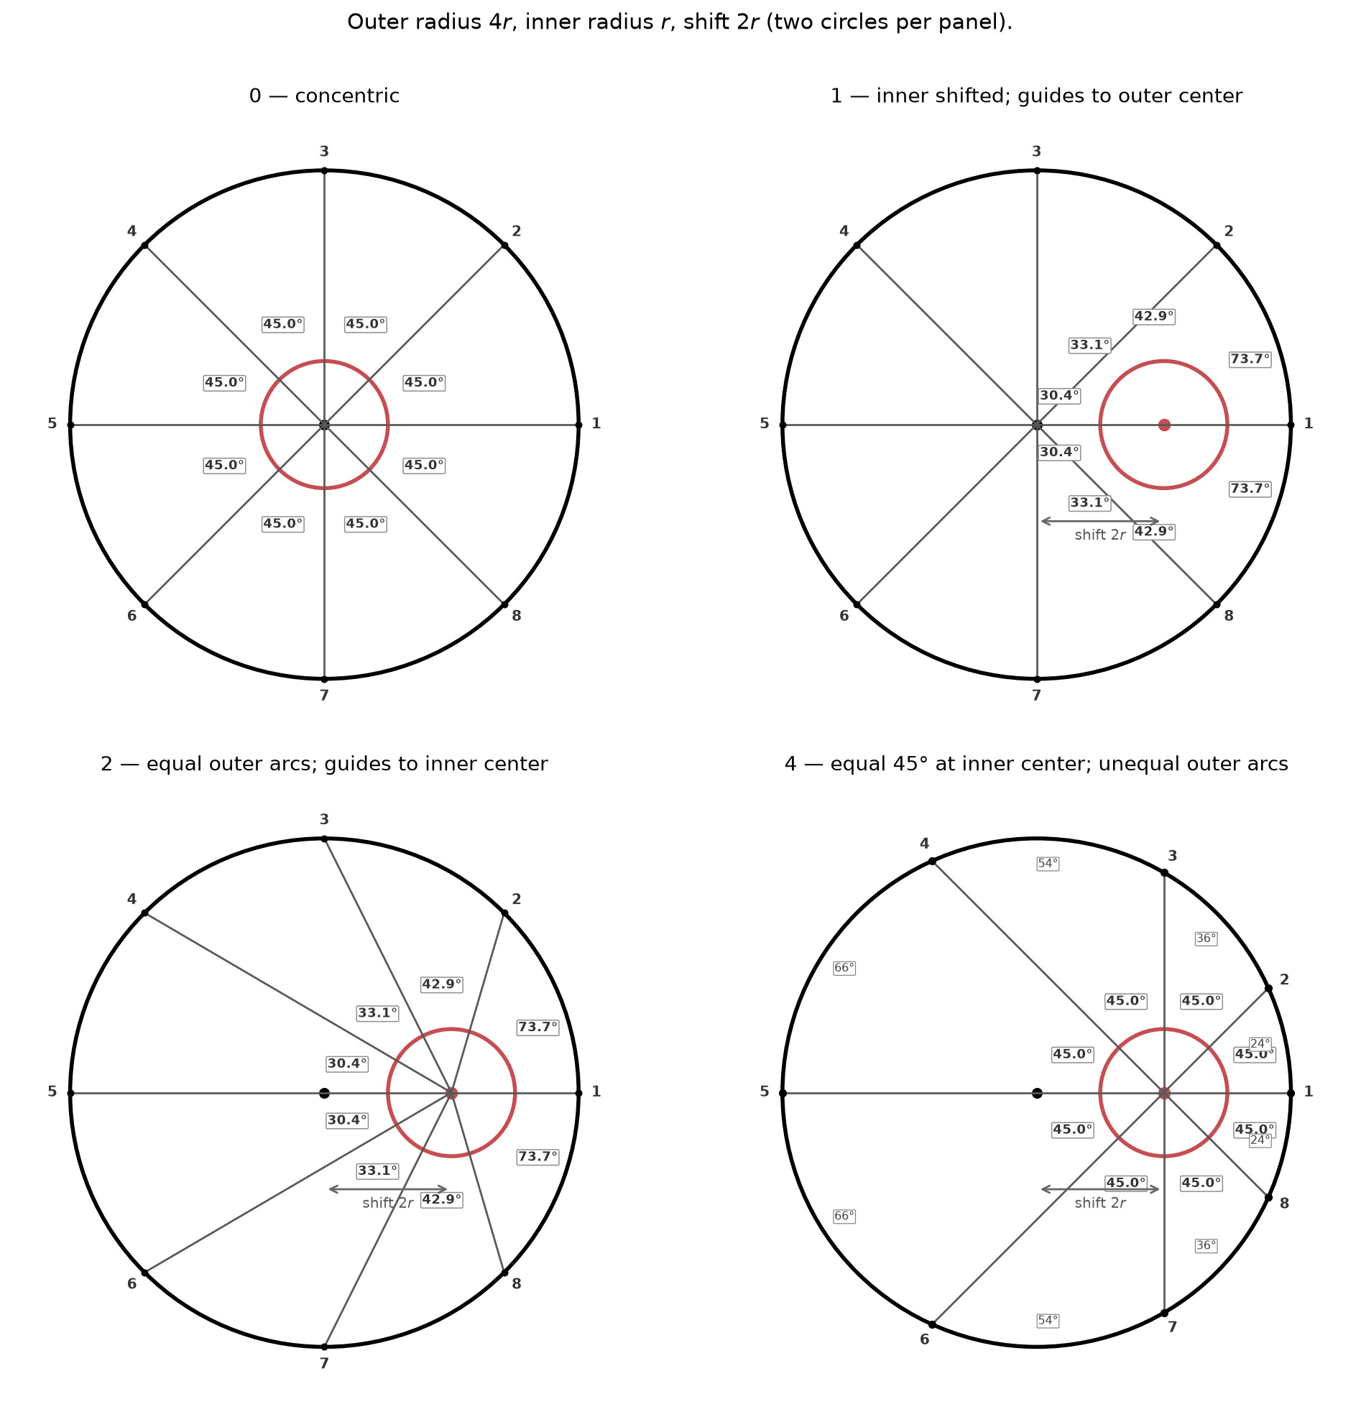
362/395 figures/four_scenarios_R4r_shift2r.png

Slide 48
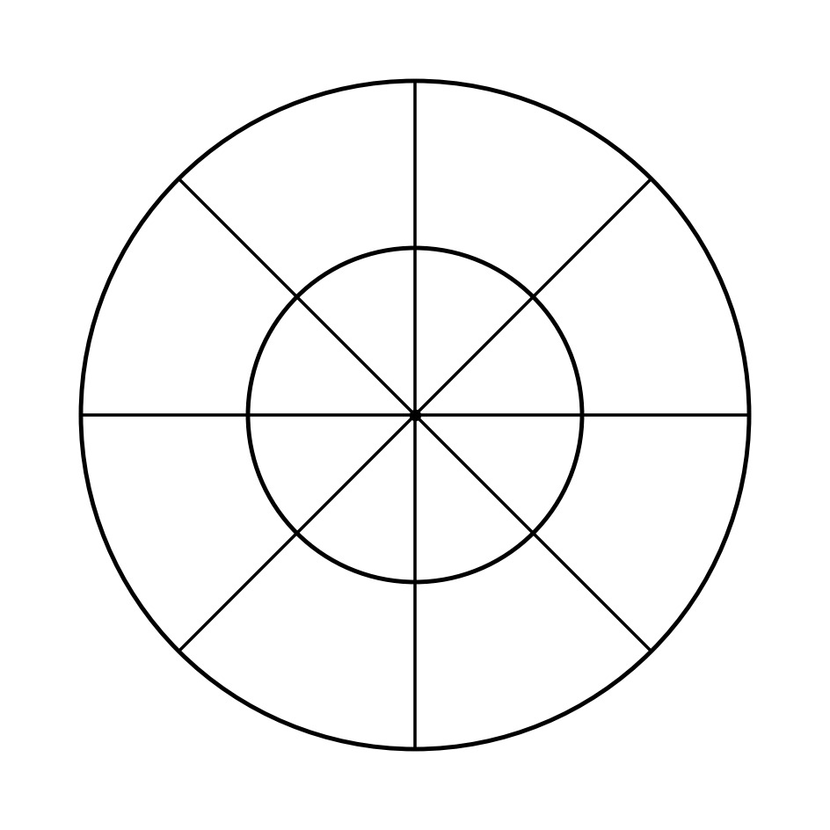
363/395 figures/two_concentric_8_radial.png

Slide 49
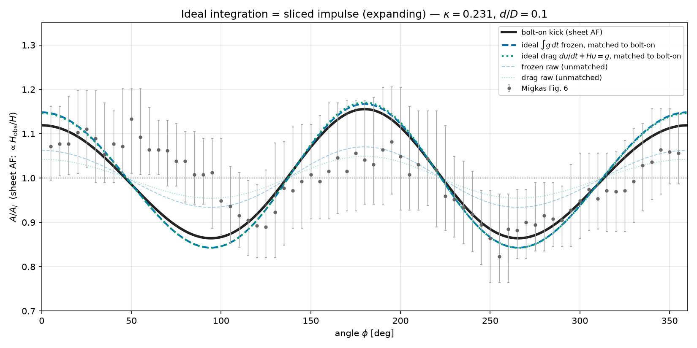
364/395 map_compare/amp_mean_param_noise/A_vs_angle_ideal_integration_sheet_AF.png

Slide 50
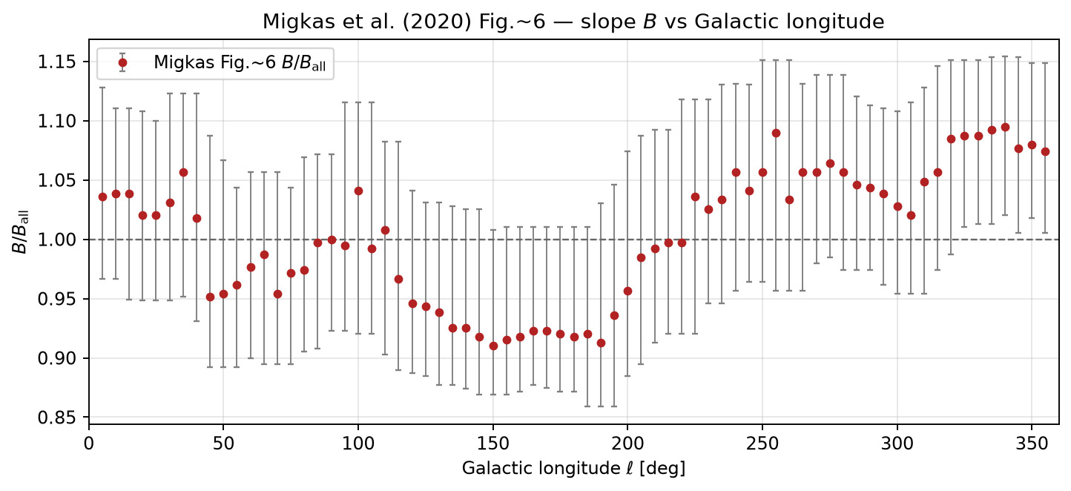
365/395 map_compare/amp_mean_param_noise/B_vs_angle_migkas_fig6.png

Slide 51
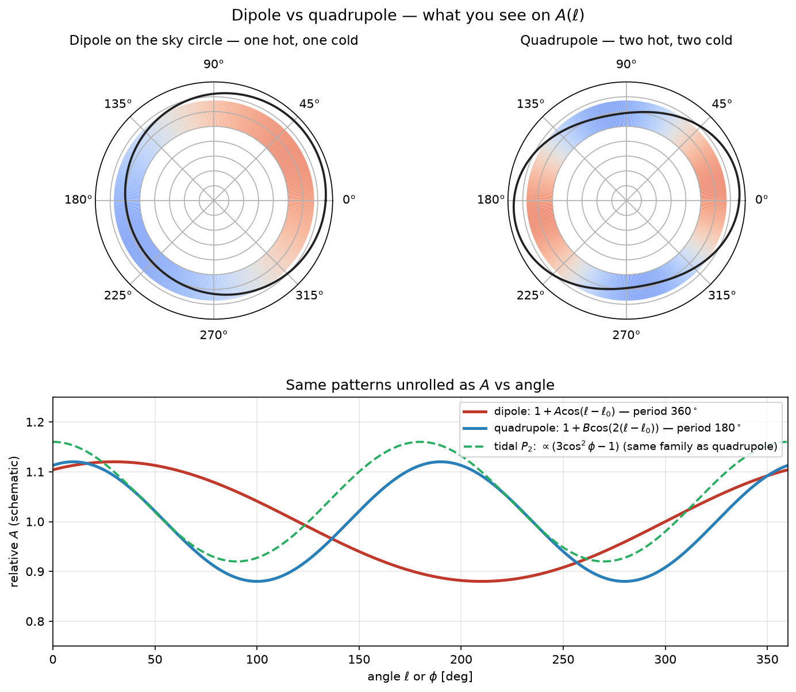
366/395 map_compare/amp_mean_param_noise/dipole_vs_quadrupole_examples.png

Slide 52

367/395 map_compare/amp_mean_param_noise/ideal_rotation_3x3x5_top_curves.png

Slide 53

368/395 map_compare/amp_mean_param_noise/rotation_Amp_phi_AB_shared_heatmaps.png

Slide 54

369/395 map_compare/amp_mean_param_noise/rotation_Amp_phi_B_top_curves.png

Slide 55

370/395 figures/cmb_dipole_estimate_coe_geometry.png

Slide 56

371/395 figures/concentric_scenario2_meet_inner_center.png

Slide 57

372/395 figures/concentric_scenario2_retarget_inner.png

Slide 58

373/395 figures/ray_numbering_sc012.png

Slide 59

374/395 map_compare/amp_mean_param_noise/R2_top5_A_B_tables.png

Slide 60

375/395 map_compare/amp_mean_param_noise/best_A_vs_angle_with_associated_B_2ell.png

Slide 61

376/395 map_compare/amp_mean_param_noise/best_B_vs_angle_with_associated_A_2ell.png

Slide 62

377/395 map_compare/amp_mean_param_noise/coe_axis_3d_b_locked.png

Slide 63

378/395 map_compare/amp_mean_param_noise/geometry_CoE_observer.png

Slide 64

379/395 figures/four_scenarios_overview.png

Slide 65

380/395 figures/hubble_from_coe_relative_velocity.png

Slide 66

381/395 figures/photon_hits_per_arc_vs_angle.png

Slide 67

382/395 figures/scenarios_024_R4r_shift2r.png

Slide 68

383/395 map_compare/amp_mean_param_noise/AB_vs_angle_migkas_fig6.png

Slide 69

384/395 map_compare/amp_mean_param_noise/A_vs_angle_ideal_plus_chris_rotation.png

Slide 70

385/395 map_compare/amp_mean_param_noise/R2_table_best_A_B_with_heatmaps.png

Slide 71

386/395 map_compare/amp_mean_param_noise/best_A_vs_angle_with_associated_B_2ell_fromB.png

Slide 72

387/395 map_compare/amp_mean_param_noise/best_B_vs_angle_with_associated_A_2ell_fromB.png

Slide 73

388/395 map_compare/amp_mean_param_noise/rotation_Amp_phi_B_R2_ranked.png

Slide 74

389/395 map_compare/amp_mean_param_noise/rotation_Amp_phi_top_curves.png

Slide 75

390/395 drive_upload_payloads/papers/stage_setting_2026-09-20/figures/best_fit_with_2ell_multiplier.png

Slide 76

391/395 figures/coe_shell_behind_projects_as_ring.png

Slide 77

392/395 figures/coe_shell_with_vs_without.png

Slide 78

393/395 map_compare/amp_mean_param_noise/best_fit_with_2ell_multiplier.png

Slide 79

394/395 figures/A_vs_angle_with_residuals_2ell.png

Slide 80

395/395 figures/A_vs_angle_after_2ell_with_residuals.png

