Slide 1
Identifying Image Composites Through Shadow Matte Consistency by Liu et al.
Sebastian Rietsch

Slide 2
Problem definition
Liu et al.: Identifying Image Composites Through Shadow Matte Consistency
Questions

Slide 3
Problem definition

Slide 4
Availability of powerful video and image editing tools
Tampered videos and images are flooding the media
Image retouching, cut-and-paste, copy-move attacks
→ Evaluating authenticity of digital photographs is a crucial task nowadays
Idea: test shadows for inconsistencies

Slide 5
Identifying Image Composites Through Shadow Matte Consistency
Qiguang Liu, Xiaochun Cao, Chao Deng, and Xiaojie Guo

Slide 6
Assumptions
Shadow properties
Algorithm outline
Shadow boundary sampling and penumbra region identification
Calculation of shadow matte value
Forgery detection using the shadow matte value
Summary
Evaluation and Limitations

Slide 7
Assumptions
Shadow properties
Algorithm outline
Shadow boundary sampling and penumbra region identification
Calculation of shadow matte value
Forgery detection using the shadow matte value
Summary
Evaluation and Limitations

Slide 8
Assumptions
Outdoor scene
One distant direct light source, e.g. the sun
Shadow receiving surfaces have to be Lambertian (only diffuse reflection)
Holds true for most shadow receiving surfaces: asphalt, brick, stone, mud, grass, and concrete
Shadow casting objects are opaque
There exists at least one authentic shadow in the image

Slide 9
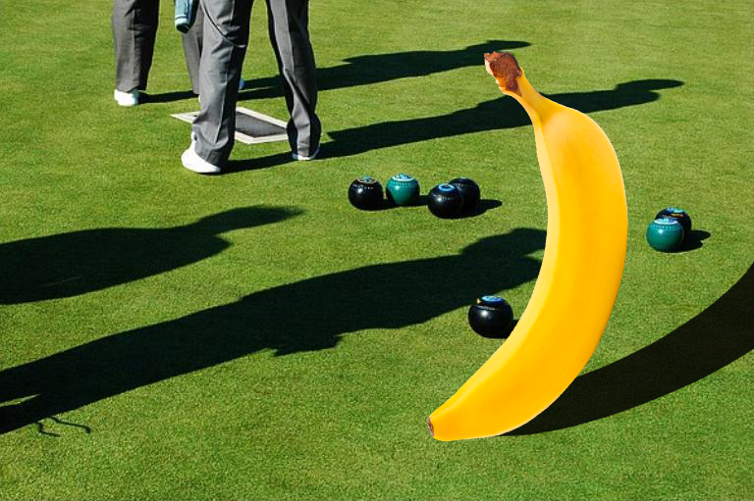

Slide 10
Assumptions
Shadow properties
Algorithm outline
Shadow boundary sampling and penumbra region identification
Calculation of shadow matte value
Forgery detection using the shadow matte value
Summary
Evaluation and Limitations

Slide 11
Geometric properties
shadow receiving surface
full shadow
light source
shadow casting object
penumbra shadow

Slide 12
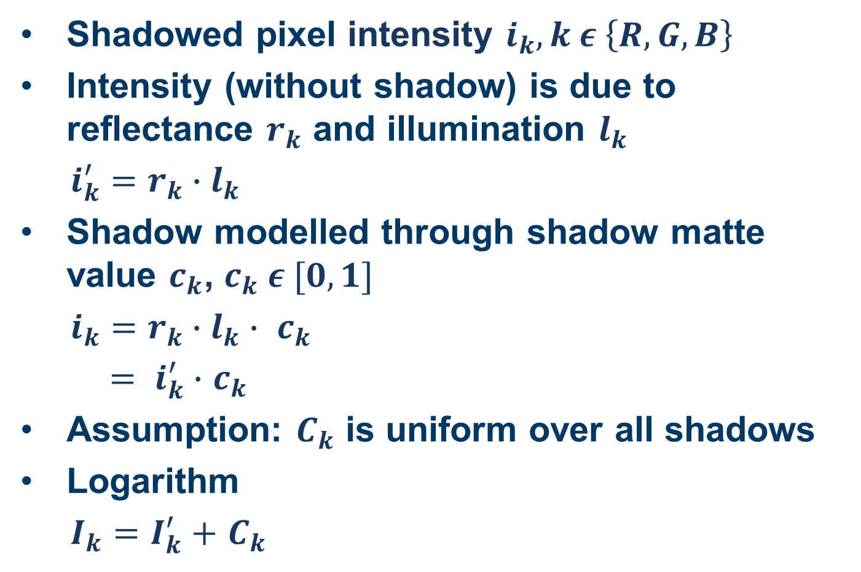
Photometric properties
Shadowed pixel intensity $i_{k}, k ε \left\{R, G, B\right\}$
Intensity (without shadow) is due to reflectance $r_{k}$ and illumination $l_{k}$
$i_{k}^{′}=r_{k}∙l_{k}$
Shadow modelled through shadow matte value $c_{k}$, $c_{k} ε [0,1]$
$i_{k}=r_{k}∙l_{k}∙ c_{k}$
$= i_{k}^{′}∙$ $c_{k}$
Assumption: $C_{k}$ is uniform over all shadows
Logarithm
$I_{k}=I_{k}^{′}+$ $C_{k}$

Slide 13
Assumptions
Shadow properties
Algorithm outline
Shadow boundary sampling and penumbra region identification
Calculation of shadow matte value
Forgery detection using the shadow matte value
Summary
Evaluation and Limitations

Slide 14
Algorithm outline
Sample two rectangular patches around two different shadow boundaries
Compute shadow matte values for both patches
If the difference between the shadow matte values exceed some threshold, one of the shadows must be forged

Slide 15
Assumptions
Shadow properties
Algorithm outline
Shadow boundary sampling and penumbra region identification
Calculation of shadow matte value
Forgery detection using the shadow matte value
Summary
Evaluation and Limitations

Slide 16
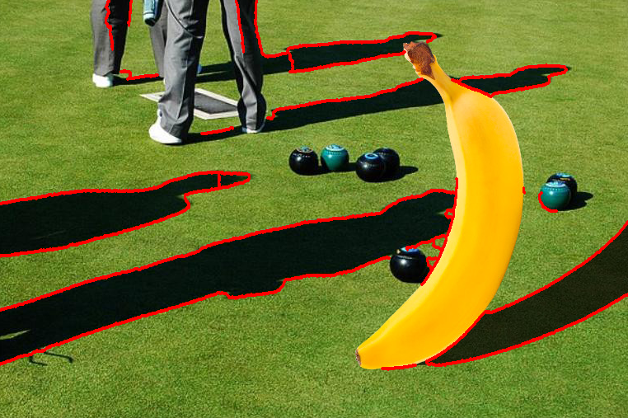

Slide 17

Shadow boundary sampling
Take $n$ connected boundary points ($n=50$)
Divide into groups of $m$ ($m=10$)
Fit a line to every group via regression
Sample $s∙m$ samples along line normal in both directions for every line ($s=20$)

Slide 18
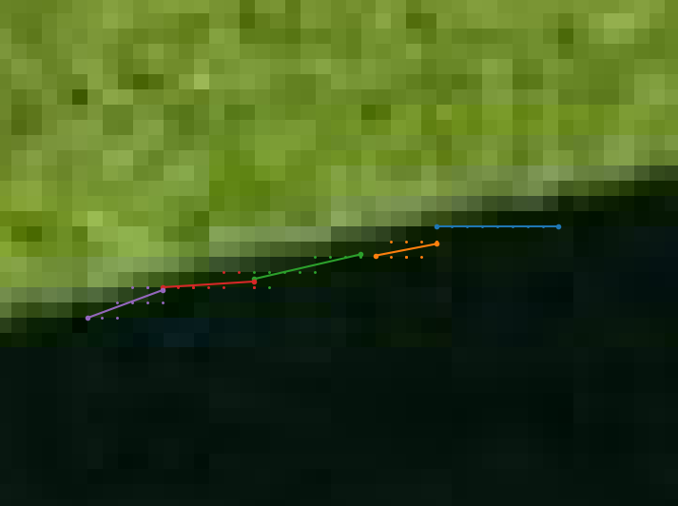
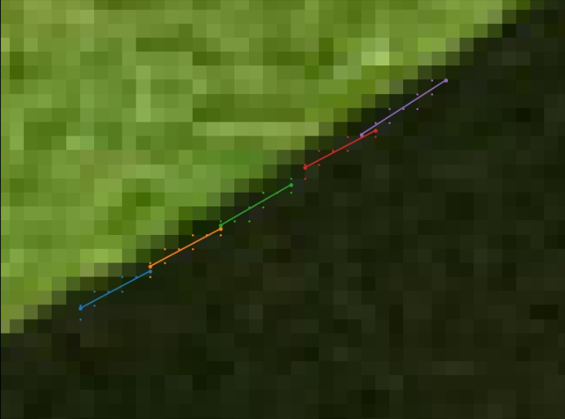

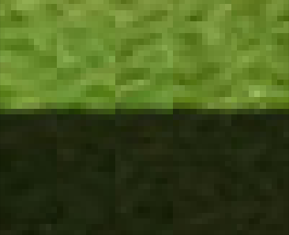
Real shadow
Forged shadow

Slide 19
Penumbra region detection
Width of penumbra region is assumed to be constant
Convert patch to grayscale, transfer to logarithm domain
Compute average along shadow direction
Normalize

Slide 20
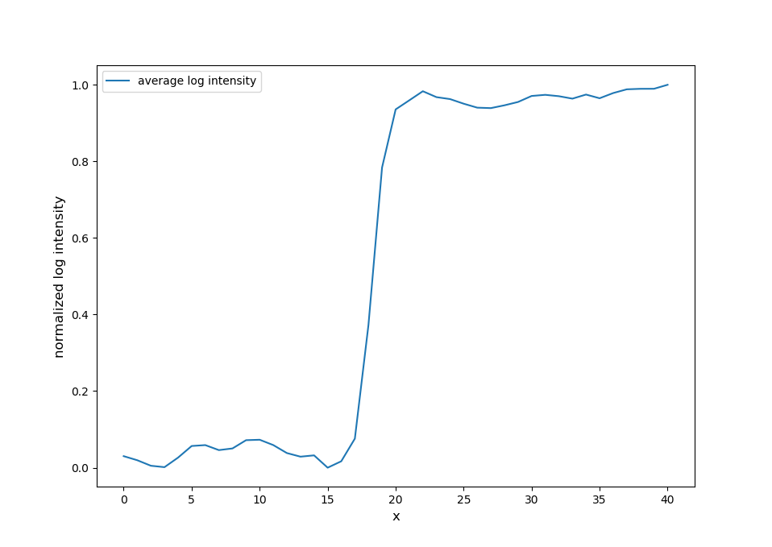

Slide 21
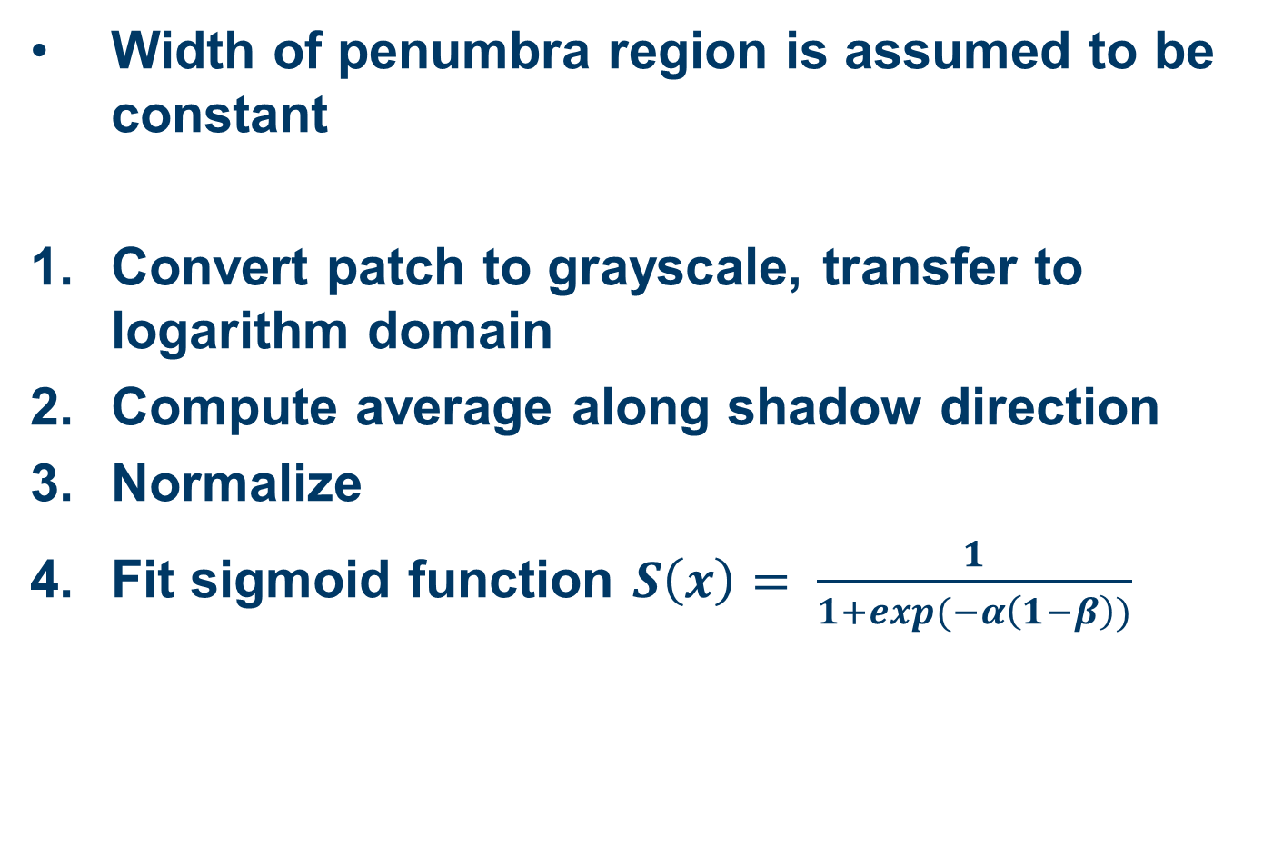
Penumbra region detection
Width of penumbra region is assumed to be constant
Convert patch to grayscale, transfer to logarithm domain
Compute average along shadow direction
Normalize
Fit sigmoid function $S\left(x\right)= \frac{1}{1+exp(−α\left(1−β\right))}$

Slide 22
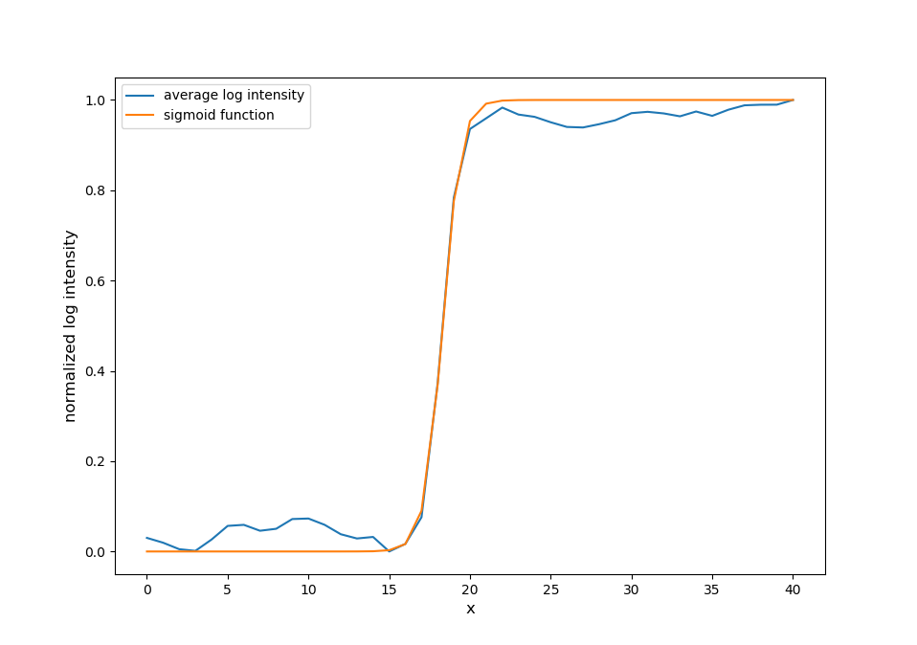

Slide 23
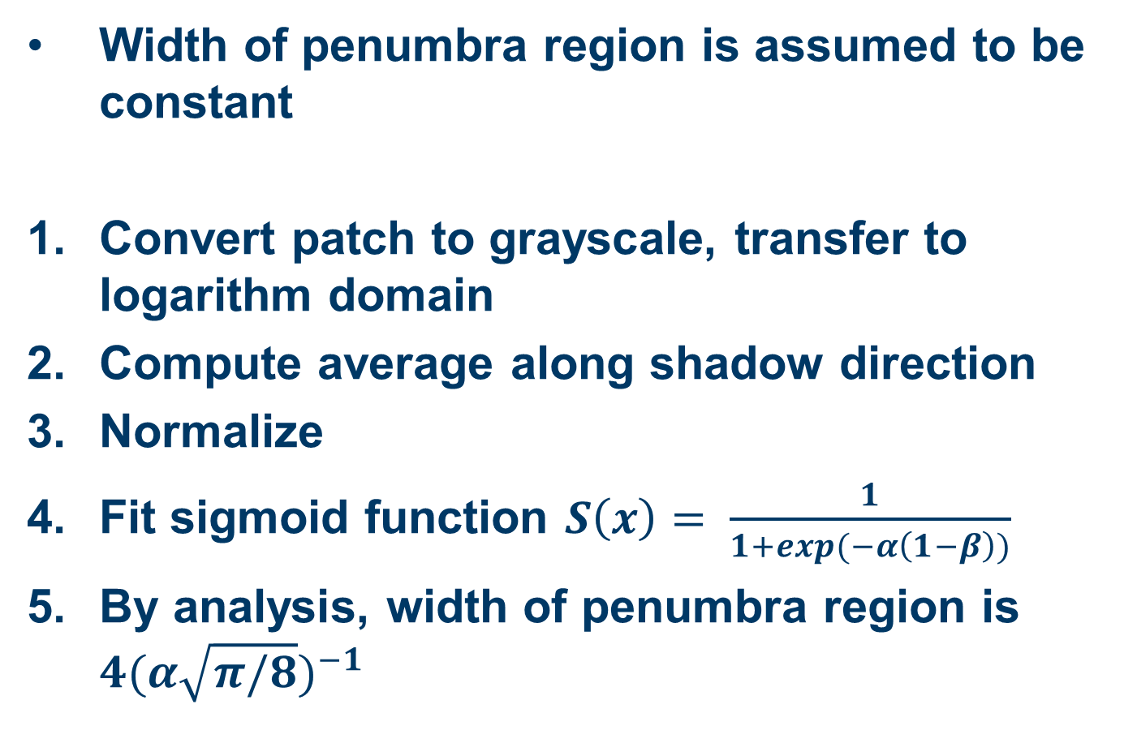
Penumbra region detection
Width of penumbra region is assumed to be constant
Convert patch to grayscale, transfer to logarithm domain
Compute average along shadow direction
Normalize
Fit sigmoid function $S\left(x\right)= \frac{1}{1+exp(−α\left(1−β\right))}$
By analysis, width of penumbra region is ${4(α\sqrt{π/8})}^{−1}$

Slide 24
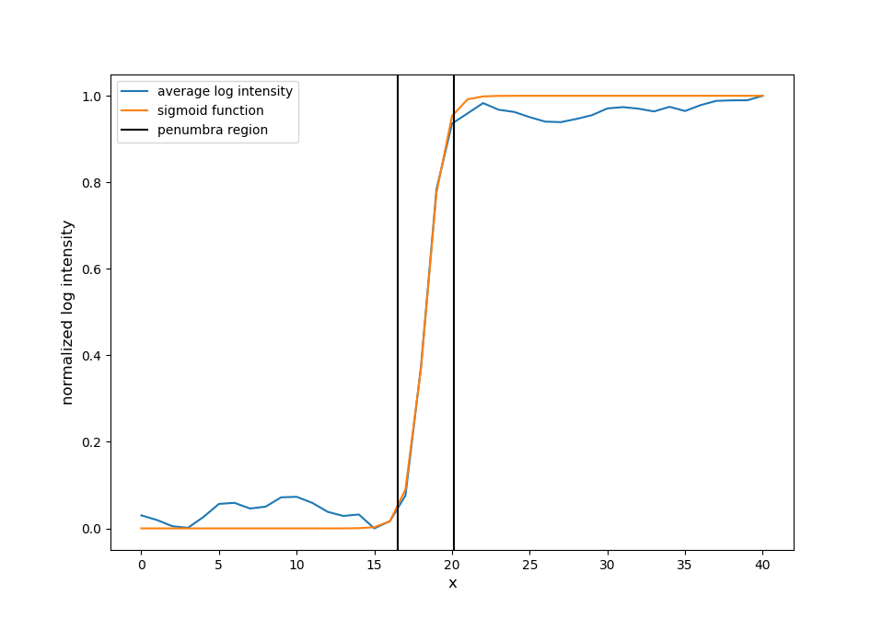

Slide 25
Assumptions
Shadow properties
Algorithm outline
Shadow boundary sampling and penumbra region identification
Calculation of shadow matte value
Forgery detection using the shadow matte value
Summary
Evaluation and Limitations

Slide 26
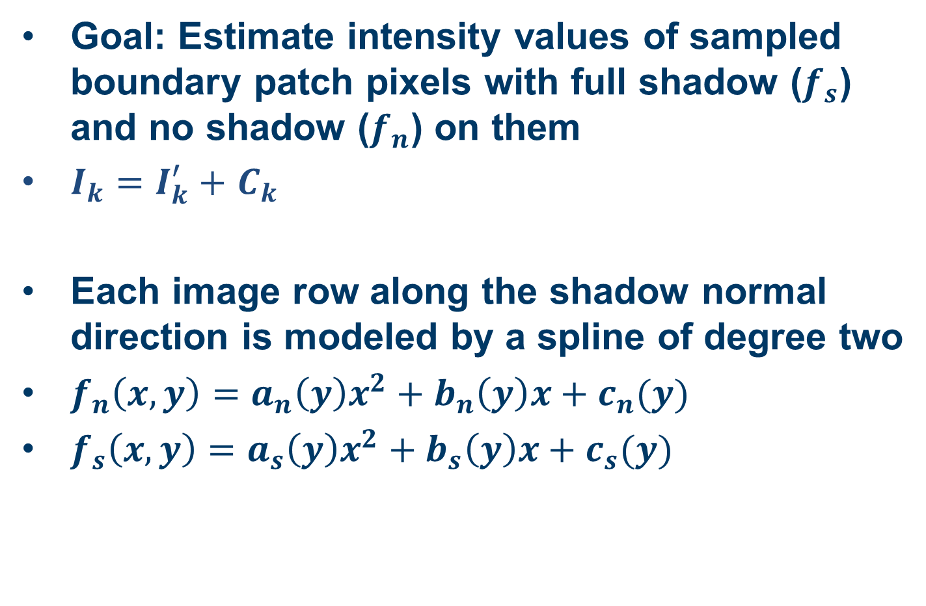
Surface estimation
Goal: Estimate intensity values of sampled boundary patch pixels with full shadow ($f_{s}$) and no shadow ($f_{n}$) on them
$I_{k}=I_{k}^{′}+$ $C_{k}$
Each image row along the shadow normal direction is modeled by a spline of degree two
$f_{n}\left(x, y\right)={a_{n}\left(y\right)x}^{2}+b_{n}\left(y\right)x+c_{n}(y)$
$f_{s}\left(x, y\right)=a_{s}\left(y\right)x^{2}+b_{s}\left(y\right)x+c_{s}(y)$

Slide 27
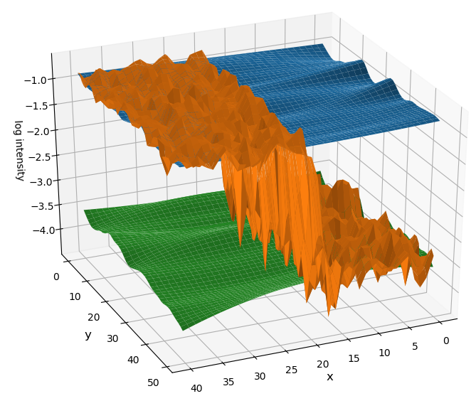



$$f_{n}$$
$$f_{s}$$
$$I$$
R-channel estimation

Slide 28
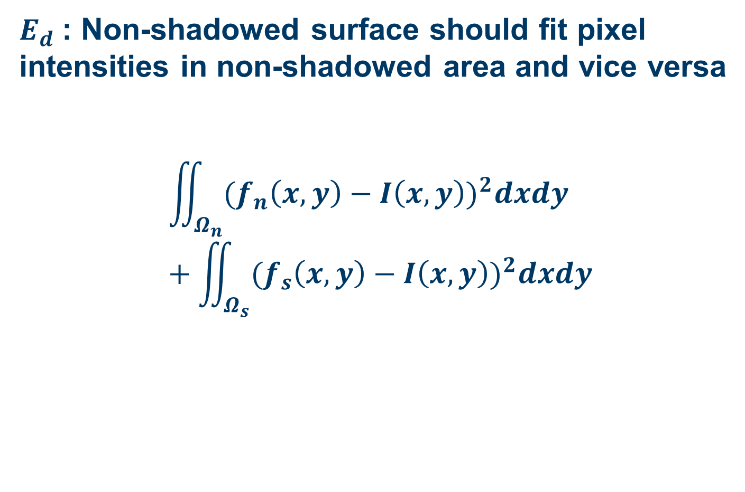
Energy functions
$E_{d}$: Non-shadowed surface should fit pixel intensities in non-shadowed area and vice versa
$$\iint_{Ω_{n}}{{(f}_{n}\left(x,y\right)−I{\left(x,y\right))}^{2}dxdy}+\iint_{Ω_{s}}{{(f}_{s}\left(x,y\right)−I{\left(x,y\right))}^{2}dxdy}$$

Slide 29
$$f_{n}$$
$$f_{s}$$
$$I$$
R-channel estimation

Slide 30
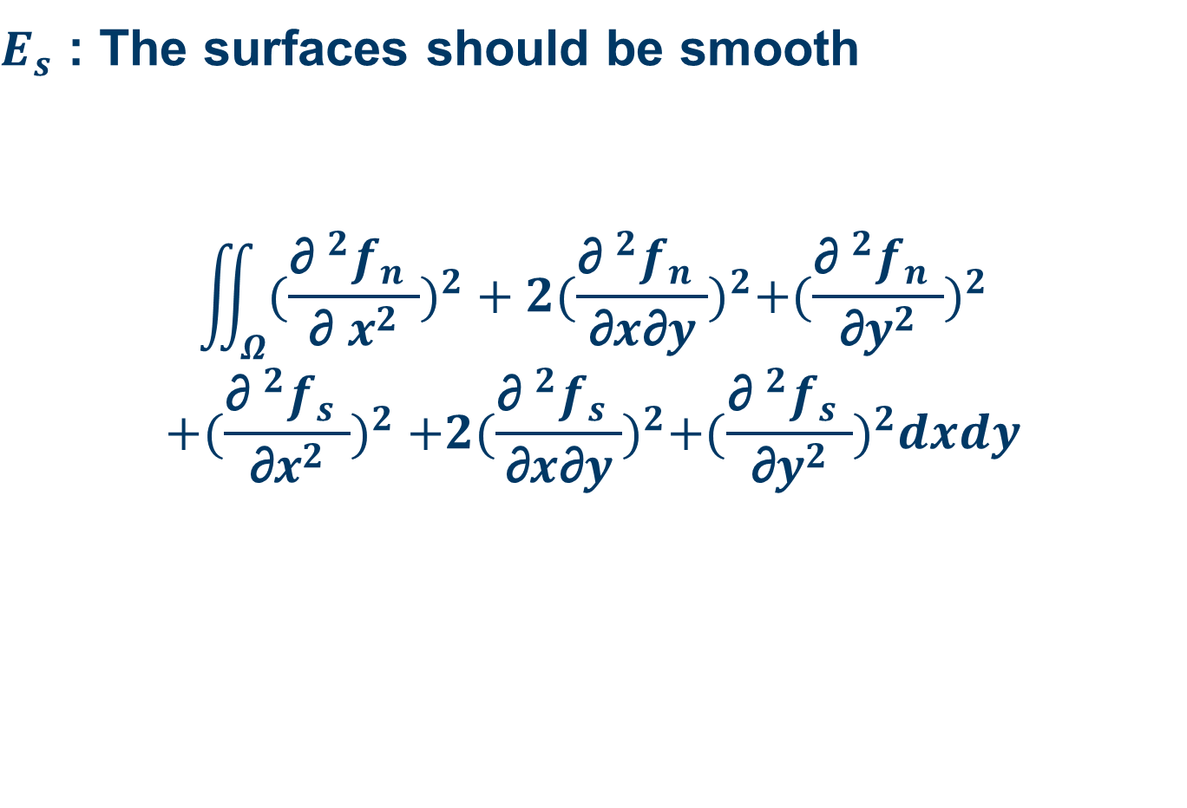
Energy functions
$E_{s}$ : The surfaces should be smooth
$$\iint_{Ω}{{(\frac{{\text{∂ }}^{2}f_{n} }{\text{∂ }x^{2}})}^{2}}+2{(\frac{{\text{∂ }}^{2}f_{n} }{\text{∂}x\text{∂}y})}^{2}+{(\frac{{\text{∂ }}^{2}f_{n} }{\text{∂}y^{2}})}^{2}$$
$$+{(\frac{{\text{∂ }}^{2}f_{s} }{\text{∂}x^{2}})}^{2} +2{(\frac{{\text{∂ }}^{2}f_{s} }{\text{∂}x\text{∂}y})}^{2}+{(\frac{{\text{∂ }}^{2}f_{s} }{\text{∂}y^{2}})}^{2}dxdy$$

Slide 31
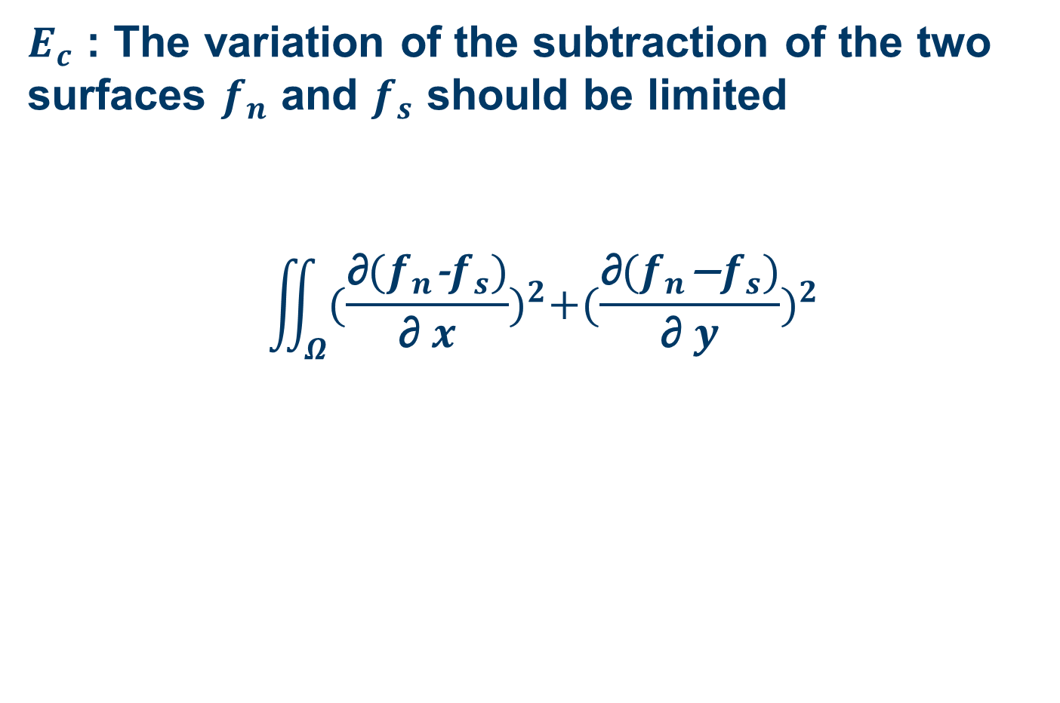
Energy functions
$E_{c}$ : The variation of the subtraction of the two surfaces $f_{n}$and $f_{s}$should be limited
$$\iint_{Ω}{{(\frac{\text{∂}(f_{n}\text{−}f_{s})}{\text{∂ }x})}^{2}+{(\frac{\text{∂}(f_{n}\text{−}f_{s})}{\text{∂ }y})}^{2}}$$

Slide 32
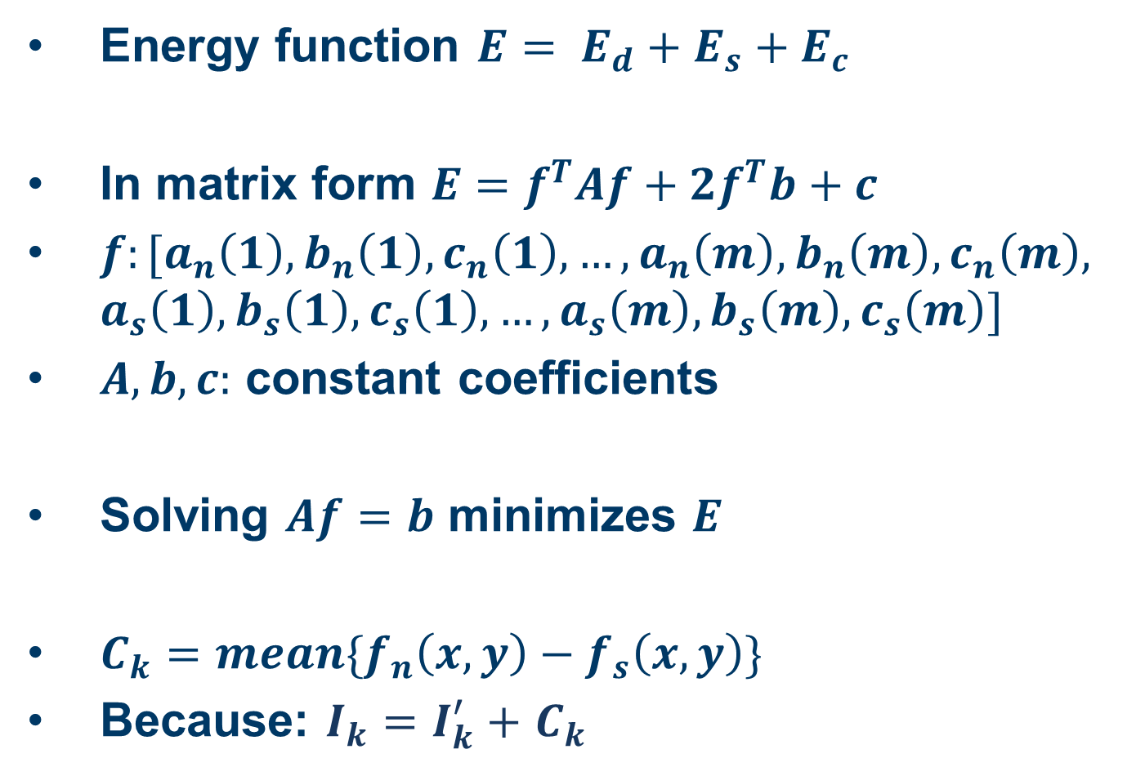
Energy functions
Energy function $E= E_{d}+E_{s}+E_{c}$
In matrix form $E=f^{T}Af+2f^{T}b+c$
$f:[a_{n}\left(1\right),b_{n}\left(1\right),c_{n}\left(1\right),…,a_{n}\left(m\right),b_{n}\left(m\right),c_{n}\left(m\right),$ $a_{s}\left(1\right),b_{s}\left(1\right),c_{s}\left(1\right),…,a_{s}\left(m\right),b_{s}\left(m\right),c_{s}\left(m\right)]$
$A, b, c:$ constant coefficients
Solving $Af=b$ minimizes $E$
$C_{k}=mean\{f_{n}\left(x,y\right)−f_{s}\left(x,y\right)\}$
Because: $I_{k}=I_{k}^{′}+$ $C_{k}$

Slide 33
Assumptions
Shadow properties
Algorithm outline
Shadow boundary sampling and penumbra region identification
Calculation of shadow matte value
Forgery detection using the shadow matte value
Summary
Evaluation and Limitations

Slide 34
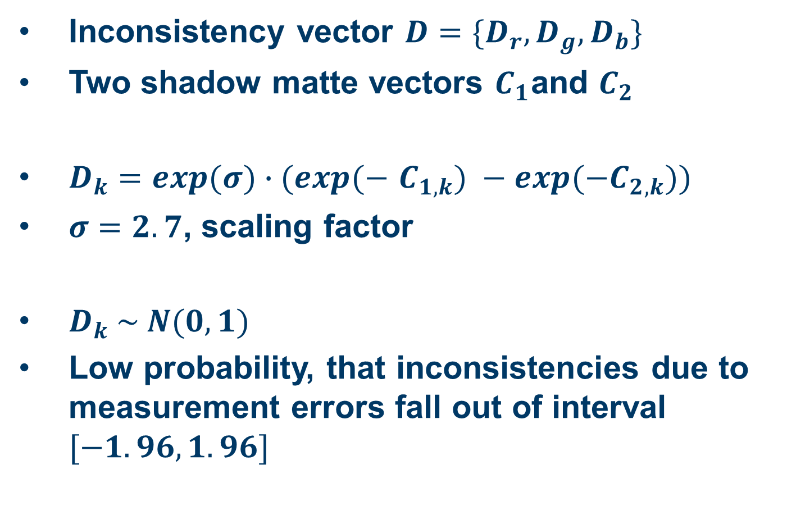
Energy functions
Inconsistency vector $D=\{D_{r},D_{g},D_{b}\}$
Two shadow matte vectors $C_{1}$and $C_{2}$
$D_{k}=exp(σ)∙(exp(−$ $C_{1,k}) −exp(−C_{2,k}))$
$σ=2.7$, scaling factor
$D_{k} \sim N(0,1)$
Low probability, that inconsistencies due to measurement errors fall out of interval $[−1.96, 1.96]$

Slide 35
Assumptions
Shadow properties
Algorithm outline
Shadow boundary sampling and penumbra region identification
Calculation of shadow matte value
Forgery detection using the shadow matte value
Summary
Evaluation and Limitations

Slide 36
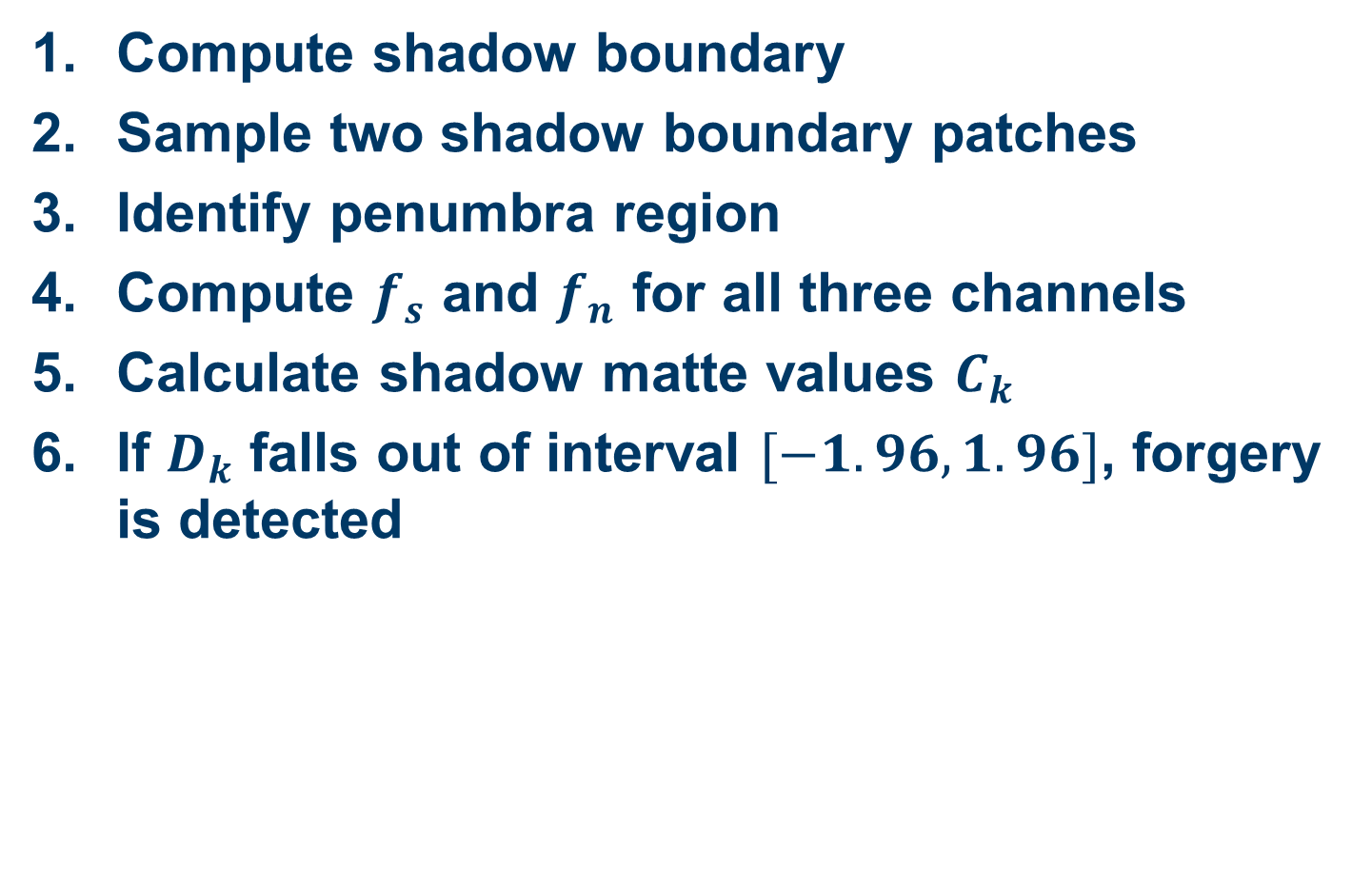
Summary
Compute shadow boundary
Sample two shadow boundary patches
Identify penumbra region
Compute $f_{s}$ and $f_{n}$ for all three channels
Calculate shadow matte values $C_{k}$
If $D_{k}$ falls out of interval $[−1.96, 1.96]$, forgery is detected

Slide 37
Assumptions
Shadow properties
Algorithm outline
Shadow boundary sampling and penumbra region identification
Calculation of shadow matte value
Forgery detection using the shadow matte value
Evaluation and Limitations

Slide 38
Evaluation
Test database
10 source and 10 target images, cut-and-paste
100 source-target pairs
40 shadowed nature images without forgery
Result: accuracy of 87%

Slide 39
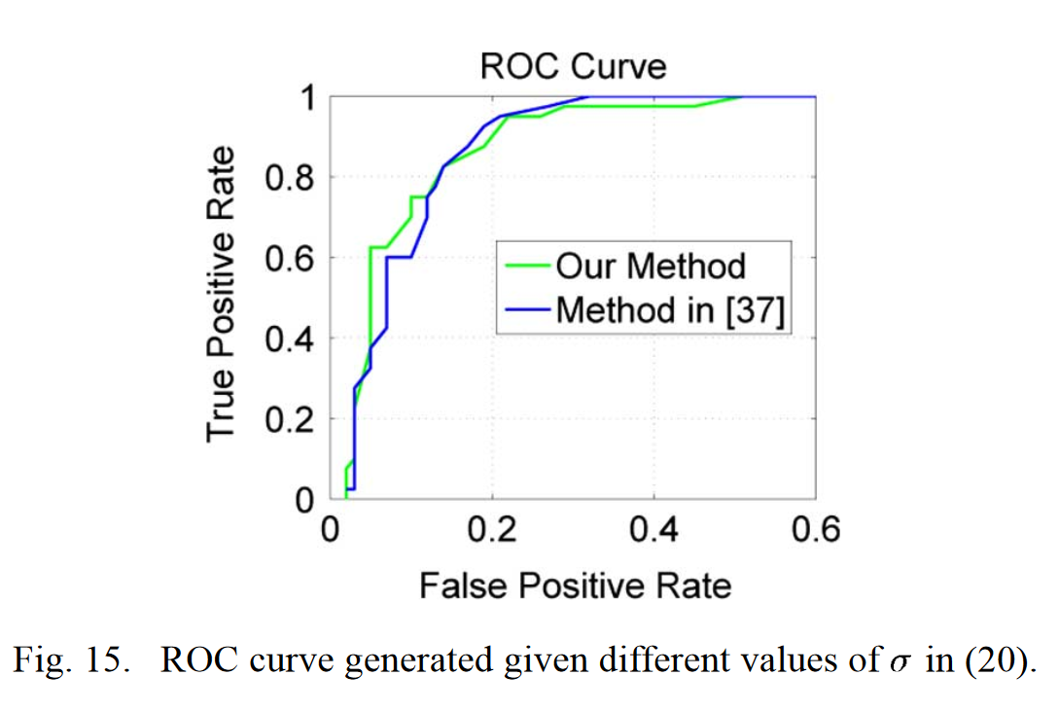
Evaluation

Slide 40
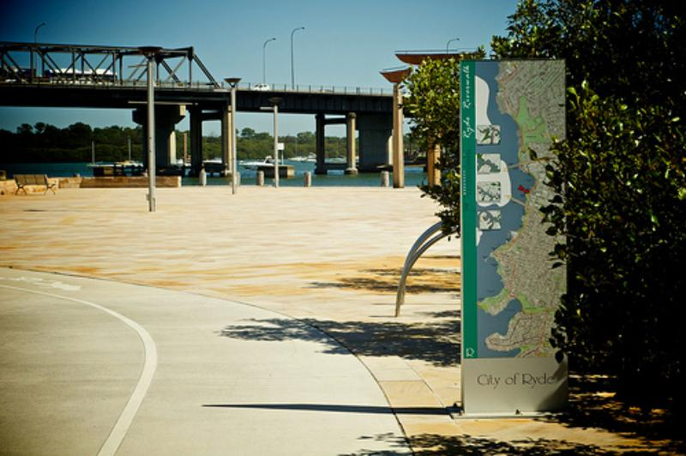
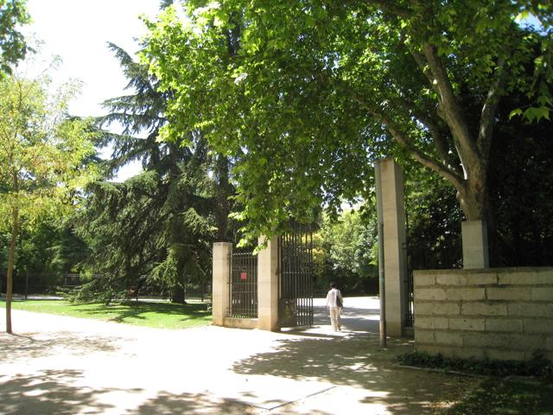
Limitations
Copy-and-move, where shadow is included
Complex, blurry shadows (for example trees)
Only small shadows available
Shadow boundary on transition between materials

Slide 41
Questions?

Slide 42
Thank you for your attention!

