Slide 1
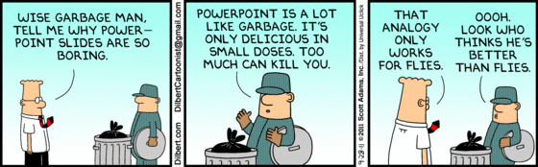
null
left sided text
Allianz O
This text field element contains styled text displaying the text-only version of the <style size=\"12\" isBold=\"true\" forecolor=\"black\">^<style forecolor=\"#808080\">Jasper</style> <style forecolor=\"#990000\">Reports</style></style> logo and some <font size=\"10\"><sup>superscript</sup></font> text and <font size=\"10\"><sub>subscript</sub></font> text. Furthermore I can handle explicit line breaks.
Allianz O
Page: 1 of
4

Slide 2
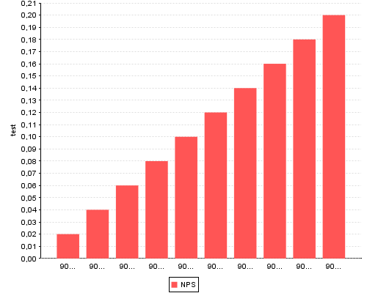
Allianz O
Page: 2 of
4

Slide 3
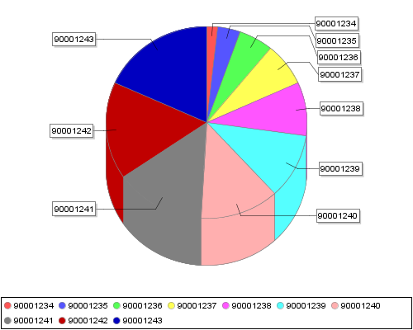
Allianz O
Page: 3 of
4

Slide 4
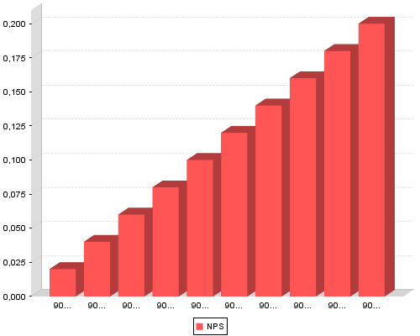
Allianz O
Page: 4 of
4

