Slide 1
18: Accessibility

Slide 2
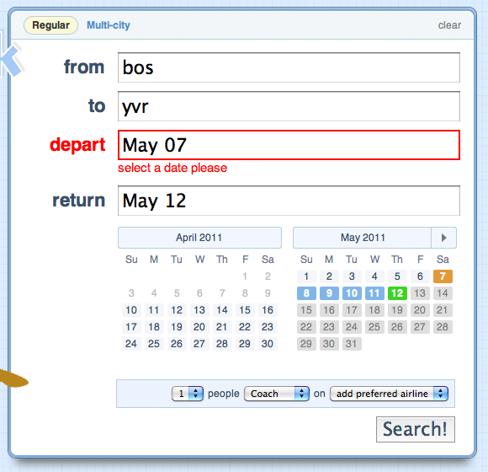
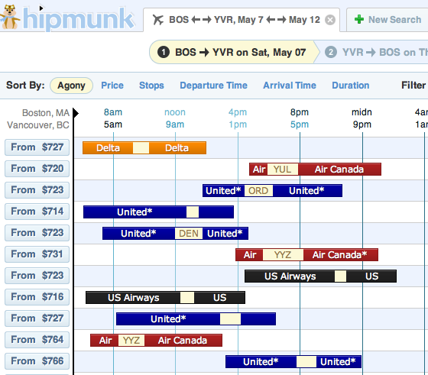
UI Hall of Fame or Shame?

Slide 3
Nanoquiz
closed book, closed notes
3 minutes (timer in upper right)
if you can’t use the online form, use paper
close your laptop when you’re done

Slide 4
Which of the following are impairments that cause disabilities in technology use? (choose all good answers)
Blindness
Color blindness
Driving a car
Walking down the street
Which of the following are good examples of the equitable use principle of universal design? (choose all good answers)
A vegetable peeler with a fat, textured grip
Automatically-opening doors at a supermarket
A subway platform that flashes and vibrates when a train is coming
The wheelchair-accessible elevator next to the 77 Mass Ave steps
0:09
0:08
0:07
0:05
0:04
0:03
0:02
0:01
0:00
3:00
2:30
2:00
1:45
1:30
1:15
1:00
0:45
0:30
0:20
0:19
0:18
0:17
0:16
0:15
0:14
0:13
0:12
0:11
0:10
0:06

Slide 5
Today’s Topics
Kinds of impairments
Kinds of assistive technology (AT)
Universal design

Slide 6
Using a Screen Reader
Listen to the screen reader
Try to answer these questions:
What page is this? (easy)
What is it featuring today? (harder)
What’s the phone number for the organization? (hardest)

Slide 7

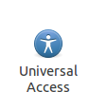
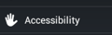
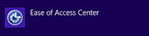
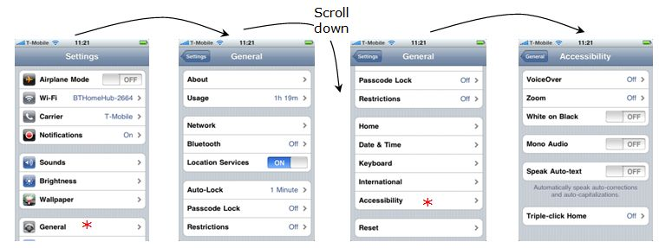
Exploring Other Assistive Technologies
Go to shoutkey.com/nought
Work in pairs
One person using a laptop, one using a phone
Explore and try out the accessibility settings of the laptop and smartphone
What impairment does each setting support?
What accessibility features do you use regularly even if you're not impaired?
Notes:
question for discussion: does anybody in the class use these features regularly even though you’re not impaired?

Slide 8
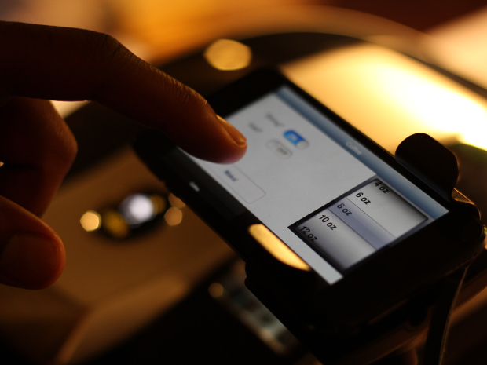
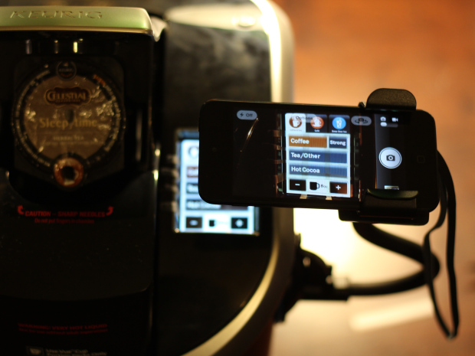
6.811 Principles & Practice of Assistive Technology

Slide 9
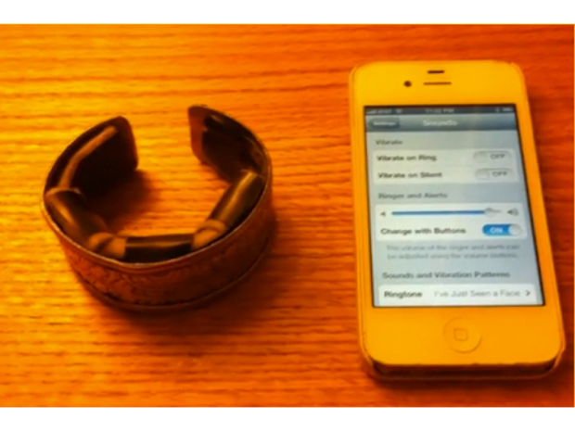
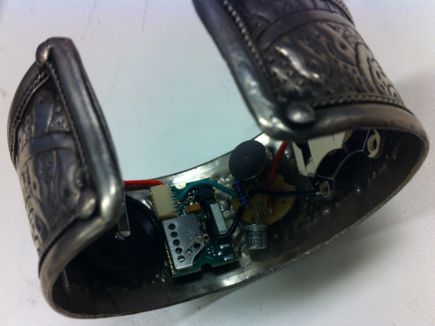
6.811 Principles & Practice of Assistive Technology

Slide 10
Which of the following are impairments that cause disabilities in technology use? (choose all good answers)
Blindness
Color blindness
Driving a car
Walking down the street
Which of the following are good examples of the equitable use principle of universal design? (choose all good answers)
A vegetable peeler with a fat, textured grip
Automatically-opening doors at a supermarket
A subway platform that flashes and vibrates when a train is coming
The wheelchair-accessible elevator next to the 77 Mass Ave steps

