Slide 1
9 Input

Slide 2
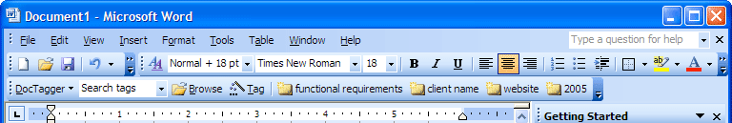
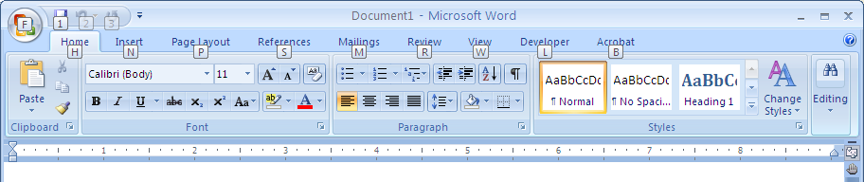
UI Hall of Fame or Shame?
Office 2003
Office 2007
Metaphors?
Internal consistency?
External consistency?

Slide 3
Nanoquiz
closed book, closed notes
3 minutes (timer in upper right)
if you can’t use the online form, use paper
close your laptop when you’re done

Slide 4
0:04
0:09
0:08
0:07
0:05
0:03
0:02
0:01
0:00
0:14
3:00
2:30
2:00
1:45
1:30
1:15
1:00
0:45
0:30
0:20
0:19
0:18
0:17
0:16
0:15
0:13
0:12
0:11
0:10
0:06
Mouse event coalescing makes it easier to … (choose all good answers)
implement a drawing program with smooth freehand curves
implement a scrollbar that doesn’t force the user to steer
implement drag-and-drop that keeps up with the mouse
write one listener for several kinds of mouse events
Suppose the mouse is clicked in the UI at right (view tree shown below it). Which event propagation orders for the click event are possible in GUI toolkits discussed in the reading? (choose all good answers)
W, P, Q, P, W
Q, W
W, P, Q
W, Q, W
Q, W, Q
Z-order: (choose all good answers)
is typically determined by the relationships of objects in the view tree
is used to determine the target of event dispatch
is used to determine event propagation
is involved in automatic redraw
W
P
Q
W
P
Q
please close your laptop when you’re done
Notes:
Which of the following are true of state machines as a pattern for thinking about user input?
Transitions between states occur when a certain input event arrives
Changes to the model or the view occur on states
Changes to the model or the view occur on transitions
Each state of the machine should produce different visual feedback
Each transition of the machine should produce different visual feedback because transitions take a long time
Answer: A, C, D
Which of the following statements are true? (choose all true answers) A. Keyboard focus is part of the input hardware. B. Mouse events always propagate down and then up the view hierarchy. C. Mouse coalescing can lead to undesirable output when sketching a freehand stroke.
Answer: C

Slide 5
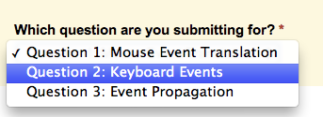
Input Event Handling
Use the same form for the next 3 questions
Change the dropdown selection to indicate which exercise you are submitting your answers for
Notes:
Form URL:
https://courses.csail.mit.edu/6.831/form/form.py?formkey=dEY2QTlfb2Y5c0M2SzAwemsxc2RZSnc6MQ

Slide 6
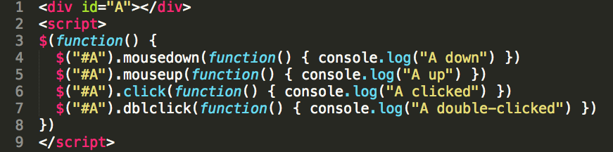

Question 1: Mouse Event Translation
Take a look at the code below:
What console output do you expect when you double click on A?
Submit your answer to shoutkey.com/quash
Notes:
Code is at http://jsfiddle.net/xL794z5f/

Slide 7
Now Try It
Code is at shoutkey.com/mosquito
What do you get when you double click on A?
When does pressing down on A fail to produce a click event?
When does two clicks on A fail to produce a double-click event?
Notes:
http://jsfiddle.net/xL794z5f/

Slide 8

Question 2: Keyboard Events
Take a look at the code below:
<textarea id=”B"></textarea>
<script>
$(function() {
$("#B").keydown(function() { console.log("B down”) })
$("#B").keyup(function() { console.log("B up”) })
$("#B").keypress(function() { console.log("B press”) })
})
</script>
What event sequence do you expect from typing a capital A?
Submit your answer to shoutkey.com/quash

Slide 9
Now Try It
Code is at shoutkey.com/unfold
What event sequence do you get from typing a capital A?
What buttons on your keyboard don't produce press events?
What buttons on your keyboard don't produce down/up events at all?
If you hold down a letter key, what events do you see?
Notes:
Code at http://jsfiddle.net/0w6g33s3/

Slide 10
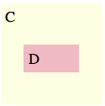

Question 3: Event Propagation
Take a look at the code below:
<div id="C”>C
<div id="D”>D</div>
</div>
<script>
$(function() {
$("div").on("mousedown mouseup ",
function(event) {
console.log(this.id
+" got " + event.type
+ " over " + event.target.id);
});
});
</script>
What event sequence do you expect from clicking D?
Submit your answer to shoutkey.com/quash

Slide 11
Now Try It
Code is at shoutkey.com/savvy
What event sequence do you get from clicking D?
What event sequence do you expect from:
click down and hold on C
move the cursor to D
release the mouse button while over D
Notes:
Code at http://jsfiddle.net/5wsLfzyn/

Slide 12
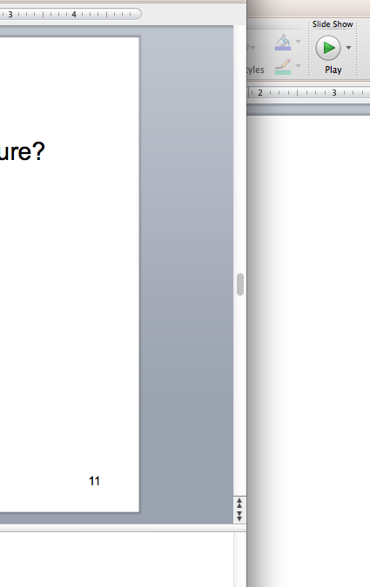
Mouse Capture
Why do scrollbars require mouse capture?

Slide 13
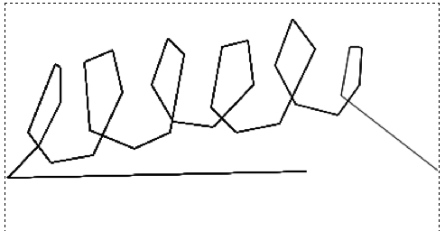
Mouse Coalescing
Code is at shoutkey.com/loin
Wave your mouse over the canvas
Change the sleep(0) to sleep(100)
What happens to your scribbling? Explain it in terms of event coalescing.
Notes:
Code at http://jsfiddle.net/ct8mkd98/

Slide 14
0:04
0:09
0:08
0:07
0:05
0:03
0:02
0:01
0:00
0:14
3:00
2:30
2:00
1:45
1:30
1:15
1:00
0:45
0:30
0:20
0:19
0:18
0:17
0:16
0:15
0:13
0:12
0:11
0:10
0:06
Mouse event coalescing makes it easier to … (choose all good answers)
implement a drawing program with smooth freehand curves
implement a scrollbar that doesn’t force the user to steer
implement drag-and-drop that keeps up with the mouse
write one listener for several kinds of mouse events
Suppose the mouse is clicked in the UI at right (view tree shown below it). Which event propagation orders for the click event are possible in GUI toolkits discussed in the reading? (choose all good answers)
W, P, Q, P, W
Q, W
W, P, Q
W, Q, W
Q, W, Q
Z-order: (choose all good answers)
is typically determined by the relationships of objects in the view tree
is used to determine the target of event dispatch
is used to determine event propagation
is involved in automatic redraw
W
P
Q
W
P
Q
please close your laptop when you’re done

