Slide 1
12: User Testing

Slide 2
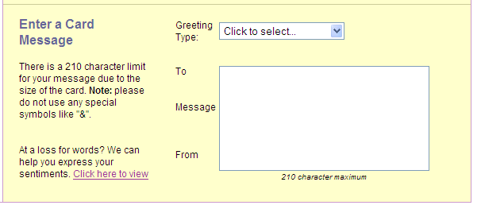
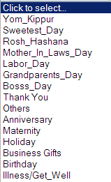
UI Hall of Fame or Shame?
Suggested by Ryan Damico
Notes:
Today’s candidate for the Hall of Shame is this entry form from the 1800Flowers web site. The purpose of the form is to enter a message for a greeting card that will accompany a delivered flower arrangement. (So you can see the whole interface, I’ve moved the Greeting Type drop-down menu to the right. In the real interface, it appears where you’d expect, right under the Greeting Type drop-down box.)
The 210 character limit is probably necessary for backend reasons (e.g. size of the card delivered with the flowers), but hard for a user to check. Suggest a dynamic progress bar showing how much of the quota you’ve used. (error prevention, flexibility & efficiency)
Special symbols like & is vague. What about asterisk and hyphen – are those special too? What am I allowed to use, exactly? (user control & freedom)
The underscores in the Greeting Type drop-down menu look like technical identifiers, and some even look mispelled because they’ve omitted other punctuation. Bosss_Day? (match the real world)
How does Greeting Type actually affect the card? (visibility) This is related to a Hall of Fame we had a little while ago: the Domino’s pizza ordering site does a much better job of showing you how your choices actually affect the final product.

Slide 3
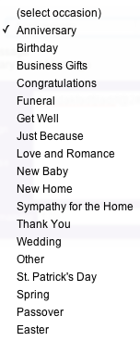
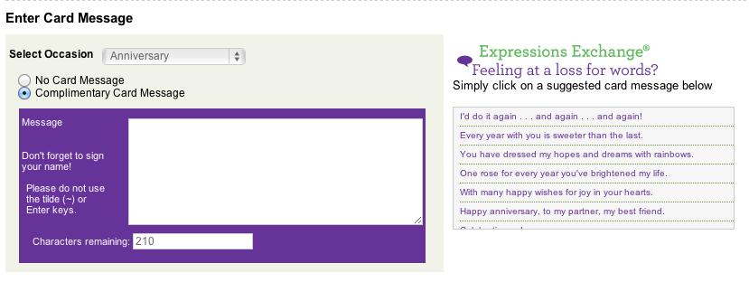

Slide 4
Nanoquiz
closed book, closed notes
3 minutes (timer in upper right)
if you can’t use the online form, use paper
close your laptop when you’re done

Slide 5
1. Which of the following are correct about user tests? (choose all good answers)
a. Formative evaluation: useful for collecting a list of usability problems.
b. Field study: useful for testing the interface in a real context.
c. Controlled experiment: useful for testing hypotheses with qualitative evidence.
2. Which of the following correctly describe ethics in experiments involving users? (choose all good answers)
a. All class projects require IRB approval.
b. UIs from research projects require IRB approval.
c. The user can stop participation at any time.
3. Which of the following are correct roles of facilitator and observer in formative evaluation? (choose all good answers)
a. Facilitator: coach the user to think aloud.
b. Facilitator: explain the interface in detail throughout the session.
c. Observer: help the facilitator run the session.
d. Observer: take notes on critical incidents.
0:09
0:08
0:07
0:05
0:04
0:03
0:02
0:01
0:00
3:00
2:30
2:00
1:45
1:30
1:15
1:00
0:45
0:30
0:20
0:19
0:18
0:17
0:16
0:15
0:14
0:13
0:12
0:11
0:10
0:06

Slide 6
Learning Objectives
Discuss ethics in user studies.
Observe and reflect on recorded usability testing sessions.
Practice formative evaluation with a prototype.

Slide 7
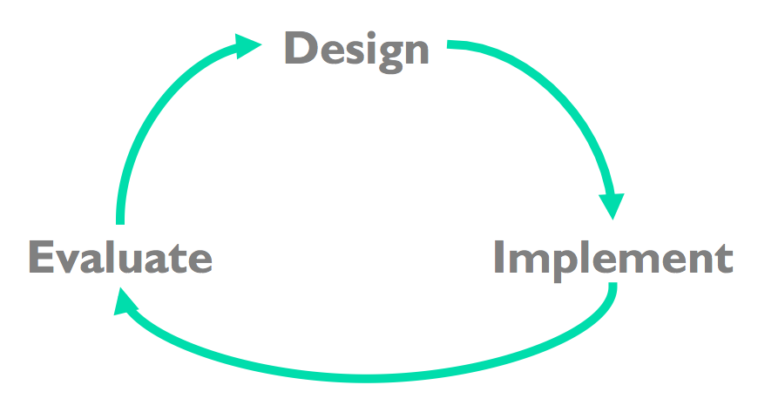
Iterative Design Cycle: Where Are We?
07: Needfinding
11: Experiment Design
12: User Testing
13: Experiment Analysis
20: Heuristic Evaluation
06: UI SW Architecture
10: Prototyping
…
Input, output, layout, …

Slide 8
Paper Prototyping Timeline
3/13 Fri: Building in studio
3/16 Mon: Testing in class (room TBD)
3/18 Wed: Testing in class (room TBD)
3/20 Fri: GR3 presentation in studio

Slide 9
Ethics in User Tests

Slide 10

A Case Study of Ethics in User Studies
1. Watch & Think.
2. Discuss in a pair.
3. Discuss as a class.
Notes:
See Venkman, P. “The Effect of Negative Reinforcement on ESP Ability.” Unpublished monograph, 1984.
For lecturer to play from your laptop: get the movie file from /afs/csail.mit.edu/proj/courses/6.831/movies/ghostbusters.avi
(you may need the VLC player to play it, because it was ripped from a DVD)
Or play it from the web:
http://youtu.be/fn7-JZq0Yxs?t=22s
Stop the video right when the guy leaves the room in anger
What did Bill Murray do wrong in this scene?
Respect for person
not quite informed consent
deception
Making participant even more stressed
User should be in control, clearly not
User can stop at any time
No reason to have 2 people inoom
Beneficience
Not “do no harm”
Risk vs benefit to society NOT right
Justiice
- Not Fair

Slide 11
Facebook Emotion Study
“We show, via a massive (N = 689,003) experiment on Facebook, that emotional states can be transferred to others via emotional contagion, leading people to experience the same emotions without their awareness.”
Kramer et al., PNAS vol. 111 no. 24
A week in 2012
Modified News Feed to show more/less emotional posts
Seeing more negative posts -> more negative posts
Seeing more positive posts -> more positive posts
Seeing less emotional posts -> less emotional posts

Slide 12
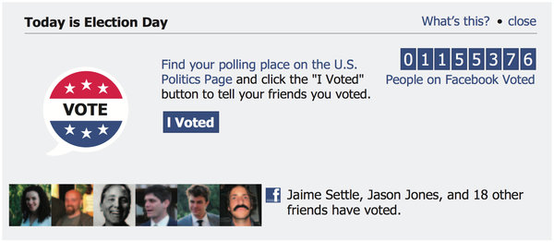
Ethical Issues in Facebook Emotion Study
Informed consent?
What does it mean to do large-scale user testing “in the wild”?
What about other A/B tests?
6.813: Active learning vs Lecture
Predicting illness based on search query
Social nudges to encourage voting

Slide 13
Formative evaluation
Roles of
User
Facilitator
Observer
What are critical incidents?
Notes:
User
Talk aloud (what’s happening, what they are trying to do, and why they took an action)
Facilitator
Briefs the user
Provides the tasks
Promote talk aloud
Controls the session
Observer
Be quiet
Take notes, especially of critical incidents

Slide 14
Usability Testing

Slide 15
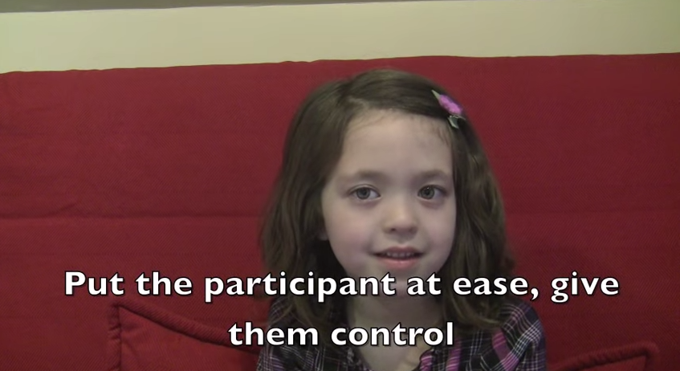
Example: Testing a Paper Prototype
Notes:
https://www.youtube.com/watch?v=9wQkLthhHKA

Slide 16
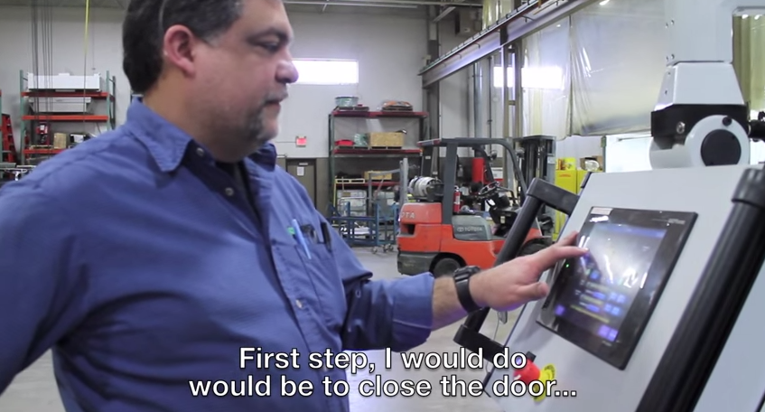
Example: Testing a Functional Prototype
Notes:
Let’s practice observing a user test, listening to think-aloud, and watching for critical incidents.
https://www.youtube.com/watch?v=-h8hUtwkMCE

Slide 17
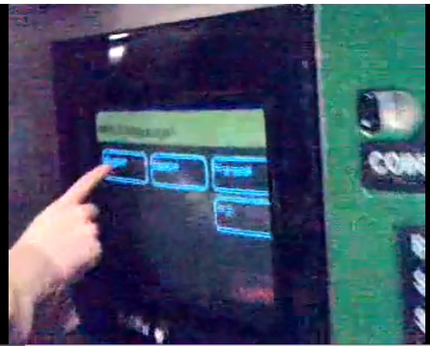
Example: Think Aloud
Notes:
Let’s practice observing a user test, listening to think-aloud, and watching for critical incidents. This isn’t really a user test – it’s even better, it’s a user interacting naturally in the wild! Watch this video of somebody using a NYC subway fare machine:
http://www.youtube.com/watch?v=mfCQbZR-nhk
Why is the user thinking aloud? Did you note any critical incidents?

Slide 18
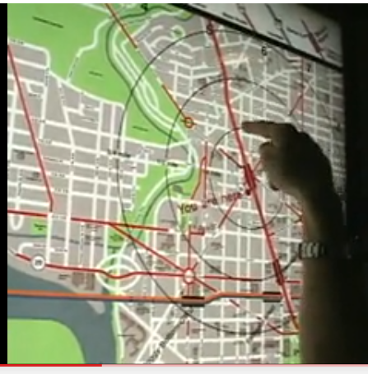
Example: Watching for Critical Incidents
Notes:
Now here’s one from the DC Metro:
http://www.youtube.com/watch?v=7TOsJCA7DHw
Note the critical incidents with their timepoints, and we’ll talk about them.

Slide 19
User Testing Game
Find someone to pair with
Rock paper scissors (1 GAME. No best 2 out of 3)
User (rock paper scissor loser)
Wizard (rock paper scissor winner)
Go to: http://tiny.cc/6813
Notes:
http://courses.csail.mit.edu/6.831/2015/handouts/12-user-testing/inclass/activities/user.shtml
http://courses.csail.mit.edu/6.831/2015/handouts/12-user-testing/inclass/activities/wizard.shtml
Efficiency: Uncommon goals (list enrollment) come first in top menu.
Learnability: Internal inconsistency between method to select course in each task.
Learnability: Bad mapping between keypad numbers and course numbers during add-course.
Safety: No undo or cancel - instead the user can 'hang up' at anytime. Hang-ups are a measure of how many problems the system has.
Lack of affordance: Dropping the MAS course is difficult unless user knows they can enter letters with numbers.

Slide 20
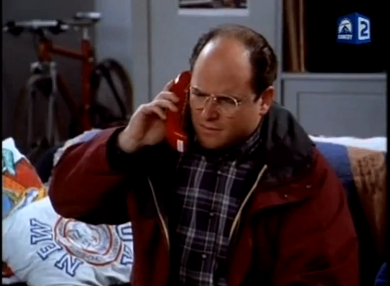
Kramer’s Moviephone
Notes:
http://www.youtube.com/watch?v=qM79_itR0Nc

Slide 21
1. Which of the following are correct about user tests? (choose all good answers)
a. Formative evaluation: useful for collecting a list of usability problems.
b. Field study: useful for testing the interface in a real context.
c. Controlled experiment: useful for testing hypotheses with qualitative evidence.
2. Which of the following correctly describe ethics in experiments involving users? (choose all good answers)
a. All class projects require IRB approval.
b. UIs from research projects require IRB approval.
c. The user can stop participation at any time.
3. Which of the following are correct roles of facilitator and observer in formative evaluation? (choose all good answers)
a. Facilitator: coach the user to think aloud.
b. Facilitator: explain the interface in detail throughout the session.
c. Observer: help the facilitator run the session.
d. Observer: take notes on critical incidents.
0:09
0:08
0:07
0:05
0:04
0:03
0:02
0:01
0:00
3:00
2:30
2:00
1:45
1:30
1:15
1:00
0:45
0:30
0:20
0:19
0:18
0:17
0:16
0:15
0:14
0:13
0:12
0:11
0:10
0:06

