Slide 1
15: Layout

Slide 2
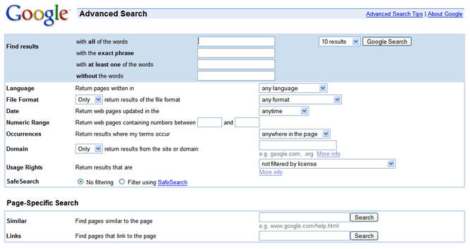
UI Hall of Fame or Shame?
Notes:
Today’s Hall of Fame and Shame is a comparison of two generations of Google Advanced Search. This is the old interface.

Slide 3
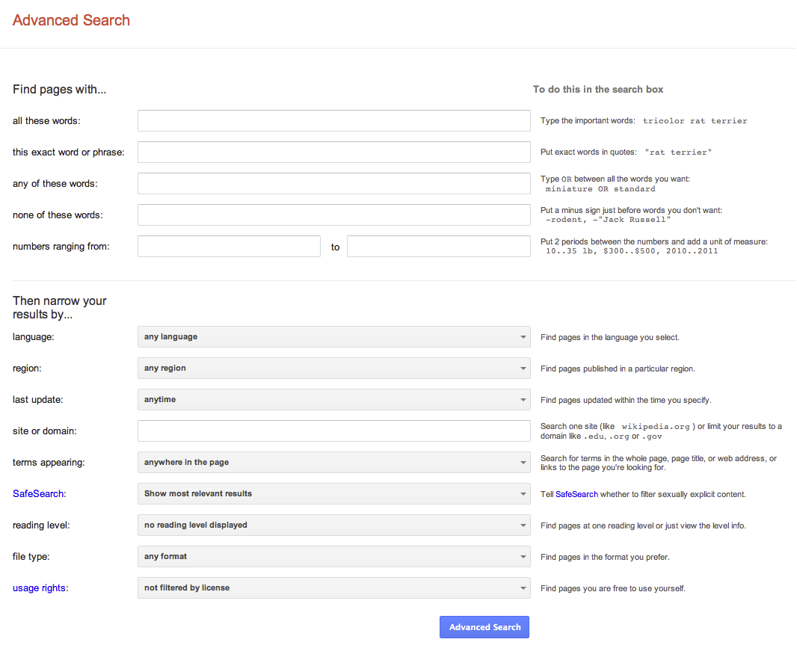
UI Hall of Fame or Shame?
Notes:
And this is the new interface.
Let’s compare and contrast these two interfaces in terms of:
- visibility (specifically self-disclosure)
- graphic design
- task analysis
- efficiency
When expanding the page horizontally, show how to do this in regular interface, learn..
Graphic design –
less busy with more whitespace, 2 column,
more simplicity, more alignment. Equal width columns
Grouping all search-related items,
Contrast is better
Task analysis
- Important tasks up top
Efficiency

Slide 5
Nanoquiz
closed book, closed notes
3 minutes (timer in upper right)
if you can’t use the online form, use paper
close your laptop when you’re done

Slide 6
White space can be used to: (choose all good answers)
avoid visual noise
group items together
preserve simplicity
set off and highlight labels
Which of the following are Gestalt principles related to layout:
hierarchy
proximity
similarity
simplicity
A grid helps with alignment and balance by: (choose all good answers)
bringing regularity to layout
dividing content into columns
ensuring all content are equal width
0:09
0:08
0:07
0:05
0:04
0:03
0:02
0:01
0:00
3:00
2:30
2:00
1:45
1:30
1:15
1:00
0:45
0:30
0:20
0:19
0:18
0:17
0:16
0:15
0:14
0:13
0:12
0:11
0:10
0:06

Slide 7
Today’s Topics
Grouping & hierarchy
Whitespace
Balance & symmetry
Alignment & grids

Slide 8
Grouping
proximity
similarity
continuity
closure
area
symmetry

Slide 9
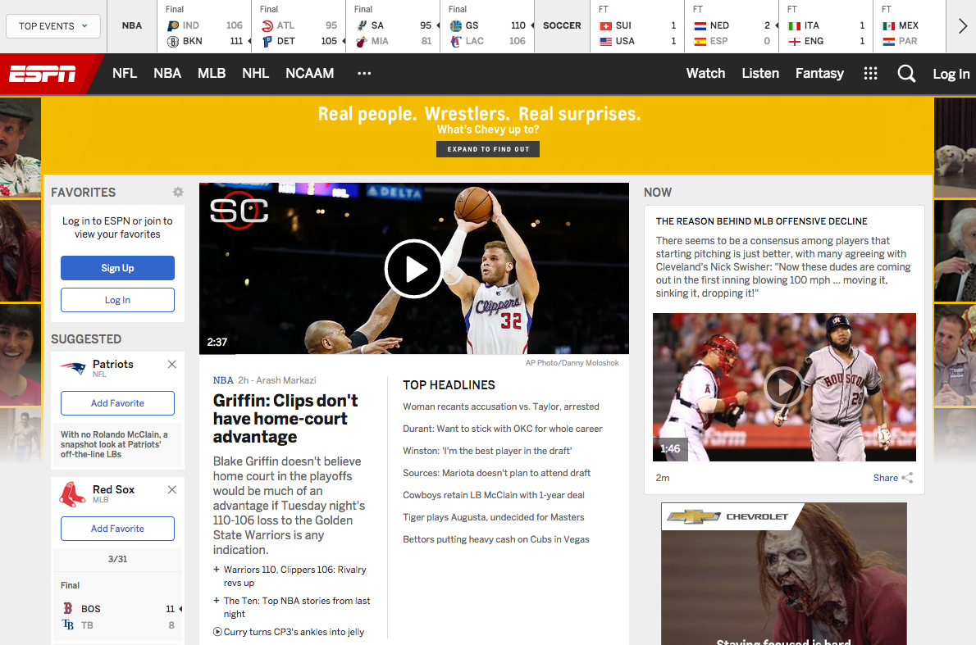
espn.go.com
Notes:
Let's discuss the layout of this page. (Note: position/size/orientation, not hue/value/shape.)

Slide 10

www.odslimo.com

Slide 11
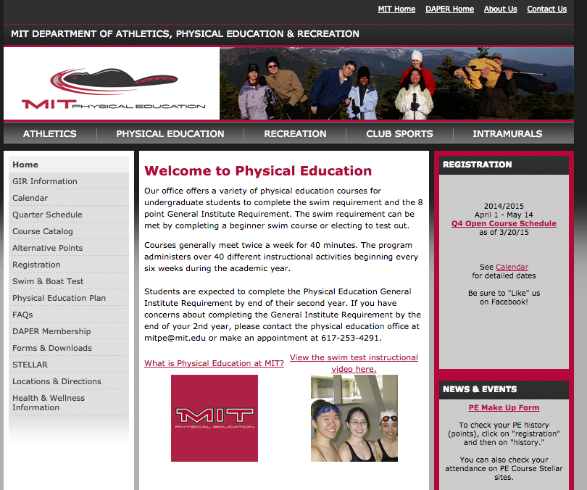
mitpe.com

Slide 12
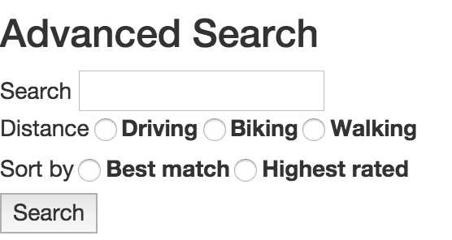
Exercise in Layout
Use Bootstrap and CSS to improve the layout of this form:
shoutkey.com/robe
Focus on:
Using a grid for alignment
Margins and padding
Vertical whitespace for grouping
(optional) Right justify labels
(optional) Submit button on the right
Notes:
http://jsfiddle.net/pwa73r69/

Slide 13
White space can be used to: (choose all good answers)
avoid visual noise
group items together
preserve simplicity
set off and highlight labels
Which of the following are Gestalt principles related to layout:
hierarchy
proximity
similarity
simplicity
A grid helps with alignment and balance by: (choose all good answers)
bringing regularity to layout
dividing content into columns
ensuring all content are equal width

