Slide 1
11: Experiment Design

Slide 2
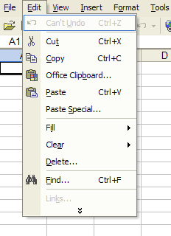
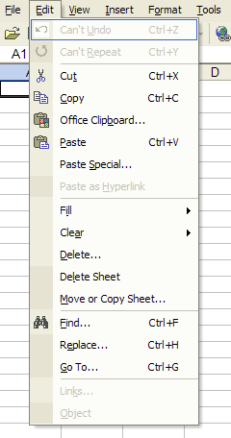
UI Hall of Fame or Shame?
Notes:
Today’s candidate for the Hall of Fame or Shame is adaptive menus, a feature of Microsoft Office 2003. Initially, a menu shows only the most commonly used commands. Clicking on the arrow at the bottom of the menu expands it to show all available commands. Adaptive menus track how often a user invokes each command, in order to display frequently-used commands and recently-used commands.
Let’s discuss the usability of this idea.
This interface is striving for a compromise between simplicity (i.e., providing as few features as possible) and task analysis (supporting the tasks required by many users, and trying to adapt to the common tasks of each individual user). Both properties are important for usability. Unfortunately they also compete with each other. Adaptive menus are an interesting hybrid technique that’s trying to satisfy both.
The downside is lack of predictability. Because the menu may change in complex and unpredictable ways – with new items appearing and underused items disappearing for no visible reason – the user can no longer rely on a lot of useful cues to find menu items. One of these cues that’s lost is spatial memory – Paste may be found at different distances down the menu each time the menu appears. Another missing cue is context: Paste’s neighbors may change as well.
Another downside is lack of user control. The adaptation happens automatically; the user can’t manually fixate or remove items from a menu.
This particular implementation of adaptive menus has some specific usability problems. When the full menu appears, the new items are inserted into place, and there’s very little contrast in the graphic design to distinguish between the old items and the new items. So the user has to search through the entire menu again.
But this particular implementation addresses other usability problems very well. When the user is hunting through all the menus, looking for a command, the full menu only has to be requested once; then all subsequent menus are fully displayed.

Slide 3
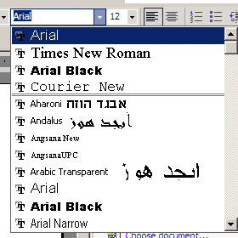
UI Hall of Fame or Shame?
Notes:
Here’s an alternative approach to providing easy access to high-frequency menu choices: a split menu. You can see it in Microsoft Office’s font drop-down menu. A small number of fonts that you’ve used recently appear in the upper part of the menu, while the entire list of fonts is available in the lower part of the menu. The upper list is sorted by recency, while the lower part is sorted alphabetically.
Let’s discuss the split menu approach too.
These menu approaches are particularly relevant to today’s lecture because they’ve been tested by a couple of excellent controlled experiments. The split menu idea was evaluated by Sears & Shneiderman, “Split menus: effectively using selection frequency to organize menus”, ACM TOCHI, March 1994. And the adaptive menu was tested by Findlater & McGrenere, “A comparison of static, adaptive, and adaptable menus”, CHI 2004.
Sears & Shneiderman: compared alphabetic, frequency-ordered, and split menus (with up to 4 high-frequency items at top of menu, ordered in same way as rest of menu, removed from the rest of menu – so not the same as Office’s font split menu). 15-item menus (randomly selected from a dictionary of 1000 common words). Three different frequency distributions across the alphabetic menu (end of menu, middle of menu, top of menu). 36 subjects, within-subjects, each saw 3x3 menus (random unique items) counterbalanced. Pulldown menus, timed from mouse press on menu bar until selection of item. 100 trials per menu, chosen from frequency distribution of menu. Measured time and ranked preference of menu type (1-3). Subjective ranking had split (1.4) > alphabetic (2.0) > frequency (2.6). Selection time for frequent items at end of menu had split (1.4s) > freq (1.5s) > alphabetic (1.7s); for frequent items at start of menu had split, alphabetic (1.4s) > freq (1.5s). Also proposed and fitted a cognitive model that high-frequency menu items take time logarithmic in item position (a la Fitts’s Law) while low-frequency items take linear time in position (visual scan).
Findlater & McGrenere: compared split menus that were static (unchanging), adaptive (changed by system), and adaptable (changed by user). Adaptive menu has two most recent and two most frequent items in the split part. Adaptable had arrow buttons next to each item to promote or demote it. Used frequency distributions from three most frequently-used Word menus (File, Format, Insert), collected from one user over 20 weeks, but changed all item names to mask them. Measured time and ranked preference (on several dimensions: overall, efficiency, ease, error, frustration, etc.). 27 subjects, within-subjects 3x3. Selection time had static (1.5), adaptable (1.6) >> adaptive (1.65). Overall preference had adaptable >> adaptive >> static.

Slide 4
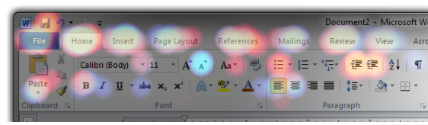
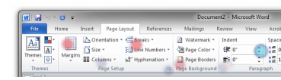
UI Hall of Fame or Shame?
Patina [Metejka et al., CHI 2013]

Slide 5
Nanoquiz
closed book, closed notes
3 minutes (timer in upper right)
if you can’t use the online form, use paper
close your laptop when you’re done

Slide 6
1. Which of the following are correct comparisons between Lab experiment, Field study, and Survey? (choose all good answers)
Lab experiments have the highest realism.
Surveys are most generalizable.
Lab experiments have the highest precision.
Field studies are least obtrusive.
2. Collecting repeated measurements is a way to improve… (choose one best answer)
internal validity
external validity
reliability
3. Which of the following are correct about experiment design techniques? (choose all good answers)
A between-subjects design typically requires more users than a within-subjects design.
Between-subjects: each user is tested under each condition.
It’s possible to mix within-subjects and between-subjects designs in an experiment.
Counterbalancing randomizes the order of tasks and conditions.
0:09
0:08
0:07
0:05
0:04
0:03
0:02
0:01
0:00
3:00
2:30
2:00
1:45
1:30
1:15
1:00
0:45
0:30
0:20
0:19
0:18
0:17
0:16
0:15
0:14
0:13
0:12
0:11
0:10
0:06

Slide 7
0:04
0:09
0:08
0:07
0:05
0:03
0:02
0:01
0:00
0:14
3:00
2:30
2:00
1:45
1:30
1:15
1:00
0:45
0:30
0:20
0:19
0:18
0:17
0:16
0:15
0:13
0:12
0:11
0:10
0:06
You are trying to understand whether interface A causes fewer errors than interface B. To maximize the precision of your answer, a good research method to use is: (choose one good answer) A. formative evaluation B. field study C. survey D. lab study
When deciding between between-subjects and within-subjects designs for an experiment, the important issues to consider are: (choose all good answers) A. population validity B. learning effects C. individual differences D. fatigue
Louis Reasoner is conducting a user study to compare two input devices A and B. Louis’s team purposely did not tell him which device they designed. This decision: (choose one best answer) A. improves reliability B. threatens external validity C. threatens internal validity D. reduces experimenter bias

Slide 8
Today’s Topics
Controlled experiments
Threats to validity and reliability
Experiment design techniques

Slide 9
Learning Objectives
Identify major design components of a controlled experiment.
Discuss ways to fight threats to validity and reliability.
Justify & critique the choice of experiment design techniques.

Slide 10
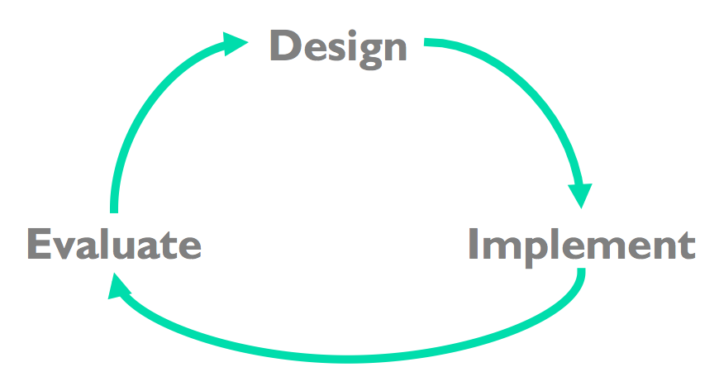
Iterative Design
07: Needfinding
11: Experiment Design
12: User Testing
13: Experiment Analysis
20: Heuristic Evaluation
06: UI SW Architecture
10: Prototyping
…
Input, output, layout, …

Slide 11
6.831: Reproduce a Controlled Experiment
11 Experiment Design
13 Experiment Analysis
RS1
Implement
RS2
Collect Data
RS3
Analyze Data

Slide 12
Controlled experiment
What are the components of a controlled experiment?
What are the possible threats to validity/reliability?

Slide 13
Is your area of the classroom representative?
Let’s divide into 3 sections: A, B, C
Let’s answer the following questions:
Are you wearing glasses?
Are you wearing a watch?
Age: 21 or under, 21-24, 25 or over
shoutkey.com/jay
Notes:
2015
https://courses.csail.mit.edu/6.831/form/form.py?formkey=1n8Huk7RDOey3bUAjuMqgHE41KhQ0VOsJ-nQGUS0kaOM
2014
https://courses.csail.mit.edu/6.831/form/form.py?formkey=dEgwMDdxRkQxbkxNWnpNMHhyV3loUGc6MQ

Slide 14
Activity: With your neighbor, think about…
What might cause the distribution of demographics in different parts of the room to be different from the overall class population?
What may be some of the dangers of using a non-representative sample?
What if you ran an experiment with each section assigned to different conditions?

Slide 15
Activity: Experiment Design
Our big question today:
“Does it take longer to type gibberish or dictionary words?”
Let’s divide up into 3 sections: A, B, C
Find a partner.
Do the experiment using one computer.
Critique the study design with a partner.
shoutkey.com/potential
Notes:
2015
http://courses.csail.mit.edu/6.831/2015/handouts/11-experiment-design/inclass/activity.shtml
OLD
http://courses.csail.mit.edu/6.831/2013/activities/ac12.shtml

Slide 16
Discussion: Experiment Design
Study setup
- Hypothesis / IV / DV?
- Lab study? Field Study? Survey?
- Between-subjects vs Within-subjects? Ordering?
- Users / Implementation / Tasks / Measurement / Hardware
Internal validity
- Ordering effects / Selection effects / Experimenter bias?
External validity
- Population / Ecological / Training / Task?
Reliability
- User differences / Measurement error / Repetition
Notes:
2015
http://courses.csail.mit.edu/6.831/2015/handouts/11-experiment-design/inclass/activity.shtml
OLD
http://courses.csail.mit.edu/6.831/2013/activities/ac12.shtml

Slide 17
1. Which of the following are correct comparisons between Lab experiment, Field study, and Survey? (choose all good answers)
Lab experiments have the highest realism.
Surveys are most generalizable.
Lab experiments have the highest precision.
Field studies are least obtrusive.
2. Collecting repeated measurements is a way to improve… (choose one best answer)
internal validity
external validity
reliability
3. Which of the following are correct about experiment design techniques? (choose all good answers)
A between-subjects design typically requires more users than a within-subjects design.
Between-subjects: each user is tested under each condition.
It’s possible to mix within-subjects and between-subjects designs in an experiment.
Counterbalancing randomizes the order of tasks and conditions.
0:09
0:08
0:07
0:05
0:04
0:03
0:02
0:01
0:00
3:00
2:30
2:00
1:45
1:30
1:15
1:00
0:45
0:30
0:20
0:19
0:18
0:17
0:16
0:15
0:14
0:13
0:12
0:11
0:10
0:06

Slide 18
0:04
0:09
0:08
0:07
0:05
0:03
0:02
0:01
0:00
0:14
3:00
2:30
2:00
1:45
1:30
1:15
1:00
0:45
0:30
0:20
0:19
0:18
0:17
0:16
0:15
0:13
0:12
0:11
0:10
0:06
You are trying to understand whether interface A causes fewer errors than interface B. To maximize the precision of your answer, a good research method to use is: (choose one good answer) A. formative evaluation B. field study C. survey D. lab study
When deciding between between-subjects and within-subjects designs for an experiment, the important issues to consider are: (choose all good answers) A. population validity B. learning effects C. individual differences D. fatigue
Louis Reasoner is conducting a user study to compare two input devices A and B. Louis’s team purposely did not tell him which device they designed. This decision: (choose one best answer) A. improves reliability B. threatens external validity C. threatens internal validity D. reduces experimenter bias

