Slide 1
13: Experiment Analysis

Slide 2
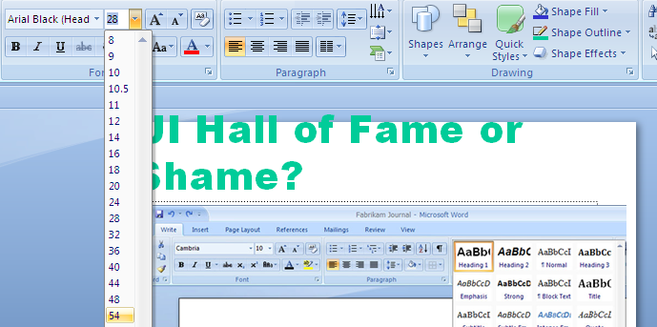
UI Hall of Fame or Shame?
Notes:
Today’s Hall of Fame or Shame example is a feature of Microsoft Office 2007 that gives a preview of what a style command will do to the document while you’re mousing over it. Here, the mouse is hovering over the 54-point choice on the font-size drop-down, and PowerPoint is showing what the selection would look like with that new style.
Let’s discuss the pros and cons of this approach from a usability point of view.

Slide 3
Nanoquiz
closed book, closed notes
3 minutes (timer in upper right)
if you can’t use the online form, use paper
close your laptop when you’re done

Slide 4
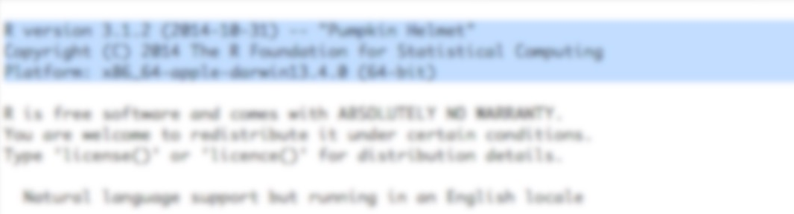
In hypothesis testing, the null hypothesis: (choose all good answers)
is the hypothesis you want to prove
is the hypothesis that a skeptic might assume
is a hypothesis that has approximately zero (“null”) probability
provides the probability distribution from which a p value is calculated
Start R on your laptop and copy and paste the first three lines of its output:
R version ...
Copyright (C) ...
Platform: ...
For which of the following hypotheses would a t test be a reasonable statistical test? (choose all good answers)
Number of hours slept each night depends on your major
MIT students are better-looking than Harvard students
German words take longer to type than English words
0:09
0:08
0:07
0:05
0:04
0:03
0:02
0:01
0:00
3:00
2:30
2:00
1:45
1:30
1:15
1:00
0:45
0:30
0:20
0:19
0:18
0:17
0:16
0:15
0:14
0:13
0:12
0:11
0:10
0:06

Slide 5
Today’s Topics
Exploratory data analysis
Hypothesis testing
Hands-on practice with statistical tests

Slide 6
Look at the Data
Load dataset #1 into R
Look at the summary statistics (mean, median, stdev) for each condition
which condition looks faster?
Graph it with standard error bars
does it look significantly faster?

Slide 7
Hypothesis Testing
What is the null hypothesis H_0?
What is the alternative hypothesis H_1?
What is a test statistic?
What is the meaning of the p value?

Slide 8
Do a T test
Do a t test on dataset #1

Slide 9
Three Conditions
Load dataset #2
Look at summary statistics and graph it
Do an ANOVA test

Slide 10
In hypothesis testing, the null hypothesis: (choose all good answers)
is the hypothesis you want to prove
is the hypothesis that a skeptic might assume
is a hypothesis that has approximately zero (“null”) probability
provides the probability distribution from which a p value is calculated
Start R on your laptop and copy and paste the first three lines of its output:
R version ...
Copyright (C) ...
Platform: ...
For which of the following hypotheses would a t test be a reasonable statistical test? (choose all good answers)
Number of hours slept each night depends on your major
MIT students are better-looking than Harvard students
German words take longer to type than English words

