Slide 1

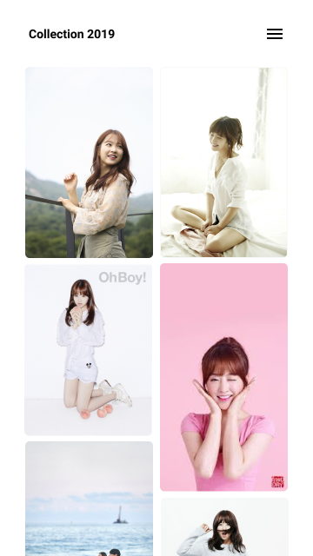
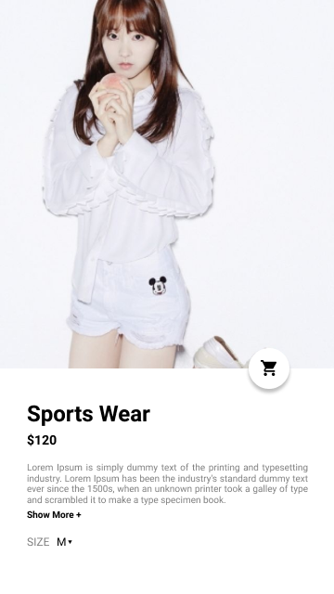
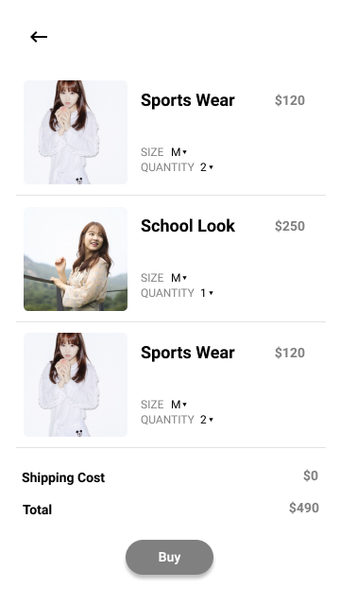
1. Use material icon
4. Make icon button with effect
5. Make page changed!
3. Use Different Font Size & Colored Text
6. Make any rounded component
2. Upload any picture from your device

