Slide 1
Cybersecurity
And Phishing

Slide 2

What is Phishing?
Phishing is a type of cyber attack in which attackers impersonate legitimate organizations or trusted entities to deceive individuals into revealing sensitive information, such as passwords, credit card numbers, social security numbers, or other personal data. This is typically done through fraudulent emails, messages, or websites that look similar to legitimate ones.
Phishing attacks often work by creating a sense of urgency or fear, prompting the victim to take immediate action, such as clicking on a link, downloading an attachment, or providing personal details.

Slide 3
Email-Phishing
Email phishing is a specific type of phishing attack where cybercriminals use email to deceive individuals into revealing sensitive information, such as login credentials, financial details, or other personal data. In an email phishing attack, the attacker impersonates a legitimate organization, service, or even a colleague in an effort to trick the recipient into taking a harmful action.
Real-life example is Elara Caring Phishing Attack.
In 2020, U.S. healthcare provider Elara Caring was subjected to a phishing attack that targeted two employees.
With only these two compromised targets, attackers gained access to employee email accounts and compromised the personal information of more than 100,000 elderly patients, including names, dates of birth, financial information, banking information, social security numbers, driver's license numbers and insurance information. The attackers maintained unauthorized access for a week before Elara Caring identified and contained the breach.

Slide 4
Spear Phishing
Spear phishing is a more targeted and sophisticated form of phishing attack where cybercriminals tailor their deceptive messages to a specific individual or organization, often using personal information to make the attack more convincing. Unlike regular phishing, which is sent out to a broad group of people, spear phishing is highly focused and often involves significant research on the victim.
Real life example is the Google and Facebook Phishing Attack
Between 2013 and 2015, a phishing campaign caused Facebook and Google losses of $100 million. The attackers took advantage of the fact that both companies had a Taiwanese supplier called Quanta. The attackers sent a series of fake invoices, pretending to be from Quanta, and the invoices were paid by Facebook and Google.
Eventually, the fraud was discovered, and Facebook and Google took legal action. The attackers were arrested in Lithuania and extradited to the U.S.. Facebook and Google were able to recover $49.7 million of the $100 million stolen.

Slide 5

SMS-Phishing
SMS phishing, also known as smishing, is a type of phishing attack that uses text messages (SMS) to trick individuals into revealing personal or sensitive information. The attacker typically impersonates a trusted entity—such as a bank, government agency, or a well-known company—and uses SMS to lure the victim into taking harmful actions, such as clicking on malicious links, downloading malware, or sharing sensitive information like passwords or credit card numbers.
Real-life example is the USPS Phishing Attack.
In 2020, a smishing campaign used the United States Post Office (USPS) as a front for an attack. Cybercriminals sent SMS messages that told recipients they should click a link to view important information about an upcoming USPS delivery. The malicious link actually took victims to various web pages designed to steal their Google account credentials.

Slide 6
Voice-Phishing
Voice phishing, also known as vishing, is a type of phishing attack that uses voice communication, typically over the phone, to deceive individuals into revealing sensitive information, such as personal identification numbers (PINs), credit card details, social security numbers, or bank account credentials. In a vishing attack, the scammer impersonates a trusted entity—such as a bank, government agency, or tech support service—to manipulate the victim into taking harmful actions.
Real-life example is Spectrum Health Phishing Attack.
In 2020, Spectrum Health System, a healthcare organization, reported a phishing attack involving a patient who received a call from an individual masquerading as an employee. The attackers aimed to extract personal data from Spectrum Health's patients and members, including member ID numbers and other personal health data associated with the account.
Spectrum Health reported that attackers used tactics such as flattery and intimidation to force victims to pass on data, money, or access to personal devices

Slide 7
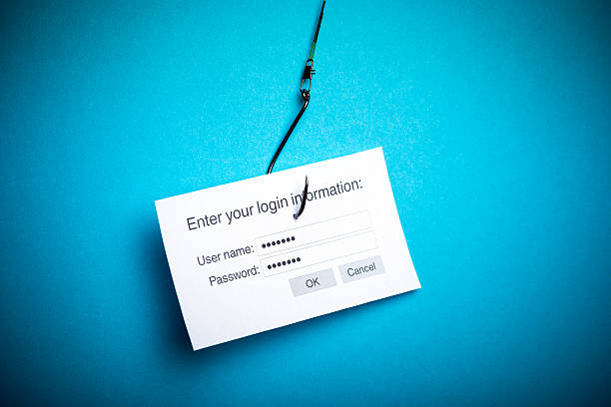
HTTPS-Phishing
HTTPS phishing, also known as SSL phishing, is a type of phishing attack where a malicious website uses HTTPS (HyperText Transfer Protocol Secure) to create the illusion of a secure and legitimate site. In an HTTPS phishing attack, the attacker sets up a fraudulent website with an SSL/TLS certificate, which makes the site appear encrypted and trustworthy, even though it’s designed to steal personal or sensitive information from the victim.
Real-life example is Levitas Capital Phishing Attack.
In 2020, a whaling attack was conducted against the co-founder of the Australian hedge fund Levitas Capital. The co-founder received an email containing a fake Zoom link. When he clicked the link, malware was deployed on the hedge fund's corporate network, generating fraudulent invoices of nearly $8.7 million.
The actual financial losses from the attack were $800,000, but the attack also damaged the hedge fund’s reputation, causing them to lose their biggest client and shut down operations.

