Slide 1

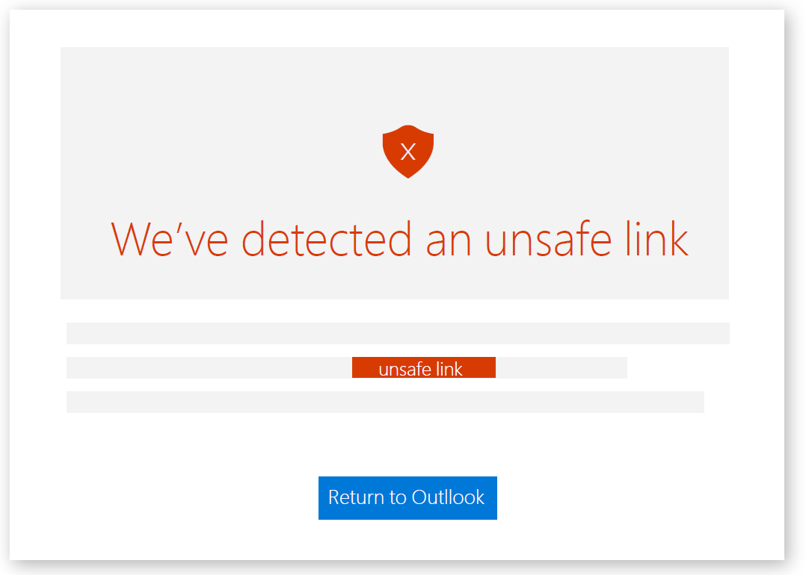
Cybersecurity
With the growing presence and sophistication of online threats like viruses, ransomware, and phishing scams, it’s important to have the right protection.
1. What is Cybersecurity
Cybersecurity is the practice of protecting systems, networks, and data from digital attacks, unauthorized access, and damage. It encompasses a wide range of measures, including the use of firewalls, encryption, secure coding practices, and user authentication protocols to safeguard both personal and organizational information. As cyber threats become increasingly sophisticated, cybersecurity also involves continuous monitoring, threat detection, and response strategies to prevent data breaches, malware infections, and other malicious activities. With the growing reliance on technology in every aspect of life, robust cybersecurity is critical not only to protect sensitive data but also to maintain the integrity, confidentiality, and availability of critical systems and services.
.

Slide 2

2. What is Cyber Threat ?
A cyber threat refers to any potential danger or malicious action that targets digital systems, networks, or data with the intent to cause harm, steal information, or disrupt operations. Cyber threats can take various forms, including malware (like viruses or ransomware), phishing attacks, denial-of-service (DoS) attacks, and unauthorized access by hackers. These threats can result in financial loss, reputational damage, or theft of sensitive information. As technology evolves, cyber threats become more sophisticated, requiring constant vigilance and advanced security measures to prevent and mitigate potential attacks.

Slide 3
3. Types of Cyber Attacks 1. Brute Force
Brute force is a type of cyber attack where an attacker systematically tries all possible combinations of passwords or encryption keys until the correct one is found. It's a trial-and-error method that relies on the computational power of a system to guess the correct credentials. In the context of password cracking, a brute force attack involves attempting every possible character combination, from simple to complex, until access is granted.
While brute force attacks can be effective against weak or simple passwords, they are time-consuming and less likely to succeed against strong, complex passwords or systems with security measures like account lockouts or multi-factor authentication (MFA). Brute force attacks are often used in combination with other techniques, such as dictionary attacks or rainbow tables, to increase efficiency.

Slide 4
4. Real-life examples of Brute Force Attack
1. The LinkedIn Data Breach (2012)
In 2012, LinkedIn suffered a major data breach when attackers obtained over 6.5 million user passwords. These passwords were initially protected with weak encryption, and hackers used brute force methods to crack them. Although the passwords were encrypted, some were found to be weak or reused across multiple sites. This incident highlighted the risks of weak password management and the importance of using strong, unique passwords.
2. GitHub Attack (2014)
GitHub, a popular platform for developers to host and share code, was targeted by brute force attacks in 2014. Attackers tried to gain unauthorized access to user accounts by repeatedly guessing passwords. The attack was successful because many users had weak passwords, and some accounts were not protected with additional security layers like 2FA. GitHub responded by implementing security measures like rate-limiting to reduce the effectiveness of brute force attacks.

