Slide 1
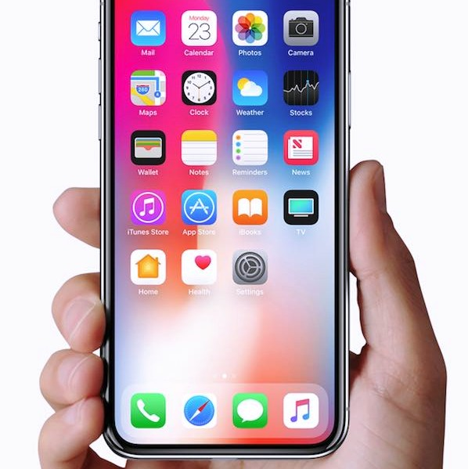

InstaCart
InstaCart

Slide 2


InstaCart

Slide 3


Background of the Study
Traditional marketing methods confront formidable challenges in today's dynamic business landscape, demanding a compelling shift towards more contemporary strategies. Their inherent limitations, such as restricted reach, high costs, and difficulties in measuring return on investment, place businesses at a disadvantage, particularly those with modest budgets. The lack of interactivity and slow response time further hamper engagement, while the inability to precisely target specific demographics limits their effectiveness in reaching the right audience. Additionally, the environmental impact of physical materials raises ethical concerns at a time when sustainability is paramount. As consumer preferences evolve towards digital interactions, the diminishing efficacy of traditional methods underscores the urgency for businesses to embrace innovative, data-driven approaches. By adapting and integrating digital strategies seamlessly, companies can not only overcome these challenges but also position themselves as agile, customer-centric entities ready to thrive in the ever-changing market landscape.
Problem Statement and System Impact
Shifting to an online marketing system offers businesses transformative advantages by overcoming challenges tied to traditional methods. This transition extends market reach globally, brings cost efficiency through digital channels, and provides measurable returns with robust analytics. The interactive nature of online platforms enhances customer engagement, and precise targeting options ensure campaigns reach the most relevant audience. Quick response times for adjustments, reduced environmental impact, and competitiveness in the digital landscape further underscore the benefits of adopting an online marketing strategy.

Slide 4
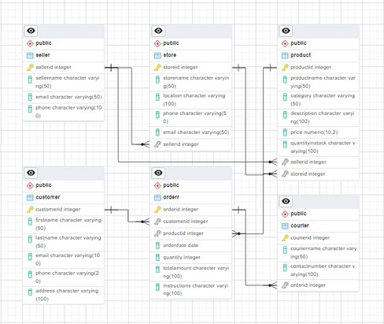
DATABASE SCHEMA

Slide 5
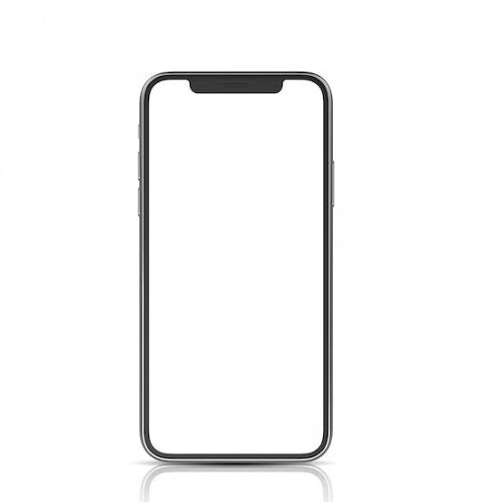
InstaCart

Slide 6
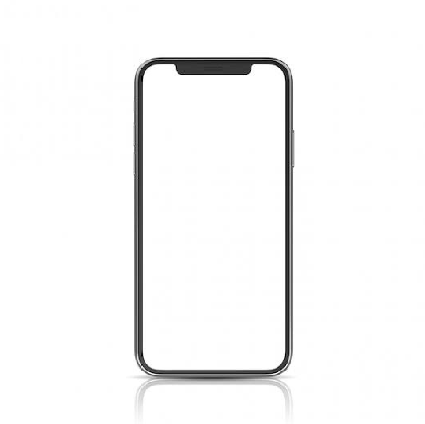

LOGIN MENU
InstaCart
LOGIN AS SELLER
LOGIN AS CUSTOMER

Slide 7

SELLER LOGIN
InstaCart
Log in as Seller
Query:
Email
SELECT sellerid FROM Seller WHERE Email =
‘email’ AND Password = ‘password’;
Password
LOGIN

Slide 8

SELLER INTERFACE
InstaCart
ADD STOCKS
VIEW ORDERS
DELIVERY MANAGEMENT
MESSAGES

Slide 9







ADD STOCKS
InstaCart
Meat
100 Stocks
Add
Query:
Cereals
100 Stocks
Add
UPDATE Product SET QuantityInStock= 100 WHERE ProductID = 10;
Add
Fruits
100 Stocks
Beverage
100 Stocks
Add
Vegetables
100 Stocks
Add

Slide 10
SELLER INTERFACE
InstaCart
ADD STOCKS
VIEW ORDERS
DELIVERY MANAGEMENT
MESSAGES

Slide 11
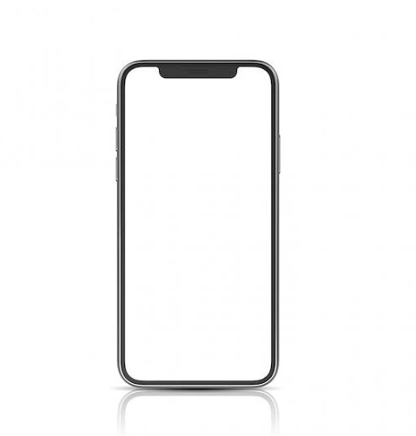

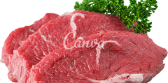



InstaCart
@Von Cedric
VIEW ORDERS
200
200
Query:
SELECT*FROM Orderr WHERE CustomerID = ‘Customerid’;
200
200
800 pesos
@Ryle Hayden
200
200
400 pesos

Slide 12
SELLER INTERFACE
InstaCart
ADD STOCKS
VIEW ORDERS
DELIVERY MANAGEMENT
MESSAGES

Slide 13



InstaCart
Cedrick Panaligan
Available
Denver Salazar
Not Available
Alleon John Perez
Not Available

Slide 14
SELLER INTERFACE
InstaCart
ADD STOCKS
VIEW ORDERS
DELIVERY MANAGEMENT
MESSAGES

Slide 15



InstaCart
Messages
Cedrick Panaligan
Von Cedric Latag
Denver Salazar
Keith Ciruelas

Slide 16

InstaCart
Cedrick Panaligan ^{Sign Out}

Slide 17
BACK TO MAIN MENU
InstaCart
LOGIN AS SELLER
LOGIN AS CUSTOMER

Slide 18
CUSTOMER LOGIN
InstaCart
Log in as Customer
Email
Password
LOGIN
NOT YET REGISTERED? CREATE AN ACCOUNT

Slide 19
InstaCart
Create an Account
First Name
Last Name
Email
Password
Contact Number
Address
Register

Slide 20
InstaCart
Log in as Customer
Query:
Email
SELECT customerid FROM Customer WHERE Email = ‘(email)’ AND Password
= ‘(password)’;
Password
LOGIN
NOT YET REGISTERED? CREATE AN ACCOUNT

Slide 21








InstaCart
Search
InstaPay
Meat
Cereals
Beverages
Fruits
Vegetables
Seafood

Slide 22

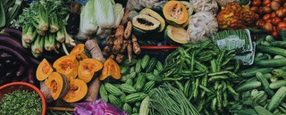
InstaCart
3
Vegetables
View your Order
Vegetables
1.1k sold
300 Pesos
ADD TO CART
Vegetables
200 sold
500 Pesos
ADD TO CART

Slide 23



InstaCart
Shopping Cart
Von Cedric Latag 0912345678
Marawoy Lipa City Batangas
VIEW ORDERS
x5
100 pesos
Query:
x5
75 pesos
SELECT*FROM Orderr
Query:
SELECT SUM(column_name)
AS total_sum FROM table_name;
x5
75 pesos
250 Pesos
20 Shipping Fee
+
270 Pesos
PLACE ORDER

Slide 24

InstaCart
Search
My Account
InstaPay
Meat
Cereals
Beverages
Fruits
Vegetables
Seafood

Slide 25








Von Cedric Latag 0912345678
To Pay
To Ship To Receive
Rate
InstaCart

Slide 26




TO SHIP
InstaCart
Ship by
KRV Express ABCDE12345
COPY TRACKING NUMBER
Sent to
Von Cedric Latag 0912345678
Marawoy, Lipa City
KRV MARKET >
Vegetables x15
PAYMENT INFORMATION
Subtotal
Shipping Fee
InstaPay
250.00
20.00
Order Total
270.00
CONTACT SELLER

Slide 27



TO RECEIVE
InstaCart
TRACKING NUMBER ABCDE12345 COPY
Order has been delivered
Your food is on the way. Rider: Kian
Order has been arrived at Mataas na Kahoy, Lipa City
Order has been arrived at San Jose, Batangas
Order placed

Slide 28

InstaCart
Seller

Slide 29
InstaCart
Seller
Sign out

Slide 30
BACK TO MAIN MENU
InstaCart
EMPLOYEE LOGIN
CUSTOMER LOGIN

