Slide 1


分野別演習 2023/07/07

Slide 2
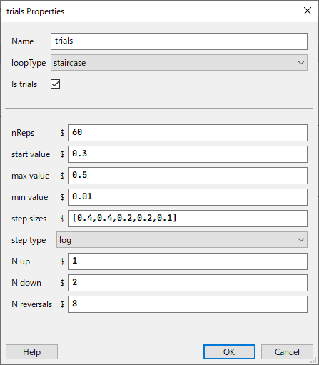
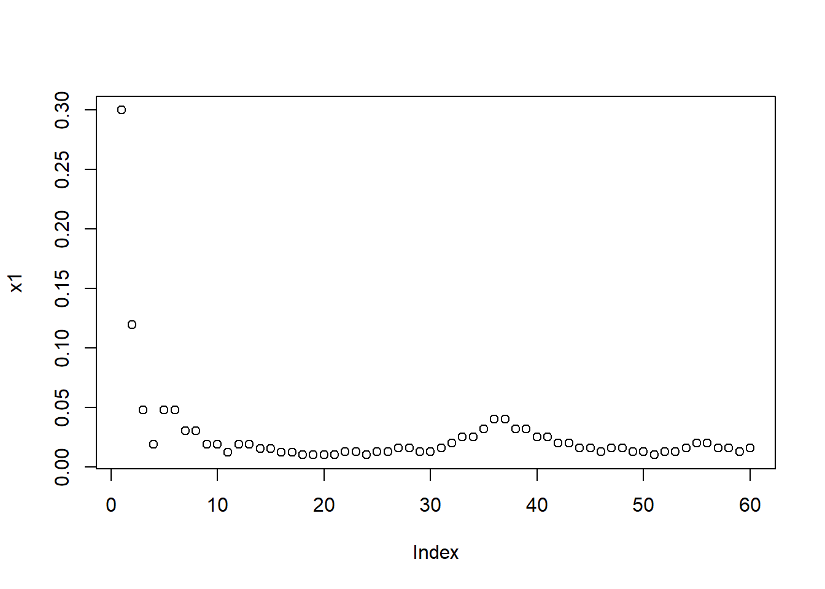
peripheral_staircase.psyexp
Orientation discrimination in peripheral vision
Staircasing on stimulus contrast for estimating threshold
1-up 2-down staircase converges to 71% accuracy
P(correct)^2 = P(incorrect) = 0.5, P(correct) = 0.71
Threshold can be estimated with small numbers of trials

Slide 3
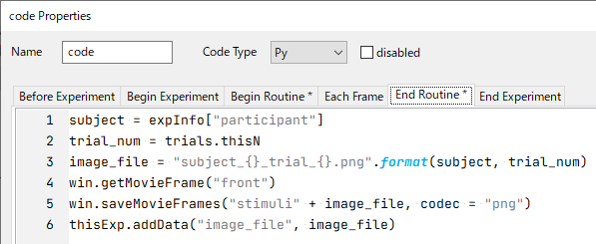
stimulus_generator.psyexp
This experiment saves the screen in each trial as png
Set grating contrast at the threshold value estimated by staircasing
Save upward and downward images as “s1.png” and “s2.png”
These images will be used in online experiment (since PsychoPy does not offer grating component for online use)

Slide 4
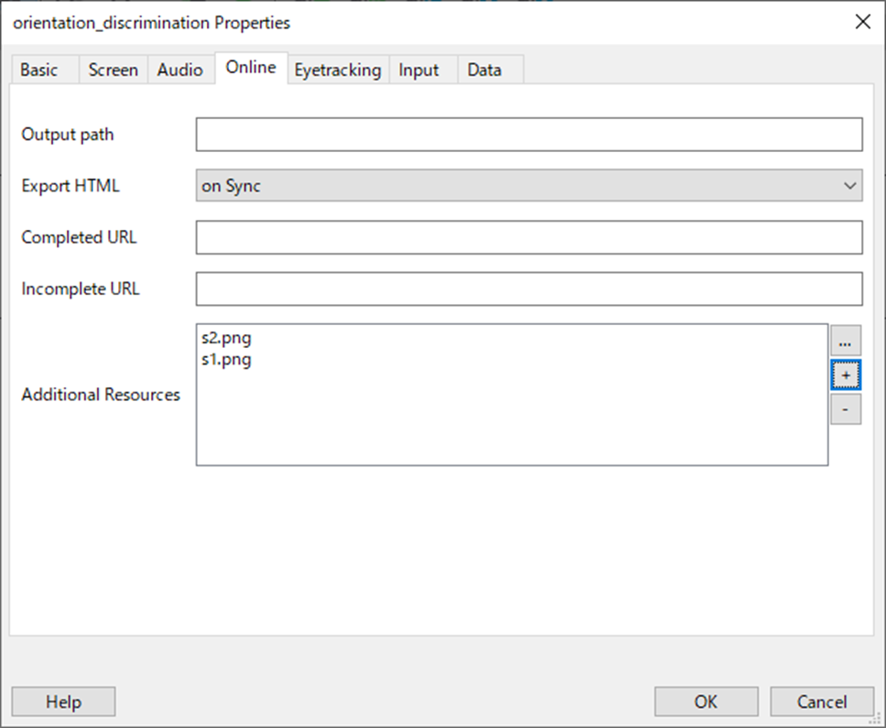
Preparation for online experiment (v2022.1.4)
Open peripheral_discrimination.psyexp
Click Setting > Online
Make Output path empty
Specify Additional Resources (image files, csv for experimental parameters, etc.)

Slide 5
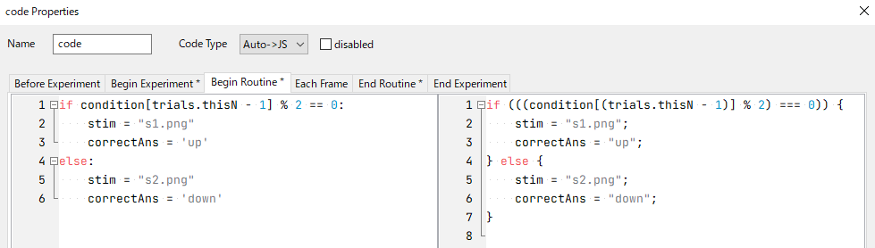
Preparation for online experiment (v2022.1.4)
Open Code components
Change Code Type to Auto->JS
Check if everything is translated correctly

Slide 6
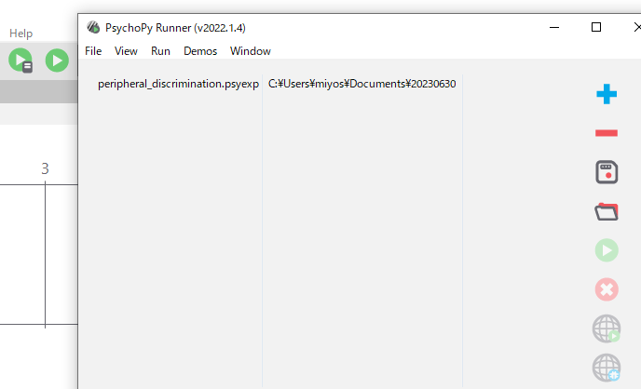
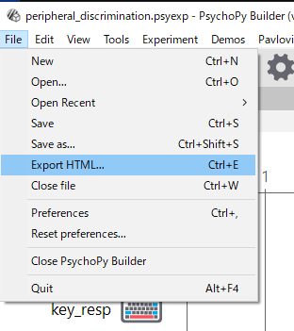
Preparation for online experiment (v2022.1.4)
Click File > Export HTML
The experiment will be translated into html & JavaScript
Save created js file as it is
Then launch translated experiment offline
Add the experiment to Runner
Launch experiment offline

Slide 7
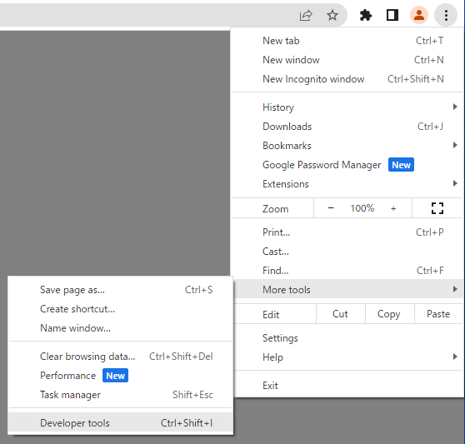
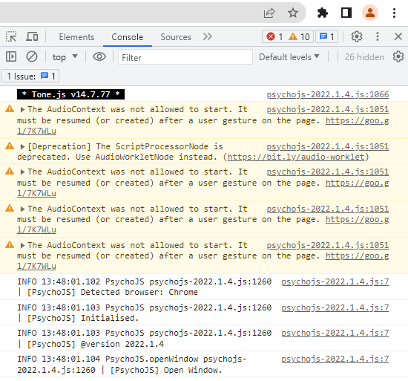
Local debugging
You can use Developer tools on Google Chrome for troubleshooting

Slide 8
Local debugging
Some functions cannot be translated into html/JavaScript (e.g., several functions of numpy)
You need to directly modify your JavaScript for those occasions (check followings)
Official documents
https://www.psychopy.org/online/
https://workshops.psychopy.org/3hrs/online.html
PsychoPy version 2020.1.3-2020.2.10, Python to JavaScript Crib Sheet
https://docs.google.com/document/d/183xmwDgSbnJZHMGf3yWpieV9Bx8y7fOCm3QKkMOOXFQ/edit#heading=h.fbo8f8y1ynwk

Slide 9
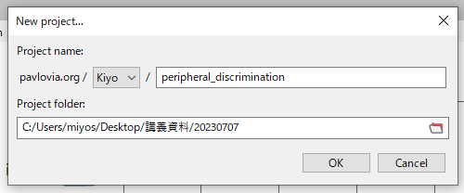
Register experiment to Pavlovia
Pavlovia: official experiment server for PsychoPy
Register your email on Pavlovia
On PsychoPy Builder, click Pavlovia.org > User > Log in to Pavlovia
Then, click Pavlovia.org > Sync > Create a project
Name the project and specify the folder location that includes your materials
Many interesting demos: https://pavlovia.org/explore?sort=DEFAULT&search=demos

Slide 10
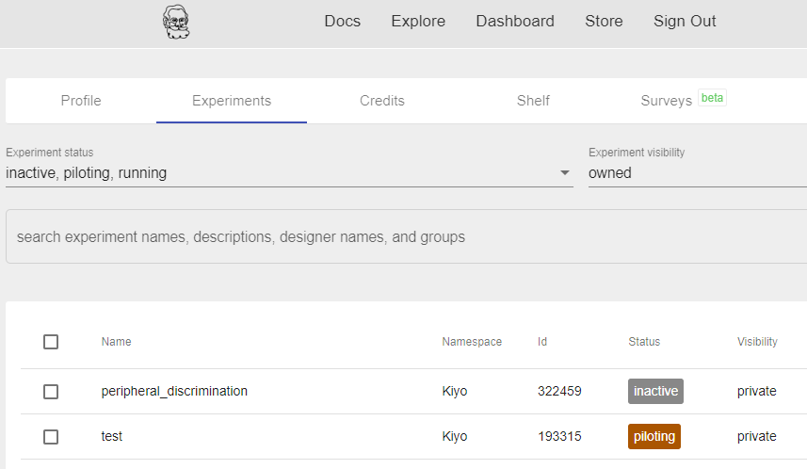
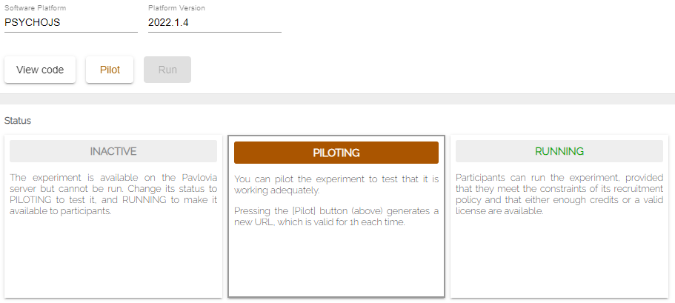
Launch your experiment on Pavlovia
Open Dashboard on Pavlovia, where you can find your project
Change the status into PILOTING, and click Pilot
Your experiment will be launched online with a temporal URL valid for an hour
In this way of use, data csv will only be stored into participants’ local computer
You need to purchase Credit to conduct large-scale online experiments
You can also distribute your experiment on crowd-sourcing platforms (Prolific, MTurk, Yahoo, etc.)

Slide 11
Homework
Design your own experiment on PsychoPy and launch it on Pavlovia
Send an experiment URL to the other students and collect data from at least 2 participants
Conduct statistical analyses on your data and interpret the resulting patterns
Summarize your findings into a few-page document, which should be submitted to PandA with related materials (e.g., py/html/JavaScript codes)

