Slide 1
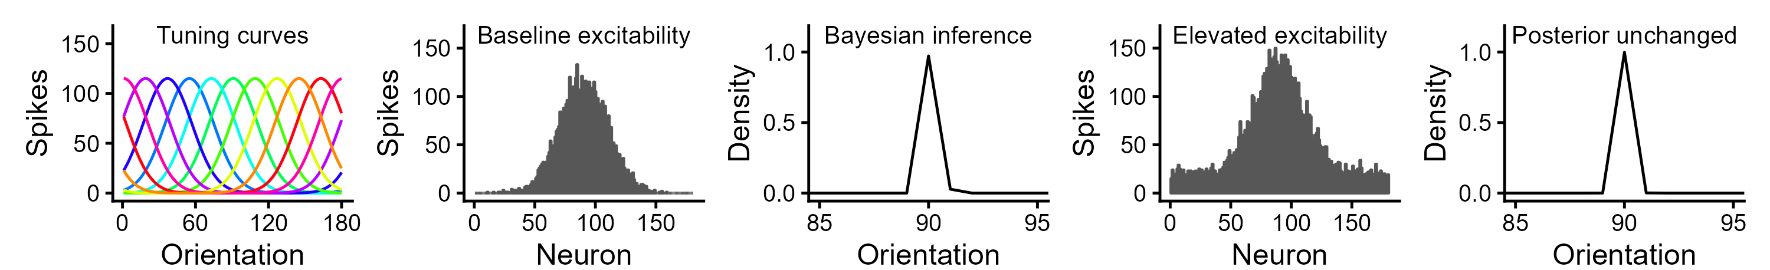
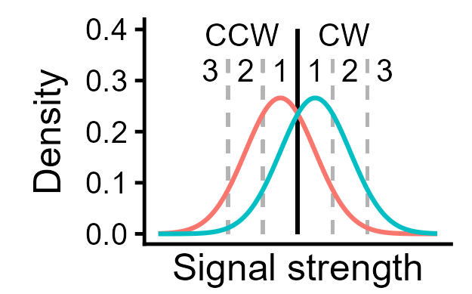

(a)
(b)
Clockwise vs. counter-clockwise discrimination
high confidence low visibility
low confidence high visibility

Slide 2

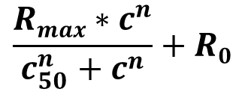
$$\frac{Rmax∗c^{n}}{c_{50}^{n}+c^{n}}+R0$$
Contrast = 15%
● 90°
＋ 100°
Contrast = 25%
● 90°
＋ 100°

Slide 3
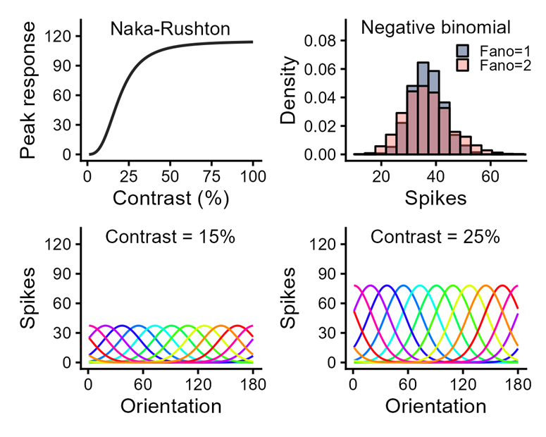
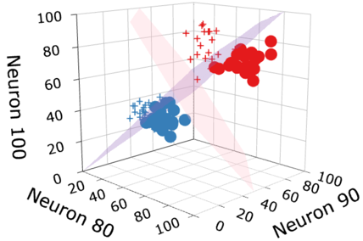
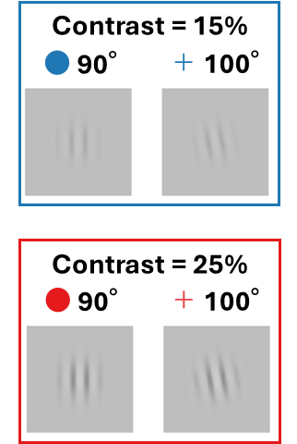
(a)
(b)

Slide 4
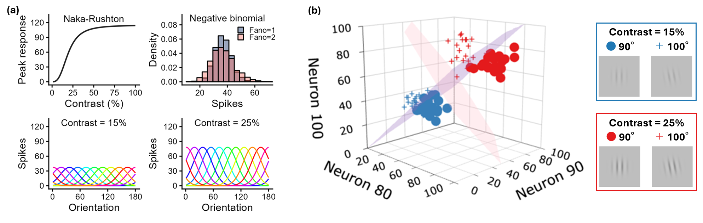

Slide 5
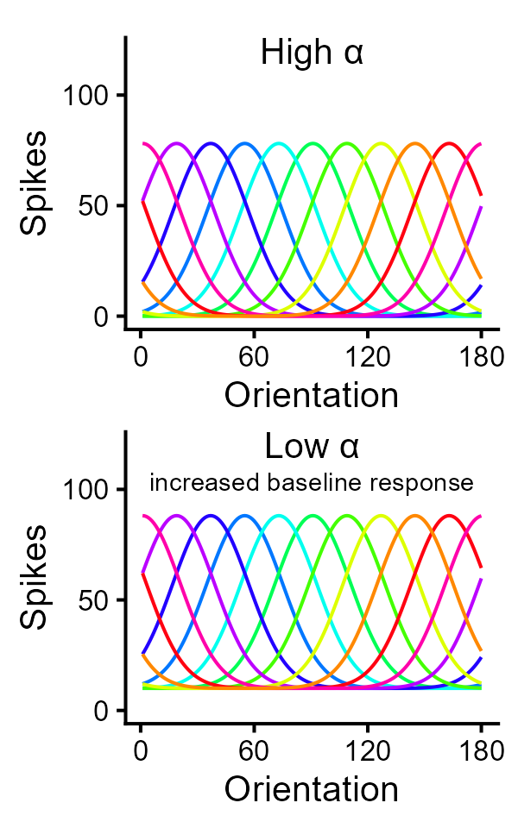
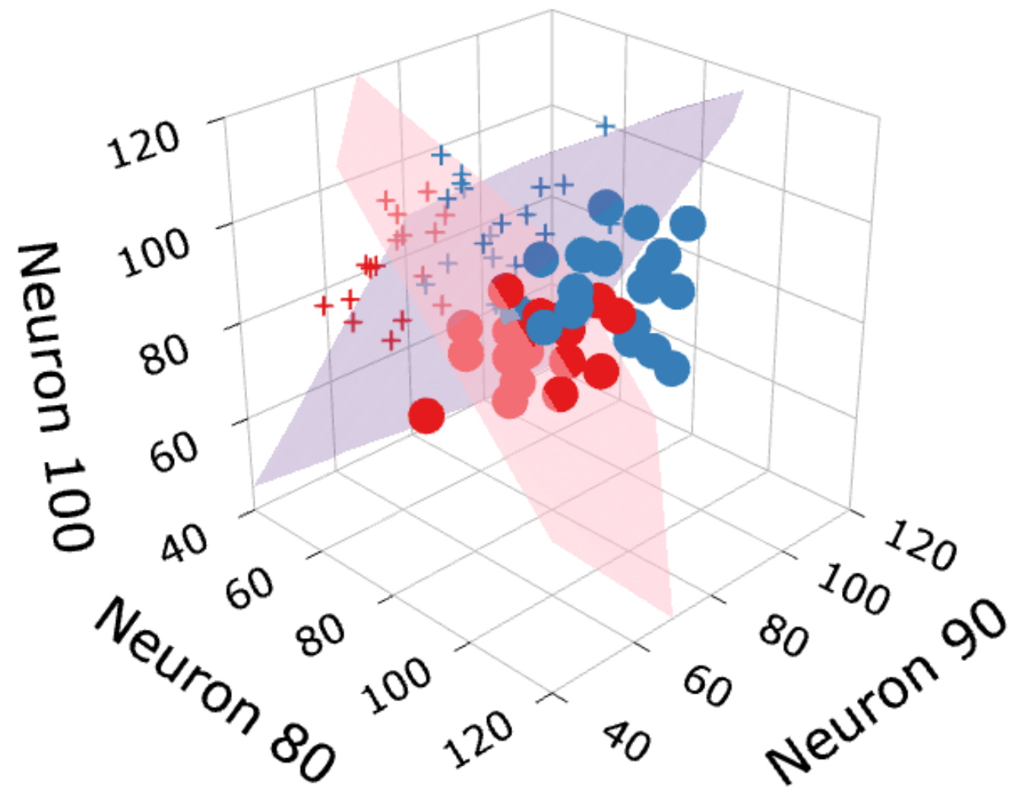
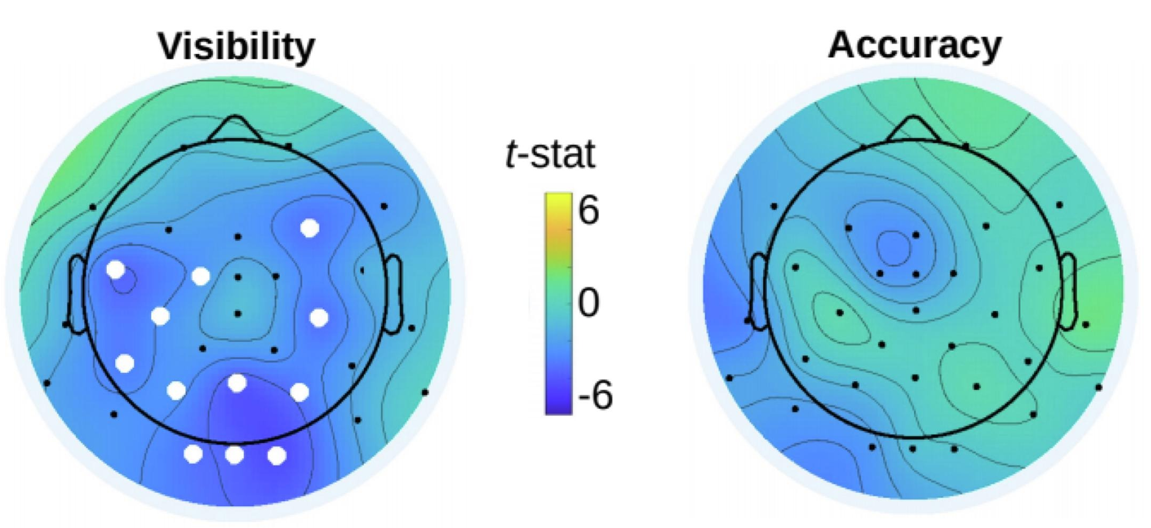
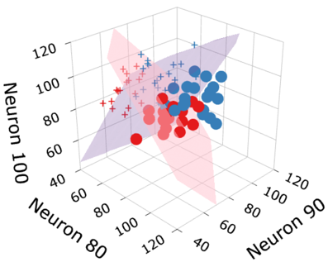
Pre-stimulus EEG α power (proxy for baseline neural excitability) predicts visual awareness but not perceptual sensitivity
Low α
High α
CW vs. CCW discrimination with visibility rating
● +
● +
More points exceed the orange visibility plane under low α
Awareness is determined along the dimension separate from sensitivity
This explains how strong phenomenology can arise decoupled from sensitivity

