Slide 1
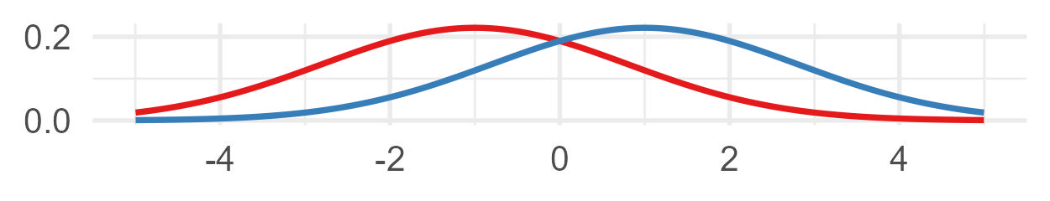
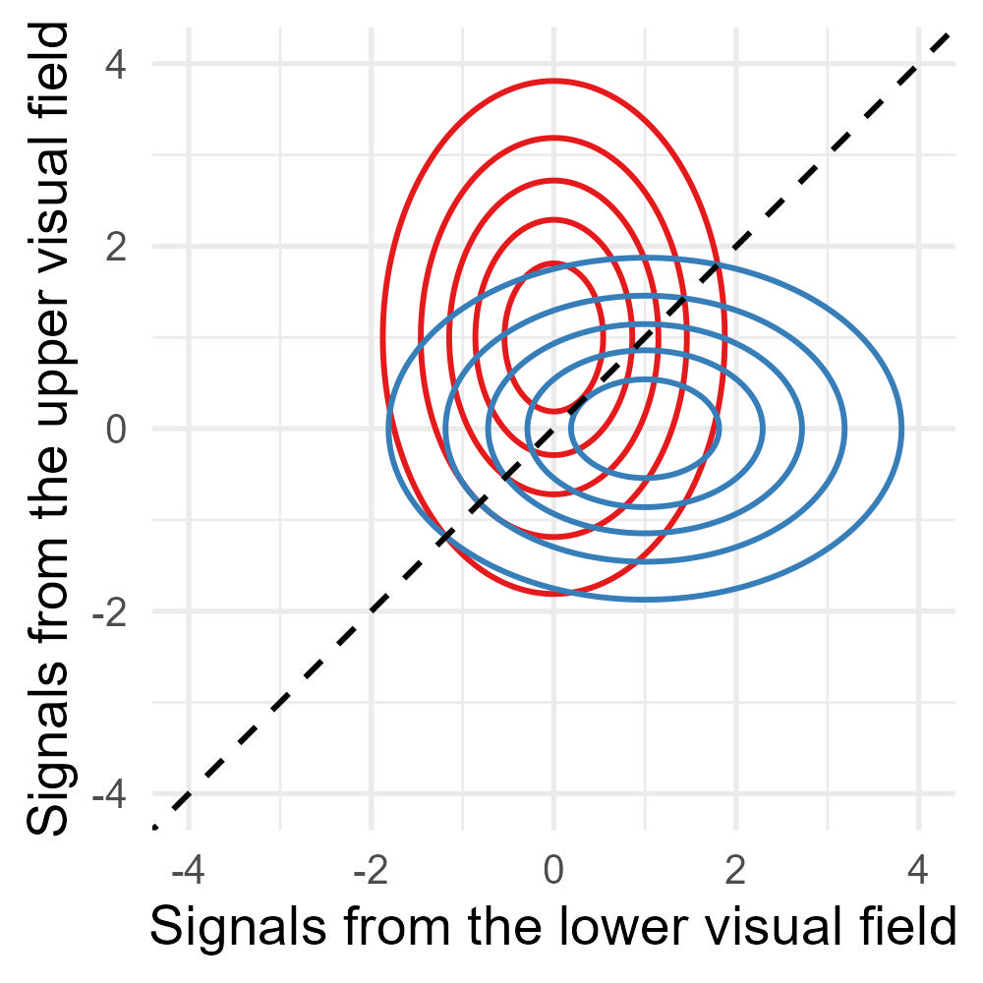
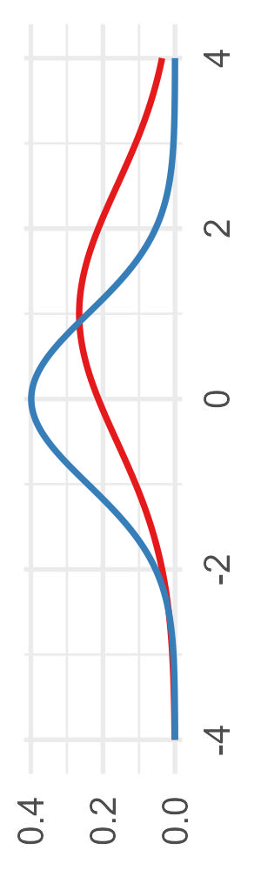
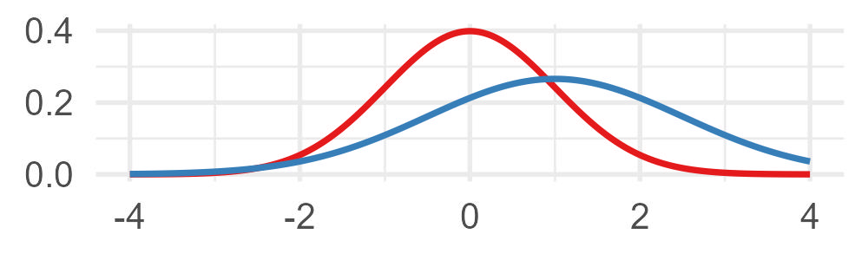


(d)
Discrimination d′ = 1.109
$\text{discrimination} \text{d}\text{′ =}$ $√2×\text{detection} \text{d}$_{a}
Detection for S1 (lower visual field)
or
(b)
(c)
or
Detection d_{a} = 0.784
Detection for S2 (upper visual field)
or
or
2AFC discrimination of S1 and S2
2AFC boundary
or
(a)
Detection d_{a} = 0.784
or

Slide 2
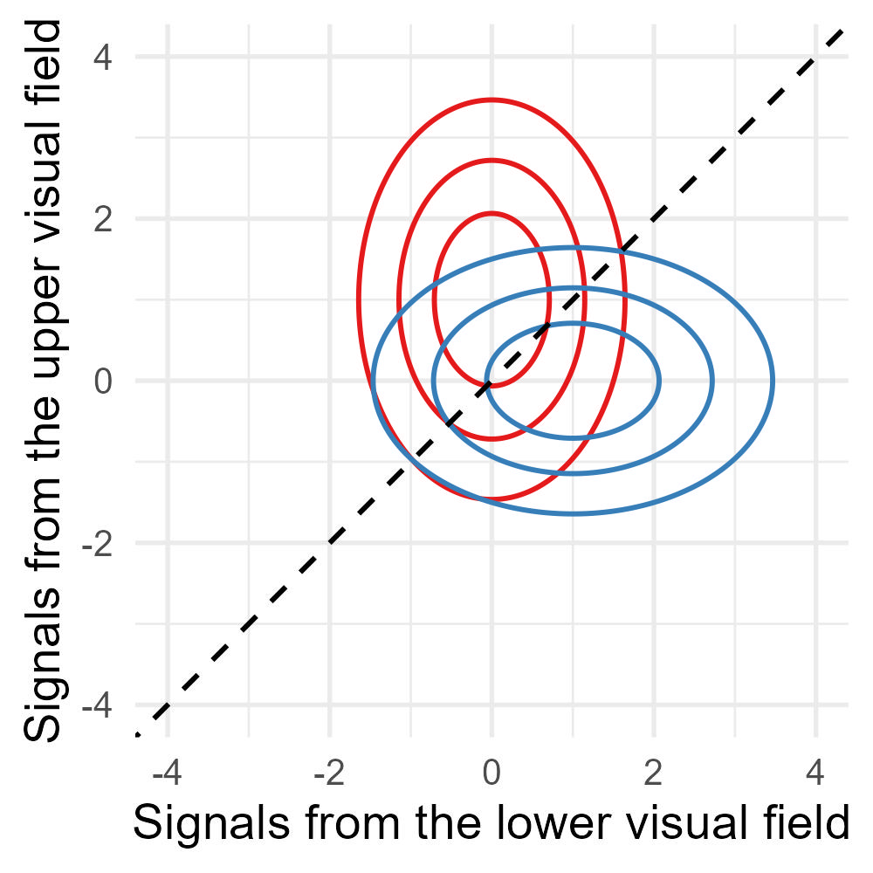

(d)
Discrimination d′ = 1.109
$\text{discrimination} \text{d}\text{′ =}$ $√2×\text{detection} \text{d}$_{a}
Detection for S1 (lower visual field)
or
(b)
(c)
or
Detection d_{a} = 0.784
Detection for S2 (upper visual field)
or
or
2AFC discrimination of S1 and S2
2AFC boundary
or
(a)
Detection d_{a} = 0.784
or

Slide 3
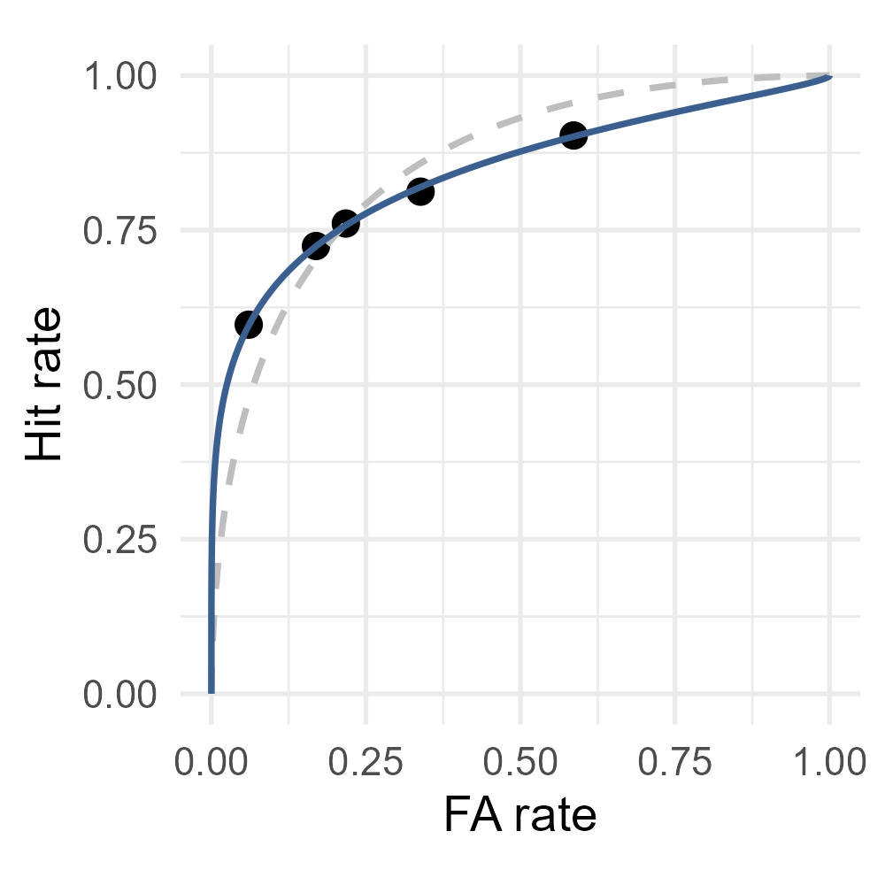
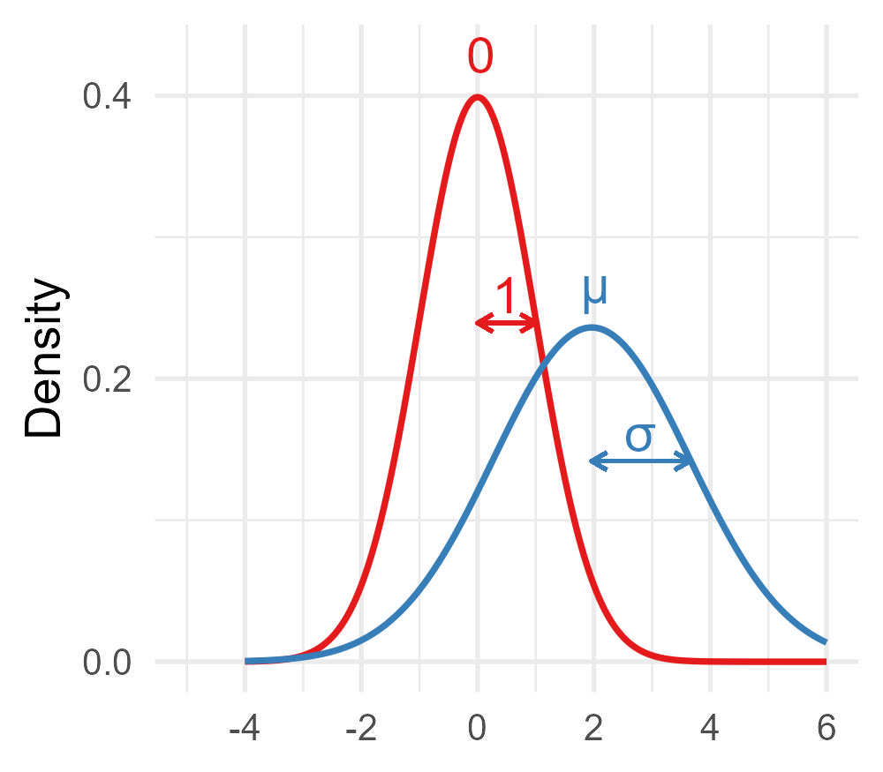
(a)
(b)

