Slide 1

WebMarket – 상품
Product

Slide 2
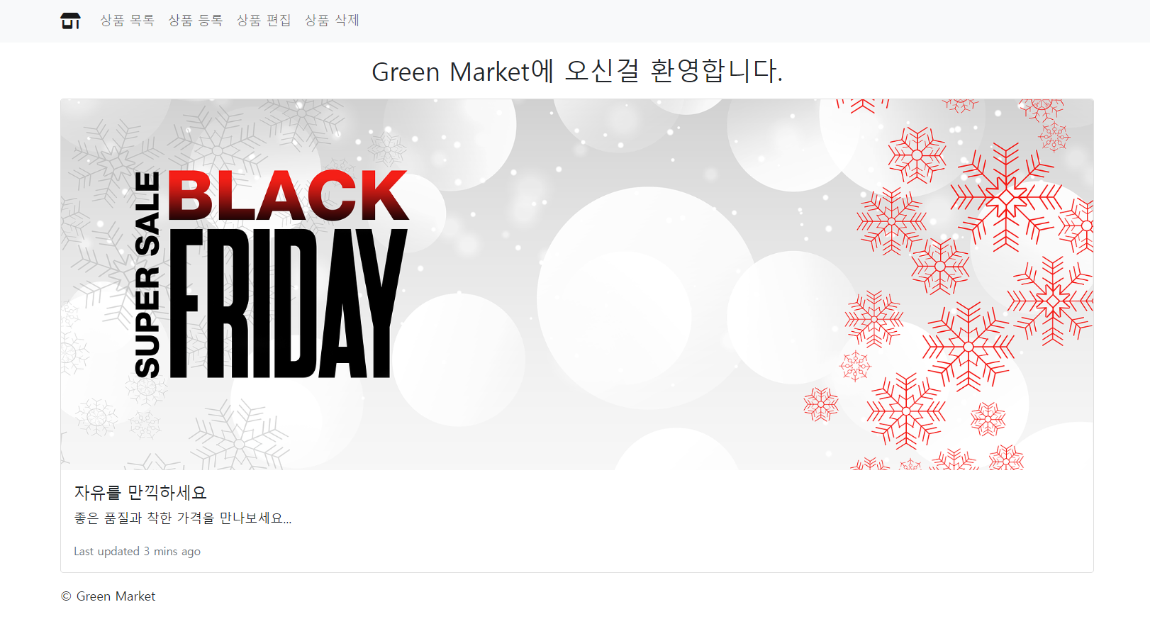
Web Shopping Mall

Slide 3
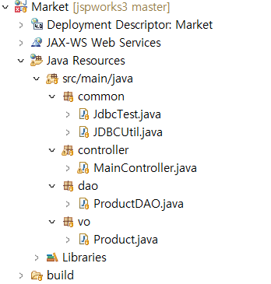
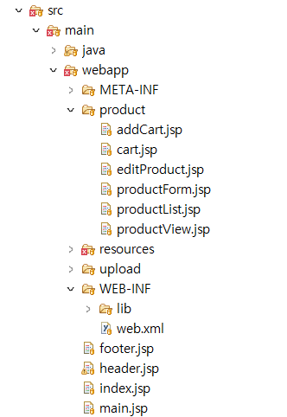
Web Shopping Mall
프로젝트 계층 구조

Slide 4
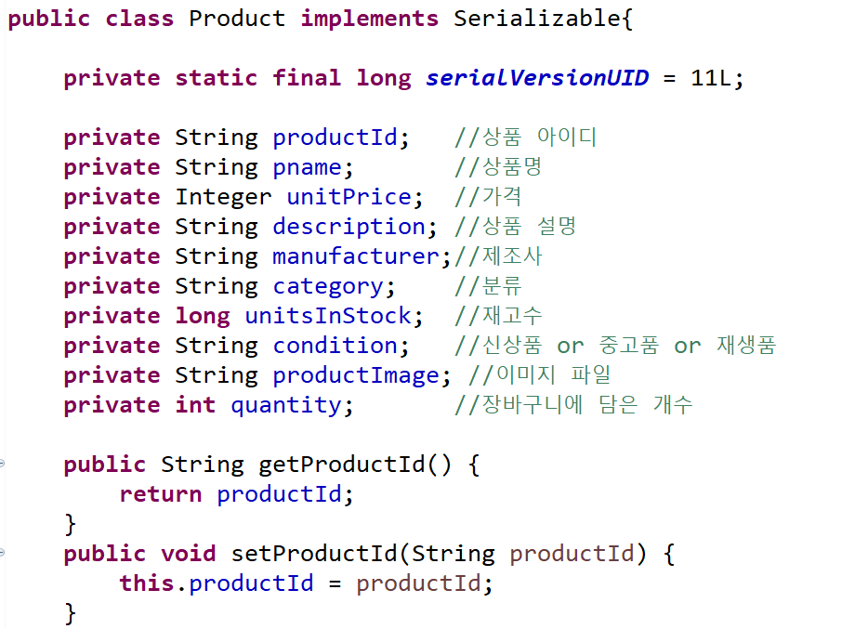
Web Shopping Mall
상품 클래스(VO)

Slide 5
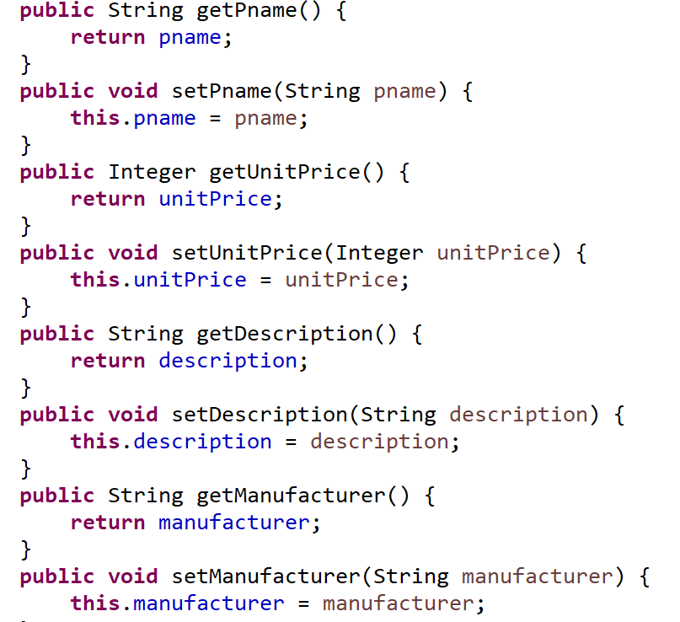
Product Class
상품 클래스(VO)

Slide 6
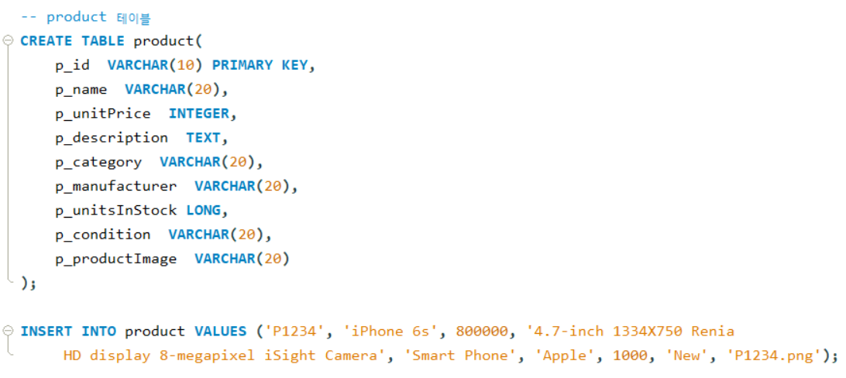
MySQL 데이터 베이스
상품 테이블 생성

Slide 7
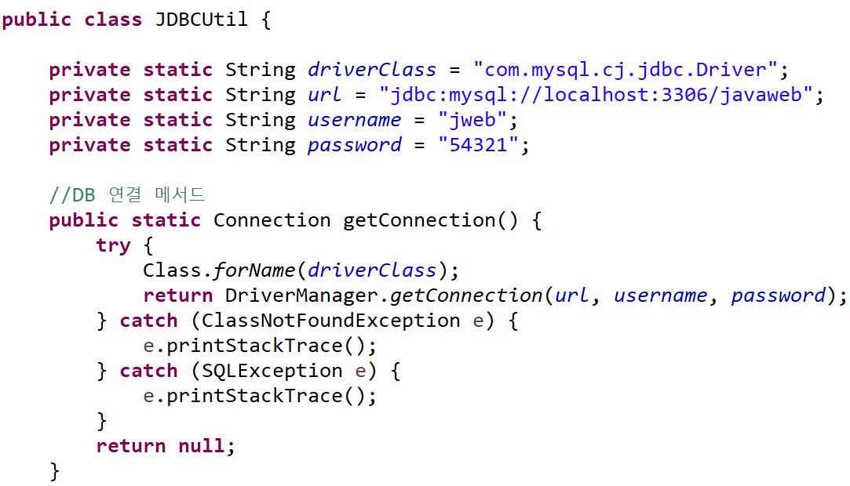
JDBCUtil – DB 연결 및 종료
JDBCUtil – DB 연결 및 종료

Slide 8
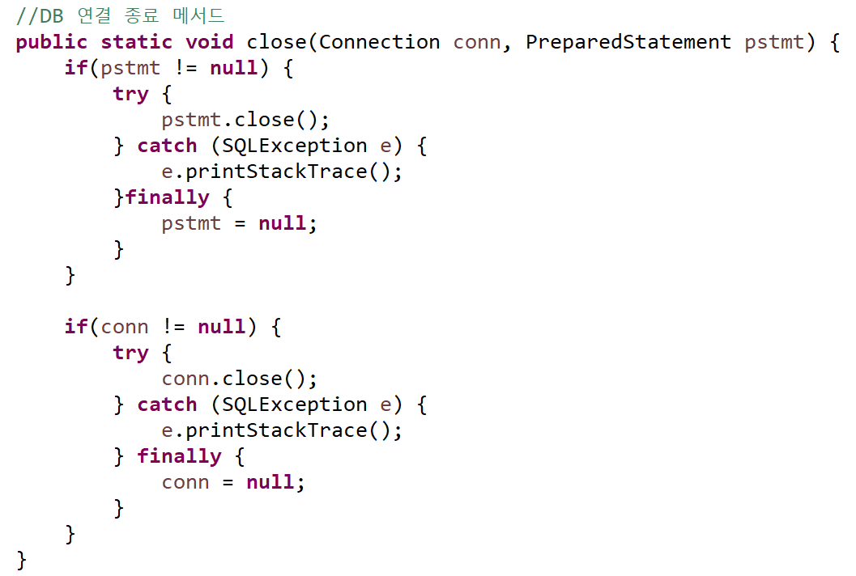
JDBCUtil – DB 연결 및 종료

Slide 9
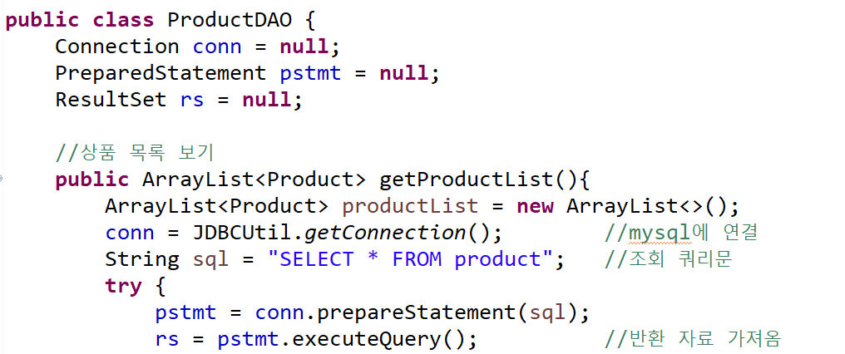
ProductDAO Class
상품 관리 클래스

Slide 10
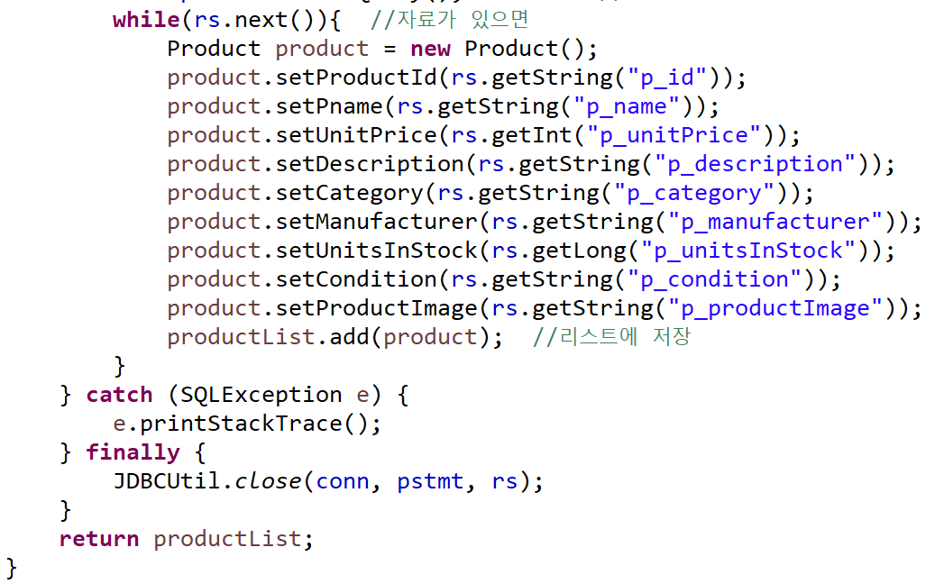
ProductDAO Class

Slide 11
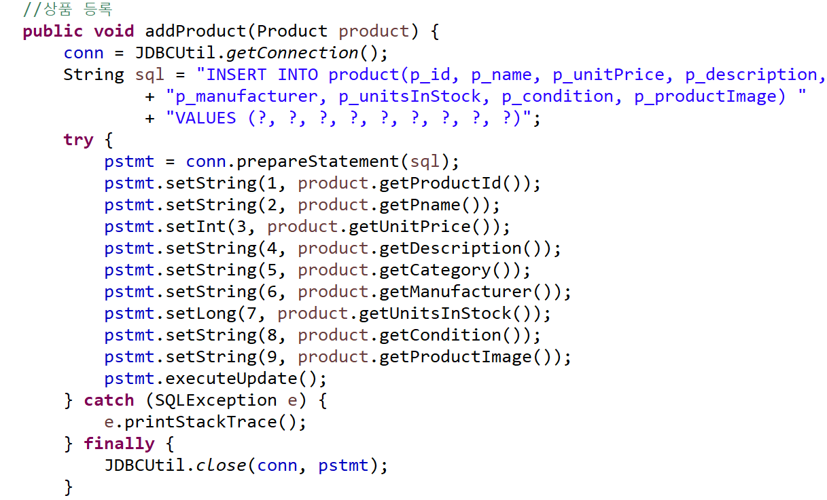
ProductDAO Class

Slide 12
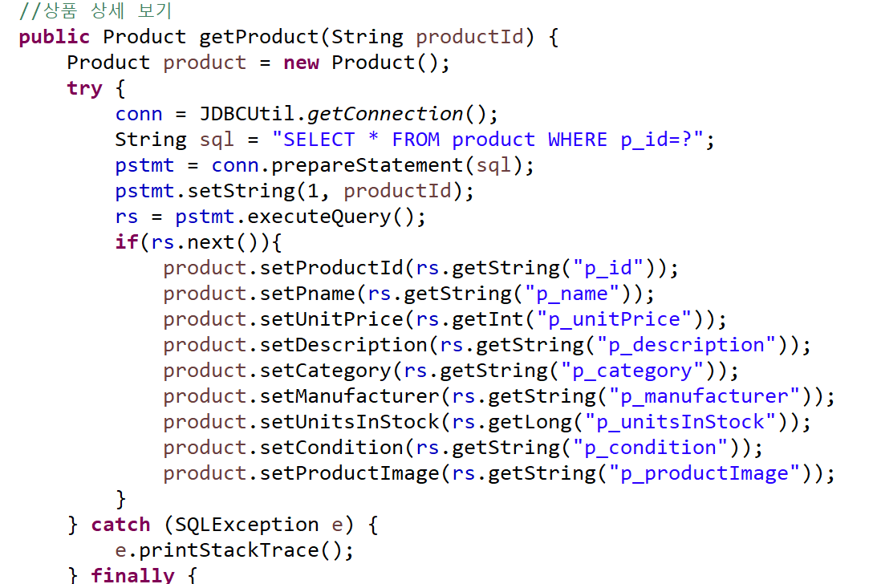
ProductDAO Class

Slide 13
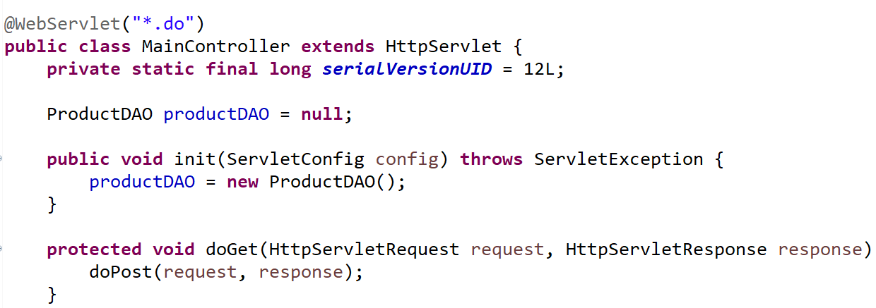
MainController
Controller – 서블릿(Servlet)

Slide 14
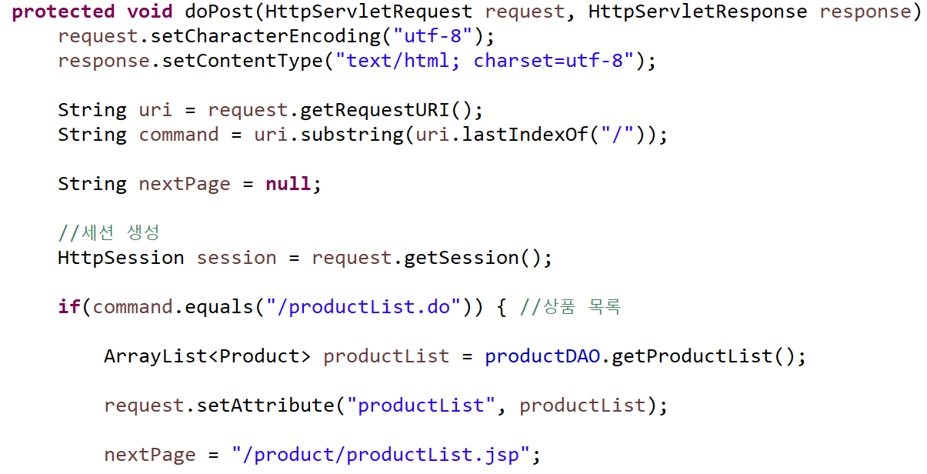
MainController

Slide 15
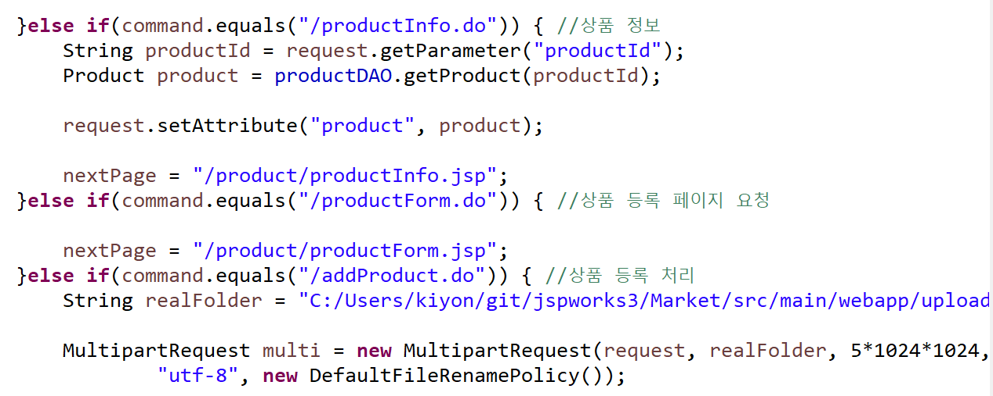
MainController

Slide 16
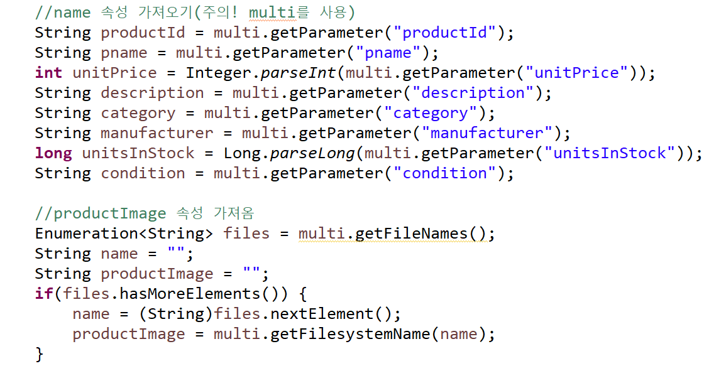
MainController

Slide 17
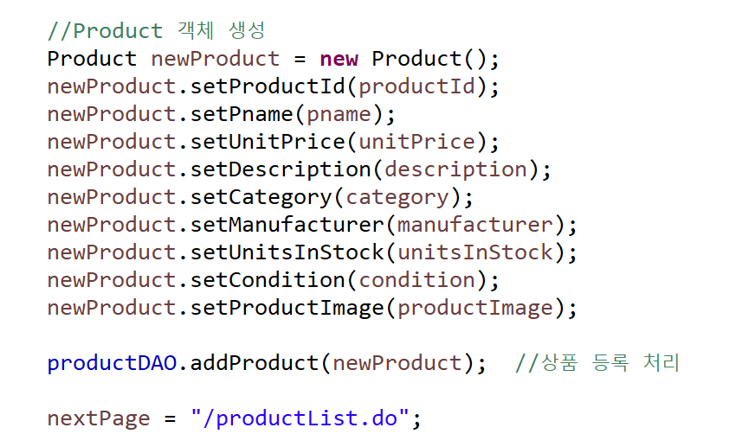
MainController

Slide 18
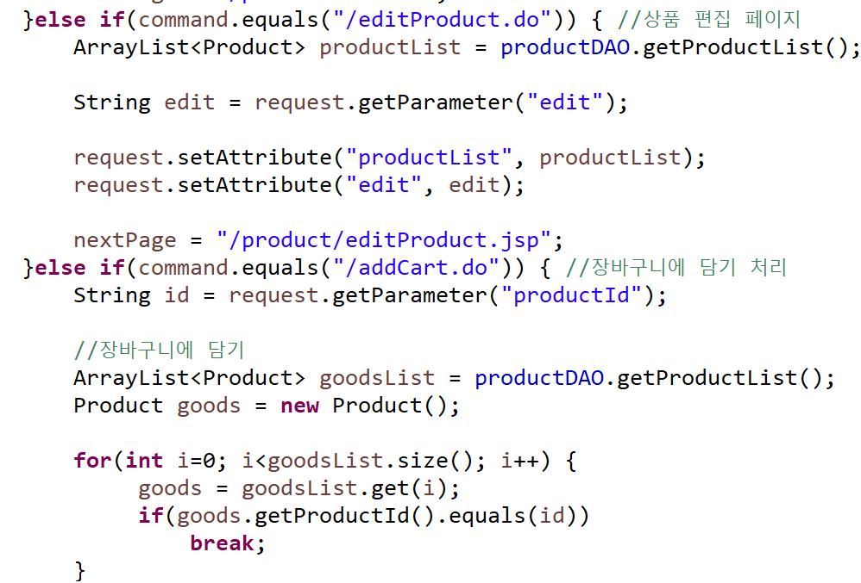
MainController

Slide 19
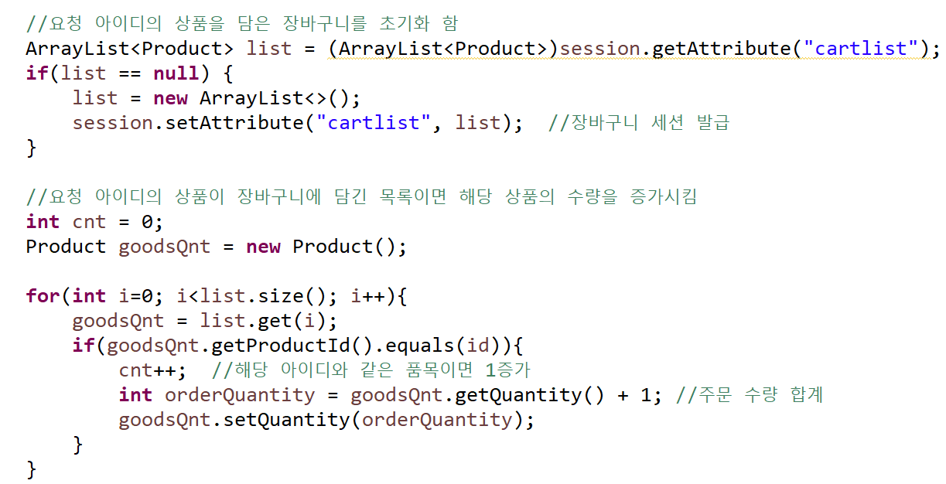
MainController

Slide 20
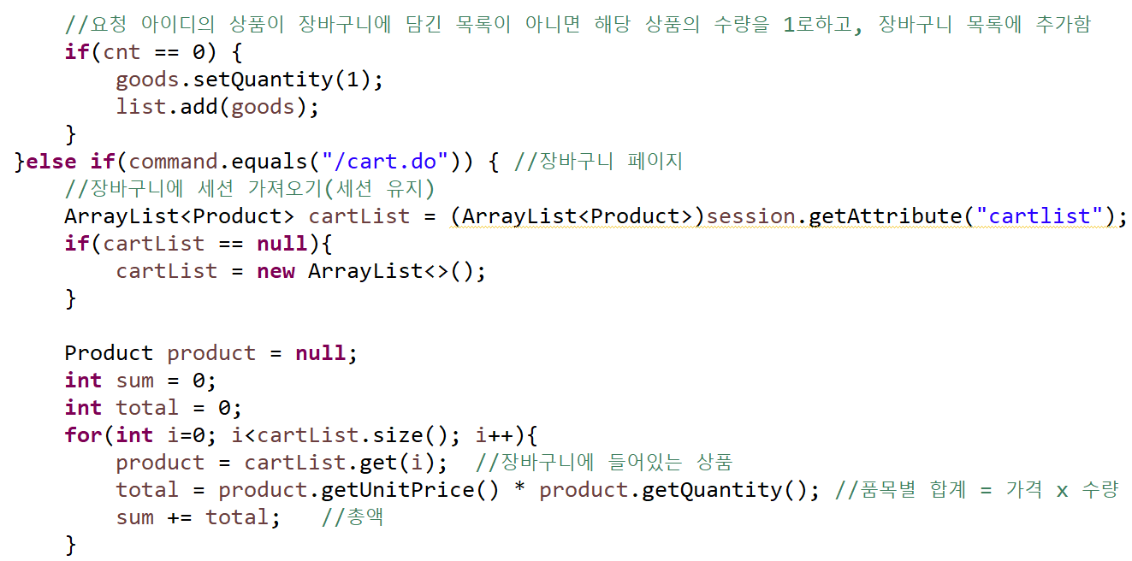
MainController

Slide 21
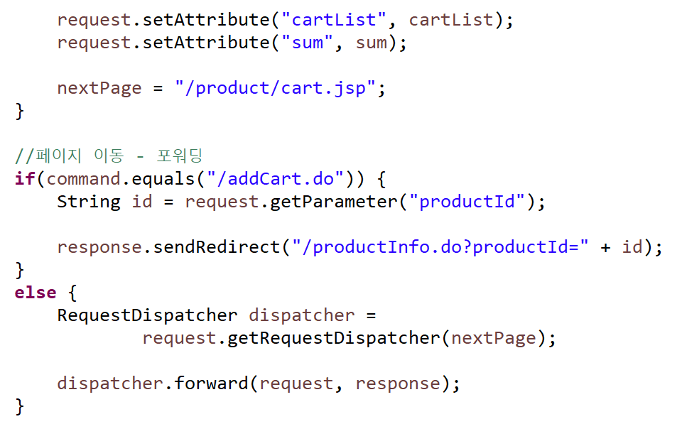
MainController

Slide 22
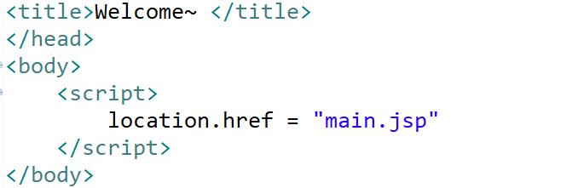
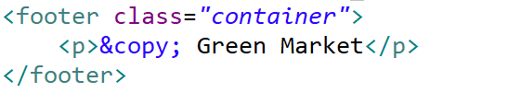
Web Shopping Mall
index.jsp
footer.jsp

Slide 23
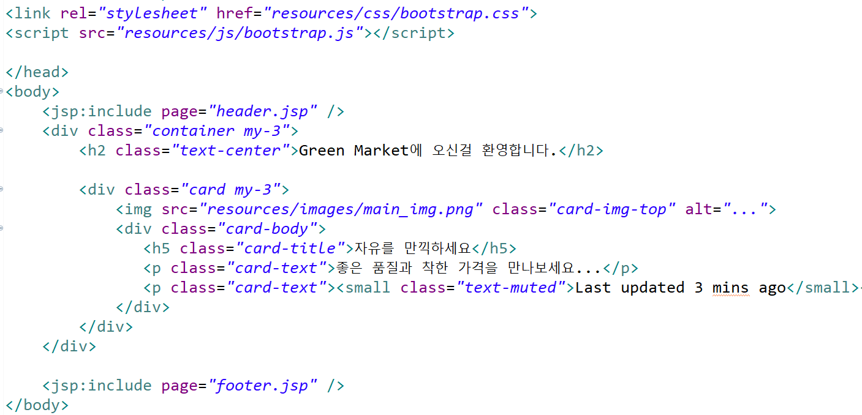
Web Shopping Mall
main.jsp

Slide 24
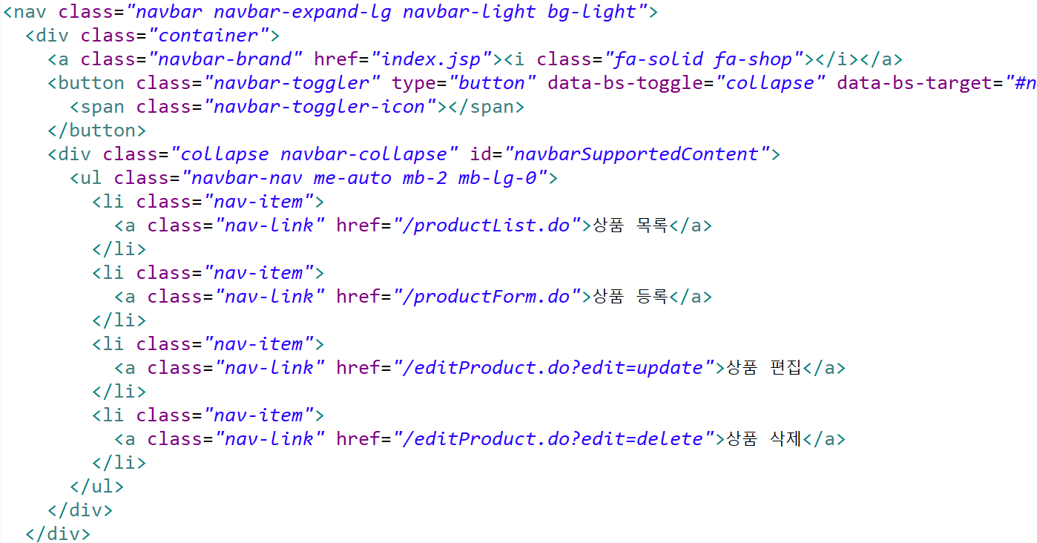
Web Shopping Mall
header.jsp

Slide 25
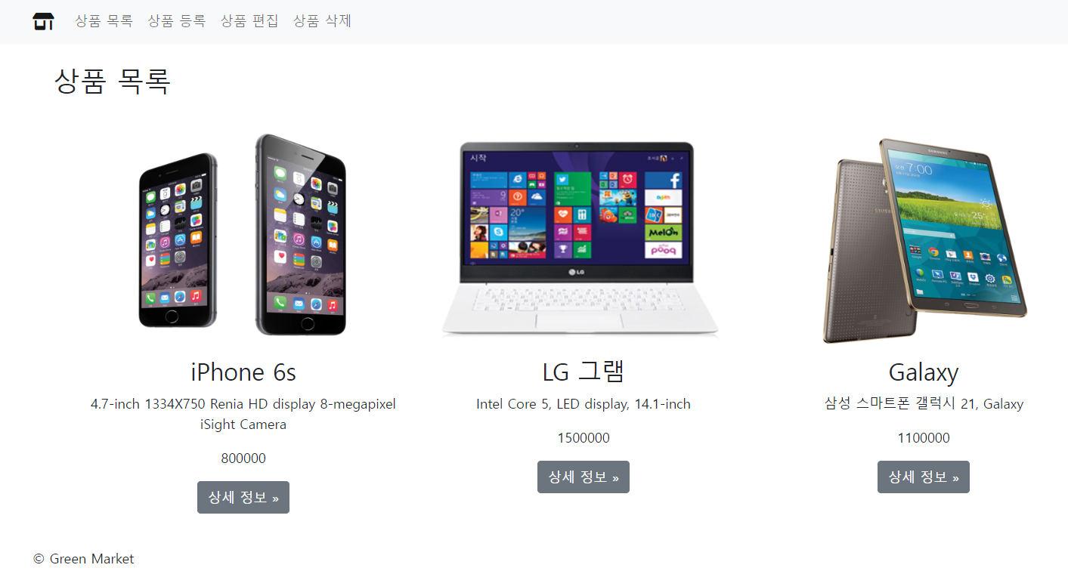
Web Shopping Mall

Slide 26
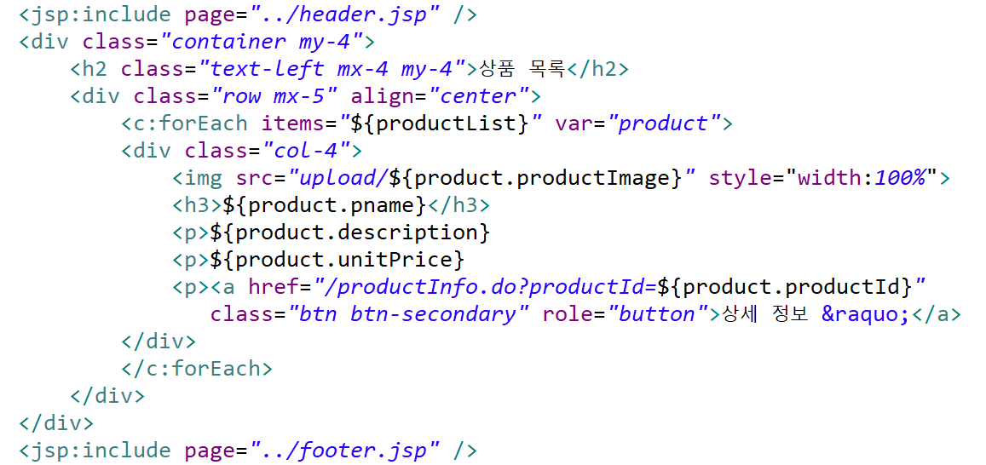
Web Shopping Mall
productList.jsp

Slide 27
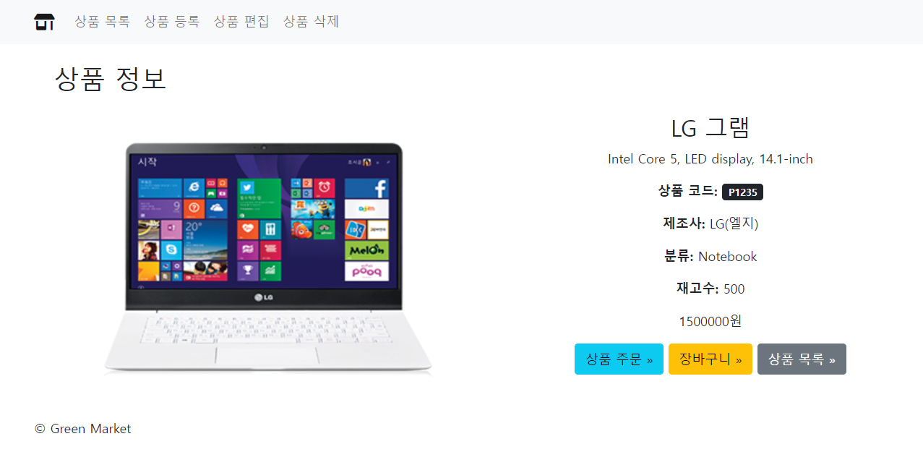
Web Shopping Mall

Slide 28
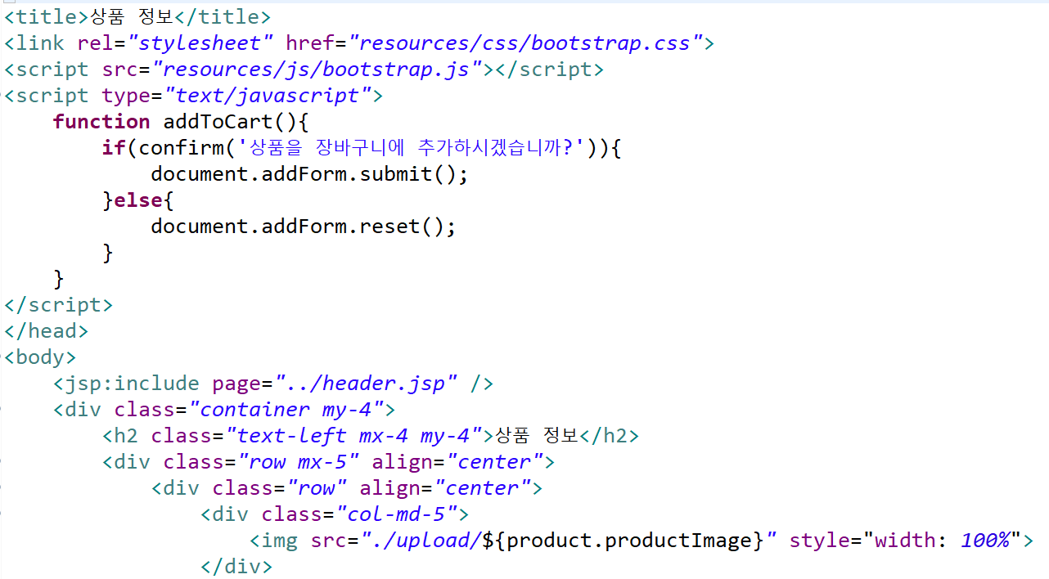
Web Shopping Mall
productInfo.jsp

Slide 29
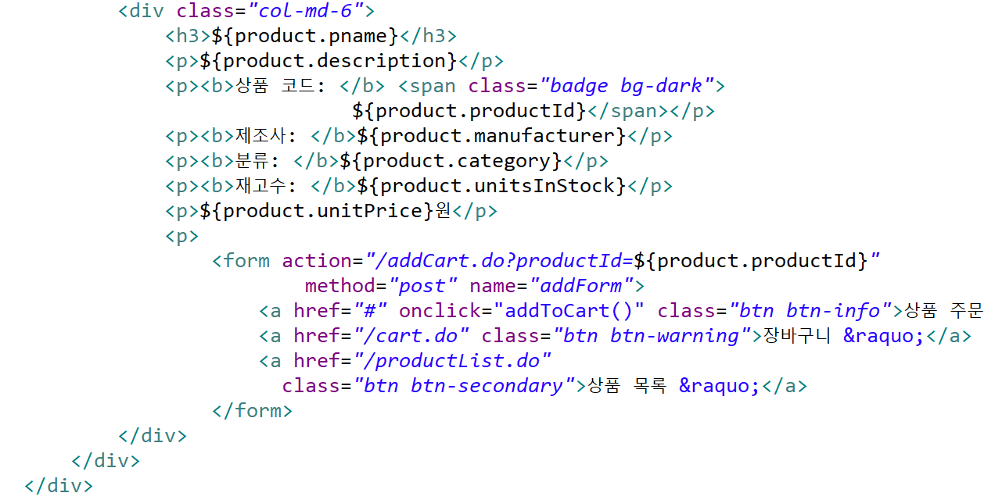
Web Shopping Mall
productInfo.jsp

Slide 30
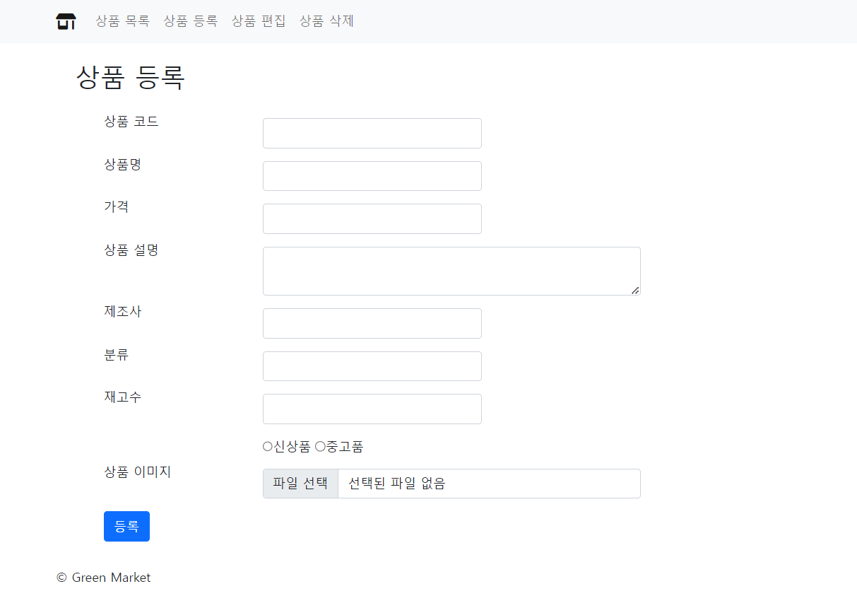
Web Shopping Mall

Slide 31
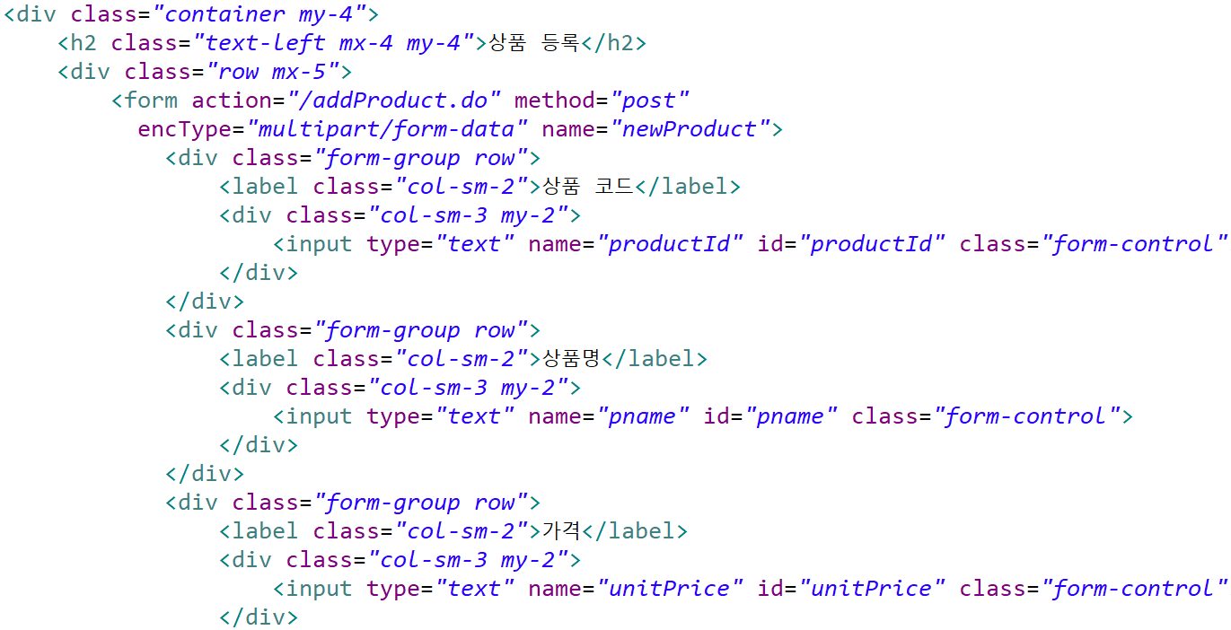
Web Shopping Mall
productForm.jsp

Slide 32
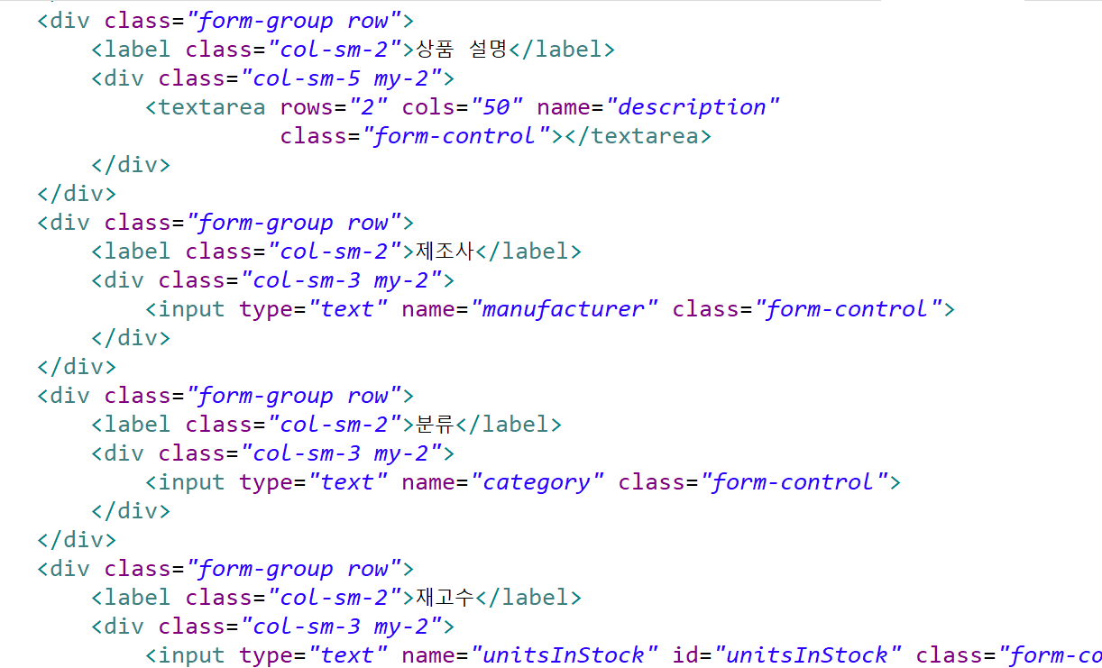
Web Shopping Mall
productForm.jsp

Slide 33
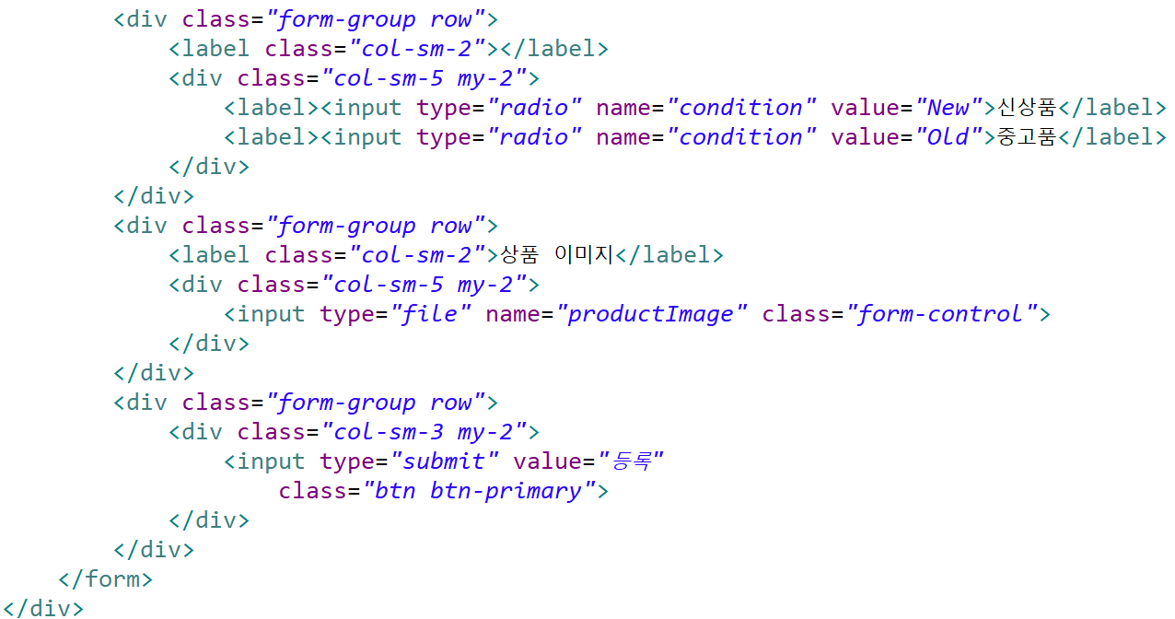
Web Shopping Mall
productForm.jsp

Slide 34
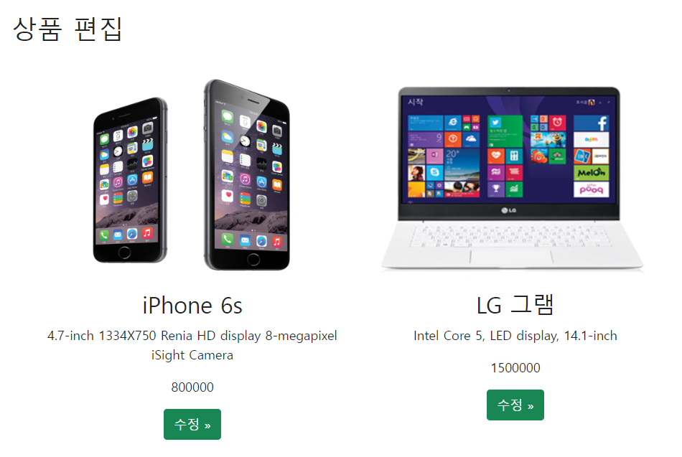
Web Shopping Mall

Slide 35
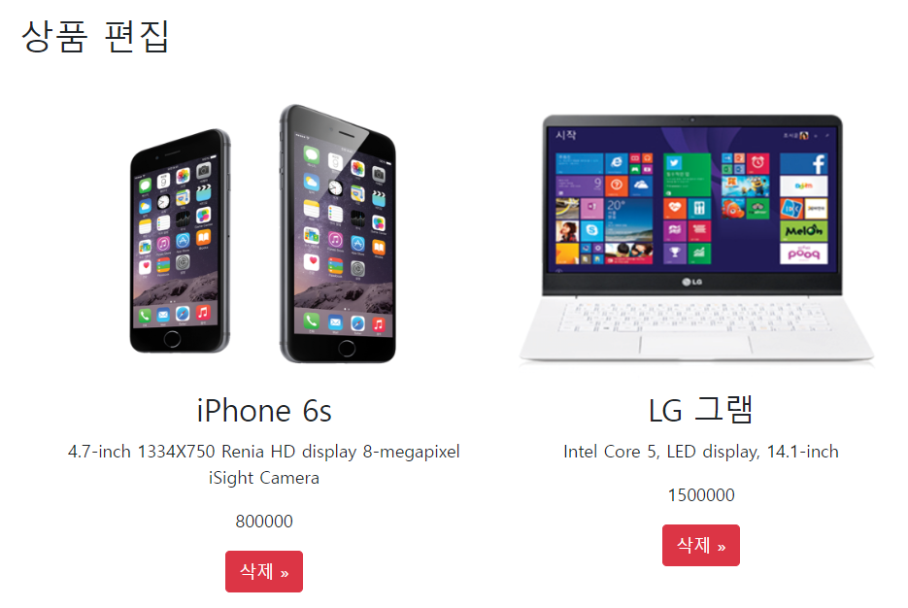
Web Shopping Mall

Slide 36
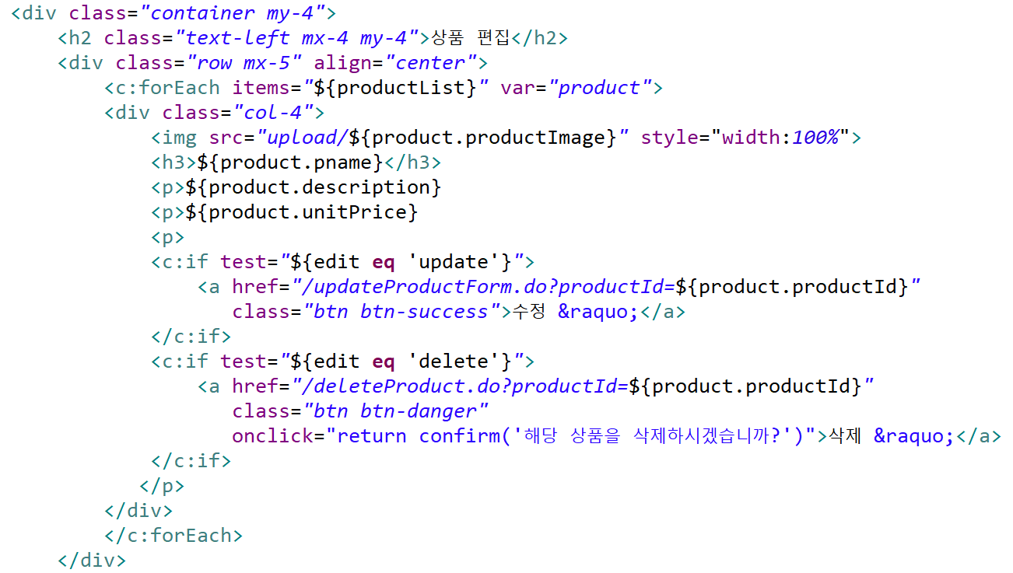
Web Shopping Mall
editProduct.jsp

Slide 37
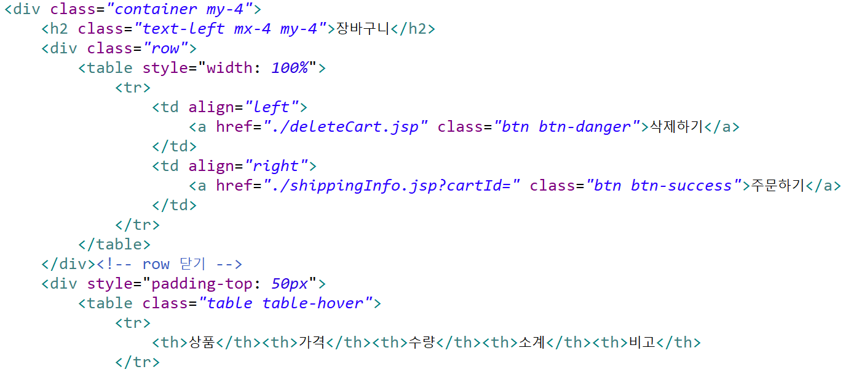
Web Shopping Mall
cart.jsp

Slide 38
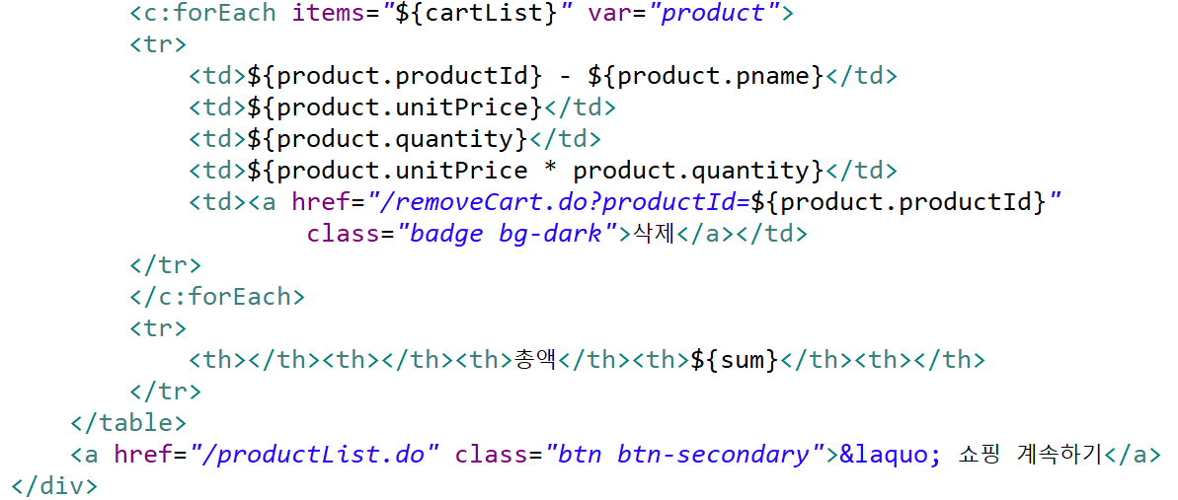
Web Shopping Mall
cart.jsp

Slide 39
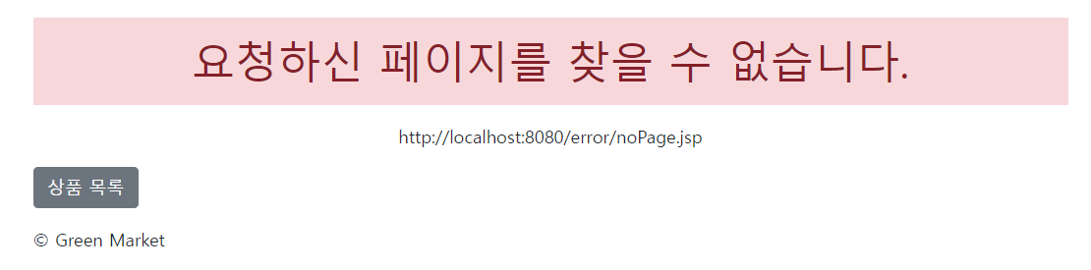
404, 500 에러 처리

Slide 40
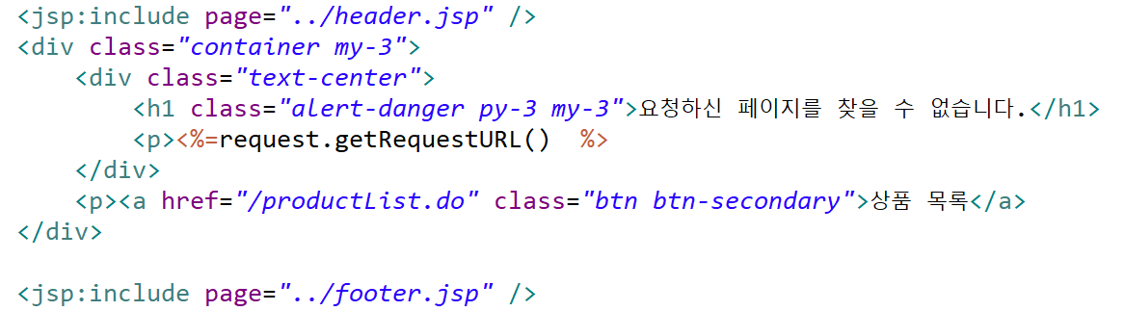
404, 500 에러 처리
errorPage.jsp

Slide 41
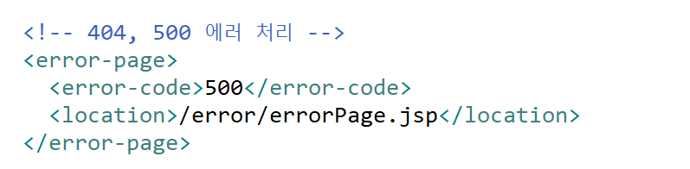
404, 500 에러 처리
web.xml

