Slide 1

WebMarket – 회원
Member

Slide 2
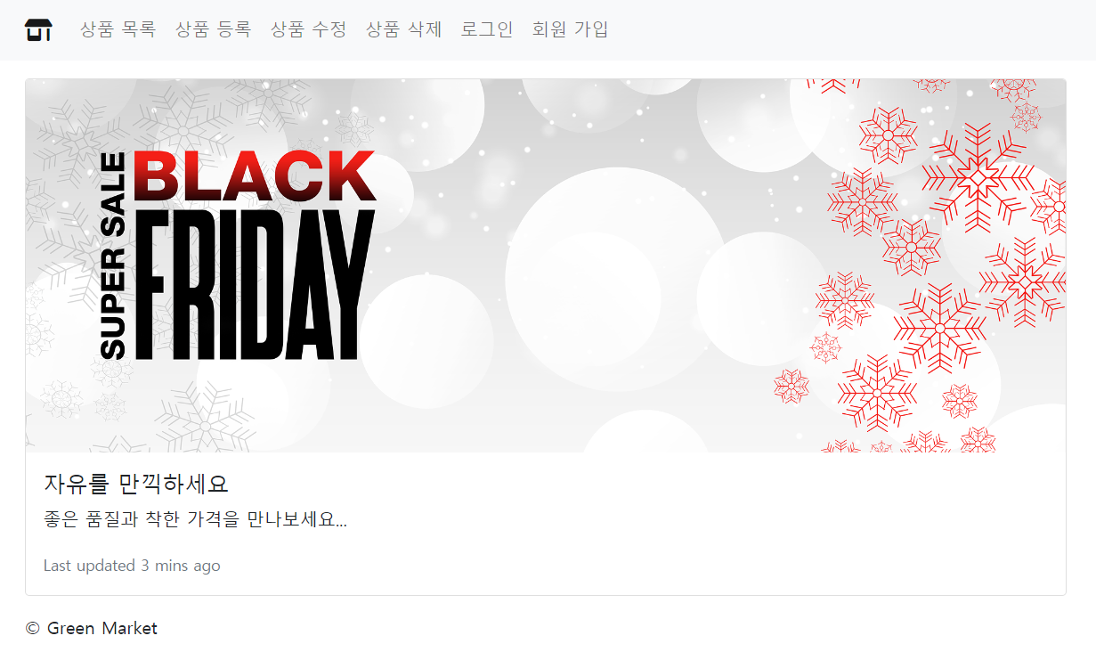
Web Shopping Mall

Slide 3
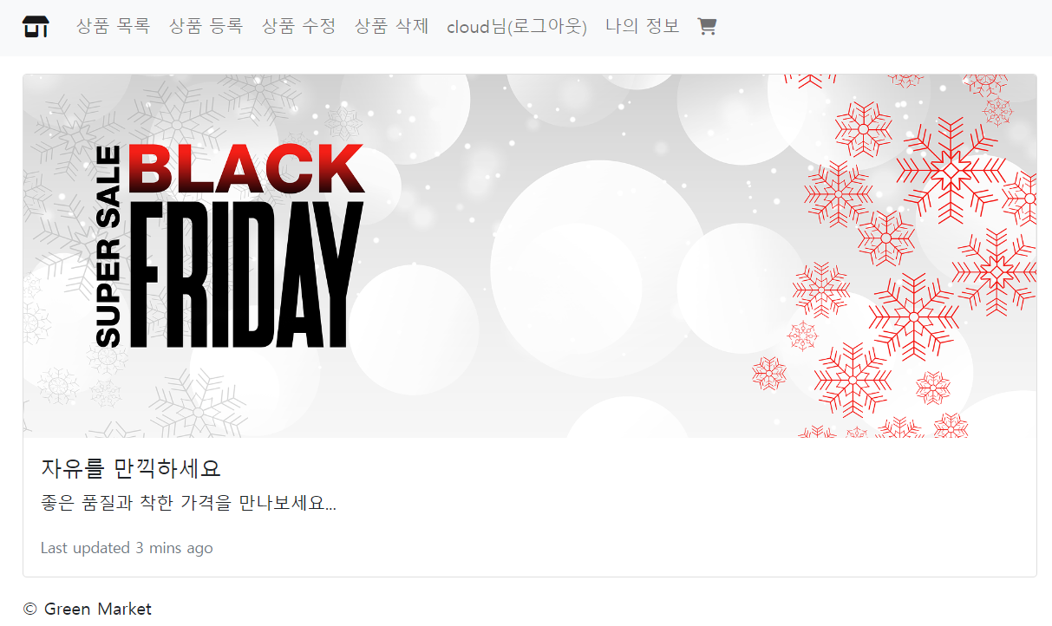
Web Shopping Mall

Slide 4
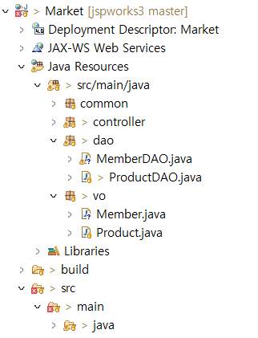
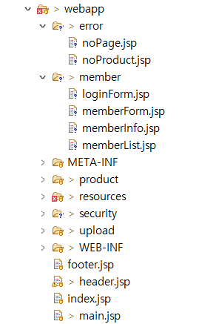
Web Shopping Mall
프로젝트 계층 구조 – 회원 구현

Slide 5
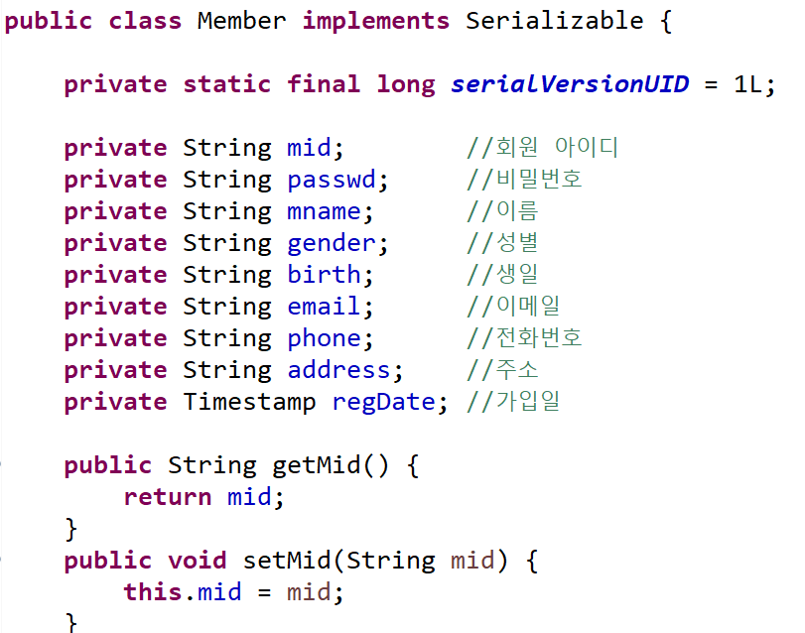
Member Class
회원 클래스(VO)

Slide 6
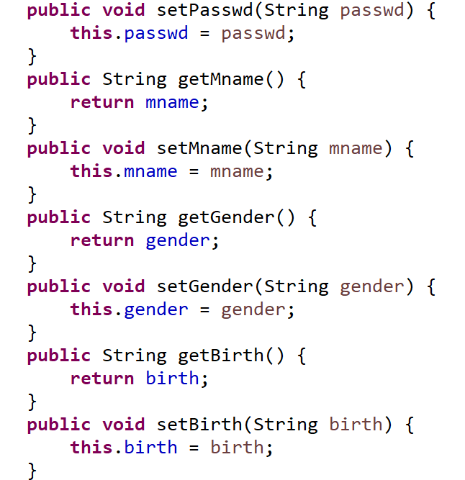
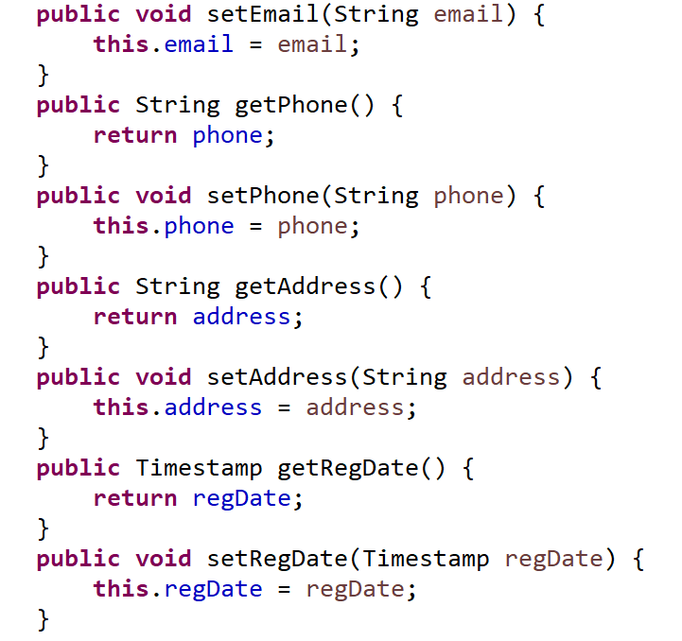
Member Class
회원 클래스(VO)

Slide 7
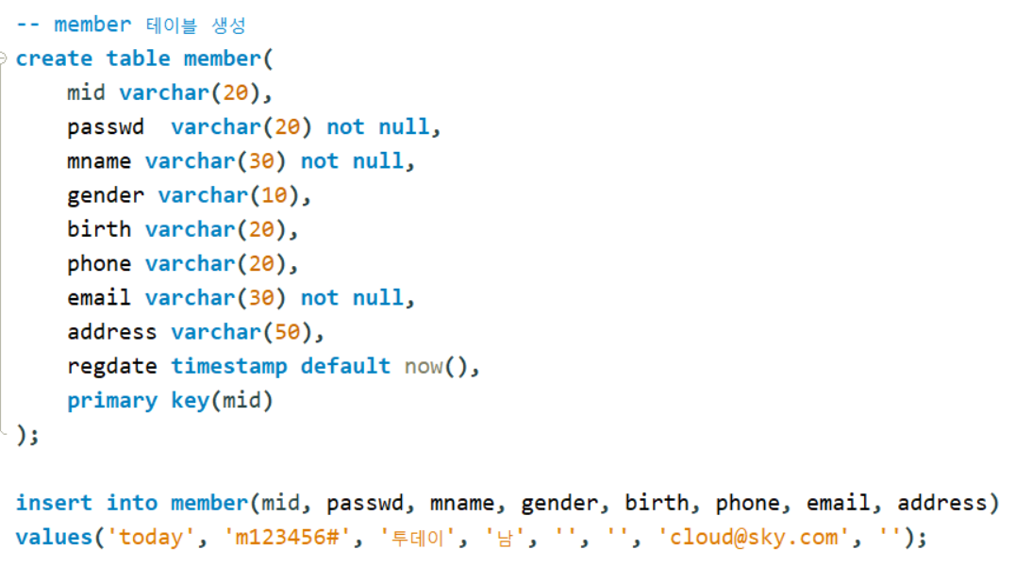
MySQL 데이터 베이스
회원 테이블 생성

Slide 8
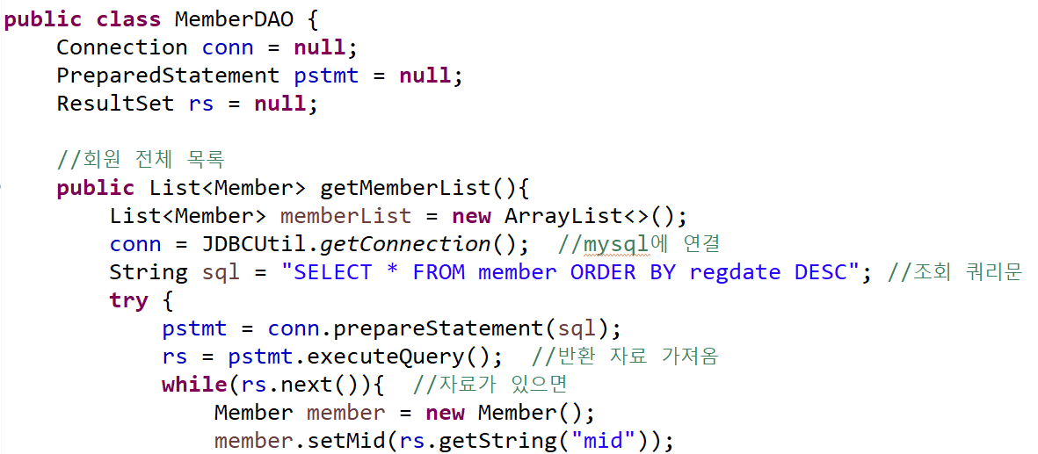
MemberDAO Class
회원 관리 클래스(DAO)

Slide 9
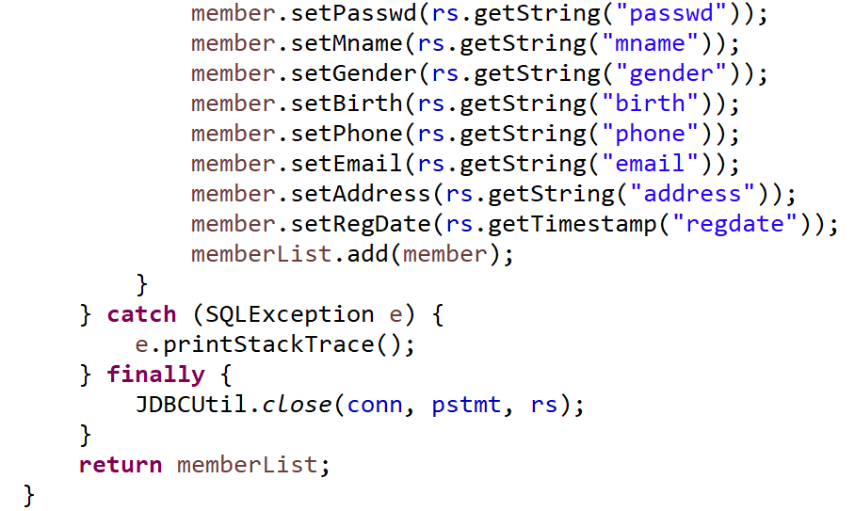
MemberDAO Class

Slide 10
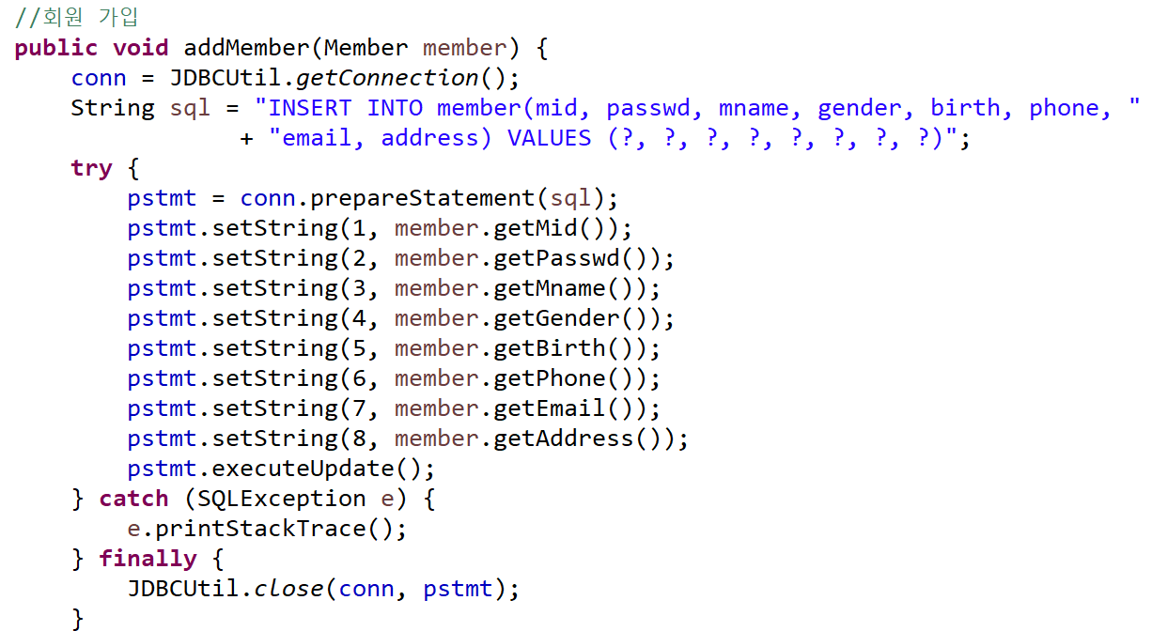
MemberDAO Class

Slide 11
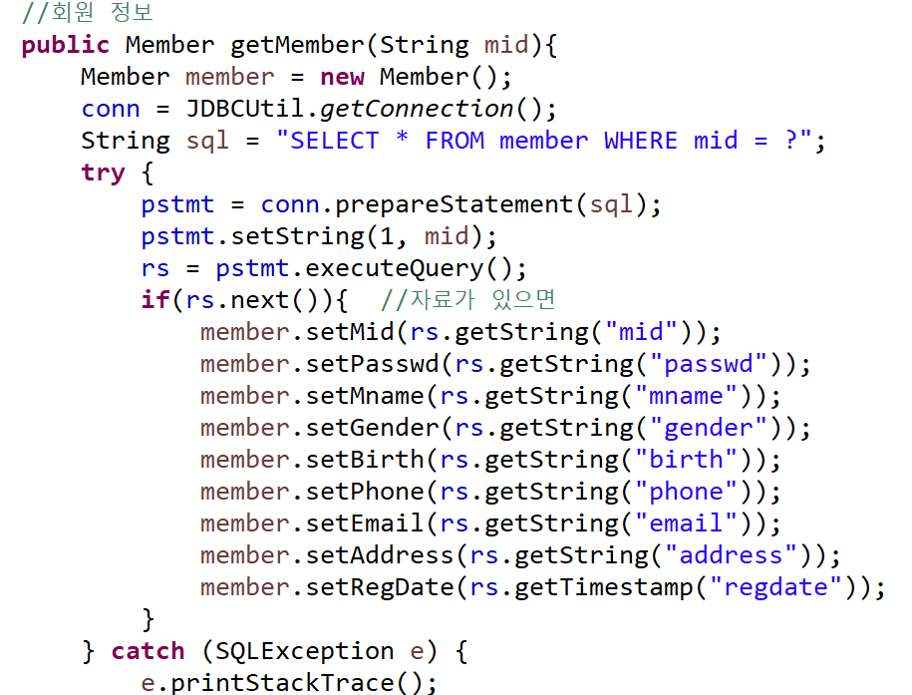
MemberDAO Class

Slide 12
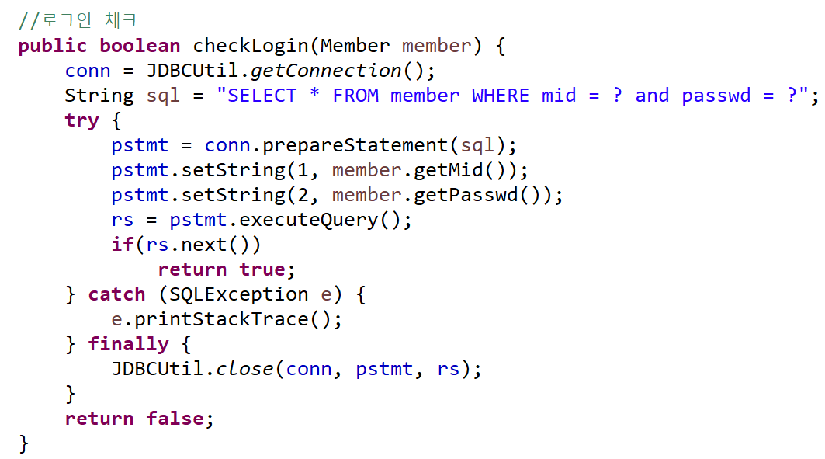
MemberDAO Class

Slide 13
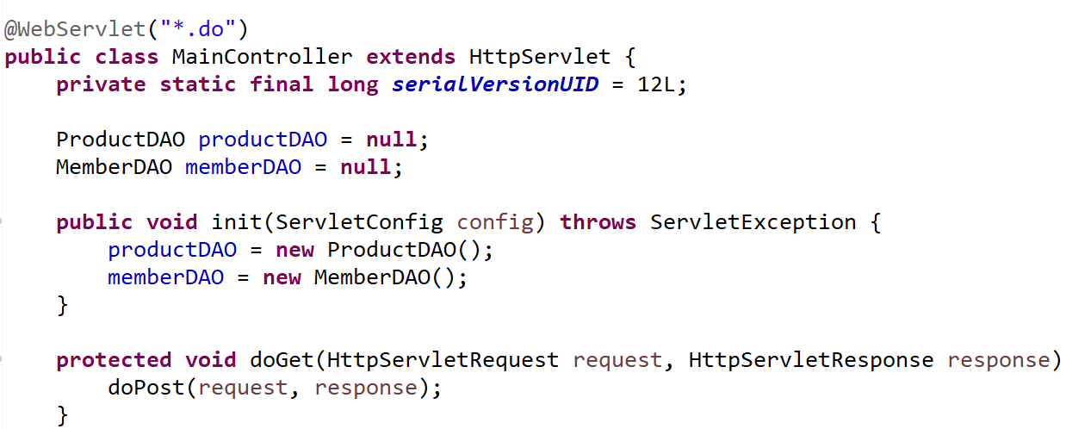
MainController
Controller – 서블릿(Servlet)

Slide 14
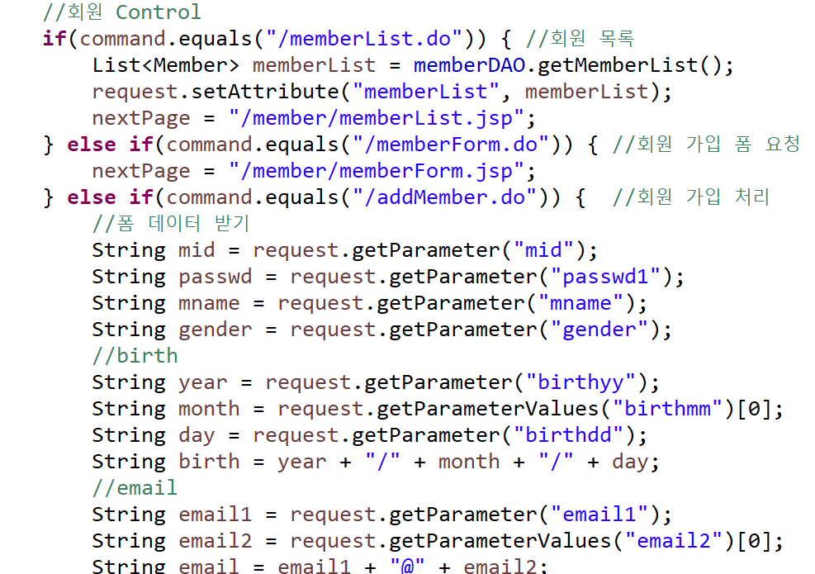
MainController

Slide 15
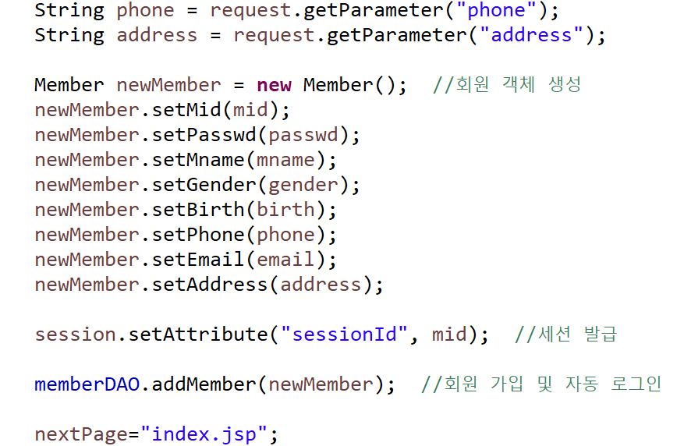
MainController

Slide 16
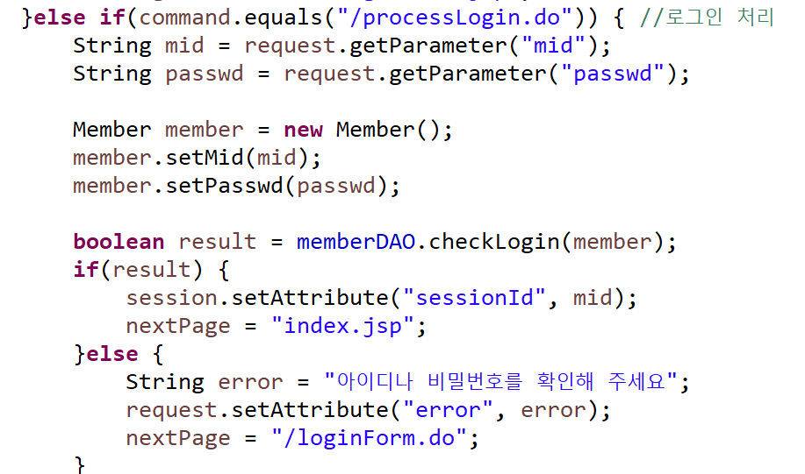
MainController

Slide 17
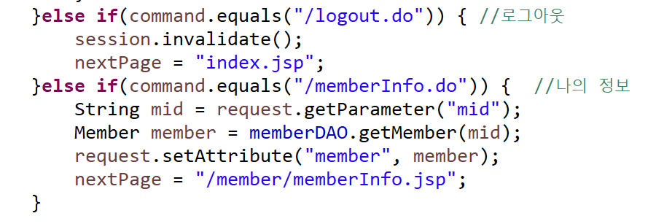
MainController

Slide 18
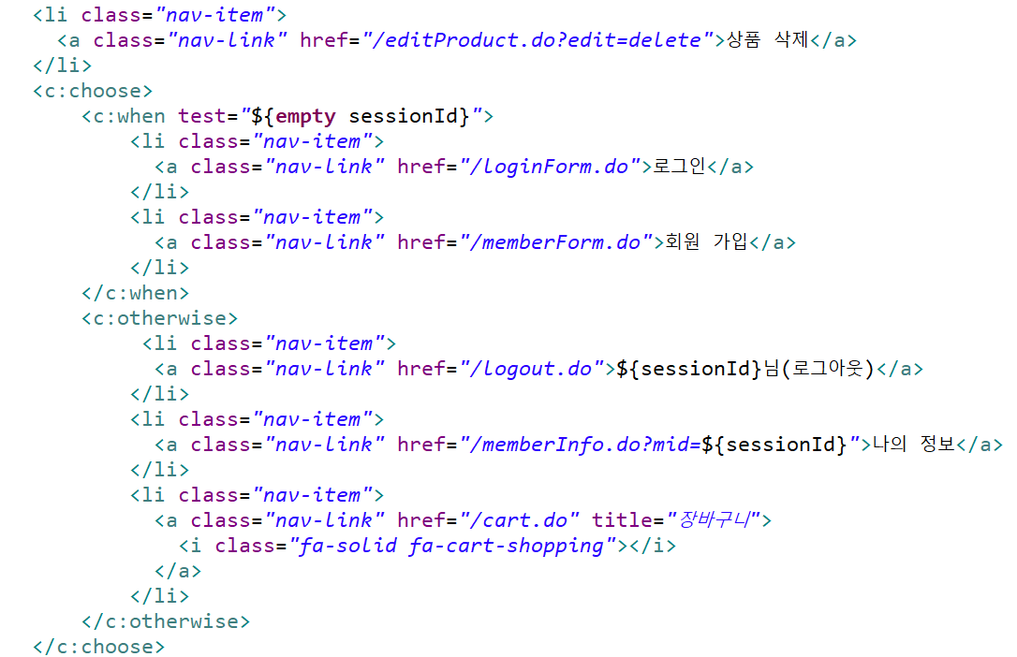
Web Shopping Mall
header.jsp

Slide 19
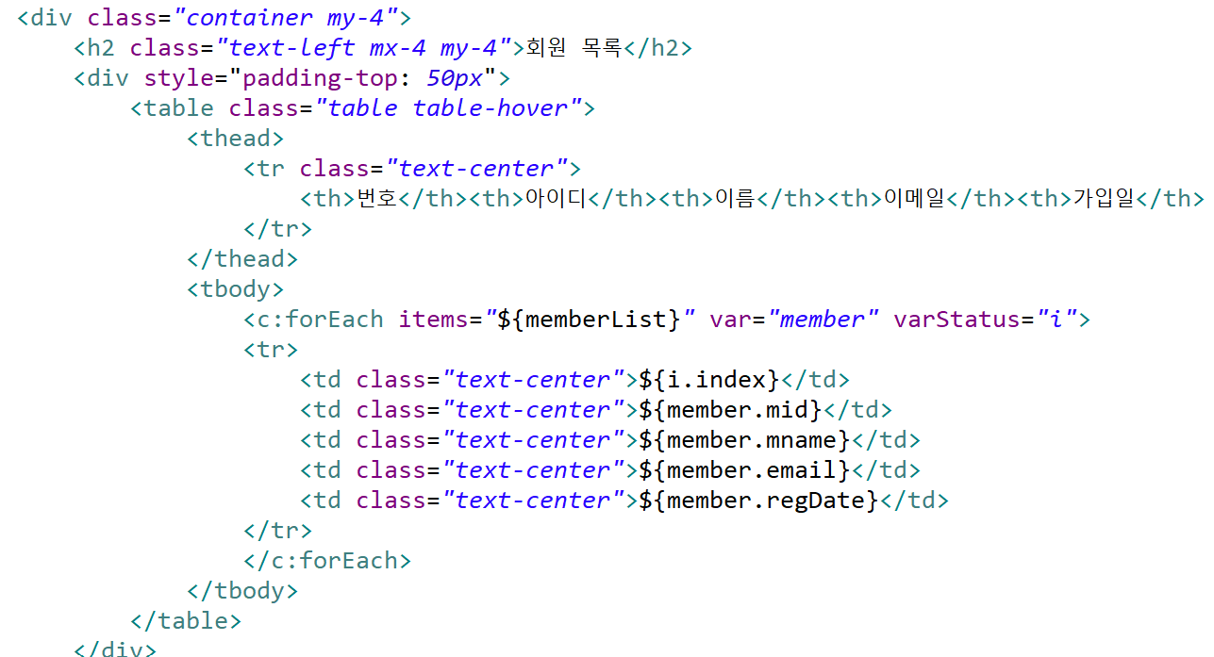
Web Shopping Mall
memberList.jsp

Slide 20
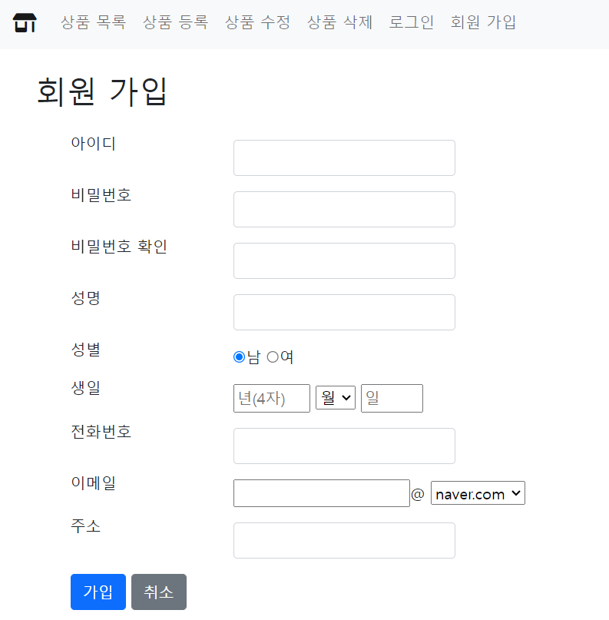
Web Shopping Mall

Slide 21
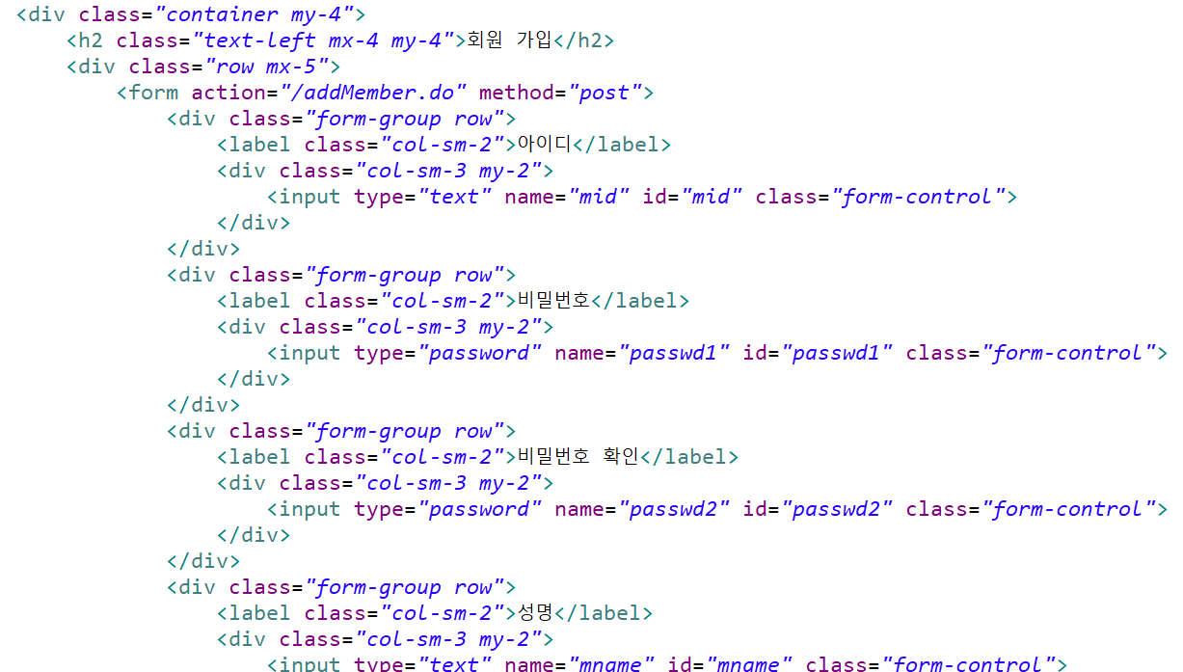
Web Shopping Mall
memberForm.jsp

Slide 22
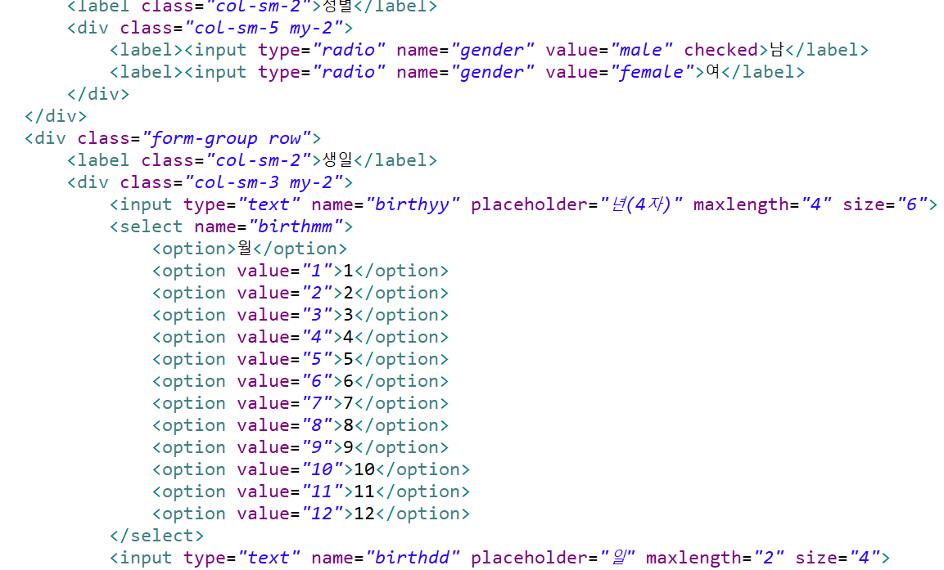
Web Shopping Mall

Slide 23
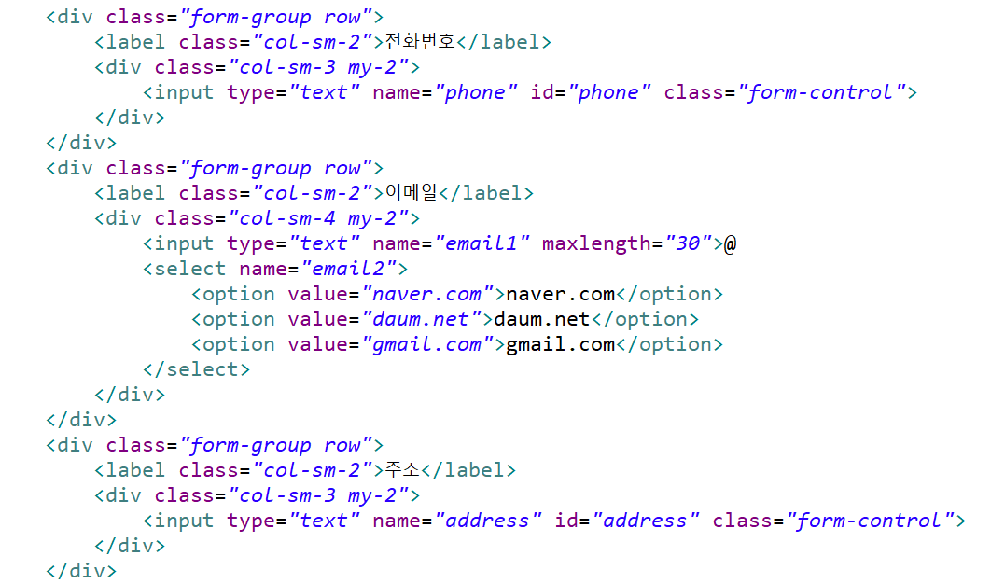
Web Shopping Mall

Slide 24
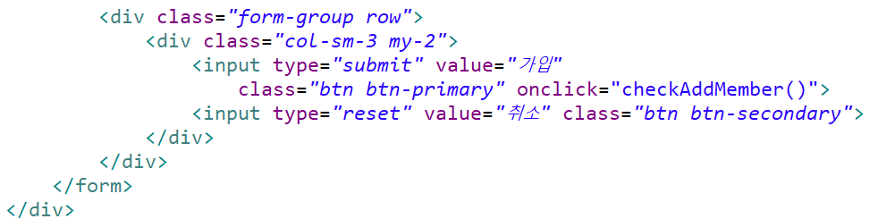
Web Shopping Mall

Slide 25
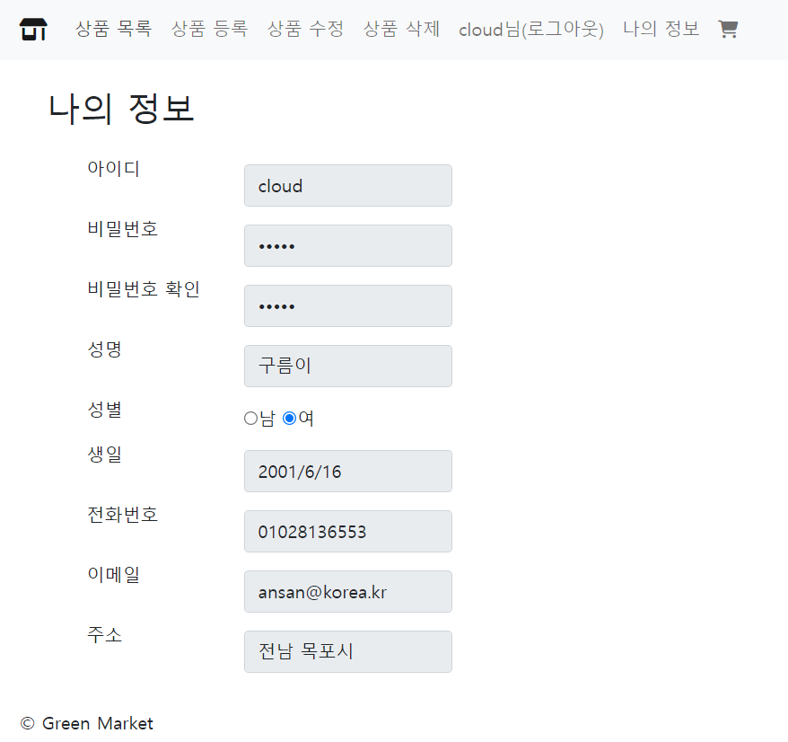
Web Shopping Mall

Slide 26
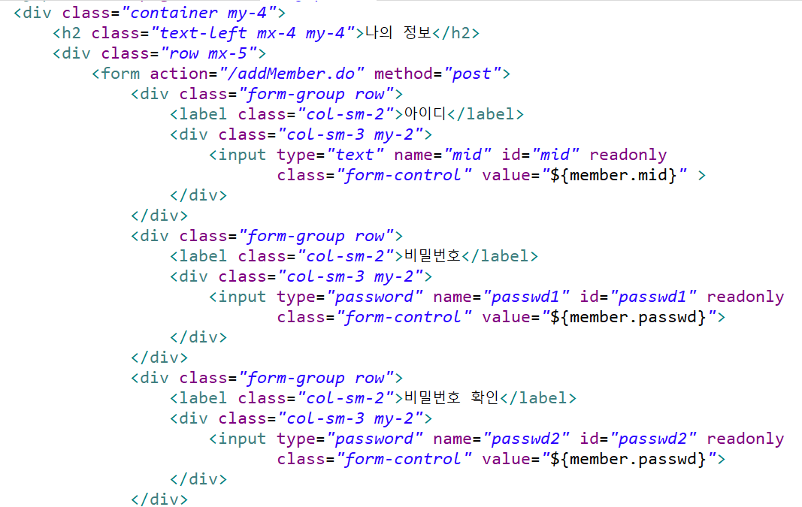
Web Shopping Mall
memberInfo.jsp

Slide 27
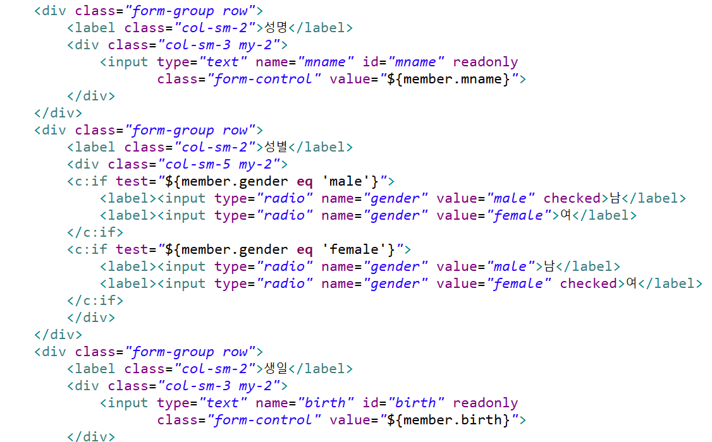
Web Shopping Mall

Slide 28
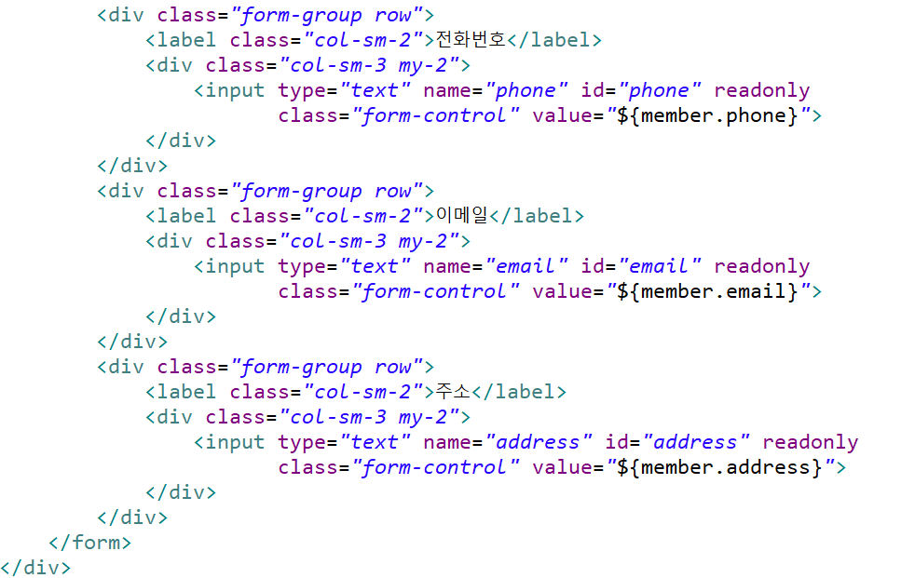
Web Shopping Mall

Slide 29
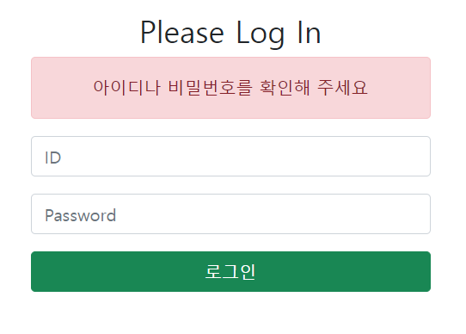
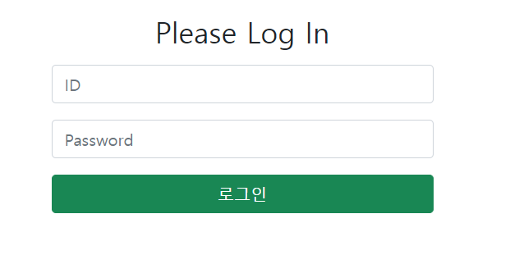
Web Shopping Mall

Slide 30
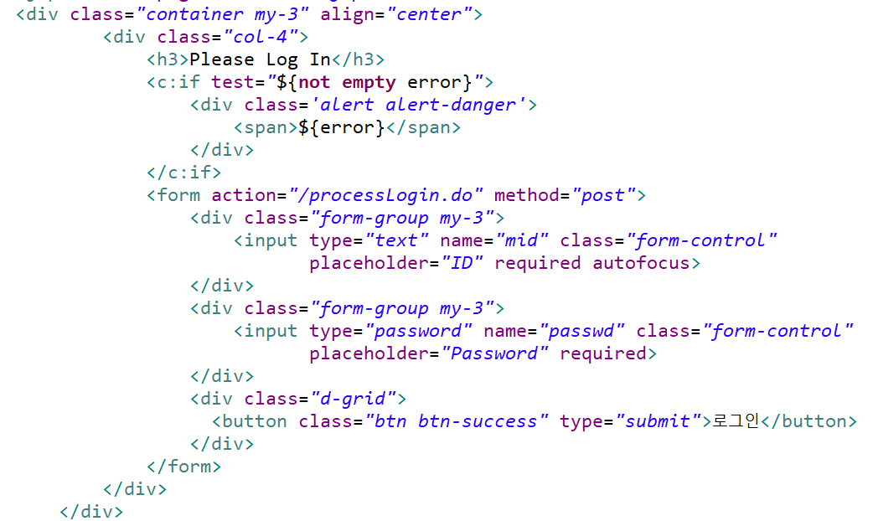
Web Shopping Mall
loginForm.jsp

