Slide 1

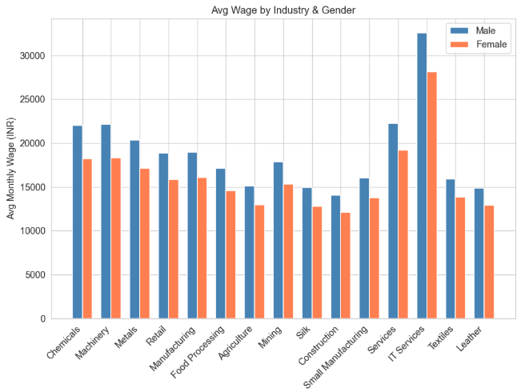
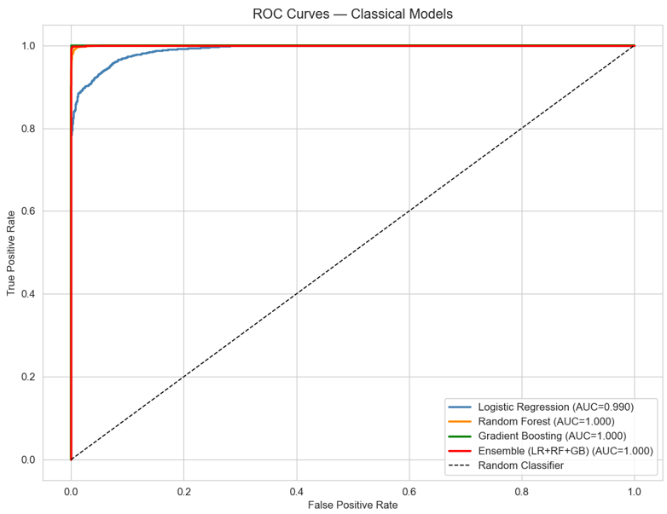
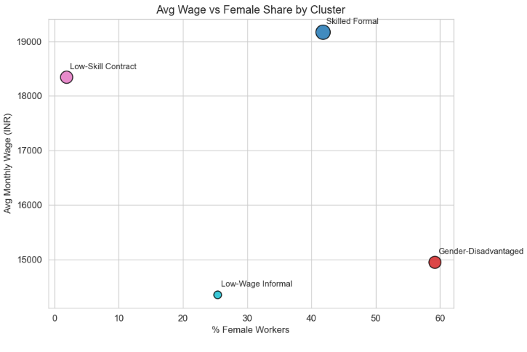
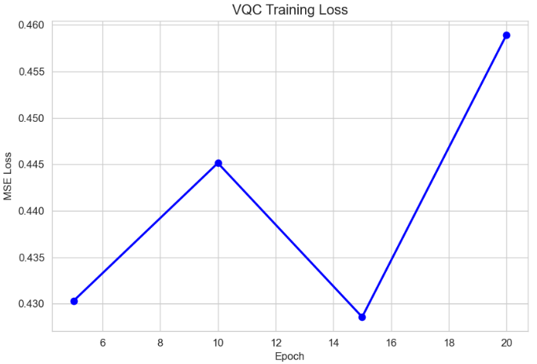
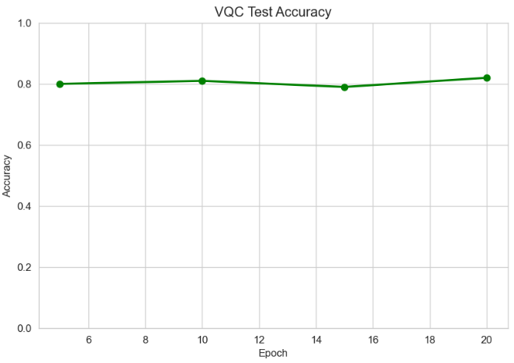
AI-Driven Detection of Wage Inefficiencies in Indian Industries
School of Computer Science and Engineering – Winter Semester 2025 - 26
Introduction
Results
Indian labour sectors face wage disparities due to weak enforcement and inefficient manual audits, creating a need for scalable, data-driven solutions. Existing work uses ML and legal NLP to analyse wage patterns but faces challenges in interpretability and data limitations. Key gaps include lack of end-to-end violation detection, enforcement factors and reliable policy diagnostics.
The developed system successfully identified underpaid workers by comparing actual wages with predicted fair wages. Classical ML models achieved strong baseline performance, while the Quantum ML model captured more complex feature interactions. The QML model showed comparable or slightly improved predictive accuracy in specific scenarios. Key factors influencing wage disparities included experience, skill level, industry type and region. The system provided interpretable insights into why workers were underpaid, supporting better decision-making. Overall, the results demonstrate the feasibility of using AII and QML for scalable and data-driven wage gap analysis.
Gender wage gap analysis – Equal Remuneration Act, 1976
Motivation
Motivated by the need for a transparent and scalable system to detect wage inefficiencies beyond manual audits. Aims to improve trust and fairness by combining explainable AI with Quantum ML for better wage analysis.
Scope of the Project
The project focuses on developing an AI-driven system to analyse wage data and detect compensation gaps across Indian industries. It uses classical, ensemble and hybrid quantum-classical models to predict fair wages and compare performance. The system emphasizes fairness evaluation and model explainability. It is deployed as a web-based tool to support data-driven wage policy decisions without replacing legal processes.
Methodology
The system is structured into modular components covering data collection, preprocessing and exploratory analysis to prepare and understand wage datasets. Baseline and ensemble ML models are implemented to predict fair wages and analyse performance improvements. A fairness evaluation module ensures bias detection, while an explainability module interprets model decisions. A Quantum Machine Learning module explores hybrid quantum-classical approaches for advanced prediction capabilities. Finally, reporting and visualisation modules present insights, wage gap detection results and recommendations through user-friendly dashboards.
ROC Curves
Quantum Clustering – Inequality Worker Profiles
Quantum ML Training Curves
Conclusion
The project demonstrates that AI-based models can effectively identify wage inefficiencies by analysing labour data with quantum ML model capturing complex relationships beyond classical approaches. The results support the hypothesis that integrating QML enhances prediction depth and fairness in wage analysis. Key insights highlight the role of multiple socio-economic factors influencing wage disparities. Future work can focus on larger datasets, real-time deployment and improved quantum models for scalable and accurate wage monitoring.
References
The body text / font size should be between 24 and 32 points. Calibri font
Demo Video Link:
Paste the QR code of demo video link here. Should be accessible by anyone.
Student Reg. No, Name: (22BCE0984)Preeti Ambwani, (22BKT0100) Shreeya Srivastava
Guide Name: Prof. Shalini L.

