Slide 1
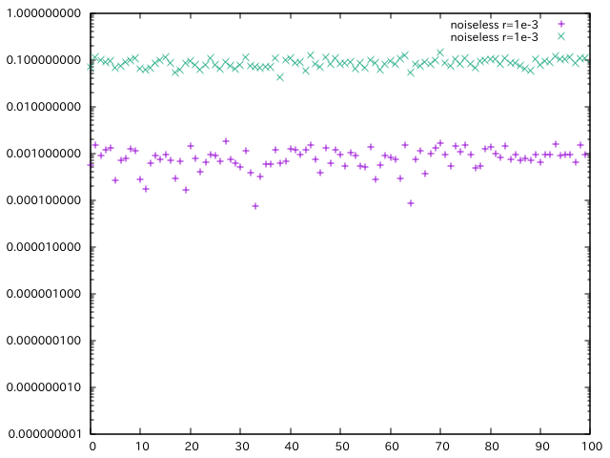
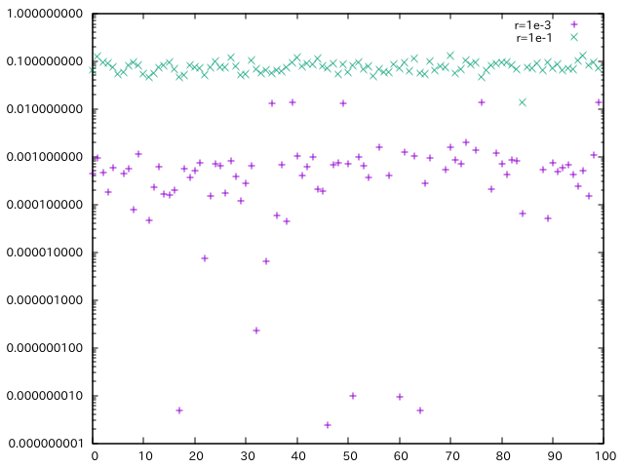
Noiseless & with Noise
140 (5.9muKarcmin), 280GHz (6.8muKarcmin)
Power-law dust without directional variation
r=1e-1, 1e-3
ノイズ無し
ノイズ有り

