Slide 1
Chapter 3-Processes
Agmas G.

Slide 2
Introduction
Process is a program in execution
Process ≠ program
The program is only part of a process;
One program can be several processes
Components of a process
The program code, also called text section
Current activity including
program counter, processor registers
Stack containing temporary data
Function parameters, return addresses, local variables
Data section containing global variables
Heap :- a memory that is dynamically allocated during run time

Slide 3
Thread
Thread is a basic unit of CPU utilization;
Belongs to a process
Is a flow of control within a process
consists of a program counter (PC), a register set, and a stack
A process can have a single or multiple thread

Slide 4
Basic idea of Thread
We build virtual processors in software, on top of physical processors:
Processor: Provides a set of instructions along with the capability of automatically executing a series of those instructions.
Thread: A minimal software processor in whose context a series of instructions can be executed. Saving a thread context implies stopping the current execution and saving all the data needed to continue the execution at a later stage.
Process: A software processor in whose context one or more threads may be executed. Executing a thread, means executing a series of instructions in the context of that thread.

Slide 5
Context Switching
A technique used for pausing what the system is doing and taking on another “possibly” urgent job.
Save the context of the current job so that it can resume back from where it has left off
Load the context of the new job
Context switching is an overhead
Processor context: The minimal collection of values stored in the registers of a processor used for the execution of a series of instructions (e.g., stack pointer, addressing registers, program counter).
Allows to handle interrupt and resume back later on
Thread context: The minimal collection of values stored in registers and memory, used for the execution of a series of instructions (i.e., processor context, state).
Process context: The minimal collection of values stored in registers and memory, used for the execution of a thread (i.e., thread context, but now also at least MMU register values).

Slide 6
Observations
Threads share the same address space.
Thread context switching can be done entirely independent of the operating system.
Process switching is generally more expensive
As it involves getting the OS in the loop, i.e., trapping to the kernel.
Creating and destroying threads is much cheaper than doing so for processes.

Slide 7
Why use threads
Some simple reasons
Avoid needless blocking: a single-threaded process will block when doing I/O; in a multi-threaded process, the operating system can switch the CPU to another thread in that process.
Exploit parallelism: the threads in a multi-threaded process can be scheduled to run in parallel on a multiprocessor or multicore processor.
Avoid process switching: structure large applications not as a collection of processes, but through multiple threads.

Slide 8
Thread Implementation
Threads are generally provided in the form of a thread package.
Thread package contains:
Operations to create and destroy threads.
Operations on synchronization variables (mutexes and conditional variables).
Three approaches to thread package implementation:
User-Level Solution
Kernel-Level Solution
Lightweight Process (LWP) Solution

Slide 9
User level solution
All operations can be completely handled within a single process.
All services provided by the kernel are done on behalf of the process in which a thread resides.
Pros:
Cheap to create and destroy threads.
Because all thread administration is kept in the user’s address space,
The price of creating a thread is primarily determined by the cost for allocating memory to set up a thread stack.
Analogously, destroying a thread mainly involves freeing memory for the stack, which is no longer used.
Both operations are cheap.
Fast thread context switching.
Cons:
If the kernel decides to block a thread, then entire process will be blocked.
Threads are used when there are lots of external events: (threads block on a per-event basis ) if the kernel can’t distinguish threads, how can it support signaling events to them?

Slide 10
Kernel-level solution
The whole idea is to have the kernel contain the implementation of a thread package.
All operations return as system calls -> results in user-space to kernel-space context switch (Expensive)
Pros:
Operations that block a thread are no longer a problem:
The kernel schedules another available thread within the same process.
External events are simple: the kernel (which catches all events) schedules the thread associated with the event.

Slide 11
Cont…
Cons:
Expensive:
Every thread operation (creation, deletion, synchronization, etc.) will have to be carried out by the kernel.
Thread context switching may become as expensive as process context switching.
Another Solution:
Mixing user-level and kernel-level threads into a single concept.
Light-weight process
The performance gain is compromised by its complexity

Slide 12
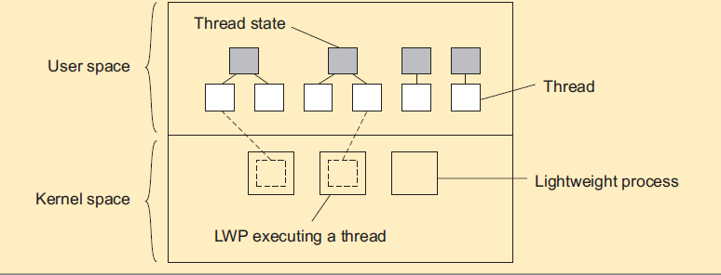
Lightweight processes
Basic idea
Introduce a two-level threading approach: lightweight processes that can execute user-level threads.

Slide 13
Principle operation
User-level thread does system call => the LWP that is executing that thread, blocks. The thread remains bound to the LWP.
The kernel can schedule another LWP having a runnable thread bound to it. Note: this thread can switch to any other runnable thread currently in user space.
A thread calls a blocking user-level operation => do context switch to a runnable thread, (then bound to the same LWP).
When there are no threads to schedule, an LWP may remain idle, and may even be removed (destroyed) by the kernel.
Note: This concept has been virtually abandoned – it’s just either user-level or kernel-level threads.

Slide 14
Threads in Distributed Systems
Threads allow blocking calls with out blocking the entire process
This makes them interesting to be used by both clients and servers in distributed system
Multi-threaded client use threads to realize distribution transparency
Example web browsers use threads to hide communication /network latency
Different parts that make up a page are fetched by different threads
Start displaying data while it is still coming in
Displays text till images and videos arrived

Slide 15
Cont…
Multiple request-response calls to other machines (RPC)
A client does several calls at the same time, each one by a different thread.
It then waits until all results have been returned.
Note: if calls are to different servers, we may have a linear speed-up.

Slide 16
Multi-threaded servers
An important use of multithreading in distributed systems is at the server side.
Main issues are:
Improving performance
Starting a thread to handle an incoming request is much cheaper than starting a process.
Exploits parallelism to attain high performance.
Single-threaded server can’t take advantage of multiprocessor.
Hides network latency.
Other work can be done while a request is coming in.
Better structure
Multithreaded programs tend to be easier to understand due to simplified flow of control.

Slide 17
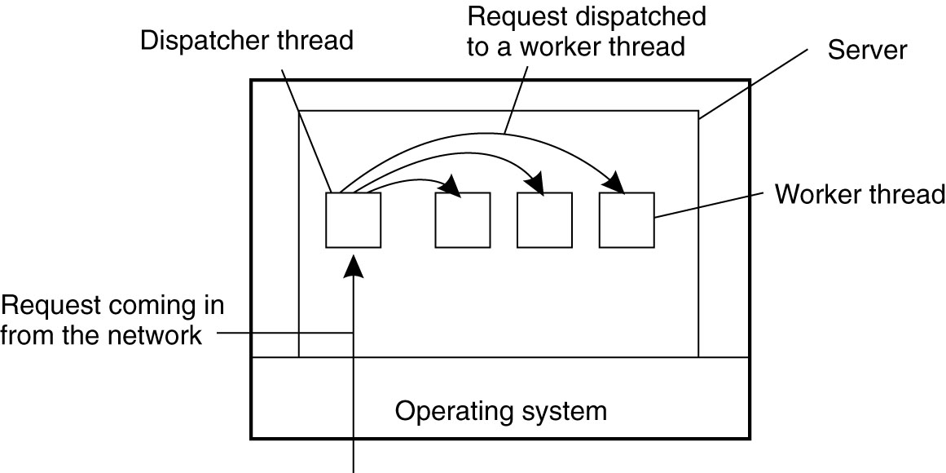
Multithreaded Servers
A popular multithreaded server organization is dispatcher/worker model.
Dispatcher thread reads incoming requests.
Worker thread is selected by the server to process a request.
Figure. A multithreaded server organized in a dispatcher/worker model.

Slide 18
Virtualization
Virtualization refers to the act of creating a virtual (rather than actual ) version of something,
Such as computer hardware platforms, storage devices, and computer network resources.
It is a logical separation of the request for some service from the physical resources that actually provide that service
Why virtualization?
Portability
Liberates applications, system services, and even the OS that supports them from being tied to a specific piece of hardware
Hardware changes faster than software
It allows to focus on logical operating environments rather than physical ones 
Notes:
legacy software is an old and outdated program that is still used to perform a task for a user, even though newer and more efficient options are available.

Slide 19
Cont…
The core idea: provide logical access to physical resources
Some forms of Virtualization
1. Application virtualization
Byte code, Common Intermediate Language (CIL)
2. Desktop virtualization
Thin client
3. Network virtualization
virtual private networks
4. Server or machine virtualization
Virtual Pc, VMWare , Virtualbox

Slide 20
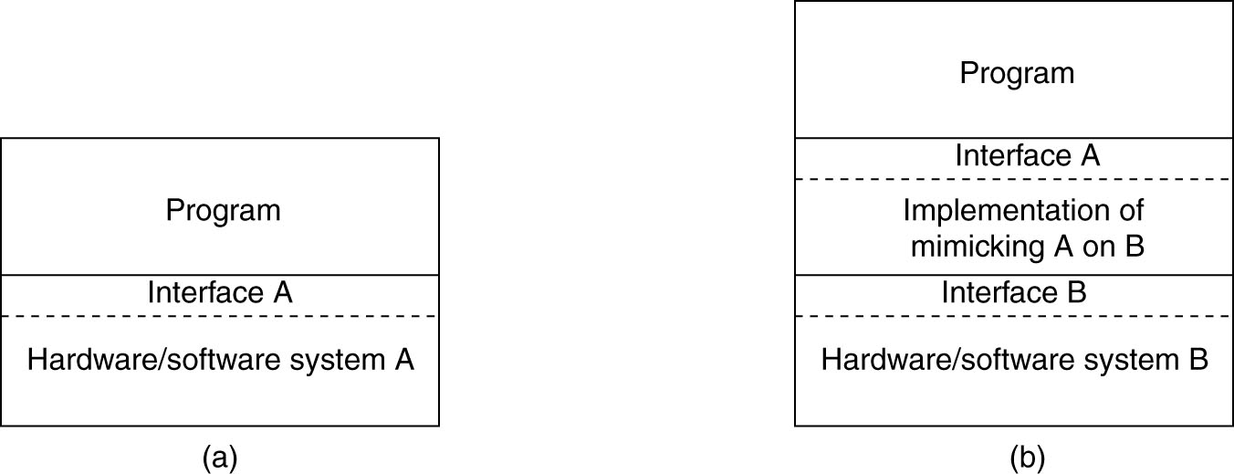
The Role of Virtualization in Distributed Systems
Figure (a) General organization between a program, interface, and system.
(b) General organization of virtualizing system A on top of system B.

Slide 21
Architectures of Virtual Machines
Computer systems often offer four types of interfaces, at three different levels:
An interface between the hardware and software, referred to as the instruction set architecture (ISA), forming the set of machine instructions. This set is divided into two subsets
Privileged instructions, which are allowed to be executed only by the operating system.
General instructions, which can be executed by any program.
An interface consisting of system calls offered by an OS.
An interface consisting of library calls
known as an application programming interface (API).
In many cases, the system calls are hidden by an API.

Slide 22
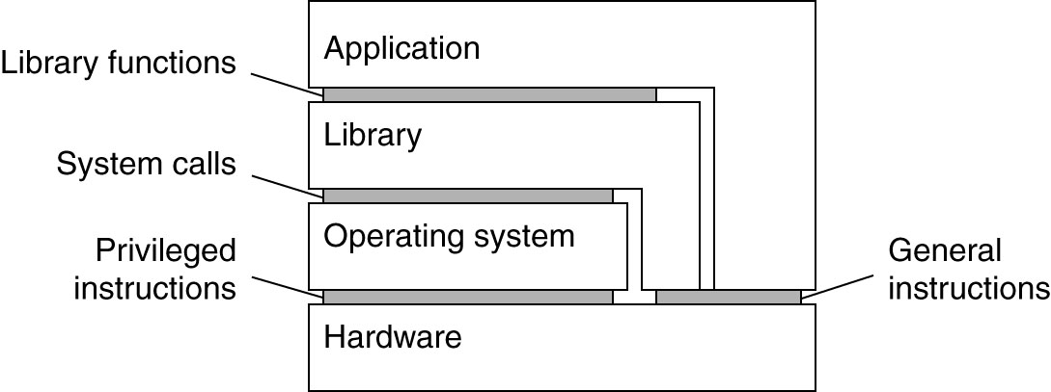
Logic View of the Three Interfaces
Generally, Virtualization can take place at very different levels, strongly depending on the interfaces as offered by various systems components
Figure. Various interfaces offered by computer systems.

Slide 23
Ways of virtualization
Often, virtualization can take place in two different ways
Build runtime system that provides instruction set to be used for executing applications
Instructions can be interpreted (JVM)
Instructions can be emulated (Running Windows applications on Unix platforms (Wine)
The emulator has to mimic the system calls
Provide a system that is essentially implemented as a layer completely shielding the original hardware
The layer is called virtual machine monitor (VMM)
It offers the complete instruction set of that same (or other hardware) as an interface
Examples: VirtualBox, VMware

Slide 24
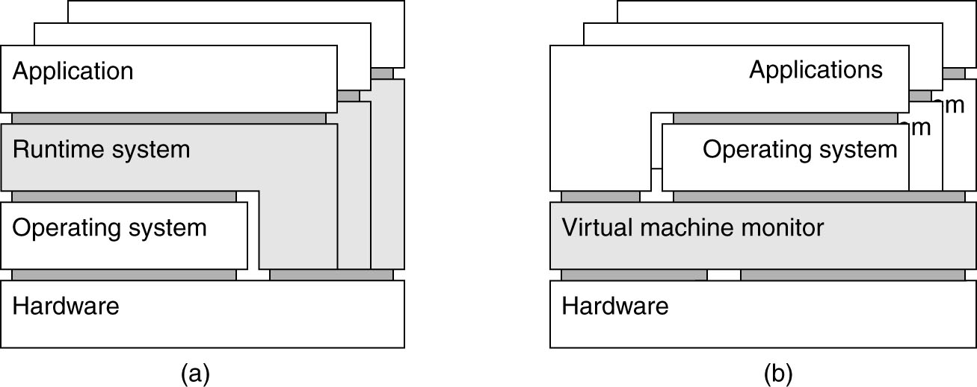
Process VMs versus VM Monitors
(a). Process VM: A program is compiled to intermediate (portable) code, which is then executed by a runtime system (Example: Java VM).
(b) VM Monitor: A separate software layer mimics the instruction set of hardware ) a complete operating system and its applications can be supported (Example: VMware, VirtualBox).

Slide 25
Application of virtual machines to distributed systems
From the perspective of distributed systems, the most important application of virtualization lies in cloud computing.
cloud providers offer roughly three different types of services:
Infrastructure-as-a-Service:- covering the basic infrastructure
Platform-as-a-Service:- covering system-level services
Software-as-a-Service:- containing actual applications
Virtualization plays a key role in IaaS.
Instead of renting out a physical machine, a cloud provider will rent out a VM (or VMM) that may possibly be sharing a physical machine with other customers
Allows for almost complete isolation between customers (although performance isolation may not be reached).

Slide 26
Code Migration
It is an act of moving a piece of code/process from one machine to another
Reasons for code migration
Load balancing
Improving performance by moving process from heavily-loaded system to lightly-loaded system /Load balancing/
Provide flexibility, i.e., clients don’t have to pre-install all software
Minimizing communication costs
Improving scalability

Slide 27
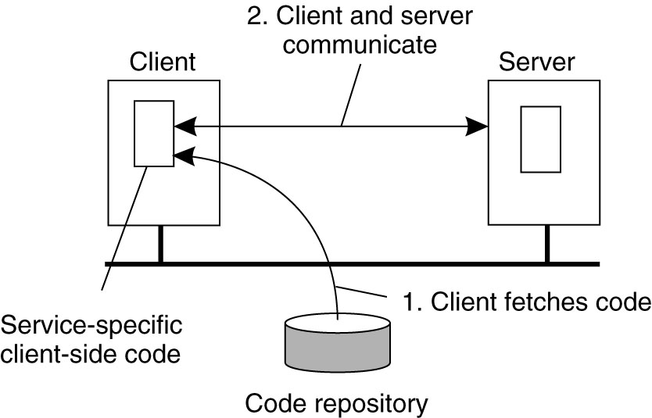
Flexibility
moving code to a client when needed
The client first fetches the necessary software, and then invokes the server.
Figure The principle of dynamically configuring a client to communicate to a server.

Slide 28
Code Migration Examples
Example 1: (Send Client code to Server)
In a client-Server system, the server holds a huge database.
If a client needs to perform many database operations, it may be better to
Ship part of the client application to the server and server sends only the results across the network.
Example 2: (Send Server code to Client)
In many interactive DB applications, clients need to fill in forms that are subsequently translated into a series of DB operation
The validation of the form can be done at server side, but
We can move the validation code to the client side:
To save the computation power of the server
To reduce Server-Client communication cost

Slide 29
Cont...
Example 3:
System administrator may be forced to shut down a server but does not want to stop the running processes (e.g. to change a part or even permanent shut down)
Temporarily freeze an environment, move to another machine and unfreeze (e.g. for debugging server production issues)

Slide 30
Approaches to Code Migration
A process consists of three segments
Code segment: contains the actual code
Resource segment: contains references to external resources needed by the process. E.g., files, printers, devices, other processes
Execution segment: stores the current execution state of a process, consisting of private data, the stack, and the program counter
Weak mobility
Move only code segment and some initialization data (and reboot execution):
The transferred program always start as new. E.g Java Applets
Strong Mobility, Migrate all three segments
Migration: move entire object from one machine to the other
A process could be stopped, moved to another machine and resumed execution where it left off.
Cloning: start a clone, and set it in the same execution state.
Multiple copies could run in parallel

Slide 31
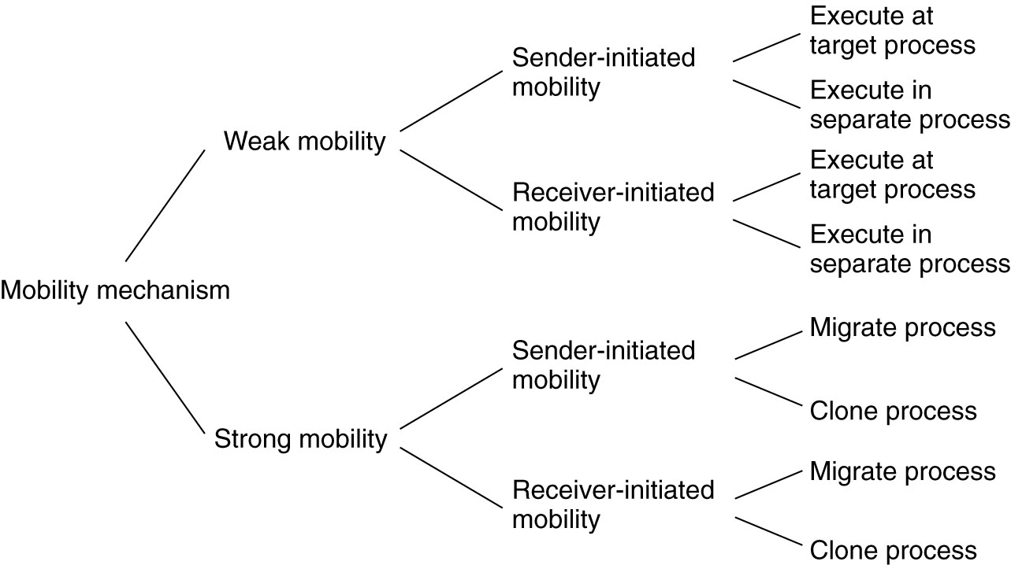
Models for Code Migration
Mobility of code can be
Receiver-Initiated: Receiver requests code
Sender-initiated: Sender pushes code
Figure. Alternatives for code migration.

Slide 32
Migration and Local Resource
Problem
An object uses local resources that may or may not be available at the target site.
Resource Types:
Fixed Resources: bound to a specific machine or environment and can not be moved (e.g. Local disk drives, communication ports)
Re-Bind to locally available resources
Unattached resources: can easily be moved (e.g. Data files)
Move
Fastened resources: may be possible but very costly (e.g. local databases or complete web sites)
Global references
Notes:
By identifier MV (or GR) GR (or MV) GR ----- Move
By value CP (or MV,GR) GR (or CP) GR ----- Copy --- move for unattached resources
By type RB (or MV,CP) RB (or GR,CP) RB (or GR) ---- Re-Bind to locally available resource for fixed resources

Slide 33
Migration in Heterogeneous Systems
Main problem
The target machine may not be suitable to execute the migrated code
The definition of process/thread/processor context is highly dependent on local hardware, operating system and runtime system
Only solution - Virtualization
Make use of an abstract machine that is implemented on different platforms:
Interpreted languages, effectively having their own VM
Virtual machine monitors allowing migration of complete OS + apps.
Takes considerable time
During migration service will be unavailable

Slide 34

.

Slide 35
End of Chapter 3

